Slide 1
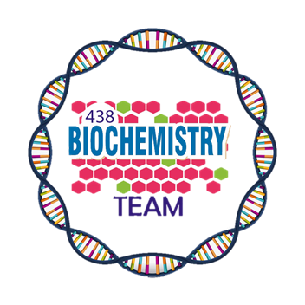

Lab orientation
Color Index:
Original slides.
Important.
Biochemistry team 438

Slide 2
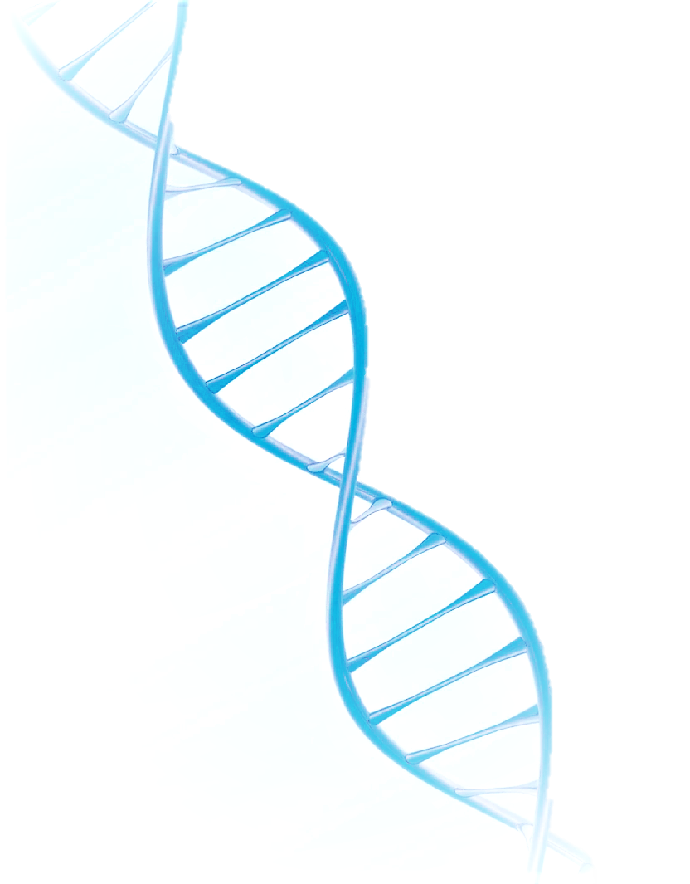
Objectives:
General safety rules followed in Biochemistry laboratory
Safety with laboratory equipment
Basic emergency procedures
Biological safety and waste disposal
The basics of spectrophotometer and general equipment to be used in the lab during Biochemistry practical sessions

Slide 3
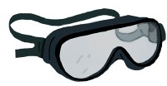
General safety rules:
Lab safety is everyone’s responsibility
Lab safety policy and procedures must be strictly followed
Always use appropriate clothes and personal protective tools (Lab coat, safety goggles, masks, gloves, no open shoes, no eye lenses), no eye lenses)
After handling chemicals, always wash your hands with soap and water.
During lab work, keep your hands away from your face. Tie back long hair.
Roll up loose sleeves.
Know the location of the fire extinguisher, fire blanket, eyewash station, and first aid kit.
Keep your work area uncluttered. Take to the lab station only what is necessary.
It is suggested that you wear glasses rather than contact lenses.
Never eat or drink during a lab work.

Slide 4
Safety with laboratory equipment:
Never use any laboratory equipment unless you are trained & have been authorised to do so
As well as injuring yourself you may cause very costly damage

Slide 5

Electrical safety:
Lay electrical cords where no one can trip on them.
Be sure your hands and your lab area are dry before using electrical equipment.
Unplug cords by pulling the plug and not the cord.

Slide 6

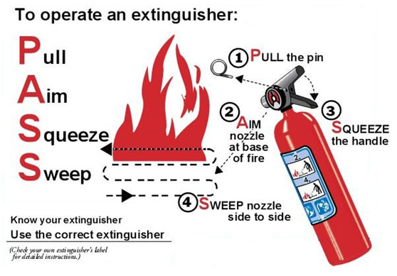
Fire safety:
Fire extinguisher:
and calling 953.
, Windows and vents
To a safe area

Slide 7
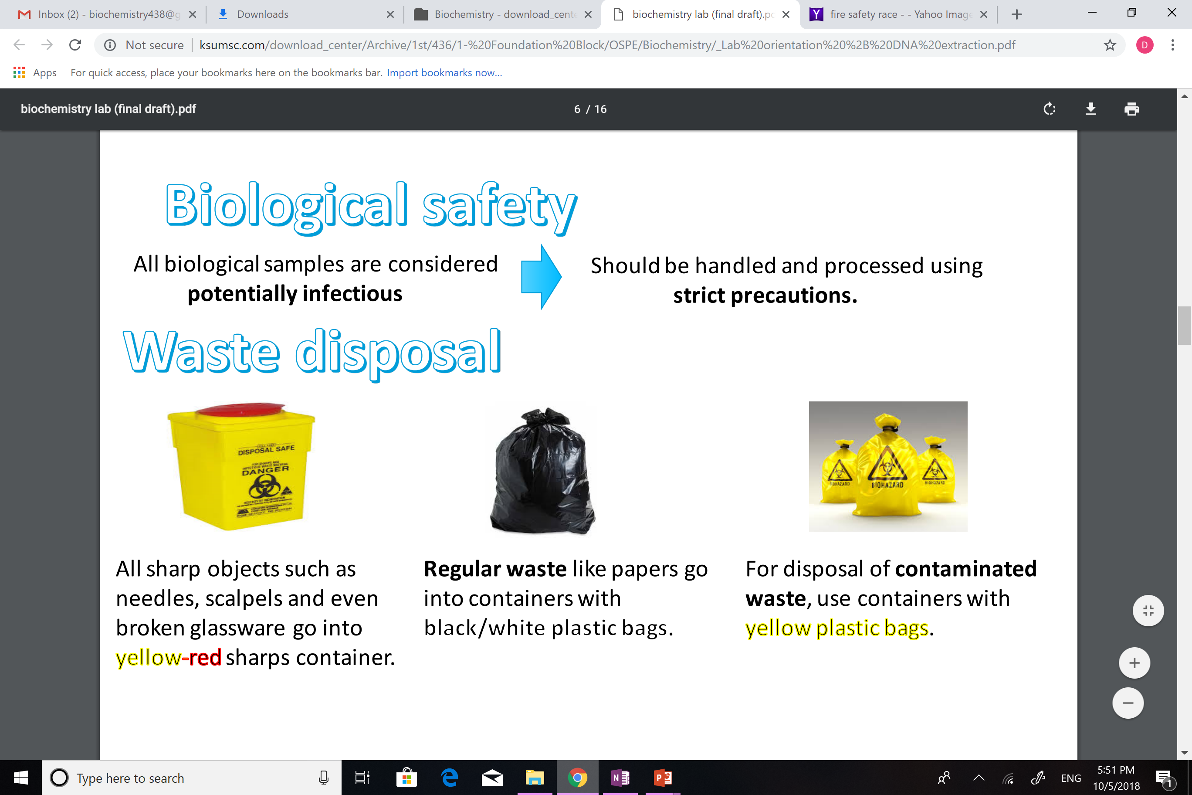
Biological safety:
All biological samples are
considered potentially
infectious
Should be handled and
processed using strict
precautions
Waste disposal:
For disposal of
Contaminated waste, use
containers with
yellow plastic bags
Regular waste like
papers etc go into
containers with
black/white plastic bags
All sharp objects such
as needles, scalpels and
even broken glassware
go into yellow-red
sharps container

Slide 9
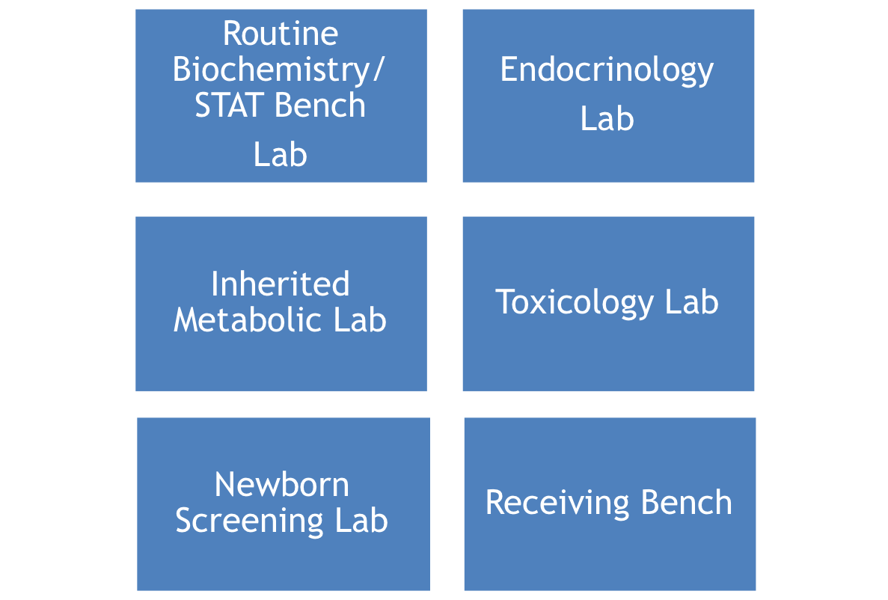
Clinical biochemistry laboratories:

Slide 10
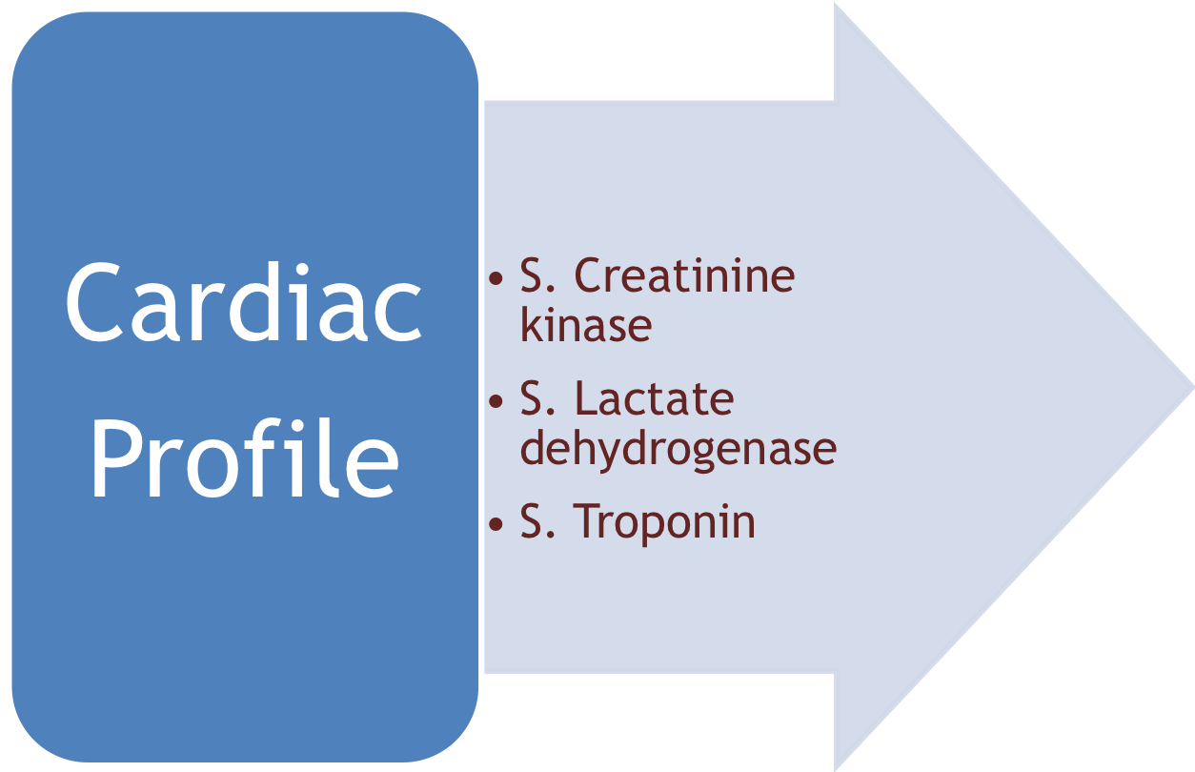
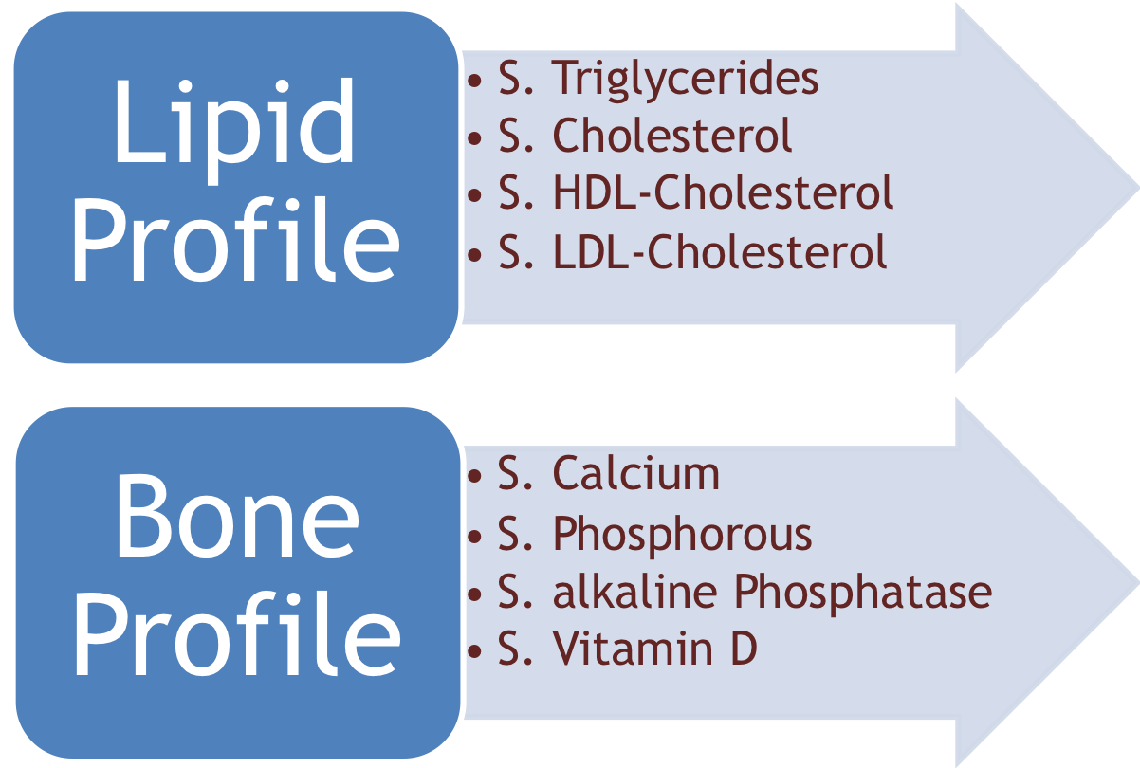
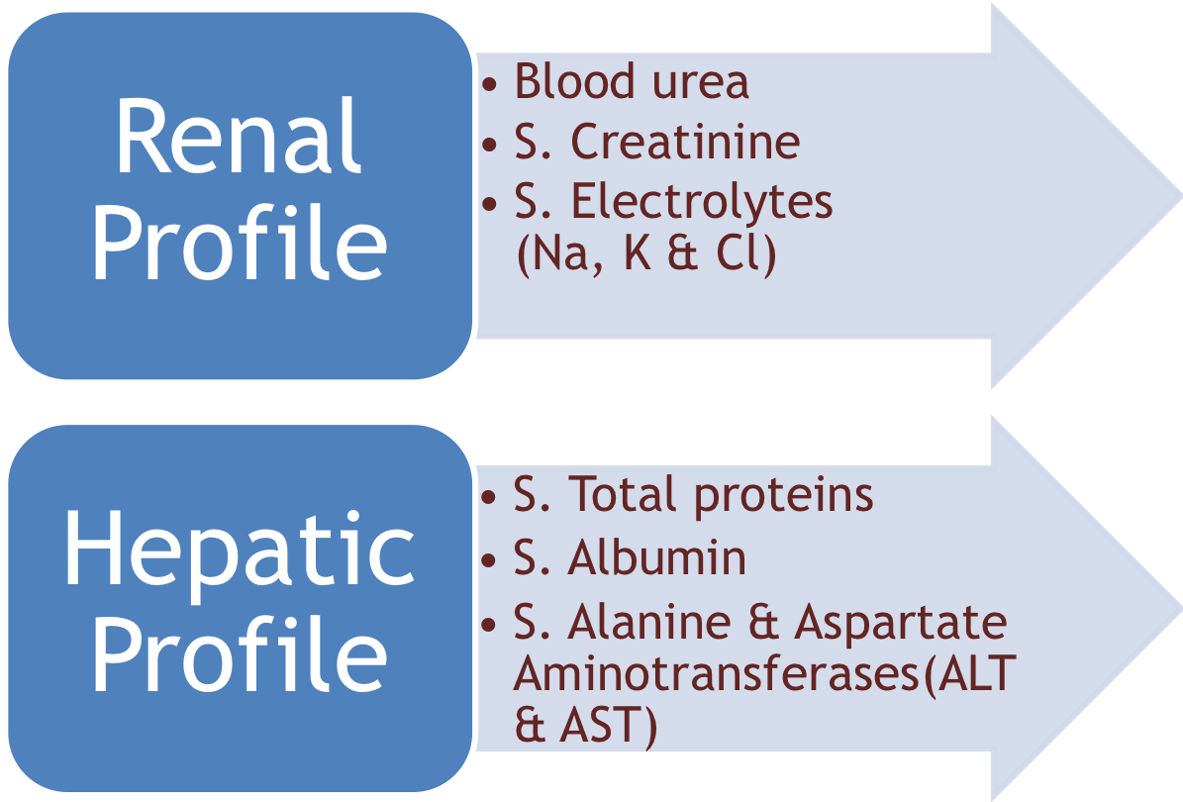
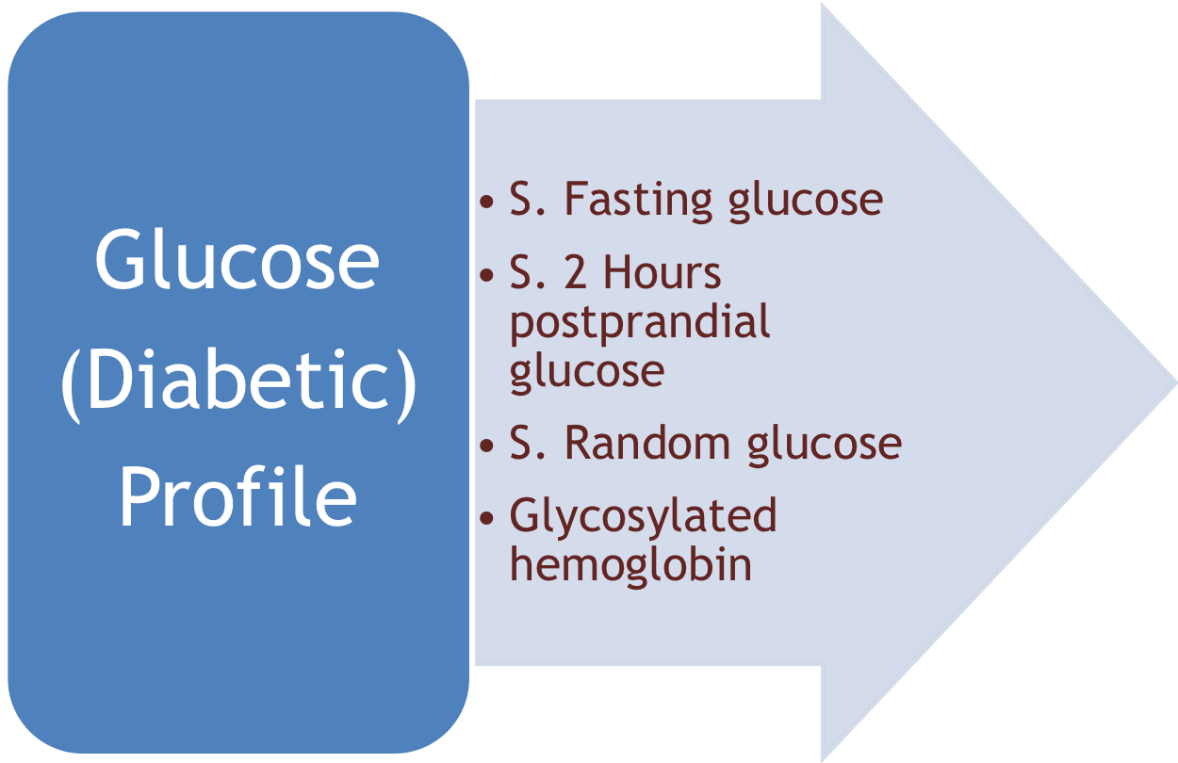
biochemical test profiles:

Slide 11

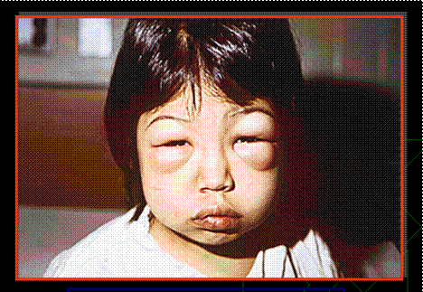
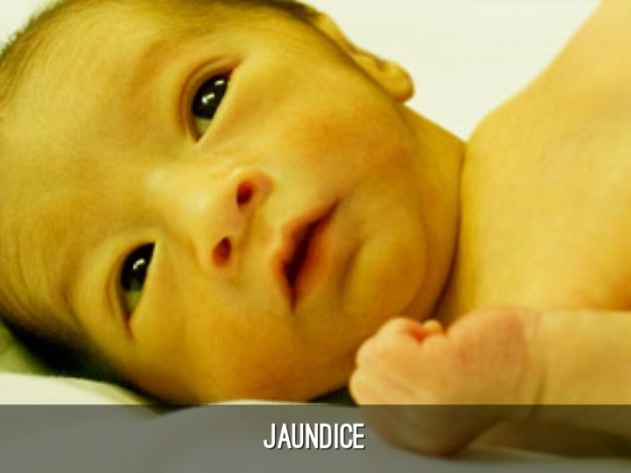
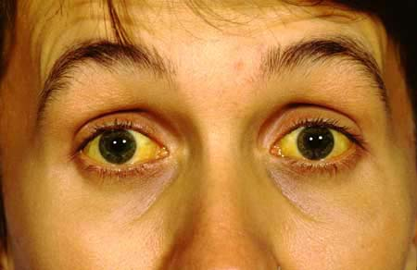

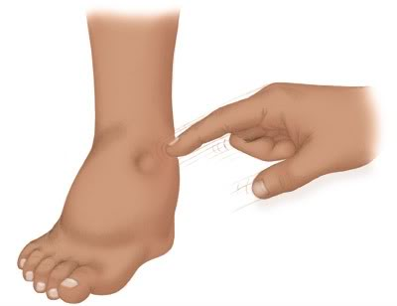
Clinical biochemistry for diagnosis of diseases:
Biochemical laboratory tests are crucial tools for diagnosis of many human diseases:
Kidney diseases
e.g., nephrotic syndrome
Liver diseases
e.g., hepatitis and jaundice

Slide 12
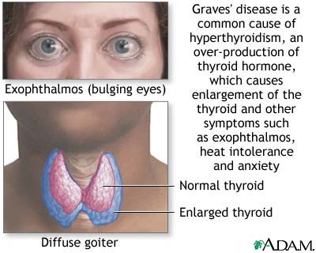
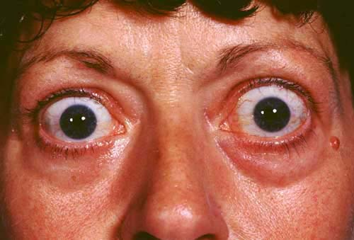

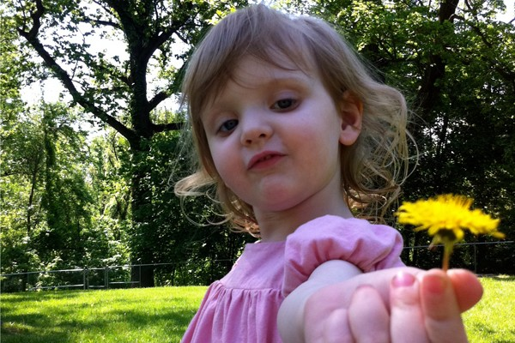
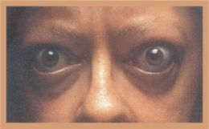
Metabolic diseases
e.g., diabetes mellitus
Cancers & malignancy
e.g., prostate cancer
Phenylketonuria (fen-ul-key-toe-NU-ree-uh), also calledPKU, is a rare inherited disorder that causes an amino acid called phenylalanine to build up in the body. PKU is caused by a defect in the gene that helps create the enzyme needed to break down phenylalanine
Endocrine diseases
e.g., Thyrotoxicosis
Inherited diseases
e.g., PKU

Slide 13
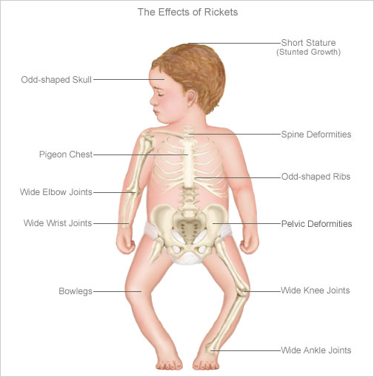
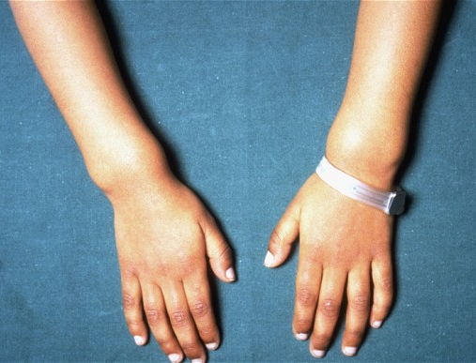
Rickets:

Slide 14
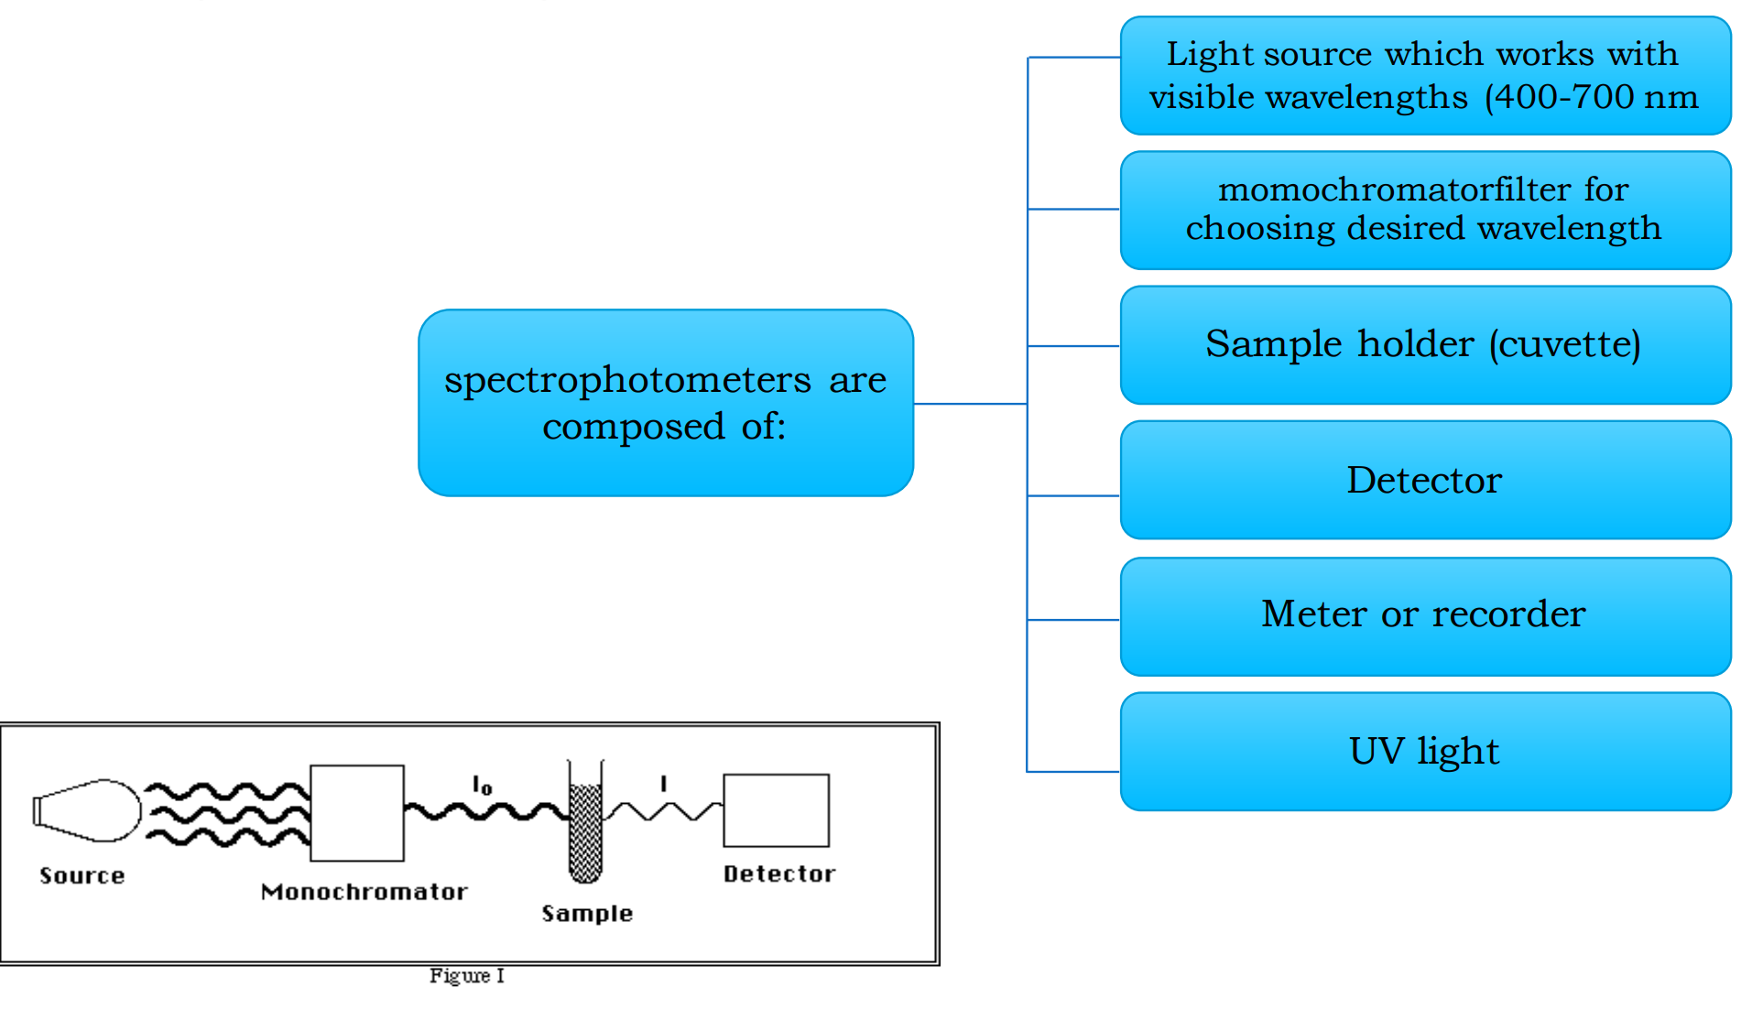
Spectrophotometer:
*Very important with spilling

Slide 15
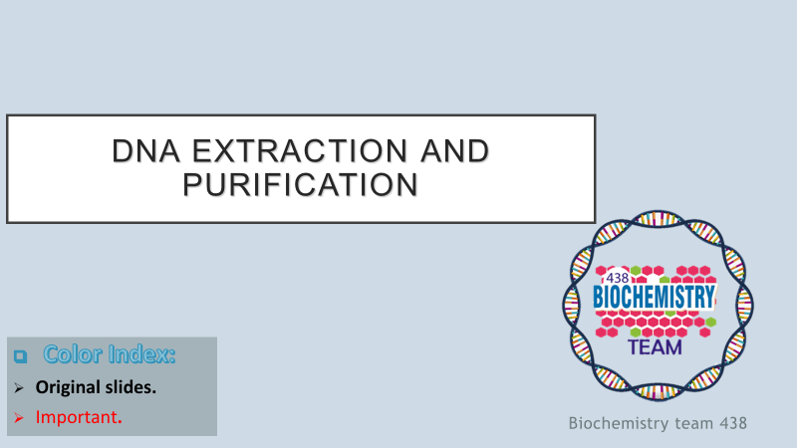

Slide 16
Objectives:
Understand the principle behind DNA extraction and purification.
Perform DNA extraction, purification and measurement according to the provided protocol (spin protocol).
Interpret the results in terms of quantity, purity and yield.
Have a knowledge about some molecular techniques and applications.

Slide 17
principle:
Genomic DNA is extracted from peripheral blood samples preserved in EDTA using QIAamp DNA Blood Mini Kit, spin protocol.
The principle of the test includes lysis of the nucleated cells using lysis buffer, which has high salt concentration that breaks the cellular membrane; after the lysing step, DNA is allowed to bind to the spin column membrane for separating the DNA from the cell debris; removal of the contaminants with wash buffers; and elution of pure DNA. The measurement of the purified DNA is performed by UV absorbance at 260nm and 280nm. DNA concentration is determined by measuring at 260nm, and the purity of the purified DNA is determined on the bases of 260nm/280nm ratio. A pure DNA falls in the accepted ratio, which ranges from 1.7 up to 1.9.
Lysis of the nucleated cells
Removal of contaminants
(any other substance other than DNA)
measurements

Slide 18
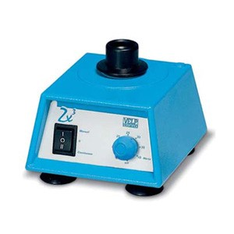
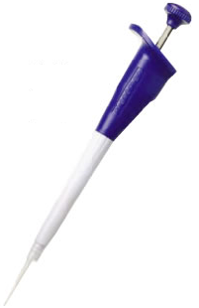
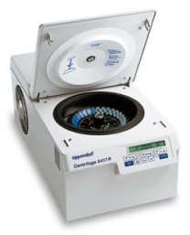
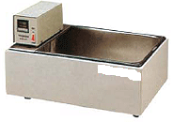
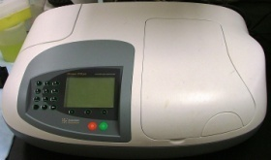
Lab Equipment:
Vortex
Automatic pipettes
Microcentrifuge
Water bath
UV-spectrophotometer

Slide 19
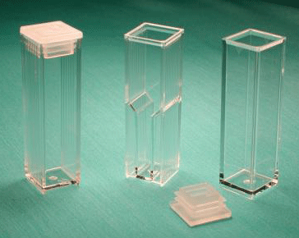
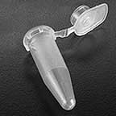
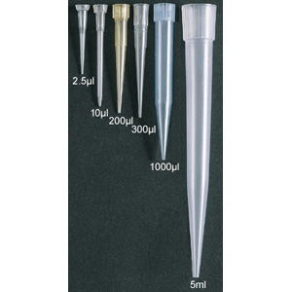
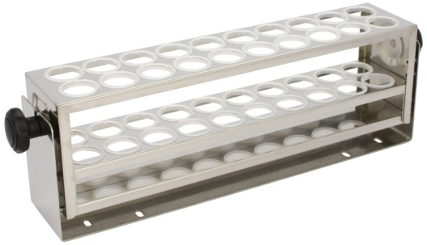
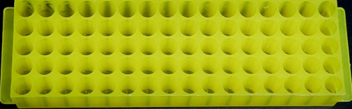
Continued…
Eppendorf tube
Cuvettes
Rack- test tube
Tips
Rack- eppendorf tube

Slide 20
Steps…
  Lysis of nucleated cells using lysis buffer.
  Binding of DNA to the membrane of spin column.
  Wash: using wash buffer.
  Elution of pure DNA.

Slide 21
Spin Protocol of
DNA Purification from Blood

Slide 22
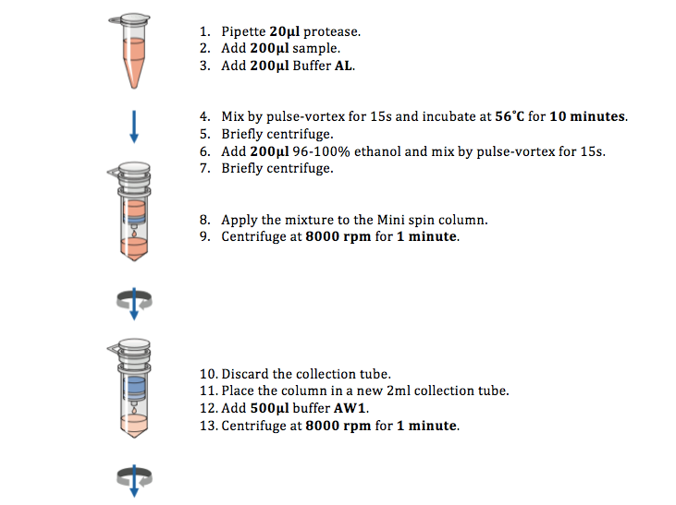

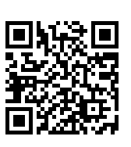
1,2,3.Protease يكون موجود بالأنبوب جاهز نضيف
buffer ALعليه عينه الدم ثم
Water path
Use pipettes
Video
https://www.youtube.com/watch?v=gmNw6CWtN5k

Slide 23
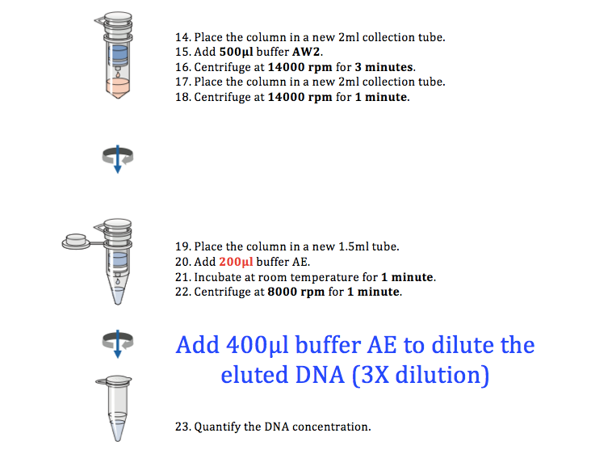

skip
After step 22. remove the upper part then add buffer AE to
After adding the buffer AE put the mixture in cuvettes tube by pipettes then into UV-spectrophotometer then do step 23

Slide 24
Quantification of the purified DNA

Slide 25
Measurements:
  Measure the Absorbance at 260nm and at 280nm.
  Assess the DNA purity= 260/280 ratio
  (Accepted ratio: 1.7 - 1.9)
  Calculate DNA Conc.: Provided A260 = 1.0, DNA is 50 μg/ml, unknown DNA Conc. can be calculated by cross multiplication
    A260 = 1.0 DNA conc. = 50 μg/ml
    A260 = 0.5 DNA conc. ?
    Note: In case of diluting the eluted sample, multiplies the final concentration by the dilution factor. This can be adjusted by the spectrophotometer.
الجهاز يحسبها لك
Done by
the spectrophotometer
DNA concentration =260nm القراءة عند ×50 μg/ml×3 القاعده باختصار و ثابته:

Slide 26
DNA Yield:
  DNA Yield μg = DNA Volume x final DNA Conc.
  Example:
  If you have
  Volume of DNA solution: 200μl (0.2 ml)
  Final DNA Conc.: 30 μg/ml
  Then, the yield (μg) = 0.2 ml x 30 μg/ml
  = 6.0 μg
=0.2 ml × concentration μg/mlباختصار وثابت:

Slide 27
Molecular Techniques and Applications
Note:
Almost all molecular biology techniques can be utilized for diagnosis and research

Slide 28
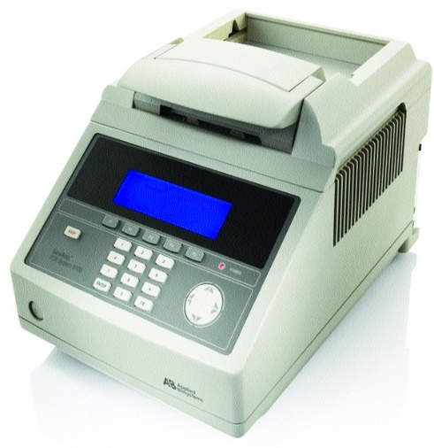
a. Amplification techniques: e.g. Polymerase Chain Reaction (PCR)

Slide 29
Continued…
Applications of PCR:
Comparison of a normal gene with a mutant form of the gene.
Detection of low-abundance nucleic acid sequences.
Forensic analysis of DNA samples.
Prenatal diagnosis.

Slide 30
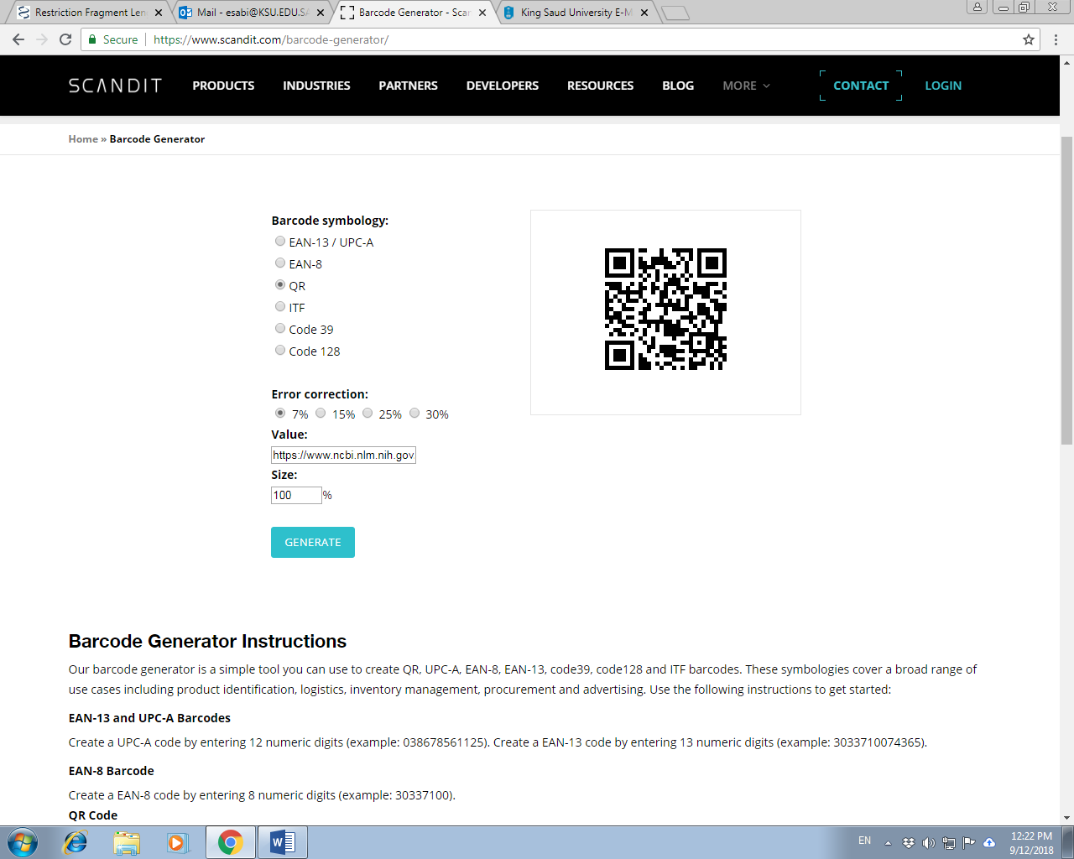
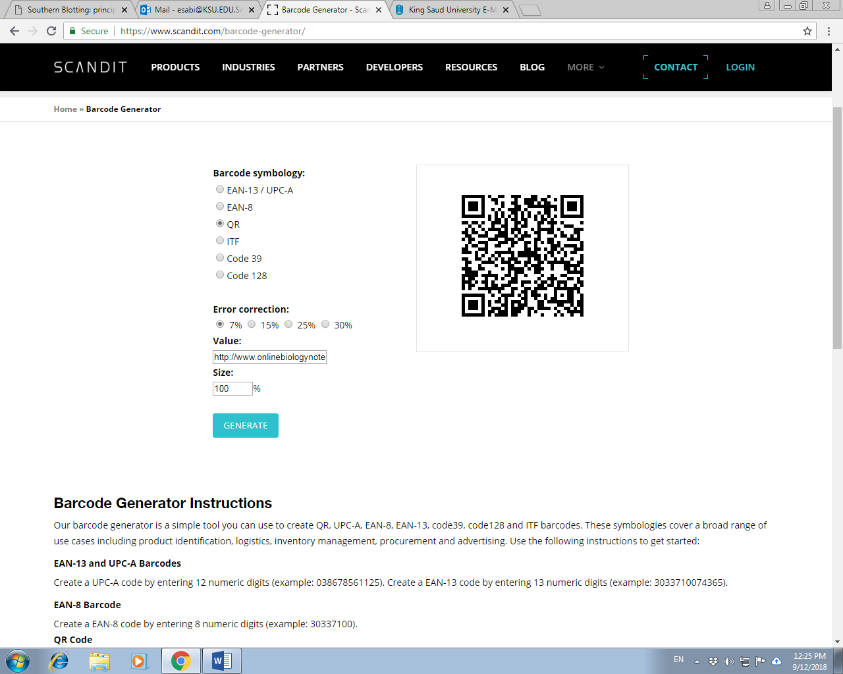
Other examples of molecular techniques:
Restriction Fragment length polymorphism (RFLP).
https://www.ncbi.nlm.nih.gov/probe/docs/techrflp/
Southern blotting.
http://www.onlinebiologynotes.com/southern-blotting-principle-procedure-application/

Slide 31
Review
DNA concentration =260nm القراءة عند ×50 μg/ml×3
  DNA Yield μg = DNA Volume x final DNA Conc.
0.2 ml × concentration μg/mlباختصار وثابت:
  DNA purity= 260/280 ratio
  (Accepted ratio: 1.7 - 1.9)

Slide 32
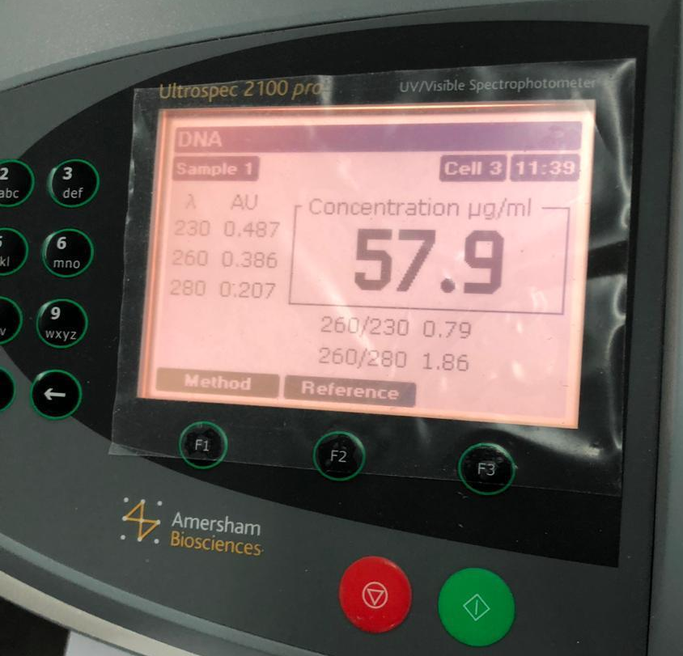
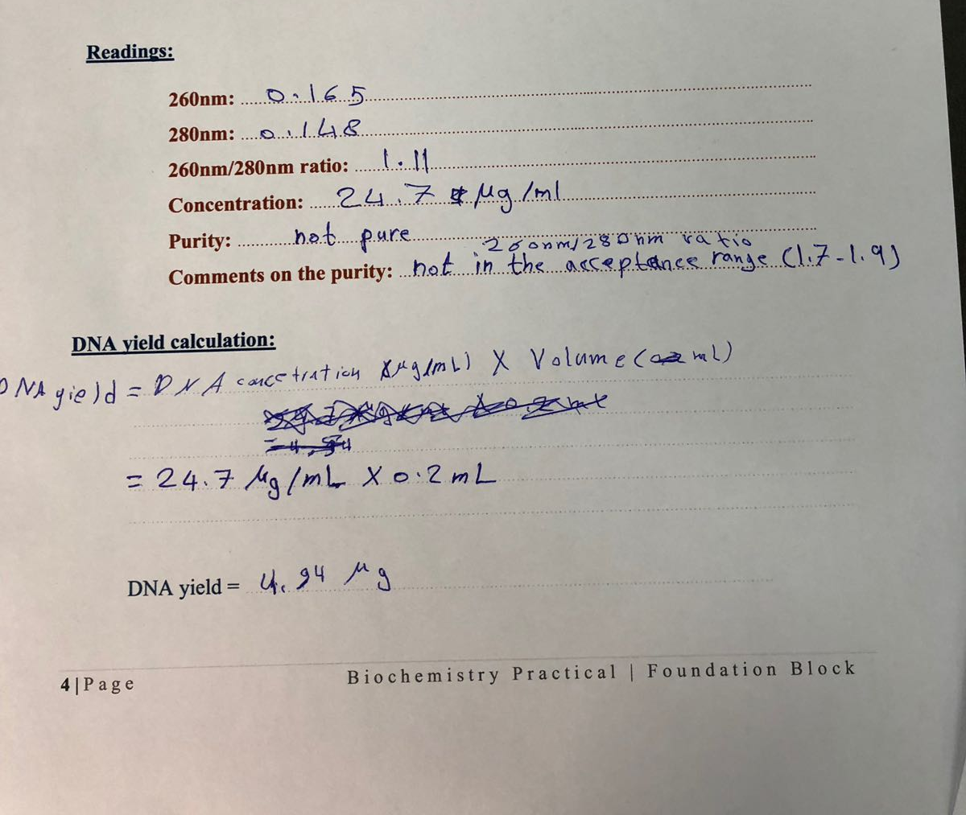
0.386
0.207
1.86
57.9 μg /ml
pure
Pure because it is on the range 1.7-1.9
DNA yield= DNA conc.(μg /ml) X DNA volume (0.2) (ml)
DNA yield= 57.9 μg /ml X 0.2 ml
= 11.58 μg
11.58 μg

Slide 33
