Slide 1
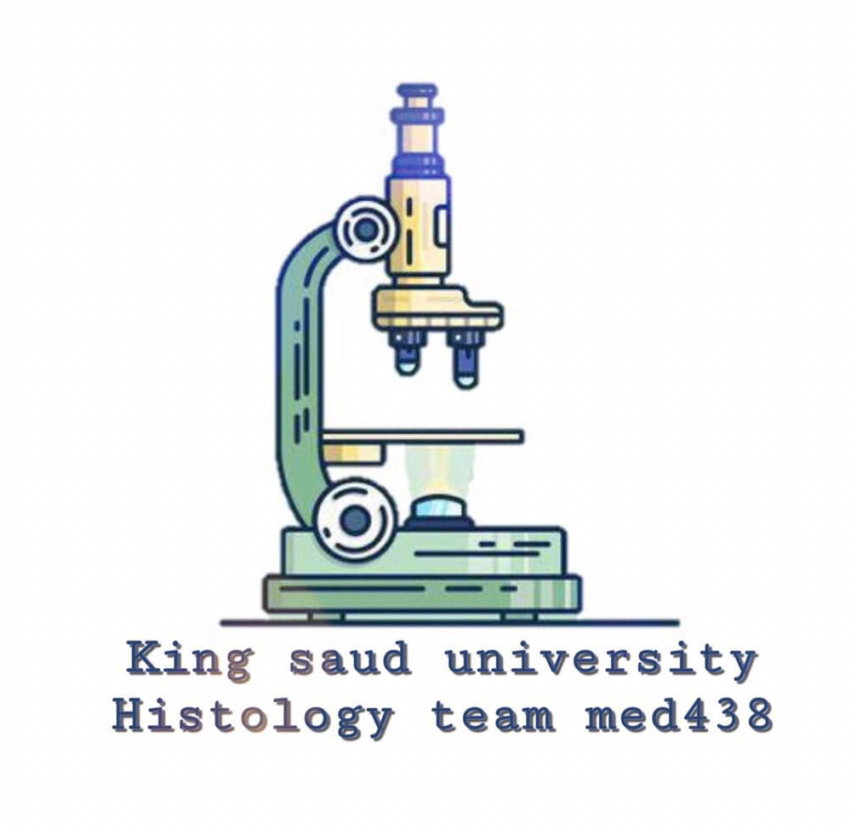
Introduction to Histology and Cell Structure
Lecture 1 :
- Colour index :
Red : important
Grey : doctors notes

Slide 2
• What is histology and how it is studied?
• Composition of the cell:
Light microscopic (L/ M) and electron microscopic (E/M) .
• Function of each component:
- Nucleus.
- Cytoplasm :
- Organelles: membranous and non membranous.
- Inclusions.
Objectives :

Slide 3
Histology : is the microscopic study of normal tissues.
Types of microscopes: LM & EM
Cells Tissues Organs Systems
Introduction :
• Thin sections are cut and mounted on glass slides. Sections are stained with Haematoxylin (H) and Eosin (E).
*Nucleus is always (basophilic) blue *Cytoplasm could be acidophilic (red)
or basophilic (blue)
LM : Produce colourful images .
EM : Produce black and white images .

Slide 4
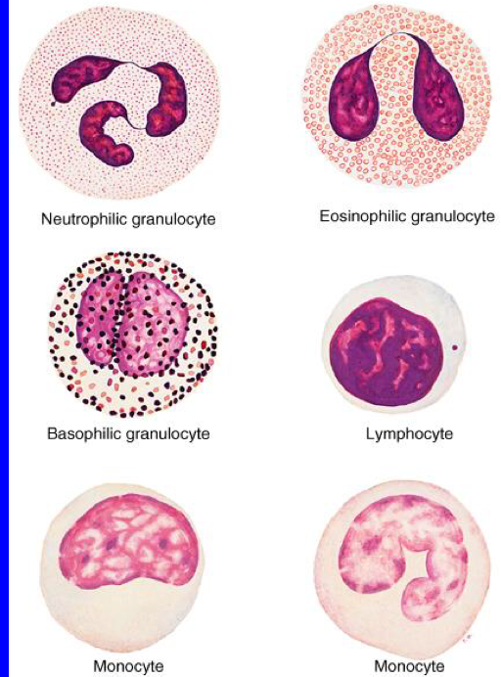
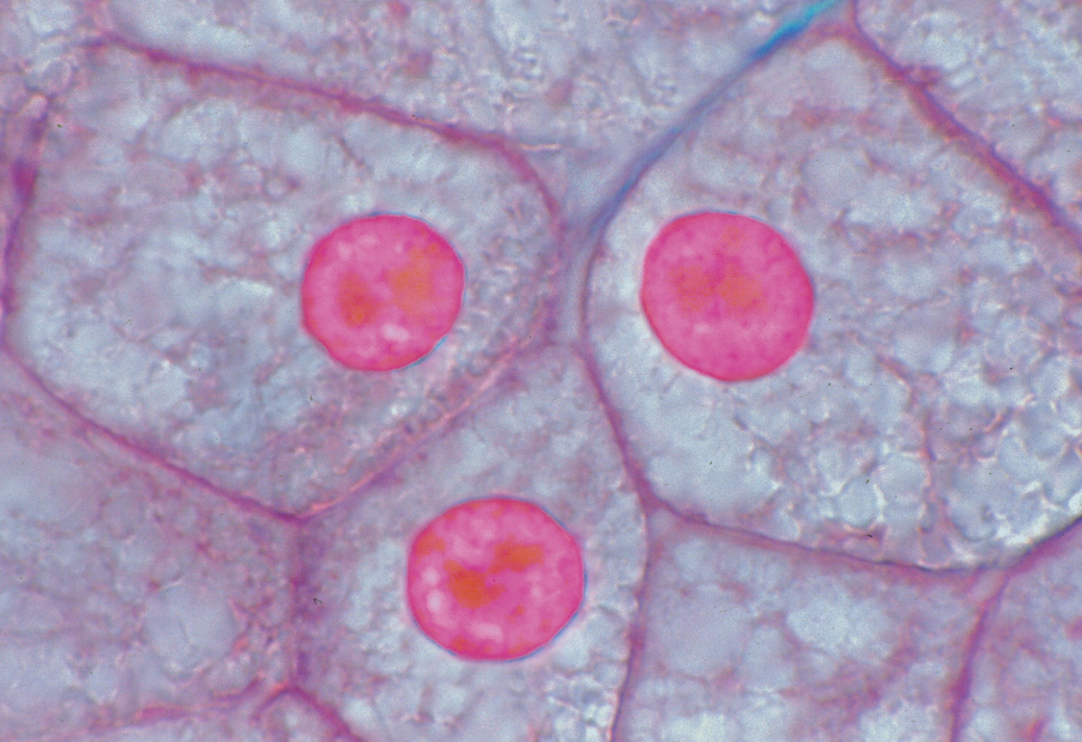
The Cell
Nucleus (L/M)
Shape of nuclei :
It Is the structural & functional
unit of all living tissues.
Cells have different shapes & size.
The Cell is made of: 1- Nucleus 2- Cytoplasm

Slide 5
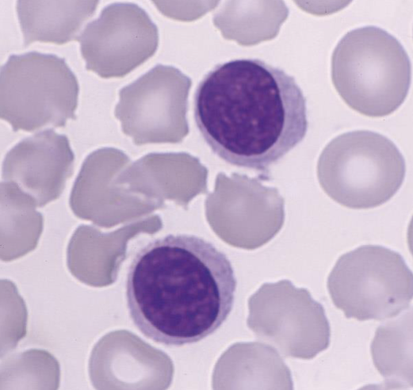
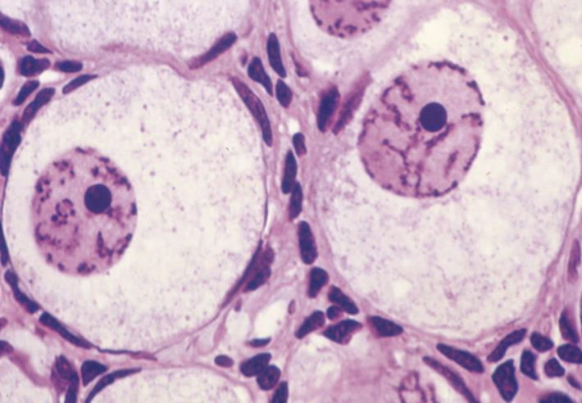
Appearance of nuclei :
Vesicular (Open Face) Nucleus. | Dark Nucleus (Deeply-stained Nucleus) Deeply Basophilic Nucleus

Slide 6
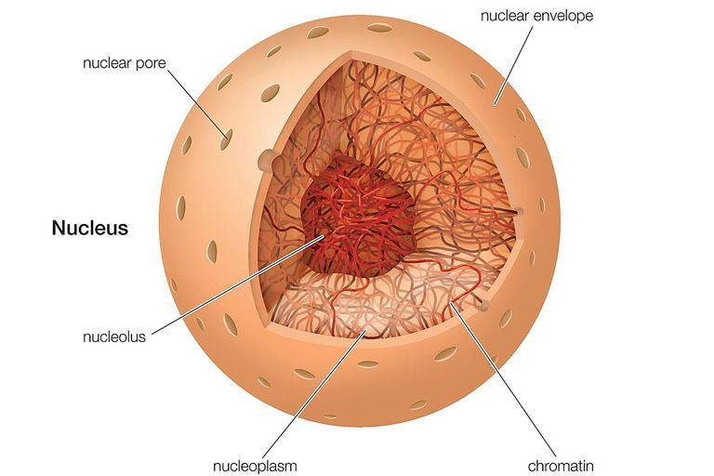
The Nucleus
Formed of:
Nuclear envelope
Chromatin
Nucleolus
Nucleoplasm
Function of the Nucleus :
It is essential for the vitality and division of the cell.
It is the site of storage of genetic information.
It is the site of formation of the three types of RNA.

Slide 7
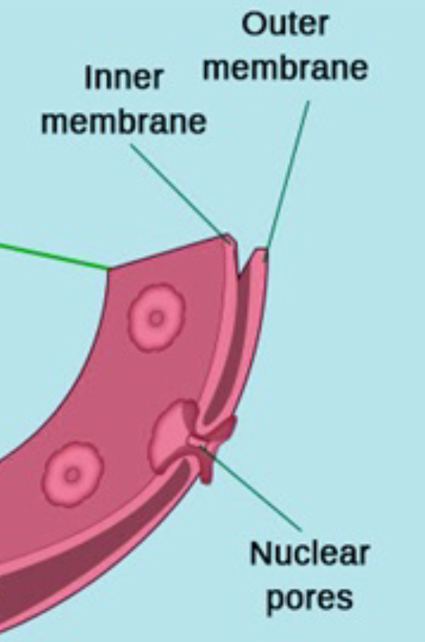
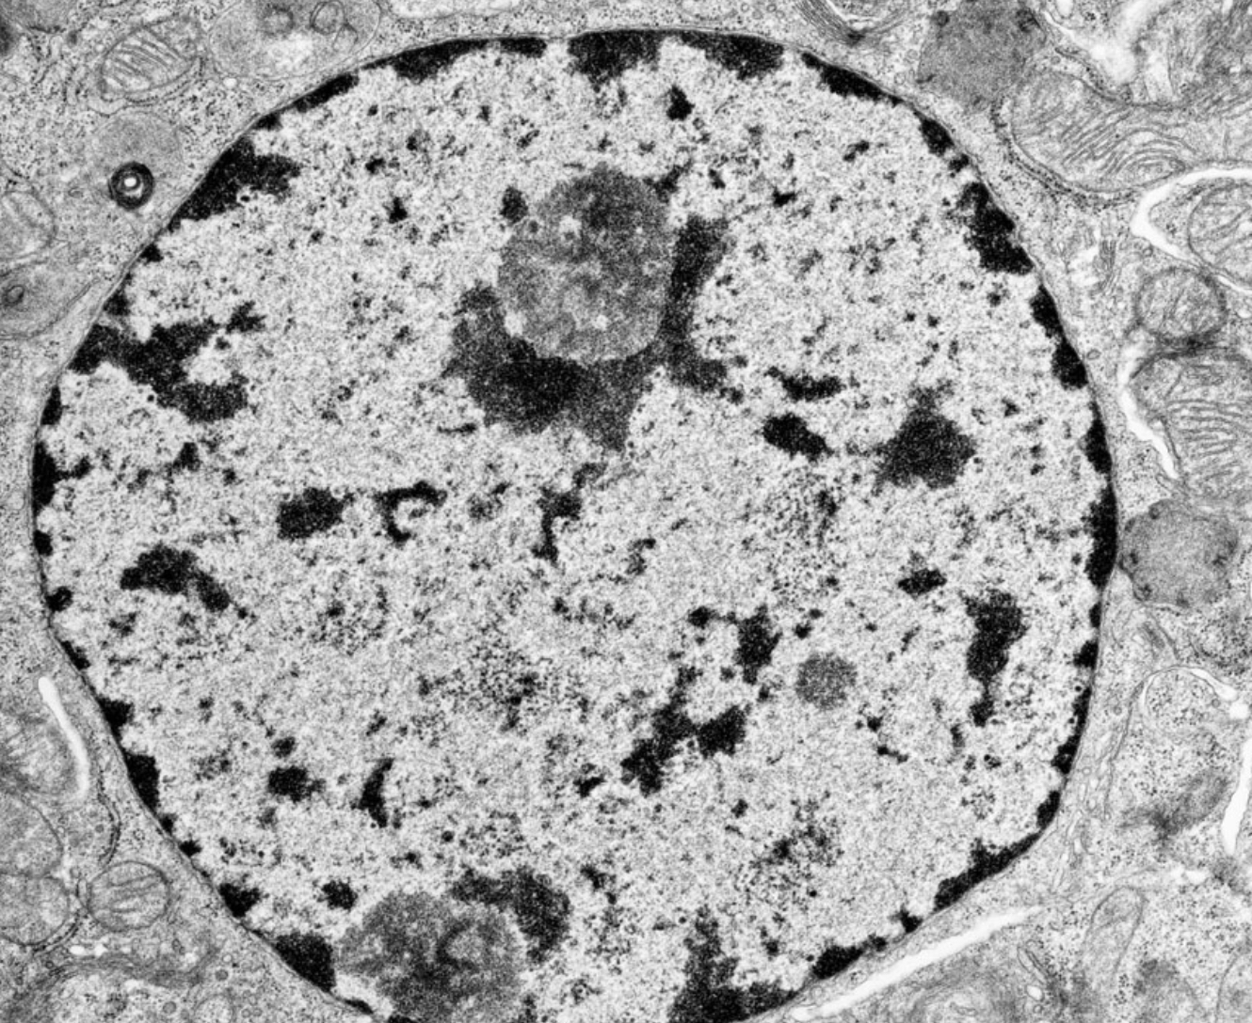
1- Nuclear envelope
Definition:
A double membrane with many pores surroundings the Nucleus .
Formed of :
1- Outer membrane
2- Inner membrane
3- Nuclear pores ( provide communication between nucleus and cytoplasm)
* the only double membrane surrounded structures in the cell are Nucleus and Mitochondria .
-Formed of DNA and protein
Two forms :
Euchromatin :
extended active chromatin
electron-lucent areas =(pale)
Heterochromatin :
condensed inactive chromatin electron-dense areas (dark)
2- Chromatin
-Functions of chromatin :
Carries genetic information .
Directs protein synthesis .

Slide 8
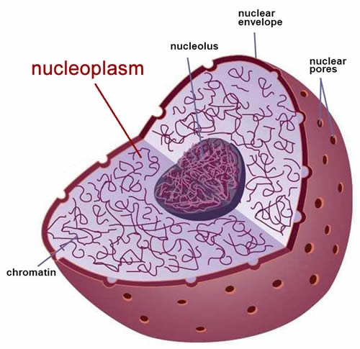
E/M : appear mostly as dark mass (electron-dense) (the largest one).
L/M : appear as spherical dark basophilic mass.
Usually one .
Not surrounded by a membrane .
Function : formation of ribosomal RNA (rRNA) witch responsible for protein synthesis in the cytoplasm .
3- Nucleolus
4- Nucleoplasm
It is a clear fluid medium in which all the contents of the nucleus are embedded.
Function: Provides a medium for movement of 3 types of RNA (ribosomal , messenger and transfer RNA) from the nucleus to the cytoplasm.

Slide 9
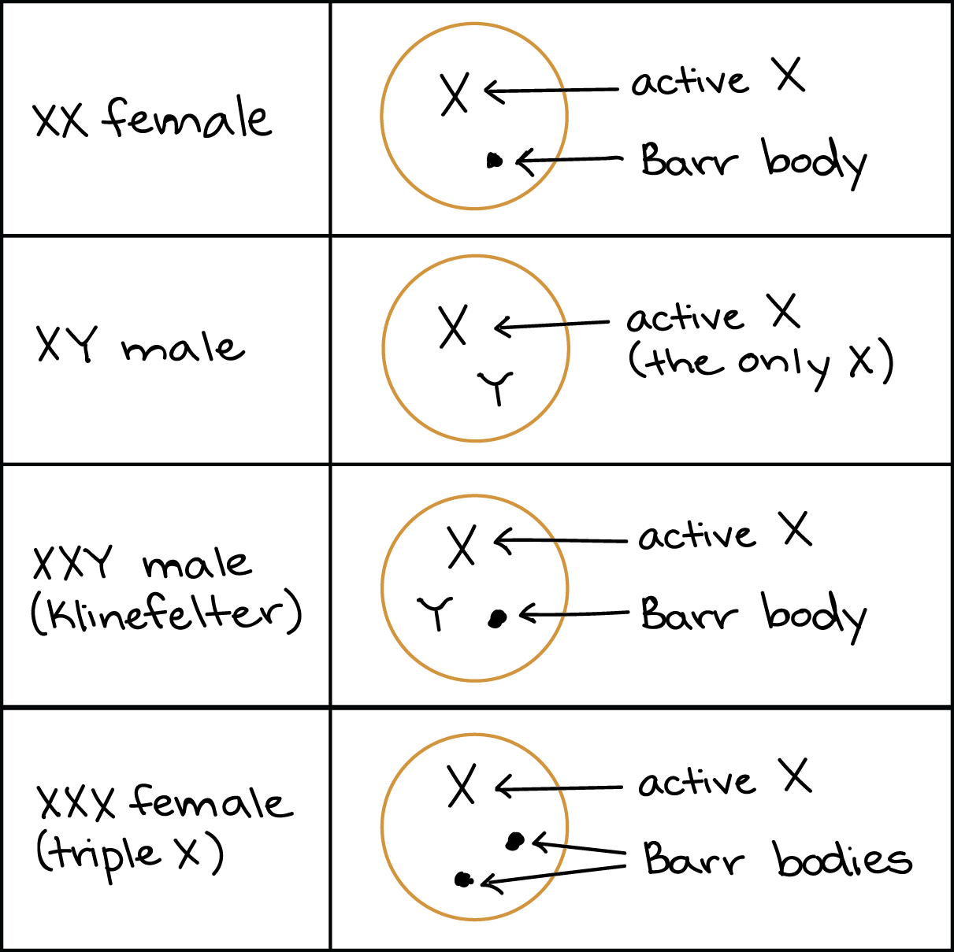
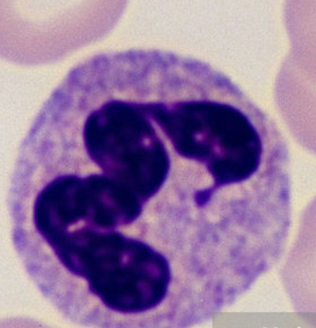
Sex chromatin (Barr body) :
A dark stained mass of chromatin , usually adherent to the inner aspect of the nuclear envelope of female somatic cells
e.g. Buccal epithelial cells.
A drumstick mass protruding from the nucleus of neutrophils.
Represents one of the two X chromosomes which is inactive (condensed) in normal female (heterochromatin).
Seen in normal female cells.
Absent in normal males cells .
Absent in females with Turner’s syndrome XO.
Seen in males with Klinefelter’s syndrome XXY.
Extra
Barr body (drumstick)

Slide 10
Summary :

Slide 11
Cytoplasm :
is formed of:
Organelles: They are specialized structures , essential for vital processes of the cell.
Inclusions: They are not essential for vitality of cells , may be present or absent.
Examples are lipids , glycogen and pigments like melanin & lipofuscin.
A) Membranous :
B) Non-Membranous :
Ribosomes.
mitochondria .
endoplasmic reticulum.
Golgi apparatus.
lysosomes .
secretory vesicles .
cell membrane.
Centrioles .
cilia and Flagella .
Filaments (actin, myosin, intermediate filaments).
Cytoskeleton (Actin, Intermediate filaments, Microtubules).
Cytoplasmic organelles :

Slide 12
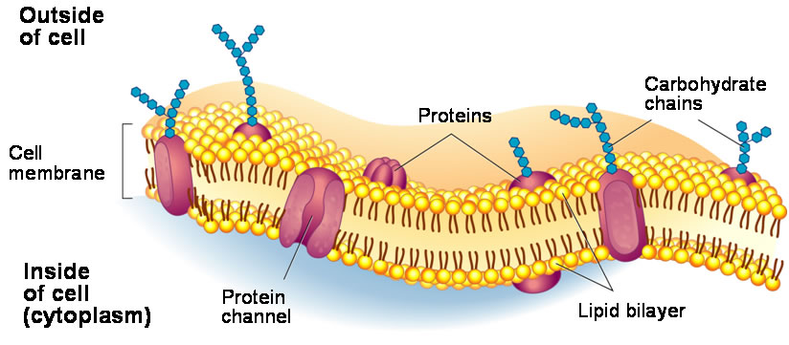
A) Membranous :
How does it appear ?
Cell membrane:
A very thin membrane surrounding the cell.
Function :
Selective barrier.
LM (Light Microscope)
Not visible.
EM (Electron Microscope)
2 dark lines separated by a light line (Trilaminar appearance).
Chemical structure:
- Phospholipid molecules :
arranged in two layers.
- Protein molecules:
peripheral and integral proteins.
- Carbohydrate molecules:
attached to either proteins or lipids (glycoproteins and glycolipids) forming the surface or cell coat.
Function of (Glycocalyx).
1- protection of the cell
2- cell recognition and adhesion.

Slide 13
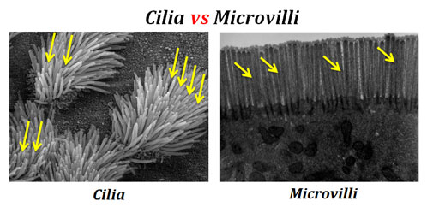
Specializations of Cell Membrane :
Cilia:
Long motile hair-like structures surrounded by cell membrane.
Their core is made of microtubules.
Microvilli (Brush border) :
Cylindrical cytoplasmic projection of apical surface to increase surface area . Their core contains actin filaments.
Intercellular junctions
1. Occluding (Tight) Junction: seals the intercellular space.
2. Adherening Junction: fixes adjacent cells together:
a) Zonula Adhering Junction.
b) Desmosome (Macula Adherening Junction).
3. Gap junction: Allow free communication between the cells.
*When a combination of 1 , 2a and 2b is present , this is called
a junctional complex.
1
2a
2b
3

Slide 14
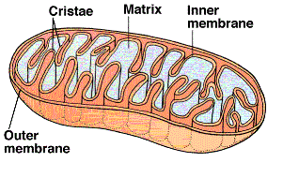
Mitochondria:
Each mitochondrion is rod-shaped .
The wall is composed of 2 MEMBRANES.
The outer is smooth, the inner is folded to form CRISTAE.
The cavity is filled with mitochondrial matrix, which contains enzymes. Also contains it’s own DNA .
Function:
Generation of ATP , which is the source of energy for the cell , They are called the power-house of the cell.
They can form their own proteins and undergo self replication.

Slide 15
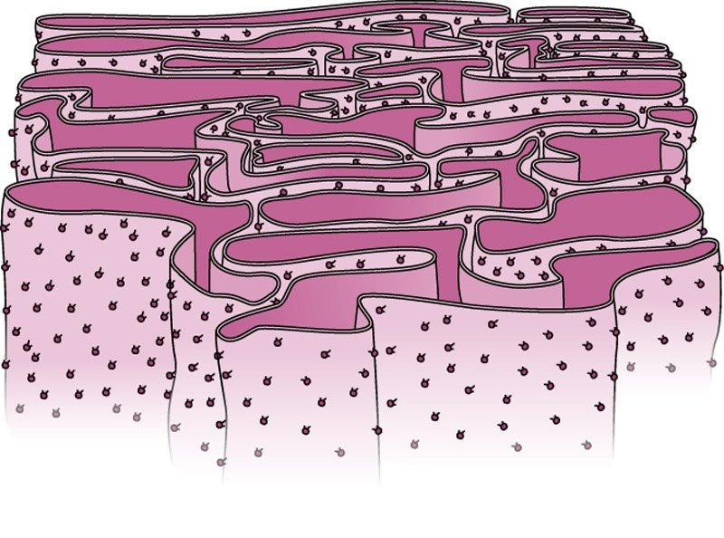
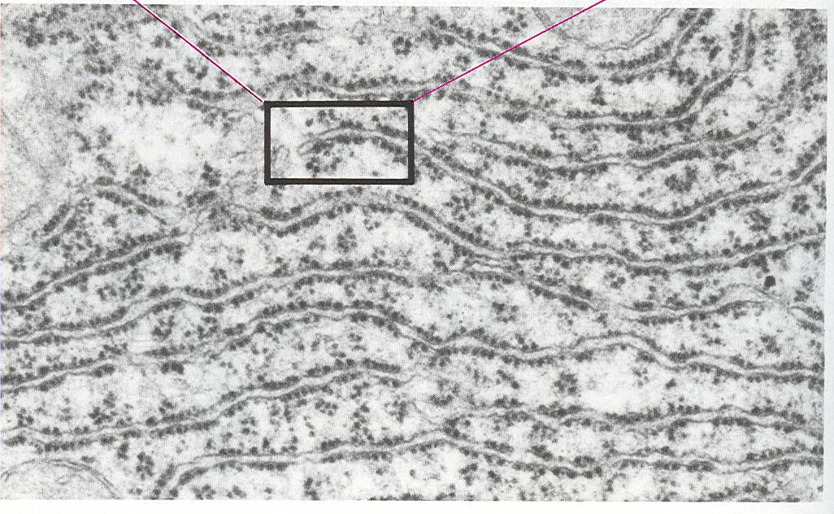
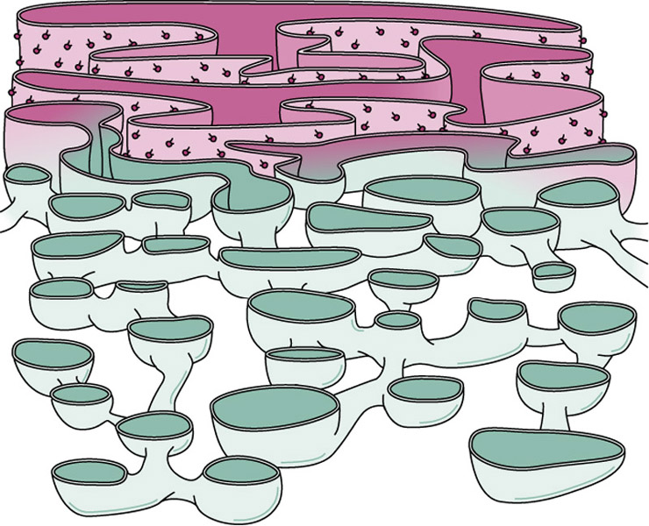
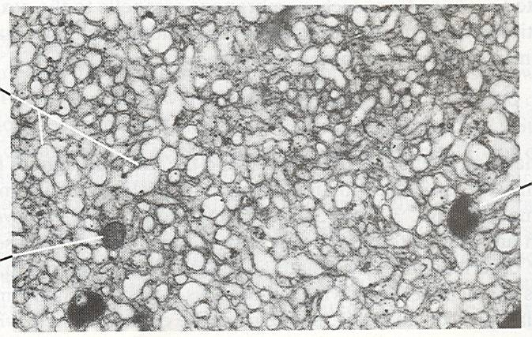
Endoplasmic reticulum
It is a system of communicating membranous tubules, vesicles, and flattened vesicles (cisternae).
Smooth Endoplasmic Reticulum | Rough Endoplasmic Reticulum
Membranous tubules and vesicles , with NO ribosomes on the surface. | Membranous sheets of flattened tubules & vesicles WITH ribosomes on the surface.
Function: 1) Synthesis of lipids & cholesterol. 2) Synthesis of steroid hormones, e.g. cortisone. 3) Helps muscle contraction, by acting as a calcium pump. 4) Detoxification of drugs & toxins. | Function: 1) Synthesis of proteins by ribosomes on its outer surface. 2) Transfer vesicles , transfer the formed protein to Golgi.
FROM 437 TEAMWORK

Slide 16
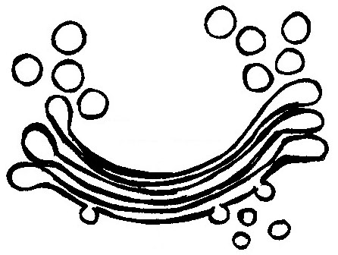
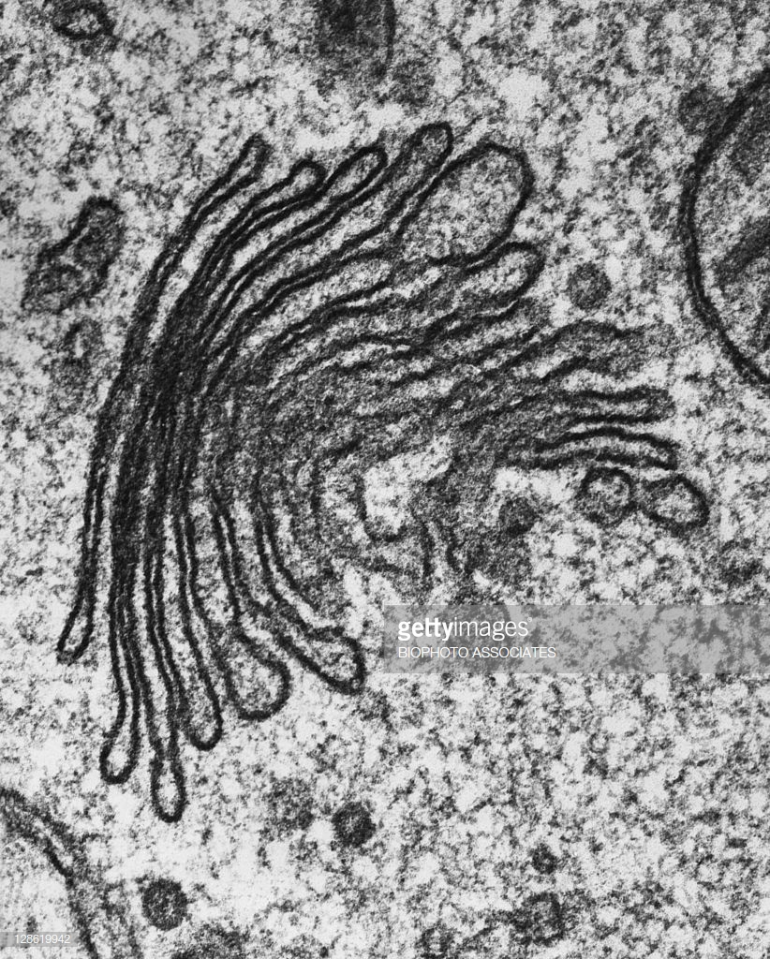
Secretory vesicles
Golgi apparatus
The secretory apparatus of the cell.
Consists of stacked saucer-shaped flattened vesicles.
Each vesicle has two faces:
1- Convex (FORMING) face: receives transfer vesicles. 2- Concave (MATURE) face: forms secretory vesicles.
Functions:
1- Sorting, modification & packaging of proteins.
2- Secretory vesicles formation.
3- Formation of lysosomes.
Mature face
Transfer vesicles
Forming face

Slide 17
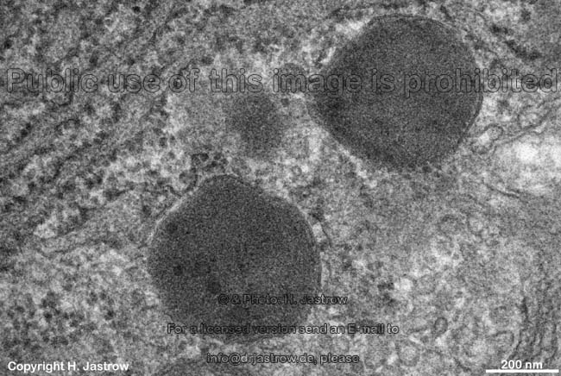
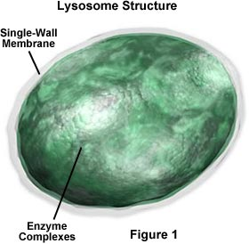
Lysosomes
The digestive apparatus of the cell.
E/M: Spherical membranous vesicles.
Contain hydrolytic enzymes.
Originate from mature surface of the Golgi apparatus, while their hydrolytic enzymes are formed in the rough endoplasmic reticulum.
Function:
intracellular digestion of ingested material or old organelles.

Slide 18
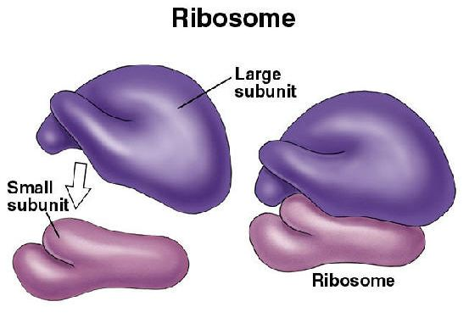
B) Non-Membranous
Ribosomes
LM: Basophilic cytoplasm is due to numerous ribosomes .
Consist of ribosomal RNA (rRNA), combined with proteins.
EM: Formed of 2 subunits.
Free in the cytoplasm (may form polyribosomes) or attached to rER
Formed in the nucleolus.
Function:
Protein synthesis.

Slide 19
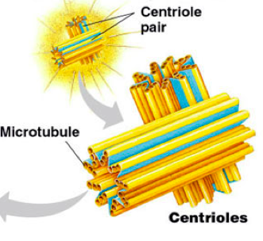
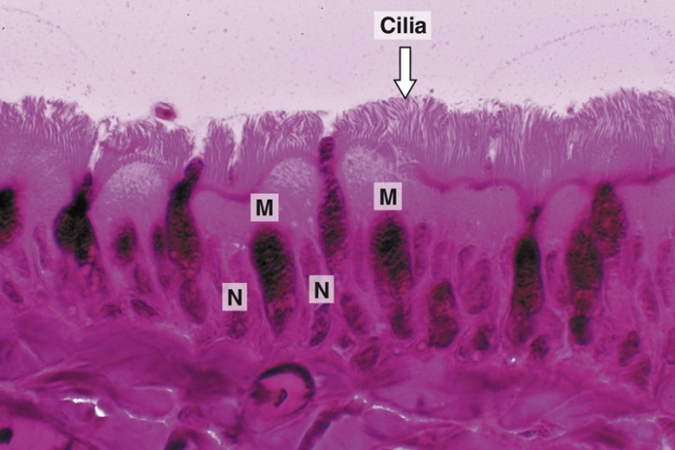
Microtubules-containing organelles :
Flagella | Cilia | Centrioles
- Longer and larger than cilia. - Form the tails of sperms. | - Hair-like striations on the free surface of some cells. - Basal body is similar to centriole. - Shaft is formed of 9 doublets and 2 central singlets of microtubules, i.e. 20 microtubules. | - 2 cylinders, perpendicular to each other. - Wall is made of 9 triplets of microtubules, i.e. 27 microtubules.
Function: Important for movement of the sperms. | Function: Movement of particles or fluids on the free surface of the cell in one direction. | Functions: 1- Essential for cell division. 2- Formation of CILIA and FLAGELLA.
FROM 437 TEAMWORK

Slide 20
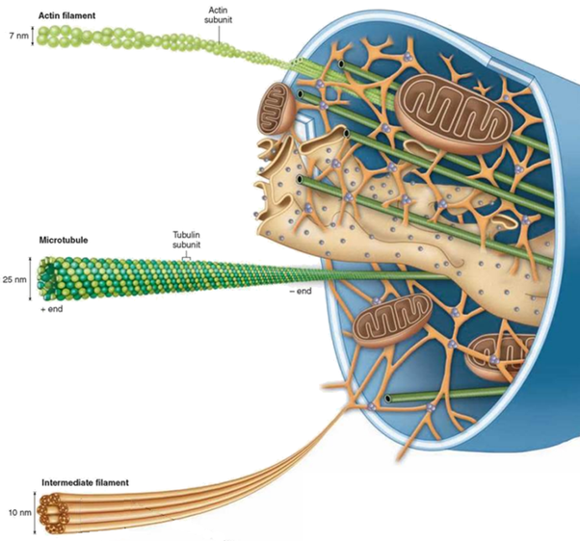
Cytoskeleton :
Microfilaments
•It is the structural skeleton of the cell.
•Consists of:
1- Microfilaments (actin).
2- Intermediate filaments, e.g. Keratin.
3- Microtubules.
•Functions:
1- Maintains shape of the cell.
2- Helps transport of material within the cell.
Microtubules
Intermediate filaments

Slide 21
Clinical application:
Immotile cilia syndrome:
•Disorder that causes infertility in male and chronic respiratory tract infection in both sexes.
•caused by immobility of cilia and flagella induced by deficiency of dynein.
•Dynein protein is responsible for movements of cilia and flagella.

Slide 22
MCQs :
1- Which organelle sorts and packages proteins within a cell? A) Rough endoplasmic reticulum B) Smooth endoplasmic reticulum C ) Lysosome D) Golgi apparatus
2- Which organelle is considered the powerhouse of the cell? A) Rough endoplasmic reticulum B) Smooth endoplasmic reticulum C) Mitochondrial D) Lysosome
3- Which of the following is NOT a membranous organelle?
A ) microtubules
B ) lysosomes
C )mitochondria
D ) endoplasmic reticulum
4- Microfilaments are composed mainly of a protein called
A ) tubulin
B ) actin
C ) myosin
D ) Chitin
5- In Golgi apparatus Which face receiving transfer vesicles ?
A) Convex face
B) Concave face
C) Both
D) Neither
6- Smooth endoplasmic reticulum is the site of
A) protein synthesis
B) carbohydrate synthesis
C) amino acid synthesis
D) Lipid synthesis
7- If you see the cytoplasm in microscope with blue color (basophilic), that means the cytoplasm stained with?
A ) Hematoxylin(H)
b ) Aldehyde fuchsine
C ) Cresyl violet
D) Eosin(E)
8- If you see electron-lucent areas (pale) in microscope, that means the form of chromatin is ?
A ) Euchromatin
B) Heterochromatin
C) A & B
D ) Barr body

Slide 23
Team members :
Abdullah alassaf
Abdullah altuwaijri
Talal jamal aldeen
Faisal alqifari
Alhanouf alhaluli
Rawan alzayed
Renad alkanaan
Nouf albrikan
Roaa aljohani
Team leaders :
Noura alnasser
Abdullah shadid

