Slide 1
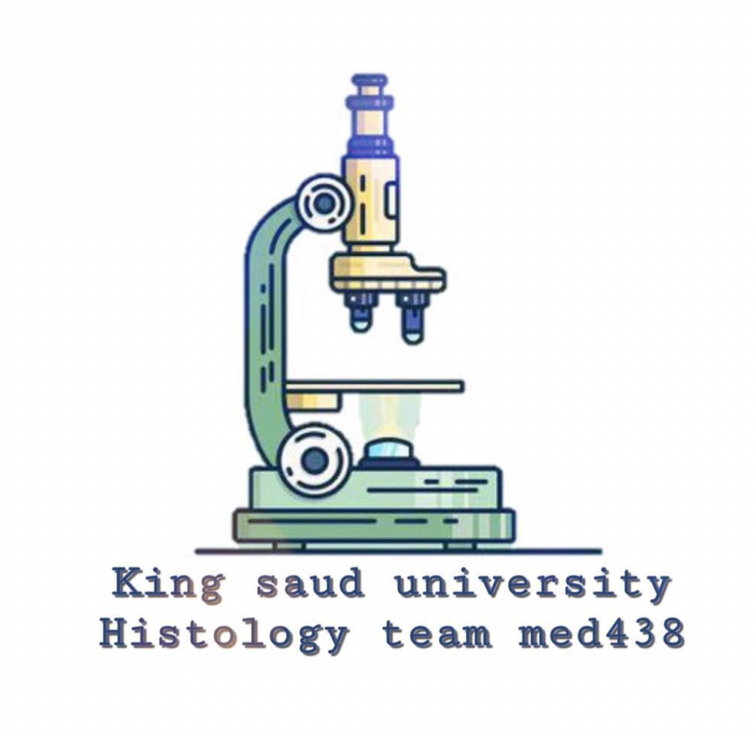
Lecture 3 :
CONNECTIVE TISSUE (C.T)
- Colour index :
Red : important
Grey : doctors notes

Slide 2
Objectives:
Enumerate the general characteristics of C.T.
Classify C.T into C.T. proper and special types of C.T.
Classify C.T. proper (C.T.P.)
Describe the structure (components) and distribution of different types of C.T.P.

Slide 3
Definition Of Connective Tissue (C.T)
It is one of 4 basic tissues.
*4 basic tissues are connective , epithelial, muscular and nervous.
it is mesodermal in origin.
its supports , binds and connects other tissues and organs providing structural and metabolic support of them.
General Characteristics :
1- C.T is formed of widely separated. (few cells with abundant extracellular matrix).
2- Most C.T. are vascular.
Components Of C.T:
Types Of C.T (Depending On Matrix):
1- Cells: difference types.
2- Fibers: Collagenous , elastic , reticular.
3- Matrix: the *intercellular substance, in which cells and fibers are embedded.
Soft = C.T Proper
Rigid (rubbery , firm) = Cartilage
Hard (solid) = Bone
Fluid (liquid) = Blood
* = Extracellular

Slide 4
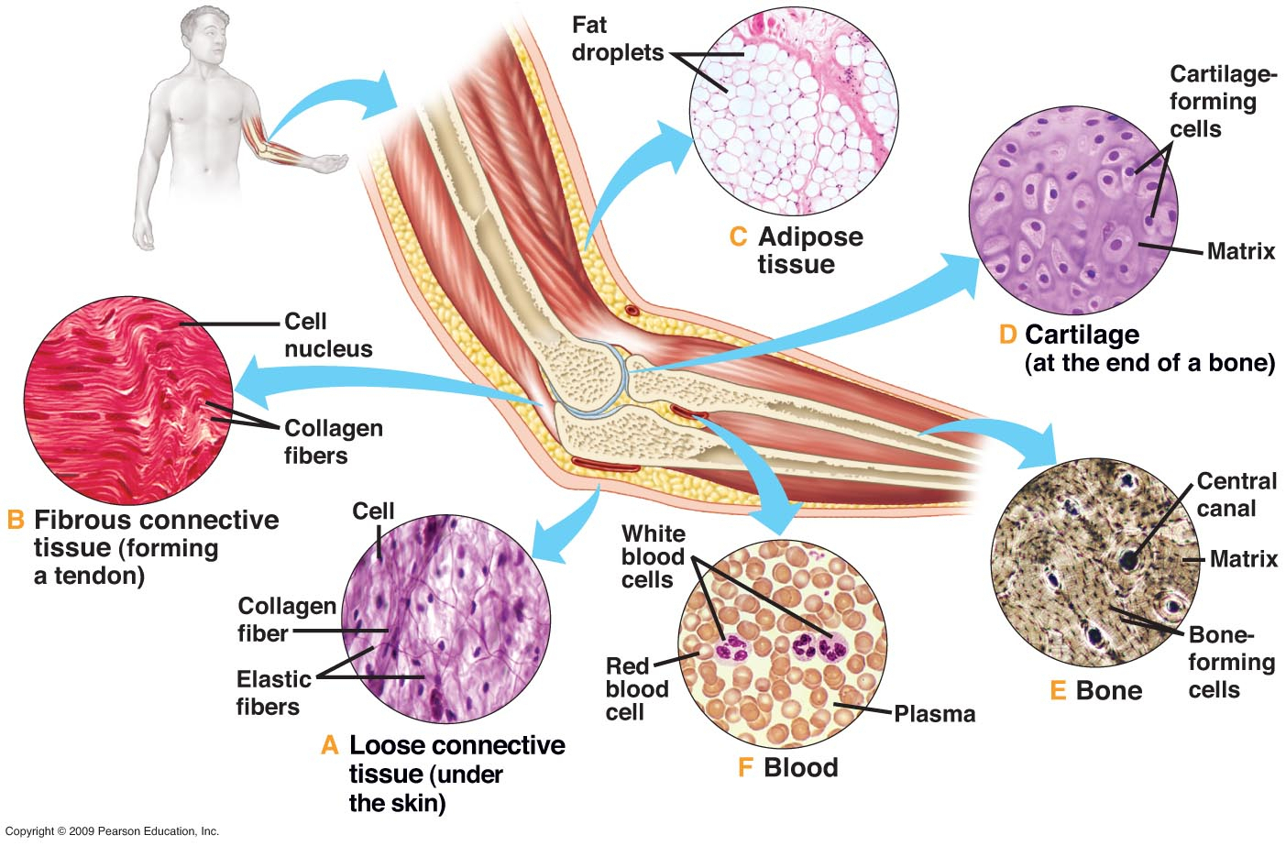
Components of Connective Tissue proper :
Cells
Fibroblasts
Macrophages
Mast cells
Plasma cells
Adipose cells
Leucocytes
Fibers
Collagen
Reticular
Elastic
Matrix

Slide 5
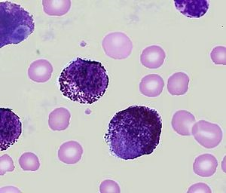
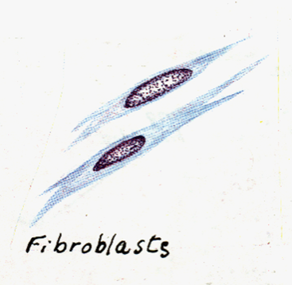
Cells
Fibroblast | Macrophages | Mast Cells
Most common cell , found nearly in all types of C.T. proper. L/M : Flat branched cells (spindle-shaped) with basophilic cytoplasm. • They can divide. • Old fibroblasts are called fibrocytes . *fibrocytes are mainly inactive . Function: 1. Formation of proteins of C.T. fibers. *the cytoplasm of these cells are rich in ribosomes which on the outer surface of Rough ER .
2. Formation of C.T. matrix. 3. Healing of wounds.
4- *Responsible for formation of 3 types of fibers ( collagen , elastic , reticular ) .
L/M :Basophilic cytoplasm, rich in lysosomes
Irregular outlines (cell membrane )
*pseudopodia (الأقدام الكاذبة) of macrophages is the cause of it’s irregular outlines.
They can divide.
They originate from blood monocytes.
Function : Phagocytosis.
L/M : Cytoplasm contains numerous basophilic cytoplasmic granules.
Function: 1. Secrete heparin (anticoagulant). 2. Secrete histamine (allergic reactions).

Slide 6
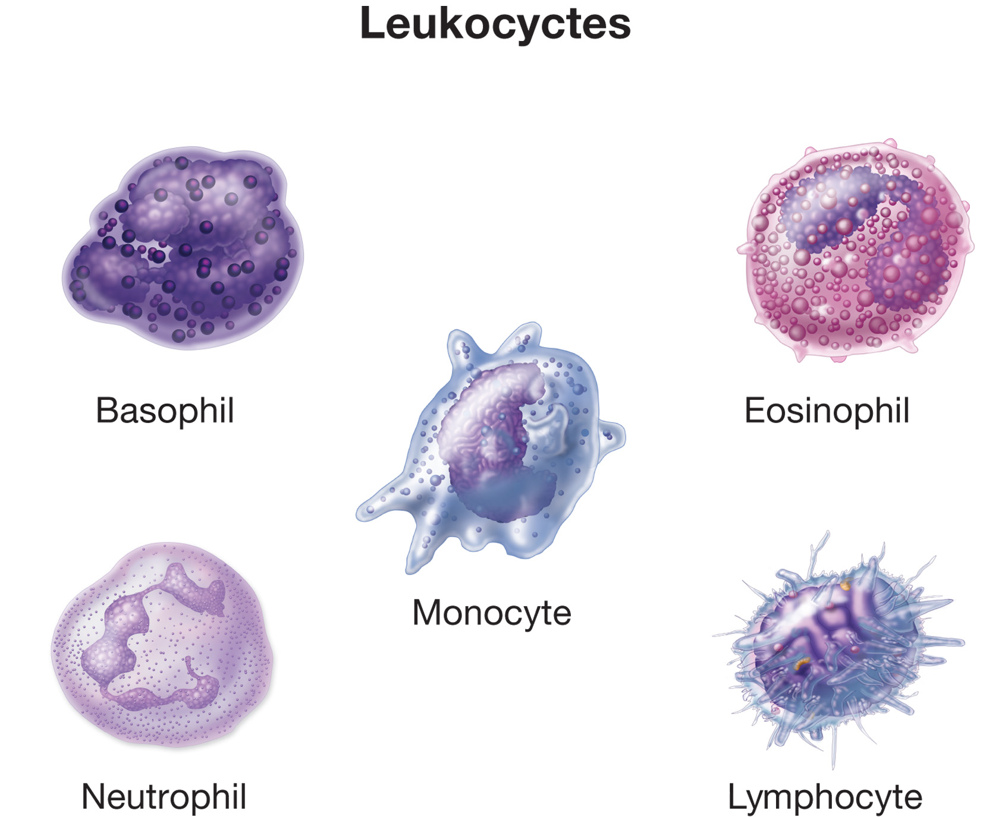
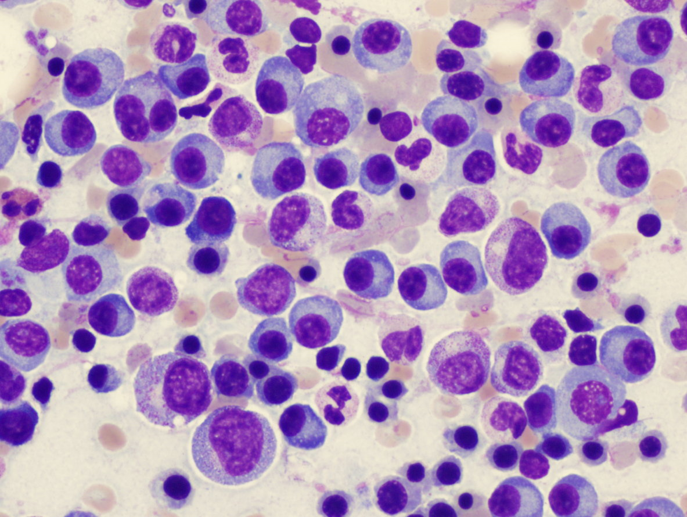
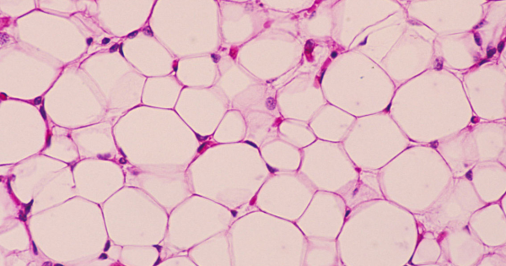
Cells
Plasma Cells *Active | Adipose Cells (Adipocytes , Fat Cells) | Leukocytes (White Blood Cells)
L/M: Basophilic cytoplasm with a negative Golgi image.
*negative Golgi image : lack of ribosomes around Golgi apparatus.
Nucleus: spherical , eccentric with a clock-face appearance of chromatin.
Derived from B-lymphocytes.*InActive
Function: Secretion of antibodies (immunoglobulins).
L/M of Unilocular Adipose Cells: • Large spherical , with a single large fat droplet. • Thin rim of cytoplasm at the periphery. • Nucleus: flattened , peripheral. *the large fat droplet squeeze the cytoplasm and nucleus to give them their shape. Function: Storage of fat.
• Appear normally in C.T. proper.
• Neutrophils increase in acute inflammation.
• Lymphocytes and monocytes increase in chronic inflammation.
• Eosinophils and basophils increase in allergic inflammation.

Slide 7
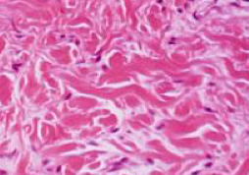
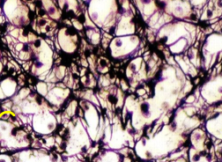
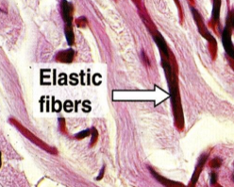
Fibers
3) Elastic Fibers | 2) Reticular Fibers | 1) Collagen Fibers
Made of elastin | Made of collagen type III | Made of collagen type I
Branched | Branch and form a network | Non-branched fiber , arranged in bundles *bundles form the branch.
Stained brown with orcein | Stained black with silver | Acidophilic
Other important types of collagen include:
1- type II (in cartilage). 2- type IV (in basement membranes)
FROM 437 TEAMWORK

Slide 8
Types Of Connective Tissue (Proper)
1) Loose (Areolar) C.T
3) Elastic Tissue
2) Dense Collagenous C.T
4) Reticular Tissue
5) Adipose Tissue

Slide 9
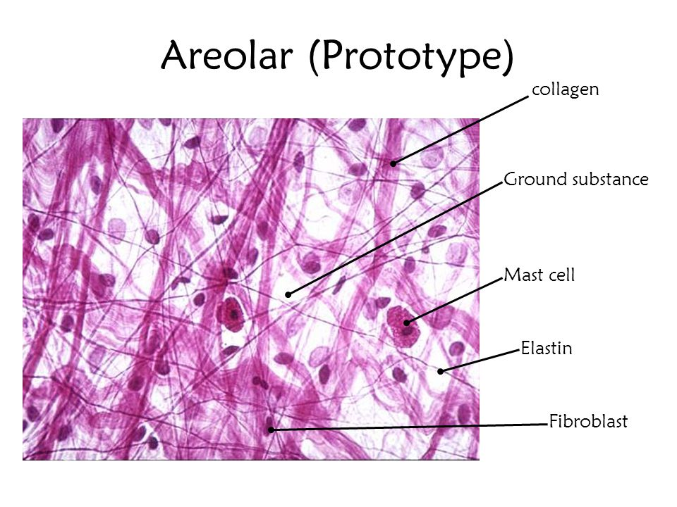
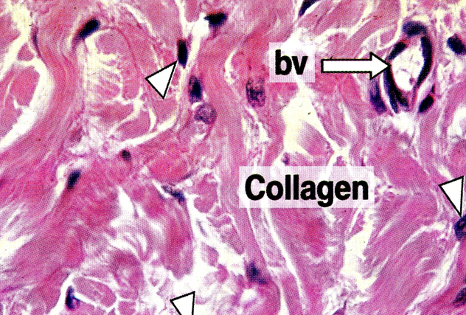
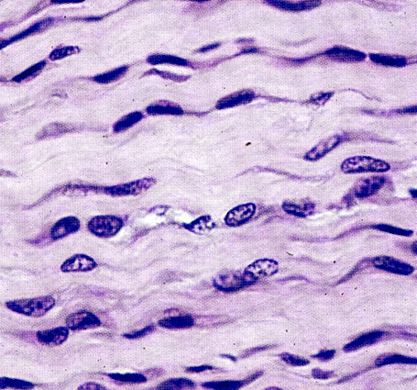
1- Loose (areolar) C.T.
The most common type of C.T. proper.
L/M:
Contains all the main components of C.T.P.
all types of C.T. cells & fibers + abundant matrix.
No predominant element in loose C.T.
Sites:
e.g. Subcutaneous tissue.
2- Dense collagenous C.T.
L/M:
Predominance of collagen fibers + fibroblasts.
Sites:
1- Dense irregular: e.g. dermis of the skin , capsules.
2- Dense regular: e.g. tendons, ligaments.
Function: tough tissue : resistant to stretch.
1
2

Slide 10
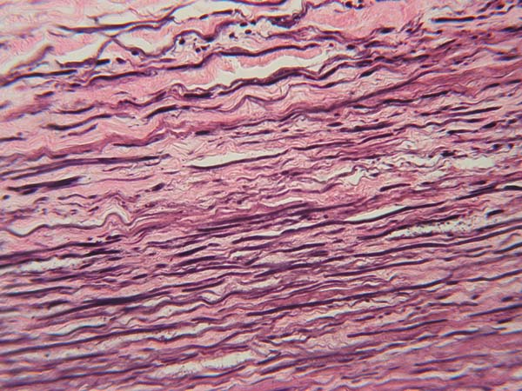
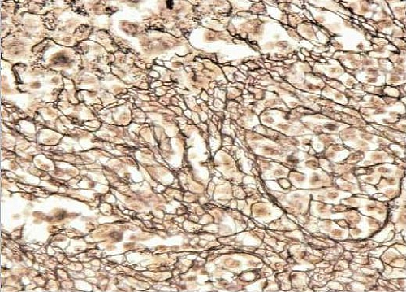
3- Elastic tissue
L/M:
Predominance of elastic fibers (sheets or membranes) + fibroblasts.
Sites:
Large arteries , e.g. Aorta
Function: elastic tissue : stretchable.
4- Reticular tissue
L/M:
Predominance of reticular fibers + reticular cells (specialized fibroblasts).
Sites:
Stroma of organs: e.g. liver , lymph node , spleen.
Function: structural support.
*Stroma means : structural elements.

Slide 11
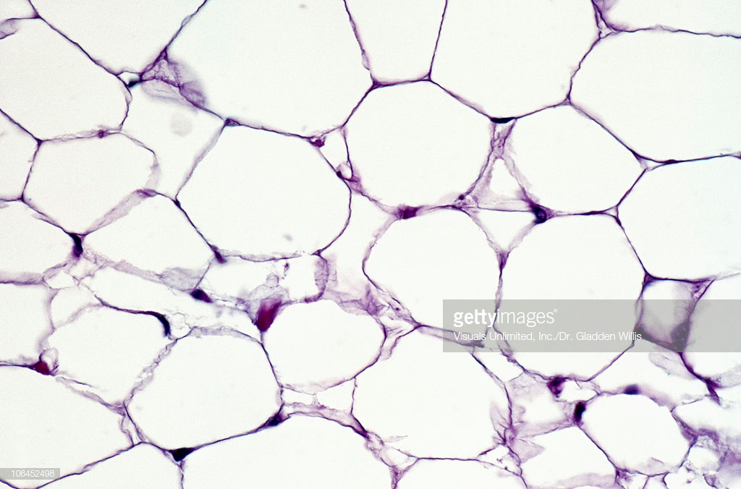
5- Unilocular adipose tissue (white adipose tissue)
L/M:
Predominance of unilocular fat cells.
Sites:
Subcutaneous tissue , especially in:
Buttocks.
Abdominal wall.
Female breast.
Around the kidney.
Function:
Synthesis , storage and release of fat.
Supports organs , e.g. kidney.
Heat insulation.

Slide 12
Functions of connective tissue proper:
1) Supports , binds , and connects other tissues and organs.
2) Nourishes the surrounding structures , through its blood vessels.
3) Its Cells provide healing of injured tissues , produce heparin , histamine , antibodies , store fat , preserve body temperature and protect against microorganisms.
4) Its fibers provide rigidity or elasticity.

Slide 13
MCQs:
1- Elastic connective tissue is found in?
A. Tendons
B. Ligaments
C. Wall of aorta
D. Liver
2- A cell which produces collagen?
A. Fibroblast
B. Mast cell
C. Plasma cells
D. Macrophage
3- Which type of cells is extensively involved in allergic reactions?
A. Plasma cell
B. Mast cell
C. Macrophage
D. Fibroblast
4- Which of the following is one of connective tissue proper?
A. cartilage
B. Lymph
C. adipose tissue
D. blood
5- The most common type of C.T. proper is?
A. Loose (Areolar)
B. Dense Collagenous
C. Elastic Tissue
D. Adipose Tissue
6- Tissue which binds and supports other tissues is called?
A. connective tissue
B. Linkage tissue
C. muscle tissue
D. nervous tissue

Slide 14
Team members :
Abdullah alassaf
Abdullah altuwaijri
Talal jamal aldeen
Faisal alqifari
Alhanouf alhaluli
Rawan alzayed
Renad alkanaan
Nouf albrikan
Roaa aljohani
Team leaders :
Noura alnasser
Abdullah shadid

