Slide 1
Lecture 2 :
Epithelial Tissue
- Colour index :
Red : important
Grey : doctors notes

Slide 2
Objectives :
Describe general characteristics of epithelial tissue.
Discuss microscopic structure and distribution of different types of epithelial membranes.
Classify glandular epithelium according to different parameters.
Enumerate the functions of epithelial tissue.
Understand the following clinical applications:
- Immotile cilia syndrome (Kartagener’s syndrome).
- Metaplasia.

Slide 3
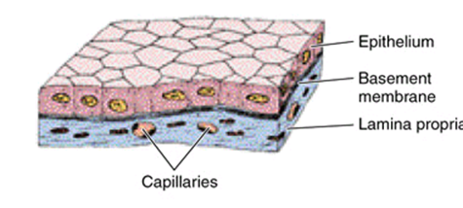
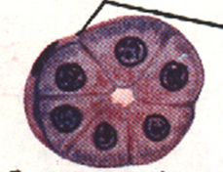
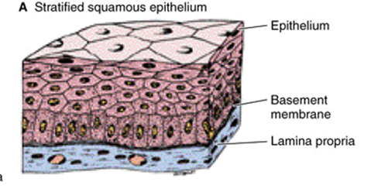
Epithelial tissue
General characteristics:
Cells are tightly joined with little intercellular space.
Rest on a basement membrane.
Avascular. ( no blood vessels )
High power of regeneration.
* Intercellular: (between the cells)
Simple epithelium
Classification:
Epithelial membranes:
Glands (Glandular Epithelium).
A- Simple epithelium: one layer.
B- Stratified epithelium: more than one layer.
* Epithelial tissue is surrounded by connective tissue so they can get what they need from the blood vessels of the connective tissue.

Slide 4
Function of epithelium:
1- Protection as in epidermis of skin.
2- Secretion as in glands.
3- Absorption as in small intestine.
4- Excretion as in kidney.
5- Reproduction as in gonads.
6- Smooth lining as in blood vessels.
*The different between secretion and excretion.
Secretion: used in the body
E.g. hormones
Excretion: waste products
E.g. : urine

Slide 5
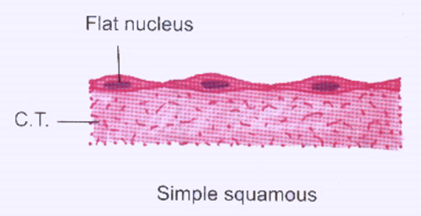
A) Simple Epithelium
1- Simple Squamous Epithelium:
One layer of flat cells with flat nuclei.
Provides smooth thin surface.
Examples of sites:
- Endothelium (lining the CVS "cardiovascular system").
- Alveoli "air sacs" of lung .( 95% is covered by simple squamous epithelium )
* The shape of the nucleus follows the shape of the cell (often).

Slide 6
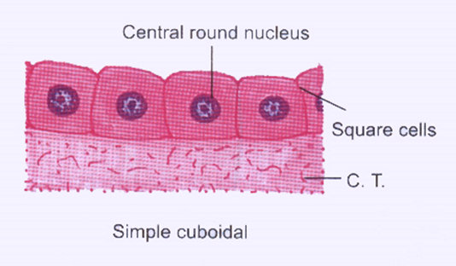
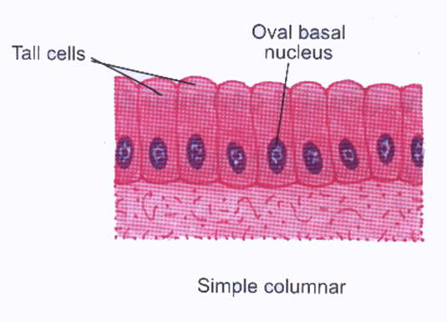
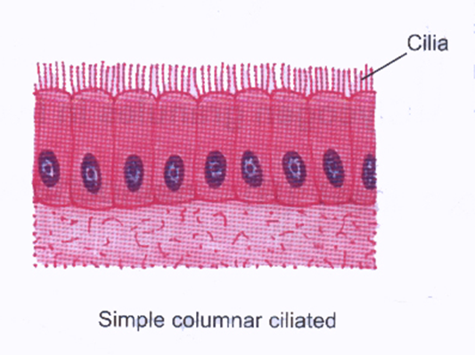
2- Simple Cuboidal Epithelium:
One layer of cuboidal cells with central rounded nuclei.
Example of sites:
Thyroid follicles
3- Simple Columnar Epithelium:
One layer of columnar cells with basal oval nuclei.
Types:
Non-ciliated:
Example of sites: Lining of stomach , gall bladder , and intestines (with goblet cells). *goblet cell secretes the main component of mucus.
Ciliated:
with cilia on free surface. Example of sites: Fallopian tubes. * other names : uterine tube , oviduct

Slide 7
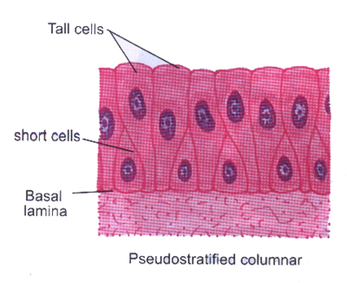
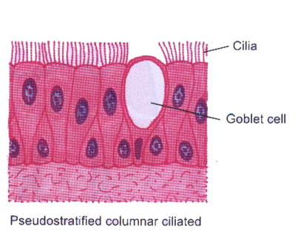
4- Pseudo-Stratified Columnar:
One layer of columnar cells.
Some cells are tall.
Others are short and don’t reach the surface.
All cells rest on the basement membrane.
Nuclei appear at different levels.
Types:
Non-ciliated: Example of sites: vas deferens.
Ciliated with goblet cells" respiratory epithelium": Example of sites: trachea & bronchi.

Slide 8
B) Stratified Epithelium
* Named stratified squamous based on the superficial layer of cells
1) Stratified squamous epithelium | 2) Transitional epithelium | 3)Stratified columnar epithelium
Multiple layers of cells. Basal cells are columnar with basal oval nuclei. Intermediate cells are polygonal with central rounded nuclei. Surface cells are flat with flattened nuclei. Types: 1) Keratinized: with a layer of keratin on the surface. 2) Non-keratinized: without a layer of keratin on the surface. | Multiple layers of cells. Basal cells are columnar. Intermediate cells are polygonal. Surface cells are large cuboidal with convex free surface and may be binculcated . | Multiple layers of cells. Basal cells are columnar. Intermediate cells are polygonal. Surface cells are columnar.
Example of sites: 1) Keratinized: epidermis of skin. 2) Non-keratinized: esophagus. | Example of sites: urinary bladder. | Exampleof sites: large ducts of glands. * Some parts of urethra
Full bladder
Empty bladder

Slide 9
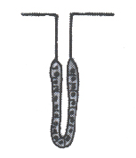
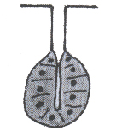
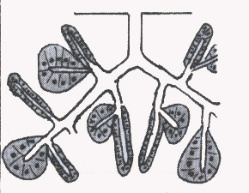
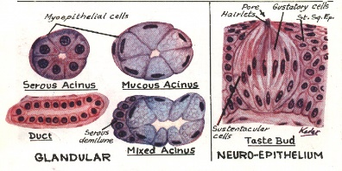
Glands (glandular epithelium)
Classified according to:
1-Presence or absence of ducts | 2-Number of cells | 3-Mode of secretion | 4-Shape of secretory part | 5-Nature of secretion
a) Exocrine: (has ducts) e.g. salivary glands. b) Endocrine: (does not have ducts) e.g. thyroid gland. c) Mixed: e.g. pancreas | a) Unicellular: e.g. goblet cells. b) Multicellular: e.g. salivary glands. | a) Merocrine: No part of the cell is lost with the secretion, e.g. salivary glands. b) Apocrine: The top of the cell is lost with the secretion, e.g. mammary gland. c) Holocrine: The whole cell detaches with the secretion, e.g. sebaceous glands. | a) Tubular: e.g. intestinal gland. b) Alveolar (acinar): e.g. mammary gland. 3) Tubulo-alveolar: e.g. pancreas. | a) Serous: e.g. parotid gland. b) Mucous: e.g. goblet cells. c) Muco-serous: e.g. sublingual gland. d) Watery: e.g. sweat gland.
1
2
3
1 2 3

Slide 10
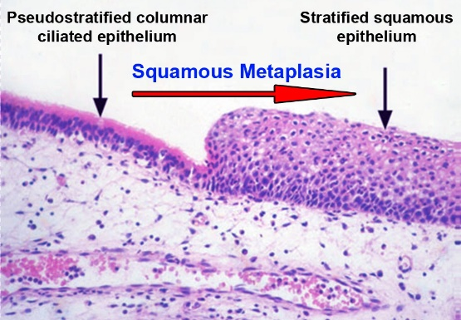
Clinical Application
Immotile cilia syndrome (Kartegener’s Syndrome):
Disorder that causes infertility in male and chronic respiratory tract infection in both sexes.
It is caused by immobility of cilia and flagella induced by deficiency of dynein.
*(Dynein protein is responsible for movements of cilia and flagella.)
Metaplasia:
It is the transformation of one type of tissue to another in response to injury.
This condition is usually reversible if the injury is removed.
Example: pseudostratified ciliated columnar epithelium of the respiratory passages, e.g. trachea , of heavy smokers may undergo squamous metaplasia , transforming into stratified squamous epithelium.

Slide 11
MCQs:
1-Fallopian tubes is example of ?
A) ciliated Pseudo-Stratified Columnar
B) ciliated Simple Columnar Epithelium
C) transitional epithelium
D) stratified columnar epithelium
*2-All epithelial tissue rest on?
A) lamina
B) nuclei
C) basement membrane
D) basal cell
*3-What function of Dynein protein?
A) protection the cilia & flagella
B) growth of cilia.
C) movements of cilia and flagella
D) movement of cilia only
*4-Kartegener’s syndrome causes chronic respiratory tract infection in?
A) children
B) males
C) females
D) both sexes
*5-If the injury is removed, metaplasia is usually?
A) reversible
B) irreversible
C) chronic
D) Acute
*6-What differences between nuclei of simple squamous epithelium & simple cuboidal epithelium?
A) Simple squamous epithelium: flat nuclei Simple cuboidal epithelium: basal oval nuclei
B) Simple squamous epithelium: central rounded nuclei. Simple cuboidal epithelium: flat nuclei
C) Simple squamous epithelium: basal oval nuclei Simple cuboidal epithelium: central rounded nuclei
D) Simple squamous epithelium: flat nuclei Simple cuboidal epithelium: central rounded nuclei
* FROM 437 TEAMWORK

Slide 12
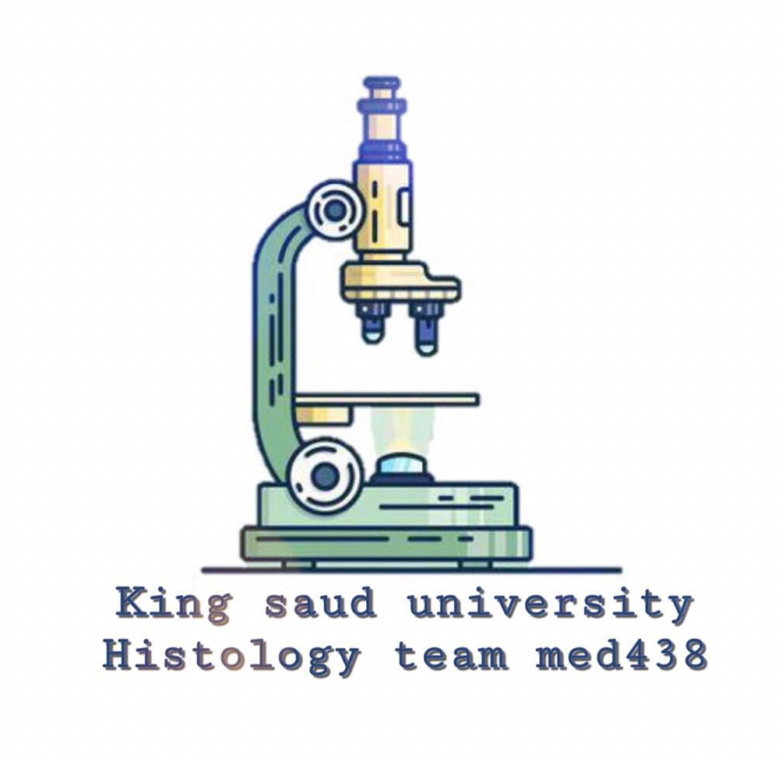
Team members :
Abdullah alassaf
Abdullah altuwaijri
Talal jamal aldeen
Faisal alqifari
Alhanouf alhaluli
Rawan alzayed
Renad alkanaan
Nouf albrikan
Roaa aljohani
Team leaders :
Noura alnasser
Abdullah shadid

