Slide 1
Lymphoid Tissue
Lecture 4 :
- Colour index :
Red : important
Grey : doctors notes

Slide 2
Objectives :
Describe the microscopic structure of the following organs in correlation with their functions:
1- Lymph nodes.
2- Spleen.
3- Tonsils.
4- Thymus.

Slide 3
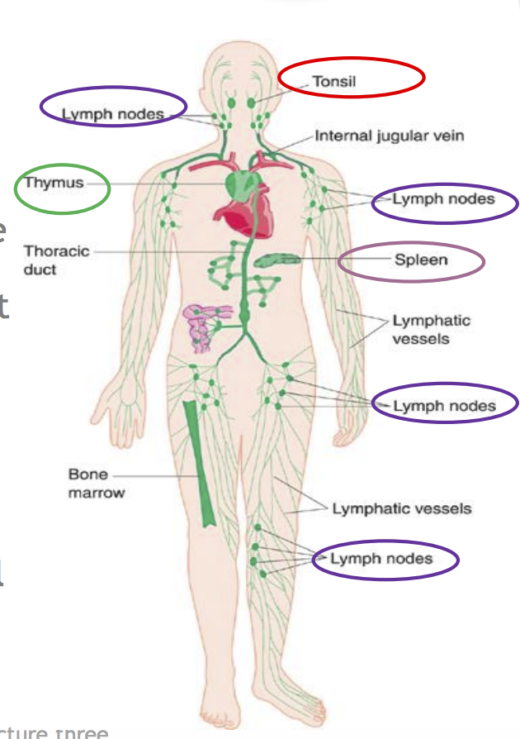
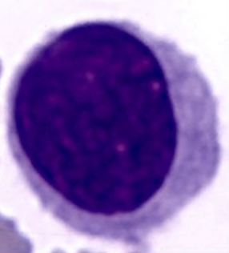
LYMPHOID TISSUE
*lymphoid tissue = leucocytes + lymphocytes
Diffuse: *(mucosa associated lymphoid tissue)
Encapsulated *has capsule
Lymph nodes
Spleen
Tonsils (Are incompletely
encapsulated)
Thymus
EXTRA
Primary lymphoid organs: organs where lymphocytes are formed and matured
Example: red bone marrow and thymus
Secondary lymphoid organs: other lymphoid organs:
Example: lymph node, spleen, tonsils, MALTs, peyer’s patches
*mucous membrane : It consists of epithelial + connective tissue , It is located in wet area for example: inside the mouth or nose
*the lymphatic system consist of lymphatic organs and lymphatic Vessels
Lymphocyte

Slide 4
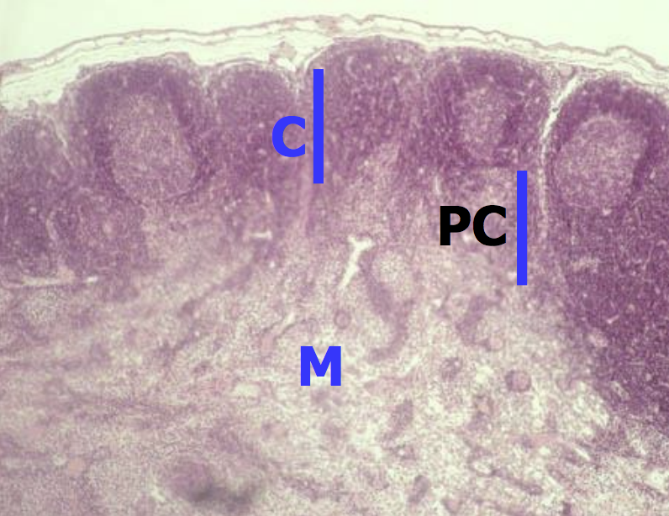
Lymph Nodes :
Ovoid , kidney shaped organs.
Each node has:
1- A convex surface which receives afferent lymph vessels. *a = Arrive
2- A hilum where efferent lymph vessels leave and drain lymph from the node. *e = Exit
Each lymph node has a dense connective tissue capsule.
From the capsule , connective tissue septa ( trabeculae) extend into the outer part
(cortex) of the node and divide it into incomplete compartments.
The framework of the node is formed by
reticular connective tissue.
Each lymph node is divided into three regions:
1- Cortex
2- Paracortex
3- Medulla

Slide 5
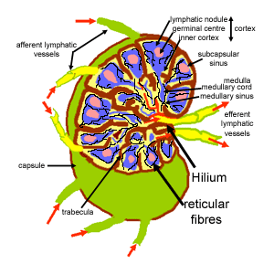
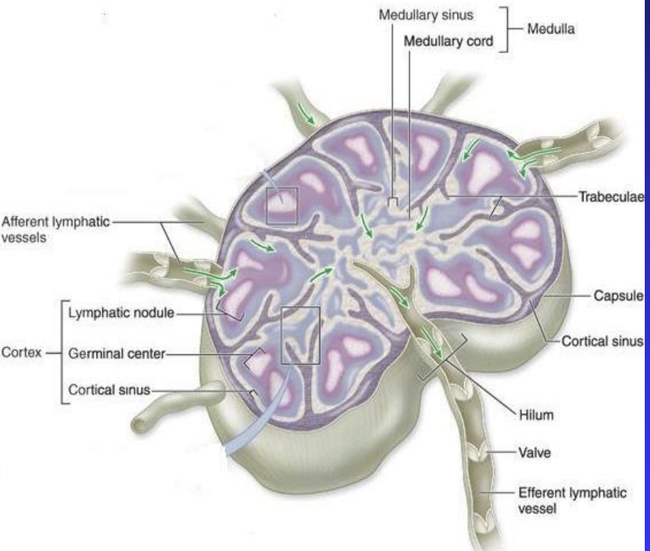
*-The capsule is dense , irregular collagenous connective tissue
-it has lymphatic vessels to filter the lymph.
S
*Afferent lymphatic vessels:
-carry the lymph towards the lymph nodes to be poured in supcapsular sinus.
-it has more than one vessel.
*Efferent lymphatic vessel:
-carry cleaned , filtered lymph.
-it has one vessel to give enough time for filtration the lymph.

Slide 6
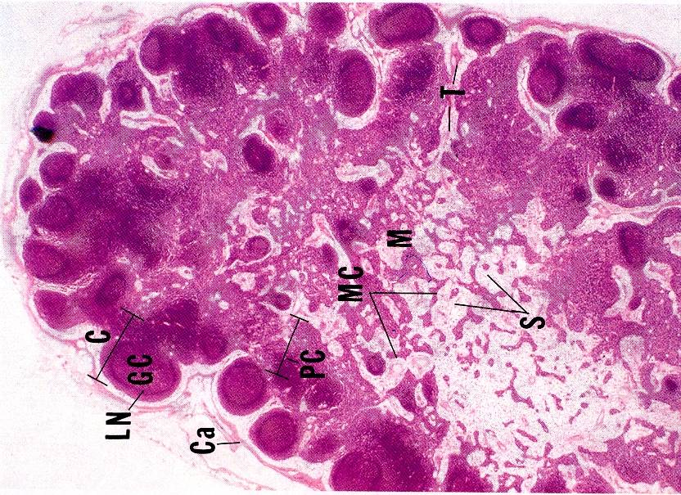
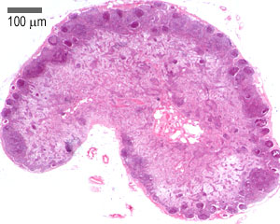
LYMPH NODES
*The type of collagen is very important
Stroma
*supportive tissue
(B) Parenchyma
*(lymphoid tissue + lymph sinuses)
Capsule
*type 1 collagen
Trabeculae (septa)
Reticular C.T *extension of trabeculae
type 3 collagen
Cortex
Paracortex
Medulla

Slide 7
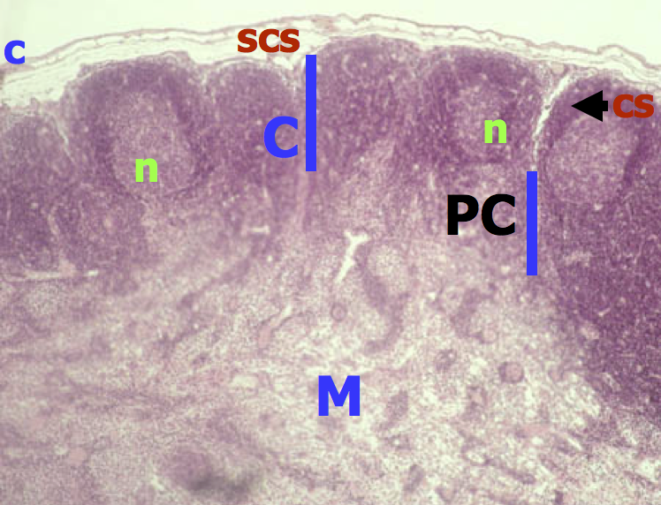
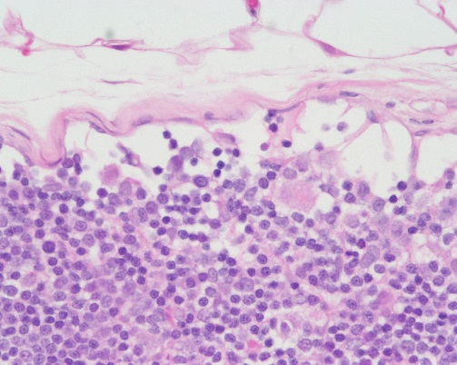
Lymph nodes :
Cortex
Contains the :
1- Subcapsular lymphatic sinus.
2- Cortical sinuses.
3- Lymphoid nodules (primary & secondary):
Composed mainly of B lymphocytes , macrophages
and reticular cells.
*All the lymphatic organs are rich in macrophage because it is immune organ.
*The macrophage move along the lymphatic to clean it.

Slide 8
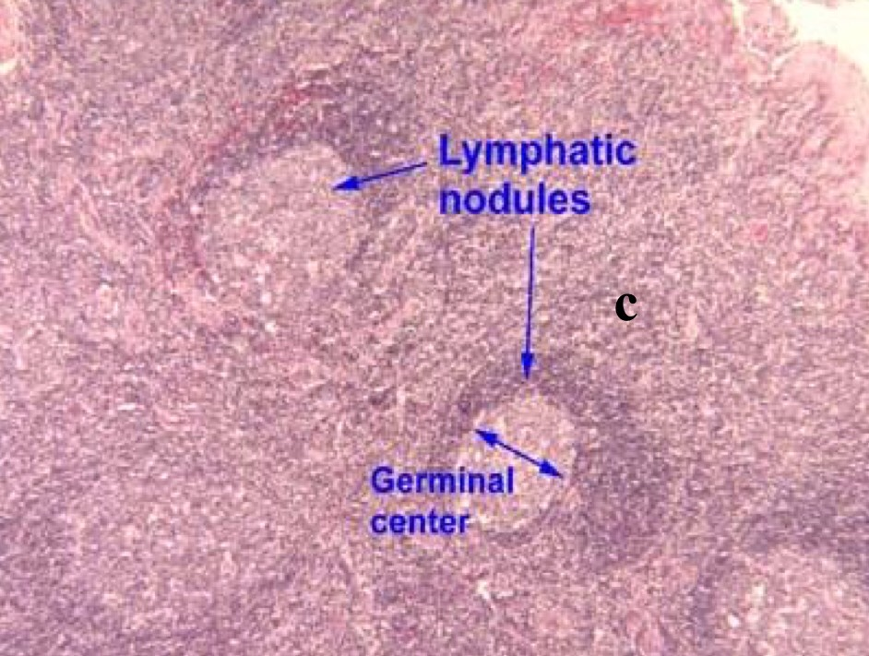
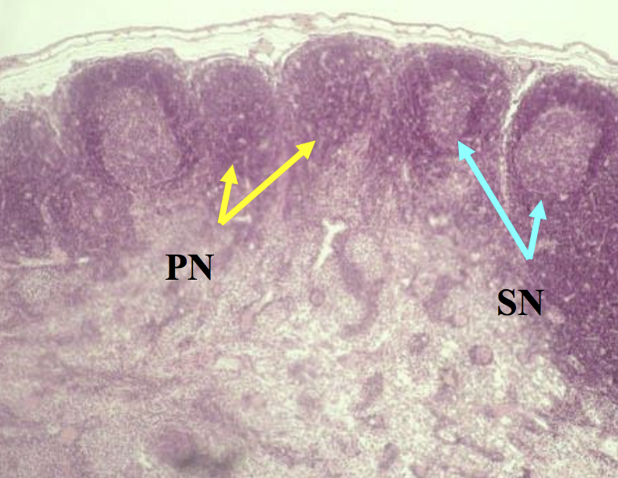
Lymph Nodules (Follicles): * B cells is the main type of cells
Cortex
Lymph nodules are small masses of lymph tissue (lymphocytes).
Lymph nodules may be:
(A) Primary nodules: formed of virgin B lymphocytes.* with out germinal center
(B) Secondary nodules: with paler germinal centers and it Contain:
- Germinal centers , central light areas filled with activated B lymphocytes
(B lymphoblast) , plasma cells and macrophages.
- The germinal center is surrounded by a darker-staining region called the corona.
*lymph nodule exist only on the cortex part of lymph node
*primary nodules before infection
*Secondary nodules after infection
One color
Two color

Slide 9
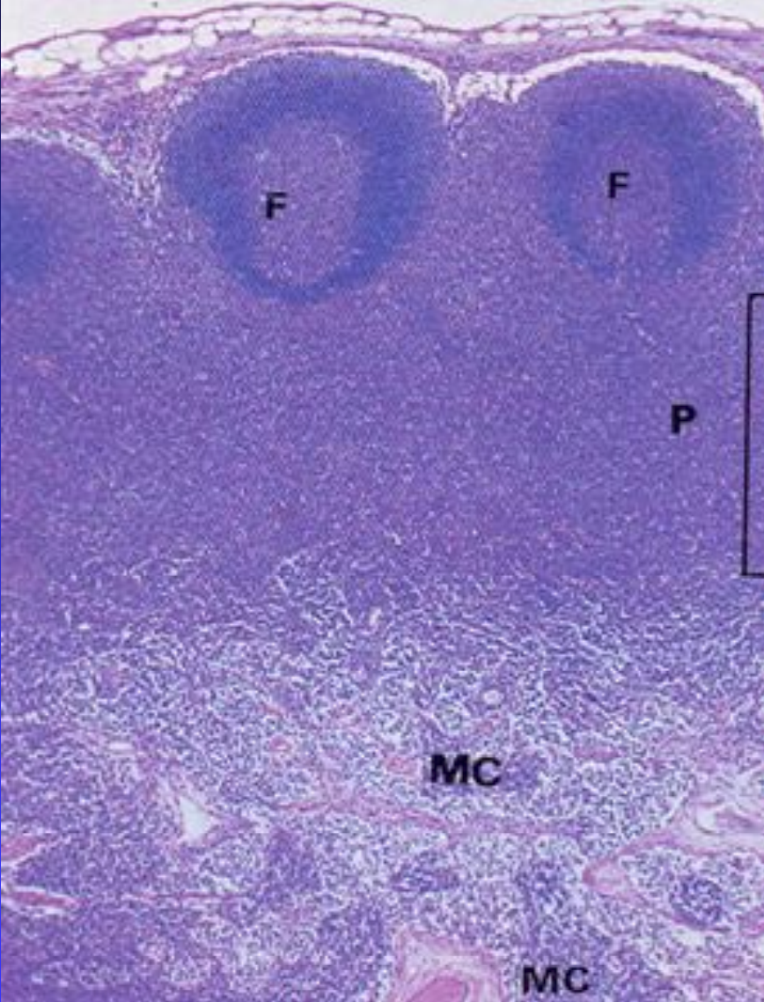
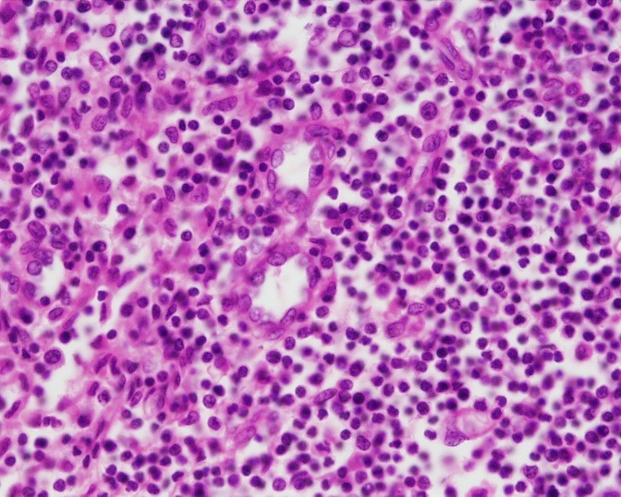
Paracortex
• It is the region between cortex and medulla.
• It is the thymus dependent zone and contains T lymphocytes.
• It contains high endothelial venules through
which lymphocytes enter the lymph node ,
B cells enter the cortex and T cells settle in the paracortex.
• Has NO nodules.
Many small condense cell "inactive"
Few large lighter cell "active form of the immune cells"
* T lymphocytes came from bone marrow and then activate in the thymus
* B lymphocytes came and activate in bone marrow
Blood vessels

Slide 10
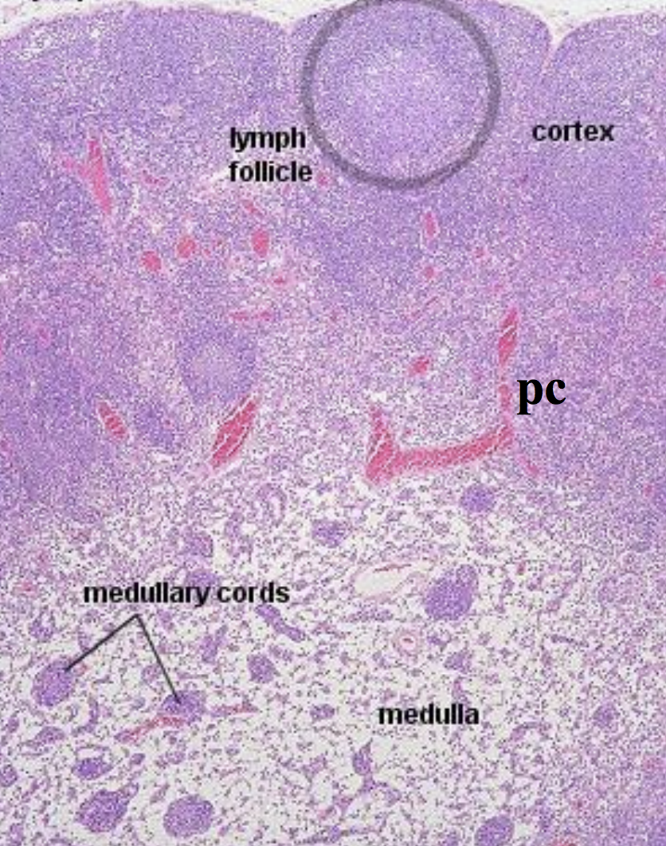
Medulla
Consists of:
1- Medullary cords.
Which composed of:
B & T lymphocytes , plasma cells and macrophages.
2- Medullary lymph sinuses.
Which continuous with:
the subcapsular and cortical lymph sinuses.
*The main type of cells is T cells

Slide 11
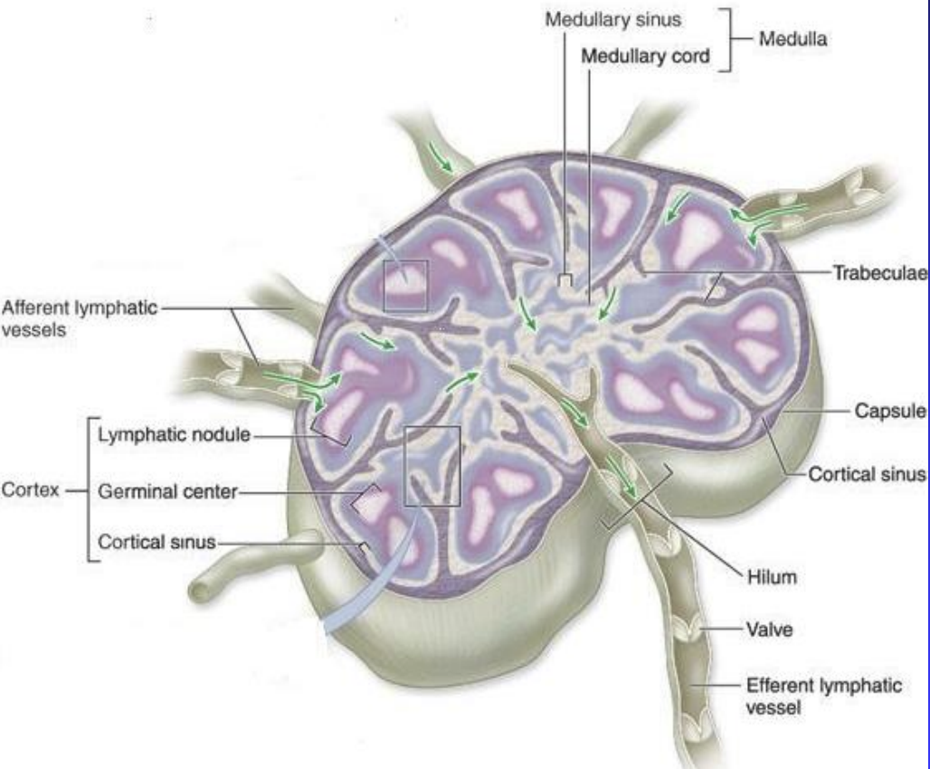
Lymph Flow Through The Lymph Node
Afferent lymph vessels
Subcapsular sinuses
Cortical sinuses
Medullary sinuses
Efferent lymphatic vessels

Slide 12
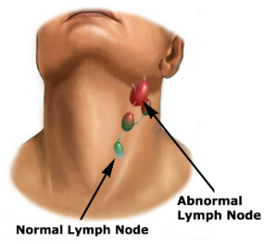
Function of lymph node:
1- Proliferation of B and T lymphocytes.
2- Filtration of lymph from bacteria and other foreign substances.
Clinical applications:
(Palpable lymph node)
The presence of antigen or bacteria leads to rapid proliferation of lymphocytes of the lymph node (L.N) , leading to increase of L.N. to several times of its normal size , so the L.N. becomes enlarged and palpable to the touch.
*in normal condition , not palpable

Slide 13
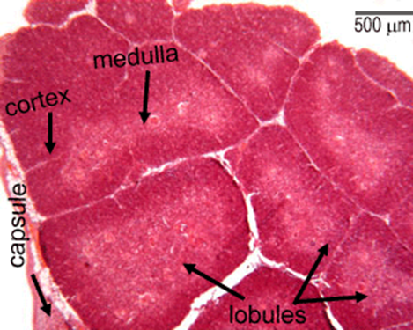
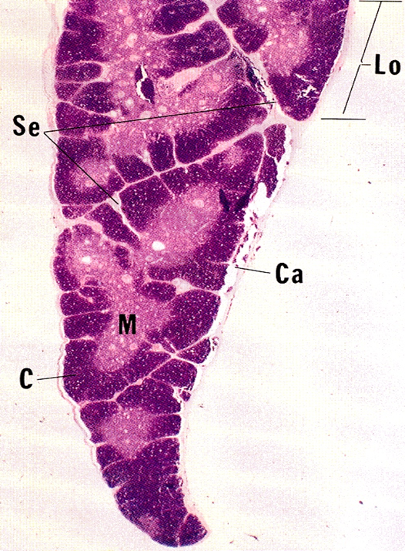
Thymus
A) Stroma :
1- Capsule
2- Interlobular trabeculae: incomplete
B) Thymic Lobule :
1- Cortex
2- Medulla
*Thymus is composed of 2 lobes divided into incomplete lobules
*It is located between sternum and heart , it’s a capsulated organ
*White areas in the pic represent connective tissues
*Each lobule consists of medulla and cortex surrounded by an outer capsule

Slide 14
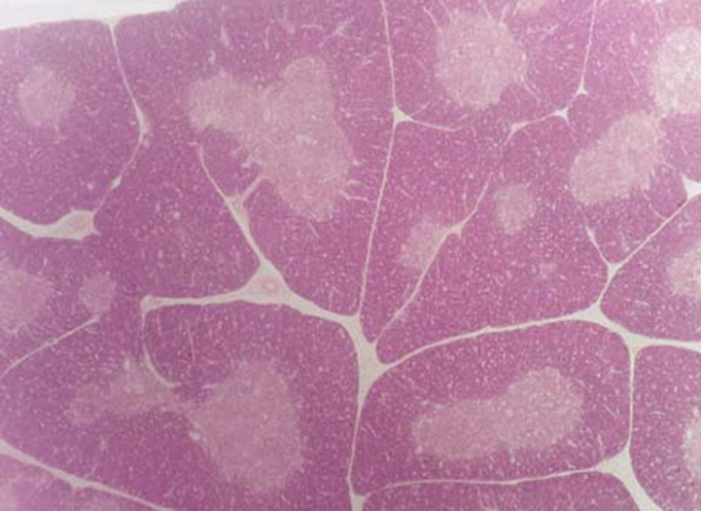
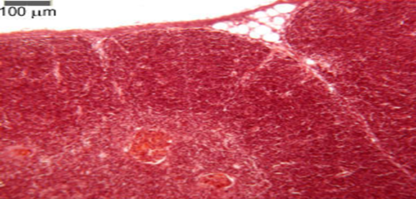
Thymus
Bilobed lymphoid organ located in thorax.
Enclosed in a thin connective tissue capsule.
Septa (trabeculae) from the capsule into the organ , subdividing it into incomplete lobules.
Possesses no lymph nodules , no lymph sinuses , no reticular fibers.
*Medulla is the pale area
*Cortex is the dark area “rich in T lymphocyte”
*No B cells
*No plasma cells (antibodies)

Slide 15
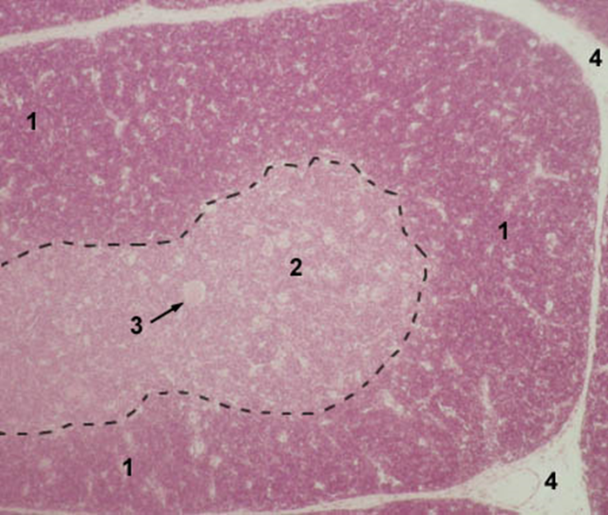
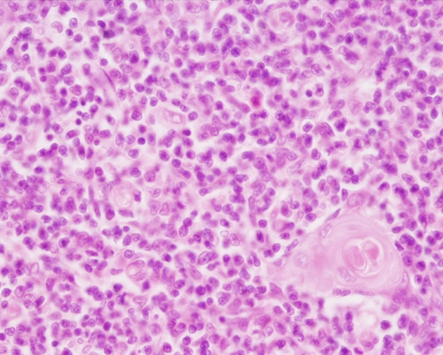
Thymus
Each lobule is divided into an outer cortex and inner medulla.
CORTEX: is darker than the medulla because it is populated with immunologically immature T-lymphocytes (more than 90% will die) , epithelial reticular cells , and macrophages. Here the immature T cells undergo proliferation , and transform into mature cells and then migrate to medulla.
MEDULLA: consists of mature T-lymphocytes , epithelial reticular cells , thymic (Hassall’s) corpuscles and macrophages.
*All lymphatic tissues have macrophages
From 437:
*Inactive T cell will be in cortex of thymus than it will be engulf by macrophages.
*Active T cell will be in medulla of the thymus.
*Epithelial reticular cells are special component only for thymus. *Epithelial reticular cells responsible for maturation of T cell.
1 - cortex 2 - medulla 3 - Hassall's corpuscle 4 - interlobular connective tissue (septa)
*epithelial reticular cells only found in thymus

Slide 16
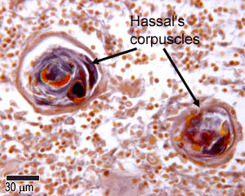
Hassall’s Corpuscles
Are composed of groups of concentrically arranged keratinized epithelial reticular cells.
Are found in medulla of thymic lobules.
Increase in number with age.
Probably represent a degenerative process.
*Hassall’s corpuscles are degenerated group of epithelial reticular cell.
*Their function differ when located in cortex.

Slide 17
Function Of Thymus:
1- Maturation of T lymphocytes (produce immunocompetant T lymphocytes).
2- It involutes after puberty and becomes infiltrated by adipose tissue.
3- Remnants of thymus remain in adult to form T lymphocytes.
4- No B lymphocytes , no plasma cells in the thymus.
*Maturation of T lymphocyte happens in the cortex because the epithelial reticular cells of the cortex have the ability to secrete factors essential for the maturation of immature T lymphocyte.
*Mature = immunocompetent
*Immature= immunoincompetant

Slide 18
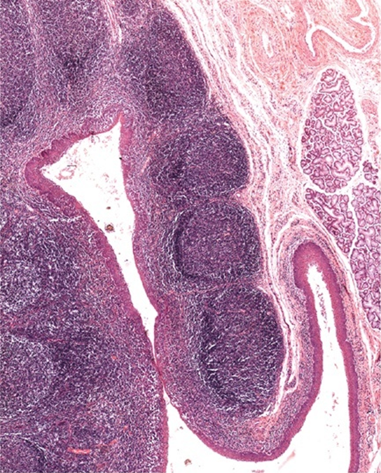
Tonsils
The tonsils contains:(palatine, pharyngeal, and lingual) are incompletely encapsulated aggregates of lymphoid nodules that guard the entrance to the pharynx.
Function: production of antibodies.
-Palatine Tonsils
Bilateral , located at the entrance of the oral pharynx.
Incomplete capsule separates its deep aspect from the wall of the pharynx.
The superficial aspect is covered by stratified squamous non keratinized epithelium that dips into 10-12 crypts.
The parenchyma is composed of lymphoid nodules with germinal centers.
*Pharyngeal and linqual tonsils have the same structure , but different sizes
*Palatine and linqual are stratified squamous
*Pharyngeal is pseudostratified squamous

Slide 19
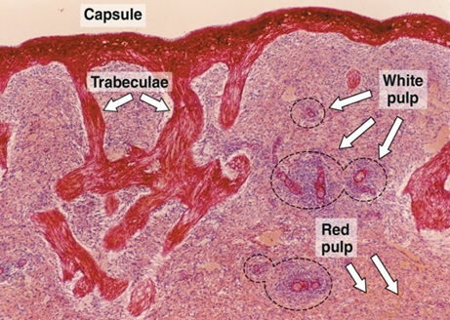
Spleen
- Stroma of Spleen:
1-Capsule:
is covered by visceral layer of peritoneum; mesothelium.
Is formed of fibromuscular C.T:
Dense fibrous C.T + smooth muscle cells.
*The capsule takes the dark red coloration because of the presence of the muscles.
2-Trabeculae: Are irregular, incomplete , divide the spleen into intercommunicating compartments (lobules).
3-Reticular C.T
From 437: Reticular connective tissue located in lymph nodes , bone marrow , spleen and liver.

Slide 20
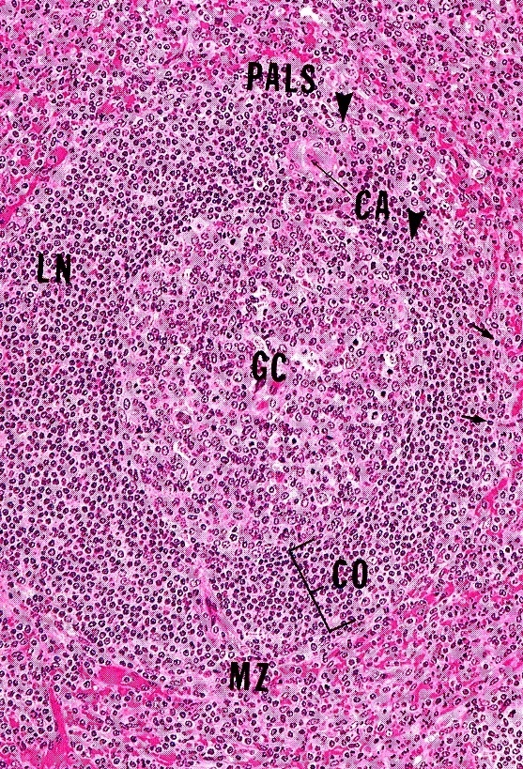
- Parenchyma Of Spleen :
Spleen
A) White pulp.
B) Red pulp.
N.B: 1- No cortex 2- No medulla 3- No afferent lymphatic vessel.
*Afferent lymphatic vessel is only found in the lymphatic nodes.
*The rest of organs have efferent lymphatic vessel.
A) White Pulp:
1-Periarterial lymphatic sheaths (PALS): housing T lymphocytes. *First layer of the arteriole
2-Lymphoid follicles (with germinal centers): housing B lymphocytes.
N.B: Both1&2 have the acentrically located central artery
(central arteriole) , (follicular arteriole).

Slide 21
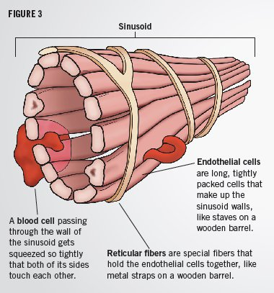
- Parenchyma Of Spleen :
Spleen
B) Red pulp:
1-Splenic (pulp) cords:
Extravasated blood cells , plasma cells , macrophages & reticular cells and fibers.
2-Splenic blood sinusoids:
Are lined with elongated fusiform endothelial cells with large intercellular spaces , supported by discontinuous , circular basement membrane.

Slide 22
Cells Of Parenchyma Of Spleen:
1. Lymphocytes.
2. Plasma cells.
3. Macrophages.
4. Blood elements (RBCs , leucocytes and blood platelets).

Slide 23
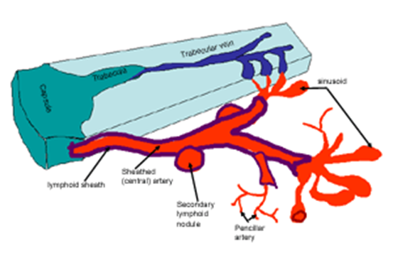
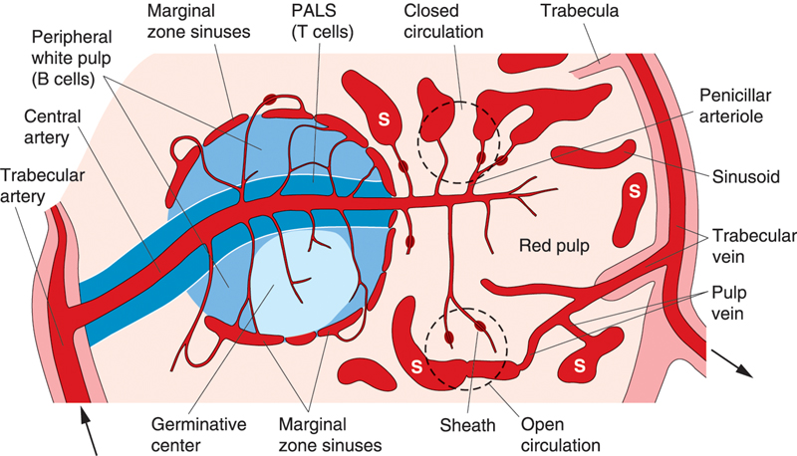
Splenic *Microcirculation
*Means : Circulation of the blood in the smallest blood vessels

Slide 24
Function Of Spleen :
1- Filtration of blood.
2- Phagocytosis of old RBCs & old blood platelets , invading microorganisms.
3- Production , proliferation of immunocompetent B & T lymphocytes.
4- Production of antibodies.

Slide 25
Clinical Applications
Rupture of the Spleen
Spleen is a fragile or friable organ , so major trauma to the upper left abdominal quadrant usually leads to rupture of the spleen. Surgical removal of that ruptured spleen is essential.
*In case of spleen damage , liver takes over in blood filtration
*spleen can easily damaged
To understand the Lymphatic System more , see these videos :
https://www.youtube.com/watch?v=kjLwVqxwaIM&feature=share
https://www.youtube.com/watch?v=QD9AdNXSQe4&feature=share

Slide 26
MCQs :
1-Part of the stroma?
A) Capsule
B) Cortex
C) Medulla
D) Paracortex
5-Surgical removal of the spleen is essential if?
It is inflamed
B) It is attacked by microorganisms
C) It is Ruptured
D) All the above
2-One of spleen's functions is?
A) Maturation of T lymphocytes
B) Filtration of the lymph fluid
C) Filtration of blood
D) Production of antigens
6-There is No B lymphocytes , no plasma cells in?
A) Thymus
B) Spleen
C) Tonsils
D) Lymph nodes
3-Which one of these is not found in the spleen?
White pulp
B) Capsule
C) Afferent lymphatic vessel
D) Trabeculae
7-red bone marrow and thymus are considered as?
A) Primary lymphoid organs
B) Secondary lymphoid organs
C) Tertiary lymphoid organs
D) Non of these
4-The presence of ______ leads to enlarged lymph node?
Red Blood Cells
B) Antigens or Microorganisms
C) Neutrophils
D) Antibodies
8-One of the following is NOT a secondary lymphoid organ?
A) Spleen
B) Lymph node
C) Thymus
D) Tonsils

Slide 27
Team members :
Abdullah alassaf
Abdullah altuwaijri
Talal jamal aldeen
Faisal alqifari
Alhanouf alhaluli
Rawan alzayed
Renad alkanaan
Nouf albrikan
Roaa aljohani
Team leaders :
Noura alnasser
Abdullah shadid

