Slide 1
INFLAMMATION AND REPAIR
Lecture #5-#10
Twitter: @Pathology438
Important in Red.
Doctor’s notes in Green.
Not imp is in Orange(or stated)
You will find out in the link below if any correction or notes unmentioned in the team’s work were to be added. Please check it Frequently.
The editing file for the final's lectures

Slide 2
Table of contents
5th lec
Objectives ……………………………………………………..…..3
Definition of inflammation ……………………….....4
Causes and steps of inflammation ………….….5
Source of chemical mediators …………….……….6
Types of inflammation ………………………...………...7
Events of acute inflammation ……………...……...8
Clinical (cardinal) signs of inflammation ….9
Phases of Changes in Vascular caliber and flow……………………………………...………………………………..10
Increased Vascular permeability ………….........11
Normal capillary exchange VS exchange
During inflammatory response …………………………....12
Summary ……………………………………………………………..13
Quiz ……………………………………………………………...……….15
6th lec
Cellular activity………………………………………………….17
Steps of extravasation of leukocytes from the blood to the tissue …………………………………………...18
Adhesion Molecules and Receptors …………..21
Steps of selectins and integrins acting …….22
Leukocyte adhesion and transmigration ...24
Properties of neutrophils and macrophages.25
Leukocyte Adhesion deficiency ………………….26
Chemotaxis ……………………………………………………….27
Leukocyte activation ……………………………………..29
Steps of phagocytosis …………………………………….30
Phagocytosis by neutrophils ……………………….33
Defects in Leukocyte function …………………….35

Slide 3
Table of contents
7th & 8th lec
Outcome of acute inflammation…………………………..37
Morphological patterns of acute inflammation.38
Chronic inflammation……………….…………………………….43
Cells in chronic inflammation…………….………………..50
Chemical mediators of inflammation………….……..55
Inflammation systemic manifestation………….…..67
9th lec & 10th lec
Describe the differences between repair processes: regeneration, healing and fibrosis. List examples of each cell type…………………………………...70
Know the difference between the various cell in regenerative abilities type …………………………………...72
Know the mechanism of repair and formation of granulation tissue…………………………………………………...74
Phases of cutaneous wound healing……………...….78
primary intention and by secondary intention...79
factors associated with delayed wound healing..81
List complication of wound healing……………...…....82
Define Granulomatous inflammation……………...…85
the pathogenesis of granuloma formation………..87
Types of granulomas(causes and examples)…...88
granulomas (tubercles).............................................89
Summary……………………………………………………………………..90
quiz ……………………………………………………………………………….91


Slide 4
Objectives:
Define inflammation.
List cells & molecules that play important roles in inflammation.
Types of inflammation: acute and chronic inflammation.
Recognize the cardinal signs of inflammation.
Describe the sequence of vascular changes in acute inflammation (vasodilation, increased permeability) and their purpose.
Compare normal capillary exchanges with exchange during inflammatory response.
Define the terms edema, transudate, and exudate.
Describe the steps involved in extravasation of leukocytes from the blood to the tissues.
Know the steps at which selectins and integrins act.
Describe the meaning and utility of chemotaxis. Understand the role that chemokines play in inflammation.
Describe the steps involved in phagocytosis and the role of IgG and C3b as opsonins and receptors.
List the mechanisms of microbial killing.
Know various defects in leukocyte function.

Slide 5
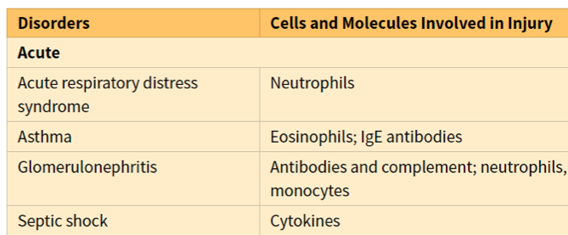
What is inflammation?
Inflammation is a local response of the vascularized living tissue to infection and damaged tissue that brings cells and molecules of host defense from the circulation to the sites where they are needed.
Aim of inflammation is to localize and eliminate the causative agent, limit tissue injury and restore tissue to normality.
Therefore, Inflammation is part of innate immunity (a broad protective response).
Inflammation is terminated when the offending agent is eliminated and the secreted mediators are broken down or dissipated.
There are active anti-inflammatory mechanisms that serve to control the response and prevent it from causing excessive damage to the host.
Inflammation can induce harm e.g. Anaphylactic reaction - rheumatoid arthritis - atherosclerosis. And as the table shows:-

Slide 6
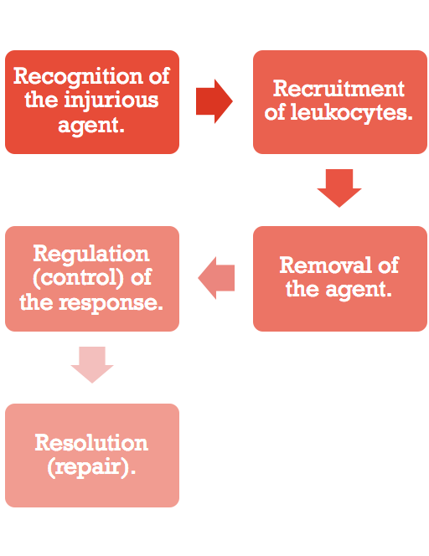
Causes of inflammation:
Bacteria.
Viruses.
Parasites.
Fungi.
Radiation.
Physical injury (fractures), trauma.
Thermal injury, frostbite.
Burns.
Immunological injury(AID).
Infection after surgeries.
Toxic substances.
Chemical injury.
Tissue death (MI).
Steps of inflammation:
The steps of the inflammatory response can be remembered as the five Rs:

Slide 7
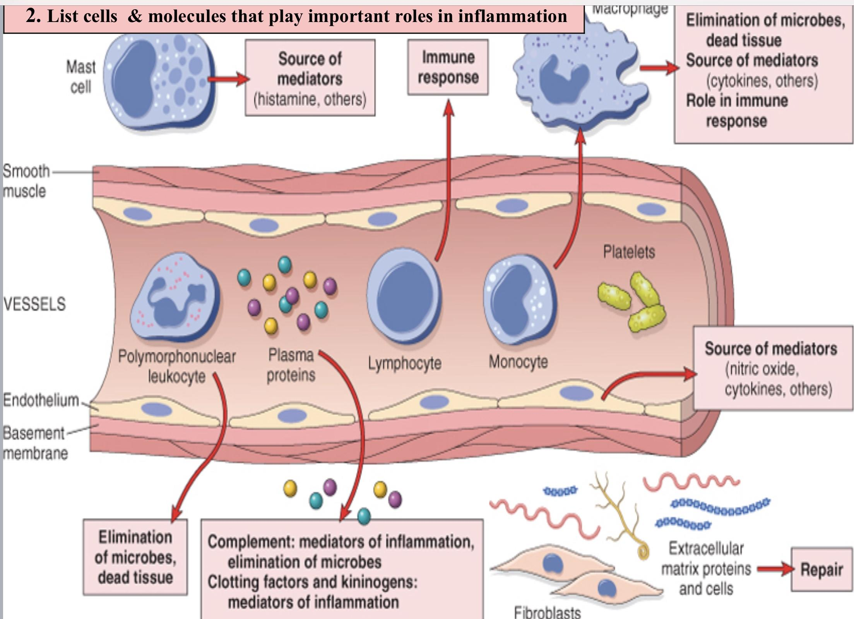
Chemical Mediators
Inflammation is mediated by chemical substances called Chemical Mediators.
Source:
1. Phagocytes and other host cells (leukocyte, endothelium, mast cell and macrophages).
2. Plasma proteins.
Cells of inflammation

Slide 8
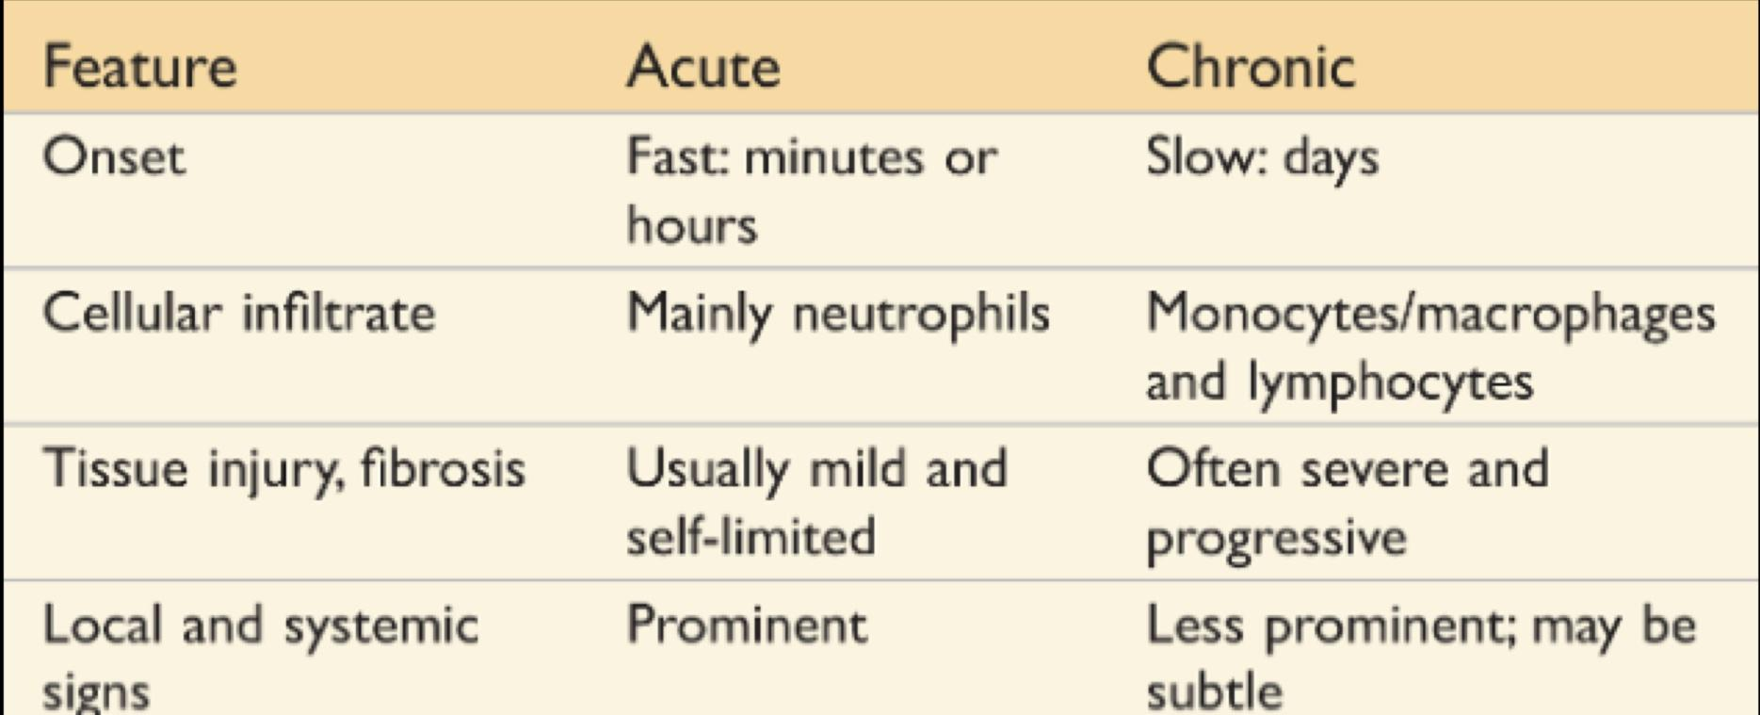
Types of inflammation:
Acute:
A rapid response to an injurious agent that serves to deliver mediators of host defense leukocytes and plasma proteins to the site of injury.
Chronic:
persistent injury.
The outcome of acute inflammation:
Elimination of the noxious stimulus, followed by decline of the reaction and repair of the damaged tissue. | Persistent injury resulting in chronic inflammation.

Slide 9
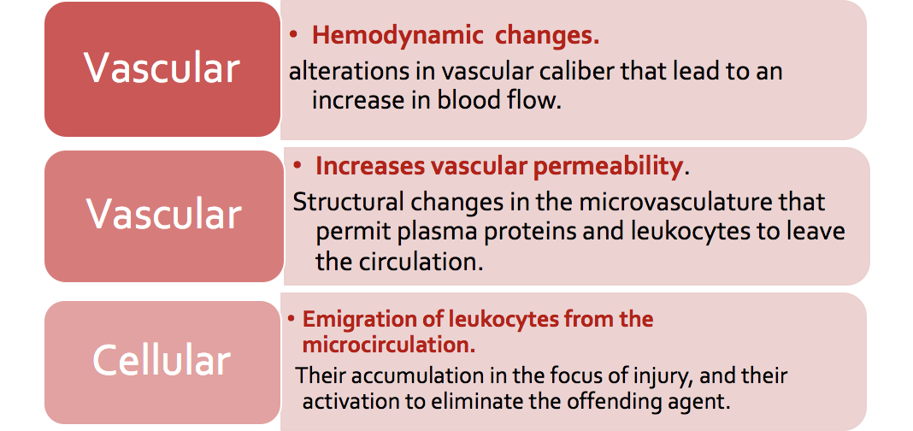
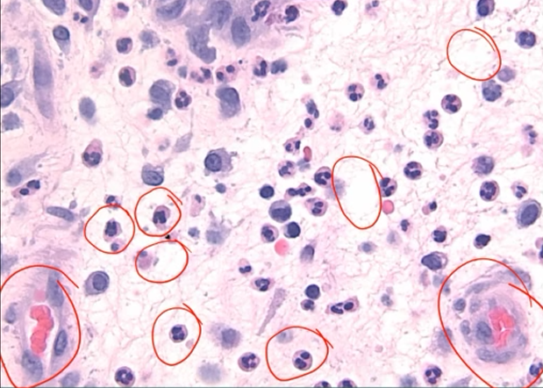
Events of acute inflammation:
Click me, I am a helpful Video!
*will be discussed later on
Edema
Neutrophils
Blood vessel dilation

Slide 10
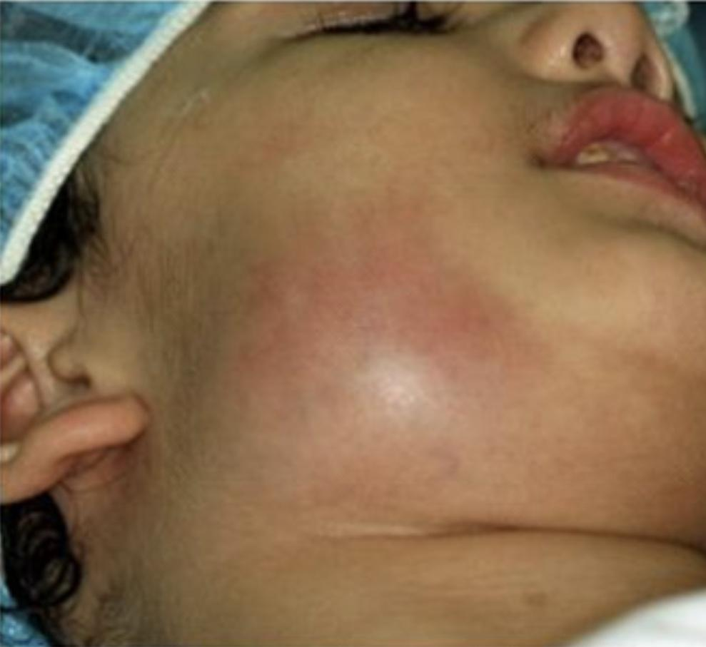
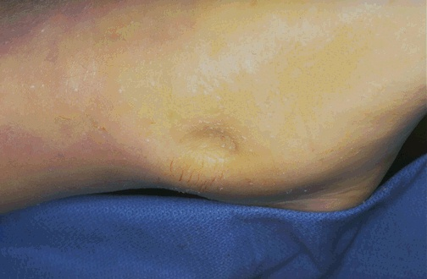
Clinical (Cardinal) signs of inflammation:
The 5 ancient cardinal signs of inflammation are:
Tumor (swelling) | Rubor (redness) | Calor (warmth) | Dolor (pain) | Functio Laesa (loss of function)
These signs appears in the Surface of the skin and also in the internal organs.
More signs of inflammation (Systemic manifestation):
Fever (pyrexia).
Malaise (feeling unwell).
Increase erythrocyte sedimentation rate ESR
Increased levels of C-reactive proteins (will be discussed later).
Chills (رجفان).
Vomiting .
Moreover, in systemic manifestation. There is increase erythrocyte sedimentation rate (ESR) the time which red blood cell sediment (settle down) in one hour (normal <20mm\hr in males while in female <30mm\hr)
abnormal values happens due to increase in blood viscosity .

Slide 11
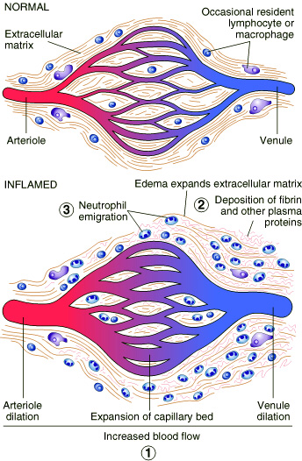
Changes in Vascular Caliber and Flow
An antigen - is any foreign particle it can be (bacteria, viruses, parasites, suture material) - will enter the body and there will be a temporary vasoconstriction (Vascular contraction) that will last for a few seconds to 5 minutes.
After vasoconstriction, arteriolar vasodilation (by chemical mediators) occurs, resulting in locally increased blood flow (Histamine effect -From mast cell- →vasodilation (↓BP) and engorgement of the capillary beds. This vascular expansion is the cause of the redness (erythema), warmth and stasis of blood flow (slow circulation due to dilated small vessels packed with red blood cells). This lasts as long as the acute inflammation persists.
As stasis develops, leukocytes (principally neutrophils) begin to accumulate along the vascular endothelial surface moving from the center to the periphery of the blood vessel; in a process called margination.
It will slow the circulation just in the site of inflammation.
Slowing of circulation
more blood go to the capillaries (redness and warmth)
Vasodilation (hemodynamic changes)

Slide 12
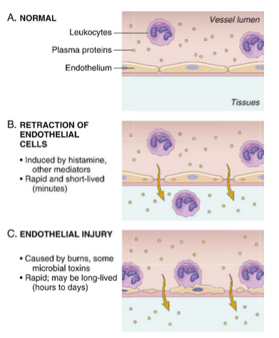
(2) Increased Vascular Permeability
(most important one )
A hallmark of acute inflammation (escape of a protein rich fluid). Induced by histamine, kinins, and other mediators.
Which increase in vascular permeability (caused by histamine) → endothelial cells contraction → more neutrophils → edema.
It affects small & medium size venules, through gaps between endothelial cells.
It result in swelling (tumour) which occurs as a cardinal sign of inflammation.
→ Increased vascular permeability happens at the venule because is it is much thinner that the arteriole.
→ Vasodilation (increased diameter of the vessel) happens at the arteriole because it has muscles that contract.
Principal mechanisms of increased vascular permeability in inflammation and their features and underlying causes.
Venules
Arterioles, capillaries and venules.
Chemical mediators that cause vasoconstriction and vasodilation and increase vascular permeability: Histamine (in mast cells) and Serotonin (in platelets, aka 5-hydroxytryptamine). Histamine causes both. Serotonin only dilation.

Slide 13
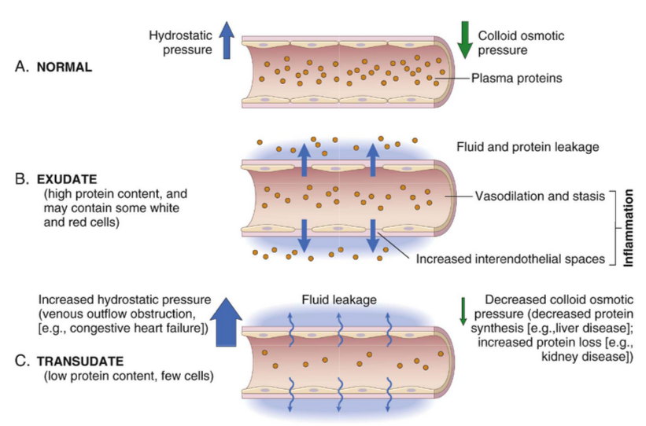
Normal capillary exchange V.S.
Exchange during inflammatory response
Increased blood volume lead to increased local hydrostatic pressure leading to transudation of protein poor fluid into the extravascular space. Types of pressure in the capillaries :
1) Hydrostatic pressure: due to the pressure from the blood to the vessel wall.
2) Colloid osmotic pressure: due to the concentration of proteins in the vessel.
Edema is defined as: an excess of fluid in the interstitial space or serous cavities.
It can be either an exudate or a transudate.
Transudate | Exudate
Is a fluid with low protein content and a specific gravity of less than 1.012. It is essentially an ultrafiltrate of blood plasma that results from osmotic or hydrostatic imbalance across the vessel wall, without an increase in vascular permeability. Caused by: liver & renal failure. | An inflammatory extravascular fluid that has a high protein concentration, cellular debris, and a specific gravity above 1.020. It implies significant alteration in the normal permeability of small blood vessels in the area of injury. Caused by: chronic inflammation & high lymphocyte.
In transudate, there is decrease in colloid pressure that pulls water inside blood vessels by plasma protein or increase in capillary pressure.
Transudate is caused by two reasons: 1- loss of proteins by renal failure (more protein excretion outside the body through urine)—>transudate edema. 2- decreased in proteins synthesis due to liver diseases (less amount of protein synthesis )—>transudate edema. 3- heart failure. More capillary pressure on the blood vessels because blood flow is decreased-> transudate edema.

Slide 14
Summary
General Features and Causes of Inflammation:
Inflammation is a beneficial host response to foreign invaders and necrotic tissue, but also may cause tissue damage.
The main components of inflammation are a vascular reaction and a cellular response; both are activated by mediators that are derived from plasma protein and various cells.
The steps of the inflammatory response can be remembered as the five Rs: (1) Recognition of the injurious agent, (2) Recruitment of leukocytes, (3) Removal of the agent, (4) Regulation (control) of the response, and (5) Resolution (repair).
The causes of inflammation include infections, tissue necrosis, foreign bodies, trauma, and immune responses.
Epithelial cells, tissue macrophages and dendritic cells, leukocytes, and other cell types express receptors that sense the presence of microbes and necrotic cells. Circulating proteins recognize microbes that have entered the blood.
The outcome of acute inflammation is either elimination of the noxious stimulus followed by decline of the reaction and repair of the damaged tissue, or persistent injury resulting in chronic inflammation.
Phases of changes in vascular caliber and flow
Vasoconstriction
Transient (temporary) of arterioles which lasts for 3-5 seconds.
Vasodilatation
It involves the arterioles (or venules or vessels), Leading to increase the blood flow by histamine (which produced in mast cells)
Increase permeability
Slowing of the circulation due to increase permeability of the microvasculature, this leads to outpouring of protein-rich fluid in the extravascular in tissues -> it will make the area warm and red.
Stasis
Slow circulation due to dilated small vessels packed with red cells.

Slide 15
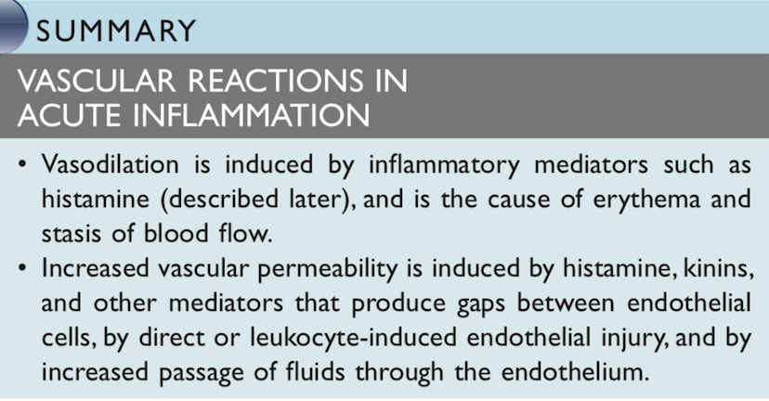

Slide 16
Quiz
MCQ’s
Q1- A patient with acute bacterial infection will have as increased number of: A) neutrophils B) macrophages C) eosinophils D) lymphocytes
Q2-all of the following are cardinal signs of inflammation except: A) swelling B) warmth C) pain D) chills
Q3-One of the following is seen in acute inflammation? A) Exudate B) Transudate C) Mainly monocytes (macrophages) D) Very slow
Q4-Vasodilation and increases in vascular permeability is caused by which of the following chemical mediators? A) histamine B) LTB4 C) TNF D) C5a
Q5-The following is involved is the retraction of endothelial cells: A) Venules B) Capillaries C) Arterioles D) Venules arterioles and capillaries
Q6-The following is involved in endothelial injury: A) Venules B) Capillaries C) Arterioles D) Venules arterioles and capillaries
SAQ’s
Q7-Cardinal signs of inflammation are caused by what?
Q8-list the 5 cardinal signs of inflammation (external manifestation of inflammation)?
Q9-On microscopic examination finding of Rouleaux formation (stacking of RBCs) of RBCs means there what?
Vascular changed and leukocyte recruitment and activation
Tumors swelling Rubor redness Calor warmth Dolor pain Functio laesa loss of function
Inflammation
1: A
2: D
3: A
4: A
5: A
6: D
10: F
Q10-Inflammation can occur in dead tissues?

Slide 17
Acute inflammation:
CELLULAR EVENTS
A critical function of inflammation is to deliver leukocytes to the site of injury (leukocyte extravasation) and to activate the leukocytes to perform their normal functions in host defense.
Leukocytes function in fighting inflammation:
Ingest offending agents.
Kill bacteria and other microbes.
Get rid of necrotic tissue and foreign substances.
However،
Leukocytes may induce tissue damage and prolong inflammation, since the leukocyte products that destroy microbes and necrotic tissues can also injure normal host tissues.
Cells involved in inflammation
Eosinophils: can dispense antihistamines. They are increased in the following event:
Parasitic infection.
Hypersensitivity infection.
Allergic reaction (for eg: bronchial asthma)
<lymphocytes, neutrophils, mast cells were all previously mentioned> but if you’d like to read furthermore: S5-6 of histology’s 438 teamwork

Slide 18
Steps of extravasation of leukocytes from blood to tissue
First: Recruitment of leukocytes.
A multistep process involving attachment of circulating leukocytes to endothelial cells and their migration through the endothelium (extravasation).
It has 3 steps:
In the lumen:
Margination
Margination is the first step of leukocytes action during acute inflammation cells. Because blood flow slows early in inflammation (stasis), the endothelium can be lined by neutrophils (pavementation).
Rolling
Adhesion to endothelium.
Vascular endothelium normally does not bind circulating cells so molecules and receptors are needed.
Diapedesis or Transmigration across the endothelium.
Diapedesis occurs predominantly in the postcapillary venules.
Migration in interstitial tissues towards a chemotactic stimulus.
The type of emigrating leukocyte varies with:
The type of stimulus | The age of the inflammatory response
_ In viral infections, lymphocytes may be the first cells to arrive. _ In some hypersensitivity reactions and parasitic infection, eosinophil may be the main cell type. – Chronic inflammation: lymphocytes, plasma cells and macrophages are present. | In most forms of acute inflammation: neutrophils predominate in the inflammatory infiltrate during the first 6 to 24 hours, then are replaced by monocytes in 24 to 48 hours. neutrophils are more numerous in the blood, they respond more rapidly to chemokines, but are short-lived; they undergo apoptosis and disappear after 24 to 48 hours, whereas monocytes survive longer.
Second: Removal of offending agent.

Slide 19
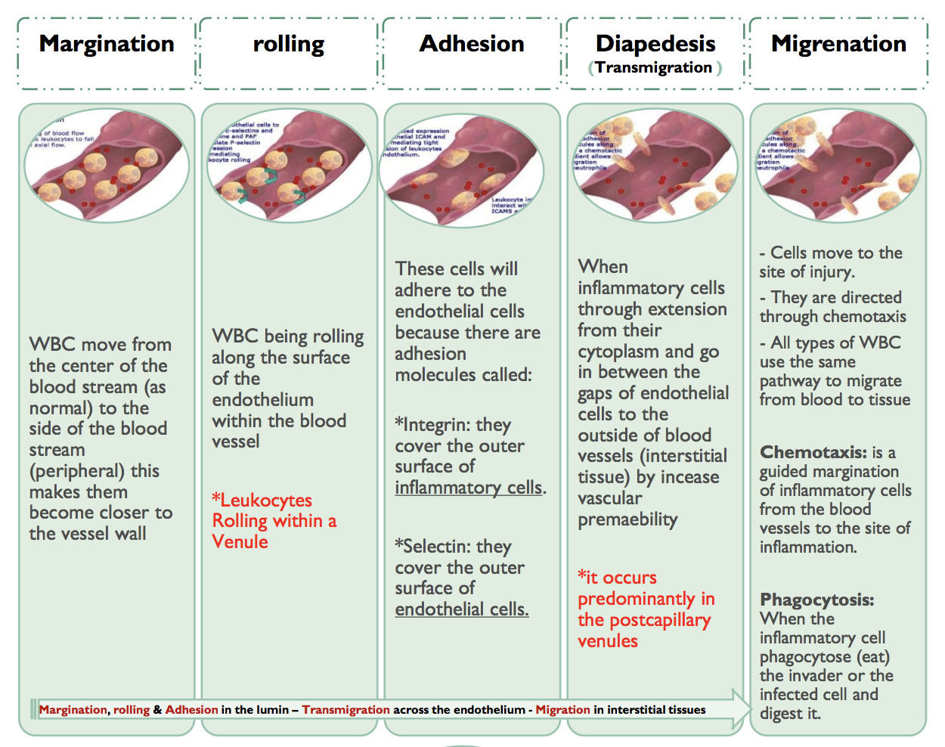
Helpful slide from 437

Slide 20
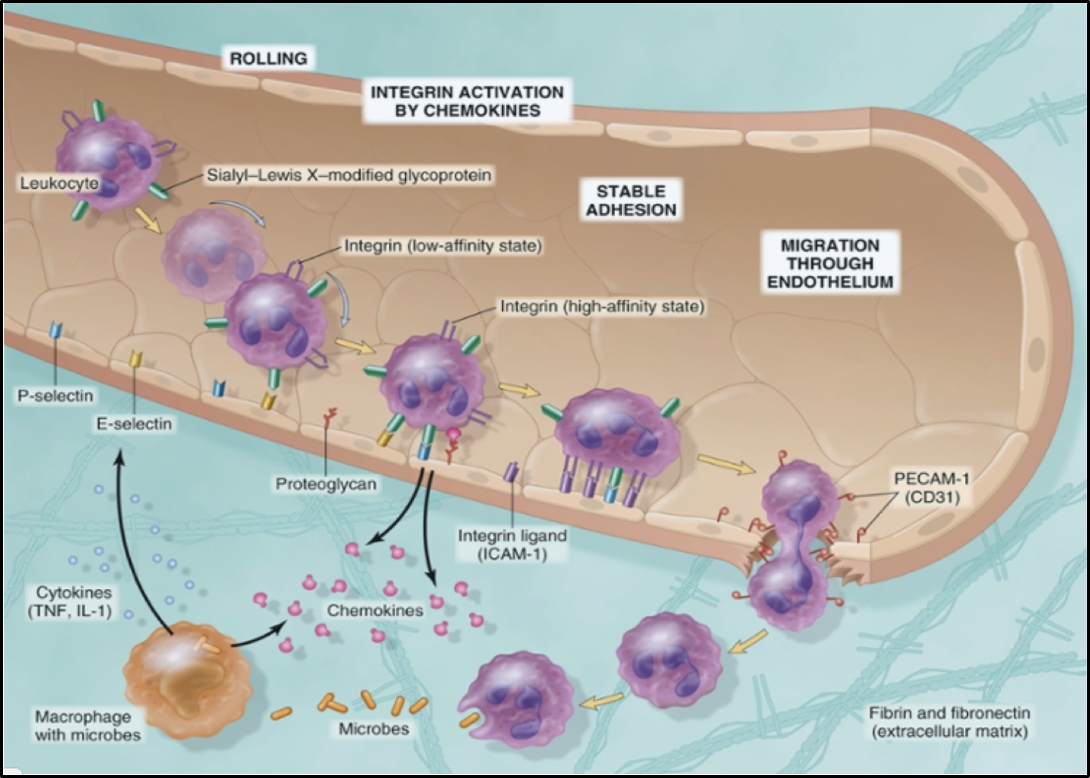
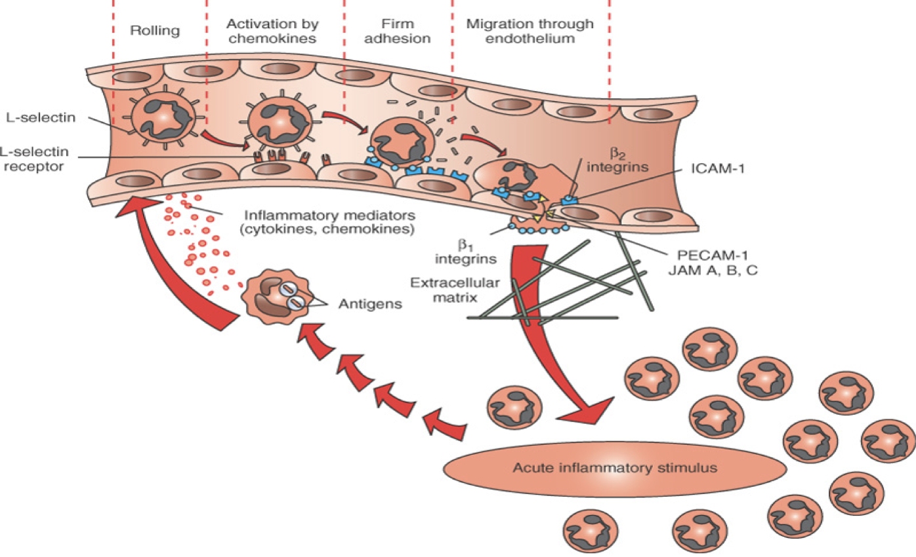
margination
Diapedesis
Chemotaxis

Slide 21
Adhesion molecules and receptors.
Click me! I am a helpful video.
Selectins (surface of endothelial cells) They help inflammatory cells adhere to endothelial cells |  |  | Integrins
E-selectin: confined to endothelium induced by TNF*& IL-1. | P-selectin: present in endothelium and platelets from Weibel-Palade bodies. | L-selectin: expressed on most leukocyte and endothelium | Are transmembrane heterodimeric glycoproteins, made up of α and β chains, expressed on leukocytes and bind to ligands on endothelial cells. Integrins are up regulated on leukocytes by C5a & LTB4 resulting in firm adhesion with vessel wall.
The immunoglobulin family molecules |  |  | Mucin-like glycoproteins: PECAM-1 (Platelet endothelial cell adhesion molecule)
ICAM-1 (intercellular adhesion molecule 1) VCAM-1 (vascular cell adhesion molecule 1) IL-1 and TNF activate intercellular adhesion molecule (ICAM) and vascular cell adhesion molecule (VCAM) on venular endothelial cells. |  |  | These glycoproteins are found in the extracellular matrix and on cell surfaces. Neutrophils moving along the venular endothelium dissolve the venular basement membrane (release type IV collagenase) exposed by previous histamine-mediated endothelial cell contraction and enter the interstitial tissue.
TNF (tumor necrosis factor): A Cytokine secreted by macrophages, activates the process of cell adhesion by promoting migration of cells from inflammatory cells .

Slide 22
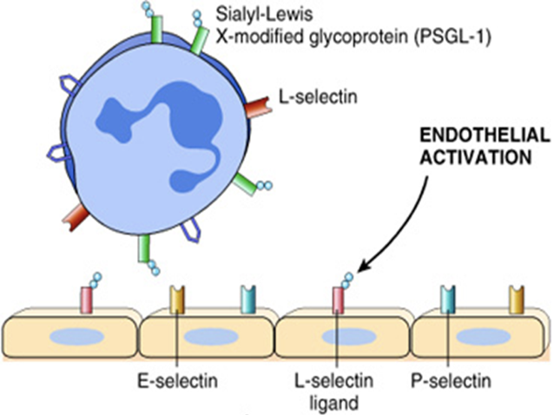
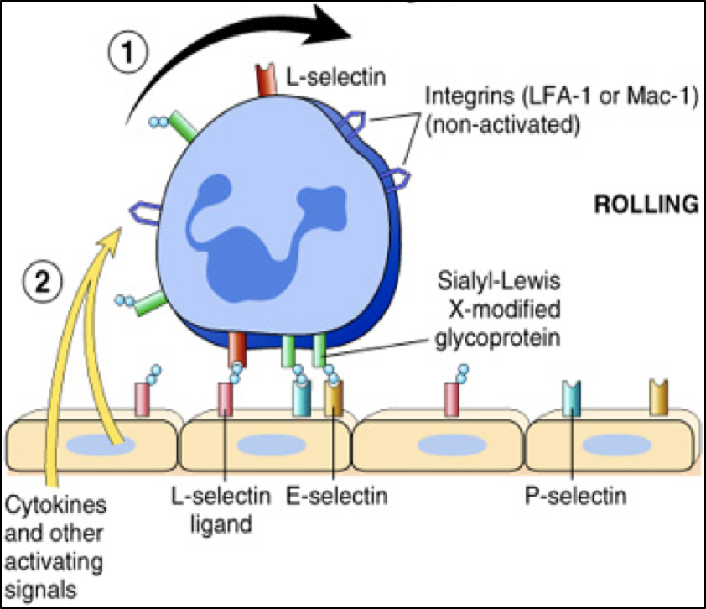
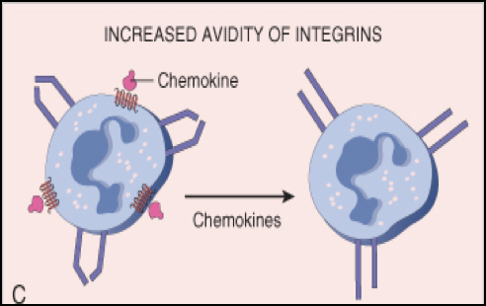
Steps of selectins and integrins acting.
1
E-selectin & P-selectin bind to Sialyl-Lewis X glycoprotein and slow the leukocytes
Rolling
2
Integrins are up regulated on leukocytes by C5a & LTB4 resulting in firm adhesion with vessel wall

Slide 23
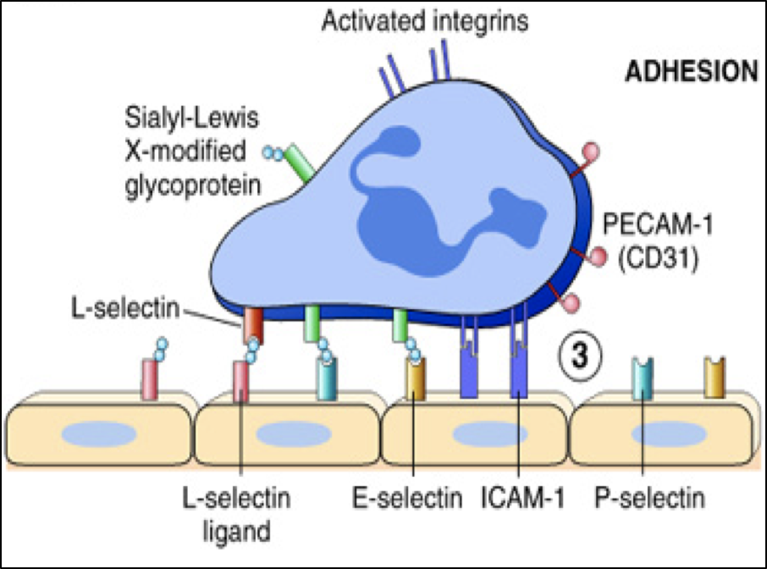
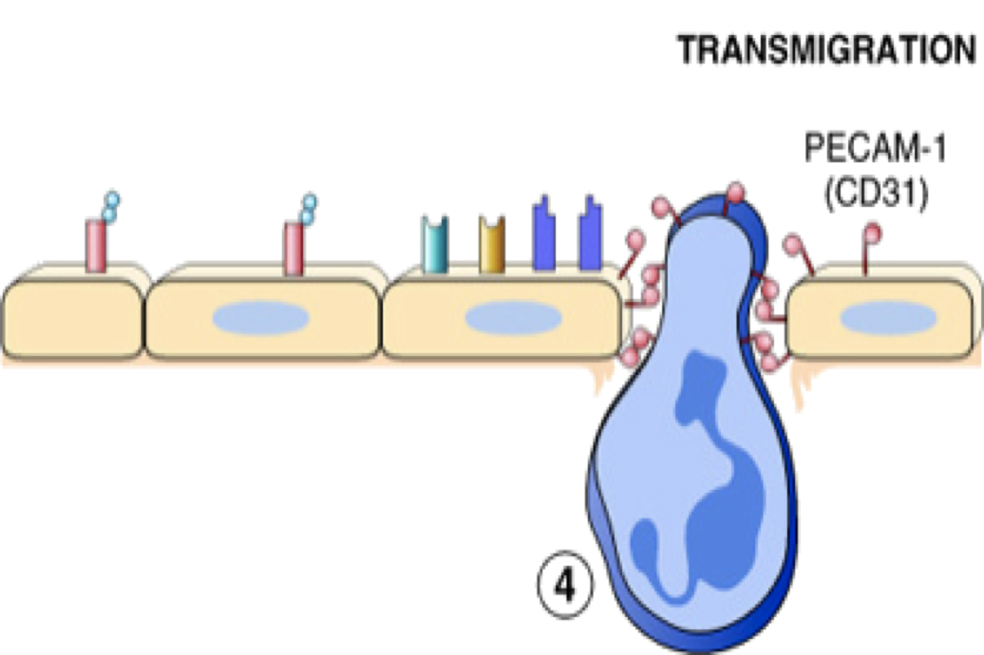
Steps of selectins and integrins acting.
IL-1 and TNF activate intercellular adhesion molecule (ICAM) and vascular cell adhesion molecule (VCAM) on venular endothelial cells.
3
adhesion to endothelium
4
Neutrophils, monocytes, lymphocytes, eosinophils, and basophils all use the same pathway to migrate from the blood into tissues

Slide 24
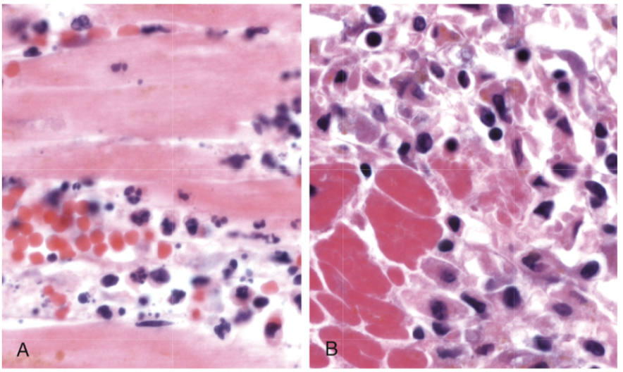
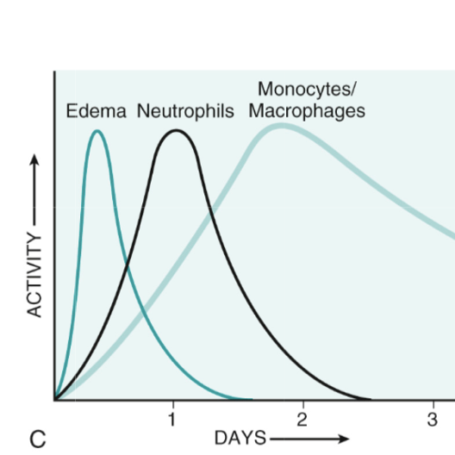
Leukocyte Adhesion and Transmigration
First day: edema Second day: neutrophils After the second day: neutrophils are replaced by monocytes. WHY?
Neutrophils are more numerous in the blood, they respond more rapidly to chemokines, But are short-lived; they undergo apoptosis and disappear after 24 to 48 hours, whereas monocytes survive longer.

Slide 25
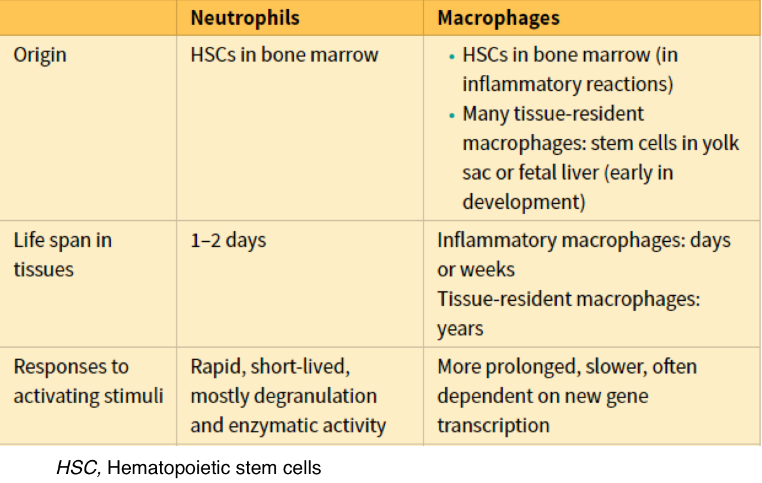
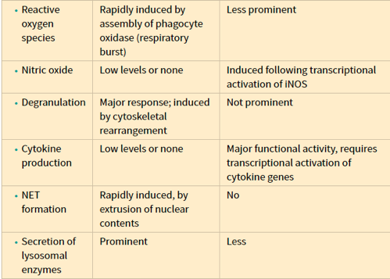
Properties of Neutrophils and Macrophages
اعرفوا فقط أول 3 خانات
HSC, Hematopoietic stem cells

Slide 26
Leukocyte Adhesion Deficiency
محذوف
Two types:
01
LAD type 1 is a deficiency of β2-integrin.
LAD type 2 is mutations in fucosyl transferase required for synthesis of sialylated oligosaccharide (normally binds selectins).
02
Clinical findings:
Delayed separation of umbilical cord.
Increased circulating neutrophils (leukocytosis due to loss of the marginating pool).
Recurrent bacterial infection that lack pus formation Poor wound healing.

Slide 27
Chemotaxis
After extravasation, leukocytes emigrate in tissues toward the site of injury by a process called chemotaxis, defined as locomotion oriented along a chemical gradient (from an area of lesser concentration of the factor to an area of greater concentration of the factor).
mediated by substances known as chemotactic factors, that diffuse from the area of tissue damage.
Chemoattractants can be exogenous (made by something other than the host's body) or endogenous (made by the body's own cells).
Exogenous | bacterial products
Endogenous | components of the complement system, particularly C5a. products of the lipoxygenase pathway, mainly leukotriene B₄ (LTB₄). cytokines, particularly those of the chemokine family (e.g. IL-8).
IL-1 and C5a and C3a can cause pain and fever (that’s one of the cardinal signs of inflammation (Dolor) .
Chemokines act on the adherent leukocytes and stimulate the cells to migrate toward the site of injury or infection.

Slide 28
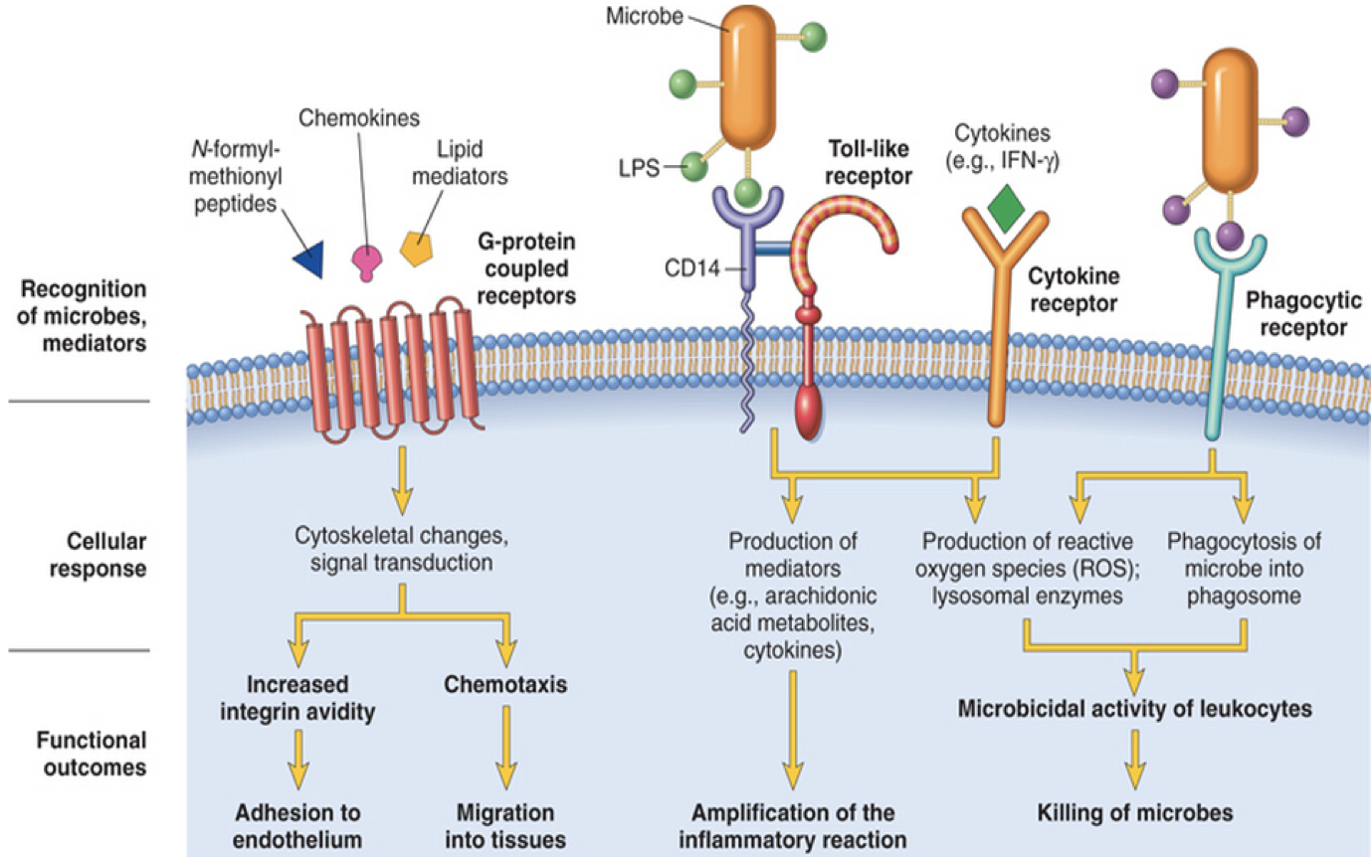
Chemotaxis
فقط اعرفوا أسماء المستقبلات
All these chemotactic agents bind to specific seven-transmembrane G-protein-coupled receptors on the surface of leukocytes
This binding will:
Increase in cytosolic Ca2+.
Activate Protein kinase C and phospholipase A2.

Slide 29
Leukocyte Activation
Phagocytosis
Intracellular destruction
Liberation of substances that destroy
extracellular microbes and dead tissues
Production of mediators

Slide 30
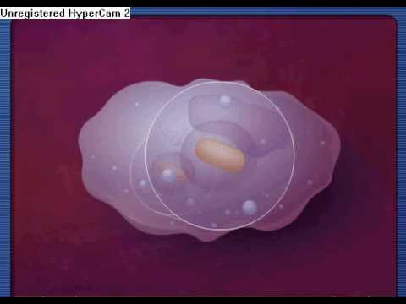
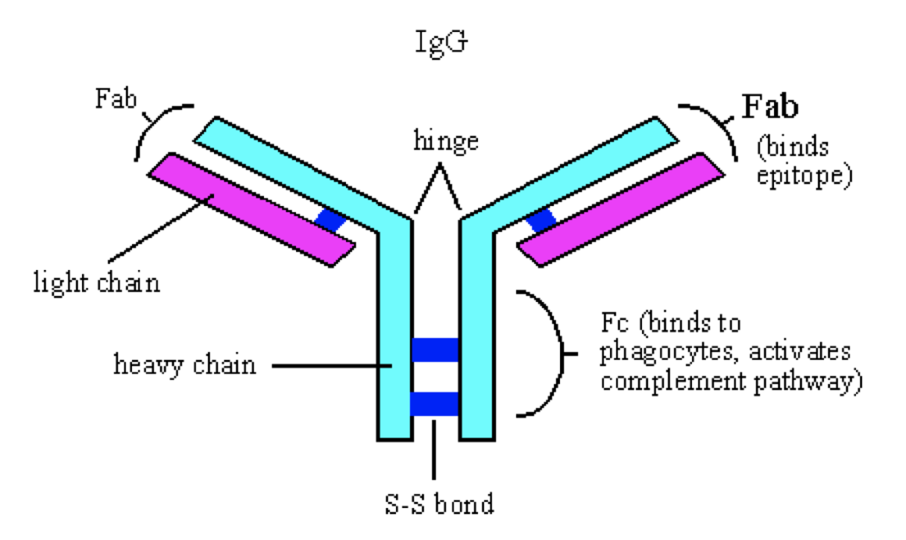
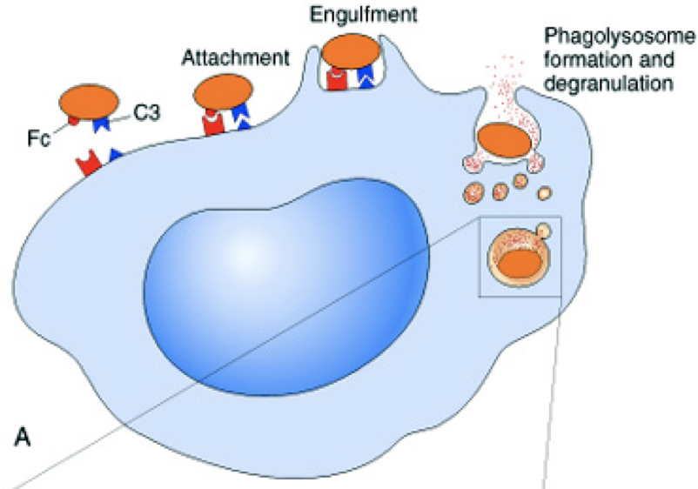
Steps of Phagocytosis
Is the process of coating a particle, such as a microbe, to target it for phagocytosis.
substances that promote opsonization are opsonins (تغطي المايكروب بطبقة تخليه جذاب أكثر), they include:
– antibodies (IgG)
– complement proteins (C3)
– lectins: mannose-binding lectin (MBL), collectins, fibronectin, fibrinogen, and *C-reactive protein.
These substances are recognized by receptors on phagocytes (Fc and C3b receptors).
1
Recognition and Attachment
Opsonization
During engulfment, extensions of the cytoplasm (pseudopods) flow around the particle to be engulfed, eventually resulting in complete enclosure of the particle within a phagosome.
The phagocytic vacuole then fuses with a lysosomal granule, resulting in phagolysosome.
*C-reactive protein: is a type of acute phase proteins secreted by the liver in response to inflammation.
2
Engulfment

Slide 31
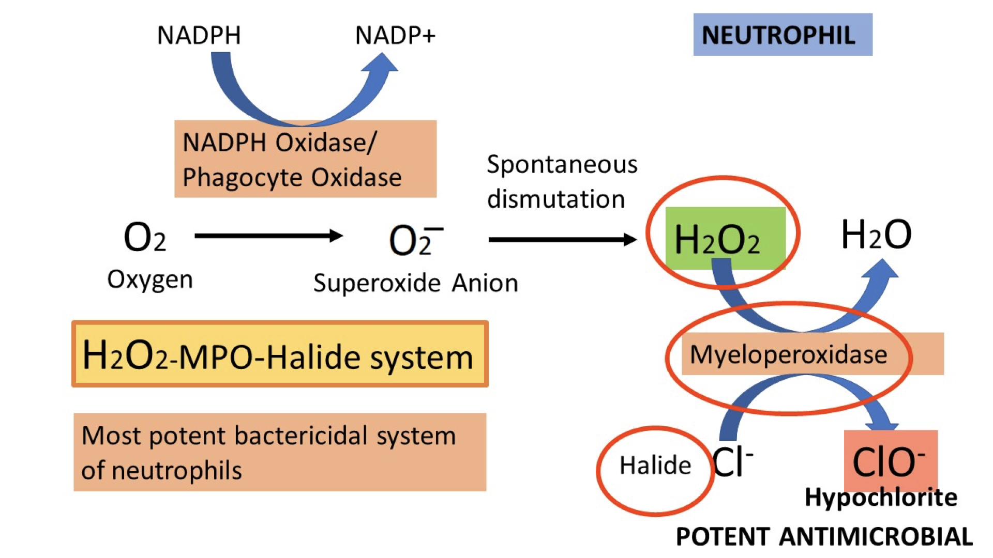
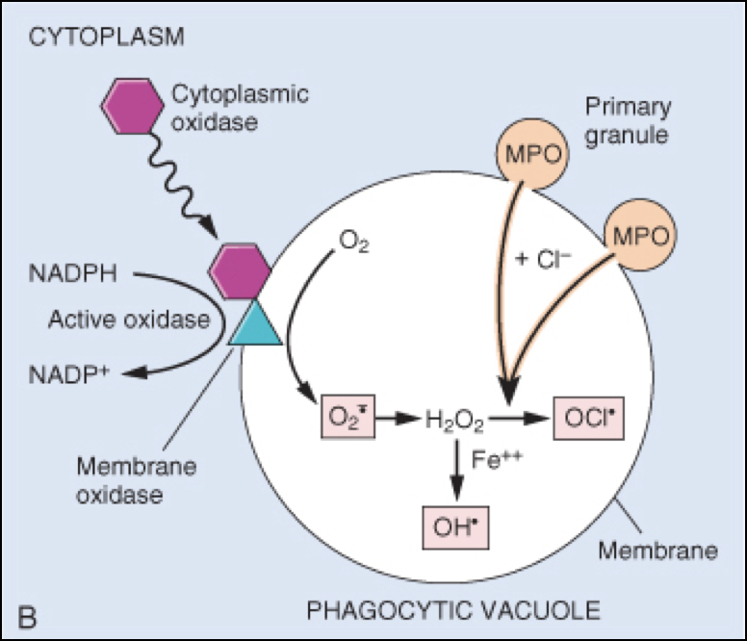
Steps of Phagocytosis
3
Killing and Degradation
There are two microbial killing mechanisms:
Oxygen-dependent mechanism.
The H₂O₂-MPO-halide system is the most efficient bactericidal system in neutrophils.
leukocytes have great difficulty killing bacteria in phagolysosomal vacuoles by halogenation. It is dependent on the oxidative burst that follows ingestion of a bacterium. superoxide anion (O2-) is formed as a result, which is converted to hydrogen peroxide (H2O2) by the superoxide dismutase reaction (SOD). Meanwhile, the lysosomal enzyme, myeloperoxidase (MPO), has entered the phagolysosome when lysosomal contents are emptied into the phagocytic vacuole (phagosome). In the presence of a halide ion (Cl-), MPO catalyzes the formation of an hypohalous (usually hypochlorous) acid (ClO-), which kills the bacterium.

Slide 32
Steps of Phagocytosis
3
Killing and Degradation
Oxygen-independent mechanism.
_ Through the action of substances in leukocyte granules. Which include:
Bactericidal permeability increasing protein (BPI): Activates phospholipase and degrades membrane phospholipids.
Lysozyme: Degrades bacterial coat oligosaccharide.
Major Basic Protein: Cytotoxic for parasites.
Defensins: Create holes in microbial membranes and kills them.
Lactoferrin.
_ These harmful proteases are controlled by a system of anti-proteases in the serum.
_ It Can potentiate further inflammation by damaging tissues.
_Neutrophil granules contain other enzymes, such as elastase, that also contribute to microbial killing.

Slide 33
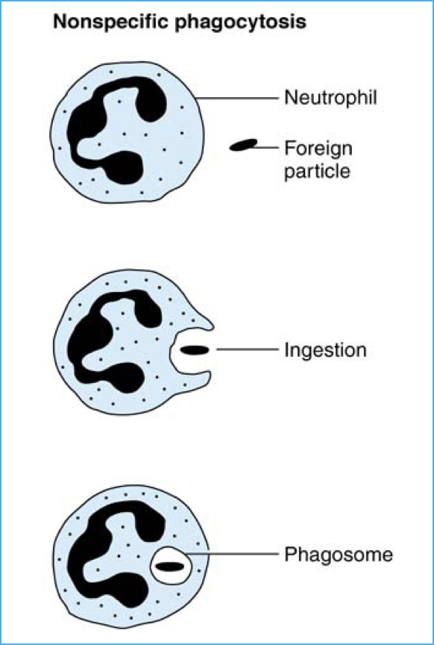
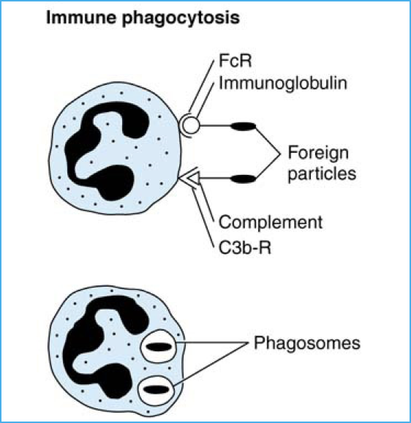
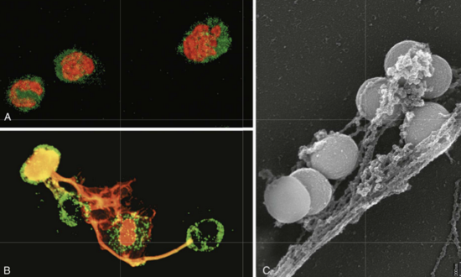
Phagocytosis by neutrophils
Immune phagocytosis is much more efficient than non specific phagocytosis.
Neutrophil extracellular traps (NETs) :
Healthy neutrophils with nuclei stained red and cytoplasm green.
Release of nuclear material from neutrophils (note
that two have lost their nuclei), forming extracellular traps.
An electron micrograph of bacteria (staphylococcus) trapped in NETs.
NETs provide an additional mechanism of killing microbes that does not involve phagocytosis.

Slide 34
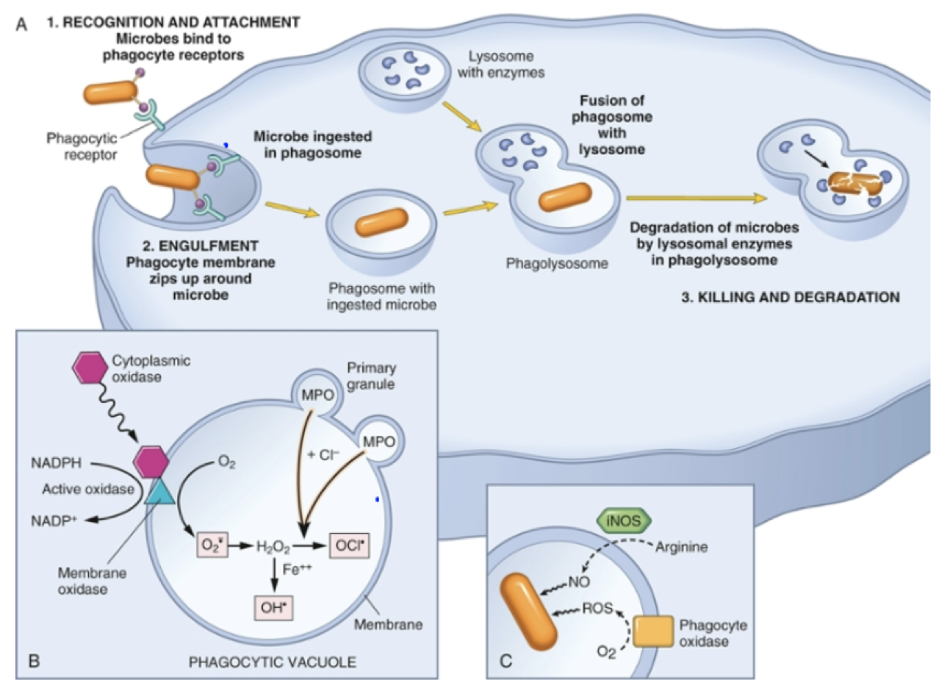

Slide 35
Defects in Leukocyte Function.
محذوووف
Defects in Leukocyte Function and Associated Diseases:
Defects in leukocyte function, both genetic and acquired, lead to increased vulnerability to infections:
1) Genetic:
Defects in Adhesion: Leukocyte adhesion deficiency type 1 and 2.
Defects in Phagocytosis: Chédiak-Higashi syndrome. (Protein involved in organelle membrane fusion).
Defects in Microbicidal Activity: Chronic granulomatous disease. (Decreased oxidative burst).
2) Acquired:
Chemotaxis: Thermal injury, diabetes, malignancy, sepsis, immunodeficiencies.
Adhesion: Hemodialysis, diabetes mellitus.
Phagocytosis and microbicidal activity: Leukemia, anemia, sepsis, diabetes, neonates, malnutrition.
Defects in leukocyte adhesion.
Defects in phagolysosome function.
Defects in microbicidal activity.
Chédiak-Higashi syndrome | Chronic granulomatous disease
- A defect in phagolysosome formation. - An autosomal recessive disease that results from disordered intracellular trafficking of organelles, ultimately impairing the fusion of lysosomes with phagosomes. (No phagolysosome) Clinical feature: Increased risk of pyogenic infection Neutropenia (defect in generation from bone marrow). Giant granule formation (granules formed cannot move in cytoplasm). Defective primary hemostasis ( platelet granule are not secreted) Albinism. Peripheral neuropathy. | 2 types: A. X-linked: NADPH oxidase (membrane component) B. Autosomal recessive: 1. NADPH oxidase (cytoplasmic components) 2. Myeloperoxidase deficiency: (absent MPO-H202 system) pt. have increased risk of candida infection. -Due to NADPH oxidase defect (X-linked or autosomal recessive) -Leads to infection and granuloma formation with catalase positive organisms, particularly staphylococcus aureus, pseudomonas cepacia, serratia marcescens, nocardia and aspergillus.

Slide 36
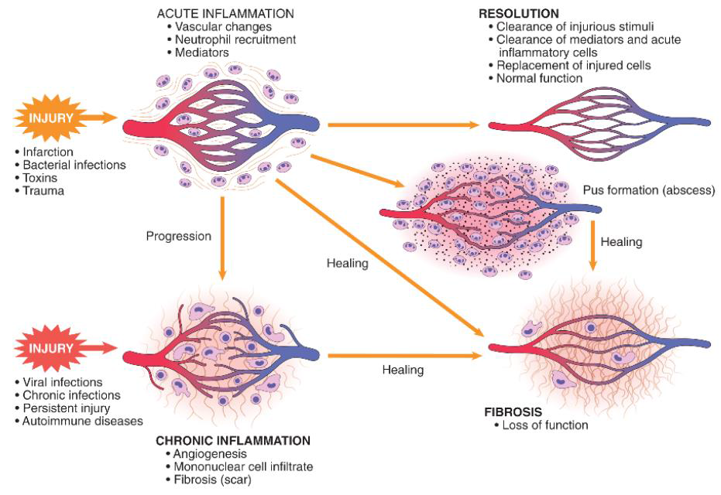
Outcome of acute inflammation
1) Abscess formation: the inflammation will be concentrated in an abscess which is filled with pus.
2) Complete resolution: Clearance of injurious stimuli, and everything is back to normal.
3) Healing: a scar is formed and there will be fibrosis.
4) Acute inflammation will progress to chronic inflammation.
Diseases which are always chronic: TB , Hepatitis B and C (Hepatitis A may be acute), chronic gingivitis Smoking: COPD (chronic obstructive pulmonary disease), Brucellosis (unpasteurized milk).
36

Slide 37
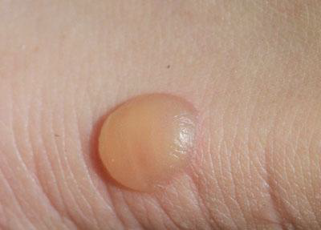
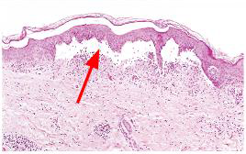
Morphological Patterns of Acute Inflammation
1) Serous inflammation: characterized by the outpouring of a watery,. Serous inflammation: is the accumulation of the fluid under the epidermis.
Example: The skin blister resulting from a burn or viral infection.
Serous inflammation. Low-power view of a cross-section of a skin blister showing the epidermis separated from the dermis by a focal collection of serous effusion.
2) Fibrinous inflammation. (Fibrinous pericarditis): caused as a consequence of more (repeated) severe injuries, this result in greater vascular permeability that allows large molecules (i.e. Fibrinogen) to pass the endothelial barrier.
Fibrinous inflammation: it is plasma protein and Fibrin (a coagulation factor).Acute inflammation of serous cavity is fibrinous secondary to activation of coagulation cascade.
Effusion: abnormal accumulation of fluid in cavities.
Ascites: abnormal accumulation of fluid in the peritoneal cavity.
Exudate occur in serous cavities (peritoneal, pleural, pericardium, and synovia) and meninges.
Fibrinous exudates may be removed by fibrinolysis, if not: it will make vascular granular tissue formation and fibrin (Organization).
greater vascular permeability
Exudate feature
indicates inflammation

Slide 38
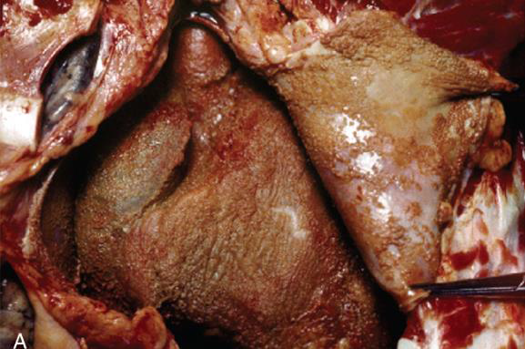
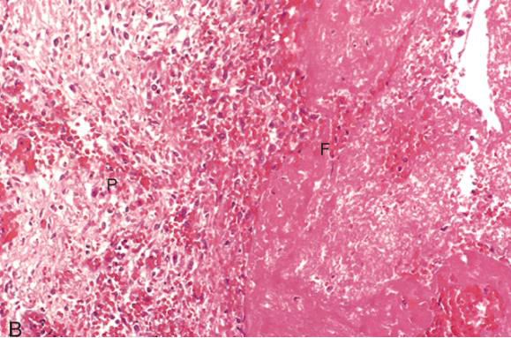
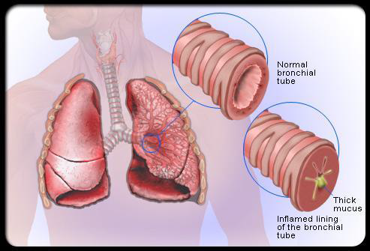
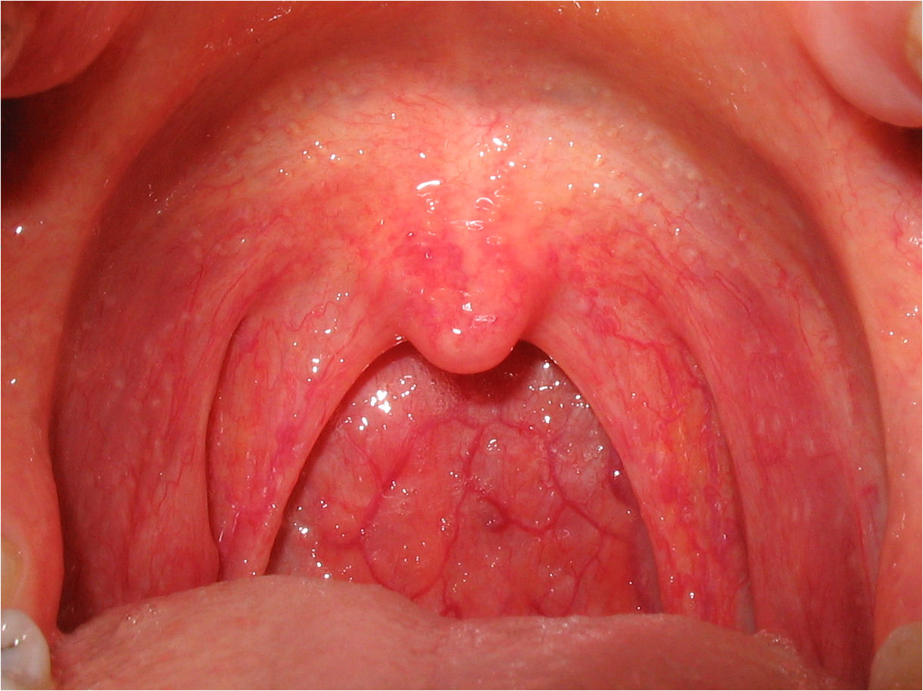
Morphological Patterns of Acute Inflammation cont.
A: Deposits of fibrin on the pericardium. B: A pink meshwork of fibrin exudate (F) overlies the pericardial surface (P)
3)Catarrhal inflammation: Regular cold where there is increased secretion of mucus.
4) Pseudomembranous colitis: an inflammation that doesn’t produce pus or abscess. occurs in some people who have taken antibiotics. It is most often seen in people who are in the hospital.
5) Gangrenous.

Slide 39
Suppurative/ Purulent inflammation.
Suppurative/ Purulent inflammation:
1-It produces pus.
2-The abscess contains neutrophils and cellular debris and is surrounded by congested blood vessels. Because of the underlying tissue destruction, the usual outcome with abscess formation is scarring.
3-Pyogenic bacteria: Bacteria that produces lots of pus. Examples: (Staphylococcus aureus and streptococci) in Cellulitis .
· Staphylococcus aureus (pyogenic) (causes osteomyelitis)and streptococcus pyogen .
· It contains pus, ﬁbrin, WBCs, and bacteria.
· Empyema (pus) of the gall bladder (stones) pyogenic inﬂammation.
· Empyema of appendix.
· Purulent inﬂammation (in lung secondary to pneumonia).
Steps for detecting suppurative inflammation
. Extract a pus and make a culture.
· Broad spectrum antibiotics and anti-cyclooxygenases is given while waiting for culture results.

Slide 40
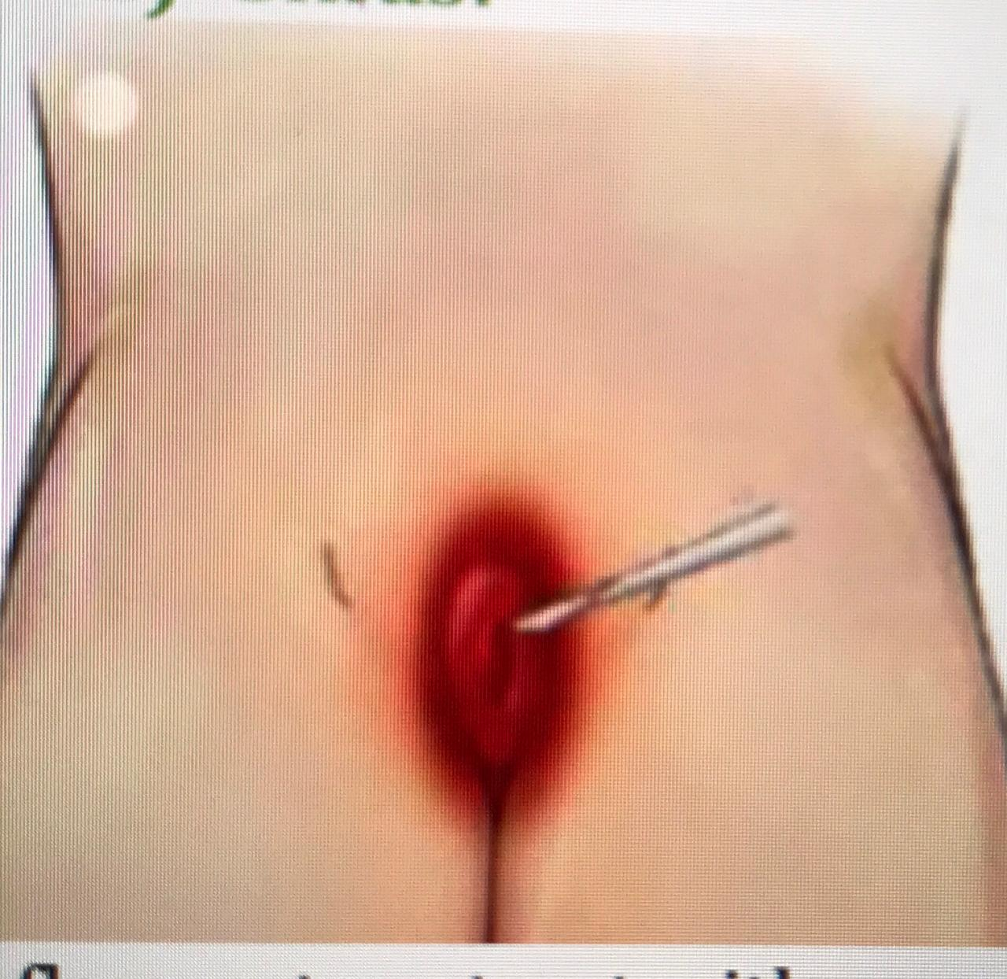
Suppurative/ Purulent inflammation cont.
Examples of Suppurative inflammation:
Ulcer:
A local defect (hole) on the surface of an organ or tissue. It produces necrotic cells and sloughing 15(an exclusion of dead layer).
Microscopically: we find epithelial necrosis fibrin and some acute inflammatory cells on the surface and under it, a layer of inflammatory vascular granulation tissue.
it is vascular because chronic inflammation is associated with angiogenesis (formation of new blood vessels) so he has a vascular growth factor.
Ulcers: defect of surface epithelium.
2) Sinus:
Inflammatory tract with one opening (pilonidal sinus in the lower back). It contains pus + ingrown hairs (foreign body) chronic inflammatory reaction (very common)
- Acute Inflammation
Sinus : mostly one opening towards the skin and usually pus forming for drainage.

Slide 41
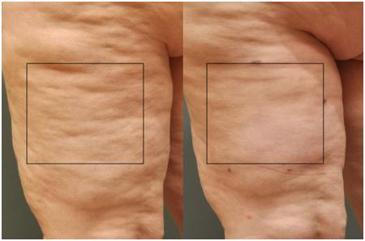
Suppurative/ Purulent inflammation cont.
3) Fistula:
-ناسور شرجي و يسبب حكة وافرازات تلوث الملابس
Chronic inflammatory tract that has two openings between two various epithelia (usually starts from the colon and open in the skin (very common)
( nonspecific )
2 Opening one inside and one outside
4) Cellulitis:
- Inflammation in the interstitial underneath the skin because of bacteria
Cellulitis : is an acute inflammation in a wide area or is an acute inflammation that spreads to the surrounding tissue.

Slide 42
Chronic Inflammation
Features of chronic inflammation:
-Persistent inflammation : (Absence of polymorphs(neutrophils) due to its life span of 1–3 days, and are replaced by macrophages, lymphocytes and plasma cells).
-Tissue injury : (Continuous tissue injury and necrosis).
-Scarring: prominent fibrosis : (Proliferation of fibroblasts with collagen production leading to Fibrosis).
-Prolonged host response to persistent stimulus.
-Long duration is major factor in chronic inflammation
-Always chronic inflammation causes fibrosis and organization.
organization : is the formation of vascular granulation tissue ,fibres tissue and when it heal it causes fibrosis
What is fibrosis?
Fibrosis is : the increase in extracellular matrix (ECM) → formed of collagen and may have proteoglycan but the most important is the collagen (Connective Tissue).
Fibrosis causes loss of function when formed
Fibrinous pericarditis is acute inflammation with time it may become chronic organization and fibrosis will occur, this will lead to adhesion and that will lead to loss of function of heart then constrictive pericarditis will be the last result

Slide 43
Chronic Inflammation cont.
Causes of chronic inflammation :
2-Immune-mediated inflammatory diseases (hypersensitivity diseases- Autoimmune diseases)
Such as :
-Inflammatory bowel disease
3-Prolonged exposure to potentially toxic agents
Such as :
Inhaled particulate silica, which can induce a chronic inflammatory response in the lung silicosis)
1-Persistent infections by microbes that are difficult to eradicate
Such as :
-Mycobacterium tuberculosis
Brucella
Transported by milk or cheese
Chronic irritation from harvesting

Slide 44
Chronic Inflammation cont.
Chronic inflammation is characterized by a 3 different set of reactions :
1. Infiltration with mononuclear cells, including:
2. Tissue destruction, (largely induced by the products of the inflammatory cells)
3. Repair, involving new vessel proliferation (angiogenesis) and fibrosis
What is angiogenesis?
Angiogenesis is : formation of new vessels caused by sprouting; old blood vessels produce new ones. This can be seen in connective tissue to increase the blood supply and help in the healing process and they are mediated by some chemical mediators (vascular proliferation factor / vascular derived proliferation factor) (VPF/VDPF).
Macrophages
Plasma cells
Lymphocytes

Slide 45
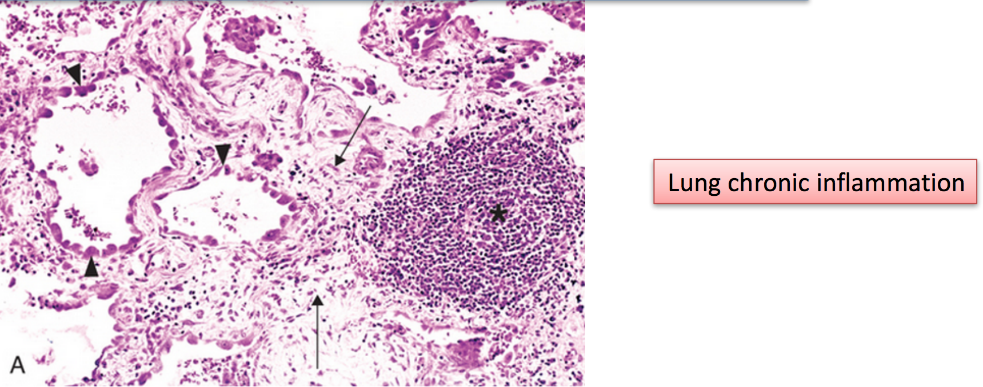
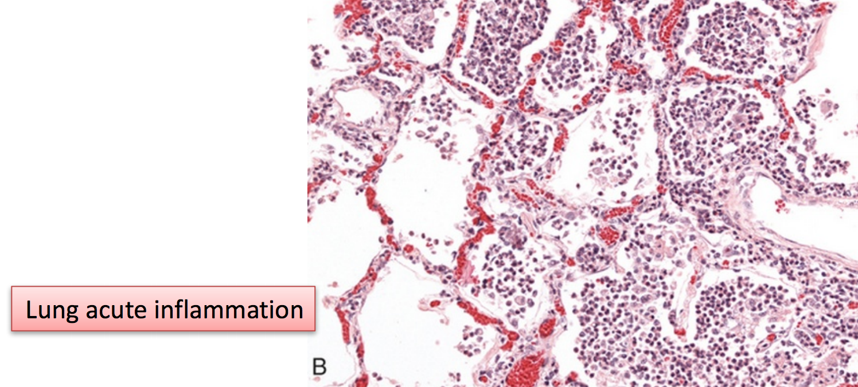
Chronic Inflammation cont.
The difference is the formation of giant cell and the presence of macrophages in the chronic inflammation while the majority in acute inflammation is neutrophils

Slide 46
Chronic Inflammation cont.
Chronic inflammation patterns
More info in next slides
Chronic non specific inflammation
Chronic granulomatous inflammation
Autoimmune
Diseases
eg: autoimmune thyroiditis
Foreign material
eg: silicates
eg:
TUBERCULOSIS(TB)

Slide 47
Chronic Inflammation cont.
What is a granulation tissue and what is a granulomatous inflammation?
Granulation tissue : contains new small blood vessels, fibroblasts, and mononuclear cells in an edematous extracellular matrix; formation of granulation tissue is part of the repair response. A granulomatous inflammation is a form of chronic inflammation. When we say granuloma, we mean the second one
● Granulation tissue → non specific
● Granuloma → specific
A-granulation tissue and chronic inflammation
Granulation tissue is often associated with chronic inflammation (non specific). It represents a healing phase following acute inflammation. Endothelial proliferation is prominent.
How is the granulation tissue formed?
1-At the beginning, the interstitial tissue is edematous (has edema, exudate)which has acute and chronic inflammatory cells.
2- After a while, the acute inflammatory cells go away and it is dominated by chronic inflammatory cells.
3-Finally, fibroblasts dominate the interstitial tissue.

Slide 48
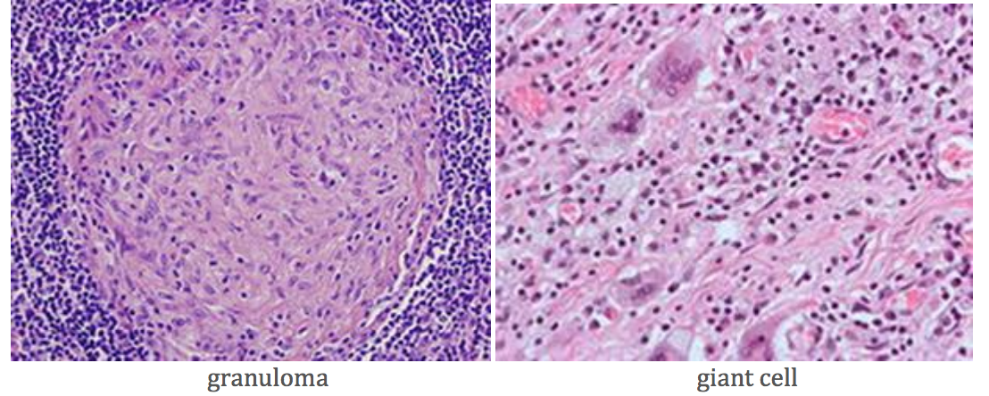
Chronic Inflammation cont.
B-Granulomatous inflammation
Characteristic of this type of chronic inflammation are granulomas which form 0.5 to 2.0 mm aggregations of epithelioid macrophages surrounded by a rim of lymphocytes. Epithelioid macrophages have an appearance suggestive of squamous epithelial cells due to their abundant pink cytoplasm.
Granulomatous inflammation may be caused by: foreign bodies , mycobacterial infection for example: (Tuberculosis, leprosy, schistosomiasis, the gamma of tertiary syphilis, cat-scratch disease, lymphogranuloma venereum, tularemia).
● Sometimes the granuloma contains caseous necrosis as in TB.
What are multinucleated giant cells? They form from the cytoplasmic fusion of macrophages.
What are langhans cells?
Langhans are giant and large cells found in granulomatous conditions. They are formed by the fusion of epithelioid cells (macrophages), and contain nuclei arranged in a horseshoe-shaped pattern in the cell periphery

Slide 49
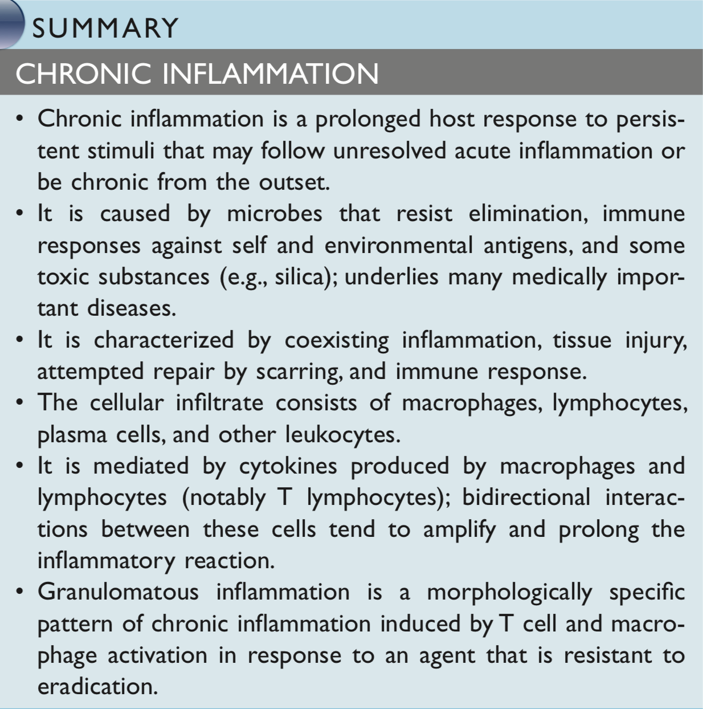

Slide 50
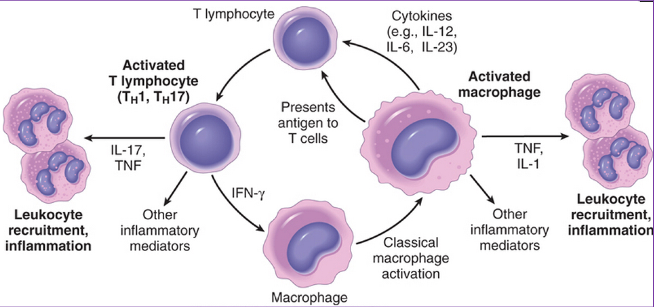
Cell in Chronic Inflammation.
Complex interactions between several cell populations and their secreted mediators.
Mediated by the interaction of monocyte/macrophages with T and B lymphocyte, plasma cells and others.
Macrophages
They develop from monocyte.
Macrophages are found in tissues, while monocyte are found in the bloodstream.
Macrophages (histiocytes). Histiocytes is less active in phagocytosis, but other than that they are the same.
Macrophages may be activated by a variety of stimuli, including:
cytokines (e.g., IFN-γ) secreted by sensitized T lymphocytes and by NK cells.
bacterial endotoxins.
For more info

Slide 51
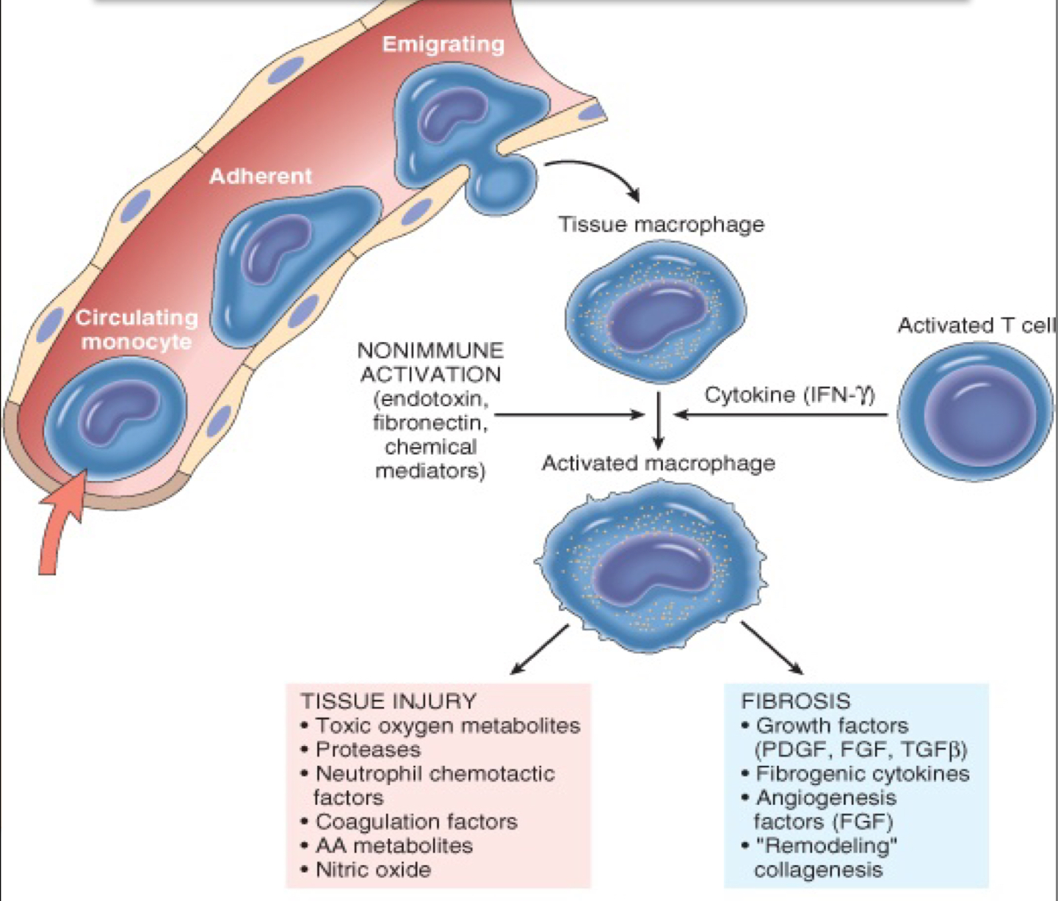
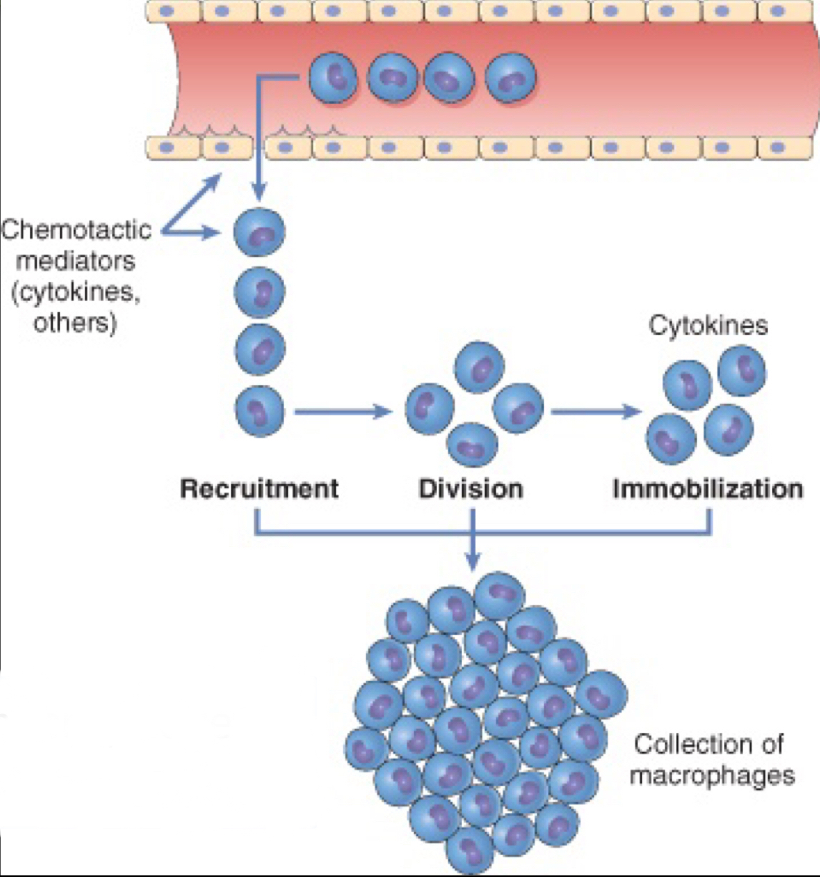
The roles of activated macrophages in chronic inflammation.
Eliminate injurious agents such as microbes.
Initiate the process of repair.
Secrete mediators of inflammation, such as cytokines (TNF, IL-1, chemokines, and eicosanoids).
Display antigens to T lymphocytes and respond to signals from T cells, thus setting up a feedback loop.
It is responsible for much of the tissue injury in chronic inflammation.
Macrophages/Monocytes
In chronic inflammation, macrophage accumulation persists, this is mediated by different mechanisms:
Recruitment of monocytes from the circulation.
Local proliferation of macrophages.
Immobilization of macrophages.
Collection of activated macrophages: Granuloma.

Slide 52
Cell in Chronic Inflammation cont.
Lymphocytes
Lymphocytes are two types T lymphocytes and B lymphocytes.
T lymphocytes function is cell mediated immunity (CMI).
T lymphocytes produce various types of lymphokines (protein mediators), which have local effects.
Most lymphocytes cells in the circulating blood are T lymphocytes.
It characterizes chronic inflammation.
Increase in lymphocytes is an indication of viral infection (however can be bacterial like TB).
plasma cells
B lymphocytes function is humoral immunity.
B lymphocytes transferred to plasma cells (when it’s activated).
Plasma cells produce immunoglobulins (antibodies).
It’s increased in chronic inflammation.
It’s especially prominent in chronic inflammation involving mucosal surfaces.
Plasma cells are found in tissues
Has an eccentric and a clock like nucleus and plenty of rough ER that produce immunoglobulin protein and it modified B lymphocytes T lymphocytes

Slide 53
Cell in Chronic Inflammation cont.
Mast cells
Have a lot of granules and contain major basic protein
which destroys tissue and attracts inflammatory cells in allergic reaction.
Plays an important role in allergic reaction especially type one because it has granules which contains histamine and.
When there is allergic the immunoglobulin E (IGE) will bind on the receptor which is on the surface of the mast and when this binding occurs, the mast cell will release the granules.
The histamine which is inside the granules, the serotonin (5-hydroxy tryptamine) which come from platelets, and the mast cells are found in the tissue and the bone marrow.
Eosinophils
It mostly has two loops.
It has eosinophilic granules (reddish, or acidophilic).
Eosinophil can do phagocytosis but it’s very weak.
Possess many of the neutrophil’s enzymes, in addition they can dispense antihistamine in the area of histamine release.
It’s increased in blood from 1-2% (normal) to 20% (abnormal tested in the stool) in patient with parasitic infection (infestation) and allergic reaction like bronchial asthma.
It can seen in both acute and chronic inflammation.

Slide 54
Cell in Chronic Inflammation cont.

Slide 55
Chemical Mediators of inflammation
Chemical mediators are responsible for the vascular and cellular events in acute inflammation. Meditators may be produced locally by cells at the site of inflammation, or maybe derived from inactive circulating precursors.
So these chemicals were circulating in the blood plasma (produced by the liver) and when they reach the site of inflammation, they become active. Examples: complement system & kinin system.
Chemical mediators are divided into two types:
1. Cell derived:
● Platelets.
● Lymphocyte.
● Macrophages.
● Basophils
● Endothelial cells.
● Mast cell
2. Plasma protein derived: Proteins are usually manufactured in the liver and released to the circulation

Slide 56
Chemical Mediators of inflammation cont.
1. Cell derived
Histamine
Secreted by:
Mast cells (It's a type of inflammatory cells that is found only in the tissue and it has granules inside them histamine and serotonin).
Basophils (Basophils are found in peripheral blood. I usually have multiple granules. And its nuclei have more than one lobe).
Platelets
Histamine causes:
● Vasodilatation.
● Increase vascular permeability.
● Endothelial activation
How is histamine released? When there is a physical injury, such as trauma or heat, immune reactions involving binding of IgE antibodies to their receptors on mast cells. After this binding, mast cells will release histamine from its granules
Example: When a bee stings you, its antigen will cause a hypersensitivity reaction in the body. This will lead to increased production of IgE, which will bind to mast cells and make it produce histamine. This explains how the bee sting leads to the production of all these effects on the body.
Serotonin (5 hydroxytryptamine)
● Serotonin comes from metabolized amino acid called tryptophan.
● Secreted by platelets.
● Serotonin causes: vasoconstriction
Platelets play a major role in blood Coagulation. So serotonin is secreted by the platelets to cause vasoconstriction.

Slide 57
Chemical Mediators of inflammation cont.
Platelet activating factor (PAF)
Secreted by:
mast cell
leukocyte
endothelial cell
Reactive oxygen species (free radical) - ROS
● Secreted by leukocyte.
● ROS causes damage of tissue and killing of microbes.
Note: in leukocytes there are different oxidative enzymes lead to formation of ROS. ROS are not stable and have to go into reactions and these reactions damage the cell.
ROS types:
Hydroxyl group (OH).
Superoxide (O₂-).
Hydrogen peroxide (H₂O₂).
NITRIC OXIDE (NO)
Secreted by:
1 - endothelial cells (also called endothelium)
2 - macrophage
Nitric oxide causes:
1 - vasodilation: it relaxes the smooth muscles of the blood vessels.
2 - killing of microbes.
PAF causes:
vasodilation
increase vascular permeability
leukocyte adhesion
chemotaxis
degranulation and oxidative burst

Slide 58
Chemical Mediators of inflammation cont.
Cytokines
● Cytokines: are polypeptide products of many cell types that function as mediators of inflammation and immune responses and they carry signals to neighboring cells.
● Cytokines has different elements such as: Tumor Necrosis Factor (TNF) and Interleukin.
Secreted by:
macrophagous
endothelial cells
mast cell
lymphocyte
TNF and IL-1 cause:
local: stimulate the expression of adhesion molecules on endothelial cells (endothelial activation).
Systemic: fever, metabolic abnormalities and shock (hypothesen).
Notes:
● The major cytokines in acute inflammation are TNF, IL-1, and IL-6. Other cytokines that is more important in chronic inflammation such as IL-12.
● Most of modern anti inflammation and immunity diseases drugs are anti TNF.

Slide 59
Chemical Mediators of inflammation cont.
Chemokines
Any of a class of cytokines with functions that include attracting white blood cells to sites of infection (chemotaxis).
Secreted by:
leukocytes
activated macrophages
Prostaglandins
secreted by:
mast cells
leukocytes
Prostaglandins are very important because a lot of anti inflammatory drugs, such as antipyretics and analgesics work on blocking prostaglandins (anti-prostaglandins).
Note: when the phospholipid of the cell membrane is metabolized by the action of phospholipases, arachidonic acid (fatty acid) is produced. The arachidonic acid is further metabolized by cyclooxygenase and gives various prostaglandins.
Phospholipid → (via phospho lipases) arachidonic acid → (via cyclooxygenases) prostaglandins
Leukotrienes
secreted by :
mast cells
leukocytes
Chemokines causes:
chemotaxis
leukocyte activation
Prostaglandins causes:
pain
vasodilation
Fever
leukotriene causes :
increase vascular permeability
chemotaxis
leukocyte adhesion and activation

Slide 60
Chemical Mediators of inflammation cont.
Leukotrienes cont’
Note: when the phospholipid of the cell membrane is metabolized by the action of phospholipases, arachidonic acid (fatty acid) is produced. The arachidonic acid is further metabolized by 5- lipoxygenase and gives rise to leukotrienes (B4 , C4 , D4 , E4)
● Leukotriene B4 induced chemotaxis.
● Leukotriene C4 , D4 and E4 increase vascular permeability and active leukocytes.
phospholipid → (via phospholipase) arachidonic acid → (via 5-lipoxygenase) leukotriene

Slide 61
Chemical Mediators of inflammation cont.
Leukotrienes cont’
So if I want to stop the inflammation in the patient, I can inhibit the phospholipase and make it stop producing arachidonic acid by STEROIDS.
Arachidonic acid may be digested by:
Note: PGD2: Prostaglandin D2
PGE2: Prostaglandin E2

Slide 62
Summary of Chemical Mediators of inflammation
Very important slide

Slide 63
Chemical Mediators of inflammation cont.
2. Plasma protein derived mediators: Complement system: The complement system ,which is consisted of a group of plasma proteins, is synthesized by the liver and is found in the plasma.
Usually found in blood (serum) produced by liver. They are acute phase proteins
What is the difference between plasma and serum?
They are the same; but plasma has coagulation factors and serum has no coagulation factors (they were used). E.g. C-reactive proteins
- The complement system is made from 20 proteins.
- The complement system can be activated by : ● Classical pathway; Activated by Immune Complexes that contain antibodies bound to an antigen.
● Alternative pathway: Microbial products directly activate complement system.
● Mannose-binding lectin (MBL) pathway; MBL binds to mannose on microorganisms and activates the complement system.
be careful, the classical pathway requires antibody to activate the pathway, but the alternative pathway does not require antibodies for its activation.
IgE causes histamine release
Immunology talks about the complement system in detail, but what is important in pathology and inflammation? ● C3a and C5a (anaphylatoxins)—Stimulate mast cell release of histamine (vasoactive amines) → inflammation; (cause vasodilation)
Note:When complements sit on the surface, they stimulate mast cells.
● C5a —Leukocyte chemotactic factor. ● C3b —It is an opsonin, it prepares the microorganism for phagocytosis. It will coat the antigen and prepare it for phagocytosis. ● C5b-C9 (Membrane Attack Complex [MAC]) —Cell lysis. ● MAC (( C5b-9 )) is a part of the complement system. It will work on the cell membrane of the microorganism and cause their lysis. It can kill the bacteria. It may also cause cell injury

Slide 64
Chemical Mediators of inflammation cont.
Opsonins enhance recognition, attachment and phagocytosis of bacteria. • Important opsonins include immunoglobulins (Fc portion of IgG), complement system product (C3b), and plasma proteins such as collectins (which bind to bacterial cell walls). • When immunoglobulins coat the bacteria or antigen they make them amenable
What are phagocytic cells?
● Macrophages (histiocytes). Histiocytes is less active in phagocytosis, but other than that they are the same.
● Neutrophils
● Eosinophil (weakly phagocytic). - In some diseases we check the blood for complement system protein. If they were low, this means that they have been used, and this means that I am dealing with an inflammatory process or inflammation. If it was normal it means that the immunologic system is not activated and I am not dealing with an inflammatory process.
What do we mean by cascade?
cascade: It is a process where one thing leads to another. We should know two cascades : The complement system cascade and coagulation cascade.

Slide 66
Chemical Mediators of inflammation cont.
Kinin system The kinin–kallikrein system, or simply the kinin system, consists of blood proteins that play a role in inflammation, blood pressure control, coagulation and pain. Its important mediators bradykinin and kallidin are vasodilators and act on many cell types.
related to the second cascade: coagulation cascade (12 factors)
The Kinin System does not get activated unless the coagulation cascade is activated. ● If the coagulation cascade was activated (especially factor 12 which is called the Hageman factor) it stimulates the cascade of the kinin system.
● What is important from the kinin system? Bradykinin.
● Bradykinin is a pain stimulator and increases the vascular permeability.
● The actions of Bradykinin are short-lived. WHY? Because it is rapidly degraded by kininases present in plasma and tissues.
● So when there is inflammation, the coagulation system is activated ● Inflammation stimulates coagulation Coagulation cascade starts from
hageman factor (factor 12). It stimulates the coagulation cascade
Kinens are lipids in the blood produced by the liver or kidney
● Proteases activated during coagulation: NOT IMPORTANT
Notes:Hemophilia (factor 8 deficiency) (broken tooth and broken leg require
factor 8 addition)

Slide 67
Chemical Mediators of inflammation cont.
Kinin system cont’:
Complement system: Leukocyte chemotaxis (C3a and C5a), opsonization (C3b) and cell killing (by C5b-9 Membrane attack complex).
- Hageman factor activation leads to kinin activation.
- Bradykinin is created after the kinin activation and it causes pain.

Slide 68
Inflammation systemic manifestation
1- Leukocytosis :
Increase in WBC count 15,000 to 20,000
2- Lymphocytosis :
German measles.
3- Eosinophilia.
4-Leukopenia.
Systemic effects of inflammation
Acute phase
Reaction/Response :
IL-1 and TNF
Bone marrow :
IL-1 and TNF
Leukocytosis
Lymphoid organs.
Liver :
IL-6, IL-1, TNF
C-reactive proteins.
Serum amyloid A.
Fibrinogen.

Slide 69
Summary of Chemical Mediators of inflammation
Highly important table(it basically summarizes the mediators in this lecture

Slide 70
Goal of the repair process
To restore the tissue to its original state after inflammatory reaction.
Some tissues can be completely reconstituted after injury, such as the repair of bone after a fracture or the regeneration of the surface epithelium in a cutaneous wound.
For tissues that are incapable of regeneration, repair is accomplished by connective tissue deposition, producing a scar.

Slide 71
If damage persists, inflammation becomes chronic, and tissue damage and repair may occur concurrently. Connective tissue deposition in these conditions is usually referred to as fibrosis.

Slide 72
The differences between the various cell in regenerative abilities types
Repair by tissue regeneration or healing depend on cell type.
Cell type | Regenerative abilities
Labile cells | continue to proliferate throughout life: squamous, columnar, transitional epithelia; hematopoietic and lymphoid tissues.
Stable cells | retain the capacity of proliferation but they don’t replicate normally: parenchymal cells of all glandular organs & mesenchymal cells.
Permanent cells | cannot reproduce themselves after birth: neurons, cardiac muscle cells.

Slide 73
Examples of labile cells: STEM CELLS
Bile duct

Slide 74
The mechanism of repair
Healing is usually a tissue response to:
A wound (commonly in the skin).
An inflammatory processes in internal organs.
Cell necrosis in organs incapable of regeneration.
Healing occur as a response to inflammatory processes in internal organs
• Repair begins early in inflammation.
• At site of inflammation, fibroblasts and vascular endothelial cells begin proliferating to form a specialized type of tissue (hallmark of healing) called:
granulation tissue
• The process is called organization.

Slide 75
Repair by connective tissue (granulation tissue)
It consists of:
1. Fibroblasts surrounded by abundant extracellular matrix.
2. Newly formed blood vessels.
3. Scattered macrophages and some other inflammatory cells.
Role of macrophages in wound healing
Will discuss in next slide

Slide 76
The role of macrophages in wound healing
• Cleanup of debris, fibrin, and other foreign material at the,site of repair.
• Macrophages recruit other cells: fibroblasts and angioblasts
•Stimulation of matrix production, interleukins that stimulate fibroblasts and angioblasts to produce the extracellular matrix.
• Remodeling of the scar. They secrete collagenases
• Secretion of transforming growth factor beta (TGF-B)
• TGF-beta has anti inflammatory action and plays a role in tissue repair and fibrosis.
Fibroblast Migration and Proliferation
 Migration of fibroblasts to the site of injury and their subsequent proliferation are triggered by multiple growth factors, including mainly TGF-β and others e.g. PDGF,EGF,FGF,and the cytokines IL-1 and TNF.
This leads to: 1. increased synthesis of collagen and fibronectin. 2. decreased degradation of extracellular matrix (ECM) by metalloproteinases.

Slide 77
ECM Deposition and Scar Formation
 As repair continues, the number of proliferating endothelial cells and fibroblasts decreases.
 Net collagen accumulation,however, depends not only on increased collagen synthesis but also on decreased degradation.
Granulation tissue morphology
As early as 24 hr. after injury, fibroblasts and vascular endothelial cells begin proliferating to form (by 3-5 days) granulation tissue (pink soft granular appearance on the surface of the wound.)
New granulation tissue is often edematous.
histologically : granulation tissue is composed of :
Proliferation of new small blood vessels.
Proliferation of fibroblasts.
Macrophages.
Angiogenesis from Endothelial Precursor Cells

Slide 78
Scar formation
• Further healing: increased collagen, decreased active fibroblasts and new vessels (thrombosis and degeneration)
• At the end: scar (inactive fibroblasts, dense collagen,fragments of elastic tissue, extracellular matrix,few vessels).
Functions of the Extracellular Matrix
The ECM is much more than a space filler around cells.
Its various functions:
Mechanical support.
Control of cell proliferation.
Scaffolding for tissue renewal.
Establishment of tissue microenvironments.

Slide 79
Cutaneous Wound healing
Primary union (healing by 1st intention) | Secondary union (healing by 2nd intention)
Clean surgical incision. No significant bacterial contamination. Minimal loss of tissue. Clot, scab formation. | More extensive loss of cells and tissue: Infarction. Inflammatory ulceration. Abscess formation. Surface wound with large defect. Large tissue defect that must be filled.
Primary union
24 Hours
Day 3
Day 5
collagen bridges the incision, epidermis thickens.
hematoma & neutrophils, mitotic activity of basal layer, thin epithelial layer.
Hageman factor (factor 12) will activate both the coagulation sequence and the kinin system as an initial response to this injury.
Macrophages & granulation tissue.
2nd week
End of 1st month
Later
scar (cellular connective tissue, intact epidermis, lost appendages).
collagen type III is slowly replaced by collagen type I and the wound acquires tensile strength.
continued collagen and fibroblasts, blanching.
By the end of third month, the tissue has approximately 80% of its original strength.

Slide 80
Cutaneous Wound healing
Secondary union
It occur in large, gaping wounds, as well those that are infected or contain foreign material.
The basic process of healing is the same in all wounds. In contrast to healing by primary intention, wounds healing by secondary intention:
Require more time to close because the edges are far apart
Show a more prominent inflammatory reaction in and around the wound
Contain more copious granulation tissue inside the tissue defect
wound contraction (5 to 10%), due to myofibroblast (It has the ability to contract)
Differences between primary intention and secondary intention:
Primary union
Secondary union

Slide 81
Delayed wound healing
Causes:
Infection (the most important cause of delay in healing; it prolongs inflammation and potentially increases the local tissue injury).
Foreign bodies in the wound
Mechanical factors (Suture help healing of wound)
Nutritional deficiencies (protein deficiency and vitamin C deficiency inhibit collagen synthesis and retard healing. Zinc and copper deficiency)
Poor perfusion (due either to arteriosclerosis and diabetes or to obstructed venous drainage)
Excess corticosteroid
Collagen synthesis
Proline
hydroxylation
by vitamin C.

Slide 82
Excess corticosteroid
Have well-documented anti-inflammatory effects, and their administration may result in weakness of the scar.
However, the anti-inflammatory effects of glucocorticoids are sometime desirable. For example, in corneal infections.
complications in cutaneous wound healing
Complications in wound healing can arise from abnormalities in any of the basic components of the repair process. These aberrations can be grouped into three general categories:
(1) deficient scar formation
(2) excessive formation of the repair components
(3) formation of contractures.
Wound dehiscence
Wound ulceration
Keloid
Contracture

Slide 83
What is keloid?
Keloids are excessive scars composed of irregularly deposit hyalinized collagen bands. They may appear as bulging masses.
What is the difference between keloid and hypertrophic scar?
Keloid | Hypertrophic Scar
Keloids are the result of an overgrowth of dense fibrous tissue that usually develops after healing of a skin injury. The tissue extends beyond the borders of the original wound, does not usually regress spontaneously, and tends to recur after excision. | hypertrophic scars are characterized by erythematous, pruritic, raised fibrous lesions that typically do not expand beyond the boundaries of the initial injury and may undergo partial spontaneous resolution. Hypertrophic scars are common after thermal injuries.

Slide 84
Formation of contractures
Common on the palms, the soles, and the anterior aspect of the thorax.
Contractures are commonly seen after serious burns
It can compromise the movement of joints.
Fibrosis in Parenchymal Organs
Fibrosis is a pathologic process induced by persistent injurious stimuli such as chronic infections and immunologic reactions, and is typically associated with loss of tissue.

Slide 85
The definition of granulomatous inflammation
A form of chronic inflammation characterized by the formation of granulomas.
Why is it important?
Granulomas are encountered in certain specific pathologic states.
Recognition of the granulomatous pattern is important because of the limited number of conditions (some life-threatening) that cause it.
Chronic inflammation
Macrophage, lymphocytes
and plasma cells
Acute inflammation
Neutrophils

Slide 86
Morphology of granulomas
Granuloma: a nodular collection of epithelioid macrophages (squamous cell-like appearance) surrounded by a rim of lymphocytes.
Langhans type giant cell
microscopic aggregation of activated macrophages
Lymphocytes
Langhans type giant cell
Lymphatic rim
Caseous necrosis
Epithelioid macrophage
Section of a lymph node with caseation necrosis
The nuclei arranged either peripherally (Langhans- type giant cell) or haphazardly (foreign body-type giant cell).

Slide 87
Granulomatous Inflammation pathogenesis
Neutrophils ordinarily remove agents that incite an acute inflammatory response. However, there are circumstances in which reactive neutrophils cannot digest the substances that provoke acute inflammation.
IFN-γ released by the CD4+ T cells of the TH1 subset is crucial in activating macrophages. This is considered as type IV hypersensitivity.
When macrophages have successfully phagocytosed the injurious agent but it survives inside them.
When an active T lymphocyte-mediated cellular immune response occurs. Lymphokines produced by activated T lymphocytes inhibit migration of macrophages and cause them to aggregate in the area of injury and form granulomas.

Slide 88
Types of granulomas
Foreign body granuloma (non immune) | Immune granuloma
Forms when material such as sutures where they are large enough to preclude phagocytosis. Foreign bodies: —Graft material —talc (associated with IV drug abuse) Can be identified in the center of the granuloma, by polarized light (appears refractile). | Caused by insoluble particles, typically microbes. Bacteria —Tuberculosis —Leprosy —Actinomycosis(commonly affects the face and neck) — Cat-scratch disease Parasites —Schistosomiasis —Leishmaniasis Fungi —Histoplasmosis —Blastomycosis Metal/Dust —Berylliosis Diseases with unknown cause: 1. Sarcoidosis(Non-caseating granuloma) 2. Crohn’s disease
These material don’t incite any specific inflammatory immune response. | They're capable of inducing a cell-mediated immune response.
*filamentous, *gram-positive *non–acid-fast

Slide 89
Tuberculosis: Mycobacterum tuberculosis
Mycobacteria – ‘fungus like bacteria”
acid fast bacilli [AFB] (they have a high content of complex lipids that readily bind the Ziehl-Neelsen [carbol fuchsin] stain and subsequently resist decolorization).
Cord factor: is a glycolipid molecule found in the cell wall of Mycobacterium TB and similar species.It protects M. tuberculosis from the defenses of the host
Cord factor presence increases the production of the cytokines IL-12 , IL-1β, IL-6 and TNF which are all pro-inflammatory cytokines important for granuloma formation.
Red cylindrical bacteria

Slide 90
Take home messages
The various cell types (ie, labile, stable, and permanent cells) affect the outcome of healing.
Three main phases of cutaneous wound healing:
(1) inflammation, (2) formation of granulation tissue, and (3) ECM deposition and remodeling
Healing by primary intention occur in surgical clean wound and healing by secondary intention occur when excessive tissue damage is present.
Several factors are associated with delayed wound healing.
Complication of wound healing include failure of healing, contracture and excessive scar formation.

Slide 91
Quiz
Q1: Which of the following in not. Q2: A deficiency of the following in
a part of the granulation tissue ? known to impair wound healing.
A)Fibroblast. A) Lead.
B)Blood vessels. B)Vitamin B12.
C)Eosinophils. C)Zinc.
D)Macrophages. D)Corticosteroids.
Q3: Which of the following cells. Q4: One of the following is a
proliferate but they don’t complication of wound healing ?
replicate normally ? A)Keloids.
A)Hematopoietic. B)Fibrinoid necrosis
B)Neurons. C)Myocardial infarction
C)Transitional. D)Inflammation
D)Mesenchymal cells.
Q5: One of the following is not Q6:A patient has skin damage due to
a characteristic of healing by primary trauma that heals by fibrosis. Which
union ( healing by first intention ) of the following is mainly responsible
in the skin . for contraction of the wound?
A)Large amount of granulation tissue. A)Endothelial cells.
B)Relatively inconspicuous scarring. B) Fibroblasts.
C)Production of type | and type || collagen. C) Macrophages.
D)Proliferation of epidermal cell. D)Myofibroblasts.
Answers:
Q1:- C. Q2:- C
Q3:- D. Q4:- A
Q5:- A. Q6:- D

Slide 92
Team members
Team leaders
نجود العبداللطيف
مهند أحمد
طيف الشمري
طارق العقيل
عبدالرحمن الحواس
عبدالله الحوامدة
عبدالله العيسى
عبدالله النويبت
غادة السدحان
غيداء الشهري
فيصل القبلان
لمى الزامل
لينا النصار
محمد عجارم
مهند مكاوي
نايف السليس
نجود العلي
نورة المزروع
هيفاء العيسى
ياسمين الموسى
عبد العزيز الشومر
نايف الحسيني
إبراهيم الدخيل
إبراهيم الشقراوي
أمجد البارودي
أميرة الزهراني
الهنوف الهلولي
الوليد الصالح
بدر القرني
حميد الحافظ
دينا عورتاني
رهام يوسف
ريما السرحاني
ريما المطوع
ريما القحطاني
ريناد المطوع
سارة العريفي
سهيل باسهيل
شهد بن سليم
طيبة الزيد
Special thanks to:
Team 434

