Slide 1
Skin and Soft-Tissue Infections
IMPETIGO, ABSCESSES, CELLULITIS, AND ERYSIPELA

Slide 2
Objectives
Describe the anatomical structure of skin and soft tissues.
Differentiate the various types of skin and soft tissue infections and there clinical presentation.
Name bacteria commonly involved in skin and soft tissue infections
Describe the pathogenesis of various types of skin and soft tissue infections
Recognize specimens that are acceptable for different types of skin and soft tissue infections
Describe the microscopic features and colony morphology of Staphylococcus aureus and group A Streptococcus and how to differentiate them from other bacteria
Discuss non-microbiological investigations
Describe the major approaches to treat of skin and soft tissue infections either medical or surgical.

Slide 4
Introduction
Common
Can be mild to moderate or sever muscle or bone and lungs or heart valves infection .
Staphylococcus aureus and Streptococcus are the most cause common
Emerging antibiotic resistance among
  Staphylococcus aureus (methicillin resistance)
  Streptococcus pyogenes (erythromycin resistance)

Slide 5
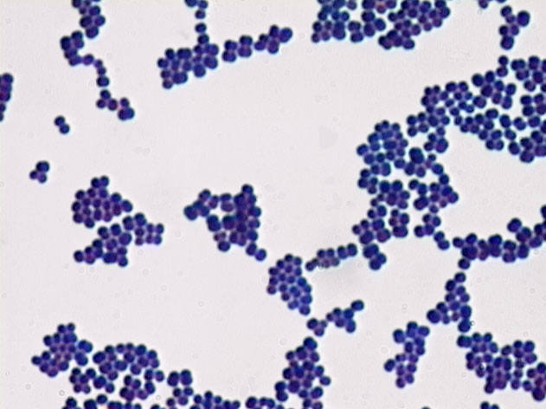
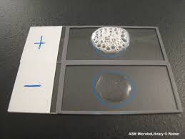
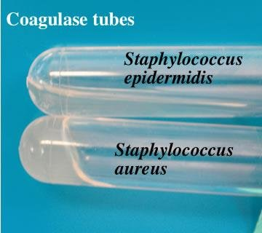
Gram positive cocci in clusters
Catalase positive
Coagulase positive

Slide 6
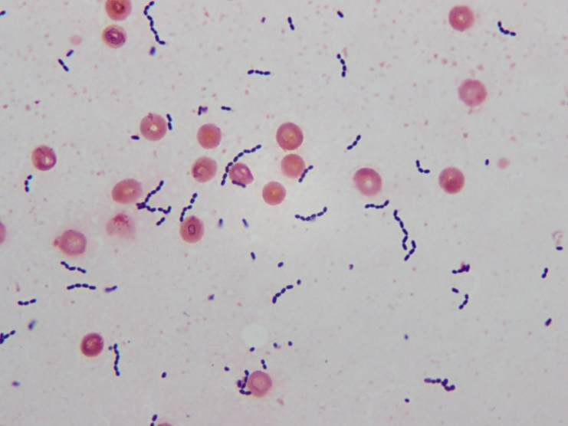
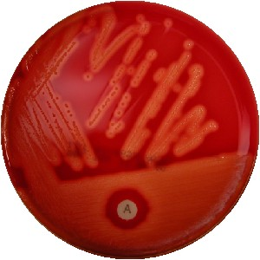
Gram positive cocci in chain
Catalase negative
Beta hemolytic
Bacitracin sensitive

Slide 7
Key to developing an adequate differential diagnosis requires
History
  Patient’s immune status, the geographical locale, travel history, recent trauma or surgery, previous antimicrobial therapy, lifestyle, and animal exposure or bites
Physical examination
  To determine the severity of infection
Investigation
  CBCs, Chemistry
  Swab, biopsy or aspiration
  Radiographic procedures (X-rays, CT, MRI)
    Level of infection and the presence of gas or abscess.
Diagnostic and therapeutic
  Surgical exploration or debridement
  Antibiotics treatment

Slide 8
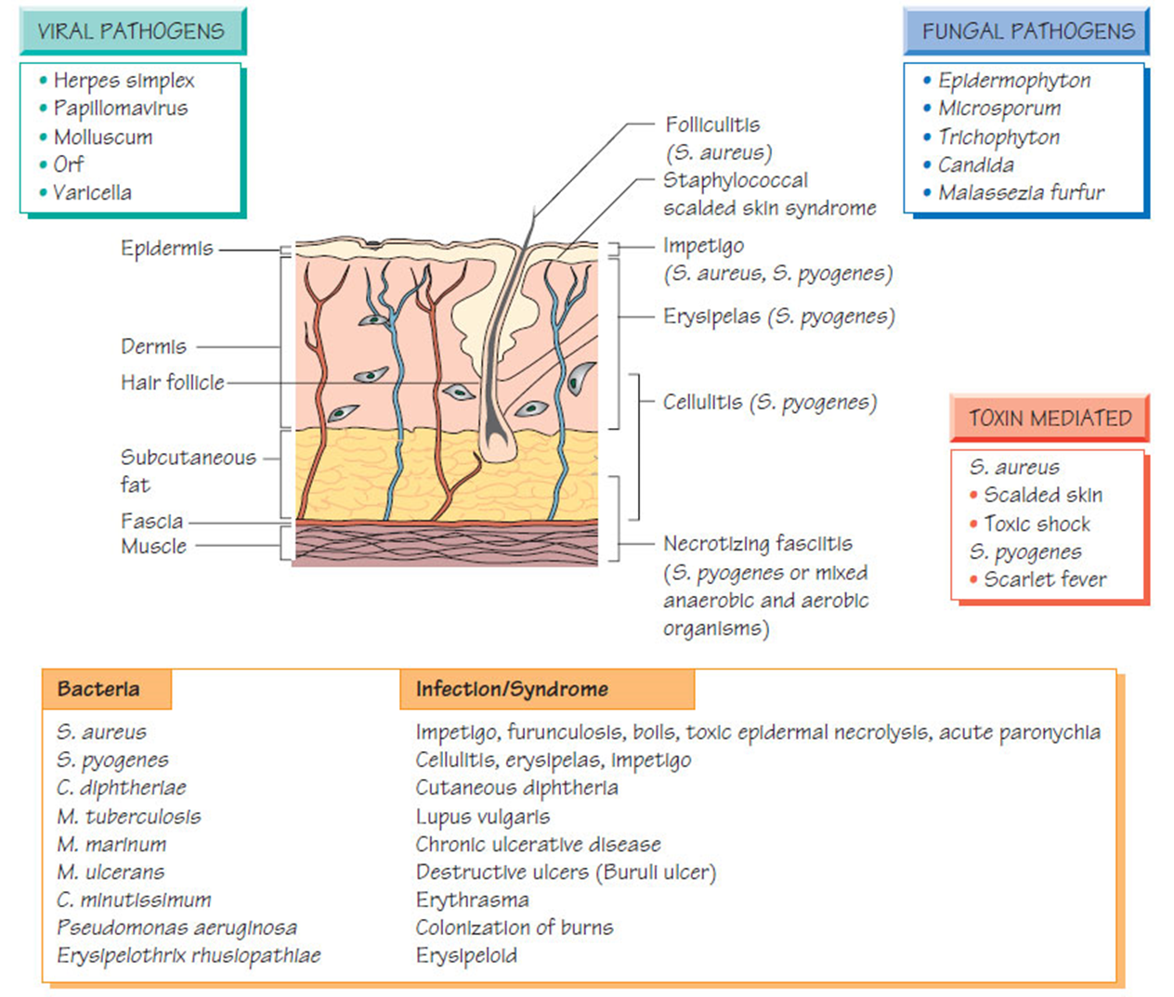

Slide 9
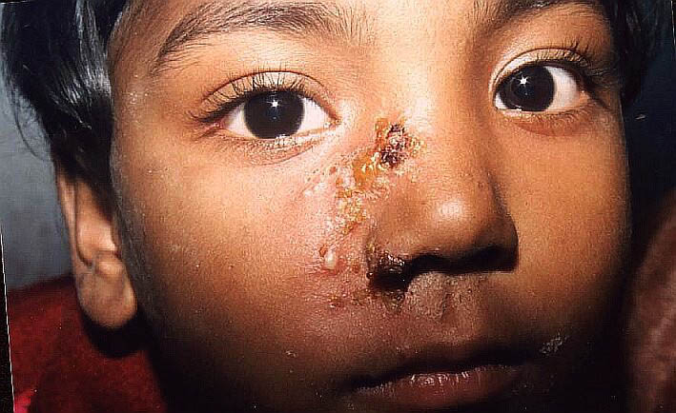
IMPETIGO-( Pyoderma)
  A common skin infection
  Children 2–5 Yr in tropical or subtropical regions
  Nearly always caused by β-hemolytic streptococci (GAS)
  In some cases β-hemolytic streptococci (GAS) and S. aureus.
  Rarely by S. aureus only
  Nonbullous (Streptococcus) or Bullous (S. aureus )
  Consists of discrete purulent lesions
  Exposed areas of the body( face and extremities)
  Skin colonization- Inoculation by abrasions, minor trauma, or insect bites
  Systemic symptoms are usually absent.
  Poststreptococcal glomerulonephritis.
    (anti–DNAse B, ASO)
  Treatment
    Cefazolin, Cloxacillin , or erythromycin
    Mupirocin
Notes:
ASO: antistreptolysin O

Slide 10
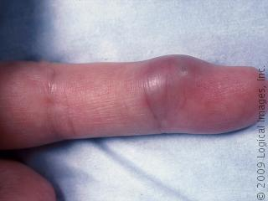
ABSCESSES, CELLULITIS, AND ERYSIPELA
  Cutaneous abscesses.
    Collections of pus within the dermis and deeper skin tissues.
    Painful, tender, and fluctuant
    Typically polymicrobial, S. aureus alone in ∼ 25 %
    Do Gram stain, culture, and systemic antibiotics
      Multiple lesions, cutaneous gangrene, severely impaired host defenses, extensive surrounding cellulitis or high fever.
        Incision and evacuation of the pus

Slide 11
Furuncles and carbuncles.
  Furuncles (or “boils”) are infections of the hair follicle (folliculitis ), usually caused by S. aureus, in which suppuration extends through the dermis into the subcutaneous tissue
  Carbuncle- extension to involve several adjacent follicles with coalescent inflammatory mass - back of the neck especially in diabetics
  Larger furuncles and all carbuncles require incision and drainage.
  Systemic antibiotics are usually unnecessary

Slide 12
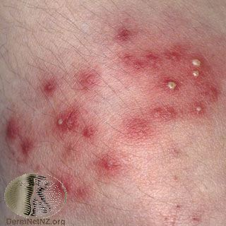
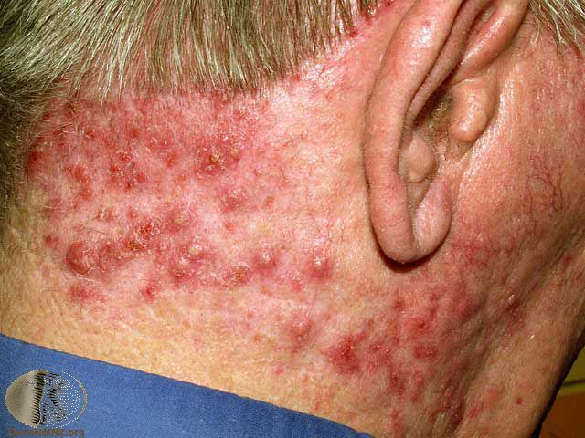
  Outbreaks of furunculosis caused by MSSA, and MRSA,
    Families-prisons-sports teams
    Inadequate personal hygiene
    Repeated attacks of furunculosis
    Presence of S. aureus in the anterior narse- 20-40%
    Mupirocin ointment- eradicate staphylococcal carriage nasal colonization

Slide 13
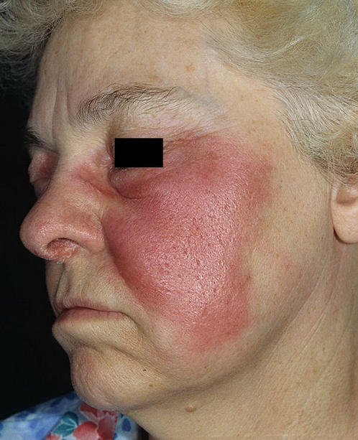
Erysipelas and Cellulitis.
  Diffuse spreading skin infections, excluding infections associated with underlying suppurative foci
  Most of the infections arise from streptococci, often group A, but also from other groups, such as B, C, or G.
  Erysipelas
    Affects the upper dermis (raised-clear line of demarcation)
    Red, tender, painful plaque
    Infants, young children-
    β-hemolytic streptococci ( group A or S. pyogenes)
    Penicillin-IV or oral.

Slide 14
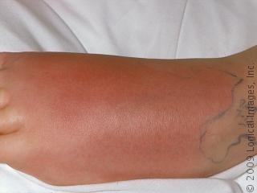
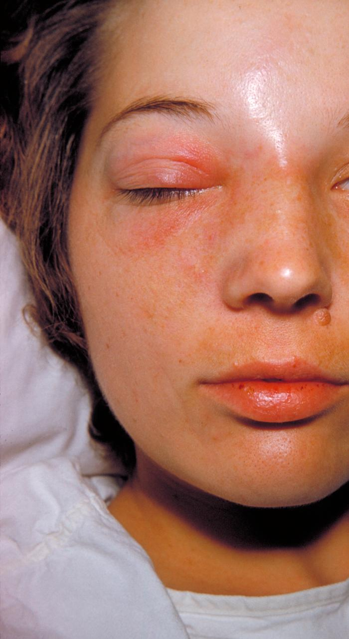
  Cellulitis
  Acute spreading infection involves the deeper dermis and subcutaneous tissues.
    β-hemolytic streptococci, Group A streptococci, and group B streptococci-diabetics
    S. aureus : commonly causes cellulitis- penetrating trauma.
    Haemophilus influenzae periorbital cellulitis in children
    Risk factors ; Obesity, venous insufficiency, lymphatic obstruction (operations), preexisting skin infections- ulceration, or eczema,
    CA-MRSA
      Carry Panton-Valentine leukocidin gene
      More sensitive to antibiotics
      Can lead to sever skin and soft tissue infection or septic shock

Slide 15
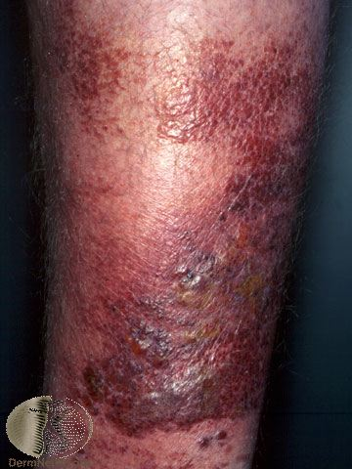
Diagnosis and Treatment
Clinical diagnosis Symptoms and Signs
High WBCs, blood culture rarely needed
Aspiration and biopsy might be needed in diabetes mellitus, malignancy, animal bites, neutropenia (Pseudomonas aeruginosa ), immunodeficiency, obesity and renal failure
Observe for progression to sever infection(increased in size with systemic manifestation ie . fever, leukocytosis)
Treatment: cover Streptococcus and Staphylococcus
  Penicillin, cloxacillin, cefazolin(cephalexin),clindamycin
  Vancomycin or linazolid in case of MRSA
    Clindamycin, TMP-SMZ for CaMRSA

Slide 16
Necrotizing fasciitis
Flesh-eating disease

Slide 17
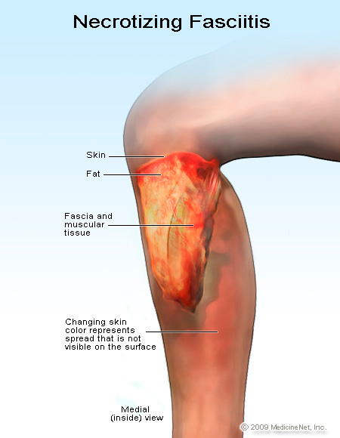
Introduction
It is a rare deep skin and subcutaneous tissues infection
It can be monomicrobial (Type II) or (polymicrobial Type I) infection
Most common in the arms, legs, and abdominal wall and is fatal in 30%-40% of cases.

Slide 18
Introduction
Monomicrobial
  Group A streptococcus (Streptococcus pyogenes)
  Staphylococcus aureus or CA-MRSA
  Vibrio vulnificus (liver function)
  Clostridium perfringens (gas in tissues) (Type III)
Polymicrobial
  Caused by aerobic and anaerobic bacteria
  E.g. Fournier's gangrene (perineum and genital area)
  Bacteroides fragilis
  Gram-negative bacteria (synergy).
    E. coli, Klebsiella, Pseudomonas
  Stretptococcus (other than group A)
  Uncommonly fungi

Slide 19
Risk factors
Immune-suppression
Chronic diseases: ( diabetes, liver and kidney diseases, malignancy
Trauma:(laceration, cut, abrasion, contusion, burn, bite, subcutaneous injection, operative incision)
Recent viral infection rash (chickenpox)
Steroids
Alcoholism
Malnutrition
Idiopathic

Slide 20
Pathophysiology
Destruction of skin and muscle by releasing toxins
  Streptococcal pyrogenic exotoxin
  Superantigen
    Non-specific activation of T-cells
    Overproduction of cytokines
    Severe systemic illness (Toxic shock syndrome)

Slide 21
Signs and symptoms
Rapid progression of sever pain with fever , chills (typical)
Swelling , redness, hotness, blister, gas formation, gangrene and necrosis
Blisters with subsequent necrosis , necrotic eschars
Diarrhea and vomiting (very ill)
Shock organ failure
Mortality as high as 73 % if untreated

Slide 22
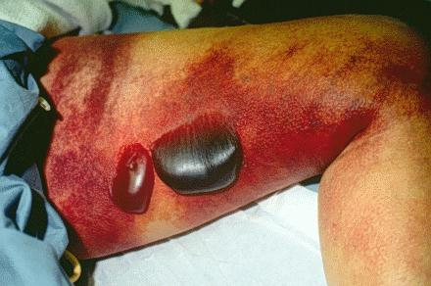
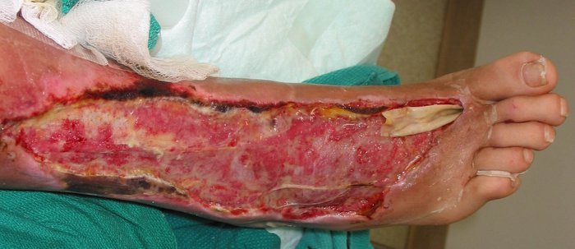
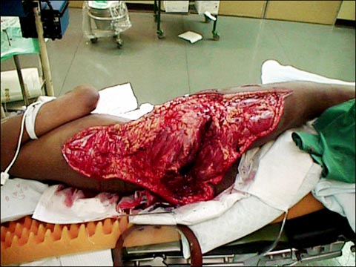
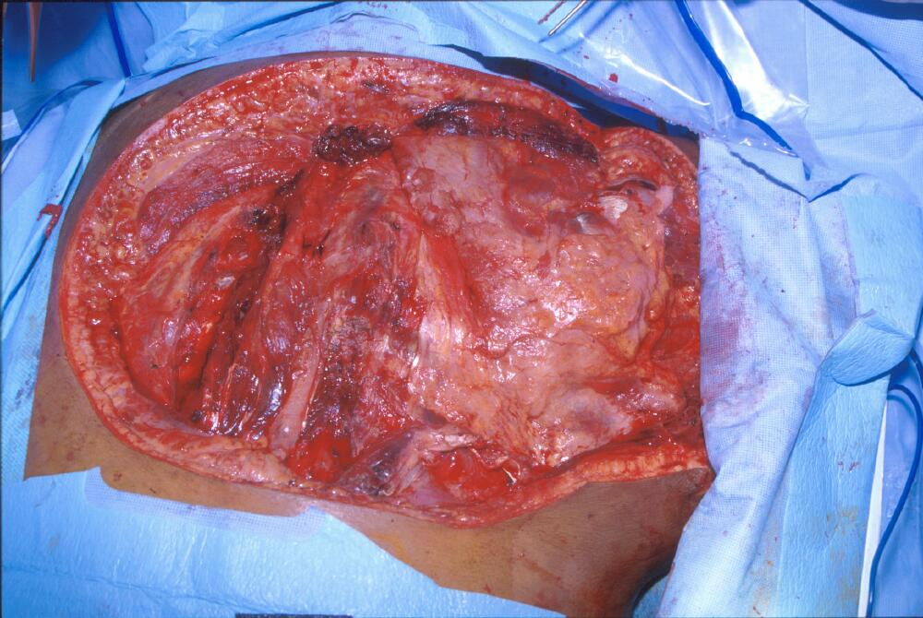
Notes:
Necrotizing fasciitis and clostridial myonecrosis due to infection with Clostridium septicum. The patient required multiple extensive debridements down to bone (see image), but did not survive the severe infection with severe septic shock. Blood and wound cultures were positive for the organism. At autopsy, an occult colonic malignancy was also noted--presumably the source for her infection.

Slide 23
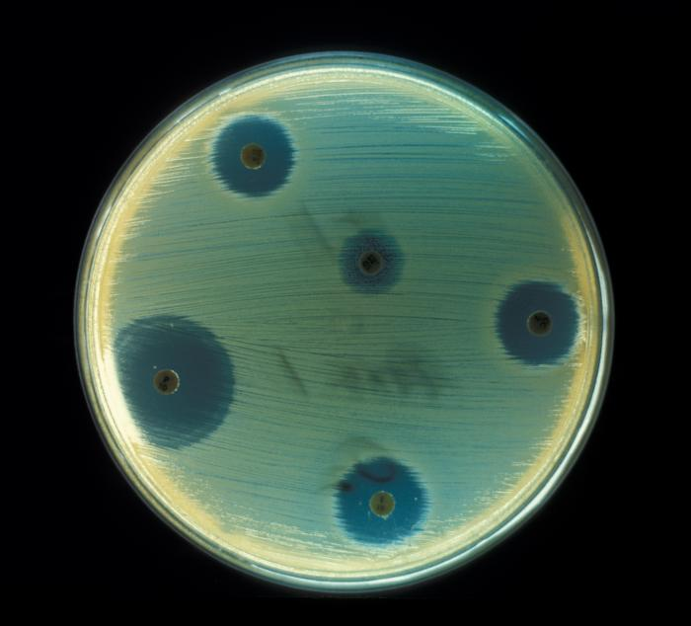
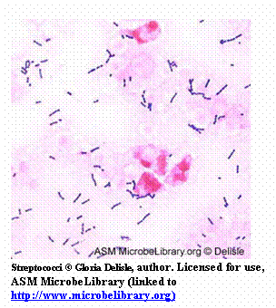
Diagnosis
A delay in diagnosis is associated with a grave prognosis and increased mortality
Clinical-high index of suspicion
Blood tests
  CBC-WBC , differential , ESR
  BUN (blood urea nitrogen)
Surgery debridement- amputation
Radiographic studies
  X-rays : subcutaneous gases
  Doppler CT or MRI
Microbiology
  Culture &Gram's stain
    ( blood, tissue, pus aspirate)
  Susceptibility tests

Slide 24
Treatment
If clinically suspected patient needs to be hospitalized OR require admission to ICU
Start intravenous antibiotics immediately
Antibiotic selection based on bacteria suspected
broad spectrum antibiotic combinations against
  methicillin-resistant Staphylococcus aureus (MRSA)
  anaerobic bacteria
  Gram-negative and gram-positive bacilli
Surgeon consultation
  Extensive Debridement of necrotic tissue and collection of tissue samples
  Can reduce morbidity and mortality

Slide 25
Treatment
Antibiotics combinations
  Penicillin-clindamycin-gentamicin
  Ampicillin/sulbactam
  Cefazolin plus metronidazol
  Piperacillin/tazobactam
  Clostridium perfringens - penicillin G
Hyperbaric oxygen therapy (HBO) treatment

Slide 26
Pyomyositis
Acute bacterial infection of skeletal muscle, usually caused by Staphylococcus aureus
No predisposing penetrating wound, vascular insufficiency, or contiguous infection
Most cases occur in the tropics
60% of cases outside of tropics have predisposing RF: DM, EtOH liver disease, steroid rx, HIV, hematologic malignancy

Slide 27
Pyomyositis
Hx of blunt trauma or vigorous exercise (50%), then period of swelling without pain. 10-21 days later, pain, tenderness, swelling and fever, Pus can be aspirated from muscle. 3rd stage: sepsis, later metastatic abscesses if untreated
Dx: X-ray, US, MRI or CT
Rx: surgical drainage +abx

Slide 28
Other Specific Skin Infections
Epidemiology | Common Pathgen(s) | Therapy
Cat/Dog Bites | Pasturella multocida; Capnocytophaga | Amox/clav (Doxy; FQ or SXT + Clinda)
Human bites | Mixed flora eikenella corrodens | Hand Surgeon; ATB as above
Fresh water injury | Aeromonas | FQ; Broad Spectrum Beta-lactam
Salt water injury (warm) | Vibrio vulnificus | FQ; Ceftazidime
Thorn , Moss | sporothrix schenckii | Potassium iodine
Meat-packing | Erysipelothrix | Penicillin
Cotton sorters | Anthrax | Penicillin
Cat scratch | Bartonella | Azithromycin

Slide 29
TAKE HOME POINTS
Most commonly caused by Staphylococcus aureus and Streptococcus pyogenes
Risk factors for developing SSTIs include breakdown of the epidermis, surgical procedures, crowding, comorbidities, venous stasis, lymphedema
Most SSTIs can be managed on an outpatient basis, although patients with evidence of rapidly progressive infection, high fevers, or other signs of systemic inflammatory response should be monitored in the hospital setting

Slide 30
TAKE HOME POINTS
Superficial SSTIs typically do not require systemic antibiotic treatment and can be managed with topical antibiotic agents, heat packs, or incision and drainage.
Systemic antibiotic agents that provide coverage for both Staphylococcus aureus and Streptococcus pyogenes are most commonly used as empiric therapy for both uncomplicated and complicated deeper infections.

Slide 31
Reference:
Ryan, Kenneth J.. Sherris Medical Microbiology, Seventh Edition. McGraw-Hill Education.
  Skin and Wound Infections, part of the chapter on Infectious Diseases: Syndromes and Etiologies
  Staphylococci, chapter 24
  Streptococci, chapter 25

Slide 32


