Slide 1
MUSCULOSKELETAL SYSTEM BLOCK An introduction to myopathies and muscular dystrophy
Pathology
Dr.Amany Fathaddin

Slide 2
Objectives:
At the end of this lecture, the students should be able to:
Understand the structure of the various types of muscle fibers.
Acquire a basic knowledge of the classification of myopathies and give examples of these disorders.
Understand the meaning of the term muscular dystrophy and have a basic knowledge of the incidence and clinicopathological manifestations of Duchenne's and Becker's muscular dystrophies.
Know the pattern of inheritance of myotonic dystrophy and its clinicopathological presentations.

Slide 4
Normal skeletal muscle has relatively uniform polygonal myofibers with peripherally placed nuclei that are tightly packed together into fascicles separated by scant connective tissue. A perimysial interfascicular septum containing a blood vessel is present

Slide 5
The two principal pathologic processes seen in skeletal muscle are denervation atrophy, which follows loss of axons
and those due to a primary abnormality of the muscle fiber itself, referred to as myopathy

Slide 6
Muscle fiber types
The fiber types, are determined by the neuron of the motor unit:
Type 1 fibers: slow twitch “aerobic” type I are high in myoglobin and oxidative enzymes and have many mitochondria, in keeping with their ability to perform tonic contraction
Type 2 fibers : fast twitch are rich in glycolytic enzymes and are involved in rapid phasic contractions
Since the motor neuron determines fiber type, all muscle fibers of a single unit are of the same type.
The fibers of a single motor unit are distributed across the muscle, giving rise to a checkerboard pattern of alternating fiber types

Slide 8
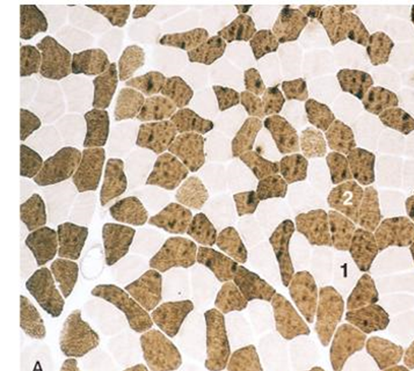

Slide 9
Diseases that affect skeletal muscle can involve any portion of the motor unit:
primary disorders of the motor neuron or axon
abnormalities of the neuromuscular junction
a wide variety of disorders primarily affecting the skeletal muscle itself (myopathies)

Slide 10
MYOPATHY
Myopathy as a term may encompasses a heterogeneous group of disorders, both morphologically and clinically
Recognition of these disorders is important for genetic counseling or appropriate treatment of acquired disease

Slide 11
MUSCLE ATROPHY
A non-specific response
Characterized by abnormally small myofibers
Muscle fiber atrophy is shared by both neuropathic and myopathic processes. However, certain disorders are associated with particular patterns of atrophy.

Slide 12
MUSCLE ATROPHY
Causes:
Simple disuse, type II fibers
Exogenous glucocorticoids or endogenous hypercortisolism (proximal weakness)
Myopathies
Neurogenic atrophy

Slide 13
MUSCLE ATROPHY Neurogenic Atrophy
Neurogenic Atrophy :
Both fiber types
Characterized by fiber type grouping and grouped atrophy
Deprived of their normal enervation, skeletal fibers undergo progressive atrophy
injury and regeneration of peripheral nerves alters muscle innervation, it will change the distribution of type I and type II myofibers.

Slide 14
Clusters of both atrophic myofibers (C) (grouped atrophy) and fiber-type grouping (D), patchy areas in which myofibers share the same fiber type, are features of neurogenic remodeling. The ATPase reaction shown in D is one method of distinguishing between fiber types, as type I fibers stain more lightly than type II fibers. Note loss of the “checkerboard” pattern

Slide 15
inflammatory infiltrates usually are absent in skeletal muscle disorders caused by abnormal innervation.
Prolonged disuse of muscles due to any cause (e.g., prolonged bed rest in the sick, casting of a broken bone) can cause focal or generalized muscle atrophy, which tends to affect type II fibers more than type I fibers.
Glucocorticoid exposure, whether exogenous or endogenous (e.g., in Cushing syndrome), also can cause muscle atrophy. Proximal muscles and type II myofibers are affected preferentially by these agents.

Slide 16
MUSCLE ATROPHY Neurogenic Atrophy

Slide 17
MUSCULAR DYSTROPHIES
A heterogeneous group of inherited disorders
Often presenting in childhood
Characterized by progressive degeneration of muscle fibers leading to muscle weakness and wasting
Histologically, in advanced cases muscle fibers are replaced by fibrofatty tissue

Slide 18
Duchenne Muscular dystrophy (DMD)and Becker Muscular Dystrophy(BMD
X-Linked Muscular Dystrophy
The two most common forms of muscular dystrophy
DMD is the most severe and the most common form of muscular dystrophy, with an incidence of about 1 per 3500 male births
DMD becomes clinically evident by age of 5, →progressive weakness leading to wheelchair dependence by age 10 to 12 years →death by the early 20s
Although the same gene is involved in both BMD and DMD, BMD is less common and much less severe

Slide 19
Pathogenesis
Both DMD and BMD are caused by mutations in the dystrophin gene located on the short arm of the X chromosome (Xp21).
Dystrophin is a very large protein found in skeletal and cardiac muscle, brain, and peripheral nerves

Slide 20
It is part of the dystrophin-glycoprotein complex . This complex stabilizes the muscle cell during contraction and may be involved in cell signaling through interaction with other proteins.
Dystrophin-glycoprotein complex defects are thought to make muscle cells vulnerable to transient membrane tears during contraction that lead to calcium influx.
The result is myofiber degeneration that with time outpaces the capacity for repair.
The dystrophin-glycoprotein complex also is important for cardiac muscle function; this explains why cardiomyopathy eventually develops in many patients

Slide 21
Pathogenesis
In the affected families females are carriers; they are clinically asymptomatic but often have elevated serum creatine kinase and show minimal histologic abnormalities on muscle biopsy.
Female carriers and affected males who survive into adulthood are also at risk for developing dilated cardiomyopathy

Slide 22
Muscle biopsy specimens from individuals with DMD show little or no dystrophin by both staining and western blot analysis
People with BMD, who also have mutations in the dystrophin gene, have diminished amounts of dystrophin, usually of an abnormal molecular weight, reflecting mutations that allow synthesis of an abnormal protein of smaller size

Slide 23
Morphology
Clinical Course.
The histologic alterations in skeletal muscles affected by DMD and BMD are similar except that the changes are milder in BMD 1- The hallmarks are ongoing myofiber necrosis and regeneration. 2- Progressive replacement of muscle tissue by fibrosis and fat is the result of degeneration outpacing repair. 3- marked variation in myofiber size and 4- abnormal internally placed nuclei. Both DMD and BMD also affect cardiac muscles, which show variable degrees of interstitial fibrosis

Slide 24
Duchenne muscular dystrophy. Histologic images of muscle biopsy specimens from two brothers. A and B, Specimens from a 3-year-old boy. C, Specimen from his brother, 9 years of age. As seen in A, at a younger age fascicular muscle architecture is maintained, but myofibers show variation in size. Additionally, there is a cluster of basophilic regenerating myofibers (left side) and slight endomysial fibrosis, seen as focal pink-staining connective tissue between myofibers. In B, immunohistochemical staining shows a complete absence of membrane-associated dystrophin, seen as a brown stain in normal muscle (inset). In C, the biopsy from the older brother illustrates disease progression, which is marked by extensive variation in myofiber size, fatty replacement, and endomysial fibrosis.

Slide 26
Clinical Features
Boys with DMD:
Normal at birth, and early motor milestones are met on time
first symptoms of DMD are clumsiness and an inability to keep up with peers due to muscle weakness
Weakness begins in the pelvic girdle muscles and then extends to the shoulder girdle
Enlargement of the calf muscles associated with weakness, a phenomenon termed pseudohypertrophy, is an important clinical finding
The increased muscle bulk is caused initially by an increase in the size of the muscle fibers and then, as the muscle atrophies, by an increase in fat and connective tissue
Pathologic changes are also found in the heart, and patients may develop heart failure or arrhythmias

Slide 27
Clinical Features
Cognitive impairment seems to be a component of the disease and is severe enough in some patients to be considered mental retardation
Serum creatine kinase is elevated during the first decade of life but returns to normal in the later stages of the disease, as muscle mass decreases
Death results from respiratory insufficiency, pulmonary infection, and cardiac decompensation

Slide 30
BMD
BMD becomes symptomatic later in childhood or adolescence and progresses at a slower and more variable rate.
Many patients live well into adulthood and have a nearly normal life span.
Cardiac involvement can be the dominant clinical feature and may result in death in the absence of significant skeletal muscle weakness.

Slide 31
Myotonic Dystrophy
Myotonia, the sustained involuntary contraction of a group of muscles, is the cardinal symptom in this disease.
Patients often complain of “stiffness” and have difficulty in releasing their grip, for instance, after a handshake.
Myotonia can often be elicited by percussion of the thenar eminence.

Slide 33
Pathogeneis
Mutations in the gene that encodes the dystrophia myotonica protein kinase (DMPK).
In normal subjects, this gene contains fewer than 30 repeats of the sequence CTG, whereas in severely affected persons, several thousand repeats may be present.
Myotonic dystrophy thus falls into the group of disorders associated with trinucleotide repeat expansions
Myotonic dystrophy exhibits the phenomenon of anticipation, characterized by worsening of the disease manifestations with each passing generation due to further trinucleotide repeat expansion.

Slide 34
Morphology
Skeletal muscle may show variation in fiber size.
Increase in the number of internal nuclei.
Another well-recognized abnormality is the ring fiber

Slide 35
Clinical Course.
The disease often presents in late childhood with abnormalities in gait
weakness of the hand intrinsic muscles and wrist extensors.
Atrophy of muscles of the face and ptosis .
Cataracts
Other associated abnormalities include frontal balding, gonadal atrophy, cardiomyopathy, smooth muscle involvement, decreased plasma IgG, and abnormal glucose tolerance.
Dementia has been reported in some cases

Slide 36
Inflammatory myopathies
1- Infectious
2 - Noninfectious inflammatory

Slide 37
Noninfectious Inflammatory Myopathies
Inflammatory myopathies make up a heterogeneous group of rare disorders characterized by immune-mediated muscle injury and inflammation

Slide 38
Based on the clinical, morphologic, and immunologic features, three disorders:
Polymyositis
Dermatomyositis
Inclusion body myositis

Slide 39
Dermatomyositis
inflammatory disorder of the skin as well as skeletal muscle.
skin rash that may accompany or precede the onset of muscle disease. The classic rash takes the form of ** a discoloration of the upper eyelids associated with periorbital edema ** scaling erythematous eruption over the knuckles(Gottron’s lesions).
Muscle weakness is slow in onset, bilaterally symmetric
It typically affects the proximal muscles first. As a result, tasks such as getting up from a chair become increasingly difficult.
Dysphagia
Extramuscular manifestations, including interstitial lung disease, vasculitis, and myocarditis, may be present in some cases
According to several studies, 20% to 25% of adults with
dermatomyositis have cancer (paraneoplastic)

Slide 40
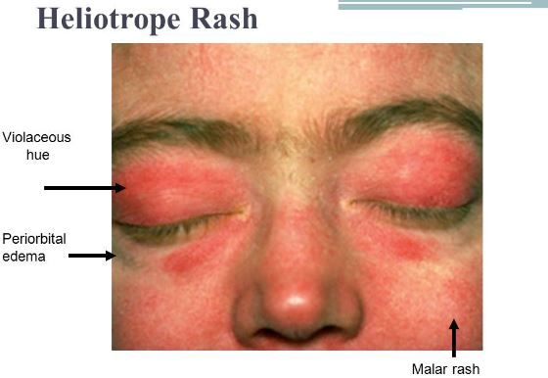

Slide 41
Morphology
Mononuclear inflammatory infiltrate located predominantly around small blood vessels.
Groups of atrophic fibers are particularly prominent at the periphery of fascicles. This “perifascicular atrophy” is sufficient for diagnosis, even if the inflammation is mild or absent.
marked reduction in the intramuscular capillaries

Slide 44
Polymyositis.
This inflammatory myopathy is characterized by symmetric proximal muscle involvement, similar to that seen in dermatomyositis.
It differs from dermatomyositis by the lack of cutaneous involvement and its occurrence mainly in adults.
Similar to dermatomyositis, there may be inflammatory involvement of heart, lungs, and blood vessels.

Slide 45
Morphology
lymphocytes surround and invade healthy muscle fibers.
Both necrotic and regenerating muscle fibers are scattered throughout the fascicle, without the perifascicular atrophy seen in dermatomyositis.
There is no evidence of vascular injury in polymyositis.

