Slide 1
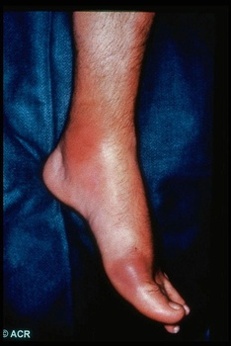
Drugs in gout

Slide 2
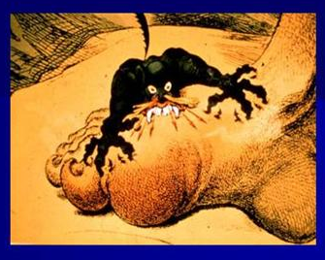
ilos
Know the pathophysiology of gout
Outline the stages of gout and the therapeutic objectives in each stage
Describe drug and non-drug treatment of gout
Classify drugs used for treatment of gout
Identify the mechanism of action of drugs used for treatment of gout
Study in detail the pharmacology of drugs
used for treatment of gout

Slide 3
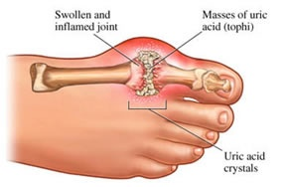
What is Gout?
Gout is usually characterized by recurrent attacks of acute inflammatory arthritis with red, tender, hot and swollen joints
Deposits of sodium urate crystals in articular, periarticular, and subcutaneous tissues
May be primary or secondary
Primary – hereditary error of purine metabolism
Secondary – drugs that inhibit uric acid excretion or increase rate of cell death or another acquired disorder

Slide 4
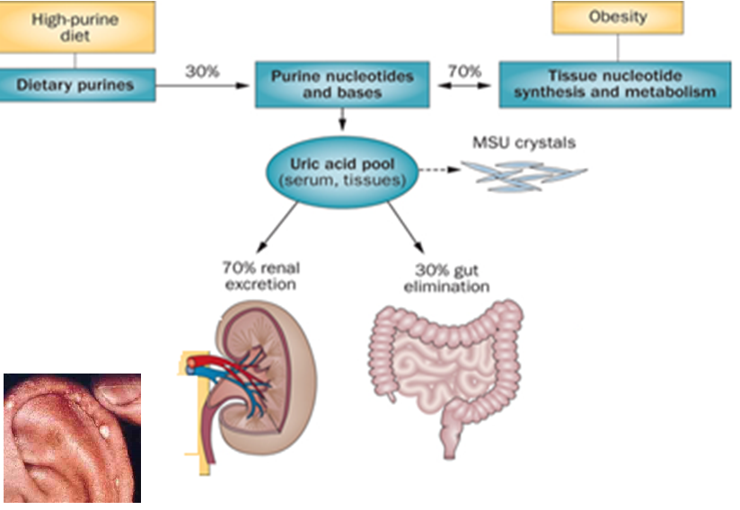
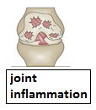
Untreated Gout May Lead to… Tophaceous masses of MSU crystals in cartilage & joints, Renal stones, Urate nephropathy
Joint inflammation
Tofi
Nephrolithiasis

Slide 5
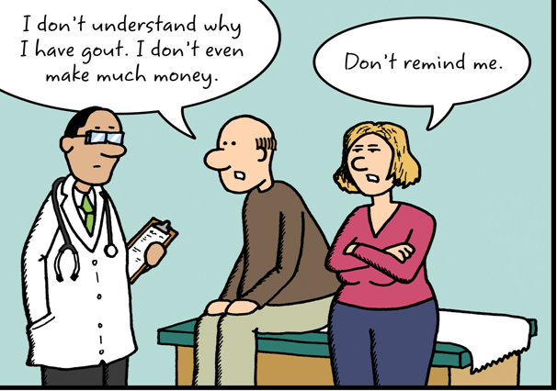
epidemiology
Gout was historically known as "the disease of kings" or "rich man's disease."
Prevalence of hyperuricemia 5%
Prevalence of gout 0.2%
Male to female ratio 10:1

Slide 6
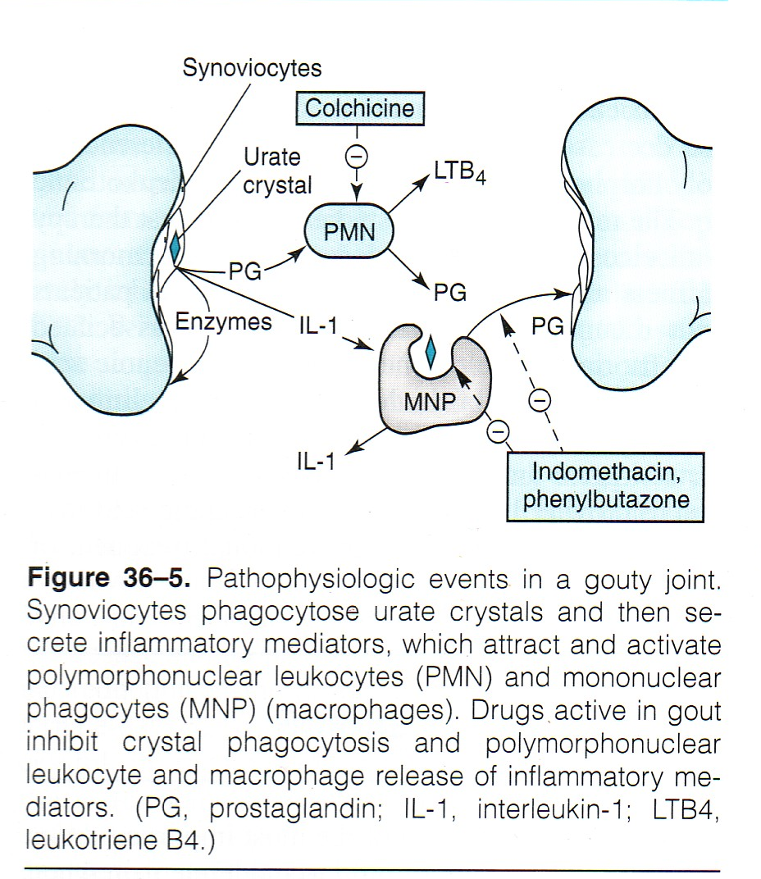

Slide 7
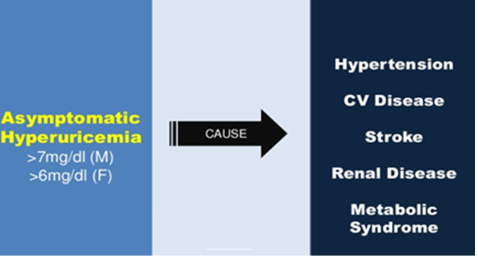
Stages of gout
Four distinct stages: a)asymptomatic hyperuricemia; b)acute intermittent gout; c) Intercritical stage ; d) chronic gout
Treat or not
to treat?
Terminate
The attack
Prevent recurrent attacks
-Prevent complications
-Lower serum uric acid
Notes:
In most cases diagnosis of gout is based on clinical presentation, which is quite characteristic: severe pain developing within hours, tenderness, warmth, swelling and erythema, e. g. in the first metatarsophalangeal or metacarpophalangeal joint. Frequently, gout flares up following rich meals and alcohol consumption, in the middle of the night.

Slide 8
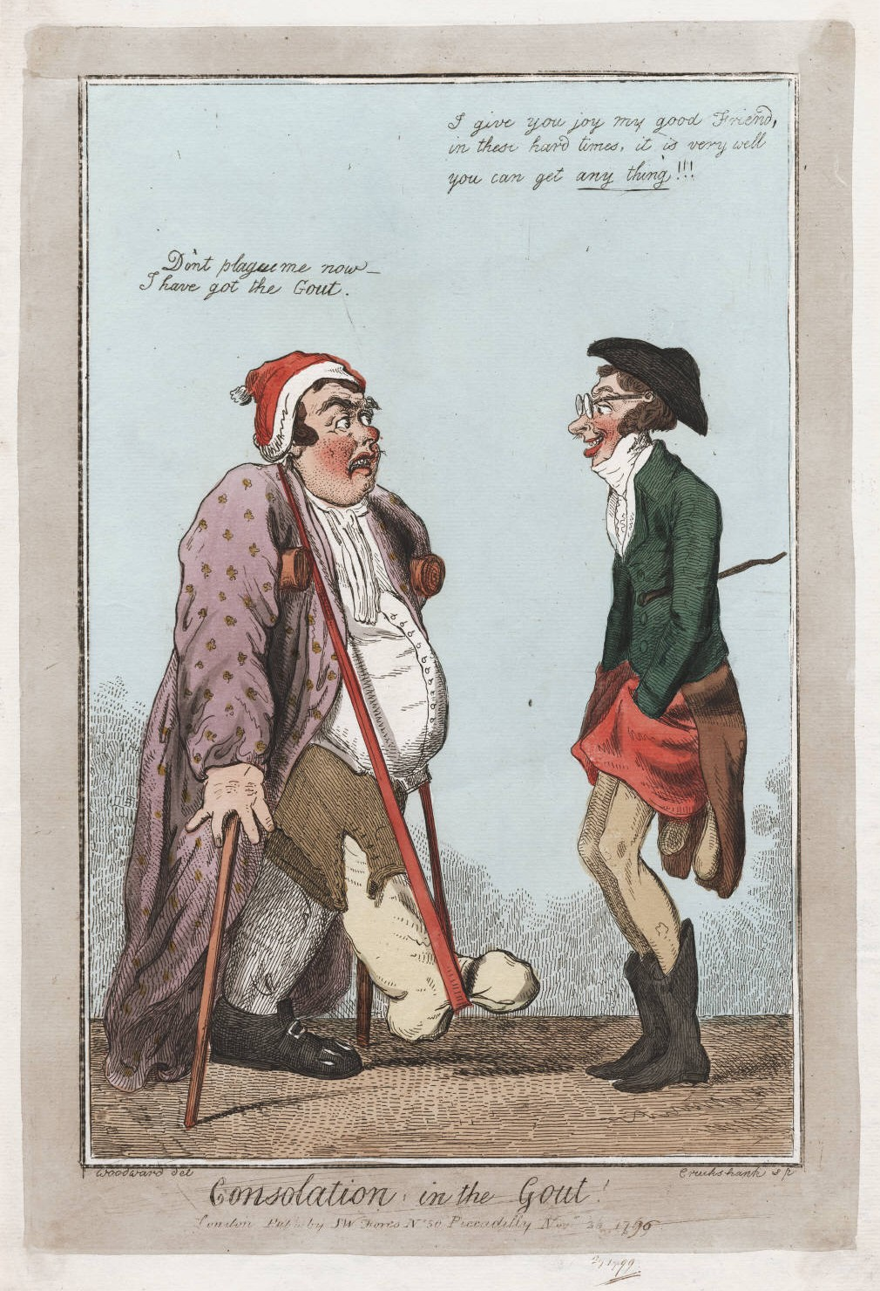
Drugs in gout
Treatment
of gout
Non-pharmacologic
Pharmacologic

Slide 9
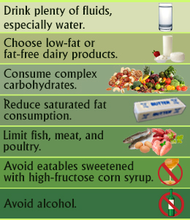
Non-pharmacologic Therapy
Lifestyle modifications
Loss of weight
Exercise
Diet control
Smoking cessation
Notes:
Dietary measures
Weight reduction
Avoidance of alcohol
Avoidance of foods high in purines
High: Sardines, anchovies, herring, mussels, liver, kidney, goose, venison, meat soups, sweetbreads, beer & wine
Moderate: Chicken, salmon, crab, veal, mutton, bacon, pork, beef, ham

Slide 10
Aim of pharmacotherapy
Most therapeutic strategies for gout involve lowering the uric acid level below the saturation point (<6 mg/dL), thus preventing the deposition of urate crystals.
This can be accomplished by:
interfering with uric acid synthesis with allopurinol, Febuxostat
increasing uric acid excretion with probenecid or sulfinpyrazone
inhibiting leukocyte entry into the affected joint with colchicine
administration of NSAIDs

Slide 11
Drugs in gout
Uricostatic
Allopurinol ,
Febuxostat
Uricosuric
Probenecid ,
Sulfinpyrazone
Anti- inflammatory
NSAIDs, Steroids
Tubulin inhibitors
Colchicine

Slide 12
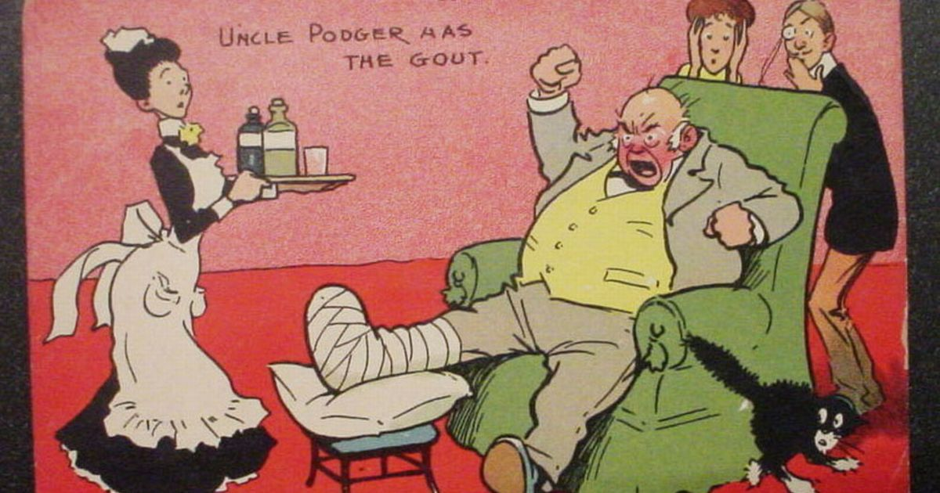
Treatment of acute gout
Acute gouty arthritis
Colchicine
NSAIDs
Corticosteroids

Slide 13
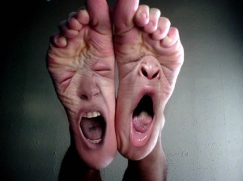
NSAIDS
NSAIDs are the most commonly used first-line treatment
Head-to-head studies show few differences between drugs
Full doses of NSAID should be initiated immediately
and tapered after resolution of symptoms
Avoid NSAIDs:
GI ulcer
Bleeding or perforation
Renal insufficiency
Heart failure
Use of oral anticoagulants

Slide 14
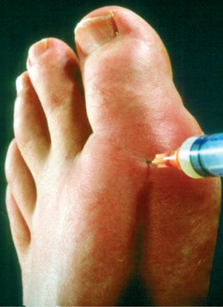
steroids
Corticosteroids are a good alternative where NSAIDs
and colchicine cannot be used or in refractory cases
Studies showed equal efficacy between corticosteroid
and NSAIDs, with no reported side-effects with
short-term use of corticosteroids
In elderly people, patients with liver or hepatic impairment, IHD, PUD, hypersensitivity to NSAIDs
-Intra articularly (preferred route if one or two joints affected)
-Orally
-Intramuscularly or intravenously.
Notes:
PUD : Peptic ulcer disease IHD : ischemic heart disease

Slide 15
Colchicine
Alkaloid obtained from autumn crocus
Minimal effect on uric acid synthesis , excretion & is not analgesic

Slide 16
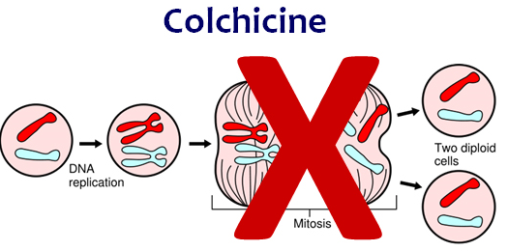
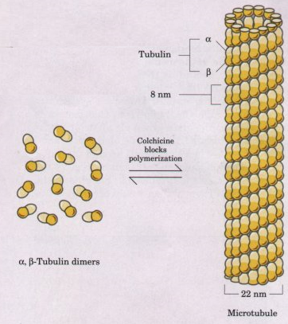
mechanism
Binds to microtubules in neutrophils
Inhibits cell division
Inhibits chemotactic factors
Inhibits inflamosomes & IL-1 production

Slide 17
Colchicine
pharmacokinetics
Administered orally, rapidly absorbed from the GI tract
Reaches peak plasma levels within 2 hours
Recycled in the bile and is excreted unchanged in the faeces or urine
Use should be avoided in patients with a creatinine clearance of less than 50 mL/min.

Slide 18
Colchicine
Clinical uses
Treatment of gout flares
Prophylaxis of gout flares
- Treatment of Mediterranean
fever
Notes:
Familial Mediterranean fever (FMF) is also called recurrent polyserositis. With brief recurrent episodes of peritonitis, pleuritis, and arthritis, usually with accompanying fever.

Slide 19
adrs
Diarrhea (sometimes severe)
Nausea
Vomiting
Abdominal cramps
Dehydration
Bone marrow depression
Cardiac toxicity, arrhythmia
Vascular collapse
Hepatotoxicity , alopecia

Slide 20
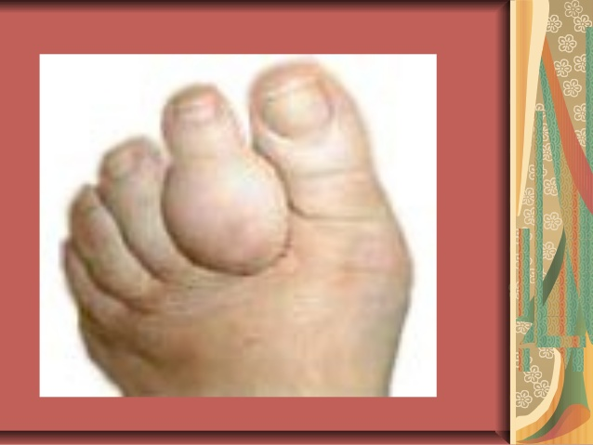
Prevention of recurrent attack
Inhibition of uric acid synthesis
-Allopurinol
-Febuxostat
Uricosuric drugs
-Probenacid
Sulfinpyrazone
Mammalian
Uricase

Slide 21
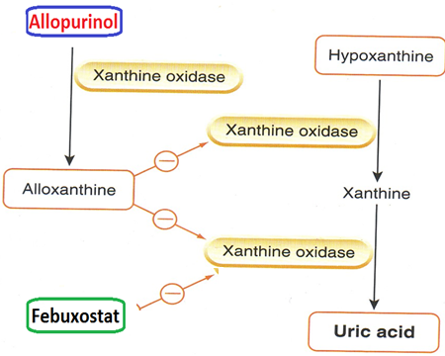
Inhibitors of uric acid synthesis
Inhibit xanthine oxidase
Include allopurinol & febuxostat
Allopurinol is metabolized by xanthine oxidase into alloxanthine which is pharmacologically active

Slide 22
pharmacokinetics
Absorption 70%
Protein binding negligble 5%
Hepatic metabolism, 70% converted to active metabolite(oxypurinol)
Oxypurinol is elminated unchanged in urine
Allopurinol Hypersensitivity Syndrome
Xanthine
Oxidase
Allopurinol
Oxypurinol
Toxic Epidermal Necrolysis
Dress Syndrome

Slide 23
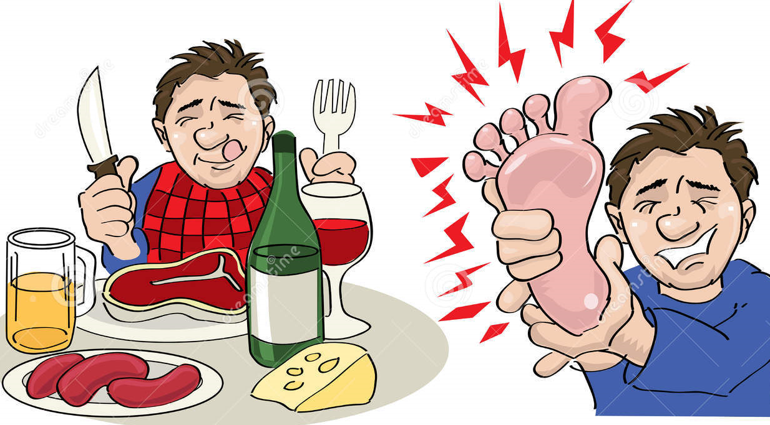
adrs
Diarrhea, nausea, abnormal liver tests
Acute attacks of gout
Fever, rash, toxic epidermal necrolysis
hepatotoxicity, marrow suppression
vasculitis
DRESS syndrome
Drug Reaction, Eosinophilia,
Systemic Symptoms
20% mortality rate

Slide 24
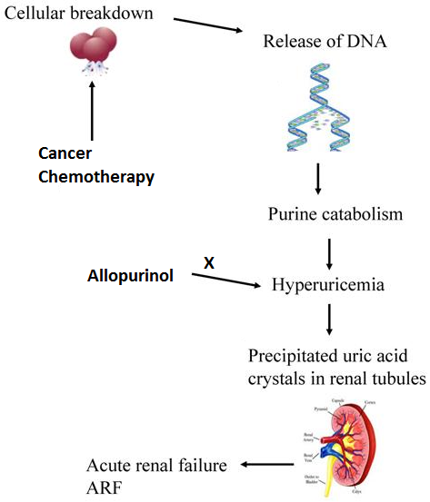
Allopurinol
Clinical uses
Management of hyperuricemia of gout
Uric acid stones or nephropathy
It is a drug of choice in patients with
both gout & ischemic heart disease
Severe tophaceous deposits (uric acid deposits in tissues)
Management of hyperuricemia associated with chemotherapy
Prevention of recurrent calcium oxalate kidney stones

Slide 25
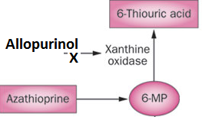
Drug Interactions
Warfarin & dicumarol
inhibits their metabolism
Reduce the metabolism of
6-mercaptopurine
and azathioprine
With ampicillin : increases frequency
of skin rash

Slide 26
Febuxostat
Oral specific xanthine oxidase inhibitor
Indicated for the management of hyperuricemia in patients with gout (as it reduces serum uric acid levels)
Chemically distinct from allopurinol (non purine)
Can be used in patients with renal disease

Slide 27
Febuxostat
pharmacokinetics
Given orally once daily, well absorbed (85%)
Metabolized in liver , mainly conjugated to glucouronic acid
Given to patients who do not tolerate allopurinol
99% protein bound
t½ 8 hours

Slide 28
Febuxostat
adrs
Increases number of gout attacks during
the first few months of treatment
Increases level of liver enzymes
Nausea, diarrhea
Headache
Numbness of arm or leg

Slide 29
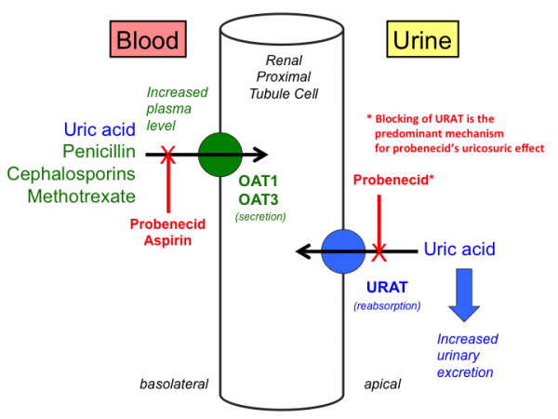
Uricosuric drugs
Mechanism
Blocks tubular reabsorption of uric acid &
enhances urine uric acid excretion
Probenecid inhibits Urate Transporters (URAT) in the apical membrane of the proximal tubule
It also inhibits organic acid transporter(OAT)→↑plasma concentration of penicilin
Sulfinpyrazol inhibits URAT1 & OAT4
Notes:
l

Slide 30
Uricosuric drugs
Control hyperuricemia and Prevent tophus formation
Probenecid moderately effective
Increases risk of nephrolithiasis
Not used in patients with renal disease
Some drugs reduce efficacy (e.g., aspirin)

Slide 31
adrs
Probenecid
Exacerbation of acute attack
Risk of uric acid stone
GIT upset
Allergic rash

Slide 32
Contra-indications
History of nephrolithiasis
Recent acute gout
Existing renal disease
Less effective in elderly patients

Slide 33
Drugs in Gout
Sulfinpyrazone
Sulfinpyrazone can aggravate peptic ulcer disease
Aspirin reduces efficacy of sulfinpyrazone
Sulfinpyrazone enhance the action of certain anti-diabetic drugs

Slide 34
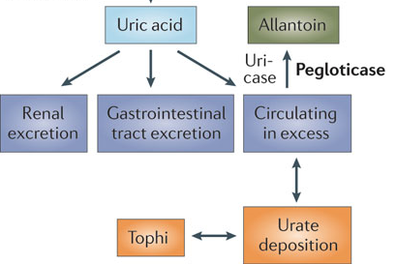
Recombinant mammalian uricase
Pegloticase
A uric acid specific enzyme which is a recombinant
modified mammalian uricase enzyme
enzymatically convert urate to allantoin, which is more soluble and readily excreted in the urine
Given I.V.➔ peak decline in uric acid level within 24-72 hours

Slide 35
Pegloticase
Used for the treatment of chronic gout in adult patients refractory to conventional therapy
ADRS
Infusion reactions
Anaphylaxis
Gout flare
Arthralgia, muscle spasm
Nephrolithiasis
Notes:
.

