Slide 1
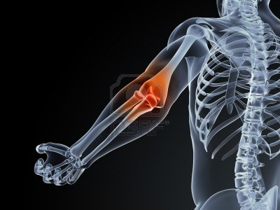
ARM &
ELBOW JOINT
Khaleel Alyahya, PhD, MEd
King Saud University
College of Medicine
@khaleelya

Slide 2
OBJECTIVES
At the end of the lecture, students should:
Describe the attachments, actions and innervations of:
Biceps brachii
Coracobrachialis
Brachialis
Triceps brachii
Demonstrate the following features of the elbow joint:
Articulating bones
Capsule
Lateral & medial collateral ligaments
Synovial membrane
Demonstrate the movements; flexion and extension of the elbow.
List the main muscles producing the above movements.
Define the boundaries of the cubital fossa and enumerate its contents.

Slide 3
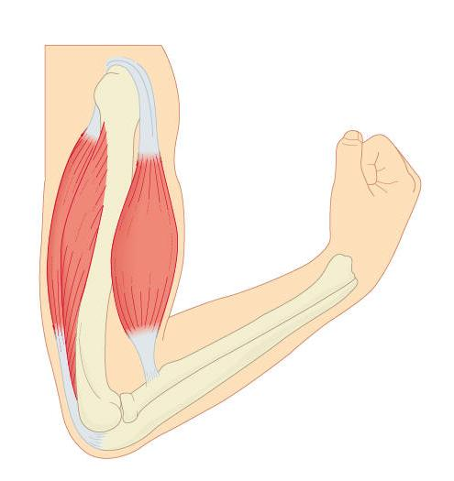
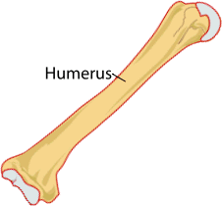
THE ARM

Slide 4
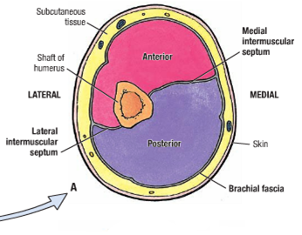
INTRODUCTION
An aponeurotic sheet separating various muscles of the upper limbs, including lateral and medial humeral septa.
The lateral and medial intermuscular septa divide the distal part of the arm into two compartments:
Anterior compartments
also known as the flexor compartment
Posterior compartments
also known as the extensor compartment

Slide 5
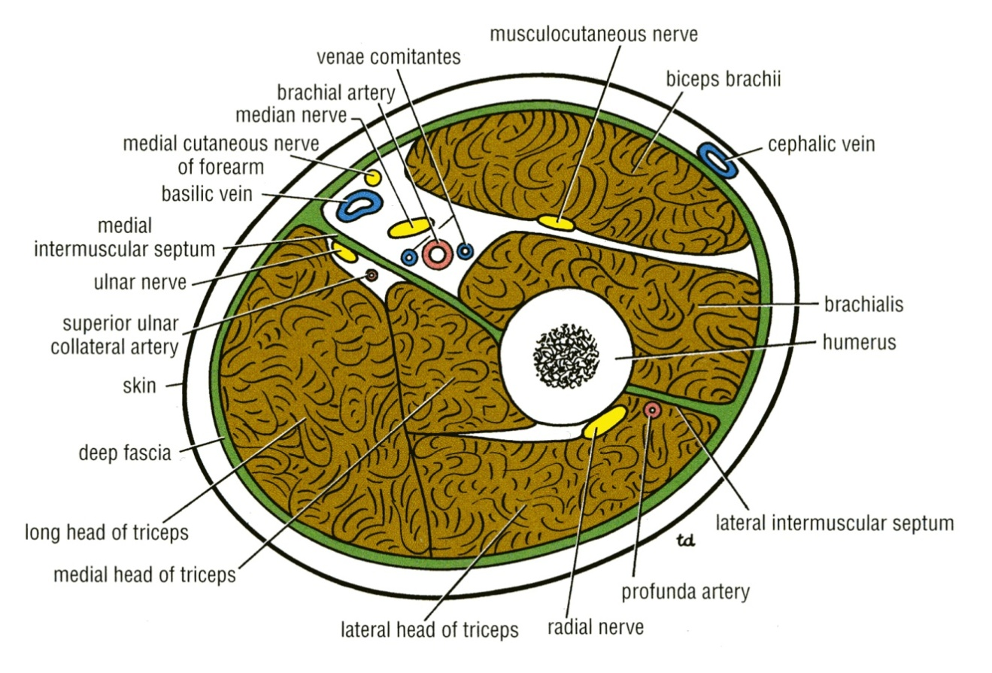
ANTERIOR FASCIAL COMPARTMENT
Muscles: Biceps brachii, Coracobrachialis & Brachialis.
Blood Vessels: Brachial artery & Basilic vein.
Nerves: Musculocutaneous and Median.

Slide 6
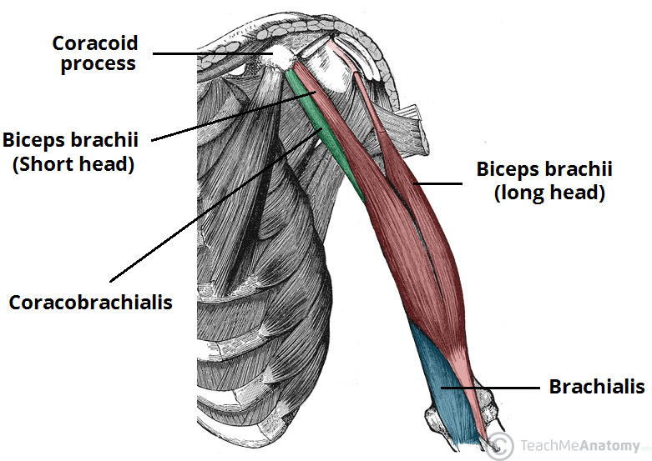
MUSCLES OF ANTERIOR COMPARTMENT

Slide 7
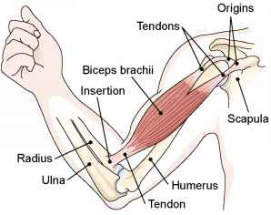
BICEPS BRACHII
Origin:
Long Head from supraglenoid tubercle of scapula (intracapsular)
Short Head from the tip of coracoid process of scapula
The two heads join in the middle of the arm
Insertion:
In the posterior part of the radial tuberosity.
Into the deep fascia of the medial aspect of the forearm through bicipital aponeurosis.
Nerve supply:
Musculocutaneous
Action:
Powerful flexor of elbow
Strong supinator of the forearm
used in screwing.
Weak flexor of shoulder

Slide 8
CORACOBRACHIALIS
Origin:
Tip of the coracoid process
Insertion:
Middle of the medial side of the shaft of the humerus
Nerve supply:
Musculocutaneous
Action:
Flexor
Weak adductor of the arm

Slide 9
BRACHIALIS
Origin:
Front of the lower half of humerus
Insertion:
Anterior surface of coronoid process of ulna
Nerve supply:
Musculocutaneous & Radial
Action:
Strong flexor of the forearm

Slide 10
POSTERIOR FASCIAL COMPARTMENT
Muscles: Triceps
Vessels: Profunda brachii & Ulnar collateral arteries
Nerves: Radial & Ulnar

Slide 11
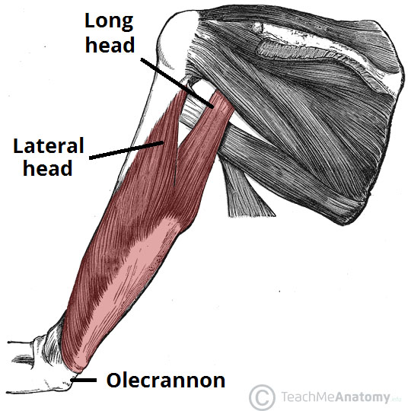
MUSCLES OF POSTERIOR COMPARTMENT

Slide 12
TRICEPS
Origin:
Long Head from infrglenoid tubercle of the scapula
Lateral Head from the upper half of the posterior surface of the shaft of humerus above the spiral groove
Medial Head from the lower half of the posterior surface of the shaft of humerus below the spiral groove
Insertion:
Common tendon inserted into the upper surface of the olecranon process of ulna
Nerve supply:
Radial nerve
Action:
Strong extensor of the elbow joint

Slide 13
CUBITAL FOSSA
It is an area of transition between the anatomical arm and the forearm.
It is located as a triangular depression on the anterior surface of the elbow joint.

Slide 14
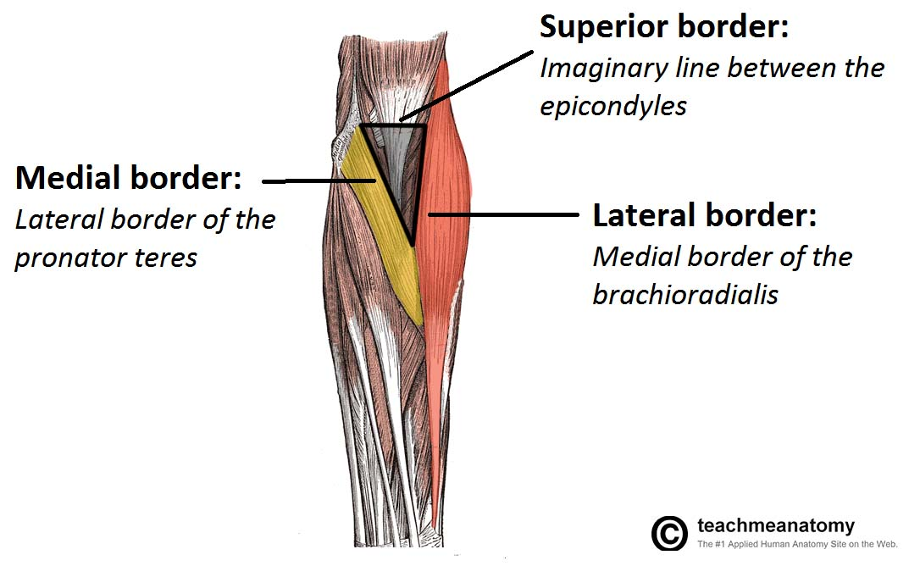
BOUNDARIES OF CUBITAL FOSSA
Base
Line drawn through the two epicondyles of humerus
Laterally
Brachioradialis
Medially
Pronator teres
Roof
Skin, superficial & deep fascia and bicipital aponeurosis
Floor
Brachialis medially and supinator laterally.

Slide 15
CONTENT OF CUBITAL FOSSA
(From medial to lateral side)
3. Biceps brachii tendon
1. Median nerve
4. Deep branch of radial nerve
2. Brachial artery
divides into radial & ulnar arteries.
Ulnar artery
Radial artery

Slide 16
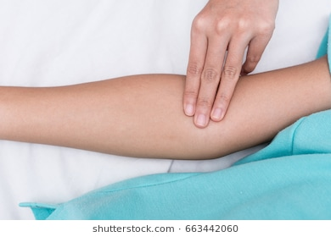
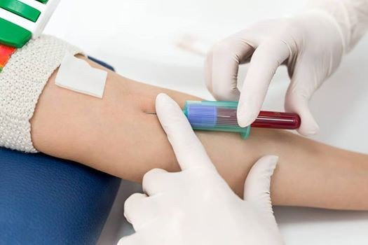
CLINICAL RELEVANCE
The brachial pulse can be felt by palpating immediately medial to the biceps tendon in the cubital fossa.
The median cubital vein is located superficially within the roof of the cubital fossa.
It connects the basilic and cephalic veins, and can be accessed easily – this makes it a common site for venepuncture.

Slide 17
ELBOW JOINT

Slide 18
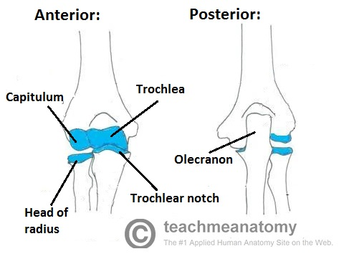
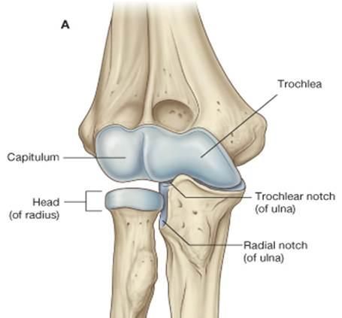
ARTICULATING SURFACES
The elbow is the joint connecting the upper arm to the forearm.
It is classed as a hinge-type synovial joint.
It consists of two separate articulations:
Trochlea and capitulum of the humerus above
Trochlear notch of ulna and the head of radius below
The articular surfaces are covered with articular cartilage (hyaline).

Slide 19
CAPSULE
The elbow joint has a capsule enclosing the joint. This in itself is strong and fibrous, strengthening the joint.
The joint capsule is thickened medially and laterally to form collateral ligaments, which stabilize the flexing and extending motion of the arm.
Anteriorly: attached
Above - To the humerus along the upper margins of the coronoid and radial fossae and to the front of the medial and lateral epicondyles.
Below - To the margin of the coronoid process of the ulna and to the anular ligament, which surrounds the head of the radius.
Posteriorly: attached
Above - To the margins of the olecranon fossa of the humerus.
Below - To the upper margin and sides of the olecranon process of the ulna and to the anular ligament.

Slide 20
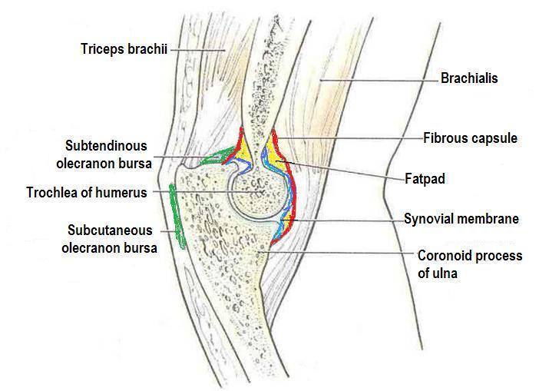
BURSAE
A bursa is a membranous sac filled with synovial fluid.
It acts as a cushion to reduce friction between the moving parts of a joint, limiting degenerative damage.
There are many bursae in the elbow, but only a few have clinical importance:
Subtendinous – between the olecranon and the tendon of the triceps brachii, reducing friction between the two structures during extension and flexion of the arm.
Subcutaneous (olecranon) bursa – between the olecranon and the overlying connective tissue (implicated in olecranon bursitis).

Slide 21
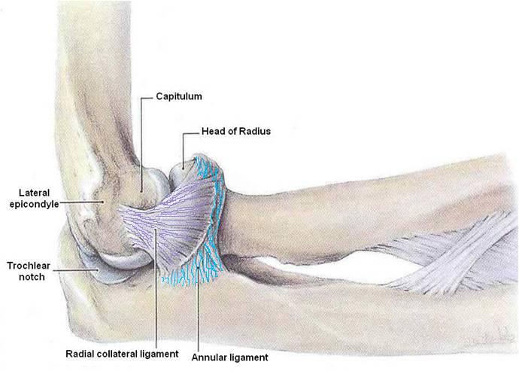
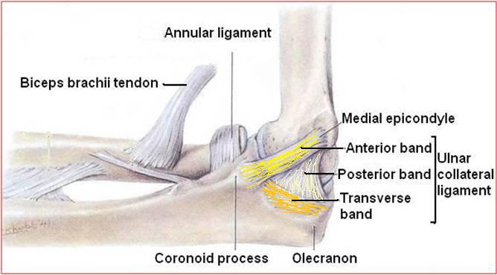
LIGAMENTS
Lateral (Radial Collateral) Ligament
Triangular in shape:
Apex
Attached to the lateral epicondyle of humerus
Base
Attached to the upper margin of annular ligament.
Medial (Ulnar Collateral) Ligament
Anterior strong cord-like band
Between medial epicondyle and the coronoid process of ulna
Posterior weaker fan-like band
Between medial epicondyle and the olecranon process of ulna
Transverse band
Passes between the anterior and posterior bands

Slide 22
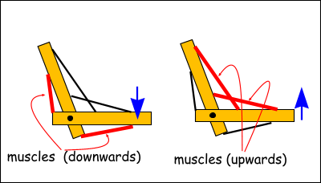
MOVEMENTS
Flexion
Is limited by the anterior surfaces of the forearm and arm coming into contact.
Extension
Is limited by the tension of the anterior ligament and the brachialis muscle.
The joint is supplied by branches from the:
Median
Ulnar
Musculocutaneous
Radial nerves

Slide 23
CARRYING ANGLE
Angle
Between the long axis of the extended forearm and the long axis of the arm
Opens
Laterally
About
170 degrees in male and 167 degrees in females
Disappears
When the elbow joint is flexed
Permits
The forearms to clear the hips in swinging movements during walking, and is important when carrying objects
165⁰-170⁰

Slide 24
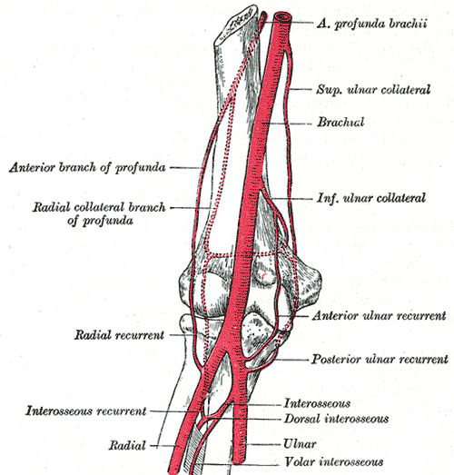
BLOOD SUPPLY
The arterial supply to the elbow joint is from the cubital anastomosis, which includes recurrent and collateral branches from the deep brachial arteries.

Slide 25
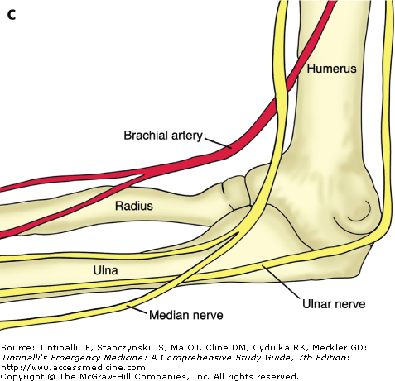
INNERVATION
The innervation is provided by the median, musculocutaneous and radial nerves anteriorly, and the ulnar nerve posteriorly.

Slide 26
CLINICAL RELEVANCE

Slide 27
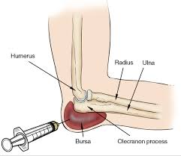
BURSITIES
Subcutaneous bursitis
Repeated friction and pressure on the bursa can cause it to become inflamed.
Because this bursa lies relatively superficially, it can also become infected (e.g cut from a fall on the elbow)
Subtendinous bursitis
This is caused by repeated flexion and extension of the forearm, commonly seen in assembly line workers.
Usually flexion is more painful as more pressure is put on the bursa.

Slide 28
DISLOCATION
An elbow dislocation usually occurs when a young child falls on a hand with the elbow flexed.
The distal end of the humerus is driven through the weakest part of the joint capsule, which is the anterior side.
The ulnar collateral ligament is usually torn and there can also be ulnar nerve involvement
Most elbow dislocations are posterior, and it is important to note that elbow dislocations are named by the position of the ulna and radius, not the humerus.

Slide 29
QUESTIONS!

