Slide 1

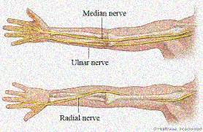
MSK 115
Radial & Ulnar Nerves
DR. ZAHID KAIMKHANI
MD,M.Phil,PhD

Slide 2
Radial & Ulnar Nerves
ANAT 113
Objectives
By the end of this session we should be able to:
Describe the anatomy of the radial & ulnar nerves regarding: - Origin,
  - Course &
  - Distribution.
List the branches of the nerves.
Describe the causes and manifestations of nerve injury.

Slide 3
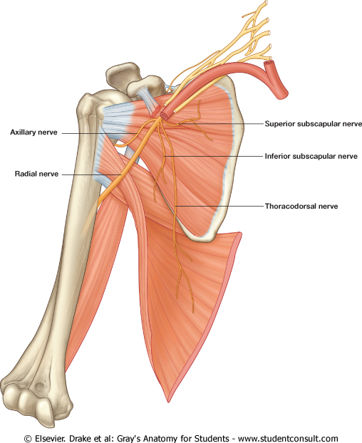
Radial & Ulnar Nerves
MSK 115
Radial Nerve
Origin:
One of the five branches of the Posterior cord of the brachial plexus
Begins in the axilla
The largest branch
Supplies:
Nerve of the extensor compartment i.e.
Muscles of the posterior compartment of the arm & the fore arm
S
T
A
R
S

Slide 4
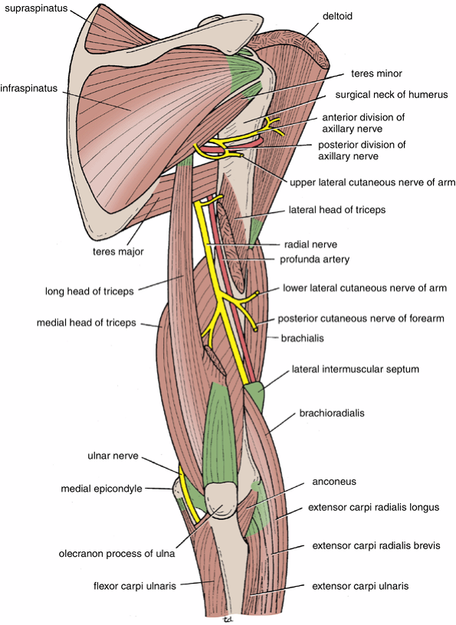
Radial & Ulnar Nerves
MSK 115
Radial Nerve
In the Arm
It winds around the back of the arm in the Spiral Groove on the back of the humerus between the heads of the triceps.
In the spiral groove, the nerve is accompanied by the Profunda Vessels, and it lies directly in contact with the shaft of the humerus (a Dangerous Position).

Slide 5
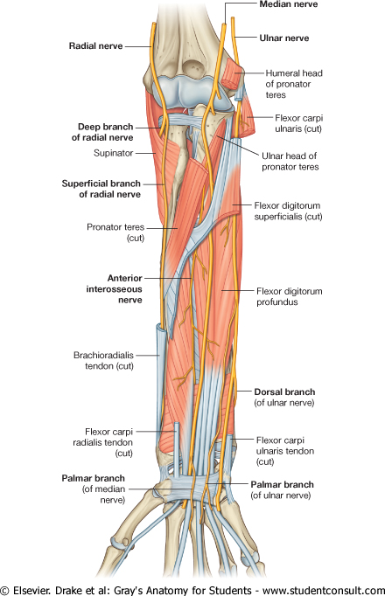
Radial & Ulnar Nerves
MSK 115
Radial Nerve
In the Forearm
It pierces the Lateral Intermuscular septum.
Descends in front of the Lateral Epicondyle.
Passes forward into the Cubital Fossa
Divides into
1.Superficial branch
  Conti. of the radial nerve
  Purely cutaneous
2. Deep branch (Post. interosseous)

Slide 6
Radial & Ulnar Nerves
MSK 115
Radial Nerve
Branches in Axilla
Cutaneous:
Posterior cutaneous nerve of arm.
Muscular:
Long & Medial Heads of Triceps.

Slide 7
Radial & Ulnar Nerves
MSK 115
Radial Nerve
Branches in Spiral Groove
Cutaneous:
Lower lateral cutaneous nerve of arm.
Posterior cutaneous nerve of forearm.
Muscular:
Lateral & Medial heads of triceps.
Anconeus.

Slide 8
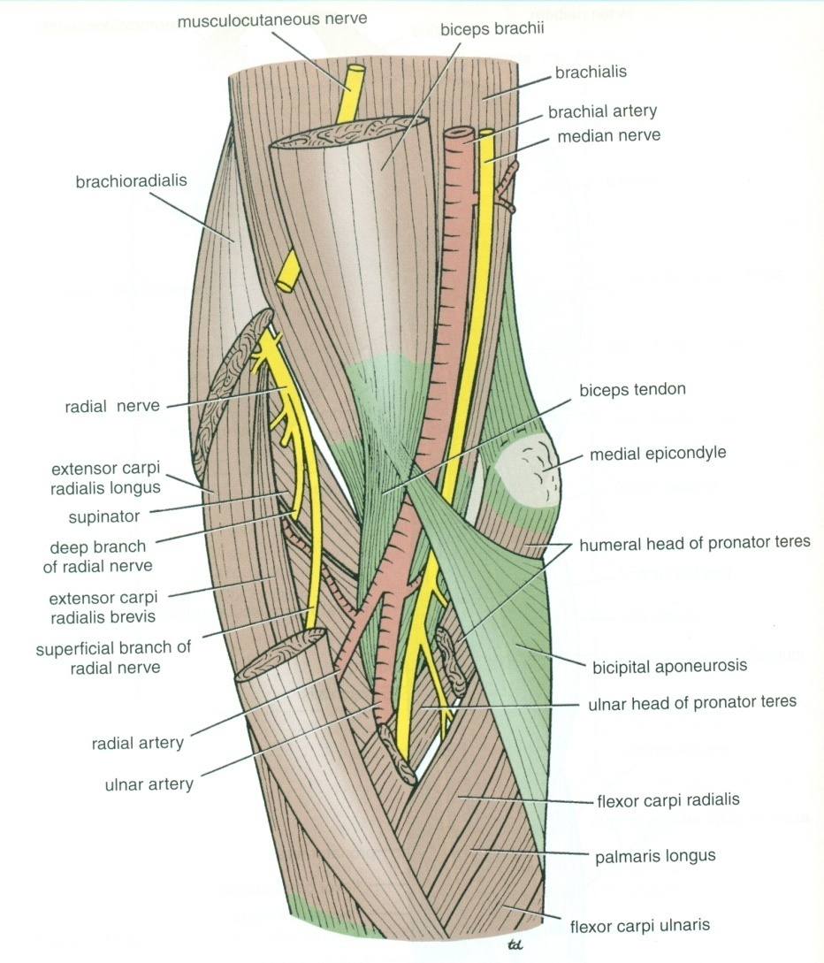
Radial & Ulnar Nerves
MSK 115
Radial Nerve
Branches
Close to Lateral Epicondyle:
In the flexor compartment of Arm
Muscular:
  Brachialis.
  Brachioradialis.
  Extensor carpi radialis longus.
Articular
  to the elbow joint

Slide 9
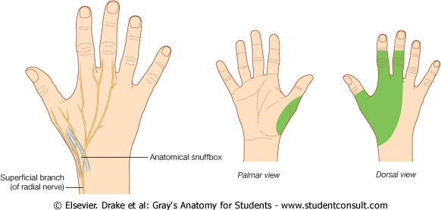
Radial & Ulnar Nerves
MSK 115
Radial Nerve
Terminal Branches
Superficial Branch
  Conti. of the radial nerve
  Purely cutaneous
  Runs down the flexor comp of the forearm
  Winds around the lower end of the radius deep to BR
  Crosses the pollicis muscles to reach the back of the hand.
  Supplies:
    The skin on the lateral (radial) two and half digits or three and a half of proximal phalanges
    The skin of the corresponding half of the hand

Slide 10
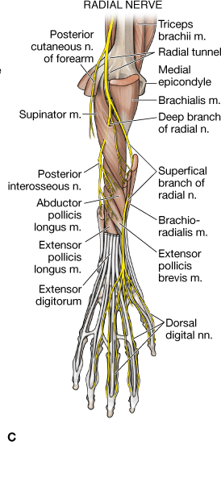
Radial & Ulnar Nerves
MSK 115
Radial Nerve
Terminal Branches
Deep Branch (Post. interosseous)
Course
It winds around the neck of the radius, within the supinator muscle, and enters the posterior compartment of the forearm
Muscular:
  Extensor carpi radialis brevis.
  Supinator.
  Extensor carpi ulnaris.
  Extensor digitorium
  Extensor digitimini
  Abductor pollicis longus.
  Extensor pollicis brevis.
  Extensor pollicis longus.
  Extensor indicis.
2.
6.
Cubital Fossa
8.
7.
4.
Extensor Compartment

Slide 11
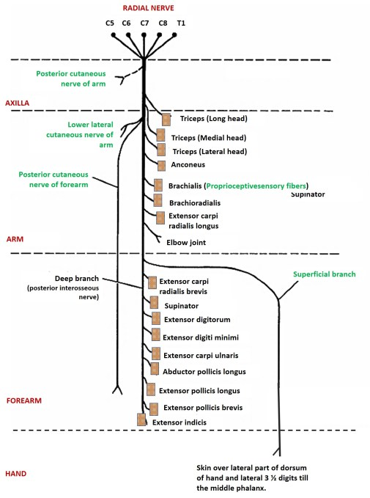
Radial & Ulnar Nerves
MSK 115
Radial Nerve
Summary of main branches

Slide 12
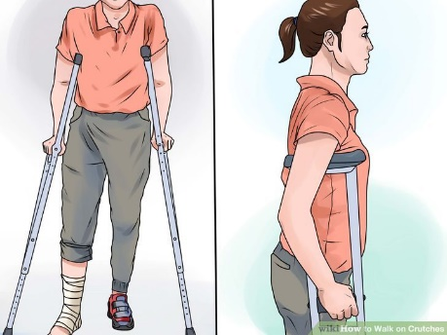
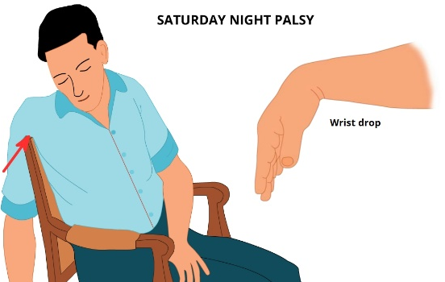
Radial & Ulnar Nerves
MSK 115
Radial Nerve
Applied Anatomy
Transient paralysis
Improper use of crutch (pressing the nerve in the axilla)
Saturday night palsy (draping the arm over the chair in a state of diminished consciousness)
Test. Extension of elbow. Result ?
Injury of the radial nerve
  Most common-fracture of the shaft of the humerus
  The characteristic lesion is “WRIST DROP”
  Inability to extend WRIST and metacarpophalangeal joint
  Elbow joint ????
  Interphalangeal Joints???
  Sensory loss –MINIMAL – WHY??

Slide 13
Radial & Ulnar Nerves
MSK 115
Radial Nerve
Applied Anatomy
Injury of the radial nerve
  Sensory loss –MINIMAL – WHY??
  Overlapping by the median and ulnar nerves
Sensory supply
Sensory loss

Slide 14
Radial & Ulnar Nerves
MSK 115
Radial Nerve
Applied Anatomy
Injury of the Deep Branch (Post. interosseous)
Causes:
  Fractures of the proximal end of the radius.
  During dislocation of the radial head.
  Clinical picture
  “No wrist Drop” {Ref. snell p-539}
  Why?
  The nerve supply to the supinator and the extensor carpi radialis longus will be undamaged, and because the latter muscle is powerful, it will keep the wrist joint extended -------No wrist Drop.
  Sensory loss – Nothing
  Overlapping by the median and ulnar nerves

Slide 15
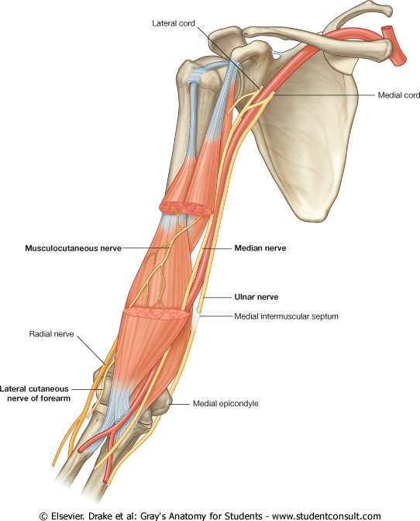
Radial & Ulnar Nerves
MSK 115
Ulnar Nerve
Origin:
Begins in the axilla
Continuation of the medial cord
Supplies:
Some flexors muscles on ulnar side of the forearm
Most of the intrinsic muscles of the hand
Skin of the ulnar one and a half digits
Course: In Arm
Descends along the medial side of the following arteries:
  Axillary.
  Brachial.
Pierces the Medial Intermuscular Septum.
Passes behind the Medial Epicondyle of the humerus. (Funny Bone)

Slide 16
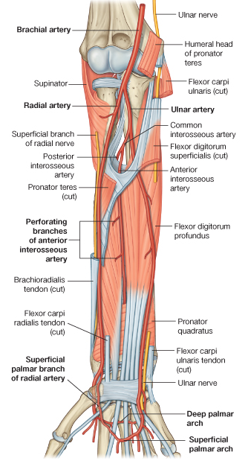
Radial & Ulnar Nerves
MSK 115
Ulnar Nerve
Course: In Forearm
Descend on FD Profundus
Deep to the Flexor Carpi Ulnaris.
It is medial to Ulnar Artery

Slide 17
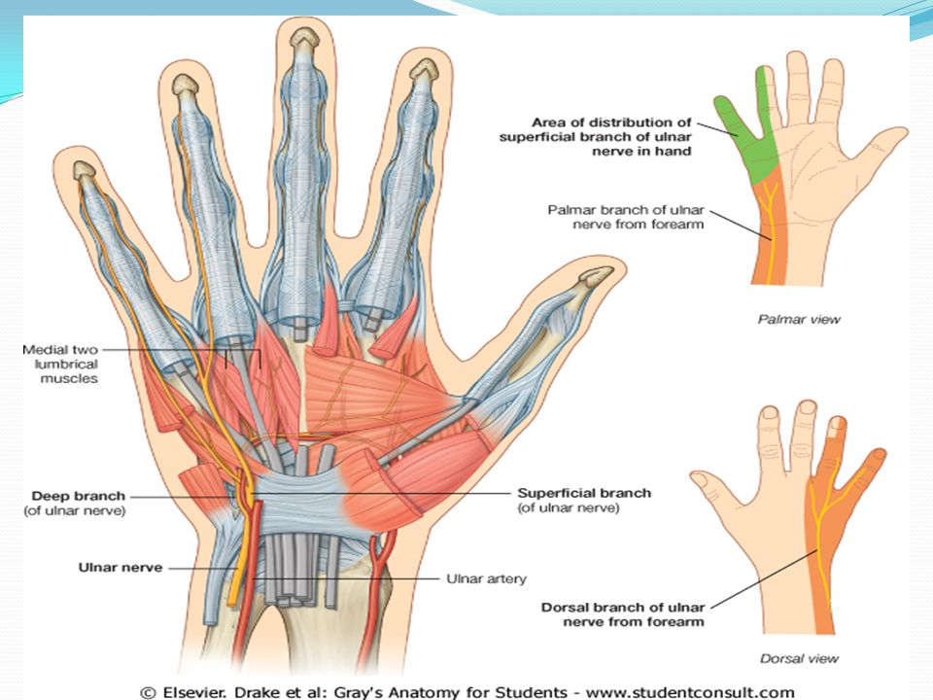
Radial & Ulnar Nerves
MSK 115
Ulnar Nerve
Course: At wrist
Passes:
  Anterior to Flexor Retinaculum.
  Lateral to Pisiform bone.
  Medial to Ulnar artery.
Divides into :
Superficial & Deep branches

Slide 18
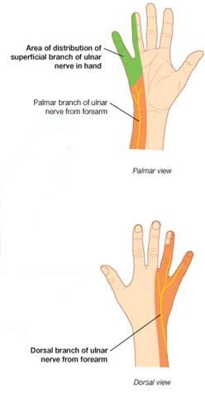
Radial & Ulnar Nerves
MSK 115
Ulnar Nerve
Branches: in the Forearm
Muscular to (1 & 1/2 muscles)
1. Flexor Carpi Ulnaris
2. Medial 1l2 of Flexor Digitorum Profundus
Articular to Elbow joint
Cutaneous:
  Dorsal (posterior) cutaneous:
  Supplies the skin over the back of Medial side of the hand & Medial 1+1/2 fingers
  Palmar cutaneous:
  Supplies the skin over the Medial part of the palm( skin over
  hypothenar eminence .

Slide 19
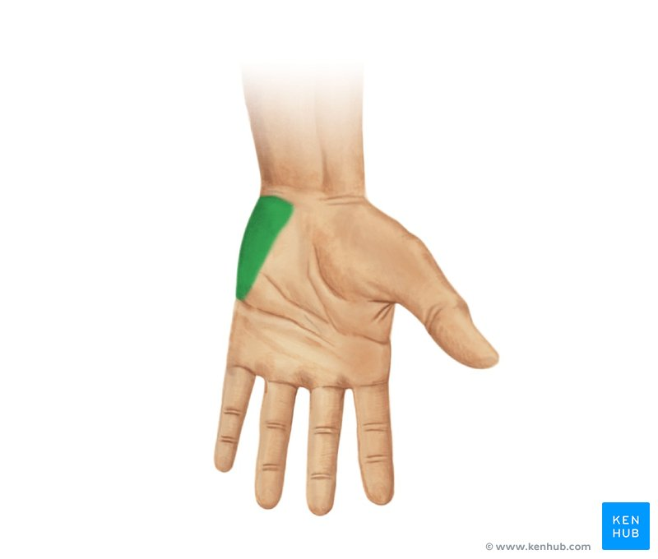
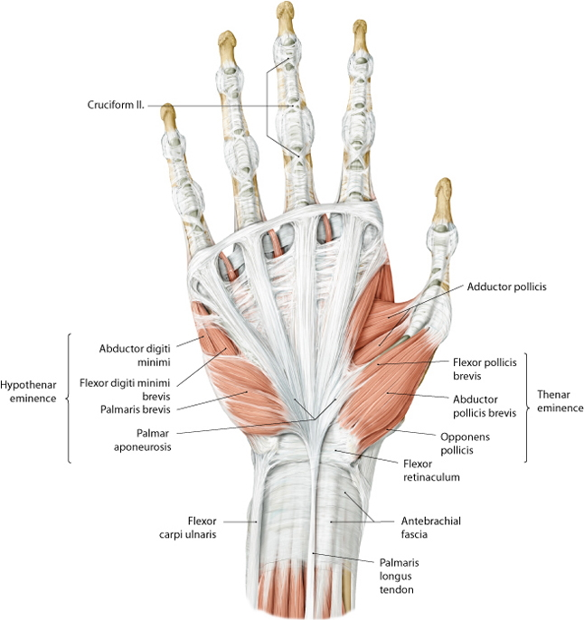
Radial & Ulnar Nerves
MSK 115
Ulnar Nerve
Terminal Branches: Superficial
Muscular to Palmaris Brevis.
Cutaneous:
  Supplies the skin over the Palmar aspect of the medial 1+ ½ fingers (including nail beds).

Slide 20
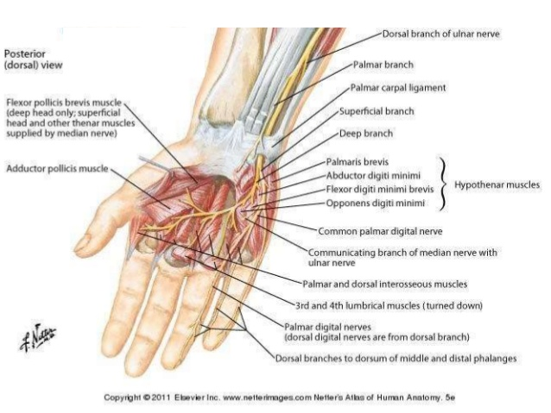
Radial & Ulnar Nerves
MSK 115
Ulnar Nerve
Terminal Branches: Deep Branch
Muscular to:
Hypothenar Eminence.
All Interossei (Palmar & Dorsal).
3rd & 4th ( Radial) Lumbricals.
Adductor pollicis
(ends by supplying it)
Articular to Carpal joints
4.
1
2
3

Slide 21
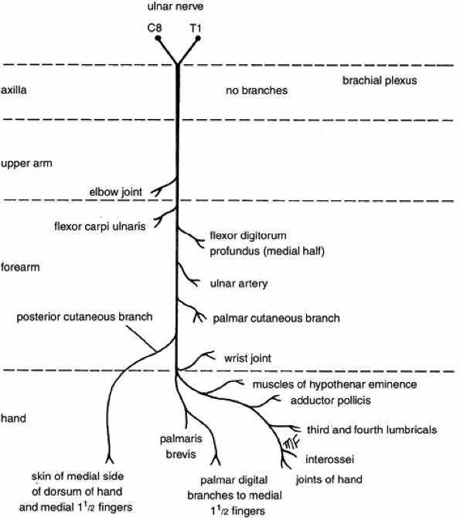
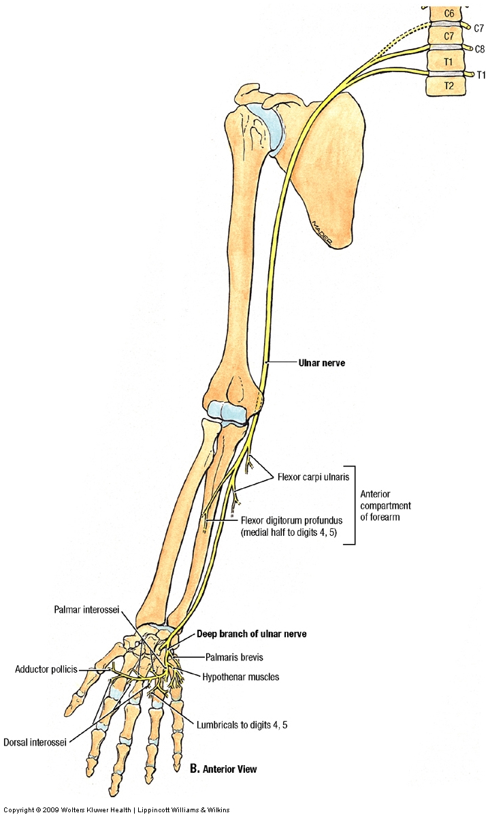
Radial & Ulnar Nerves
MSK 115
Ulnar Nerve
Summary of main branches

Slide 22
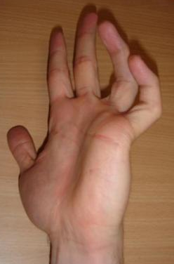
Radial & Ulnar Nerves
MSK 115
Ulnar Nerve
Applied Anatomy
Most commonly injured
  Behind the elbow
  At wrist
  The classical sign of a low lesion “CLAW HAND”
    Hyperextension of the MCP joints of ring and little fingers
    Flexion of the IP joints
  WHY?
  Paralysis of interossei & lumbricals
  Unopposed actions of extensors & FDP

Slide 23
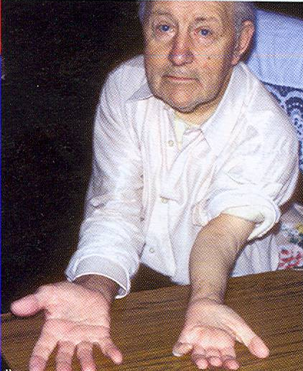
Radial & Ulnar Nerves
MSK 115
Ulnar Nerve
Applied Anatomy
Behind the elbow
Atrophy of Ulnar side of forearm.
Flexion of the wrist with Abduction.
Wasting of Hypothenar Eminence
Claw hand.
At the elbow
Claw Hand.
Wasting of Hypothenar Eminence.
HOME WORK
Cubital Tunnel Syndrome ?? Funny bone
Ulnar tunnel syndrome, also known as Guyon's canal syndrome is caused by entrapment of the ulnar nerve in the Guyon canal

Slide 24
Thanks for Listening

