Slide 1
Aerobic and anaerobic
metabolism in muscle
Musculoskeletal Block

Slide 2
Objectives
By the end of this lecture, the First year students will be able to:
Recognize the importance of ATP as energy source in skeletal muscle
Compare three systems of energy transfer in the body
Differentiate between energy metabolism in red and white muscle fibers
Understand how skeletal muscles derive ATP from aerobic and anaerobic metabolism
Discuss the importance of Cori and glucose-alanine cycles in energy metabolism

Slide 3
Overview
Three systems of energy transfer
ATP as energy source
Aerobic metabolism: red muscle fibers
Anaerobic metabolism: white muscle fibers
Cori cycle
Glucose-alanine cycle
Muscle fatigue and endurance in athletes

Slide 4
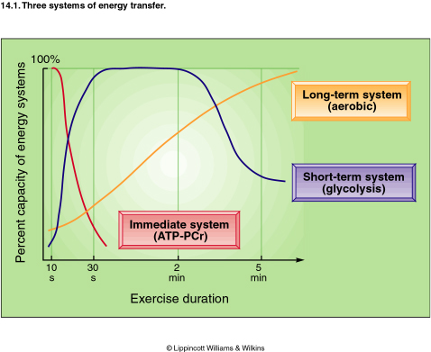
Three systems of energy transfer
Aerobic
Fatty acids
Continuous exercise
Hours
Anaerobic
Glucose
High intensity exercise
15 sec. to 2 min.
Anaerobic
Phosphocreatine (PCr)
High intensity exercise
3-15 sec.

Slide 5
ATP as energy source
The nucleotide coenzyme adenosine triphosphate (ATP) is the most important form of chemical energy stored in cells
Breakdown of ATP into ADP+PO₄ releases energy
This energy is used for all body functions (biosynthesis, membrane transport, muscle contraction, etc.)

Slide 6
ATP as energy source
The main pathway for ATP synthesis is oxidative phosphorylation catalyzed by the respiratory chain
ATP synthase catalyzes the synthesis of ATP
ADP + Pi → ATP

Slide 7
Energy metabolism in muscle
Muscle contraction requires high level of ATP consumption
Without constant resynthesis, the amount of ATP is used up in less than 1 sec. of contraction

Slide 8
Energy metabolism in muscle
Skeletal Muscle
Red Fibers
(Type I)
White Fibers
(Type II)
Suitable For
Prolonged effort
Suitable for fast,
strong contractions
Aerobic metabolism
(With O₂ supply)
Anaerobic metabolism
(Without O₂ supply)

Slide 9
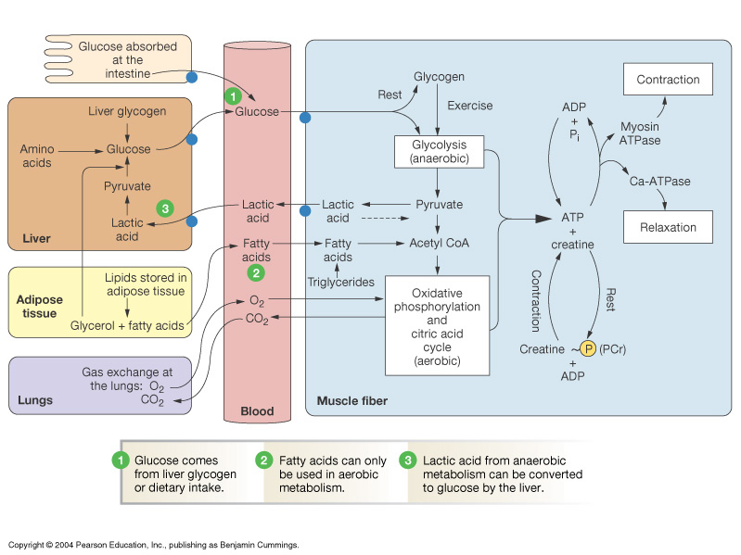
Overview of Energy Metabolism in Skeletal Muscle

Slide 10
Aerobic metabolism in red muscle fibers
Red muscle fibers are suitable for prolonged muscle activity
Their metabolism is mainly:
Aerobic and
Depends on adequate supply of O₂
They obtain ATP mainly from fatty acids
Fatty acids are broken down by β-oxidation, Krebs cycle, and the respiratory chain

Slide 11
Aerobic metabolism in red muscle fibers
Red color is due to myoglobin
Myoglobin has higher O₂ affinity than hemoglobin
It releases O₂ when its level drops

Slide 12
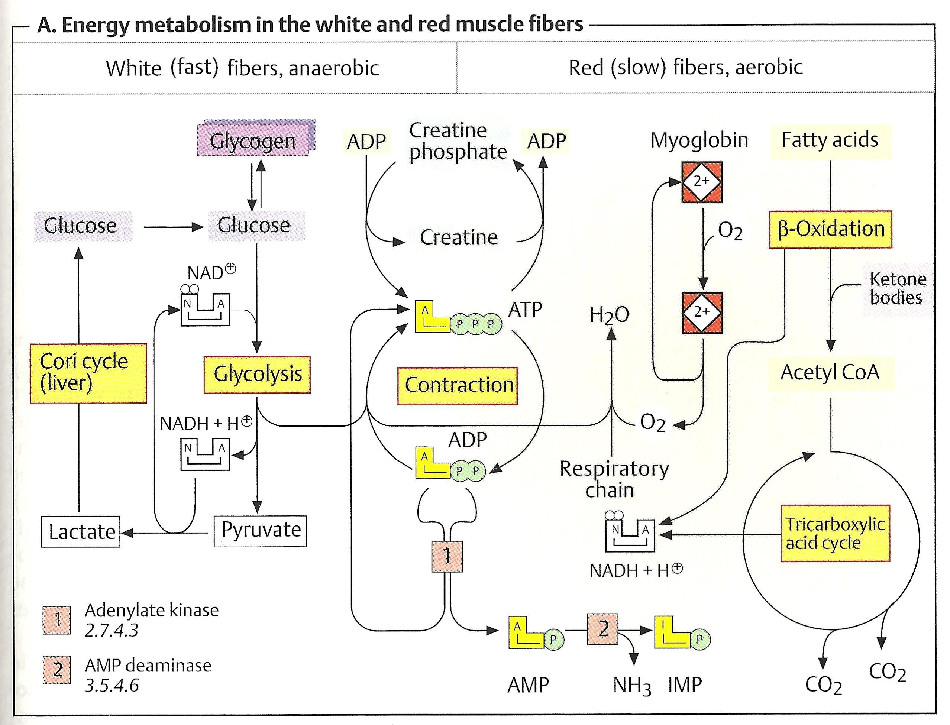

Slide 13
Anaerobic metabolism in white muscle fibers
White muscle fibers are suitable for fast, strong contractions
During intense muscle activity (weightlifting, etc.) O₂ supply from blood quickly drops
They mainly obtain ATP from anaerobic glycolysis
They have supplies of glycogen that is catabolized and undergoes glycolysis

Slide 14
Anaerobic metabolism in white muscle fibers
Glycogen → glucose-1-PO₄ → glucose-6-PO₄ → glycolysis → ATP
NADH+H⁺ is re-oxidized to maintain glucose degradation and ATP formation
Anaerobic glycolysis produces lactate
Lactate is resynthesized into glucose in the liver by Cori cycle

Slide 16
The Cori Cycle
In anaerobic glycolysis, the glucose is converted to lactate
Lactate in muscle is released into blood
Transported to the liver
Liver converts lactate into glucose via gluconeogenesis
The newly formed glucose is transported to muscles to be used for energy again

Slide 17
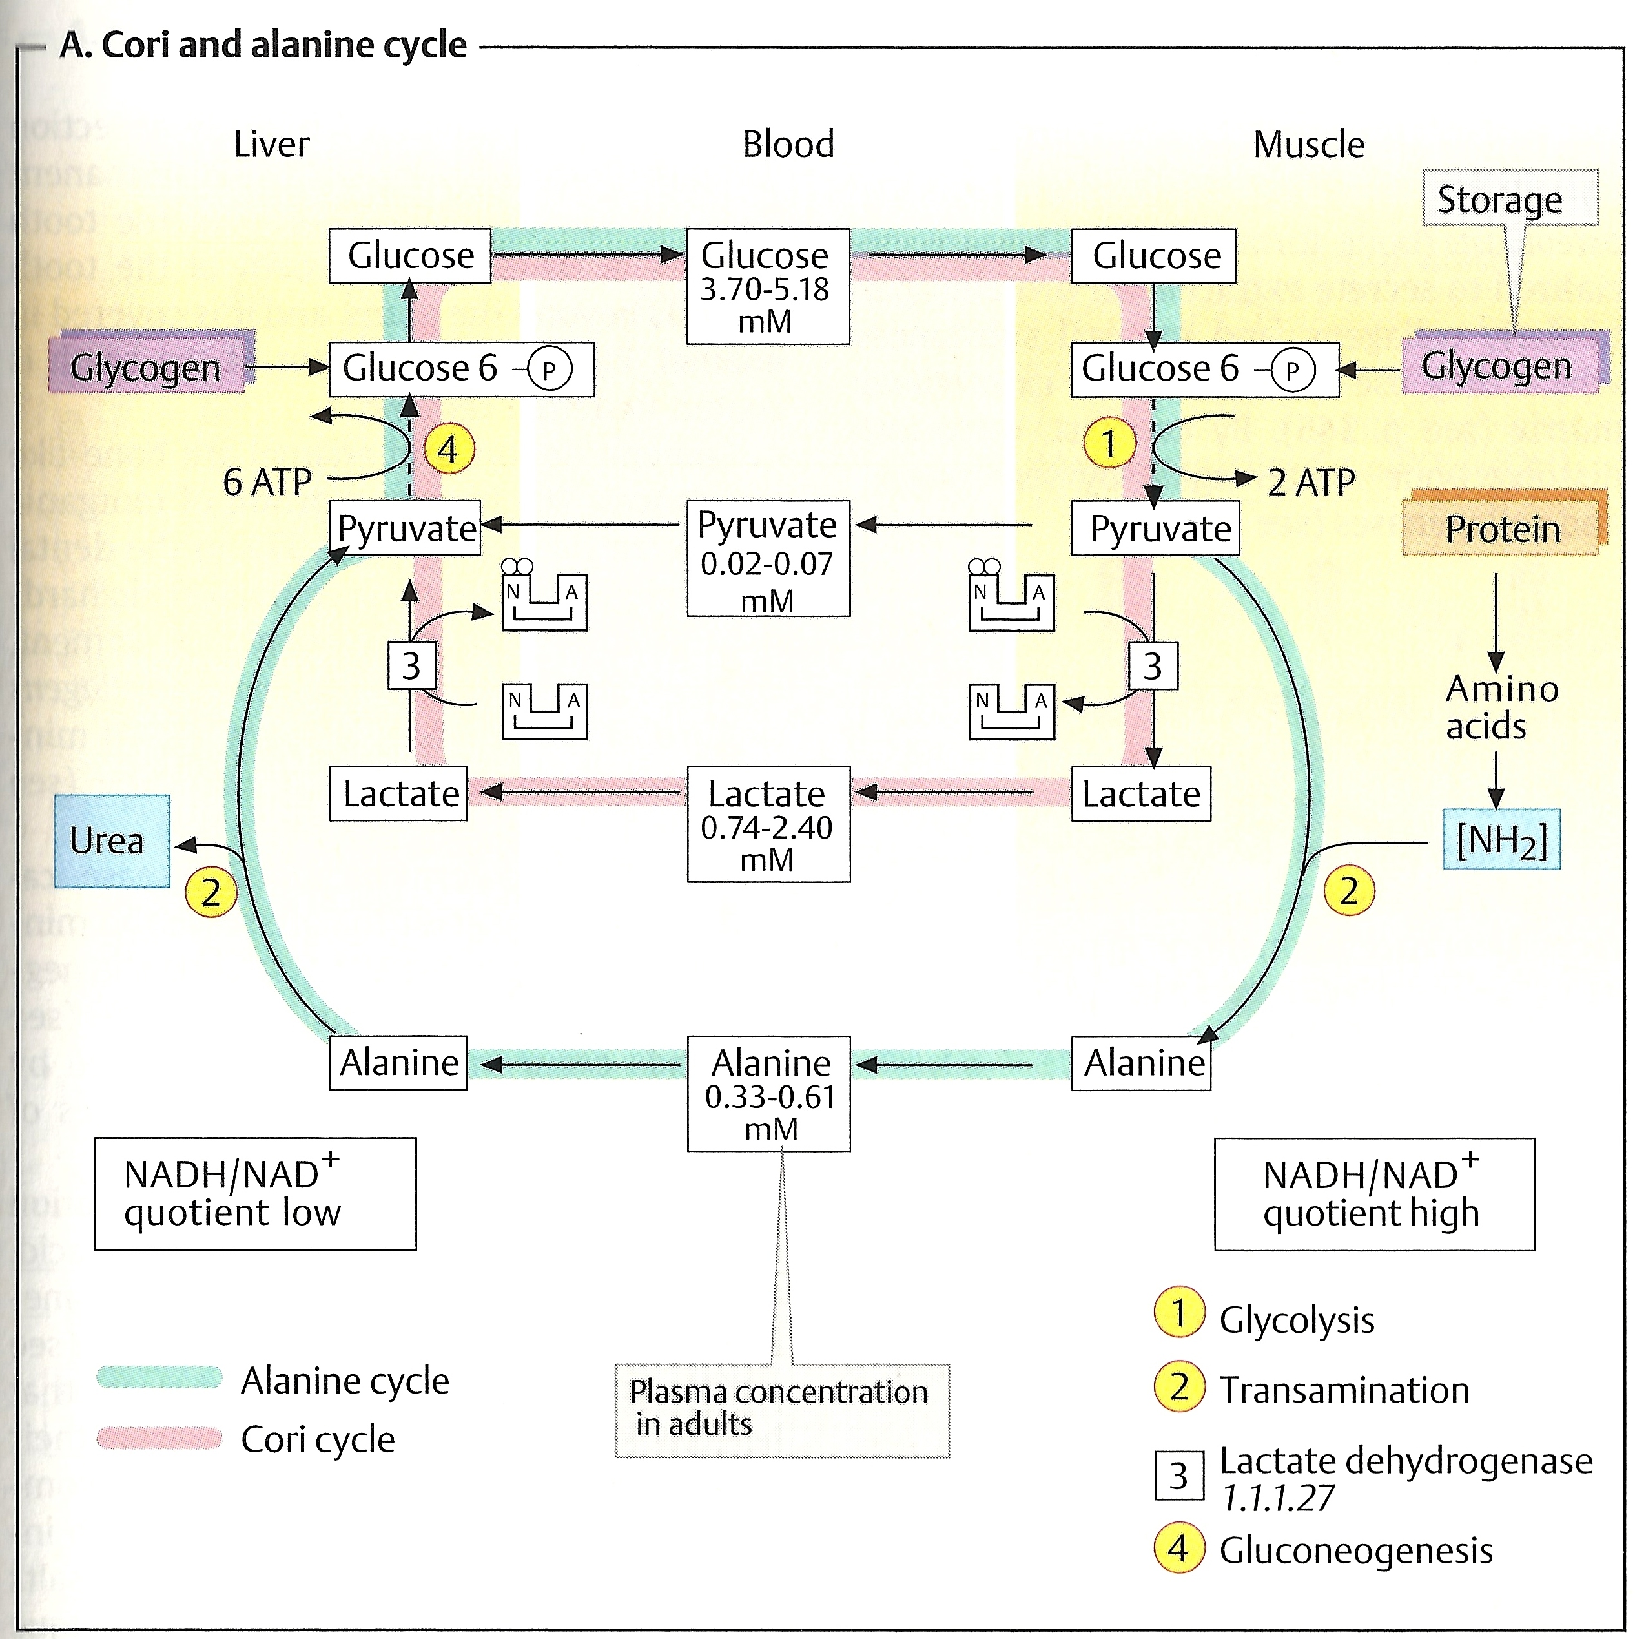

Slide 18
The Cori Cycle
Why skeletal muscles can’t produce new glucose from lactate?
Because:
Gluconeogenesis requires much more ATP than is supplied by glycolysis in muscle
O₂ deficiencies do not arise in the liver even during intense exercise
Therefore, liver always has sufficient ATP for gluconeogenesis

Slide 19
The glucose-alanine cycle
Muscles produce:
Pyruvate from glycolysis during exercise and
Amino nitrogen (NH₂) from normal protein degradation
Pyruvate is converted to alanine in muscles
Pyruvate + NH₂ → Alanine

Slide 21
The glucose-alanine cycle
This alanine is transported to liver
Liver converts alanine back to pyruvate
Alanine – NH₂ = Pyruvate
Pyruvate is used in gluconeogenesis
The newly formed glucose is transported to muscle to be used for energy again

Slide 23
The glucose–alanine cycle

Slide 24
Exercise and AMPK
Exercise
(High-energy demand)
In exercise, the metabolic enzymes are regulated thru phosphorylation by AMP-activated protein kinase (AMPK)
⬇ATP
⬆AMP
Activates AMPK
Anabolic
Pathways (Off)
Catabolic pathways
(ON)
⬆ATP

Slide 25
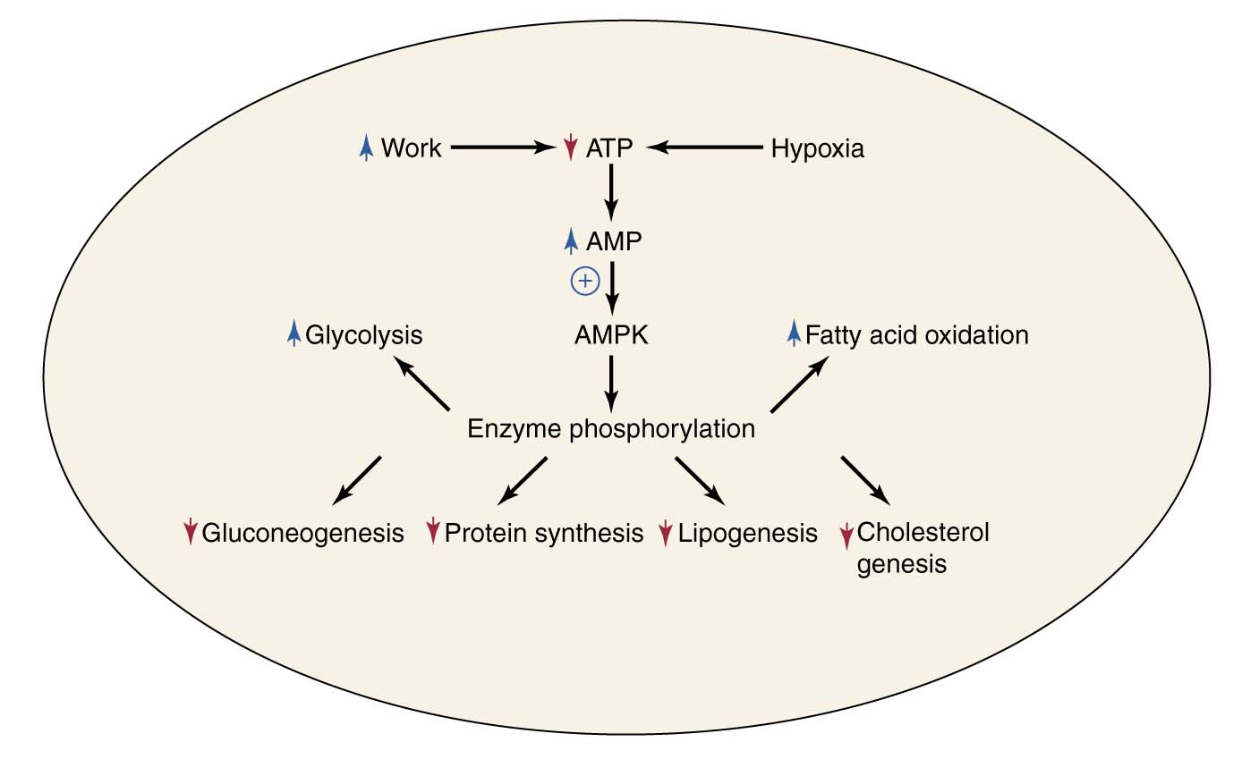
AMPK activation shuts down ATP-requiring processes and stimulates ATP-producing processes

Slide 26
Muscle fatigue and endurance in athletes
Muscle fatigue:
Inability of muscles to maintain a particular strength of contraction over time
Causes: muscle damage, accumulation of lactic acid
Athletes are able to change the proportions of red and white muscle fibers by targeted training

Slide 27
Muscle fatigue and endurance in athletes
The expression of muscle proteins can also change during the course of training
This provides them with:
High endurance during muscle activity
Efficient energy production and consumption
Delayed fatigue

Slide 28
Take home message
ATP is an important source of chemical energy needed by the cells to perform body functions
Muscular activity requires constant supply of ATP for energy either from aerobic or anaerobic metabolism
Cori and glucose-alanine cycles play an important role in regenerating glucose for energy
Athletes are able to change proportions of their red and white muscle fibers with appropriate training

Slide 29
References
Koolman, J., Roehm, K.H. Color Atlas of Biochemistry, Second Edition, 2015, Thieme New York, pp. 336–339
Textbook of Biochemistry with Clinical Correlations by Thomas M. Devlin, 6th Edition, pp. 866-868

