Slide 1
Creatine metabolism and collagen diseases
Musculoskeletal block

Slide 2
objectives
By the end of this lecture the First Year students will be able to:
Study the importance of creatine in muscle as a storage form of energy
Understand the biosynthesis of creatine
Study the process of creatine degradation and formation of creatinine as an end product
Understand the clinical importance of creatinine as a sensitive indicator of kidney function
Study the structure, function, types, and biosynthesis of collagen
Understand different diseases associated with collagen

Slide 3
Creatine Metabolism
End product
Energy source

Slide 4
Creatine biosynthesis
Three amino acids are required:
Glycine
Arginine
Methionine (as s-Adenosylmethionine)
Sites of biosynthesis:
Step 1: Kidneys
Step 2: Liver

Slide 5
Creatine biosynthesis
Arginine + Glycine
Kidneys
Ornithine
Amidinotransferase
Guanidinoacetate
SAM
Liver
Methyltransferase
SAH
Creatine

Slide 6
Distribution of body creatine
Transported from liver to other tissues
98% present in skeletal and heart muscles
In skeletal muscle it is converted to high-energy source creatine phosphate (phosphocreatine)
Creatine
ATP
ATP
Creatine Kinase
ADP
ADP + H⁺
Creatine phosphate

Slide 7
Creatine phosphate
A high-energy phosphate compound
Acts as a storage form of energy in the muscle
Provides small but, ready source of energy during first few seconds of intense muscular contraction
The amount of creatine phosphate in the body is proportional to the muscle mass

Slide 8
Creatine degradation
Creatine and creatine phosphate spontaneously form creatinine as an end product
Creatinine is excreted in the urine
Serum creatinine is a sensitive indicator of kidney disease (kidney function test)
Serum creatinine increases with the impairment of kidney function

Slide 9
Creatine degradation
H₂O
Creatine
Creatinine
ATP
ATP
Creatine Kinase
ADP
ADP + H⁺
Plasma
Pi
Creatine phosphate
Glomerular
filtration
Urine

Slide 10
Urinary Creatinine
A typical male excretes about 15 mmol creatinine/day
Decrease in muscle mass (in muscular dystrophy, paralysis) leads to decreased level of urinary creatinine
The amount of creatinine in urine is used as an indicator for the proper collection of 24 hours urine sample

Slide 11
Creatine kinase (ck)
CK is responsible for generation of energy in contractile muscular tissues
CK levels change in cardiac and skeletal muscle disorders
Creatine
ATP
ATP
Creatine Kinase
ADP
ADP + H⁺
Creatine phosphate

Slide 12
collagen
Most abundant protein in the human body
Collagen is a highly stable molecule with a half-life as long as several years
A fibrous protein that serves structural functions
Part of connective tissues, bone, teeth, cartilage, tendons, skin, blood vessels
It has a long rigid structure

Slide 13
Collagen structure
Collagen α-chain (~1,000 amino acids long) is rich in proline and glycine
The glycine residues are part of a repeating sequence:
–Gly–X–Y–,
X = Frequently proline
Y = Often hydroxyproline
(–Gly–Pro–Hyp)₃₃₃
(Y can be also hydroxylysine)

Slide 14
Collagen structure
Collagen consists of three α-chains wound around one another in a rope-like triple helix
The three polypeptide chains are held together by hydrogen bonds
Two examples of protein secondary structure: collagen helix and α-helix

Slide 15
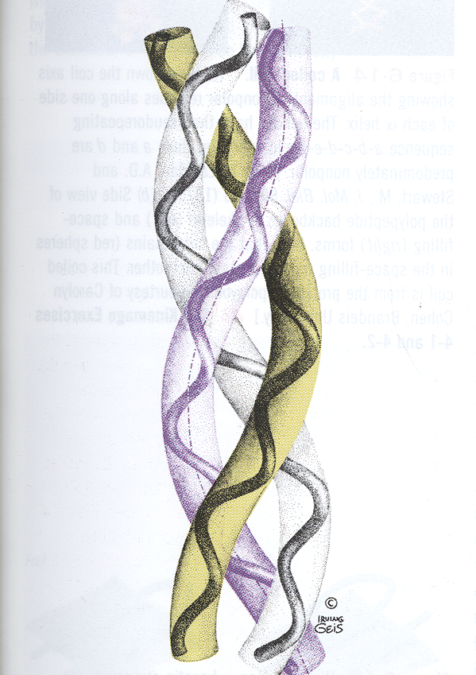
Collagen structure
Rich in proline and glycine amino acids
Proline prevents collagen chains to form α-helix because:
Proline has no back bone amino group (it is a ring structure with secondary amino group)
Therefore hydrogen bonding within the helix is not possible

Slide 16
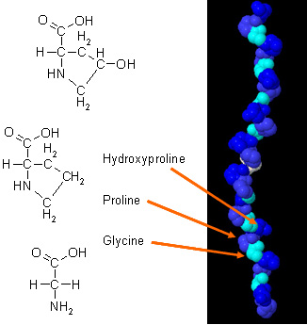
Non-standard amino acids in Collagen
Proline and lysine are converted to:
Hydroxyproline and Hydroxylysine
By hydroxylase enzymes
During post-translational modifications
The enzyme requires vitamin C for its function

Slide 17
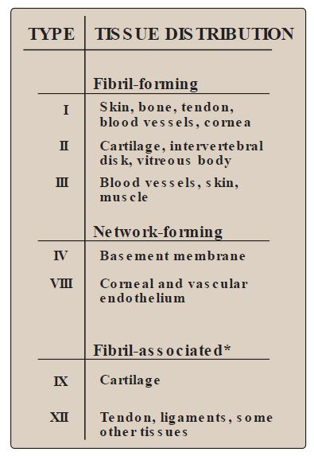
Types of collagen
Types of collagen depend on function
Variations in the amino acid sequence of α-chains result in different properties
Examples:
Type I: (α1)₂ α₂
Type II: (α1)₃

Slide 18
biosynthesis of collagen
Synthesized in fibroblasts, osteoblasts, chondroblasts
Pre-pro → Pro → Mature collagen
Polypeptide precursors are enzymatically modified to form triple helix
Hydroxylation of proline and lysine residues
Glycosylation of some hydroxylysine residues with glucose or galactose

Slide 19
biosynthesis of collagen
Secreted from Golgi vacoules into the extracellular matrix as procollagen
Cleaved by N- and C- procollagen peptidases to release triple helical tropocollagen molecules
Tropocollagen molecules spontaneously associate to form collagen fibrils

Slide 20
Crosslinking of collagen fibrils
Lysyl oxidase oxidatively deaminates some of the lysine and hydroxylysine residues in collagen
The reactive aldehydes – allysine and hydroxyallysine condense with lysine or hydroxylysine residues in neighbouring collagen molecules to form covalent cross-links
This produces mature collagen fibres

Slide 21
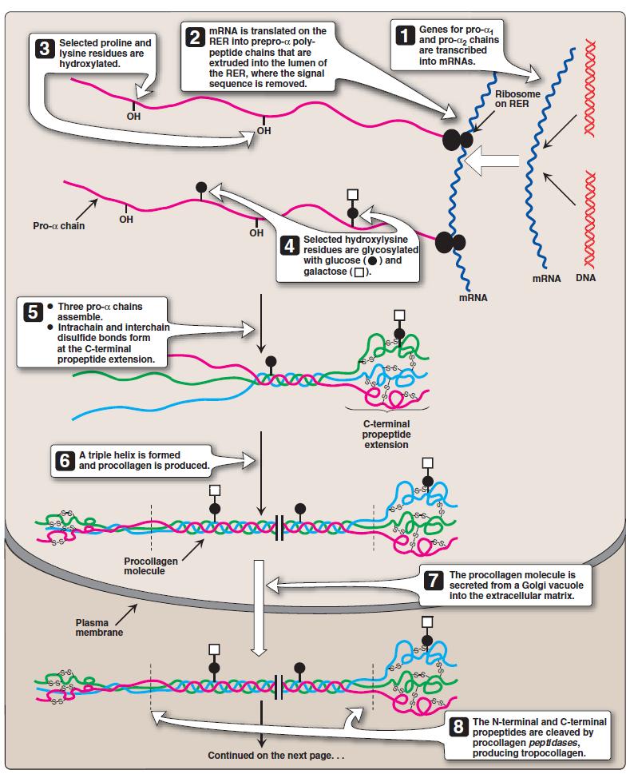

Slide 22
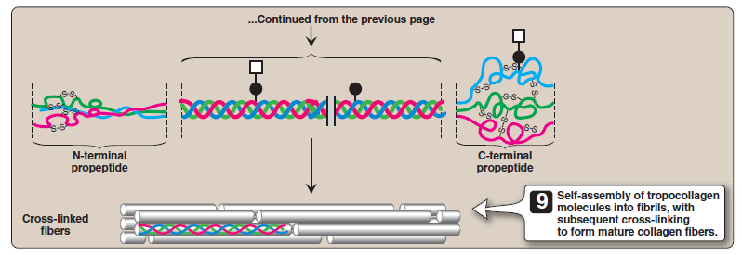

Slide 23
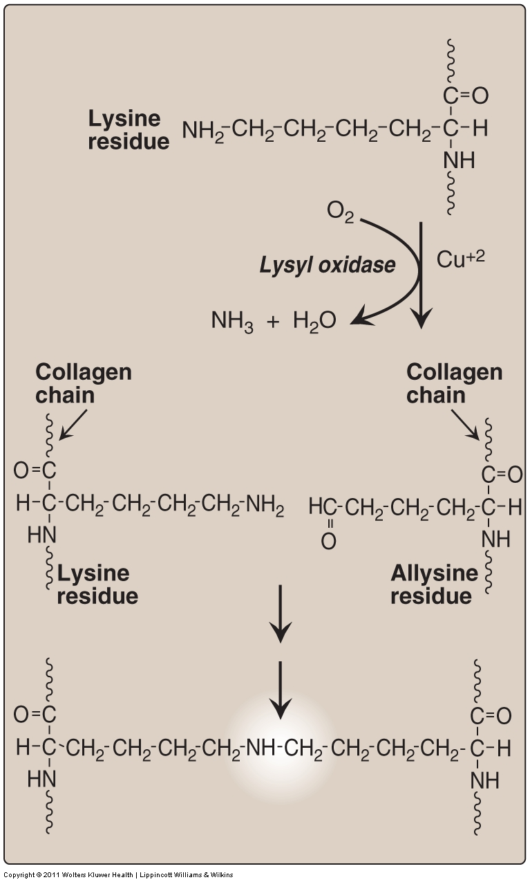

Slide 24
Collagen diseases
Acquired disease:
Scurvy due to vitamin C deficiency
Geneticlly inherited diseases:
Ehlers-Danlos syndromes (EDS)
Osteogenesis imperfecta (OI)

Slide 25
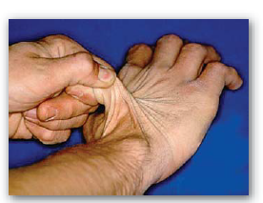
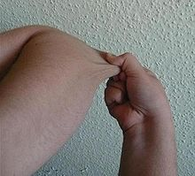
Collagen diseases
Ehlers-Danlos syndrome
Due to deficiency of lysyl hydroxylase or N-procollagen peptidase
Mutations in the amino acid sequences of collagen I, III and V
Characterized by hyper-extensibility of joints and skin

Slide 26
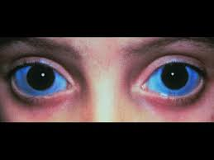
Collagen diseases
Osteogenesis imperfecta (brittle bone disease):
Bones fracture easily with minor or no trauma
Mutations replace glycine with amino acids having bulky side chains preventing the formation of triple helical conformation
Type I (most common) characterized by mild bone fragility, hearing loss and blue sclerae

Slide 27
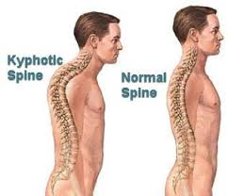
Collagen diseases
Osteogenesis imperfecta (brittle bone disease):
Type II (most severe) and lethal in the perinatal period (fractures in utero)
Type III (severe form)
Fractures at birth, short stature, spinal curvature
Leading to a humped back (kyphotic)
appearance and blue sclerae

Slide 28
references
Lippincott’s Illustrated Reviews, Biochemistry, 6th edition, Denise R. Ferrier, Lippincott Williams & Wilkins, USA, pp. 43-49 and 287-288.
Bishop’s Clinical Chemistry 6th edition, pp. 223-227.

