Slide 1
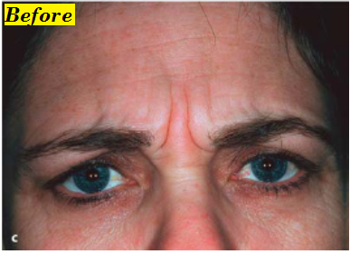
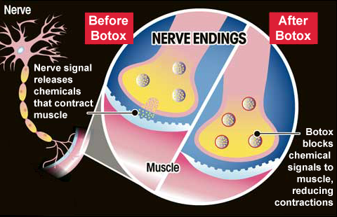
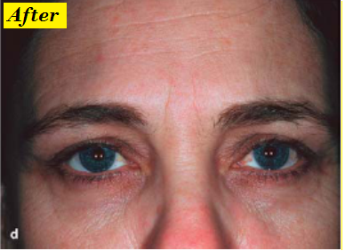
Direct Cholinomimetics
Amanita muscaria
Muscarine
What is botox?
Botulinum toxin
A toxin produced by Clostridium botulinum

Slide 2
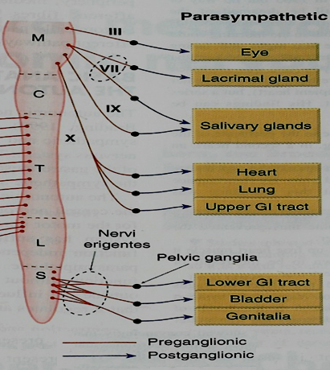
Direct Cholinomimetics
ILOS
To identify the mechanism of action of direct acting acetylcholine receptor stimulants
To discuss the pharmacokinetic aspects and pharmacodynamic effects of direct cholinomimetics
To outline the therapeutic uses and toxicity of direct cholinergic agonists

Slide 3
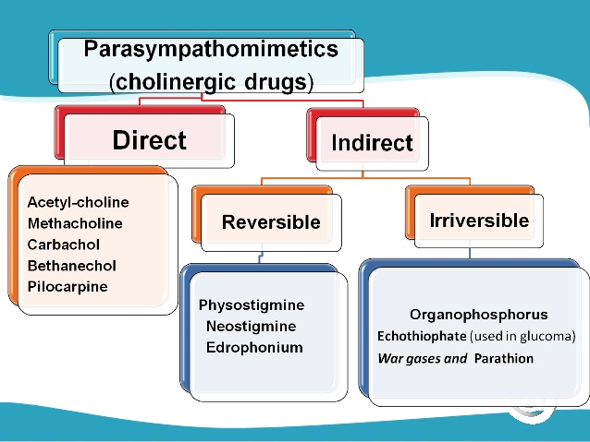
Direct Cholinergic Agonists
Classification of cholinergic agonists

Slide 4
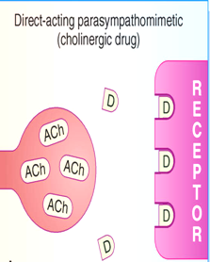
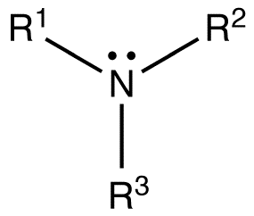
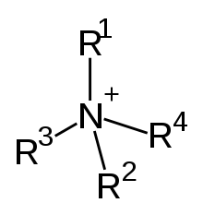
Direct Cholinergic Agonists
Produce primarily effect by activation of muscarinic or nicotinic receptors
Classification according to chemical structure
pilocarpine,
nicotine ,
lobeline
Tertiary cholinomimetics
acetylcholine ,
methacholine,
carbachol,
bethanechol
Quaternary group

Slide 5
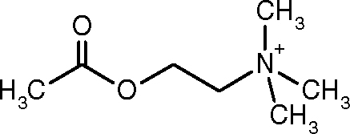
Pharmacokinetics
Acetylcholine low lipid- solubility
Poorly absorbed poorly distributed in the CNS
Hydrolyzed in the GIT , not active by the oral route
Ach is very sensitive to hydrolysis by cholinesterases
Methacholine is 3 times more resistant to hydrolysis
Carbachol & bethanechol are completely resistant to hydrolysis

Slide 6
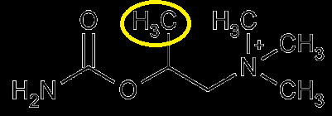
Pharmacokinetics
Presence of a methyl group on bethanechol reduces its potency at nicotinic junction.
Tertiary cholinomimetics are well absorbed from most sites of administration
Nicotine, lipid –soluble, absorbed across the skin.
Muscarinic quaternary amines , less completely absorbed from the GIT but still toxic when ingested in mushroom.
Excretion by kidney, clearance of tertiary amines can be enhanced by acidification of urine

Slide 7
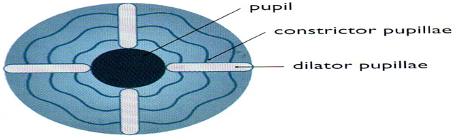
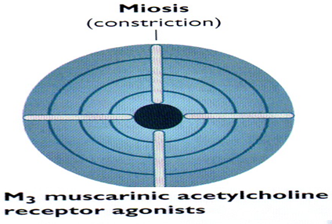
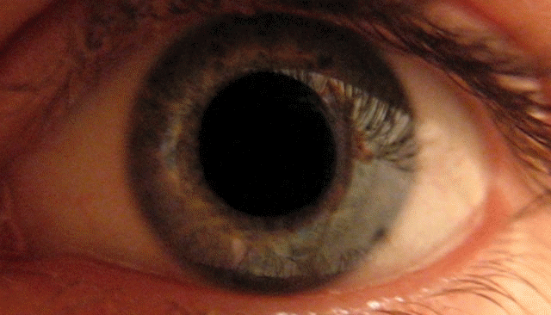
Direct Cholinergic Agonists
Direct Cholinergic Agonists
Direct Cholinergic Agonists
Pharmacodynamic effects
1-Eye
The parasympathetic innervates the constrictor pupillae , runs cirumferentially in the iris
Constrictor pupillae is important for adjusting the pupil in response to change in light intensity & regulating the intraocular pressure

Slide 8
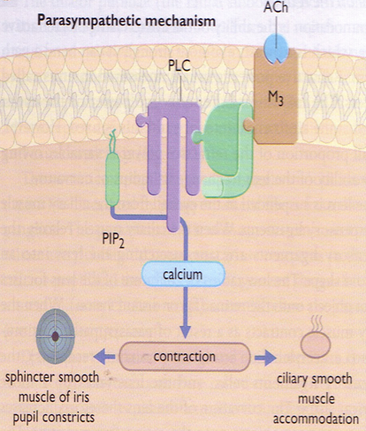
Pharmacodynamic effects
1-Eye
Parasympathetic activation contracts the ciliary muscle
Contraction of ciliary muscle pulls the ciliary body forward & inward , relaxing the tension on the suspensory ligaments of the lens

Slide 9
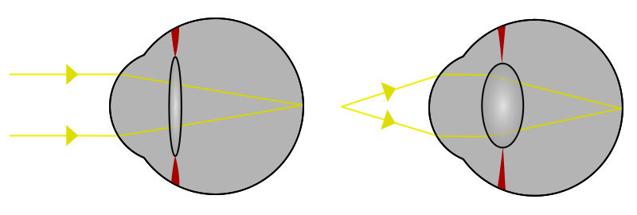
Pharmacodynamic effects
1-Eye
When the ciliary muscle contracts, the lens bulge more →↓focal length, this parasympathetic reflex is essential to accommodate for near vision

Slide 10
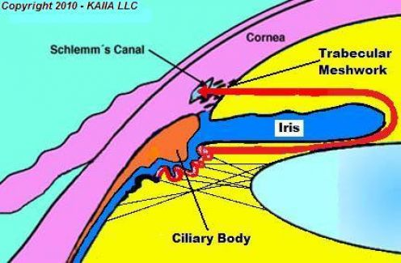
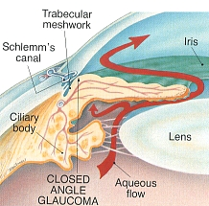
Pharmacodynamic effects
Aqueous humour secreted
by the cells of the epithelium
covering the ciliary body , is
removed continuously by drainage
into the canal of Schlemm
In some people drainage of aqueous humour is impeded when the iris is dilated → folding of the iris tissue occludes the drainage angle →↑intraocular pressure

Slide 11
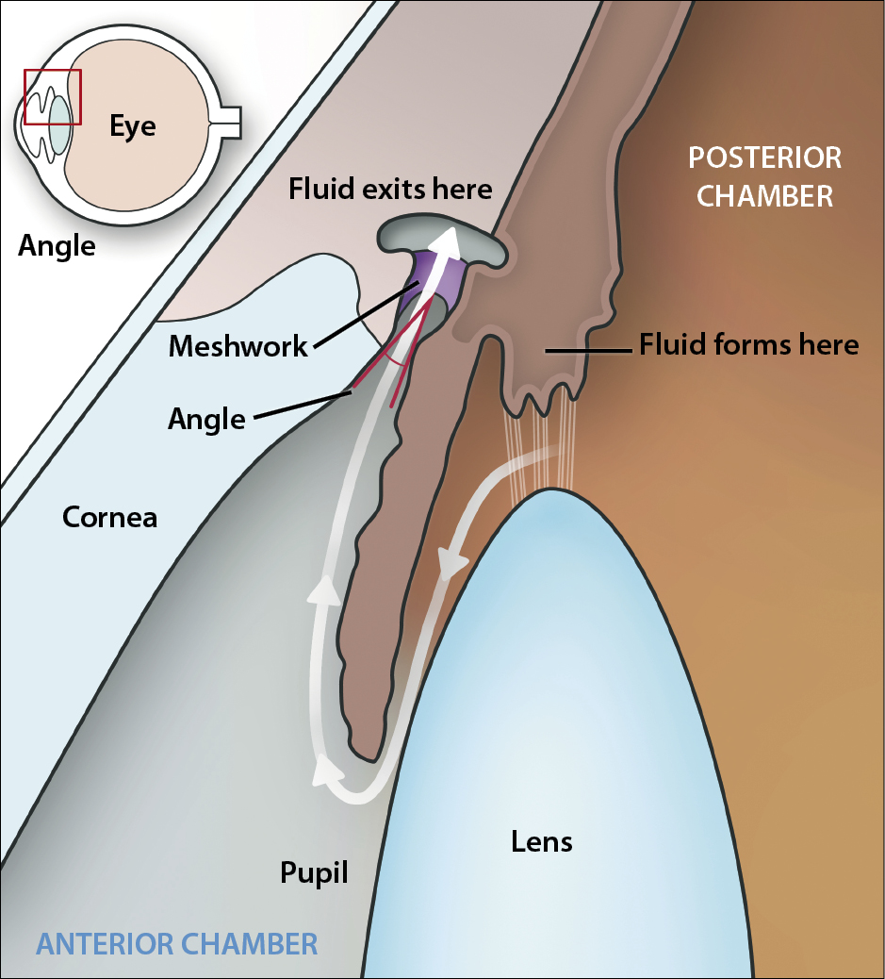
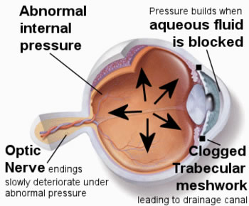
Pharmacodynamic effects
Activation of constrictor pupillae →↓ intraocular pressure in these individuals
Also ↑tension in the ciliary body allow drainage
Normal intraocular pressure is 10-15mmHg above atmospheric pressure . Abnormally raised pressure →retinal detachment

Slide 12
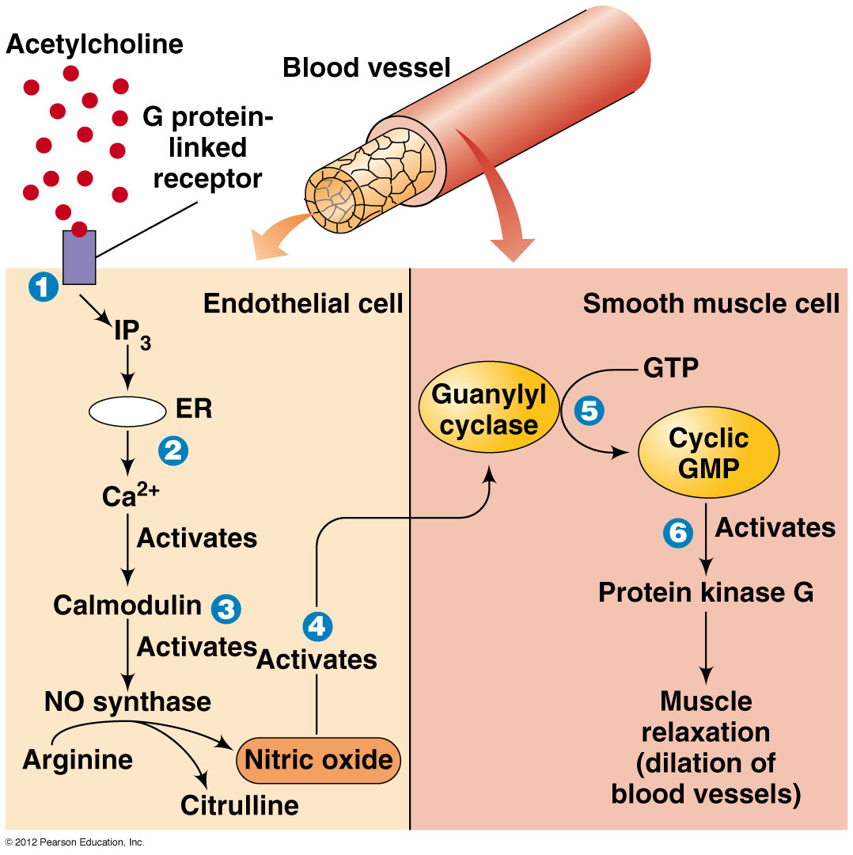
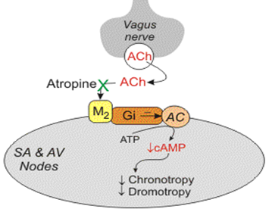
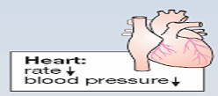
Pharmacodynamic effects
2-Cardiovascular effect
Ventricle has sparse parasympathetic innervations
Cardiac slowing , ↓CO→↓force of contraction of the atrium
Vasodilation occurs , effect not associted with muscarinic innervations
BP: Hypotension is opposed by reflex sympathetic discharge

Slide 13
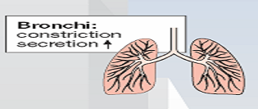
Pharmacodynamic effects
3-Respiratory system
Muscarinic stimulants contract smooth muscles of bronchial tree
↑Glandular secretion, may cause symptoms in individuals with asthma

Slide 14
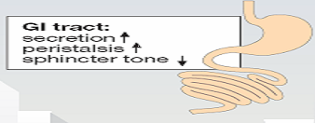
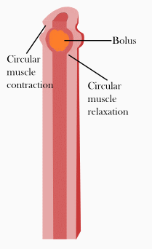
Pharmacodynamic effects
4-GIT:-
↑Secretion of gastric glands
↑Peristaltic movement
Sphincters relaxed.

Slide 15
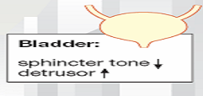
Pharmacodynamic effects
5-Genitourinary tract:-
Stimulate muscles of bladder & relax sphincters promoting voiding
Human uterus is not sensitive to muscarinic agonists
6-Miscellaneous secretory glands:-
Stimulate secretion of sweat , lacrimal, nasopharyngeal glands

Slide 16
Pharmacodynamic effects
7-CNS:-
Both muscarinic & nicotinic receptors are found in the CNS
Nicotine & lobeline
alerting action
High level of nicotine convulsions & coma

Slide 17
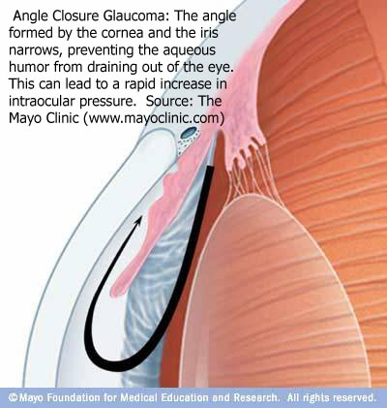
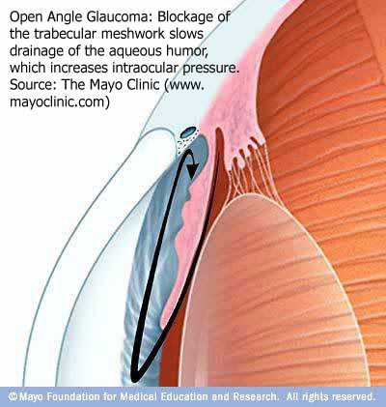
Clinical Uses
1-The Eye
Glaucoma
1- Primary
A- Angle closure
B- Open angle
2- Secondary
caused by trauma, inflammation, surgical procedures

Slide 18
Clinical Uses
Acute angle closure
Medical emergency , initially treated by drugs
Surgery for permanent correction [irridectomy]
Muscarinic stimulants ↓intraocular pressure by:-
1-facilitating outflow of aqueous humor
2-↓rate of its secretion
Methacholine, carbachol,
pilocarpine
e.g. Direct stimulants

Slide 19
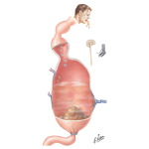
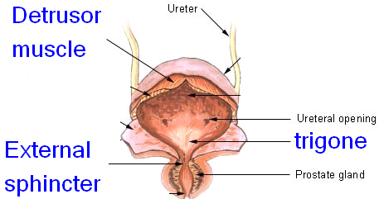
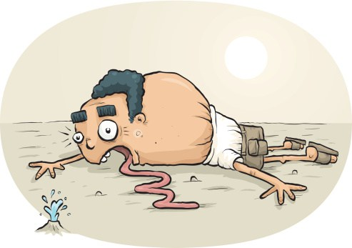
Direct Cholinergic Agonists
Clinical Uses
2-GIT & Urinary tract
A-Postoperative ileus “atony or paralysis of the stomach following surgery
B-Postoperative urinary retention
Bethanechol
C-Xerostomia → Pilocarpine

Slide 20
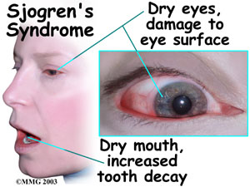
Sjogren's Syndrome
Sjogren's Syndrome is an autoimmune disease. characterized by the abnormal production of antibodies directed to the lacrimal and salivary glands→ eye and mouth dryness.
Cevimeline is a direct muscarinic agonist with particular effect on M3 receptors.
By activating the M3 receptors cevimeline stimulates secretion by the salivary & lacrimal glands thereby alleviating dry mouth & dry eye
Rapidly absorbed after oral administration and excreted unchanged in urine

Slide 21
Toxicity
A-Directly- acting muscarinic stimulants:- nausea, vomiting ,diarrhoea, salivation, cutaneous vasodilatation, bronchial constriction
DUMBELS
B-Directly- acting nicotinic stimulants:-
I] Acute toxicity
1- CNS stimulant action, convulsions , coma , respiratory arrest
2-Skeletal muscle endplate depolarization →depolarization block & respiratory paralysis
3-Hypertension & cardiac arrhythmias

Slide 22
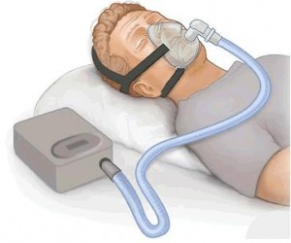
Toxicity
Treatment of symptoms:-
Muscarinic excess→ atropine
CNS stimulation → central anticonvulsants e.g. diazepam
Neuromuscular block → mechanical respiration

Slide 23
ii-Chronic nicotinic toxicity
30% of deaths due to cancer & coronary heart disease are due to smoking
Nicotine contributes to ↑risk of vascular diseases, sudden coronary death, ↑ulcer
No. cigarettes / day

Slide 24
Muscarinic receptors
Pharmacological actions | Locations | Receptor
CNS excitation Gastric acid secretion | CNS gastric parietal cells | M1 Excitatory
Cardiac inhibition (Bradycardia) | Heart | M2 Inhibitory
Secretion of glands Smooth muscle contraction Vasodilatation (via nitric oxide) | Exocrine glands Smooth muscles (GIT, urinary tract, bronchial muscles) Vascular endothelium | M3 Excitatory
memory, arousal, attention and analgesia | CNS | M4 & M5

Slide 25
Cholinergic or parasympathetic receptors
Muscarinic receptors Peripheral cholinoceptors | Nicotinic receptors Central cholinoceptors
Excitatory or inhibitory | Almost excitatory
On all peripheral organs innervated by postganglionic parasympathetic fibers | Autonomic ganglia Nn sympathetic & parasympathetic stimulation
Heart (bradycardia, M2) exocrine glands (secretion, M3) | Adrenal medulla Nn release of catecholamines (adrenaline & noradrenaline)
Smooth muscles (contraction, M3) (GIT, urinary tract, bronchial muscles, uterus) | Skeletal muscles Nm contraction

Slide 26
Muscarinic actions of Ach
Cholinergic actions | Organs
Contraction of circular muscle of iris (miosis)(M3) Contraction of ciliary muscles for near vision (M3) Decrease in intraocular pressure (IOP) | Eye
bradycardia ( decrease in heart rate ) (M2) Release of NO (EDRF) | Heart endothelium
Constriction of bronchial smooth muscles Increase in bronchial secretion M3 | Lung
Increase in motility (peristalsis) Increase in secretion Relaxation of sphincter -defecation M3 | GIT
Contraction of muscles Relaxation of sphincter M3 Urination | Urinary bladder
Increase of secretions of exocrine glands sweat, saliva, lacrimal, bronchial, intestinal secretions M3 | Exocrine glands

Slide 27
Pilocarpine | Bethanechol | Carbachol | ACh
Tertiary non polar | Quaternary Polar | Quaternary Polar | Quaternary Polar | Chemistry
Complete | better absorbed than Ach | better absorbed than Ach | NOT | Absorption
NOT metabolized by cholinesterase |  |  | metabolized by cholinesterase | Metabolism by cholinesterase
Longer (++) | Longer (++) | Longer (++) | Very short | Duration
oral, eye drops | Oral S.C. | Oral, eye drops S.C. | I.V. eye drops | administration

Slide 28
direct Cholinomimetic
Cevimeline M | Pilocarpine | Bethanechol M | Carbachol M,N | ACh M, N
Muscarinic | Muscarinic | Muscarinic | Muscarinic Nicotinic | Muscarinic Nicotinic | Receptors
+++ | +++ | +++ | +++ | +++ | Muscarinic
Exocrine glands | More on eye, exocrine glands | GIT, Urinary bladder | Eye, GIT Urinary bladder | NOT | Selectivity
NO | NO | NO | +++ | +++ | Nicotinic
Sjogren's syndrome | Glaucoma Xerostomia | Paralytic ileus Urinary retention | Glaucoma | NO | Uses

