Slide 1
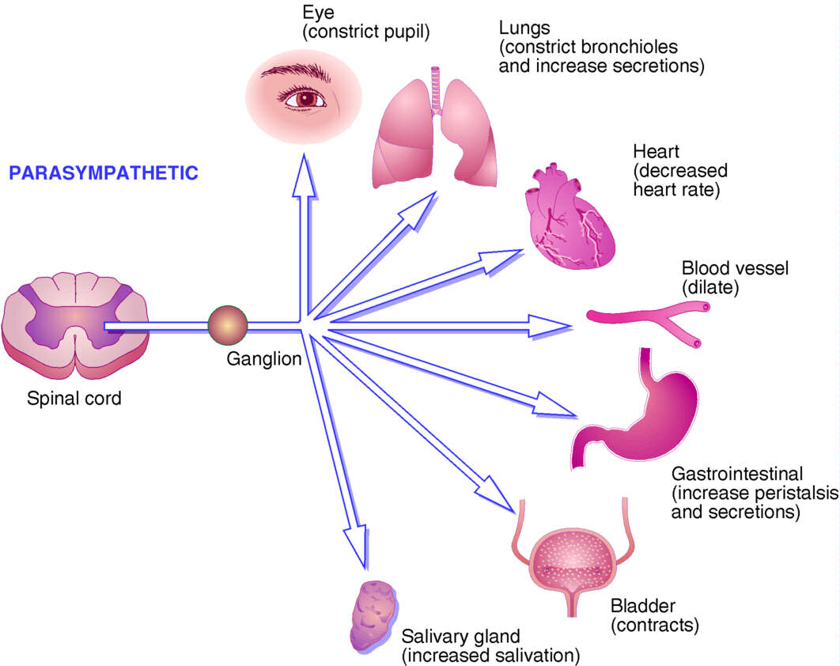
inDirect Cholinomimetics
ILOS
To identify the mechanism of action of indirect acting acetylcholine receptor stimulants
To discuss the pharmacokinetic aspects and pharmacodynamic effects of indirect cholinomimetics
To outline the therapeutic uses and toxicity of indirect cholinergic agonists
To highlight the therapy of cholinergic toxicity

Slide 2
Indirectly –acting cholinoceptor stimulants:-
1. quaternary ammonium groups
edrophonium
quaternary amine
neostigmine
tertiary amine
physostigmine
Most of the organophosphates are highly lipid soluble except ecothiopate
3-Organophosphates

Slide 3
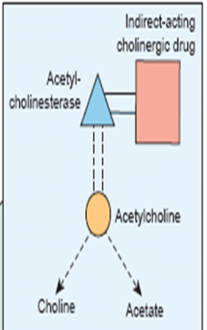
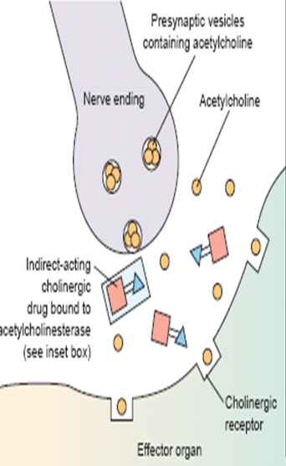
Mechanism of action
↓Aetylcholinesterase→↑level of endogenous Ach.

Slide 4
Mechanism of action
Bind reversibly by electrostatic forces to the active site, preventing access of Ach , enzyme-inhibitor complex is short lived’2-10min’
Edrophonium
Carbamate esters
Physostigmine(non-polar), neostigmine, pyridostigmine
Form covalent bond, more resistant to hydrolysis’ 0.5-6hr’

Slide 5
Mechanism of action
Organophosphates
Phosphorylate enzyme ,hydrolysis very slow ‘hundreds of hours’.
Due to the long duration they are called irreversible inhibitors
Pralidoxime is used as cholinesterase regenerator for organic phosphate poisoning

Slide 6
Pharmacokinetics
Absorption of quaternary ammonium salts is poor (ionized)
Distribution in the CNS is negligible
Physostigmine well absorbed can be used topically in the eye
Carbamates are relatively stable in aqueous solution, but can be metabolized by esterases
Organophosphates , well absorbed from the skin , lung, gut & conjunctiva except ecothiopate, (less stable in aqueous solution)

Slide 7
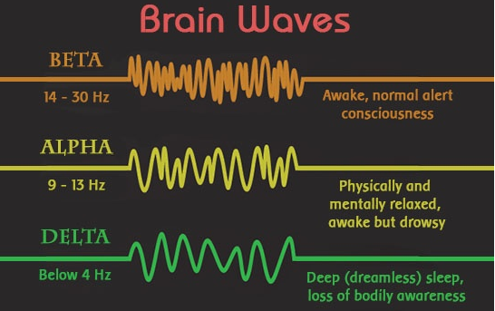
Pharmacodynamic effects
Primary effect is to potentiate the action of endogenous Ach
1-CNS
In low concentration:- The high lipid-soluble inhibitors cause diffuse activation of EEG→ alerting response(ß wave)
↑Concentration →generalized convulsions followed by coma & respiratory arrest

Slide 8
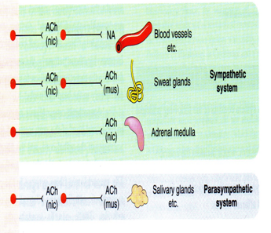
Pharmacodynamic effects
2-CVS
Activation in both sympathetic & parassympathetic ganglia & neuroeffector junction
In the heart effects of parasympathetic limb predominate, ↓HR, ↓conduction velocity through AV node, ↓atrial contractility, ↓CO. Modest change in Bp.

Slide 9
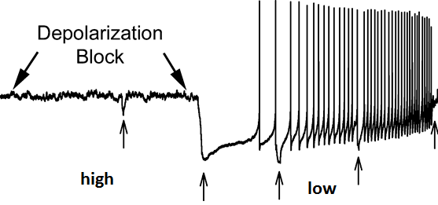
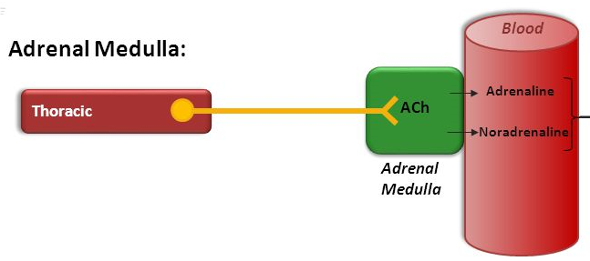
Pharmacodynamic effects
3-Neuromuscular junction
Low concentration → Intensify the effect of endogenous Ach ↑ force of contraction
High concentration →fibrillation of muscle fibers, membrane depolarization becomes sustained → depolarization block
Adrenal medulla
Release of catecholamines

Slide 10
Clinical Uses
Acute angle closure
Indirect stimulants
physostigmine, ecothiopate

Slide 11
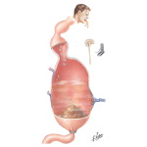
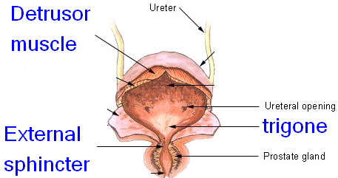
Direct Cholinergic Agonists
Clinical Uses
2-GIT & Urinary tract
Postoperative ileus “atony or paralysis of the stomach following surgery
Postoperative urinary retention
Neostigmine
Xerostomia → Pilocarpine

Slide 12
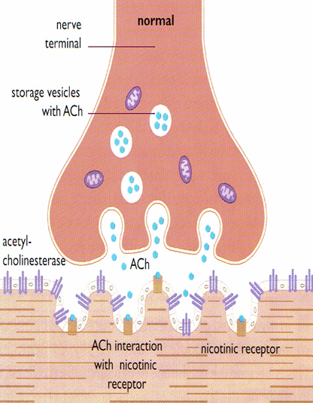
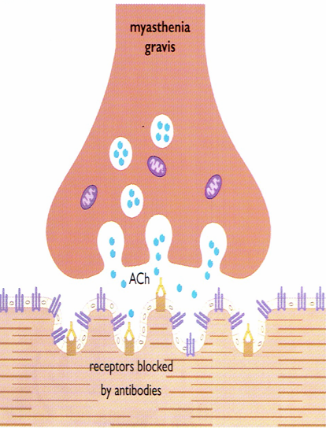
Clinical Uses
3-Neuromuscular junction:-
Myasthenia gravis
Autoimmune disease
Production of antibodies→ ↓no. of functioning nicotinic receptors at endplate

Slide 13
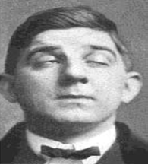
Clinical Uses
Myasthenia gravis
→Weakness ,fatigue affecting muscles of hand ,head, neck , extremities
→Ptosis, diplopia, difficulty of speaking & swallowing.
Treatment with cholinesterase inhibitors+ immunosupressants

Slide 14
Myasthenia gravis
Edrophonium is used as(1) test for diagnosis . An improvement in muscle strength last for 5min is noted. It is also used(2) to assess the adequacy of treatment with the longer –acting cholinesterase inhibitors
In case of excessive amount of cholinesterase inhibitor, a patient becomes weak because of depolarization block + symtoms of muscarinic stimulation.
If a patient improves with a dose of edrophonium, an increase in cholinesterase inhibitor is indicated

Slide 15
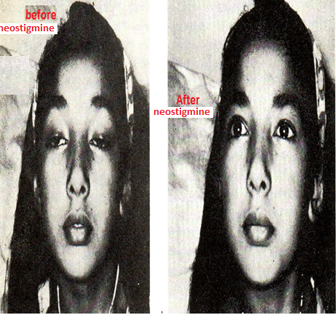
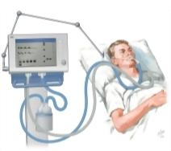
Myasthenia gravis
Severe myasthenia [myasthenia crisis], requires mechanical ventilation
Excess drug therapy [cholinergic crisis]
Chronic long term therapy→ neostigmine, pyridostigmine, ambenonium. Muscarinic side effects can be controlled by antimuscarinics

Slide 16
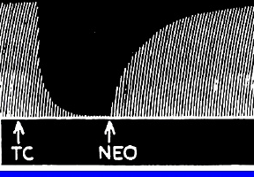
Clinical Uses
4-To reverse pharmacological paralysis produced in case of anaesthetic adjunct (neostigmine versus D-Tubacurarine).
5-Heart:- for treatment of supraventricular tachycardia, edrophonium potentates the effect of Ach at AV node →slow AV conduction & ventricular rate.
6-Antimuscarinic drug intoxication:- atropine overdose is toxic in children → severe muscarinic block
Blockade is competitive , overdose can be overcome by ↑ amount of endogenous Ach.
Physostigmine is used because it crosses the BBB , reverses central & peripheral signs.

Slide 17
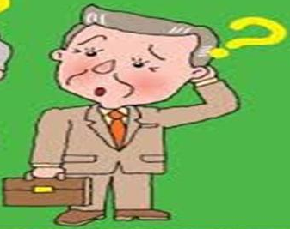
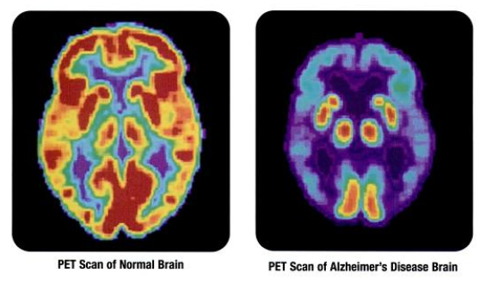
Clinical Uses
Alzheimer’s Disease
Characterized by loss of cholinergic neurons in the basal forebrain nuclei.
Thus cholinesterase inhibitors are used to treat AD
Donepezil, is not hepatotoxic
Used for treatment of dementia of AD
Taken orally

Slide 18
ii-Chronic nicotinic toxicity
C- Cholinesterase inhibitors:-
Organophosphates are used as pesticides ,veterinary vermifuge
Dominant initial signs of muscarinic excess, miosis, salivation, sweating , bronchial constriction, V,D,
CNS involvement follows accompanied by peripheral nicotinic effects

Slide 19
Therapy of cholinesterse toxicity
1- Maintenance of vital signs , respiration may be impaired
2-Decontamination to prevent further absorption, removal of cloth, washing of skin
Parenteral atropine in large doses. Pralidoxime[PAM][oxime] often

Slide 20
Contraindications
Bronchial asthma
Peptic ulcer
Angina pectoris
Urinary incontinence
Intestinal obstruction

Slide 21
Muscarinic actions
Cholinergic actions | Organs
Contraction of circular muscle of iris (miosis)(M3) Contraction of ciliary muscles for near vision (M3) Decrease in intraocular pressure | Eye
bradycardia ( heart rate ) (M2) Release of NO (EDRF) | Heart endothelium
Constriction of bronchial smooth muscles Increase bronchial secretion M3 | Lung
Increased motility (peristalsis) Increased secretion Relaxation of sphincter M3 | GIT
Contraction of muscles Relaxation of sphincter M3 | Urinary bladder
Increase of sweat, saliva, lacrimal, bronchial, intestinal secretions M3 | Exocrine glands

Slide 22
Carbamate esters
Uses | Kinetics | Actions | Drug
Myasthenia gravis treatment Paralytic ileus Urinary retention Curare toxicity | 0.5-6 hr polar | Nicotinic & muscarinic M, N | Neostigmine
Glaucoma atropine toxicity | 0.5-2hr Lipid soluble | Nicotinic muscarinic M, N, CNS | Physostigmine
Myasthenia gravis treatment | 3-6 polar | Nicotinic & muscarinic M, N | Pyridostigmine
Myasthenia gravis treatment | 4-8 polar | Nicotinic & muscarinic M, N | Ambenonium

Slide 23
Indirect Cholinomimetic
Diagnosis of Myasthenia gravis | Very Short 5-15 min, Polar | Edrophonium M, N
Myasthenia gravis treatment Paralytic ileus Urinary retention curare toxicity | Short 0.5-2hr polar | Neostigmine M, N
Glaucoma atropine toxicity | Short 0.5-2hr Lipid soluble | Physostigmine M,N, CNS
Myasthenia gravis treatment | Short 3-6, polar | Ambenonium Pyridostigmine M, N
Glaucoma. | Long 100hr, polar | Ecothiophate M, N
dementia of Alzheimer’s disease |  | Donepezil M, N

