Slide 1
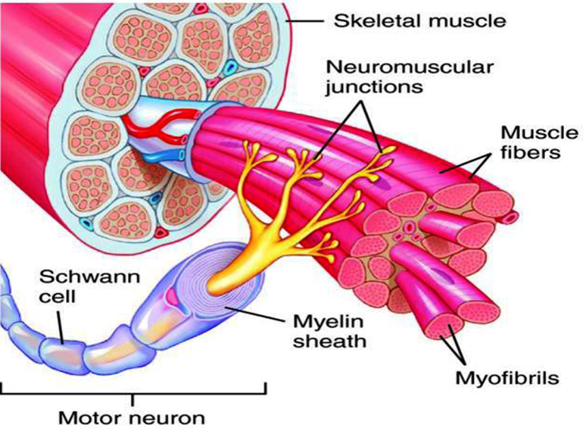
Motor Unit
Dr. Salah Elmalik
MBBS, PhD

Slide 2
Objectives
At the end of this lecture you should be able to:
Recognise the organization of the Nervous System
Identify the differences between central nervous system (CNS) & peripheral nervous system (PNS)
Understand the function & the recruitment of the motor unit. Appreciate effect of motor units number on motor action performance

Slide 3
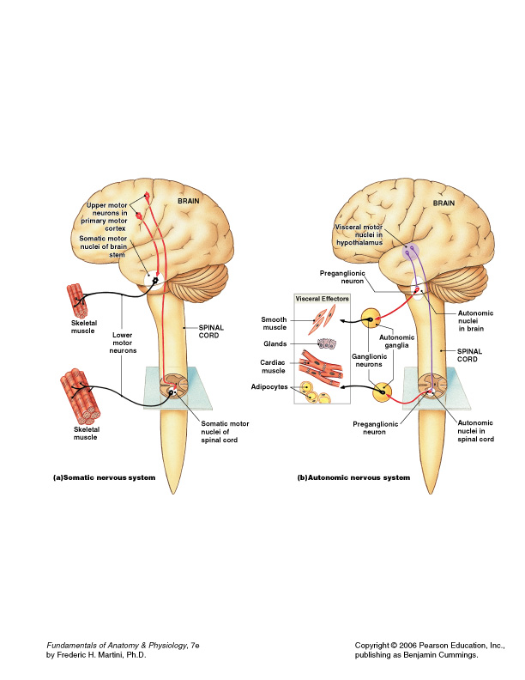
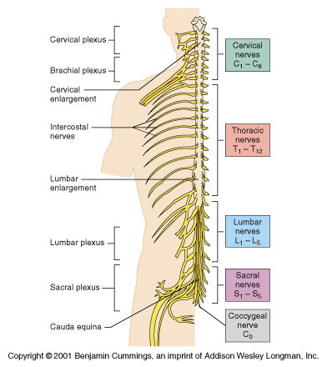
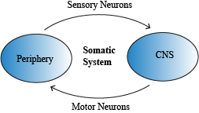
Organization of Nervous System

Slide 4
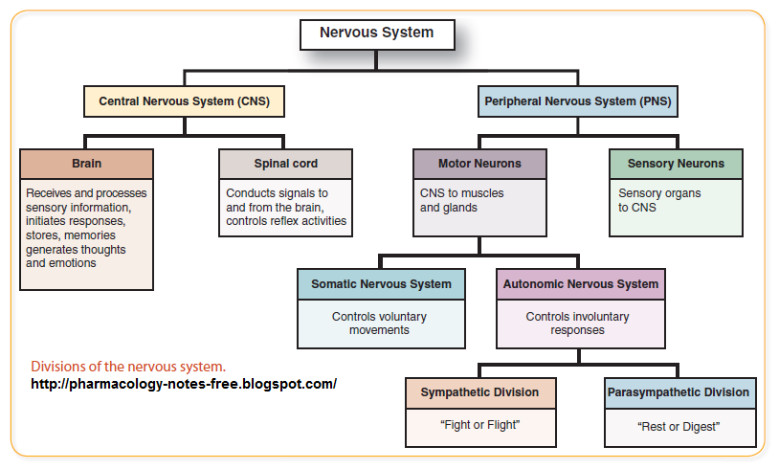

Slide 5
Nerve-Muscle Interaction
The nervous system can be divided into central (CNS) and peripheral (PNS)
It can also be divided in terms of function: motor and sensory activity
Sensory Neurons : collects info from the various sensors located throughout the body and transmits the info to the brain
Motor Neurons : conducts signals to activate muscle contraction
Skeletal muscle activation is initiated through neural activation

Slide 6
Organization of the Nervous System
1- Central nervous system (CNS)
It is the part that integrates the sensory information that it receives from diff parts of body , and coordinates the activity of all parts of the body .
It consists of :-
  The brain
  The spinal cord.
The brain is protected by the skull, while the spinal cord is protected by the vertebrae, and both are enclosed in the meninges

Slide 7
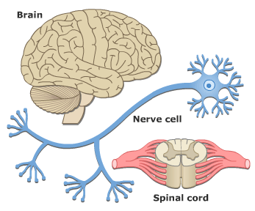
Neurons
The building unit of the nervous system is the neuron which has
  Cell body
    Nucleus
  Dendrites
  Axon
    Myelination
    Nodes of Ranvier
  Axon terminals
  Synaptic end bulbs
  Neurotransmitter
    Acetylcholine (ACH)

Slide 8
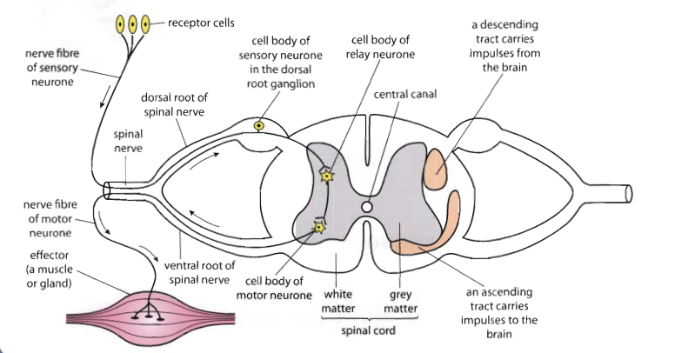
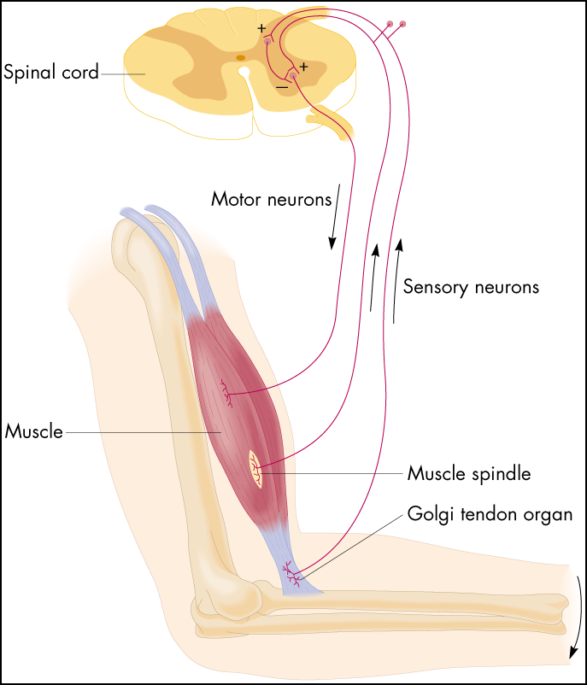
α-motor neuron in the anterior horn cell
A nerve is made of a group of axons of neurons

Slide 9
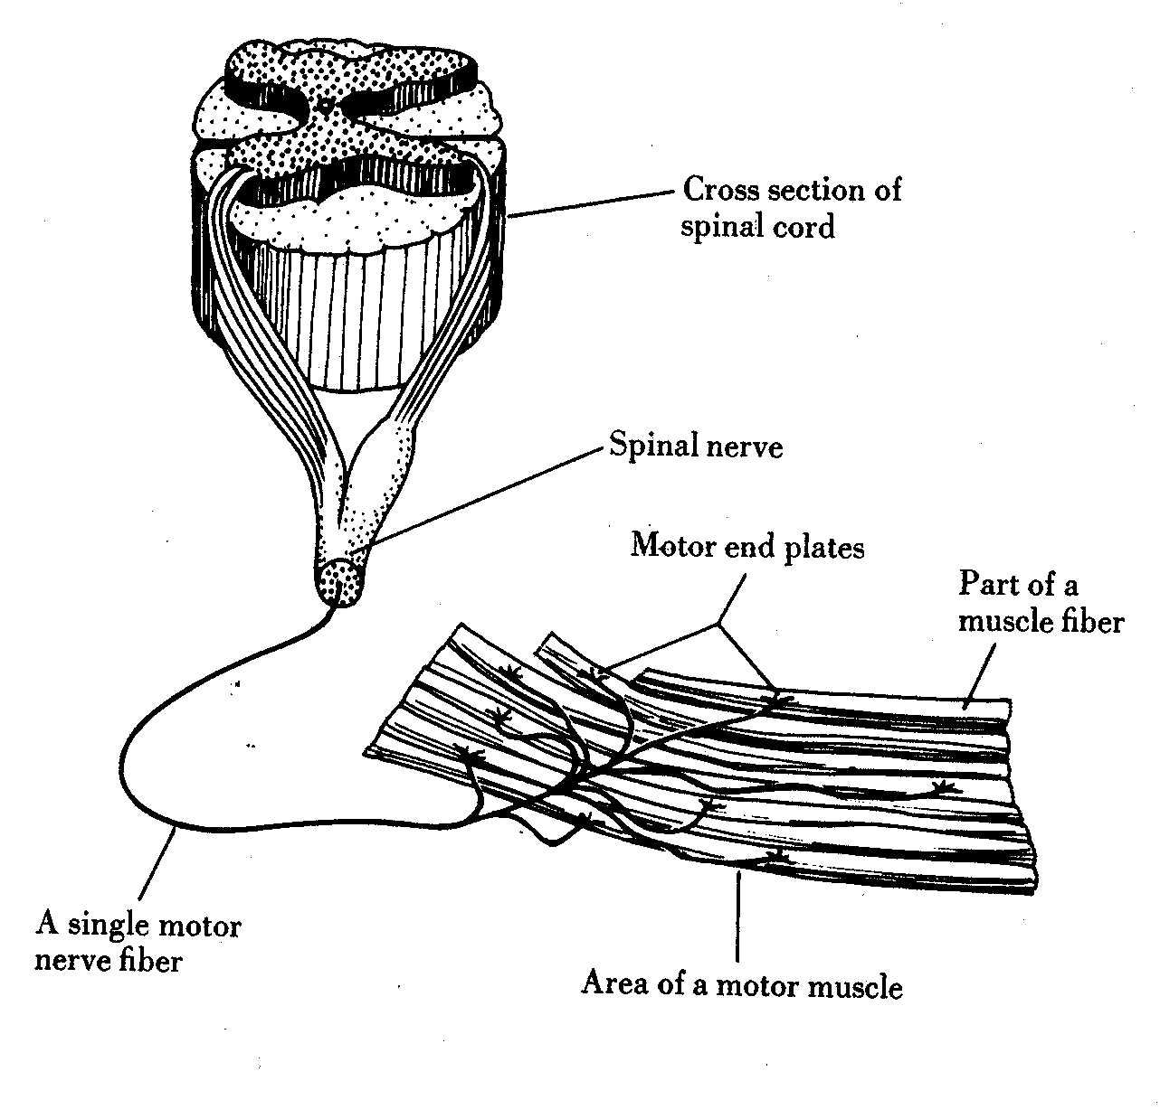
Motor Unit

Slide 10
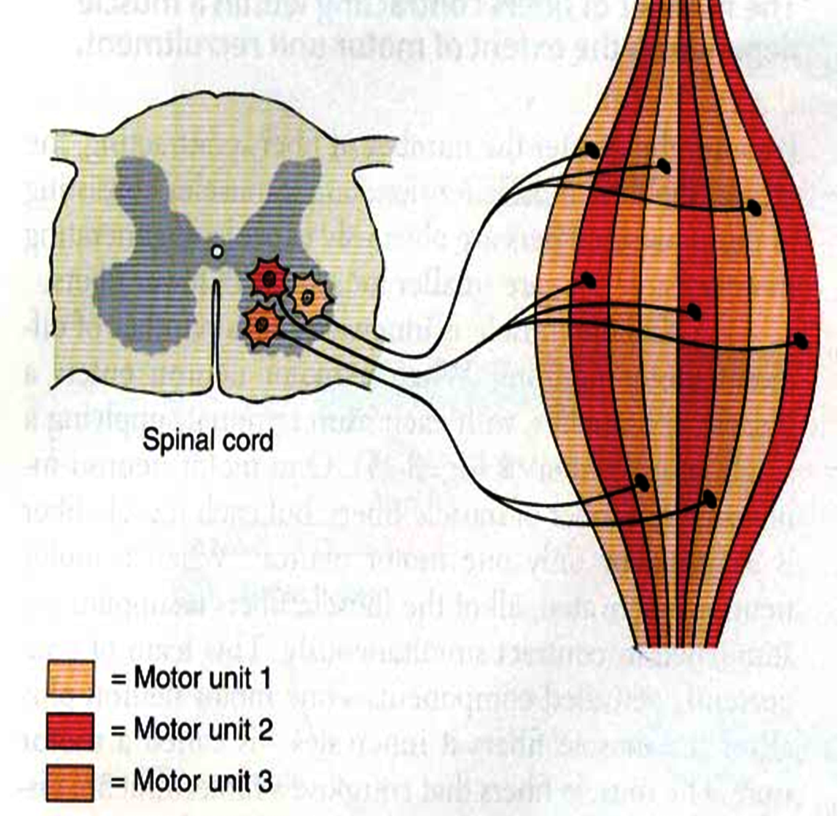
What is a Motor Unit ?
It is the α-motor neuron in the anterior horn cell , AHC ) and all the muscle fibers it innervates (supplies)
All of these muscle fibers will be of the same type (either fast twitch or slow twitch)
Each muscles consist of a number of motor units.
When a motor neuron is activated, all of the muscle fibers innervated by the motor neuron are stimulated and contract.

Slide 11
Motor Unit
The number of muscle fibers in a motor unit (innervated by 1 motor neuron) varies
  Gastrocnemius
    2,000 muscle fibers per motor neuron
  Extraocular muscles
    < 10 muscle fibers per motor neuron
Ratio of muscle fibers to motor neurons
  Affects the precision of movement

Slide 12
More precise movements
Less precise movements

Slide 13
Groups of motor units often work together to help the contractions of a single muscle .
The number of muscle fibers within each motor unit can vary.
Muscles needed to perform precise movements generally consist of a large number of motor units and few muscle fibers in each motor unit e.g Hand and eye muscles
Less precise movements are carried out by muscles composed of fewer motor units with many fibers per unit e.g Trunk muscles

Slide 14
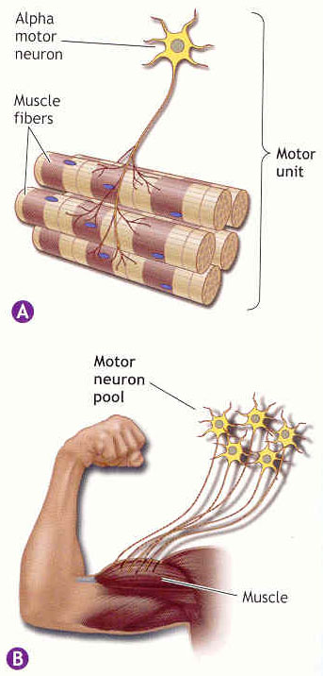
Motor unit recruitment:
The group of motor units supplying a single muscle are Motor Unit Pool
The two ways the nervous system increases force production is through
**recruitment of new motor units and
** increasing stimulation frequency (rate coding).
The activation of one motor neuron will result in a weak muscle contraction.
The activation of more motor neurons will result in more muscle fibers being activated, and therefore a stronger muscle contraction.

Slide 15
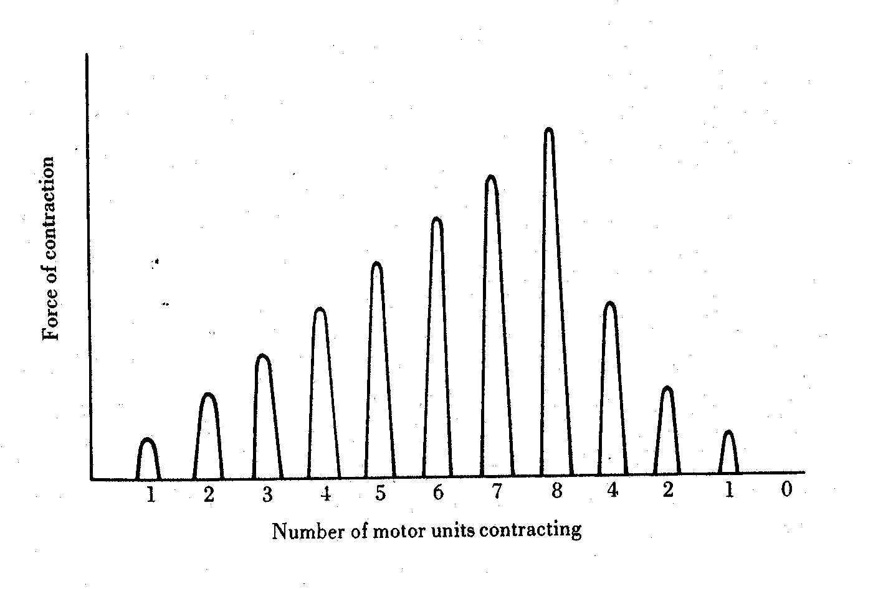
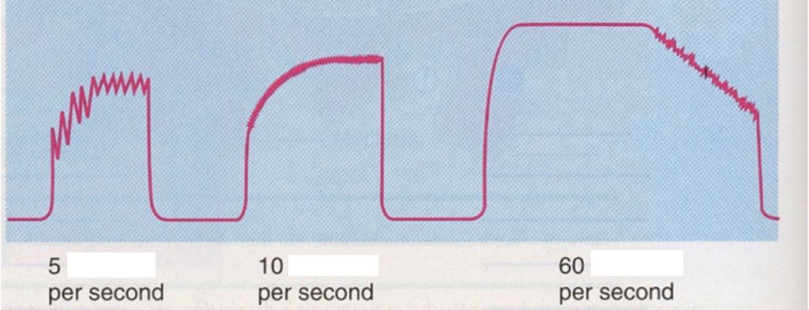
Motor unit recruitment
Recruitment of motor units is the progressive activation of a muscle by successive recruitment of contractile units (motor units) to accomplish increasing degrees of contractile strength ( force ).
When the AHC fires at slow rates , motor unit potentials (MUPs) will be at slow rate & the force of muscle contraction is weak
If AHCs fire at very fast rates → fast MUPs → stronger contraction
Increasing frequency of action potentials
resulting in stronger force of contraction

Slide 16
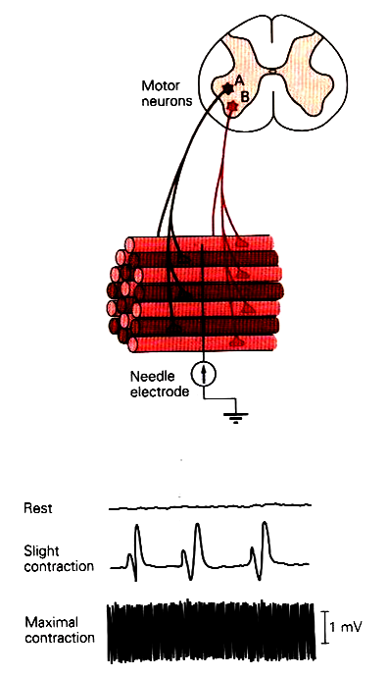
The higher the motor unit recruitment , the stronger the muscle contraction .
The force produced by a single motor unit is determined by →
(1) the number of muscle fibers in the unit , &
(2) the frequency with which the muscle fibers are stimulated by their innervating axon.
Generally, this allows a 2 to 4-fold change in force.

Slide 17
Size Principle
When CNS send a weak signal to contract muscle , the smaller motor units of the muscle stimulated first.
Then with increase the strength of signals larger and larger motor units begins to be excited

Slide 18
Recruitment
Varying the number of motor units activated.
Number & Size of Motor Units Recruited
Small motor units
Low stimulus threshold
Larger motor units
Higher stimulus threshold
Largest motor units
Highest stimulus threshold
The Size Principle
↓
↑
Amount of Force Required During Movement

Slide 19
Rate Coding
Rate coding refers to the motor unit firing rate.
  Active motor units can discharge at higher frequencies to generate greater tensions.
Recruitment versus rate coding
  Smaller muscles (ex: first dorsal interosseous) rely more on rate coding.
  Larger muscles of mixed fiber types (ex: deltoid) rely more on recruitment.

Slide 20
All or non role
  Motor Units Follows “all-or-none” principle – impulse from motor neuron will cause contraction in all muscle fibers it innervates or none
In an electrodiagnostic testing (EMG , electromyography) for a patient with weakness, careful analysis of the motor unit action potential (MUAP) size, shape, and recruitment pattern can help in distinguishing a myopathy from neuropathy.

Slide 21
Thank You

