Slide 1
Phospholipids of clinical significance
Respiratory block

Slide 2
objectives
By the end of this lecture the First Year students will be able to:
Identify the types and functions of phospholipids
Discuss the physiological importance of phospholipids
Understand the role of glycerophospholipids in lung surfactant and their clinical implications in respiratory distress syndrome (RDS)
Identify the classes and physiological functions of phospholipase enzymes

Slide 3
overview
Types and functions of phospholipids
Glycerophospholipids: Types, functions and role in lung surfactant, cell signaling and protein anchoring
Respiratory distress syndrome (RDS)
Sphingophospholipids
Phospholipids in lipoprotein particles
Phospholipases: Types and functions

Slide 4
phospholipids
Phospholipids are polar, ionic compounds that contain an alcohol group attached either to:
Diacylglycerol or
Sphingosine
Major lipids of cell membranes
Two classes:
Glycerophospholipids
Sphingophospholipids

Slide 5
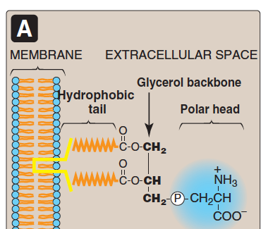
phospholipids
Their hydrophobic (non-polar) portion is attached to the membrane
Their hydrophilic (polar) portion extends outward interacting with the aqueous environment

Slide 6
Functions of phospholipids
Membrane-bound phospholipids act as:
Reservoir for intracellular messengers
Anchors to cell membranes
Nonmembrane-bound phospholipids act as:
Lung surfactant
Components of bile (as detergents to solubilize cholesterol)

Slide 7
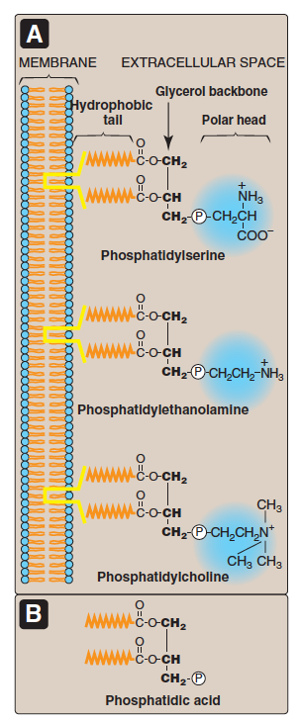
Glycerophospholipids
Also called phosphoglycerides
Contain glycerol
A major class of phospholipids
All contain phosphatidic acid (PA)
PA is the simplest phospholipid

Slide 8
glycerophospholipids
Phospholipids are derived from PA such as:
Serine + PA | Phosphatidylserine (PS) | Cell signaling Blood clotting
Ethanolamine+PA | Phosphatidylethanolamine (PE) (cephalin)
Choline + PA | Phosphatidylcholine (PC)(lecithin) | Lung surfactant
Inositol + PA | Phosphatidylinositol (PI) | Cell signaling
Glycerol + PA | Phosphatidylglycerol (PG) | Lung surfactant

Slide 9
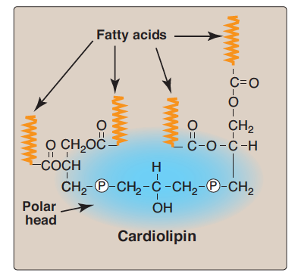
some examples
Cardiolipin
Two molecules of PA joined to an additional molecule of glycerol through PO₄ groups
In the inner mitochondrial membrane
Function: maintenance of respiratory complexes of electron transport chain

Slide 10
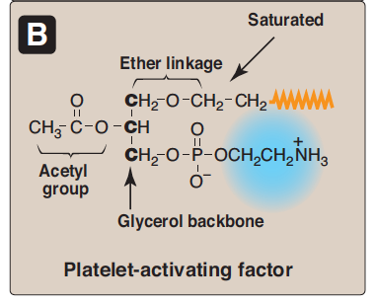
some examples
Platelet activating factor (PAF)
Binds to cell surface receptors
Triggers thrombotic and acute inflammatory reaction

Slide 11
Role of PC in Lung surfactant
Lung surfactant is a complex mixture of:
Lipids (90%) including Dipalmitoylphosphatidylcholine (DPPC)
Proteins (10%)
Alveolar cells of the lungs are lined by the extracellular fluid layer
Alveolar cells secrete DPPC (a major lung surfactant)

Slide 12
Role of PC in Lung surfactant
Surfactant decreases the surface tension of the fluid layer
Reduces pressure needed to re-inflate alveoli
Prevents alveolar collapse (atelectasis)

Slide 13
Role of PC in Lung surfactant
Respiratory distress syndrome (RDS)
In preterm infants due to deficiency of lung surfactant
A major cause of neonatal death
Treatment: Glucocorticoids to mother to promote lung maturation
In adults due to damaged alveoli by infection or trauma

Slide 14
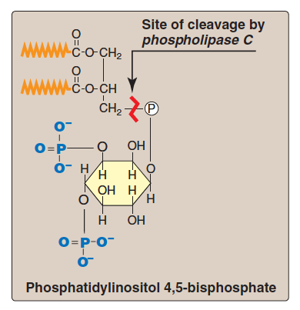
Role of PI in cell signaling
Plays important role in intracellular signaling
PI is part of calcium-phosphatidyl inositol system

Slide 15
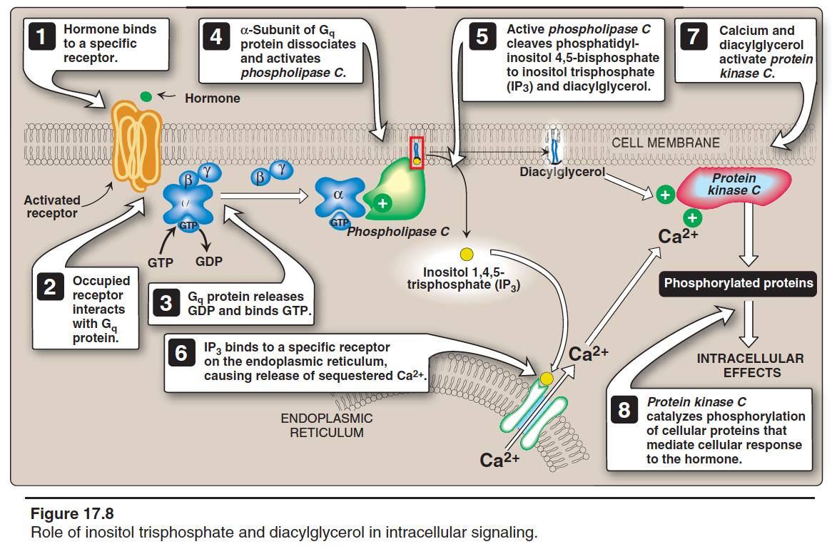

Slide 16
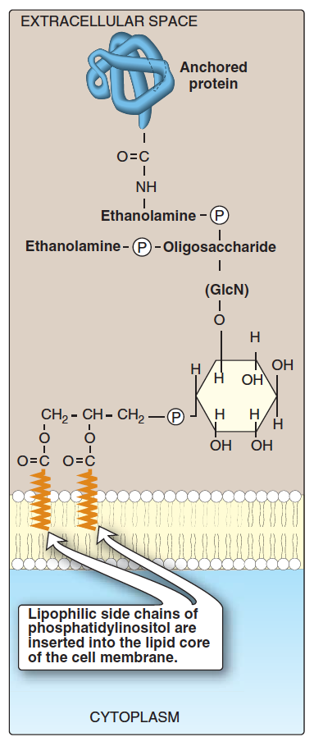
Role of PI in membrane protein anchoring
Anchoring of proteins to membranes through carbohydrate-PI bridge
Examples:
Alkaline phosphatase (on the surface of small intestine)
Acetylcholine esterase (on postsynaptic membrane of neurons)
Anchoring proteins can be cleaved by phospholipase C enzyme

Slide 17
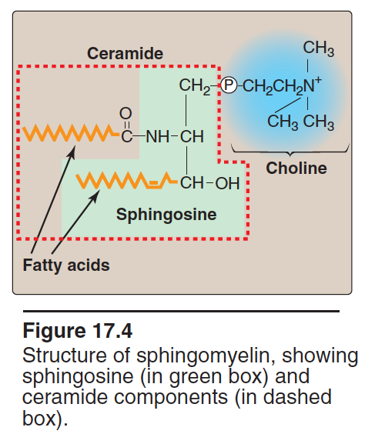
sphingophospholipids
A long-chain fatty acid attached to sphingosine
Example: Sphingomyelin
An important component of myelin that protects and insulates nerve fibers

Slide 18
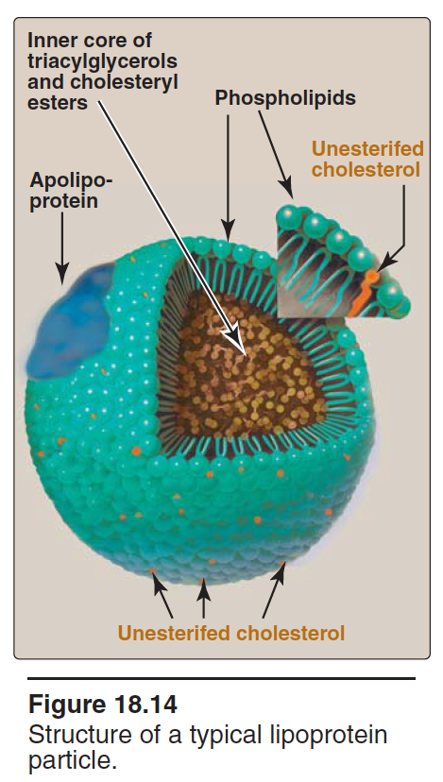
phospholipids in lipoprotein particles
The outer core of lipoprotein particles is hydrophilic
Contains phospholipids and free cholesterol
Allows transport of core lipids in aqueous plasma

Slide 19
Phospholipases
Phospholipids are degraded by phospholipase enzymes
Present in all tissues including pancreatic juice
Glycerophospholipids are degraded by:
Phospholipase A₁, A₂, C, D
Sphingophospholipids are degraded by:
Sphingomyelinase

Slide 20
Functions of Phospholipases
Digestion of phospholipids by pancreatic juice
Important for remodeling of phospholipids
Production of second messengers
Pathogenic bacteria produce phospholipases to dissolve cell membranes and spread infection

Slide 21
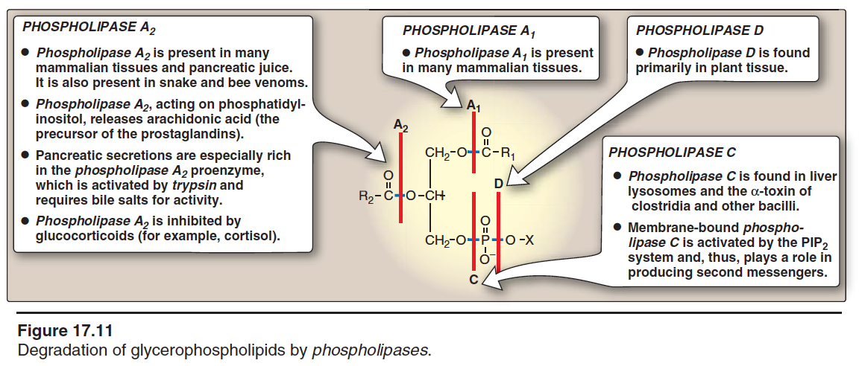

Slide 22
Take home message
Phospholipids are complex lipids that perform important physiological functions in the body
Membrane-bound phospholipids are involved in cell signaling, protein anchoring and myelin protective functions
Nonmembrane-bound phospholipids function as lung surfactant and as detergent in the bile
Phospholipases are enzymes that degrade phospholipids
They are important for remodeling of phospholipids

Slide 23
references
Lippincott’s Illustrated Reviews, Biochemistry, 6th Edition, Denise R. Ferrier, Lippincott Williams & Wilkins, USA, pp 201-207.

