Slide 1
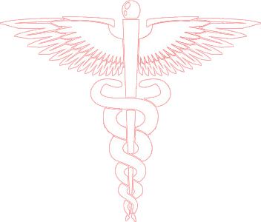
Diseases of the Respiratory System
Dr. Ammar C. Al-Rikabi
Dr. Maha Arafah

Slide 2
Diseases of the Respiratory System
Lecture 1
2018
Review of the normal Anatomy and Histology of the Respiratory System
Bronchial asthma

Slide 3
The respiratory system
Diseases of Lung

Slide 4
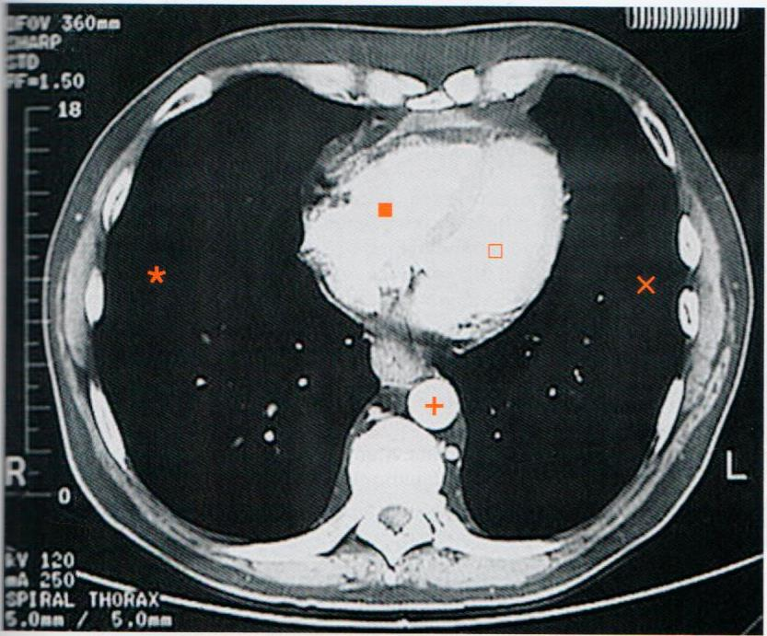
Normal lung, CT image

Slide 5
The lower respiratory tract
Diseases of Lung

Slide 6
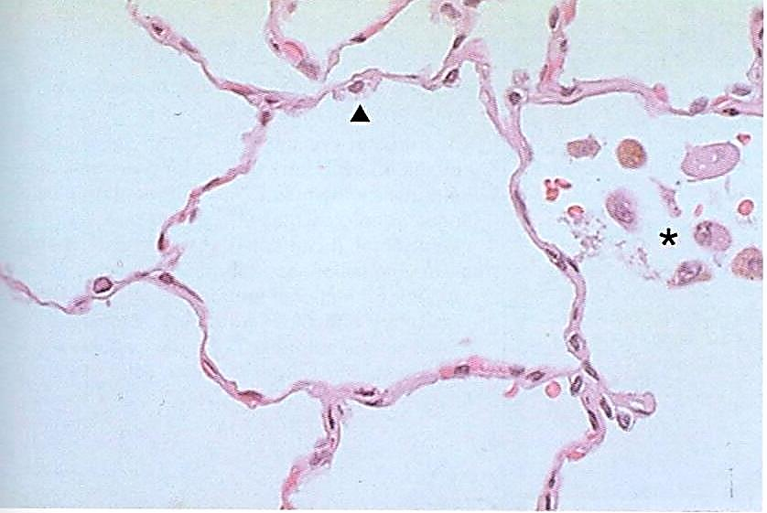
Normal adult lung

Slide 8
Diseases of the Respiratory System
Chronic Obstructive Pulmonary Diseases (COPD) including Bronchial Asthma

Slide 9
Bronchial asthma Objectives
BA is an episodic, reversible bronchoconstriction caused by increased responsiveness of the tracheobronchial tree to various stimuli.
Define bronchial asthma (BA)
Understand the pathogenesis
Understanding the morphological changes
Know the manifestation and clinical coarse of BA
List the complications of BA
Define status asthmaticus
Know the prognosis and prevention of BA

Slide 10
Extrinsic asthma:
Type 1 Hypersensitivity reaction, IgE
Childhood
Viral infection
family Hx of allergy
Intrinsic asthma:
BA associated with, aspirin, exercise, cold induced.
No Hx of allergy

Slide 11
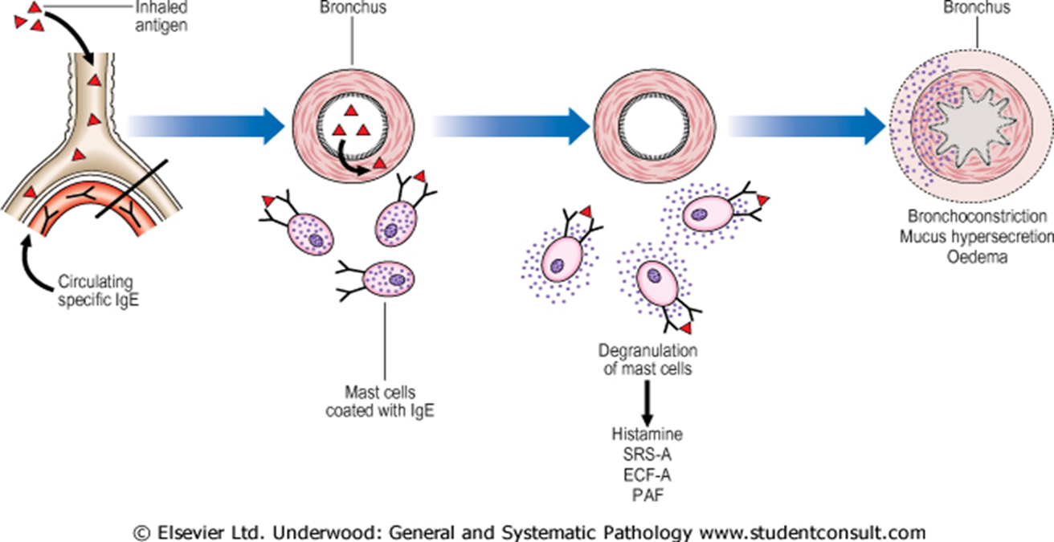
Pathogenesis of allergic asthma
Pollen
dust, virus, animal fur, sand bacteria

Slide 12
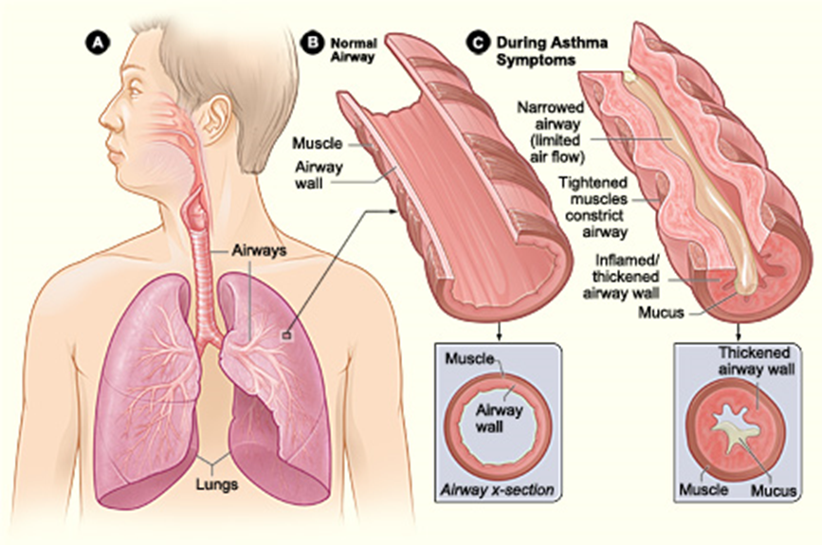
Morphological changes 0f BA

Slide 13
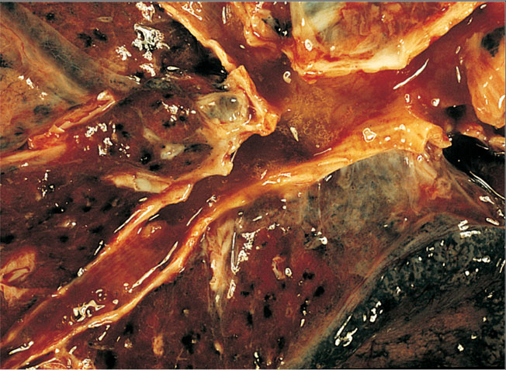
Morphological changes 0f BA
Bronchitis in an asthmatic patient. Note the presence of congested mucosa and mucoid secretions.

Slide 14
Bronchial airway in normal lung
Morphological changes 0f BA

Slide 15
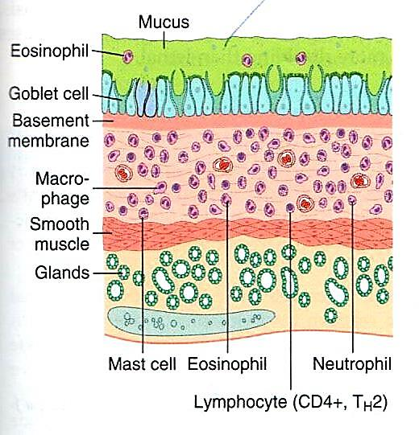
Morphological changes 0f BA
Thick Basement Membrane. Sub-basement membrane fibrosis (airway remodeling )
Edema and inflammatory infiltrate in bronchial wall.
Submucosal glands increased.
Hypertrophy of the bronchial wall muscle.
Mucous contain Curschmann spirals, eosinophil and Charcot-Leyden crystals.
Bronchial airway in asthma patient

Slide 16
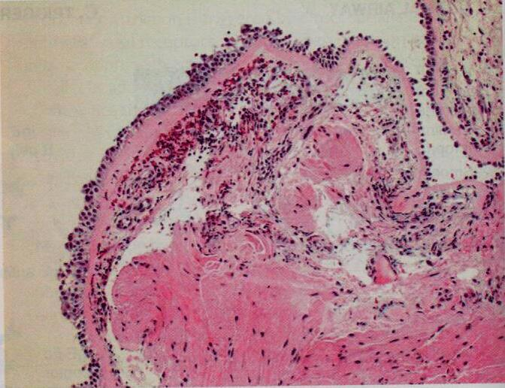
Bronchial biopsy specimen from an asthmatic patient showing sub-basement membrane fibrosis, eosinophilic inflammation and smooth muscle hyperplasia
Morphological changes 0f BA

Slide 17
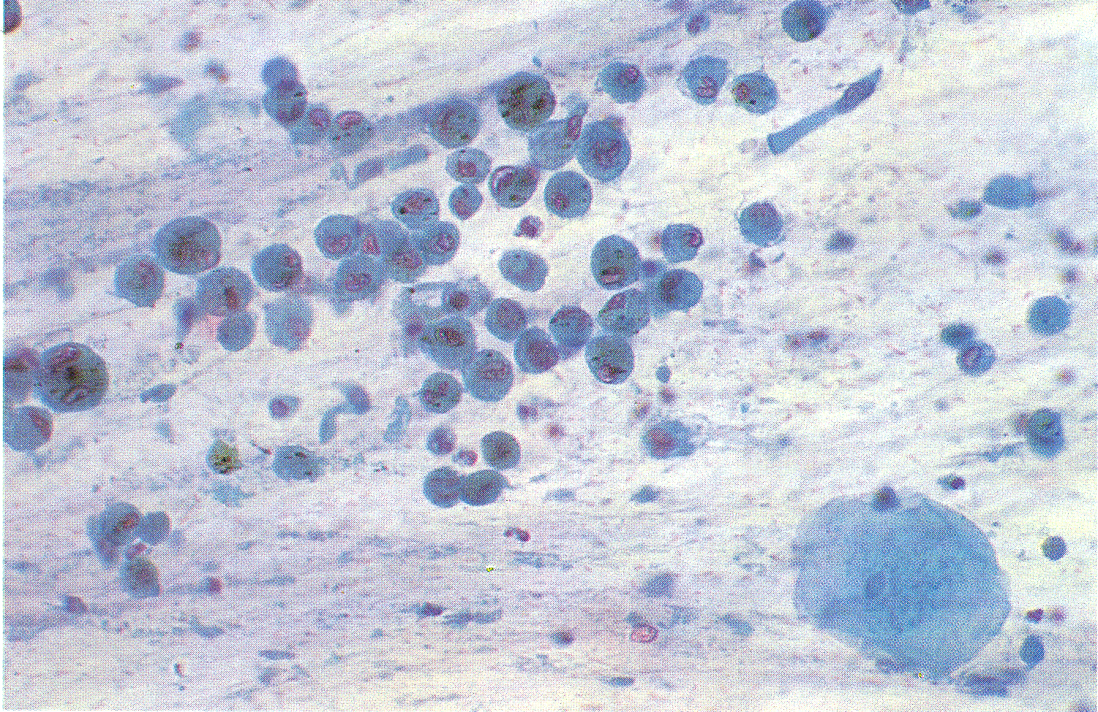
Morphological changes 0f BA
Composition of satisfactory specimen : Sputum

Slide 18
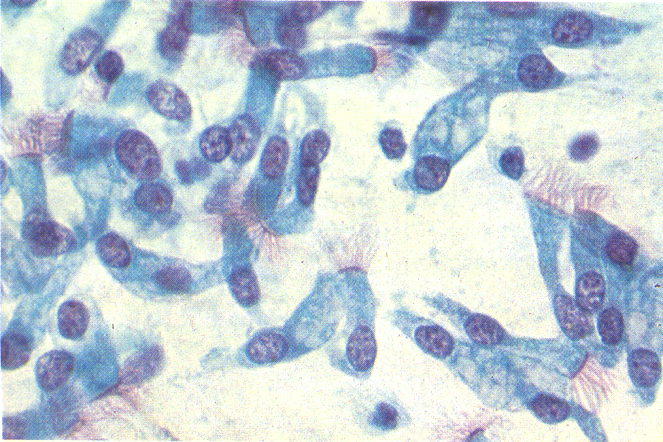
Morphological changes 0f BA
Ciliated columnar cells

Slide 19
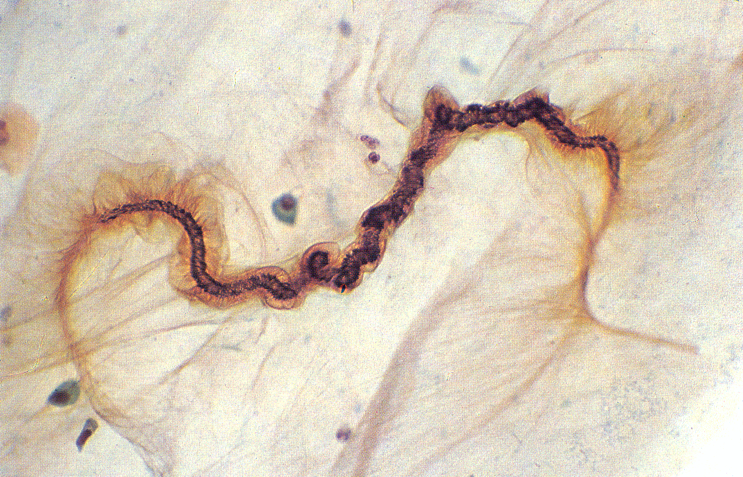
Morphological changes 0f BA
Curschmann’s spiral : Sputum

Slide 20
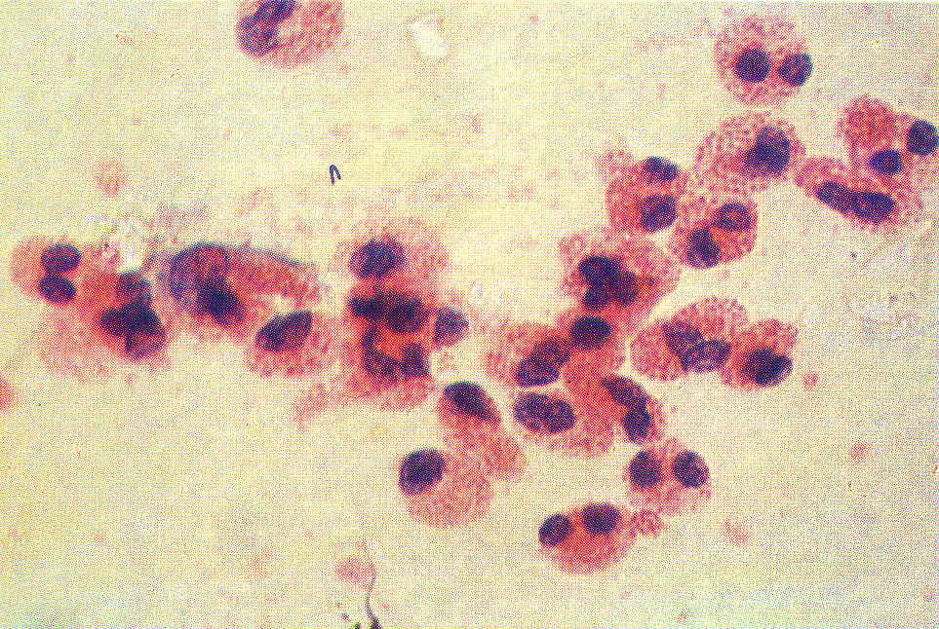
Morphological changes 0f BA
Eosinophils from a case of Bronchial Asthma

Slide 21
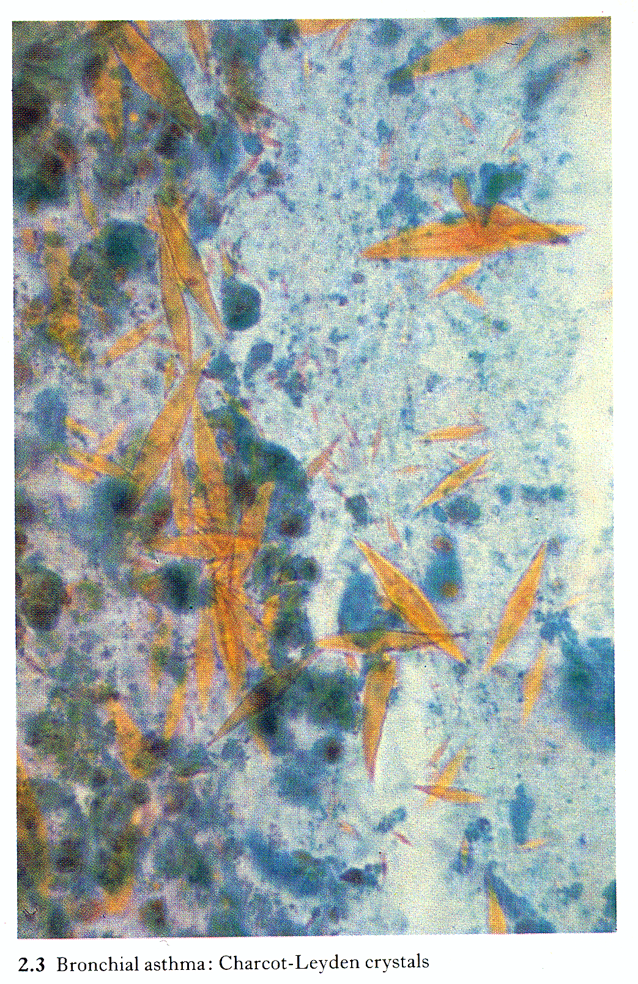
Morphological changes 0f BA
Bronchial asthma : Charcot – Leyden Crystals

Slide 22
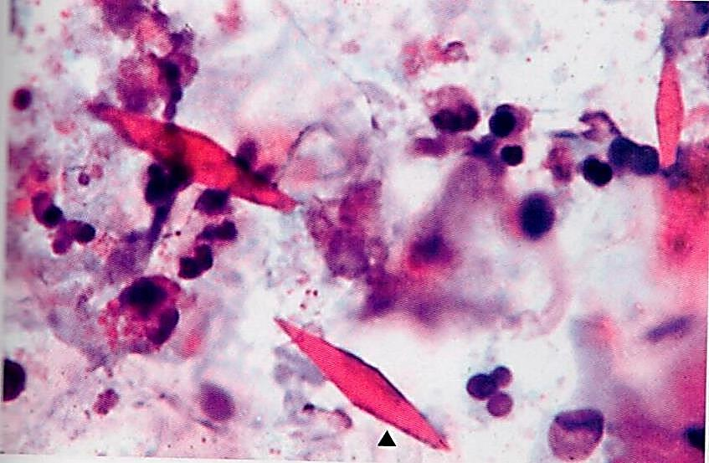
Morphological changes 0f BA
Bronchial Asthma, microscopic

Slide 23
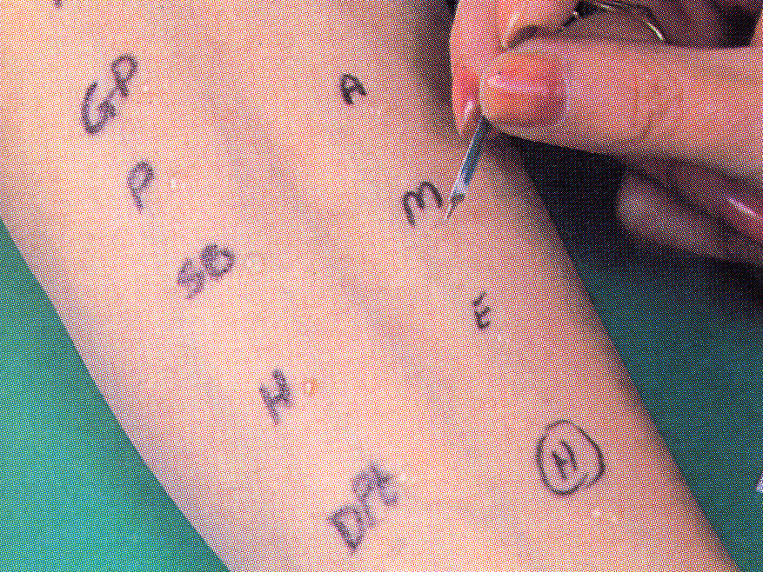
Skin prick testing in a patient with asthma.
IgE mediated type I hypersensitivity reaction to inhaled allergens

Slide 24
CLINICAL Features
Clinical features of Asthma
manifestations vary from occasional wheezing to paroxysms of dyspnea and respiratory distress.
In a classic asthmatic attack there is dyspnea, cough, difficult expiration, progressive hyperinflation of lung and mucous plug in bronchi. This may resolve spontaneously or with treatment.
Nocturnal cough
Increased anteroposterior diameter, due to air trapping and increase in residual volume
Status asthmaticus – Overinflated lungs with sever obstruction and air trapping leading to severe cyanosis and persistent dyspnea, may be fatal

Slide 25
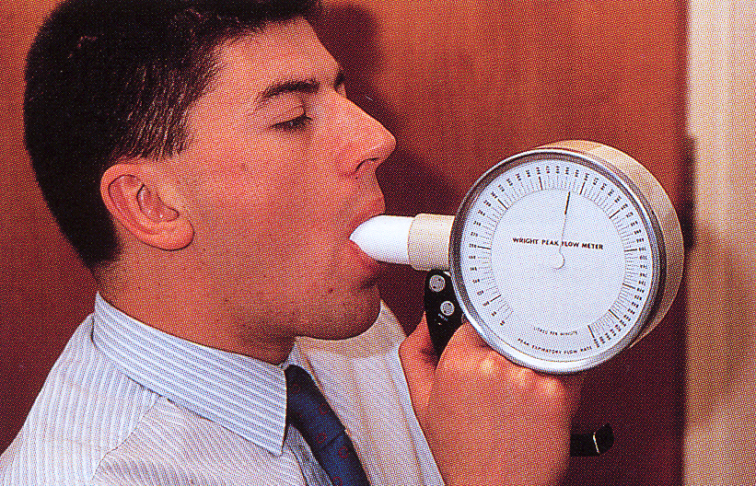
Clinical coarse of BA
The range of presentation in asthma. This patient was found incidentally to have a degree of reversible airways obstruction during a routine medical examination.

Slide 26
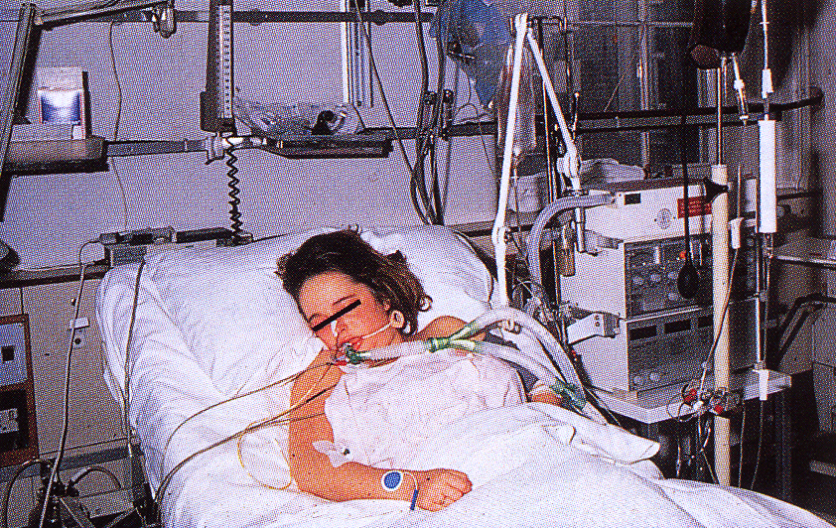
Status asthmaticus
This patient presented as a medical emergency with acute severe breathlessness and diagnosed as a case of status asthmaticus (Overinflated lungs because of sever obstruction and air trapping) which required immediate intensive care including intermittent positive-pressure ventilation.

Slide 27
COMPLICATIONS OF ASTHMA
Complications of Asthma
Airway remodeling:
some persons with long standing asthma develop permanent structural changes in the airway with sub-basement membrane fibrosis, hypertrophy of muscle and progressive loss of lung function that increase airflow obstruction and airway responsiveness.
Superimposed infection i.e. pneumonia
Chronic bronchitis
i.e. Asthmatic bronchitis: chronic bronchitis with superimposed asthma
Emphysema, pneumothorax and pneumomediastinum
Bronchiectasis
Respiratory failure
requiring intubation in severe exacerbations i.e. status asthmaticus
In some cases cor pulmonale and heart failure develop.

Slide 28
Prognosis
Prognosis of Asthma
Remission- approximately 50% of cases of childhood asthma resolve spontaneously but may recur later in life; remission in adult-onset asthma is less likely.
Mortality- death occurs in approximately 0.2% of asthmatics. Mortality is usually (but not always) preceded by an acute attack and about 50% are more than 65 years old.

Slide 29
Prevention
Prevention of Asthma
Control of factors contributing to asthma severity.
Exposure to irritants or allergens has been shown to increase asthma symptoms and cause exacerbations.
Skin test
results should be used to assess sensitivity to common indoor allergens.
All patients with asthma should be advised to avoid exposure to allergens to which they are sensitive.

Slide 30
Asthma: Summary Episodic attacks of bronchoconstriction (reversible)
Types
Extrinsic asthma: Type 1 Hypersensitivity reaction, IgE, viral infection, childhood, family Hx of allergy.
Morphology
Hypertrophy of bronchial smooth muscle & hyperplasia of goblet cells e eosinophils, thickened BM
Mucous plug e Curschmann spirals & Charcot-Leyden crystals.
Complication
Superimposed infection
Chronic bronchitis
Pulmonary emphysema
Status asthmaticus (Overinflated lungs with sever obstruction and air trapping)
Intrinsic asthma: BA associated with, aspirin, exercise, cold induced. No Hx of allergy
Remodeloing with sub-basement membrane fibrosis and hypertrophy of muscle layer

