Slide 1
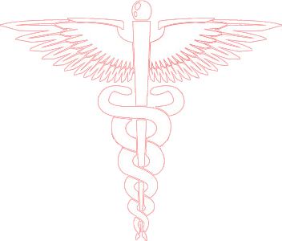
Diseases of the Respiratory System
Chronic Obstructive Pulmonary Diseases (COPD)
Prof. Ammar C. Al-Rikabi
Dr. Maha Arafah
Respiratory block
2019
Pathology
Lecture 2

Slide 2
Objectives:
Give introduction for diffuse lung disease
Compare and contrast the major clinical and functional differences between predominant chronic bronchitis versus predominant emphysema in patients with COPD
Define Bronchiectasis, its causes, presentation, morphology and significant.

Slide 3
Obstructive Lung Diseases
Obstructive lung disease
(diffuse)
Bronchial Asthma
2) Chronic obstructive pulmonary disease (COPD)
Cigarette smoking is the principle cause
10% of population above 45 year has airflow obstruction
They are of two types:
a) Chronic bronchitis
b) Emphysema
3) Bronchiectasis
Common symptoms in lung disease
Dyspnea: difficulty with breathing
Cough
Hemoptysis
Robbins Basic Pathology Table 13.1 page 498

Slide 4
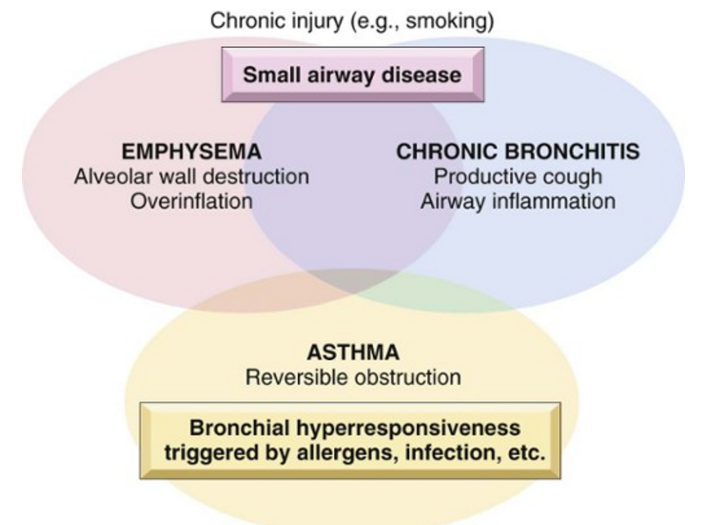

Slide 5
Diseases of the Respiratory System
Emphysema
Objectives:
Define emphysema.
Describe the gross and microscopic changes in emphysema.
Discuss the typical clinical presentation and causes of death.
Describe the most likely mechanism of emphysema (the protease-antiprotease mechanism).
Describe the pathophysiologic mechanisms of emphysema

Slide 6
Emphysema abnormal permanent enlargement of all or part of the respiratory unit accompanied by destruction of their walls
Emphysema
Associated with loss of elastic recoil and support of small airways leading to tendency to collapse with obstruction

Slide 7
Classification of emphysema
Diseases of Lung
Centriacinar:
in heavy smoker, severe in upper lobes
2. Alpha 1 antitrypsin deficiency:
Commonly affect both lower lobes at lower zones
3.Distal acinar /paraseptal:
adjacent to areas of fibrosis or atelectasis
More severe in the upper half of the lungs, young adult, unknown cause, spontaneous peumothorax
4. Irregular
Associated with scarring, e.g. in TB
Asymptomatic

Slide 8
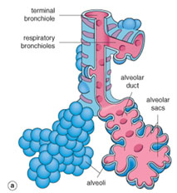
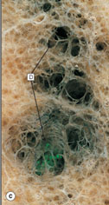
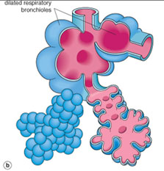
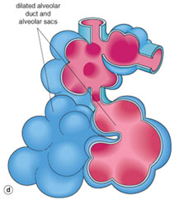
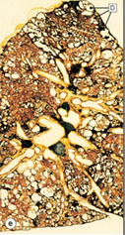
Diseases of Lung
Emphysema: morphology
Generalized emphysema. (a) Normal distal lung acinus. (b) Centriacinar emphysema. (c) Centriacinar emphysema. (d) Panacinar emphysema. (e) Panacinar emphysema (Gough-Wentworth section).

Slide 9
Emphysema
Diseases of Lung

Slide 10
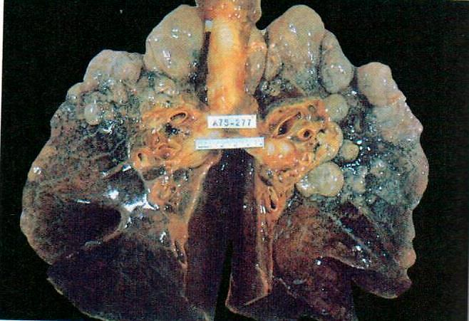
Bullous emphysema with large apical and subpleural bullae

Slide 11
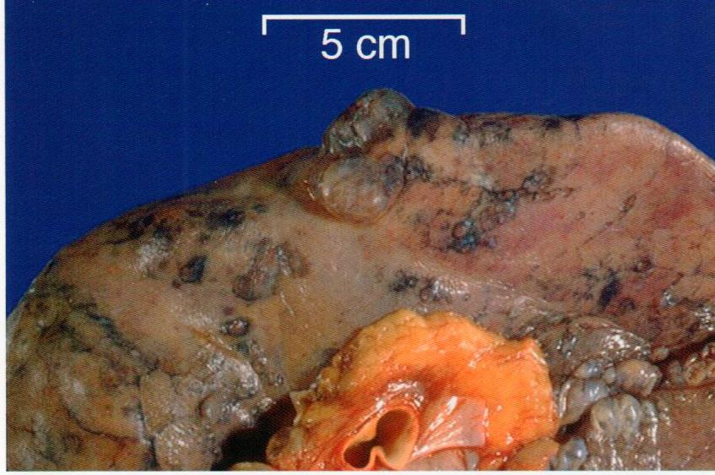
Distal acinar /paraseptal:
forming multiple cyst-like structures with spontaneous pneumothorax.

Slide 12
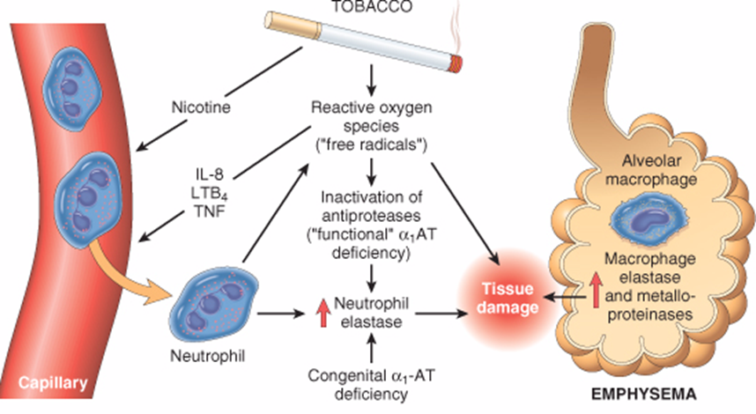
Emphysema: Pathogenesis

Slide 13
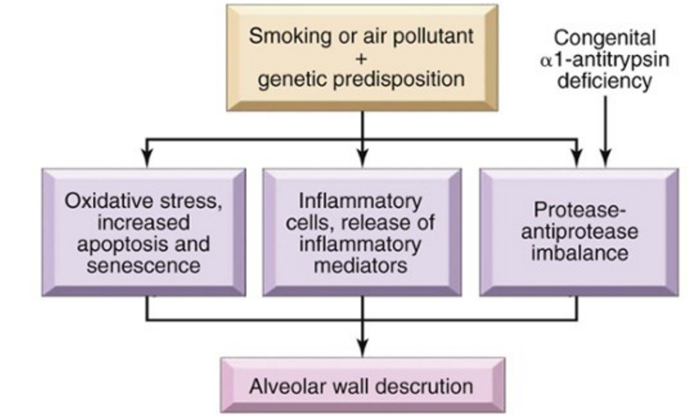
Emphysema
Emphysema: Pathogenesis
Pathogenesis of Emphysema

Slide 14
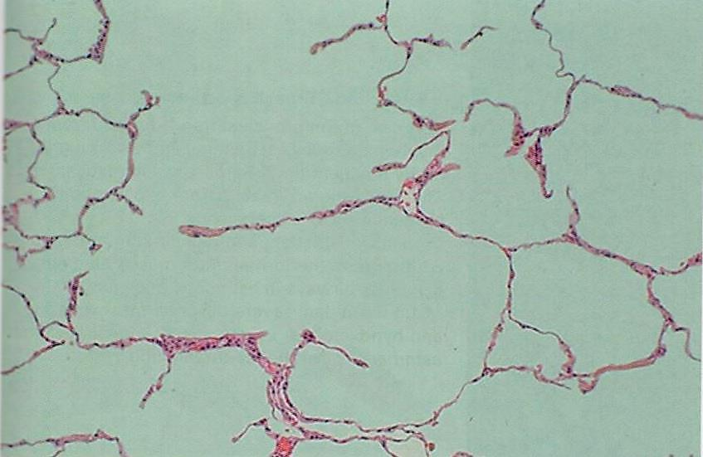
Emphysema: morphology
Destruction of some alveolar septi
Enlarged air spaces/alveolar spaces.
Paraseptal emphysema, microscopic
destruction of alveolar walls

Slide 15
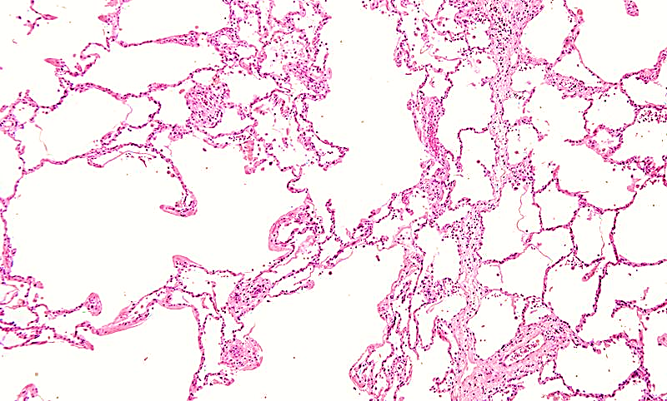
Emphysema: morphology
Enlarged air spaces
Destruction of some alveolar septi

Slide 16
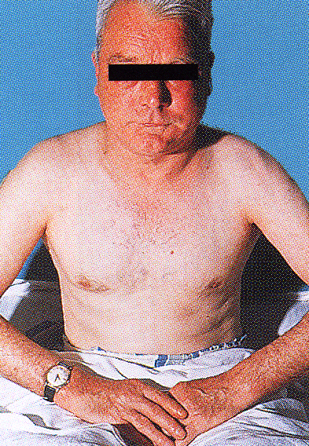
Emphysema:- Clinical features: Dyspnea
Pursed lip expiration is a common maneuver adopted by patients with severe chronic obstructive pulmonary disease including emphysema.
The patient starts to breathe out closed or nearly closed lips to keep the intrabronchial pressure high and prevent collapse of the bronchial wall and expiratory obstruction. Later in expiration the lips are blown forwards and open, often with a grunt (“fish-mouth breathing).
Patient is sitting forward in a hunched- over position

Slide 17
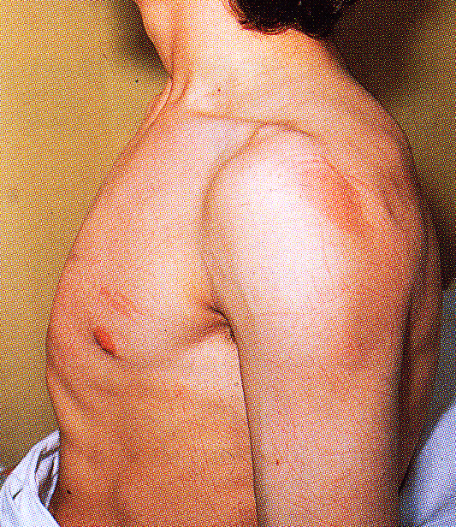
Barrel-shaped chest in a patient with emphysema.
The hyperinflation result from
air-trapping with inflammatory changes
hypersecretion of viscid contraction in the small airways.
Note the associated indrawing of the intercostal muscles. Similar changes are seen in patients with chronic bronchitis and asthma.

Slide 18
Emphysema: Complications
Pneumothorax
Pulmonary hypertension (due to destruction of small capillaries in alveolar wall and hypoxia lead to pulmonary vascular spasm)
Right-sided heart failure (Cor pulmonale)
Death from emphysema is related to:
Pulmonary failure with respiratory acidosis, hypoxia and coma or due to pulmonary hypertension.

Slide 19
Emphysema:
Emphysema: SUMMARY
Dilated air spaces beyond respiratory bronchioles due to destruction of alveolar septa
Types
Centriacinar: Smoking
Clinical features
Cough and wheezing. Dyspnea
Complications
Pneumothorax
Panacinar: deficiency of α1 AT
Paraseptal: Occurs adjacent to areas of fibrosis or atelectasis.
Irregular: scar
Weight loss
Pulmonary function tests reveal low FEV1
Pulmonary failure with respiratory acidosis, hypoxia and coma.
Right-sided heart failure (Cor pulmonale)
Pulmonary hypertension.
Pink puffers. Respiratory acidosis

Slide 20
Diseases of the Respiratory System
Chronic Bronchitis
Objectives:
Define chronic bronchitis.
Describe the causes, pathogenesis and the morphology of chronic bronchitis.
Describe the mechanism of airway obstruction in a patient with chronic bronchitis.
Understand that when severe obstruction is present in chronic bronchitis, significant emphysema is nearly always present

Slide 21
Chronic Bronchitis
Chronic Bronchitis: defined as persistent productive cough for at least 3 consecutive months in at least 2 consecutive years
Causes
Cigarette smoking is the most important risk factor
Air pollutants
Cystic fibrosis

Slide 22
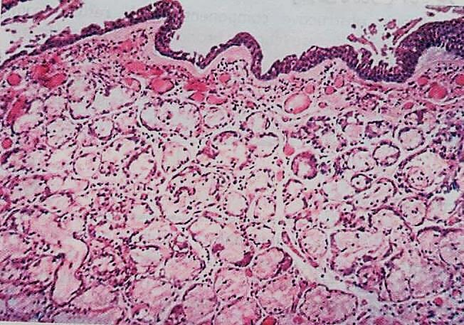
Chronic Bronchitis: morphology
Chronic bronchitis

Slide 23
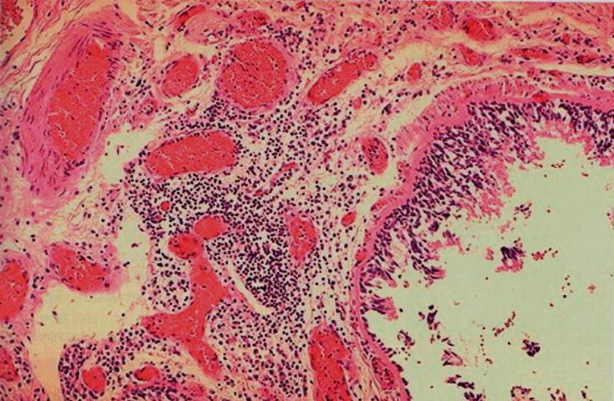
Chronic Bronchitis: morphology
Chronic bronchitis

Slide 24
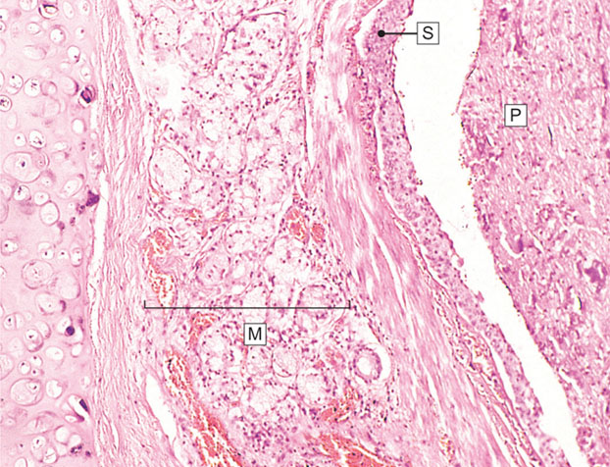
Chronic Bronchitis: morphology
Chronic bronchitis. In chronic bronchitis the main abnormality is secretion of abnormal amounts of mucus, causing plugging of the airway lumen (P)

Slide 25
Clinical features and compilcations
Chronic Bronchitis
Persistent reproductive cough
Dyspnea on exertion
Hypercapnia, hypoxemia, cyanosis (blue bloaters)
Emphysema
Cor pulmonale
Death due to further impairment of respiratory functions after superimposed acute baterial infections.

Slide 26
Chronic Bronchitis
Definition: Persistent productive cough (with sputum) for at least 3 months in at least 2 consecutive years
Causes
Cigarette smoking is the most important risk factor; air pollutants also contribute
Features
enlargement of mucous-secreting glands, goblet cell hyperplasia, chronic inflammation, and bronchiolar wall inflammation and fibrosis.
Complications
Persistent reproductive cough, dyspnea on exertion, hypercapnia, hypoxemia, cyanosis, cor pulmonale with edema (blue bloater)
Death may result from further impairment of respiratory function due to superimposed acute infections.

Slide 27
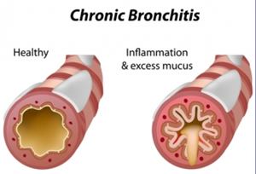
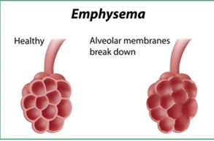

Slide 28
Bronchiectasis
Objectives:
Definition
Causes
Presentation
morphology and significant

Slide 29
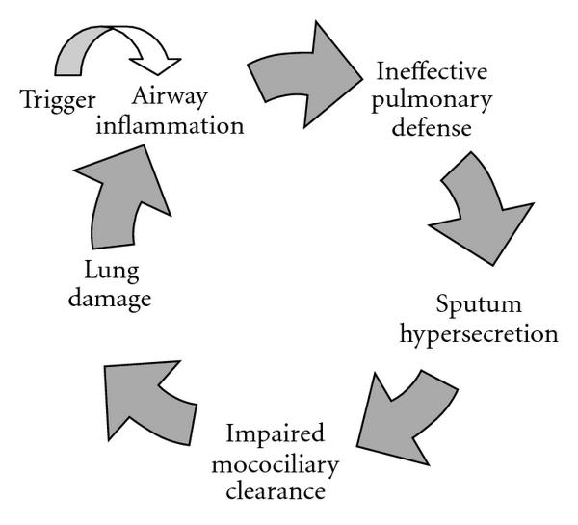
Bronchiectasis is permenant dilatation of bronchi with destruction of their walls. It is a result of chronic inflammation associated with an inability to clear mucoid secretions.
Bronchiectasis

Slide 30
us
Causes of bronchiectasis
Bronchial obstruction
Congenital or hereditary conditions
Chronic or severe infection / necrotizing pneumonia
Localized:
- tumor, foreign bodies or mucous impaction
Generalized:
- bronchial asthma
- chronic bronchitis
- Congenital bronchiectasis
- Cystic fibrosis.
- Intralobar sequestration of the lung.
- Immunodeficiency status.
- Immotile cilia and kartagner syndrome
Caused by TB, staphylococci or mixed infection

Slide 31
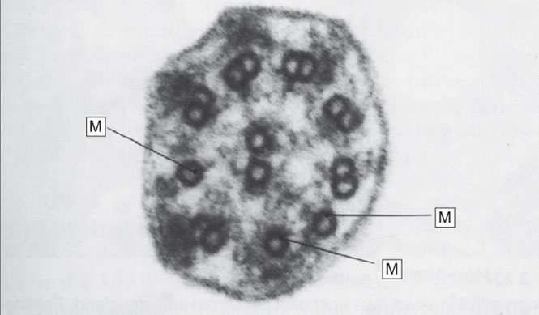
Diseases of Lung
Cilial dysmotility syndrome. Electron micrograph of cilia from a person with recurrent chest infections since childhood. The outer dynein arms are absent and there are abnormal single microtubules (M), which prevent normal motility.

Slide 32
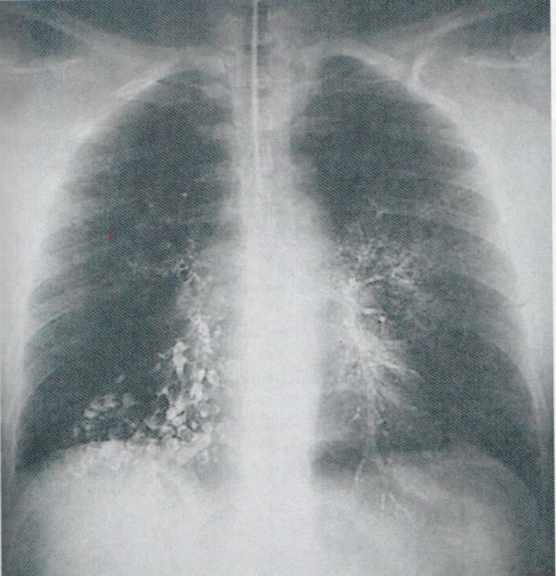
Presentation of Bronchiectasis
Severe, persistent cough associated with expectoration of mucopurulent, sometimes bad smell sputum.
Other common symptoms include dyspnea, rhinosinusitis, and hemoptysis.
Bronchiectasis, chest radiograph

Slide 33
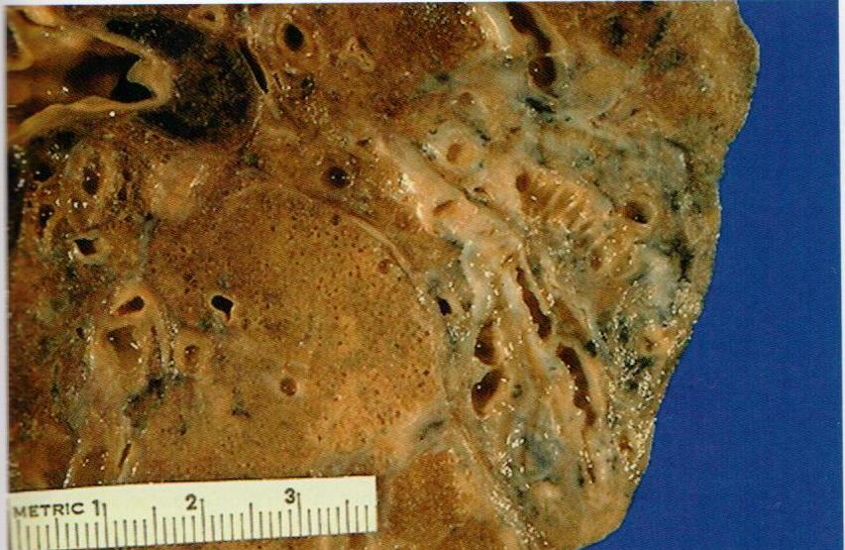
Bronchiectasis, gross

Slide 34
Diseases of Lung
Bronchiectasis
Dilatation of bronchi with destruction of bronchial walls

Slide 35
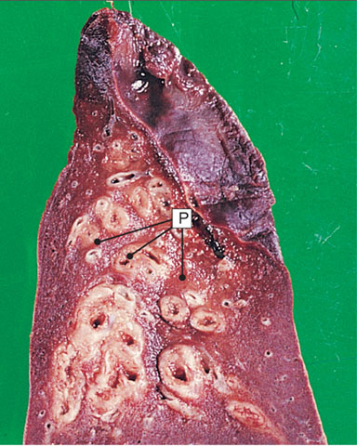
Diseases of Lung
Bronchiectasis. This is a lower lobe of lung surgically resected for bronchiectasis.

Slide 36
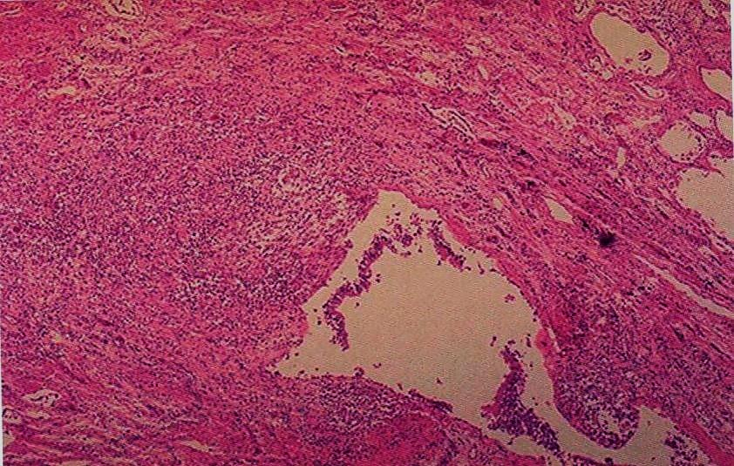
Bronchiectasis, micropscopic

Slide 37
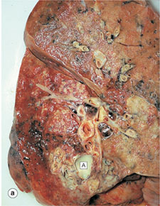
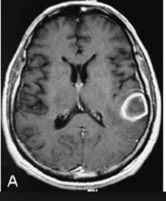
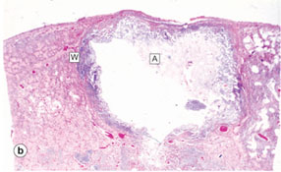
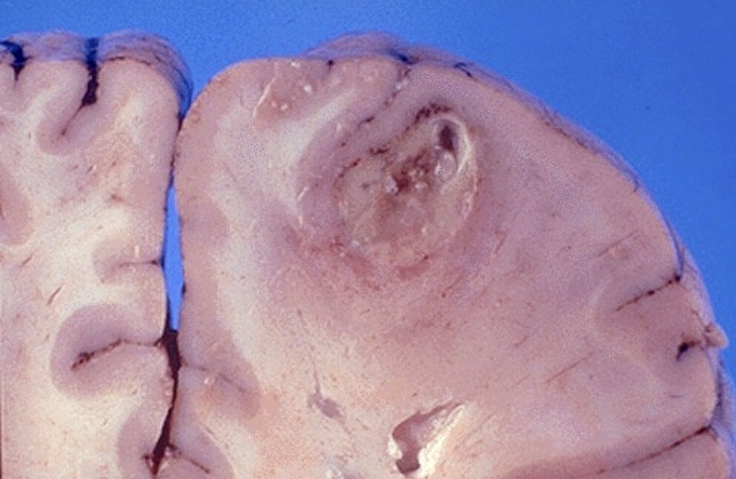
Lung Abscess
Bronchiectasis Complications
Obstructive pulmonary function (hypoxemia, hypercapnia, pulmonary hypertension, and cor pulmonale)
Lung Abscess
Rare complications: include
Metastatic brain (cerebral) abscess
Amyloidosis.
Brain (cerebral) abscess

Slide 38
Bronchiectasis:
Bronchiectasis
Dilatation and destruction of bronchi and bronchioles secondary to chronic inflammation and obstruction
Causes
Infection/ Necrotizing pneumonia
Congenital (Cystic fibrosis, Kartagener’s Syndrome)
Clinical features
Sever persistent cough with sputum (mucopurulent sputum) sometime with blood.
Complications
Rare complications: metastatic brain(cerebral) abscess and amyloidosis.
Obstruction
Clubbing of fingers.
Lung Abscess
If sever, obstructive pulmonary function

Slide 39
Diseases of Lung
Key Facts Chronic obstructive pulmonary disease
. Definition: a disease state characterized by airflow limitations that are not fully reversible. The airflow limitation is usually both progressive and associated with an abnormal inflammatory response of the lungs to noxious particles or gases.
. Cigarette smoking remains the most important cause of COPD. Other risks are recurrent chest viral infections in childhood, atopy, asthma, and occupational exposure to dusts (especially mining).
. Respiratory bronchiolitis is one of the earliest lesions seen in smokers.
. Chronic bronchitic airways show mucous hypersecretion with mucous gland hyperplasia.
. Chronic bronchitis and bronchiolitis cause airway narrowing.
. Emphysema causes loss of elastic recoil in lungs and contributes to functional airways obstruction.
. Generalized emphysema is defined as permanent dilatation of any part of the respiratory acinus, with destruction of tissue in the absence of scarring.
. There are two patterns of generalized emphysema: centrilobular and panacinar.
. Many patients with COPD have a reversible component to functional airways obstruction.
. Pulmonary hypertension and right-sided heart failure are common in long-standing chronic obstructive pulmonary disease.
. Acute deterioration in COPD is usually caused by viral or bacterial infection.

Slide 40
