Slide 1
Treatment of Acute & Chronic Rhinitis and Cough

Slide 2
Learning objectives
At the end of the lecture, students should be able to:
Define rhinitis and cough
Classify drugs used in the treatment of rhinitis
Expand on the pharmacology of different drug groups used in the treatment as; antihistamines, leukotriene antagonists, corticosteroids, decongestants and anticholinergics.
Describe the pharmacology of different expectorants and mucolytics used in the treatment of productive cough
Describe the pharmacology of antitussives (cough suppressants)

Slide 3
Rhinitis
Rhinitis is the irritation and/or inflammation of the mucous membranes inside the nose
Types:
1. Allergic (seasonal ; hay fever and perennial)
2. infectious (infection with bacteria, fungi and
viruses)
Rhinitis may be:
Acute (persist 7-14 days)
Chronic (persistent more than 6 weeks)

Slide 4
Signs and symptoms of rhinitis:
Runny nose (rhinorrhea; excess nasal secretion & discharge )
Sneezing
Nasal congestion/stuffy blocked nose
Post nasal drip
Systemic effects may be (fever, body aches,…,...)

Slide 5
Treatment of Rhinitis
A. Preventive Therapy:
1. Environmental control ( dust control, pets …..)
2. Allergen immunotherapy
B. Pharmacotherapy:
1. Anti-histamines (H₁- receptor antagonists)
2. Anti-allergics
a) Cromolyn sodium (mast cell stabilizer)
b) Montelukast (Leukotriene receptor antagonists)
3. Corticosteroids
4. Decongestants (alpha- adrenergic agonists)
5. Anti-cholinergics
6. Antibiotics (if bacterial infection occur)

Slide 6
What is histamine?
Histamine is a chemical messenger mostly generated
in mast cell that mediates a wide range of cellular responses,
Including;
-Allergic and inflammatory reactions,
-Gastric acid secretion
- Neurotransmission in parts of the brain
Histamine has no clinical application but antihistamines have
important therapeutic applications

Slide 7
Antihistamines (H_{I}–receptor antagonists):
The term antihistamine, without modifying
objective, refers to the classic H₁– receptor
blockers
These drugs do not interfere with the formation or release of histamine
They block the receptor- mediated response of a target tissue

Slide 8
1- ANTIHISTAMINES
H₁ receptor blockers
CLASSIFICATION [Chemical / Functional] USES vs ADVERSE EFFECTS
First GENERATION Second GENERATION Third GENERATION
1) ALKYLAMINES Chlorpheniramine 2) ETHANOLAMINES Dimenhydrinate Diphenhydramine 3) ETHYLENEDIAMINES Antazoline` 4) PHENOTHIAZINES Promethazine 5) PIPERAZINE Cyclizine Cetirizine Levocetirizine
6) PIPERIDINES Azatidine Fexofenadine
Loratadine Desoloratadine
Ketotifen 7) MISCELLANEOUS Cyproheptadine
Short duration
Longer duration = better control
Interactions; with enzyme inhibitors
[ macrolides, antifungals, calcium antagonists]
+ additive pharmacodynamic ADRs
No drug interactions & minimal ADRs
All are used systemic or topical

Slide 9
The older first generation drugs still widely used because they are effective and inexpensive.
These drugs penetrate the blood brain barrier (BBB) and cause sedation. Furthermore, they tend to interact with other receptors, producing a variety of unwanted adverse effects
Second generation (Non-sedating) agents are specific for H₁ receptors and they carry polar groups, they do not penetrate the BBB causing less CNS depression

Slide 10
Actions:
The action of all the H₁ receptor blocker is qualitatively similar
They are much more effective in preventing symptoms than reversing them once they have occurred
Most of these drugs have additional effects unrelated to their blocking H1 receptors, which probably reflect binding of H1 antagonists to:
Cholinergic,
Adrenergic or,
Serotonin receptors

Slide 11
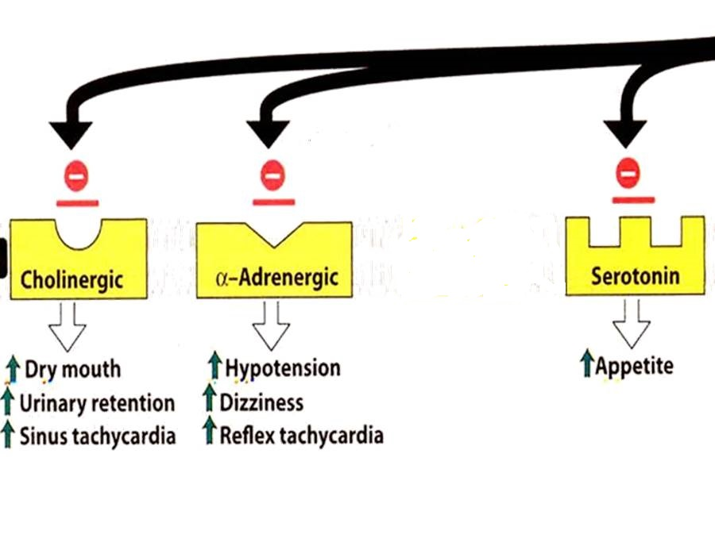
GOOD CONTROL of Rhinitis, Conjunctivitis, Urticaria, Flu (cough & sneezing)
ALLERGIES
POOR CONTROL of Asthma, Otitis, Anaphylaxis, Sinusitis, Atopic dermatitis
INDICATIONS linked to H1 block
ITCHING
Even if
non-allergic
INDICATIONS not linked to H1 block
ANTIHISTAMINES
Others
Insomnia
Sleep aid
Vertigo
Anxiety
Cough
Side Effects
Interactions
Side Effects
Interactions
Side Effects
Interactions

Slide 12
Therapeutic uses:
1. Allergic rhinitis, relieves rhinorrhea, sneezing, and itching of eyes
and nasal mucosa
2. Common cold: dries out the nasal mucosa. Often combined with
nasal decongestant and analgesics
3. Motion sickness
4. Allergic dermatoses: can control itching associated with insect bites.
5. Nausea and vomiting (Promethazine)
;

Slide 13
Pharmacokinetics:
H₁ receptor blockers are well absorbed after oral administration
Maximum serum levels occurring at 1-2 hours
Average plasma half life is 4 to 6 hours
H₁- receptor blockers have high bioavailability and distributed to all tissues including CNS
Metabolized by the hepatic cytochrome P450 system
Excretion occur via kidney except fexofenadine excreted in feces unchanged

Slide 14
Adverse effects:
Sedation, tinnitus, fatigue, dizziness, blurred vision, dry mouth
Drug interaction:
CNS depressants & cholinesterase inhibitors
Overdose:
The most common and dangerous effects of acute poisoning are those on CNS; including hallucinations, excitement, ataxia and convulsions

Slide 15
CROMOLYN & NEDOCROMYL
2-ANTI-ALLERGICS
◉ Histamine release [mast cell stabilizer by inhibiting Cl channels]
i.e. can act only prophylactic; it does not antagonize the released histamine
Used more in children for prophylaxis of perennial allergic rhinitis
Should be given on daily base and never stop abruptly.
LEUKOTRIENE RECEPTOR ANTAGONISTS Montelukast
Block leukotriene actions
For prophylaxis of lower respiratory [i.e perennial allergen, exercise or aspirin-induced asthma] > upper respiratory allergies [chronic rhinosinusitis]
ADRs; as in asthma
3-CORTICOSTERIODS
Anti-inflammatory blocks phospholipase A₂ 
arachedonic a. synthesis   prostaglandins & leukotrienes
Topical (inhaled); steroid spray; beclomethasone, & fluticasone
Given if severe intermittent or moderate persistent symptoms
ADRs; Nasal irritation, fungal infection, hoarseness of voice

Slide 16
4. DECONGESTANTS
α-Adrenergic agonists
For treatment of nasal stuffiness
SYSTEMIC
TOPICAL
PSEUDOEPHEDRINE
PHENYLETHYLAMINES
IMIDAZOLINE
Phenylephrine
Methoxamine
Naphazoline
Oxymetazoline HCI
Xylometazoline HCI
Can cause nervousness, insomnia, tremors, palpitations, hypertension
Better avoided in hypertension, heart failure, angina pectoris, hyperthyroidism, glaucoma
can cause Rebound nasal stuffiness (repeated administration (10 days -2 weeks)
5. ANTICHOLINERGICS
Ipratropium
Given as nasal drops to control rhinorrhea
So very effective in vasomotor rhinitis (watery hyper-secretion).
Its indication as bronchiodilator in asthma and ADRs  see asthma

Slide 17
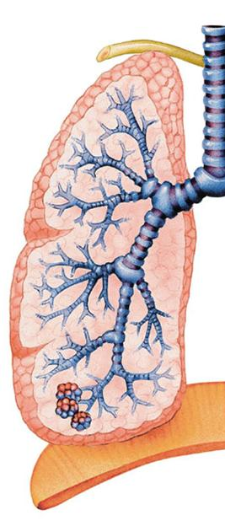
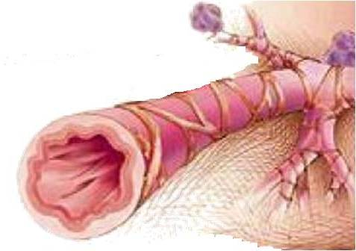
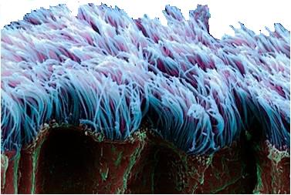
DRUGS USED IN
TREATMENT OF COUGH

Slide 18
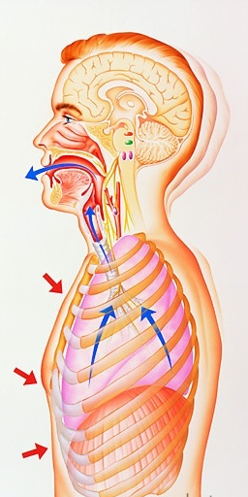
Coughing is sudden expulsion of air from the lungs through the epiglottis at an amazingly fast speed (~100 miles/ hr) to get of unwanted irritants.
Abdominal & intercostal muscles contract, against the closed epiglottis  pressure   air is forcefully expelled to dislodge the triggering irritant.
Cough may be “wet or productive” or
“dry or irritant”
2ndry to irritant vapors, gases, infections, cancer
TREATMENT
EXPECTORANTS
MUCOLYTICS
For Productive Cough
ANTITUSSIVE AGENTS
For Non-productive (dry) Cough
Notes:
self-clearing mechanism of the bronchi.[

Slide 19
EXPECTORANTS
Act by removal of mucus through
Reflex stimulation
Irritate GIT  stimulate gastropulmonary vagal reflex  loosening & thinning of secretions  Guaifenesin
ADRs ; Dry mouth, chapped lips, risk of kidney stones(uric a. excretion)
Direct stimulation
Stimulate secretory glands   respiratory fluids production  Iodinated glycerol, Na or K iodide / acetate , Ammonium chloride, Ipecacuahna
ADRs of iodide preparations ; Unpleasant metallic taste, hypersensitivity, hypothyroidism, swollen salivary glands (overstimulation of salivary secretion), & flare of old TB.
INDICATIONS
Final outcome is that cough is indirectly diminished
Common cold
Bronchitis
Pharyngitis
Chronic paranasal sinusitis

Slide 20
MUCOLYTICS
Mucolytic agents are used to dissolve or breakdown mucus in the respiratory tract. They make the mucus less viscous so that it can be coughed up with more ease.
MECHANISM OF ACTIONS
Mucolysis occurs by one or more of the following;
water content; Hypertonic Saline & NaHCO₃
◉ Adhesivness; Steam inhalation
Breakdown S-S bonds in glycoproteins  less viscid mucous; N-Acetyl Cysteine
Synthesize serous mucus + activate ciliary clearance Bromohexine & Ambroxol
Cleavage of extracellular bacterial DNA, that contributes to viscosity of sputum in case of infection; rhDNAase = recombinant human deoxyribonuclease (Pulmozyme)
INDICATIONS
Most mucolytics  effective as adjuvant therapy in COPD, asthma, bronchitis, …etc. (when there is excessive, thick mucus….)

Slide 21
1. N-Acetylcysteine 
Breakdown S-S bonds in glycoproteins
It is also a free radical scavenger  used in acetaminophen overdose
2. Bromhexine & its metabolite Ambroxol 
Synthesize serous mucus
They also immuno defence so  antibiotics usage
They also  pain in acute sore throat
3. Pulmozyme (Dornase Alpha)
 A recombinant human deoxyribo-nuclease-1 enzyme that is neubilized .
Full benefit appears within 3-7 days

Slide 22
ANTITUSSIVE AGENTS
Stop or reduce cough by acting either peripherally or centrally
1. PERIPHERALLY ACTING ANTITUSSIVES
A. Inhibitors of airway stretch receptors
In Pharynx  Use Demulcents  form a protective coating
Lozenges & Gargles
In Larynx  Use Emollients  form a protective coating
menthol & eucalyptus.
In Tracheobronchial Airway Use aerosols or inhalational of hot steam tincture benzoin compound & eucalyptos
During bronchoscopy or bronchography  Use local anaesthetic aerosols, as lidocaine, benzocaine, and tetracaine
B. Inhibitors of pulmonary stretch receptors in alveoli
Benzonatate   sensitivity (numbing) of receptors by local anesthetic action.

Slide 23
ANTITUSSIVE AGENTS
2. CENTRALLY ACTING ANTITUSSIVES
A. OPIOIDS
activating µ opioid receptors
e.g. Codeine & Pholcodine
B. NON-OPIODS
Antihistaminics (>sedating)
Dextromethorphan
It  threshold at cough center. It has benefits over opioids in being 
1. As potent as codeine
2- Less constipating
3- No respiratory depression.
4- No inhibition of mucociliary clearance
5- No addiction.
ADRs
In normal doses , nausea, vomiting, dizziness, rash & pruritus
In high doses, hallucinations + opiate like side effects on respiration & GIT

Slide 24
GOOD LUCK

