Slide 1
Lung function in health and disease
Laila Al-Dokhi

Slide 2
Types of lung function tests include
Spirometry.
Gas diffusion.
Body Plethysmography.
Inhalation challenge test.
Exercise stress test.

Slide 3
Spirometry:
It is the measurement of the speed and the amount of air that can be exhaled and inhaled.
Body Plethysmography test:
The patient is required to sit in an airtight chamber that resembles a small telephone booth. Inside the chamber is an affixed spirometer, which is used to determine the flow properties of the patient.
Cardiopulmonary Stress Testing
Used for evaluation of dyspnea that is out of proportion to findings on static pulmonary function tests
Diffusing Capacity of Lung for Carbon Monoxide
To evaluate the presence of possible parenchymal lung disease
Pulse Oximetry
The principle is measurement of O2 saturation by spectrophotometry

Slide 4
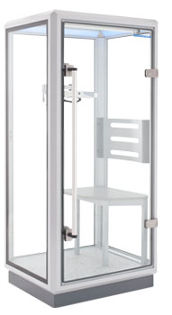
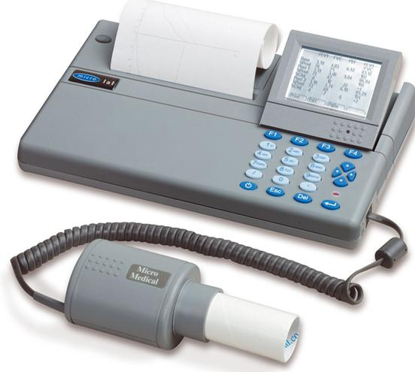
Plethysmography
Spirometer

Slide 5
Spirometry
Spirometry is a method to record volume movement of air into and out of the lungs.
Spirometry is a simple most commonly used test to:
Assess the lung performance
Measure the physiological parameters:
Lung volumes
Capacities
Flow rate
Differentiate between the obstructive and restrictive lung conditions
Play a critical role in the diagnosis, differentiation and management of respiratory diseases.

Slide 6
Physiological conditions affecting lung functions
Age
Gender
Height
Weight
Ethnic group
Pregnancy

Slide 7
Indications of Spirometry
Based on clinical features / abnormal lab tests
Symptoms:
Dsypnea
Cough
Sputum production
Chest pain
Signs:
Cyanosis,
Clubbing
Chest deformity
Diminished chest expansion
Hyperinflation
Diminished breath sounds
Prolongation of expiratory phase & crackles
Arterial blood gas analysis: Hypoxemia, hypercapnia
Abnormal chest X Ray.

Slide 8
Indications of Spirometry
To detect respiratory disease in patients presenting with symptoms of breathlessness, and to distinguish respiratory from cardiac disease.
To diagnose or manage asthma
To diagnose and differentiate between obstructive and restrictive lung disease.
To conduct pre-operative risk assessment before anesthesia
To measure response to treatment of conditions which spirometry detects

Slide 9
Indications of Spirometry
Describe the course of diseases affecting PFTs
Neuromuscular diseases: Gillian Barre Syndrome, Myasthenia gravis
Pulmonary diseases: Obstructive airway diseases, Interstitial lung diseases
Adverse reactions: Drugs with known pulmonary toxicity [Pulmonary fibrosis]

Slide 10
Indications of Spirometry
To assess the therapeutic interventions:
Bronchodilator therapy
Steroid treatment for asthma
Chronic obstructive lung disease
Interstitial lung disease

Slide 11
Indications of Spirometry
PRE OPERATIVE INDICATIONS
To determine the suitability of patients for anesthesia
To assess the risk for surgical procedures known to affect lung function.

Slide 12
Results classification
Normal
Obstructive
Restrictive
Combined

Slide 13
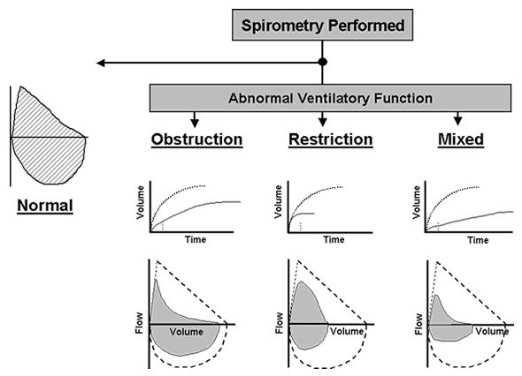
Assessment of spirometry

Slide 14
Maintaining accuracy
The most common reason for inaccurate results:
Inadequate or incomplete inhalation.
Additional breath taken during the test
Lips not sealed around the mouth piece.
Slow start to forced exhalation
Some exhalation through the nose.
Coughing.

Slide 15
Smoking and Spiromtry
Effect of smoking on lung function:
Non Smoker: In normal healthy non smoker subject after the age of 30 the expected decline in Lung function parameter [FEV1] is 25–30 ml/ year
Smoker: The average rate of decline of lung function in smokers as measured by Forced Expiratory Volume in 1 sec [FEV1] is 60-70 ml / year
Davis et al., Diabetes Care, 2004
Notes:
Early and late ins phase

Slide 16
SMOKERS AND SPIROMETRY

Slide 17
SMOKERS AND SPIROMETRY

Slide 18
DIAGNOSIS OF COPD
EXPOSURE TO RISK
FACTORS
SYMPTOMS
cough
tobacco
sputum
occupation
dyspnea
indoor/outdoor pollution
è
SPIROMETRY

