Slide 1
Dynamic Spirometry
By
Dr. Ola Mawlana

Slide 2
Objectives
At the end of this session, students should be able to:
Perform a dynamic spirometry test on a fellow student.
Describe the two graphs recorded by dynamic spirometry, namely: flow-volume loop (FVL) and the volume-time curve (forced expiratory curve “FEV₁” curve forced expiratory curve (FEV1 curve).
Analyze the components of each graph; FVL and FEV1 and describe their normal appearance.

Slide 3
5. Calculate the forced expiratory volume in the first second (FEV1) and forced vital capacity (FVC) and the FEV1/FVC ratio from the FEV1 curve.
6. Calculate the FVC, peak expiratory flow rate (PEFR), peak inspiratory flow rate (PIFR) and maximal expiratory flow rate at 50% of the forced vital capacity (MEF50).
7. Analyze the components of each graph in both obstructive and restrictive lung diseases
8. Differentiate between both obstructive and restrictive lung diseases

Slide 4
Dynamic Spirometry
Spirometry
It is the most basic and frequently performed test of pulmonary (lung) function.
It is concerned with the measurement of flow and volume of air entering and leaving the lungs.

Slide 5
Dynamic?
- Performed at forcible and max effort against time
- Measures the rate at which the lung changes volume during forced breathing.
Forced vital capacity
The max volume of air that can be forcibly and rapidly exhaled following a max inspiration.

Slide 6
Equipment
Dynamic spirometer
Nose clip.
Disposable mouth piece.

Slide 7
Dynamic Spirometer

Slide 8
Procedure
Insert a new disposable mouthpiece into the flow sensor (SP-250).
Hold the sensor in an upright position.
Insert the mouthpiece in the oral cavity (mouth) and seal the lips tightly around the mouthpiece.
Place the nose clip on the subject’s nose to avoid air escaping through nostrils.
While subject is standing, allow him/her to breathe normally through mouthpiece, approximately 3 normal breaths to record TV.
Then ask the subject to inhale as deep as possible and then follow it with a fast and forceful exhalation. The exhalation should be as fast and forceful as possible.
Two types of graphs may be recorded.

Slide 9
Two types of curves can be obtained
A Flow Volume curve B Forced expiratory volume curve (FEV)

Slide 11
Forced Expiratory Curve
The subject takes a maximal inspiration and then exhales as rapidly, as forcibly,& as maximally as possible.
A plot of volume against time.

Slide 12
A normal volume-time graph (FEV₁ curve).

Slide 13
FEV1
Volume of air expelled in the 1st sec of forced expiration starting from full inspiration
Plateau: FVC
FEV1 % or ratio
(FEV1/FVC) * 100
Fraction of the VC expired during the 1st sec of a forced expiration (NL 70%-80%)
- FEV1 is a useful measure of how quickly the lungs can be emptied.
- The ratio is a useful index of airflow limitation.

Slide 14
Normal FEV1 values (% predicted).
Parameter | Normal value (ATS/ERS)
FEV₁ | ≥ 70% (% predicted FEV1)
FVC | ≥ 70% (% predicted FVC)
FEV₁/FVC ratio | ≥ 70% (0.7)
ATS=American Thoracic Society,
ERS=European Respiratory Society

Slide 15
FVC
5
4
FEV₁ = 4L
FVC = 5L
FEV₁/FVC = 0.8
Volume, liters
3
2
1
1
2
3
4
5
6
1
Time, sec

Slide 16
A normal flow-volume loop.

Slide 17
Differences between Obstructive and Restrictive Airway Diseases

Slide 18
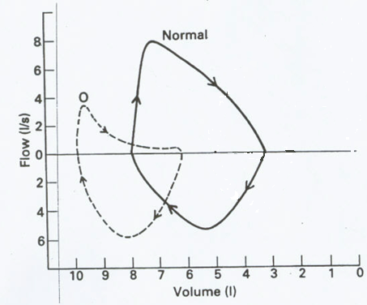
Obstructive pulmonary diseases
- MEF50↓
Effort independent part of curve:
concave (Curvilinear)
PEFR normal or ↓ in severe cases
- Inspiratory loop Normal

Slide 19
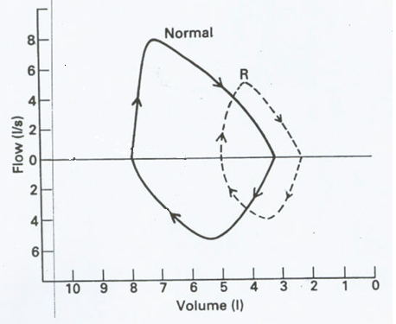
Restrictive pulmonary disease
Miniature loop (elliptical)
All flow parameters ↓

Slide 21
Obstructive Disease
Normal
5
FEV₁ = 1.8L
FVC = 3.2L
FEV₁/FVC = 0.56
=56%
4
3
Volume/ liters
2
1
Obstructive
1
2
3
4
5
6
Time, seconds

Slide 22
Restrictive Disease
5
Normal
4
3
Volume ( liters)
FEV₁ = 1.9L
FVC = 2.0L
FEV₁/FVC = 0.95
= 95%
2
1
1
2
3
4
5
6
Restrictive
Time (seconds)

Slide 24
Differences between Obstructive and Restrictive Airway Diseases
 | Obstructive pattern | Restrictive pattern | Mixed pattern
FEV₁ | ↓↓↓ | Normal or ↓ | ↓↓
FVC | Normal or ↓ | ↓↓↓ | ↓↓
FEV₁/FVC (FEV₁ %) | < 0.7 (70%) | Normal or > 0.7 (70%) | variable

Slide 25
Dynamic Spirometry was done on 3 patients, the results were the following:
A. FEV1= 4L , FVC=5L
FEV1/FVC=80%
B. FEV1=1.2L , FVC=3L
FEV1/FVC=40%
C. FEV1= 2.7 L, FVC=3L
FEV1/FVC= 90%

Slide 26
Thank You

