Slide 1
Immunology of Tuberculosis
Immunology Unit
Department of Pathology

Slide 2
Objectives
To know how M. tuberculosis infection is contracted and its initial encounter with the immune system.
To understand delayed type of hypersensitivity reaction against M. tuberculosis
To be familiar with the possible outcomes of the infection with M. tuberculosis in immuno-competent and immuno-compromised hosts.
To know the basis of interferon gamma release assay and its potential to detect latent tuberculosis.
To understand the basis of tuberculin test and its importance in gauging immunity against M. tuberculosis

Slide 3
Tuberculosis (TB)
Is an example of an infection in which protective immunity & pathologic hypersensitivity coexist, and the lesions are caused mainly by the host response

Slide 4
Introduction
Mycobacterium tuberculosis is among the most common infectious cause of death in adults worldwide.
The human host serves is the natural reservoir for M. tuberculosis.
The disease incidence is magnified by the concurrent epidemic of human immunodeficiency virus (HIV) infection.

Slide 5
Mode of transmission
Infection is acquired by inhalation of M. tuberculosis in aerosols and dust (airborne transmission)
Infected people cough up large numbers of mycobacteria
The organisms waxy outer coat can withstand drying and survive for long periods in air and house dust

Slide 6
Virulence factors
Waxy coat blocks phagocyte enzymes
Catalase-peroxidase, which resists the host cell oxidative response
Lipoarabinomannan (LAM) a glycolipid.
Can induce cytokines and resist host oxidative stress
Interfere with antigen presentation by MHC class II molecules for priming CD4 T cells.

Slide 7
Immunology
The majority of individuals in the general population who become infected with M. tuberculosis never develop clinical disease
This demonstrates that the innate and adaptive immune response of the host in controlling TB infection is effective.

Slide 8
Host factors
Innate immunity
The tubercle bacillus ultimately gets taken up by macrophages and has evolved several strategies to evade early intracellular killing mechanisms. These include:
Resistance to reactive oxygen intermediates (ROIs)
Inhibition of phagosome-lysosome fusion
Inhibition of phagosome acidification
Escape from the phagosomal compartment into the cytoplasmic space

Slide 9
Natural History of Infection
Inhalation of M. tuberculosis and deposition in lungs leads to one of the four possible outcomes
Immediate clearance of the organism
Latent Infection
Immediate onset of the disease (Primary Disease)
Onset of active disease after many years (Reactivation)

Slide 10
Primary disease (Approximately 10% of infected individuals)
The tubercle bacilli establish infection in the lungs after they are carried in droplets to reach the alveolar space.
If the innate defense system of the host fails to eliminate the infection, the bacilli proliferate inside alveolar macrophages and eventually kill the cells.
The infected macrophages produce cytokines and chemokines that attract other phagocytic cells, which eventually form a nodular granulomatous structure called the tubercle.

Slide 11
Primary disease
If the bacterial replication is not controlled, the tubercle enlarges and the bacilli enter local draining lymph nodes.
This leads to lymphadenopathy, a characteristic manifestation of primary TB.
The lesion produced by the expansion of the tubercle into the lung parenchyma and lymph node involvement is called the Ghon complex.

Slide 12
Ghon’s and Ranke complex
The lung lesions (tubercles –small granulomas (Ghon’s focus) and the enlarged lymph nodes constitutes Ghon’s complex
Tubercles may heal become fibrotic or calcified and persist as such for a lifetime (Ranke Complex)

Slide 13
Weeks after infection
M. Tuberculosis peptides presented to Th1 (CD4) lymphocytes releasing
Interferon gamma
Further activation of macrophage
Enhances the ability of macrophage to kill phagocytosed bacilli
Tumor Necrosis Factor (TNF)
Induces local inflammation and further activation of macrophages

Slide 14
Primary disease
The bacilli continue to proliferate until an effective cell-mediated immune (CMI) response develops, usually two to six weeks after infection.
Failure by the host to mount an effective CMI response and tissue repair leads to progressive destruction of the lung by:
Tumor necrosis factor (TNF)-alpha,
Reactive oxygen
Nitrogen intermediates
Contents of cytotoxic cells (granzymes, perforin)
All of the above may contribute to the development of caseating necrosis that characterizes a tuberculous lesion

Slide 15
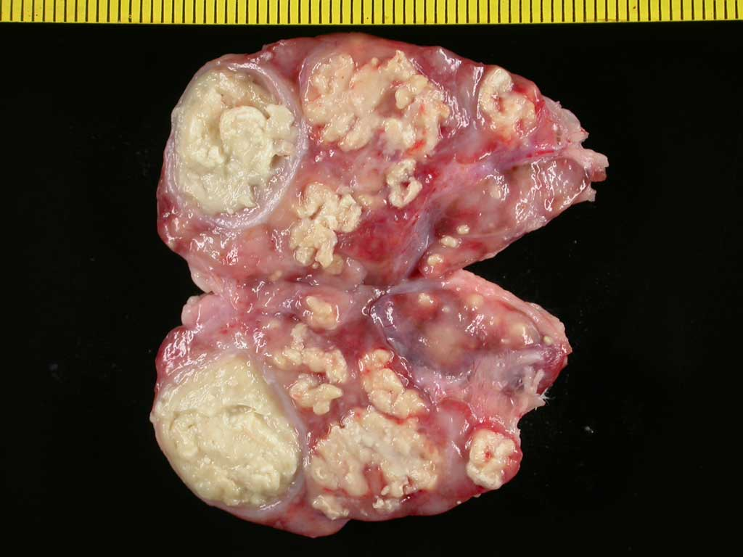

Slide 16
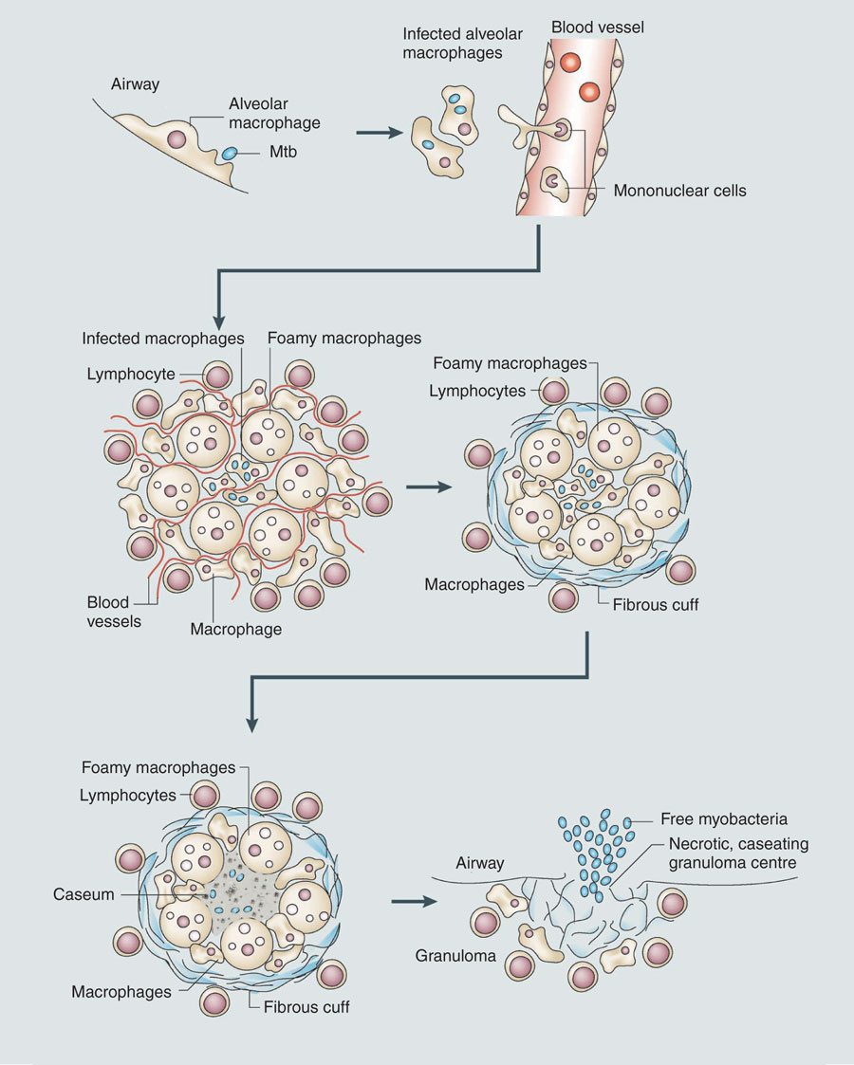
Outcomes
Bacilli can spread mechanically by erosion of the caseating lesions into the lung airways; at this point the host becomes infectious to others

Slide 17
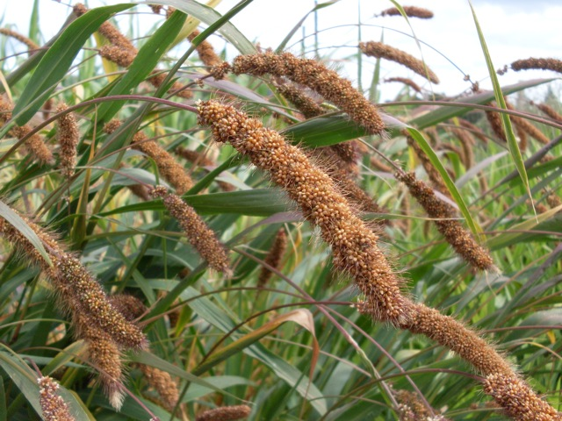
Miliary TB
Unchecked bacterial growth may lead to hematogenous spread of bacilli to produce disseminated TB.
Disseminated disease with lesions resembling millet seeds has been termed miliary TB.
Most common presentation – TB meningitis

Slide 18
Chronic Disease
In the absence of treatment, death occurs in 80 percent of cases.
The remaining patients develop chronic disease or recover.
Chronic disease is characterized by repeated episodes of healing by fibrotic changes around the lesions and tissue breakdown.
Complete spontaneous eradication of the bacilli is rare.

Slide 19
Latent Tuberculosis
1
Antigen presentation in the lymph nodes
2
Activation of CD4+ (Th1) lymphocytes
3
Low induction of CD8+ lymphocytes capable of recognizing antigen and activating macrophages by production of IFN-γ
(a phase coinciding with high rate of replication of bacilli)
4
5
Later induction of high number of CD8+ with increased production of IFN-γ and cytotoxic activity (a phase coinciding with stabilization of bacterial growth)
Bacterial load remains constant and infection is in latency (Latent TB)
(Delayed type of hypersensitivity)

Slide 20
Latent TB
This period of latency is sustained predominantly by a population of non-replicating bacilli rather than a population of growing bacilli.
It is believed that the immune response is mainly directed towards antigens secreted by growing bacilli.
Therefore non-replicating bacilli will be less obvious to the protective cellular response.
This state correlates directly with an innate resistance to anti-Mtb drugs, most of which target processes active in replicating organisms.

Slide 21
Reactivation disease
Reactivation TB results from proliferation of a previously dormant bacteria seeded at the time of the primary infection.
Among individuals with latent infection and no underlying medical problems, reactivation disease occurs in approximately 5 to 10 percent of cases.
The disease process in reactivation TB tends to be:
Localized (in contrast to primary disease)
Little regional lymph node involvement and less caseation.
The lesion typically occurs at the lung apices
Disseminated disease is unusual

Slide 22
Reactivation disease
Immuno-suppression is clearly associated with reactivation TB.
Associated conditions include:
HIV infection and AIDS
End-stage renal disease
Diabetes mellitus
Malignant lymphoma
Corticosteroid use
Inhibitors of TNF-alpha and its receptor
Diminution in cell mediated immunity associated with age

Slide 23
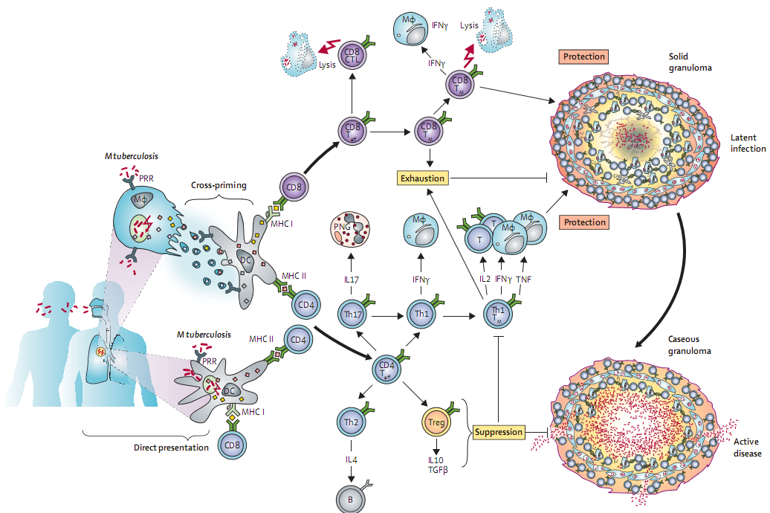

Slide 24
The role of the granuloma as a host protective factor needs a revision in thinking as it may also play a role in protecting the tubercle bacilli for its long-term survival in the host

Slide 25
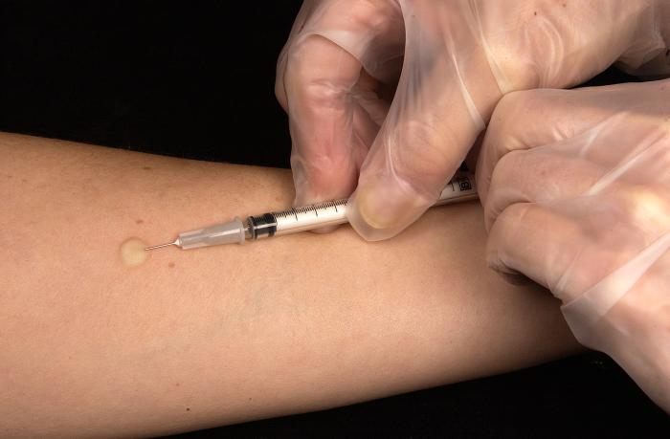
Test for immunity against TB
Delayed hypersensitivity skin test
Tuberculin test or (Mantoux)
Intradermal injection of PPD
(purified protein derivative)
Correct interpretation of the result is unreliable in immuno-compromised states affecting CMI

Slide 26
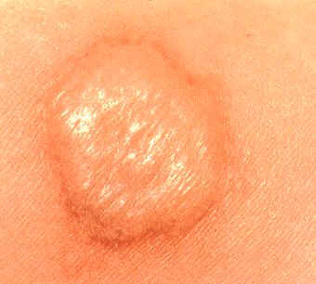
Test result is interpreted by measuring the diameter of the induration after 48 hours

Slide 27
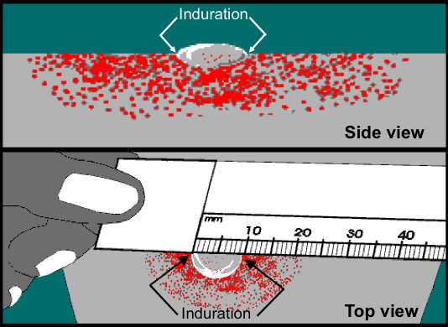

Slide 28
Delayed-type hypersensitivity (DTH) response
The DTH response does not correlate with protection against TB, since numerous BCG vaccination trials have demonstrated that disease can occur in those who mount a DTH response.
As a result, the protective T cell response must be distinguished from the T cell response associated with DTH.
An in vitro interferon-gamma release assay has been developed.
The assay is an alternative to the tuberculin skin test (TST) for detection of latent M. tuberculosis infection in human hosts.

Slide 29
IFN-γ release assay
The test measures interferon-gamma released into blood from T cells when they are activated by M. tuberculosis antigens in vitro.
The tests use antigens specific to M. tuberculosis including the early secretory antigenic target 6 (ESAT-6) and culture filtrate protein (CFP-10).
These proteins are absent in vaccine strain BCG, or M. bovis.
This enables the test to differentiate those latently infected with M. tuberculosis from those vaccinated with BCG.

Slide 30
Take home message
After exposure to M. tuberculosis immune handling of the infection determines the final outcome.
Relatively small proportion of individuals develop primary disease
Reactivation of tuberculosis can occur in patients who are immuno-compromised
Tuberculin test should be interpreted with caution as it may be difficult to differentiate between DTH against M. tuberculosis and latent disease.

Slide 31
Thank you

