Slide 1
Viral Infections of the Respiratory System
Dr. Abdulkarim Alhetheel
Assistant Professor
College of Medicine & KKUH

Slide 2
Objectives
Introduction to respiratory viral infections
Characteristics of respiratory viruses (Orthomyxoviridae, Paramyxoviridae)
Mode of transmission
Clinical features
Lab diagnosis
Treatment & prevention

Slide 3
Respiratory Tract Infections
Are the commonest of human infections and cause a large amount of morbidity and loss of time at work (sick leave).
Are common in both children and adults.
Mostly caused by viruses.
Mostly are mild and confined to the upper respiratory tract (URT).
Mostly are self-limiting disease.
URT-infection may spread to other organs causing more severe infection and death.

Slide 4
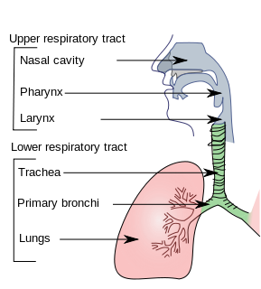
Clinical manifestations
Common cold (rhinitis).
Pharyngitis.
Tonsilitis.
Sinusitis & otitis media.
Croup (acute laryngotracheobronchitis).
Acute bronchitis.
Acute bronchiolitis.
Viral pneumonia.

Slide 5
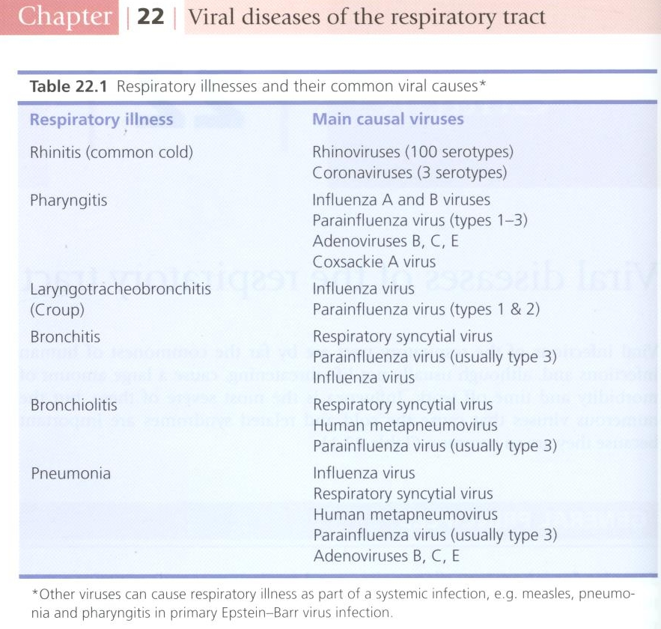

Slide 6
Influenza Virus
Family: Orthomyxoviridae.
Structural features: Enveloped virus with 2 projecting glycoprotein spikes:
Haemagglutinin (H)
Neuraminidase (N)
Genome: 8 Segmented - polarity ssRNA.
This virus is highly susceptible to mutations and rearrangements within the infected host.

Slide 7
Influenza viral proteins
Haemagglutinin (H):
Attachment to the cell surface receptors.
Antibodies to the HA is responsible for immunity.
16 haemagglutinin antigenic type, H1 – H16.
Human associated H antigenic type are H1, H2, H3.
Neuraminidase (N):
Responsible for release of the progeny viral particles from the infected cell.
9 neuraminidase antigenic type, N1 – N9.
Human associated N antigenic type are N1, N2.

Slide 8
Types of influenza virus
A
Infects human and Animal
Causes epidemic & pandemic
Causes epizootic in animal
Antigenic drift minor change
Antigenic shift major change
B
Infects human only
Causes outbreak
Antigenic drift only
C
Infects human only
Causes mild illness

Slide 10
Influenza Virus
Divided into subtypes based on the haemagglutinine and neuraminidase proteins.
The currently circulating strains are: H1N1 & H3N2.
Pathogenesis: The virus infects the epithelial cells of the nose, throat, bronchi and occasionally the lungs.
Transmission: Inhalation of infectious aerosol droplets.
I.P.: 1-4 days.
Symptoms: Fever, malaise, headache, cough, chills, sore throat, and generalized pain.
Prognosis: Usually self-limiting disease.

Slide 11
Continued..
Complications: - Primary influenza pneumonia - 2nd bacterial pneumonia - Reye’s syndrome [fatty degeneration of CNS and Liver (Aspirin)]
Lab diagnosis: routine testing by Direct detection of Influenza A or B virus from sputum, nasopharyngeal swab, aspirate (NPA) or respiratory secretion by direct immunoflourecent assay (IFA).
Other detection methods: Cell culture, PCR.
Treatment:
1: Amantadine is effective against influenza A virus only.
2: Rimantadine, Oseltamivir (Tamiflu) or Zanamivir (Relenza) are effective against both influenza A & B viruses and can be used as treatment and prophylaxis.

Slide 12
Continued..
Prevention:
Influenza vaccine: Two types of vaccines available:
1- The flu shot vaccine: Inactivated (killed vaccine).
Given to people older than 6-months, including healthy people and those with chronic medical conditions.
2- The nasal spray flue vaccine (Flu mist): Live attenuated vaccine.
Approved for use in healthy people between 5-49 years of age.
Both vaccines contain two strains of the current circulating influenza A virus and the current circulating strain of influenza B virus.
Vaccine should be given in October or November, before the influenza season begins.

Slide 13
Avian flu
Viral etiology: Avian influenza type A virus (H5N1).
Family: Typical orthomyxovirus.
Epidemiology: Wild birds are the natural reservoir for the virus. They shed the virus in saliva, nasal secretion and feces.
All domestic poultry are susceptible to infection.
They become infected, when they eat food contaminated with secretion or excretion from infected bird.
Avian influenza viruses do not usually infect human.
High risk group includes those who working in poultry farms and those who are in close contact with poultry.

Slide 14
Continued..
Symptoms in human:
Ranges from typical flu to severe acute respiratory disease.
Diarrhea, abdominal pain and bleeding from the nose have been reported.
Treatment:
Should be initiated within 48 hours.
Oseltamivir and Zanamivir are used.
Lab diagnosis: PCR, detection of the viral RNA in throat swap.

Slide 15
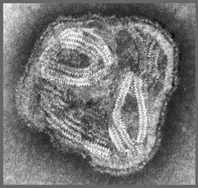
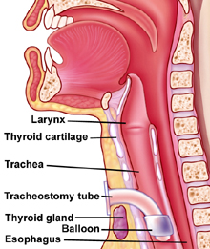
Parainfluenza Virus
Family: Paramyxoviridae.
Structural features: Enveloped virus with - polarity ssRNA genome, with 5 serotypes.
Transmission: Inhalation of infectious aerosol droplets mainly in winter.
Clinical syndrome:
Croup or acute laryngotracheobronchitis. PIV Type-I, II affect mainly in infants and young children. Fever, harsh cough, difficult inspiration can lead to airway obstruction which may require hospitalization and tracheostomy.
Bronchiolitis and Pneumonia: PIV Type-III in young children.

Slide 16
Continued..
Lab diagnosis: routine testing by Direct detection of the virus from sputum, nasopharyngeal swab, aspirate (NPA) or respiratory secretion by direct immunoflourecent assay (IFA).
Other detection methods: tissue culture, PCR.
Treatment and prevention: Supportive treatment, No specific treatment or vaccine available.

Slide 17
Respiratory Syncytial Virus (RSV) &
Human metapneumovirus
Family: Paramyxoviridae.
Structural features: Enveloped virus with - polarity ssRNA genome.
Transmission: Inhalation of infectious aerosols mainly in winter.
Clinical syndromes:
Bronchiolitis: Life-threatening disease in infant especially under 6 month of life with respiratory distress and cyanosis can be fatal and can lead to chronic lung disease in later life.
Pneumonia: can also be fatal in infant.

Slide 18
Continued..
Lab diagnosis: routine testing by Direct detection of the virus from sputum, nasopharyngeal swab, aspirate (NPA) or respiratory secretion by direct immunoflourecent assay (IFA).
Other detection methods: Isolated of virus by cell culture from N.P.A with multinucleated giant cell or syncytia as cytopathic effect (C.P.E); PCR.
Treatment and prevention: Ribavirin administered by inhalation for infants with severe condition.
Vaccine: No vaccine available, but passive immunization immunoglobulin can be given for infected premature infants.

Slide 19
Measles Virus
Family: Paramyxovidae.
Structural features: Enveloped virus with - polarity ss-RNA genome.
Transmission: Inhalation of infectious aerosol droplets.
Epidemiology: Measles virus infects human only.
Most cases in preschool children, very infectious, infection occurs mainly in winter and spring.
Pathogenesis:
The virus infects first epithetical cells of upper respiratory tract, then the virus spread to the blood causing viremia and infect the endothelial cells of blood vessels. The virus reaches the lymphoid tissue where it replicates further and disseminates to the skin causing maculopopular rash.

Slide 20
Clinical features:
I.P.: 7- 14 days.
Prodromal symptom: Fever, cough, conjunctivitis and running nose.
Koplik’s spot: Small red papules with white central dots appear mostly in buccal mucosa.
Rash: Maculopapular rash first on face, trunk, extremities.
The rash is red, become confluent, last 4 or 5 days, then disappears leaving brownish discoloration of the skin and final desquamation.
Recovery complete in normal children with life long immunity.
Complication also can occur.

Slide 21
Koplik’s Spot

Slide 22
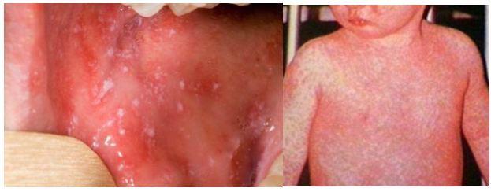
Measles

Slide 23
Complication:
1- Encephalitis: Acute or subacute sclerosing panencephalitis (SSPE)
2- Giant cell pneumonia: rare in immunocompromised children due to direct invasion of measles virus to the lung tissue.
Lab diagnosis: Serology by detection of IgM Ab using ELISA, and in case of SSPE detection of measles antibodies in CSF or detection of viral NA using PCR.
Treatment and prevention: No specific treatment, Prevention by giving the live attenuated vaccine (MMR) for Measles, Mumps and Rubella (given to all children 15 month and booster dose at school entry). Give excellent long last protection.

Slide 24
Mumps Virus
Mumps: is an acute benign viral parotitis.
Parotitis (painful inflammation and swelling of salivary gland and mainly parotid glands), it is a disease of children (5-15 years), but also can be seen in young adult with more complicated feature.
Virology Aspect:
Family: Paramyxoviridae.
Structural features: Enveloped virus with - polarity ss-RNA genome.
The viral envelope is covered with two glycoprotein spikes, hemagglutinine and neuraminidase.
Transmission: Inhalation of infectious aerosol droplets during sneezing and coughing, direct contact with saliva.

Slide 25
Epidemiology: Mumps virus infects human only.
Highly infectious, peak in winter.
Long incubation period 18-21 days.
Pathogenesis:
Infection started in the epithelial cells of upper respiratory tract, then virus spread by viremia to parotid gland mainly and to other organs as: testes, ovaries, pancreas and CNS.
Clinical Features:
Classic mumps starts with moderate fever, malaise, pain on chewing or swallowing, particularly acidic liquids.
Sudden onset of fever and painful swelling of parotid gland.
Self-limiting disease resolve within one week.
Solid and long life immunity developed.

Slide 26
Complications:
Aseptic meningitis, Encephalitis, Pancreatitis, Thyroiditis.
after puberty:
Orchitis: inflammation of one or both testicles. usually unilateral, rarely leads to sterility.
Oophoritis: inflammation of ovaries.
Lab diagnosis: Serology by detection of IgMAb using ELISA, cell culture and isolation of the virus from saliva or detection of viral NA using PCR.
Treatment and prevention:
No specific antiviral treatment.
MMR: Live attenuated vaccine for Measles, Mumps and Rubella given to all children 15 month and booster dose at school entry. Give excellent long last protection.

Slide 27
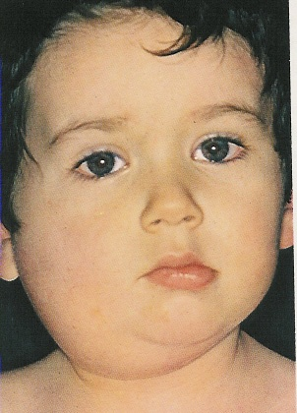
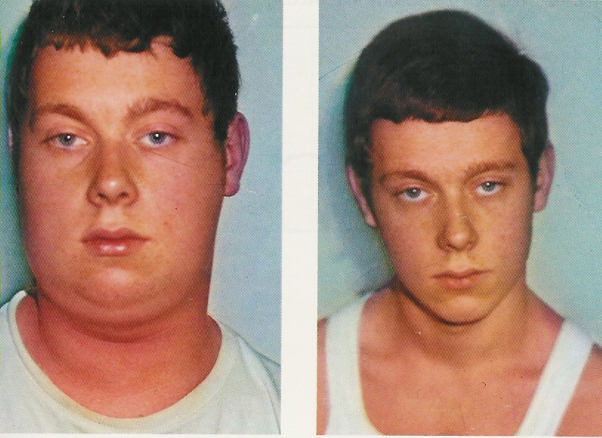
During Infection
After Recovery

Slide 28
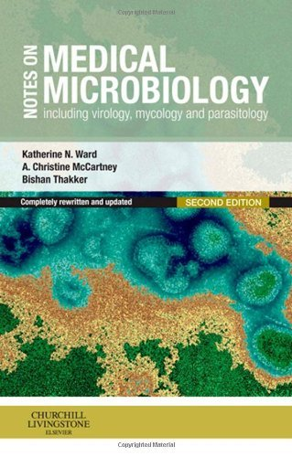
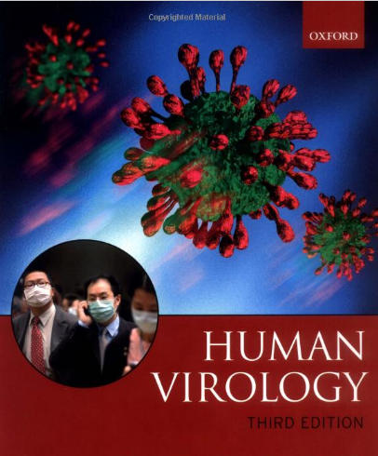
Reference books &the relevant page numbers
Notes on Medical Microbiology
By; Katherine N. Ward, A. Christine McCartney, and Bishan Thakker.
(2009)
Pages; 329-340.
Human Virology
By; Leslie Collier and John Oxford.
(2006)
Pages, 71-95.

Slide 29
Thank you for your attention!
Questions?

