Slide 1

Lecture Title:
Respiratory Fungal Infections
(Respiratory Block, Microbiology)
Lecturer name:
Dr. Ahmed M. Albarrag

Slide 2
Respiratory fungal infections
Respiratory System
Rout of infection?
Respiratory fungal infections are less common than viral and bacterial infections.
Invasive diseases have significant difficulties in diagnosis and treatment.

Slide 3
Respiratory fungal infection - Etiology
YEAST
  Candidiasis
  Cryptococcosis (Cryptococcus neoformans, C. gattii)
Opportunistic
Mould fungi
  Aspergillosis (Aspergillus species)
  Zygomycosis (Zygomycetes, e.g. Rhizopus, Mucor)
  Other mould
Dimorphic fungi
  Histoplasma capsulatum
  Blastomyces dermatitidis
  Paracoccidioides brasiliensis
  Coccidioides immitis
Primary infections

Slide 4
Primary Systemic Mycoses
  Infections of the respiratory system, (Inhalation )
  Dissemination seen in immunecompromised hosts
  Common in North America and to a lesser extent in South America. Not common in other parts of the World.
  Etiologies are dimorphic fungi
    In nature found in soil of restricted habitats.
    Primary pathogens
    They are highly infectious
  They include:
  Histoplasmosis,
  Blastomycosis,
  Coccidioidomycosis,
  Paracoccidioidomycosis

Slide 5
Aspergillosis
Aspergillosis is a spectrum of diseases of humans and animals caused by members of the genus Aspergillus.
These include
(1) Mycotoxicosis
(2) Allergy
(3) Colonization (without invasion and extension ) in preformed cavities
(4) Invasive disease of lungs
(5) Systemic and disseminated disease.
Aetiological Agents: Aspergillus species,
common species are:
A. fumigatus, A. flavus, A. niger, A. terreus and A. nidulans.

Slide 6
Classification of aspergillosis
Invasive aspergillosis
Airways/nasal exposure to airborne Aspergillus
Chronic aspergillosis
Aspergilloma of lung
Maxillary (sinus) aspergilloma
Persistence
without disease
colonisation of
the airways or nose/sinuses
Allergic
Allergic bronchopulmonary (ABPA)
Allergic Aspergillus sinusitis

Slide 7
Risk factors
  Bone marrow/ organ transplantation
  Cancer: Leukemia, lymphoma,.. etc
  AIDS
  Drugs: Cytotoxic drugs, steroids,.. etc
  Diabetes
  Others

Slide 8
Aspergillosis
Chronic Aspergillosis (Colonizing aspergillosis)
(Aspergilloma OR Aspergillus fungus ball)
    Signs include: Cough, hemoptysis, variable fever
    Radiology will show mass in the lung , radiolucent crescent
Invasive pulmonary Aspergillosis
    Signs: Cough , hemoptysis, fever, Leukocytosis
    Radiology will show lesions with halo sign

Slide 9
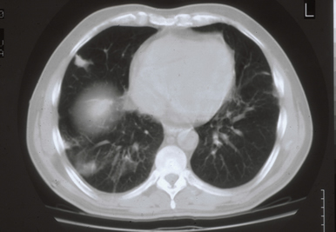
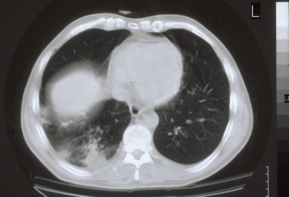
Invasive pulmonary aspergillosis
Note the Halo sign

Slide 10
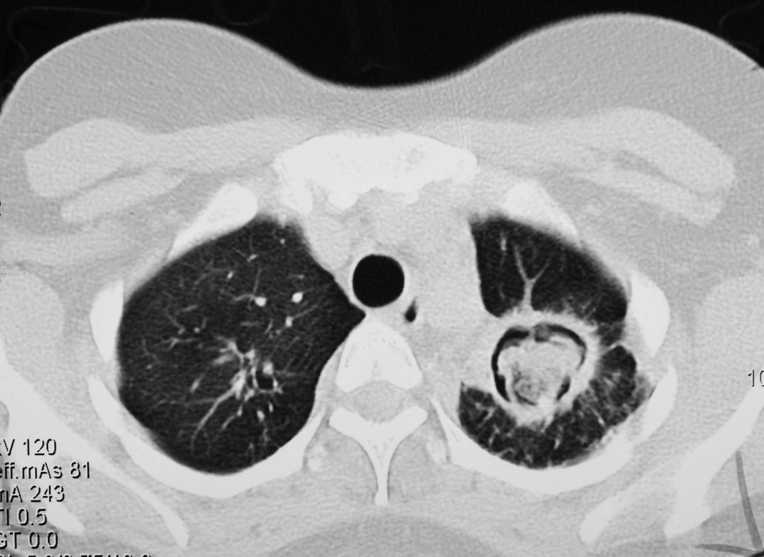
Aspergilloma
Note the Air crescent

Slide 11
Allergic bronchopulmonary (ABPA)
Symptoms of Asthma
Bronchial obstruction
Eosinophilia
Wheezing +/-
Also:
  Skin test reactivity to Aspergillus
  Serum antibodies to Aspergillus
  Serum IgE > 1000 ng/ml

Slide 12
Common airborne Fungi
Aspergillus niger
Aspergillus fumigatus

Slide 13
Fungal sinusitis

Slide 14
Fungal sinusitis
Clinical:
Nasal polyps – and other symptoms of sinusitis
In immunocompromised, Could disseminate to – eye craneum (Rhinocerebral)
The most common cause in KSA is Aspergillus flavus
In addition to Aspergillus, there are other fungi that can cause fungal sinusitis
Aspergillus sinusitis has the same spectrum of Aspergillus disease in the lung
Diagnosis
  Clinical and Radiology
  Histology
  Culture
  Precipitating antibodies useful in diagnosis
  Measurement of IgE level, RAST test
Treatment : depends on the type and severity of the disease and the immunological status of the patient

Slide 15
Diagnosis of aspergillosis
Specimen:
  Respiratory specimens: Sputum, BAL, Lung biopsy,
  Other samples:
  Blood, etc.
Lab. Investigations:
  Direct Microscopy:
  Giemsa Stain, Grecott methenamine silver stain (GMS)
      Will show fungal septate hyphae
  Culture on SDA
  Serology:
    Test for Antibody
    ELISA test for galactomannan Antigen
  PCR: Detection of Aspergillus DNA in clinical samples

Slide 16
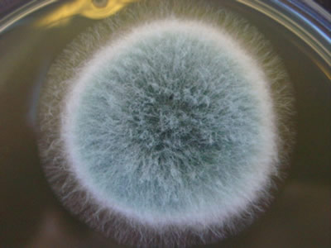
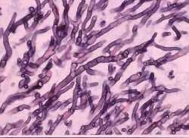
Diagnosis of aspergillosis
Cultures of Aspergillus
Smear: Septat fungal hyphae. Aspergillosis

Slide 17
Treatment of aspergillosis
Voriconazole
Alternative therapy
  Amphotericin B, Itraconazole, Caspofungin

Slide 18
Zygomycosis
Pulmonary zygomycosis
Rhinocerebral zygomycosis
Risk factors
  Transplant patients
  Malignancy
  AIDS
  Diabetic ketoacidosis
  Many others

Slide 19
Pumonary zygomycosis
Acute
Consolidation , nodules, cavitation, pleural effusion, hemoptysis
Infection may extend to chest wall, diaphragm, pericardium.
  Pulmonary infractions and hemorrhage
  Rapid evolving clinical course
Early recognition and intervention are critical
Etiology:
  Zygomycetes , Non-septate hyphae
  e.g. Rhizopus,

Slide 20
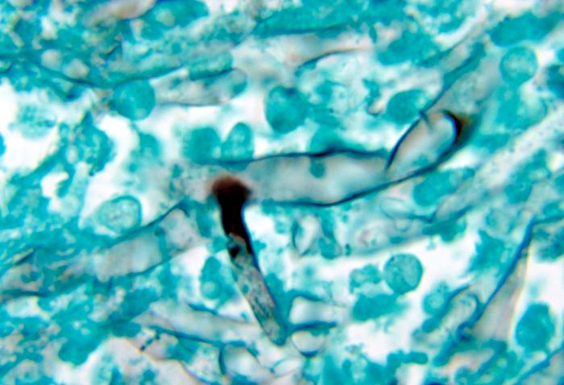
Diagnosis
Specimen:
  Respiratory specimens: Sputum, BAL, Lung biopsy,
  Other samples
Lab. Investigations:
  Direct Microscopy:
    Giemsa, Grecott methenamine silver stain (GMS)
      Will show broad non- septate fungal hyphae
  Culture on SDA (no cycloheximide)
Serology: Not available
Treatment: Amphotericin B
  Surgery

Slide 21
Pneumocystosis (PCP)
Pneumocystis pneumonia (PCP)
It is interstitial pneumonia of the alveolar area.
Affect compromised host
Especially common in AIDS patients.
Etiology:
    Pneumocystis jiroveci
Previously thought to be a protozoan parasite, but later it has been proven to be a fungus
Does not grow in laboratory media e.g. SDA
Naturally found in rodents (rats), other animals (goats, horses), Humans may contract it during childhood

Slide 22
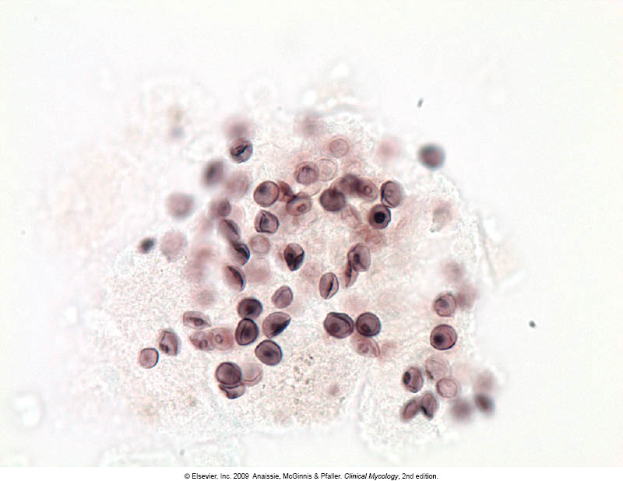
Pneumocystosis
Laboratory Diagnosis:
  Patient specimen: Bronchoscopic specimens (Bronchoalveolar lavage), Sputum, Lung biopsy tissue.
Histological sections or smears stained by GMS stain.
  Immunuofluorescence (better sensitivity)
  If positive will see cysts of hat-shape,
  cup shape, crescent
Treatment:
Trimethoprim – sulfamethoxazole
Dapsone

Slide 23
Thank You ☺
(Respiratory Block, Microbiology)
Dr. Ahmed M. Albarrag

