Slide 1
Bacterial Upper Respiratory Tract Infections (URTI)
Dr. Khalifa Binkhamis

Slide 2
Objectives
Discuss the epidemiology and various clinical presentations of URTIs
Identify the most important etiological agents causing different URTIs, and discuss their virulence factors, laboratory diagnosis and potential preventative strategies
Determine the antibiotic of choice for the different URTIs
Discuss complications of GAS and C. diphtheriae infections

Slide 3
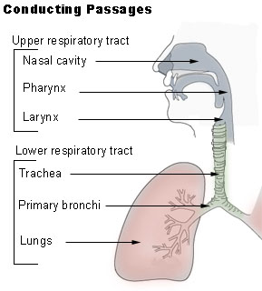
Outline
Pharyngitis
  GAS
  Diphtheria
Epiglottitis
Whooping cough
Otitis Media
Sinusitis
Deep neck space
infections

Slide 4
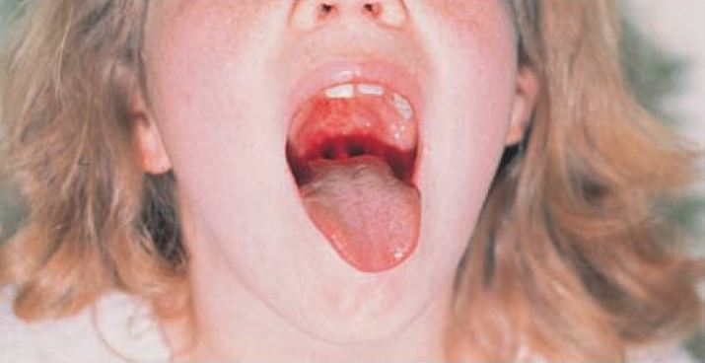
Pharyngitis
Epidemiology
  Late fall, winter, early spring
  5 to 15 years
  Etiology
    Viruses (i.e. respiratory viruses) are the most common cause
    Streptococcus pyogenes is the most important bacterial cause

Slide 5
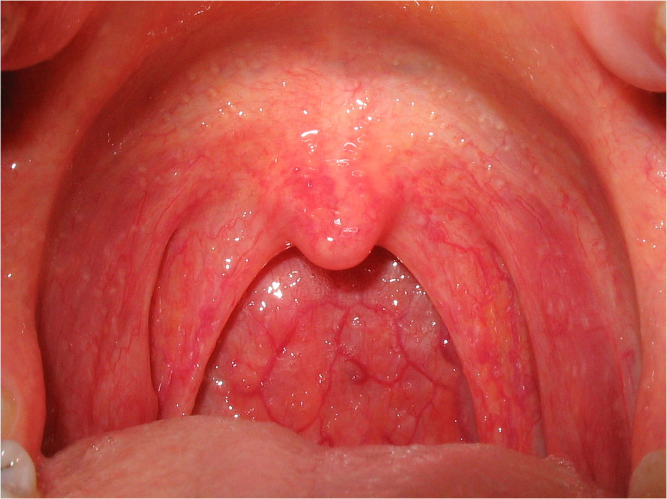
Pharyngitis
Bacterial causes include:
  Group A streptococcus *
  Corynebacterium diphtheriae
  Fusobacterium necrophorum (Anaerobic bacteria, cause of Lemierre's syndrome)
  Neisseria gonorrhoeae

Slide 6
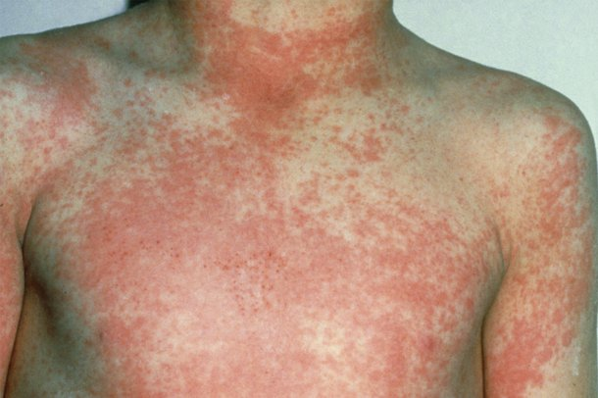
Pharyngitis
Signs and symptoms:
  Sore Throat
  Pharyngeal erythema, edema
  Fever
More consistent with viral:
  Coryza
  Cough
  Conjunctivitis
More consistent with bacterial (GAS):
  Tonsillar exudates
  Tender, enlarged >1 cm lymph nodes
  Fever 38.4 to 39.4º C
Notes:
GAS pharyngitis may present with a scarlatiniform rash, described as sandpaper-like

Slide 7
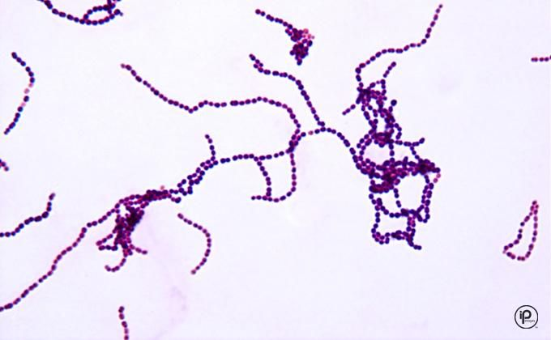
GAS
Gram positive cocci in chains
Facultative anaerobe
Beta haemolytic
Catalase negative
Causes:
  Respiratory infections
    Pharyngitis
    Otitis
    Sinusitis
  Other infections
    Skin and soft tissue
  Virulence factors
    Capsule
    M protein in cell wall
    Streptolysin O & S
    Streptococcal pyrogenic exotoxins (SPE)
Notes:
-Capsule: anti-phagocytosis & specific attachment to specific tissues
-M protein in cell wall: anti-phagocytosis & specific attachment to specific tissues
-Streptolysin O and S (haemolysins): toxic to a variety of different cell types
-Streptococcal pyrogenic exotoxins (SPE): “superantigens” directly stimulate T-cells (~1000X more than a normal immune response) and cause them release high levels of the cytokines that are responsible for fever and shock
-SPE is also responsible for various tissue destruction, including skin lesions, and perhaps scarlet fever

Slide 8
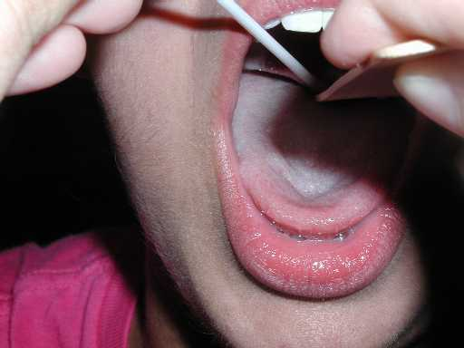
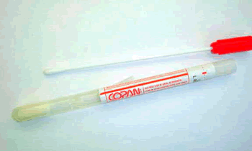
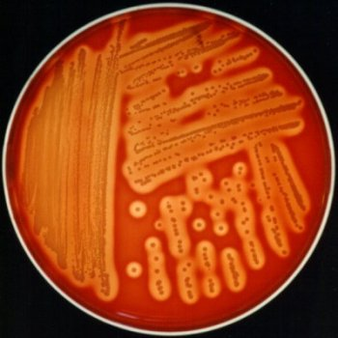
GAS Pharyngitis
Diagnosis:
  Throat swab
    Rapid Bacterial antigen detection
    Culture on blood agar
  Antistreptolysin O
Treatment:
  Penicillin x 10 days
  Allergy?
    Clindamycin or macrolide (e.g. Clarithromycin)
Notes:
We will discuss the antigen detection method more during the practical
Antibodies against Streptolysin O is a useful serological test to assess for prior group A strep infection
GAS predictably susceptible to penicillin

Slide 9
GAS Pharyngitis Complications
Suppurative
  E.g. Peritonsillar abscess, parapharyngeal space abscess
Non suppurative
  Occurs 1-6 weeks after acute S. pyogenes infection
    Rheumatic fever
    Glomerulonephritis
Notes:
Suppurative: pus forming

Slide 10
GAS Pharyngitis Complications
Rheumatic fever:
After infection of the respiratory tract.
Inflammation of heart (pancarditis), joints, blood vessels, and subcutaneous tissue.
Results from cross reactivity of anti-M protein Ab and the human heart tissue.
Acute glomerulonephritis:
After infection of the skin or the respiratory tract.
Symptoms: edema, hypertension, hematuria, and proteinuria.
Initiated by Ag-Ab complexes on the glomerular basement membrane.
Notes:
Poststreptococcal diseases (occurs 1-4 weeks after acute S. pyogenes infection, hypersensitivity responses)
Rheumatic fever: most commonly preceded by infection of the respiratory tract. Inflammation of heart (pancarditis), joints, blood vessels, and subcutaneous tissue. Results from cross reactivity of anti-M protein Ab and the human heart tissue. This disease can be reactivated by recurrent streptococcal infections, whereas nephritis does not. Penicillin used as prophylaxis for years after
Acute glomerulonephritis: preceded by infection of the skin (more commonly) or the respiratory tract. Symptoms: edema, hypertension, hematuria, and proteinuria. Initiated by Ag-Ab complexes on the glomerular basement membrane.

Slide 11
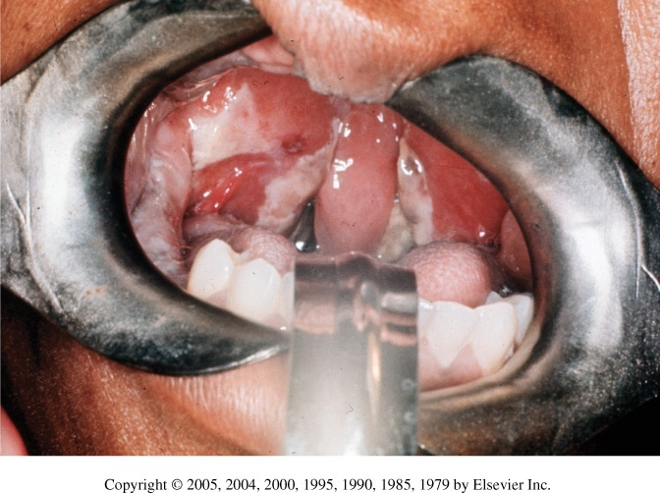
Corynebacterium diphtheriae
Rare in developed countries
  Why? How is it prevented?
Mainly presents as URTI
Formation of membranes in the throat is characteristic
Virulence
  Diptheria toxin
Notes:
-Can also present as cutaneous lesions
-Membranes only appear in 1/3 of cases
-Diptheria toxin is an exotoxin that inhibits protein synthesis

Slide 12
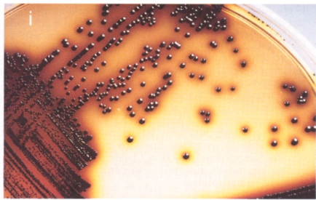
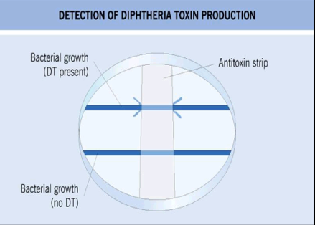
Corynebacterium diphtheriae
Diagnosis:
  Throat swab
  Culture on special media containing tellurite (e.g. Tinsdale media)
  ELEK’s Test for confirmation of toxin production
Treatment:
  Antitoxin + antibiotic
    Penicillin or erythromycin
Notes:
Can obtain throat swab for culture
Complications can lead to death

Slide 13
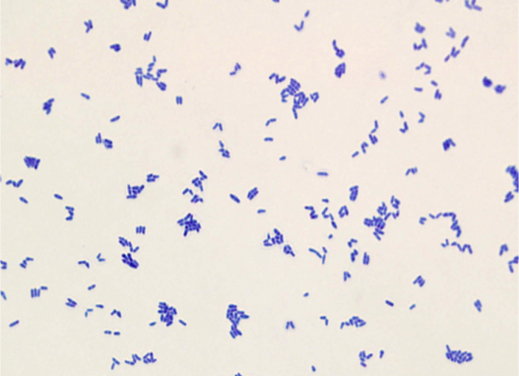
Corynebacterium diphtheriae
Prevention:
  Vaccination with diphtheria toxoid containing vaccine
Complications:
  Myocarditis
  Neuritis
Notes:
Diptheria toxoid containing vaccine is part of routine childhood immunization

Slide 14
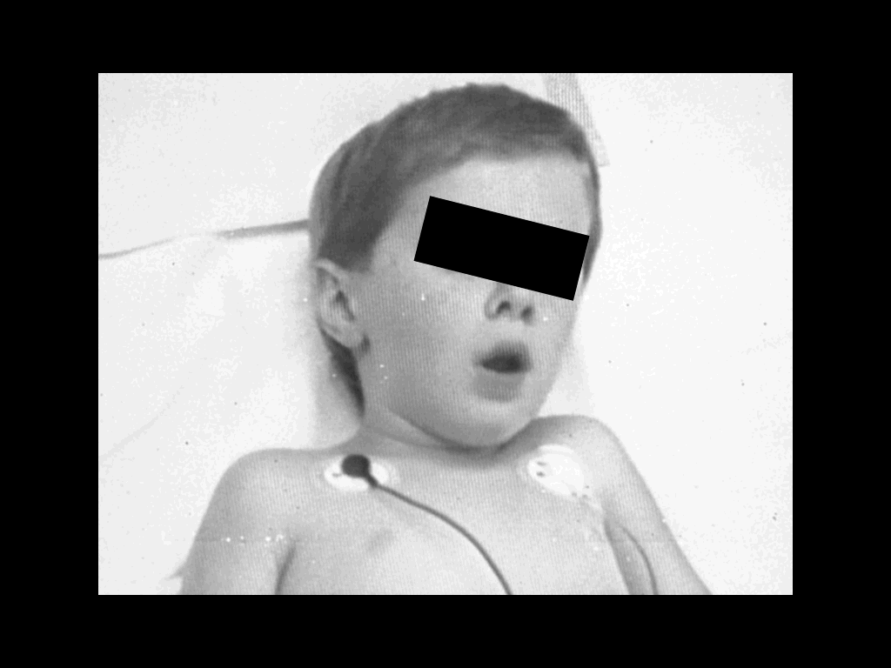
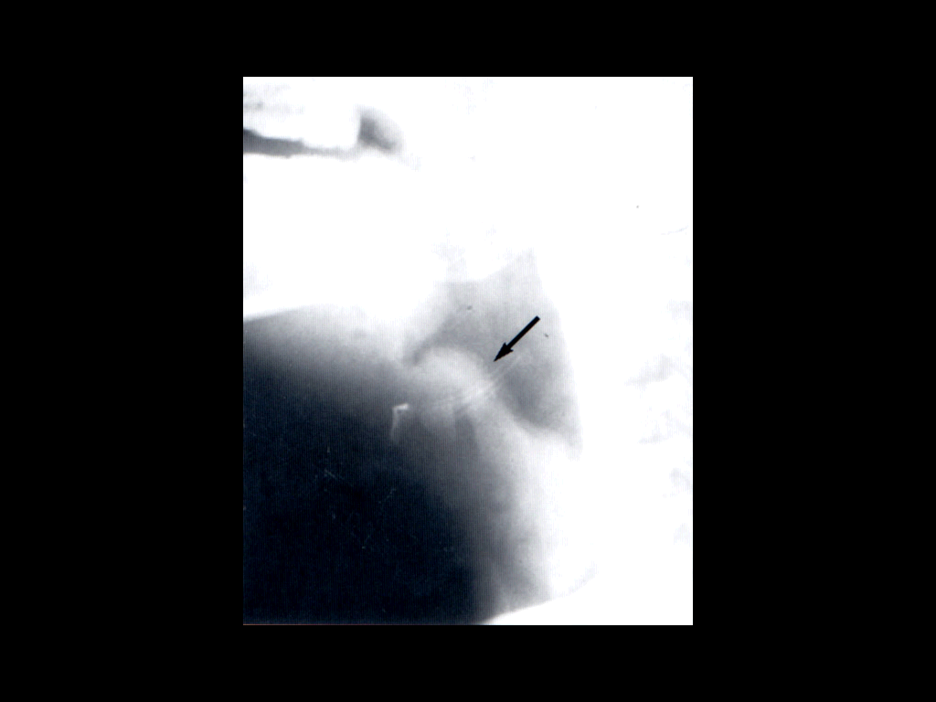
Epiglottitis
Usually young unimmunized children presented with dysphagia, drooling, and respiratory distress
Etiology
  H. influenzae Type b
  S. pneumonae
  S. aureus
  Beta hemolytic streptococci

Slide 15
Epiglottitis
Diagnosis:
  Blood cultures
  Culture of epigoltic surface (under controlled setting)
Management:
  Maintenance of airway
  Empiric treatment:
    Ceftriaxone + Vancomycin
Prevention: HiB vaccination
Notes:
HiB vaccine (Haemophilus Influenzae Type B Vaccine) is part of routine childhood immunization

Slide 16
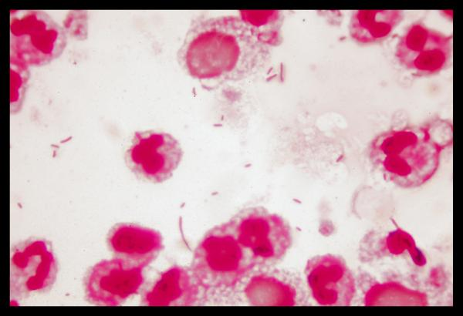
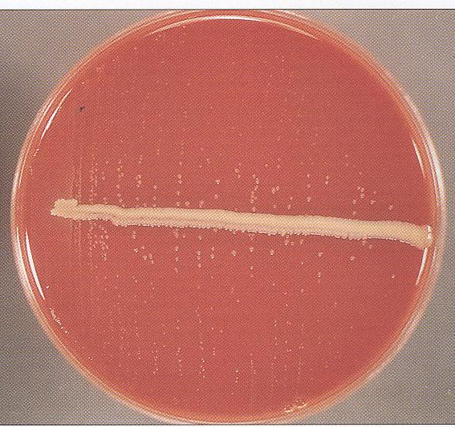
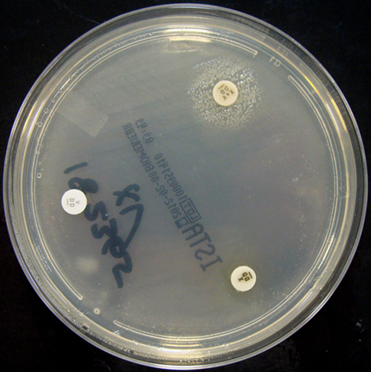
H. influenzae
Gram­ negative pleomorphic, coccoid to rod-shaped cells (coccobacilli)
Oxidase and catalase positive
Requires X (heme) and V (NAD) factors for growth
  Used to confirm ID

Slide 17
H. influenzae
Divided into:
  Encapsulated (typable) strains (main virulence factor)
    A-F
    Most important is type b
      Prevention through vaccination
    Causes invasive disease (e.g. epiglottis, meningitis)
  Non­encapsulated (nontypable) strains
    Causes local infections (e.g. sinusitis, otitis, pneumonia in elderly)
Treatment:
    Amoxicillin-clavulanate, 2nd or 3rd generation cephalosporin
Notes:
Capsule: antiphagocytic
Can be resistant to ampicillin mainly though the production of a beta lactamase enzyme (enzyme that breaks down the antibiotic)

Slide 18
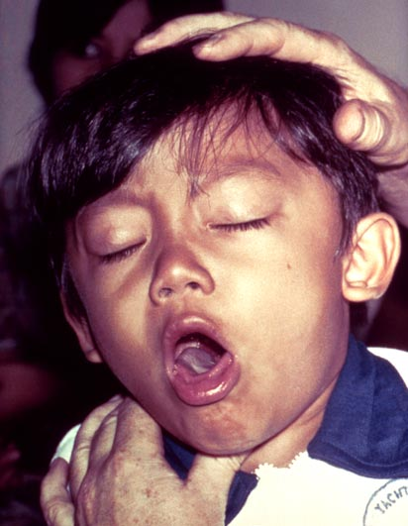
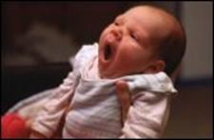
Pertussis (whooping cough)
Bordetella pertussis (GNB)
  Virulence
    Pertussis toxin *
    Filamentous hemagglutinin
    Pertactin
    Incubation period 1 to 3 wks
  Catarrhal Stage 1-2 weeks
  Paroxysmal Stage 2-4 weeks
  Convalescent Stage 1-2 weeks
Notes:
Pertussis toxin is the main virulence factor
FHA and PRN are important for adhesion and attachment

Slide 19
Pertussis (whooping cough)
Diagnosis:
  Sample:
    Nasopharyngeal (NP) swabs
  Special media needed
    Charcoal blood (Regan-Lowe)
    Bordet-Gengou
Treatment:
  Macrolide (erythromycin)
Prevention by vaccination
  Acellular pertussis-containing vaccine
Notes:
Can also do molecular tests (PCR) on NP swab sample to diagnose pertussis
Acellular pertussis-containing vaccine is part of routine childhood immunization

Slide 20
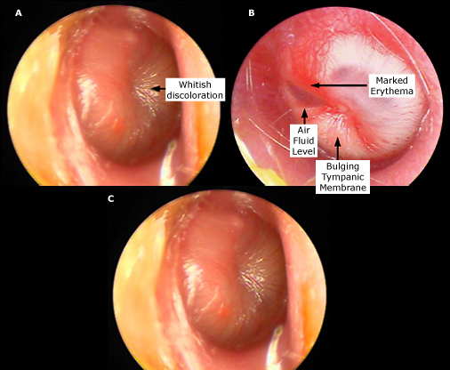
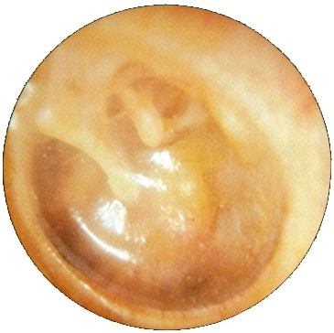
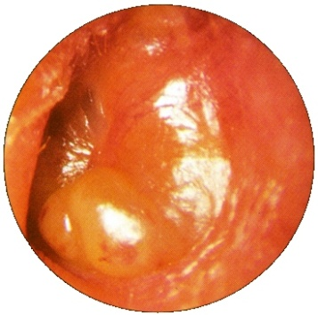
Acute Otitis Media
Fluid + inflammation of the mucosal lining of the middle ear
More common in children
Etiology:
  S. pneumoniae
  H. influenzae (non typable)
  S. aureus
  Moraxella catarrhalis
  GAS
  Viral (alone or with bacteria)
Notes:
Ear pain, bulging and erythema of tympanic membrane
GAS: group A Streptococcus

Slide 21
Acute Otitis Media
Diagnosis:
  Mainly clinical diagnosis
  Tympanocentesis sometimes needed
    Middle ear fluid can be sent for culture
Treatment
  Amoxicillin or Amoxicillin Clavulanic acid
Notes:
Tympanocentesis (aspiration of middle ear fluid): not done on all patients with otitis. Indications include critically ill patient, patient who has not responded to initial antimicrobial therapy and is toxic

Slide 22
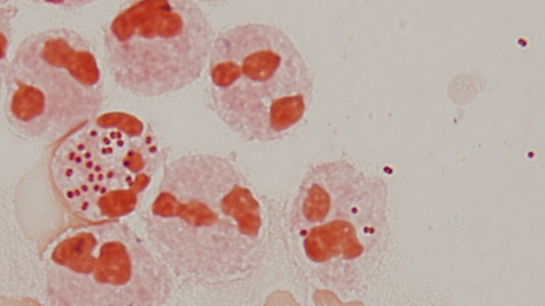
Moraxella catarrhalis
Gram negative diplococci
Catalase and oxidase positive
Causes:
  Otitis
  Sinusitis
  Pneumonia
Treamtent:
  Amox-Clav

Slide 23
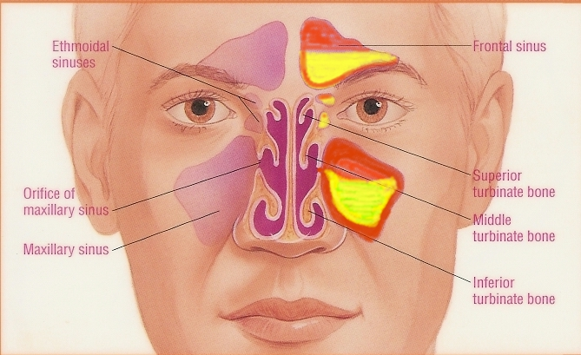
Acute Bacterial Sinusitis
More common in children
Occurs with viral URTI
Etiology:
  S. pneumoniae,
  H. infuenzae (non typable)
  M. catarrhalis
  Anaerobes
  Viral
Notes:
Sinusitis: inflammation of the paranasal sinuses

Slide 24
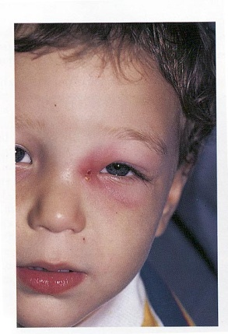
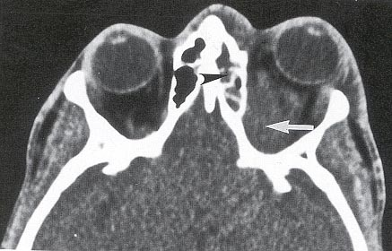
Acute Bacterial Sinusitis
  Diagnosis:
    Mainly clinical diagnosis
    Imaging (CT/MRI) when there is suspension of complications
Treatment
  Amoxicillin Clavulanic acid For 1-2 weeks
Notes:
Treatment When ongoing symptoms and fever
Potential complications: orbital infections (peri orbital or orbital cellulitis), CNS infections (meningitis, brain abscess)

Slide 25
Deep neck space infections
Lateral pharyngeal, retropharyngeal or prevertebral space
Patients are very sick and toxic
Neck stiffness can occur with retropharyngeal space infection/abscess
Retropharyngeal (danger space) infection may extend to mediastinum and present as mediastinitis

Slide 26
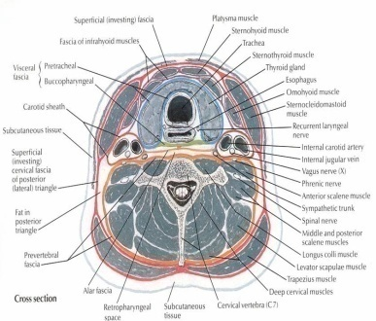
Deep neck space infections treatment
Usually polymicrobial
  Mainly streptococci and oral anaerobes
Management
  Surgery
  Antibiotics
    Meropenem
    Piperacillin
    Clindamycin
Duration
  2-3 weeks

Slide 27
References
Ryan, Kenneth J.. Sherris Medical Microbiology, Seventh Edition. McGraw-Hill Education.
  Ear and sinus infections, part of the chapter on Infectious Diseases: Syndromes and Etiologies
    Upper respiratory tract infections, part of the chapter on Infectious Diseases: Syndromes and Etiologies
  Streptococci, chapter 25
  Corynebacterium, chapter 26
  Haemophilus & Bordetella, chapter 31

