Slide 1
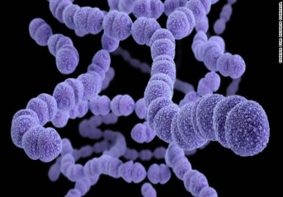
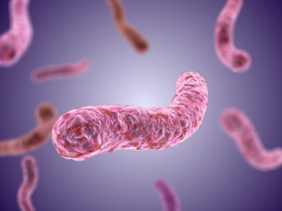
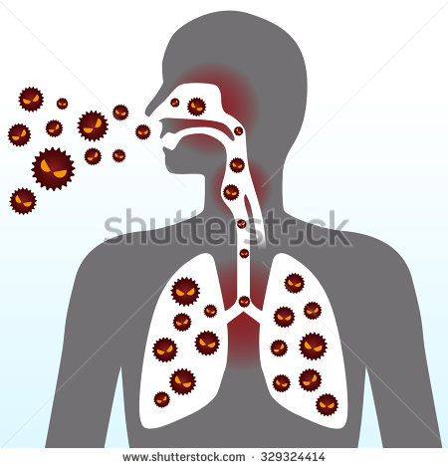
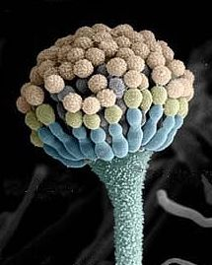
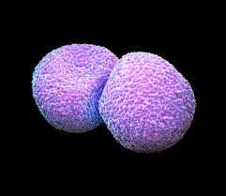
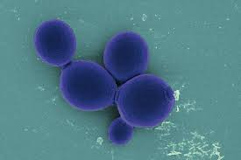
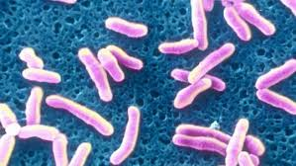
Bacteria Causing Respiratory Tract Infections
RESPIRATORY BLOCK
Dr. Fawzia Alotaibi & Dr. Khalifa Binkhamis

Slide 2
Objectives
Recognize signs and symptoms of different bacterial respiratory tract infections
Be able to come up with a short differential to relevant cases and identify the most likely causative organism
Discuss the diagnosis and treatment of different bacterial respiratory tract infections
Explain the laboratory work up of important respiratory pathogens and be able to interpret microbiological laboratory results

Slide 3
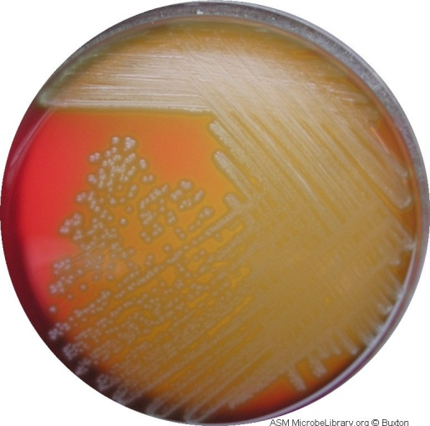
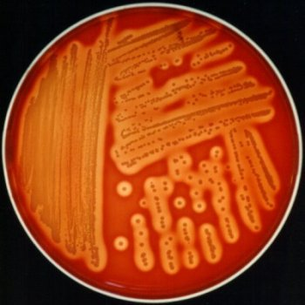
Types of Haemolysis on Blood Agar
IMAGE | DESCRIPTION | HAEMOLYSIS TYPE
 | colonies surrounded by partial haemolysis with greenish color | Alpha haemolysis
 | colonies are surrounded by a clear zone | Beta haemolysis

Slide 4
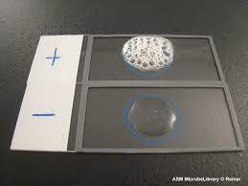
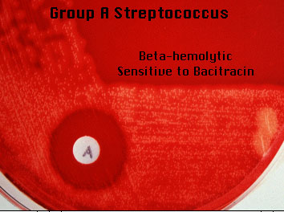
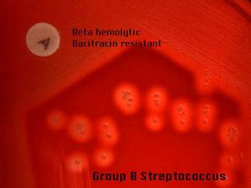
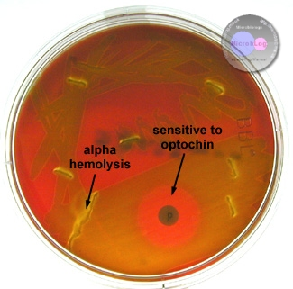
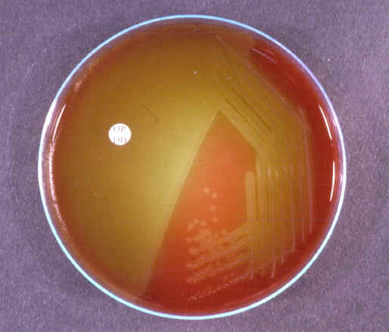
Different Tests Used in the Lab.
negative | Positive | Use | Test
Streptococcus | Staphylococcus | To differentiate between Staphylococcus & Streptococcus | CATALASE TEST
 |  | To differentiate between Streptococcus pyogenes (group A) & other beta haemolytic streptococci | BACITRACIN SUSCEPTIBILITY
 |  | To differentiate between Streptococcus pnumoniae & other alpha haemolytic streptococci | OPTOCHINSUSCEPTIBILITY

Slide 5
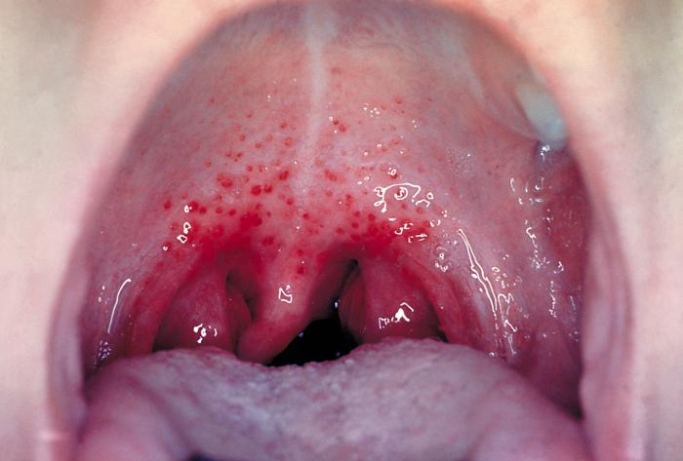
Case1
A 5 year boy was brought to KKUH, outpatient department complaining of fever and sore throat. His vaccination history was up to date. On examination his temp. was 38.5°C, the tonsillar area and pharynx were obviously inflamed with some foci of pus.
Notes:
Why do you think the vaccine history is important?

Slide 6
1. What is the differential diagnosis?
2. What investigations should be done?

Slide 7
LAB. TESTS
Specimen => throat swab
  (Rapid Antigen Detection Test) RADT
  CULTURE ON BLOOD AGAR
  Direct gram stain from throat swabs is not useful
Culture work up
  CATALASE TEST
  GRAM STAIN
  BACITRACIN SUSCEPTIBILITY TEST

Slide 8
Clinical and Epidemiologic Features

Slide 9
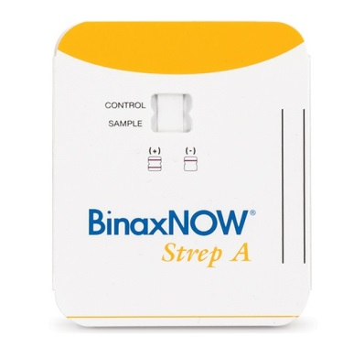
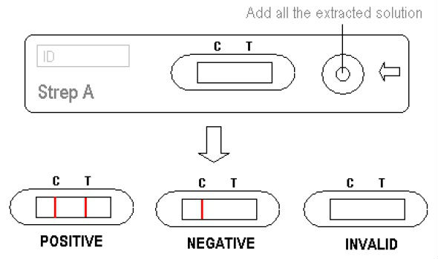
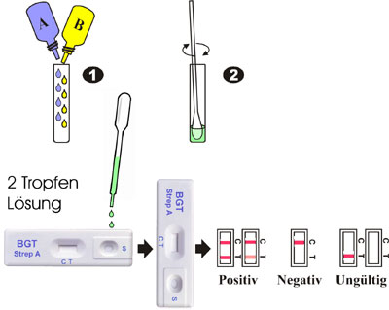
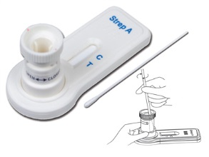
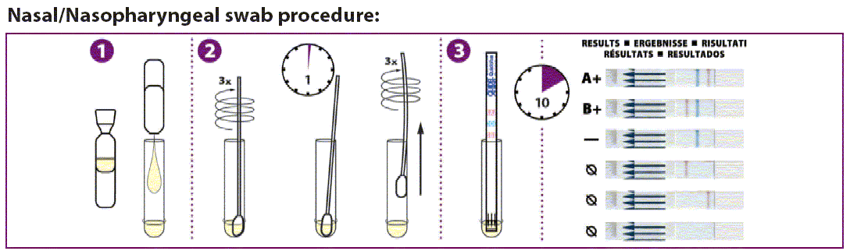
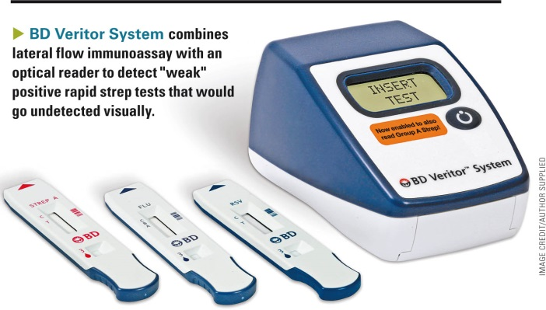
 RADT

Slide 10
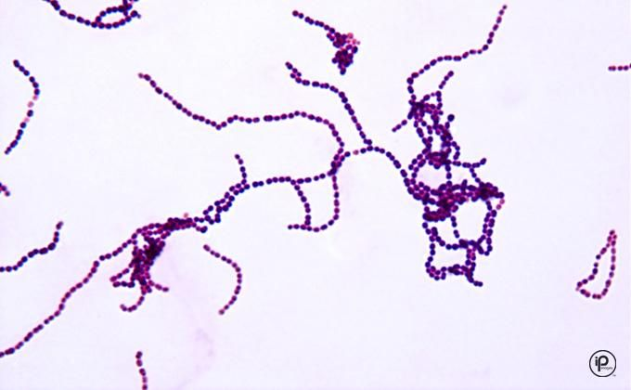
Throat swab culture showed:
Beta haemolysis on blood agar (colonies are surrounded by a clear zone).
MICROSCOPIC APEARANCE
 Culture
Gram stain From culture showed :
Gram positive cocci in Chains

Slide 11
CATALASE TEST
Catalase –ve test

Slide 12
Bacitracin Susceptibility
Bacitracin susceptible colonies
Principle:
-Bacitracin test is used for presumptive identification of group A
-To distinguish between S. pyogenes (susceptible to B) & non group A such as S. agalactiae (Resistant to B)
-Bacitracin inhibits the growth of S. pyogenes giving zone of inhibition around the disk
Procedure:
- Inoculate BAP with heavy suspension of tested organism
-Bacitracin disk (0.04 U) is applied to inoculated BAP
After incubation, any zone of inhibition around the disk is considered as susceptible
B
B

Slide 13


Lab. Test Results (Summary)
IMAGE | RESULT | TEST
 | Beta haemolyis (colonies surrounded with clear zone of haemolysis) | CULTURE ON BLOOD AGAR
 | No bubbles → catalase negative | CATALASE TEST
 | Gram positive cocci in chains | GRAM STAIN FROM CULTURE
 | Bacitracin Susceptible colonies | BACITRACIN SUSCEPTIBILITY TEST
Streptococcus pyogenes

Slide 14
1. What is the likely identity of the organism?
2. What is the best antibiotic therapy for this
child?
3. If not treated what complication may this
child have after 6 weeks period?

Slide 15
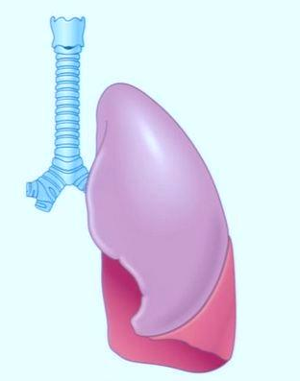
Case2
A 3-year-old girl is brought to the emergency room by her mother because she has a fever and complains that her ear hurts. She has no significant medical history. Her temperature is 38.8°C and is found to have injected tympanic membranes.

Slide 16
1. What is the differential diagnosis?
2. What investigations could be done?

Slide 17
LAB. TESTS
Specimen => middle ear fluid
  Gram stain
  Culture of the specimen on blood, chocolate and MacConkey agar
Culture work up
  Biochemical tests
  Antibiotic susceptibility test
Notes:
Tympanocentesis (aspiration of middle ear fluid) is not done on all patients with otitis.

Slide 18
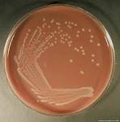
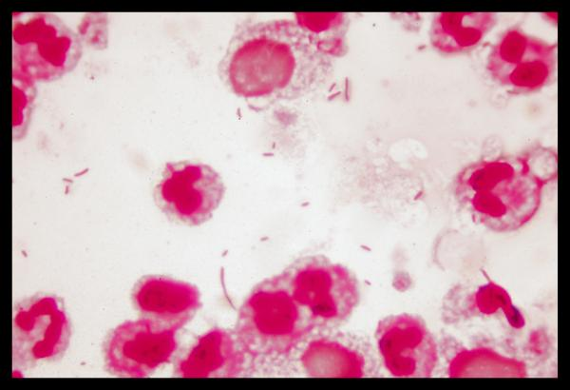
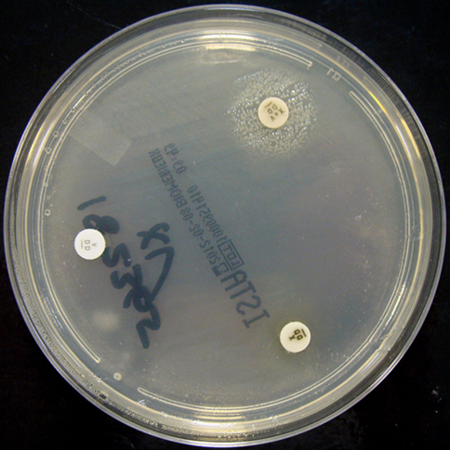
Culture on chocolate agar
MICROSCOPIC APEARANCE
Gram stain From ear discharge showed :
Gram negative coccobacilli
Nutrient agar with X and V factors:
Haemophilus influenzae grow around the disc containing X and V factors
Notes:
Haemophilus is catalase and oxidase positive
Haemophilus does not grow on MacConkey agar

Slide 19
Case3
A 28 year old female presented to the accident and emergency of KKUH with sudden onset of fever, right sided chest pain and a productive cough of purulent sputum. On examination her temperature was 39 °C. There were rhonchi and dullness on the right side of the chest. X-ray showed massive consolidation on the right side of the chest.

Slide 20
1. What is the differential diagnosis?
2. What investigations should be done?

Slide 21
LAB. TESTS
Blood work: CBC
Sputum specimen :
  Gram stain
  Culture on blood, chocolate and MacConkey agar
Culture work up
  Catalase test
  Optochin susceptibility test
  Antibiotic susceptibility test

Slide 22
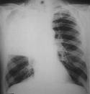
 X - Ray
The chest X- ray showed massive consolidation on the right side of the chest.

Slide 23
What should have been the empirical therapy for this case and why?

Slide 24
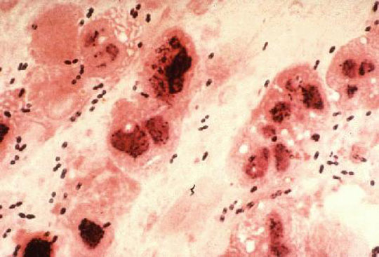
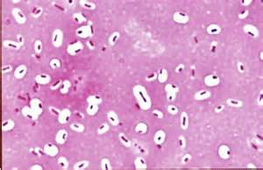
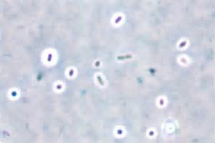
Sputum culture showed:
Alpha haemolysis on blood agar (colonies surrounded by partial haemolysis with greenish color).
MICROSCOPIC APEARANCE
 Culture
Gram stain From sputum showed :
Gram positive diplococci (arranged in piers
Negative Stains showing capsule:
Capsule stain
India ink stain

Slide 25
CATALASE TEST
Catalase –ve test

Slide 26
Optochin Susceptibility
Optochin susceptible colonies
B

Slide 27
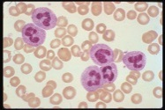
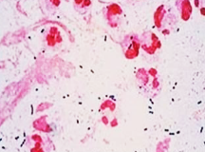
Lab. Tests Results (Summary)
 | Result | TEST
 | 45,000/ ml 90% of the cells were neutrophils | CBC
 | Alpha haemolysis (colonies surrounded by partial haemolysis with greenish color) | CULTURE ON BLOOD AGAR
 | No bubbles → catalase negative | CATALASE TEST
 | gram positive diplococci in pairs | GRAM STAIN
 | Optochin Susceptible colonies | Optochin SUSCEPTIBILITY TEST
Streptococcus pneumoniae (Pneumococcus)

Slide 28
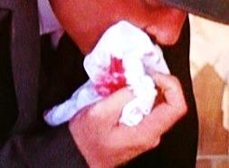
Case 4
Abdulkarim is a 65 year old Saudi man who was admitted to KKUH with a 2-3 month history of loss of appetite, weight loss, and on and off fever with attacks of cough. On examination Abdulkarim looked weak with a temperature of 38.6 °C. CVS and Respiratory system examination was unremarkable.
Two days before admission he coughed blood (haemoptysis). Abdulkarim is diabetic (for the last 5 years). His father died of tuberculosis at the age of 45 yrs.

Slide 29
1. What is the differential diagnosis?
2. What investigation should be done?

Slide 30
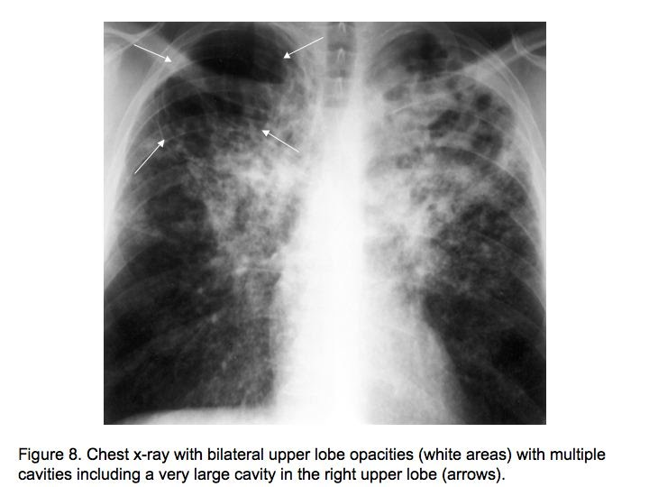
 X - Ray
The chest X- ray showed multiple opacities and cavities
Mycobacterium tuberculosis

Slide 31
The chest X- ray showed multiple opacities and cavities.
The ESR was increased (85 m /hour).
What further tests should be done?

Slide 32
LAB. TESTS
Specimen => sputum
  Ziehl-Neelsen (ZN) stain
  Culture on L.J medium ( selective for mycobacteria)
Notes:
ZN is a type of AFB stain (acid fast bacilli)

Slide 33
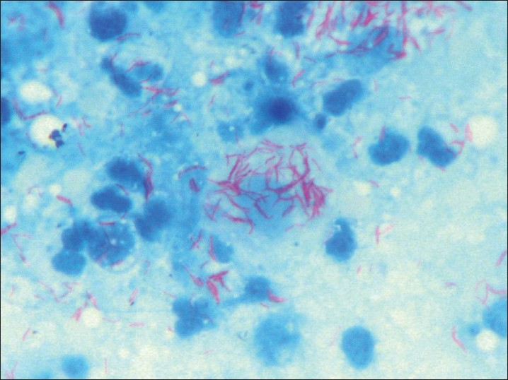
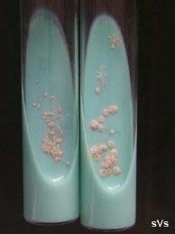
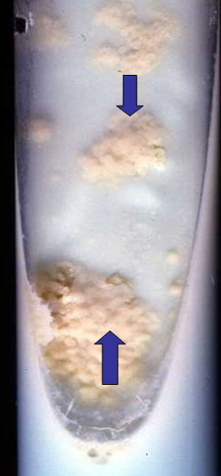
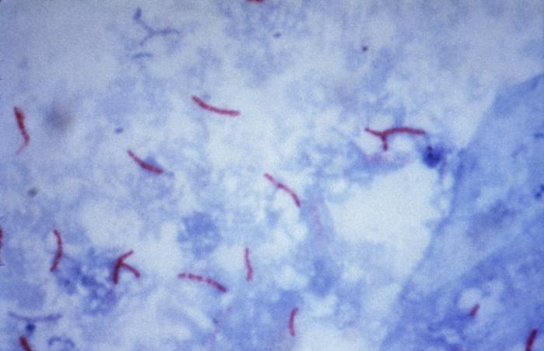
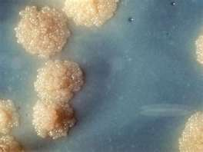
Sputum culture on Lowenstein–Jensen medium (selective for Mycobacteria) showed: showing growth of Rough, Tough and Buff colonies
MICROSCOPIC APEARANCE
 Culture
Ziel – Neelsen Stained Smear From Sputum Showing:
Acid – Fast Bacilli AFB

Slide 34
What is the probable diagnosis?
How can the diagnosis be confirmed?
Mycobacterium tuberculosis

Slide 35
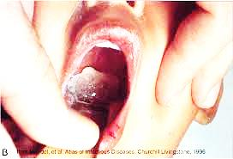
Case 5
A 5 year-old boy was brought to the emergency department complaining of sore throat , fever (38.5°C), and was found to have pharyngeal pseudomembranes
Notes:
What question might be important to ask?

Slide 36
1. What is the differential diagnosis?
2. What investigation should be done?

Slide 37
LAB. TESTS
Specimin => throat swab
  Culture on blood tellurite
  Direct gram stain from throat swabs is not useful
Culture work up:
Gram stain From culture.
ELEK test
  To confirm toxin production

Slide 38
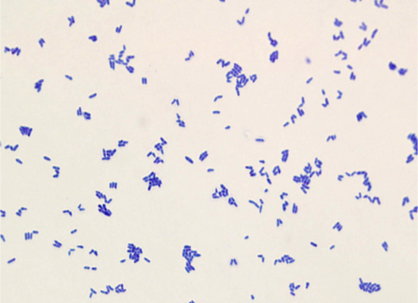
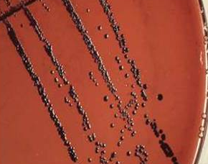
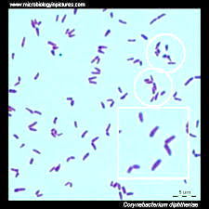
Throat swab culture on blood tellurite showed:
Black color colonies
MICROSCOPIC APEARANCE
 Culture
Gram stain From culture showed :
Gram positive bacilli (Chinese letter appearance)
Corynebacterium diphtheriae

Slide 39
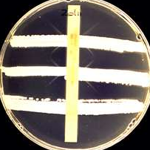
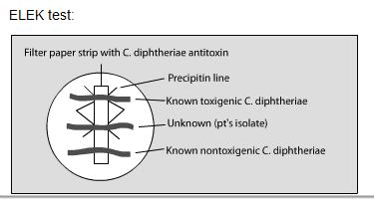
 ELEK TEST
Toxin from culture of C. diphtheriae diffuses and reacts with the diphtheria antitoxin defused from the strip and produces precipitation lines → positive test (Diphtheria exotoxin production)

Slide 40
1. What is the likely identity of the organism?
2. What is the best antibiotic therapy for this
child?
3. what complication may this child develop?

