Slide 1
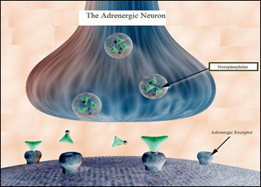
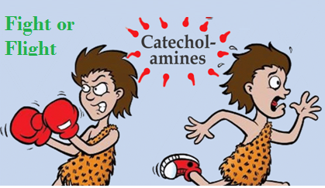
Adrenergic agonists
ILOS
Classify adrenergic agonists according to chemical structure, receptor selectivity and mode of action
Discuss pharmacodynamic actions, ADRs, indications and contraindications of adrenergic agonists

Slide 2
Adrenergic agonists
Classification
i-According to chemical structure
A- Catecholamines
1- Natural
Noradrenaline, adrenaline, dopamine
2-Synthetic
Isoprenaline
Degraded by MAO& COMT/Little CNS effects / Parenterally administered
B- Non Catecholamines
Ephedrine
Resist degradation by MAO/ Prominent CNS effects / Orally administered

Slide 3
Adrenergic agonists
ii-According to receptor selectivity
1-Selective
α₁; Phenylephrine
β₁; Dobutamine
α₂; Clonidine
β₂; Salbutamol
2-Non- selective
Noradrenaline, adrenaline, dopamine, isoprenaline, ephedrine

Slide 4
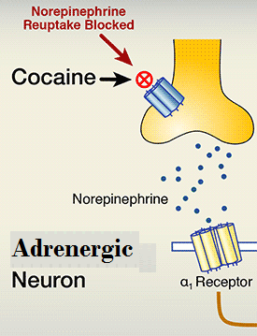
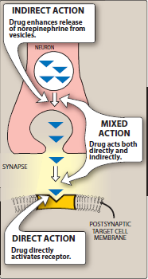
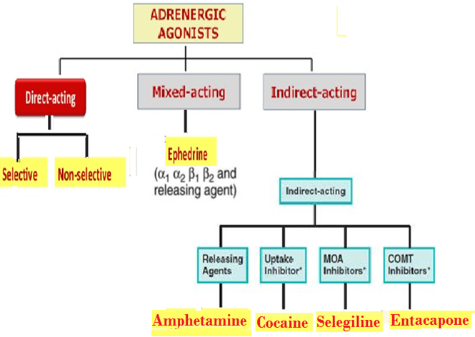
Adrenergic agonists
iii-According to mode of Action

Slide 5
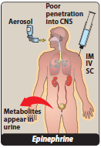
Direct- Acting
Adrenaline
Naturally released from adrenal medulla  secondary to stress, hunger, fear
Inactivated by intestinal enzymes, so given parenterally or by inhalation
Acts on all adrenergic receptors; β =/> α
Lung  bronchiodilatation (β₂)
Pregnant uterus  tocolytic (β₂), Eye  mydriasis (α₁)
CNS little, headache, tremors & restlessness

Slide 6
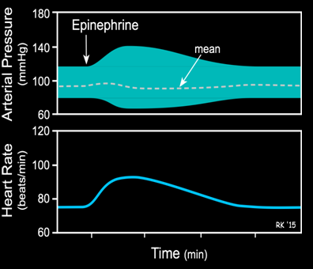
adrenaline
Pharmacological actions
Heart +inotropic, chronotropic, dromotropic (excitability)(β₁)
BP  systolic (β₁) /  diastolic . Low dose (β₂) , high dose (α₁)
Vascular SMC:- Constricts skin & peripheral vessels (α₁) . Dilates coronary & skeletal vessels (β₂)

Slide 7
Adrenaline
Indications
Used locally; as haemostatic (in epistaxsis) & as decongestant (α₁)
With local anesthetics  to reduce absorption, toxicity & bleeding from incision
Used systemically for treatment of:-
Allergic reactions  drug of choice in anaphylactic shock as it is the physiological antagonist of histamine  BP & cause vasoconstricton
In status asthmatics  given parenterally bronchodilatation (β₂) +  mucosal edema (α₁)
In cardiac arrest  direct but now through central line
N.B. Selective β₁ agonists are preferred

Slide 8
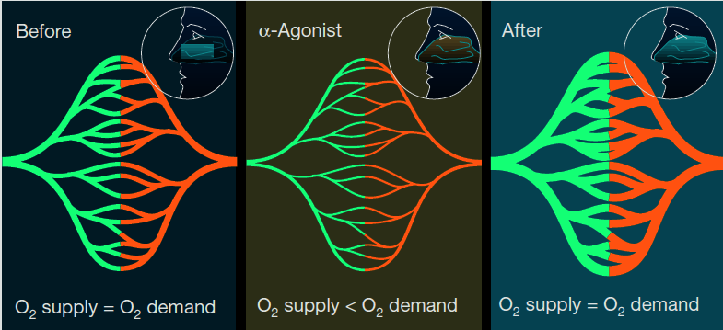
adrenaline
ADRS
Tachycardia, palpitation, arrhythmias, angina pains
Headache, weakness, tremors anxiety and restlessness.
Hypertension  cerebral hemorrhage and pulmonary edema.
Coldness of extremities, tissue necrosis and gangrene if extravasations
Nasal stuffiness; rebound congestion if used as decongestion

Slide 9
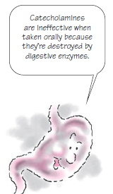
Adrenaline
contrindications
Coronary heart disease, hypertension, peripheral arterial disease.
Hyperthyroidism
Closed-angle glaucoma
(Iris relaxation  filtration angle   IOP

Slide 10
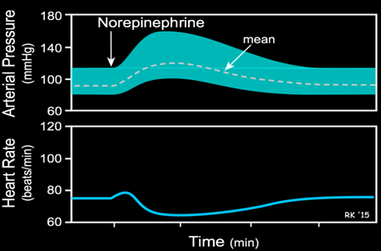
Noradrenaline
It is naturally released from postganglionic adrenergic fibers
Not much used therapeutically  severe vasoconstriction
Acts on α > β₁
Only administered IV - Not IM or Subcutaneous necrosis
It  BP [ systolic & diastolic]  reflex bradycardia (vagal stimulation)
 CO not much changed

Slide 11
Noradrenaline
indications
Used systemically; hypotensive states
In spinal anesthesia, in septic shock if fluid replacement and inotropics fail
Used topically; as a local haemostatic with local anesthetic (< tachycardia & irritability & > necrosis & sloughing)

Slide 12
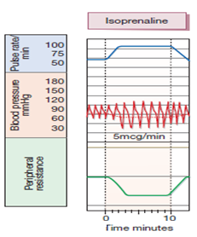
isoprenaline
It is synthetic ; show no presynaptic uptake nor breakdown by MA O  longer action.
Acts on β > > α
Slightly ↑systolic pressure, ↓diastolic pressure ,↓PVR, ↑HR
Produce broncho-dilatation Was used by inhalation in acute asthma
Used in cardiac arrest but contraindicated in hyperthyroidism & CHD

Slide 13
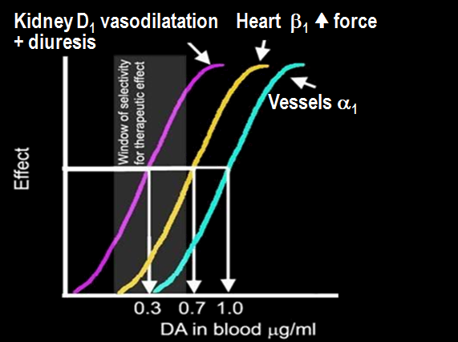
dopamine
It is a natural CNS transmitter
Released from postganglionic adrenergic fibers (> renal vessels)
Releases NE from postganglionic adrenergic fibers
Acts on D₁ > β₁ > α₁
On BP  According to dose; first  D₁ then  due to β₁
followed by α₁ effect
On heart  Inotropic, no chronotropic effect

Slide 14
dopamine
Indications
Given parenterally by continuous infusion
It is the drug of choice in treatment of SHOCK septic, hypovolaemic (after fluid replacement), cardiogenic. It  BP & CO (β₁), without causing renal impairment (D₁)
Can be given in acute heart failure (HF) but dobutamine is prefered

Slide 15
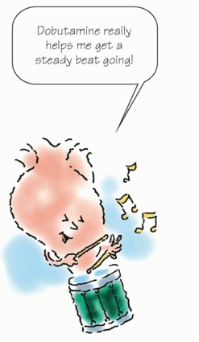
dobutamine
It is synthetic. Given IV.
Acts on β₁ > β₂ > α₁
On heart  Inotropic with little chronotropic effect
On BP  No or little  in therapeutic dose (β₁ & β₂ counterbalance + no α₁ )
Given parenterally by infusion for short term management of cardiac decompensation after cardiac surgery, in acute myocardial infarction (AMI) & HF
It is preferred because it does not  oxygen demand

Slide 16
phenylephrine
It is synthetic, noncatecholamine
Given orally & has prolonged duration of action
Systemically; Pressor agent in hypotensive states. Infusion. Acts as selective α₁ Peaks in 20 min. t_{½} 30 min
Terminate atrial tachycardia (reflex bradycardia)
Nasal decongestant. Oral
Topically; Local Haemostatic, with Local anesthesia.
Nasal & Ocular Decongestants
Used for treatment of nasal stuffiness . But can cause Rebound nasal stuffiness
Mydriatic (no cycloplegia so facilitate eye examination)

Slide 17
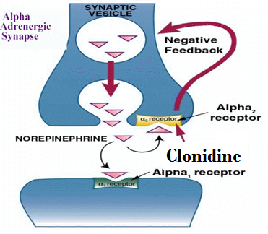
clonidine
It is synthetic, imidazoline
Given orally or as patch
Acts selectively on presynaptic α₂
◉ BP  by action on (α₂ ) at nucleus tractus solitarius to  sympathetic outflow to heart & vessels.  Antihypertensive agent
Brimonidine is an imidazoline  α₂ agonist used in glaucoma

Slide 18
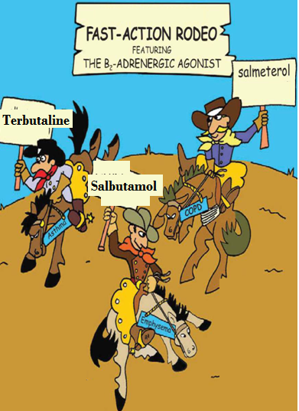
salbutamol
It is synthetic. Given orally, by inhalation or parenteral.
Acts selectively on β₂  on bronchi. Little effect on heart (β₁)
Bronchodilater  asthma & chronic obstructive airway disease (COPD)
Because t_{1/2} is 4 hrs longer acting preparations exist ; Salmeterol & Formoterol
Other selective β₂ agonists :
Terbutaline; Bronchodilator & Tocolytic
Ritodrine; Tocolytic  postpone premature labour
(labour that begins before the 37th week of gestation)

Slide 19
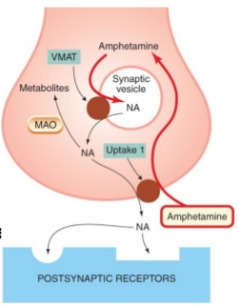
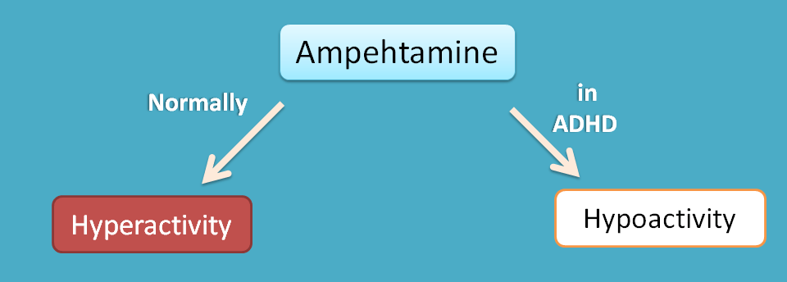
Indirectly-acting sympathomimetic amines
amphetamine
It acts indirectly; Releasing NE from adrenergic nerve endings > Blocking of its reuptake
Because it depletes vesicles from stored NE tachyphylaxsis
Absorbed orally, not destroyed by MAO, excreted mostly unchanged (by acidification of urine)
Acts on α& β  similar to epinephrine but has CNS stimulant effects; mental alertness, wakefulness, concentration & self-confidence / followed by depression & fatigue on continued use
◉ Weight   appetite  increase energy expenditure
No more used therapeutically  induces psychic & physical dependence and psychosis + the CVS side effects

Slide 20
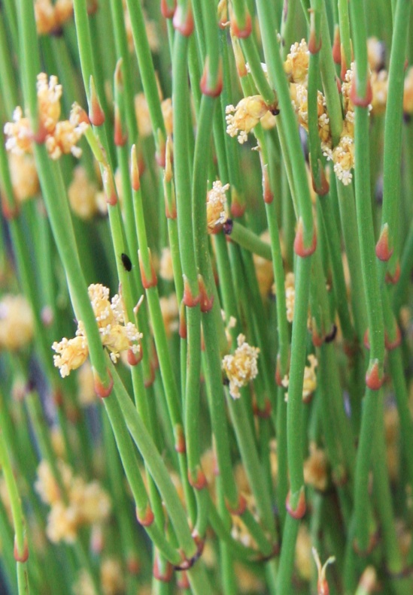
Mixed sympathomimetics
ephedrine
Plant alkaloid, synthetic, mixed sympathomimetic
Prolonged direct action on receptors  receptor down regulation
Release NE from adrenergic nerve endings depletes stores  tachyphylaxsis
Absorbed orally, not destroyed by MAO or COMT  prolonged action

Slide 21
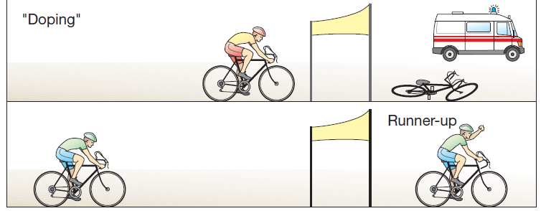
Mixed sympathomimetics
ephedrine
Acts on α& β
Facilitation of neuromuscular transmission(mythenia gravis) & retention of urine
Has CNS stimulant effects (less than amphetamine)
No more therapeutically used  but is abused by athletes and prohibited during games.
Pseudoephedrine, dual acting < CNS & pressor effects compared to ephedrine. Used as nasal & ocular decongestant & in flue remedies

