Slide 1
Control of Breathing

Slide 2
The overall processes of External Respiration

Slide 3
Objectives
By the end of this lecture you should be able to: -
Understand the role of the medulla oblongata in determining the basic pattern of respiratory activity.
List some factors that can modify the basic breathing pattern like e.g.
a- The Hering-Breuer reflexes, b- The proprioreceptor reflexes, c- The protective reflexes, like the irritant, and the J-receptors.
Understand the respiratory consequences of changing PO₂, PCO₂, and PH.
Describe the locations and roles of the peripheral and central chemoreceptors.
Compare and contrast metabolic and respiratory acidosis and metabolic and respiratory alkalosis.

Slide 4
Controls of rate and depth of respiration
Arterial PO2
When PO2 is VERY low (Hypoxia), ventilation increases.
Arterial PCO2
The most important regulator of ventilation is PCO2, small increases in PCO2, greatly increases ventilation.
Arterial pH
As hydrogen ions increase (acidosis), alveolar ventilation increases.

Slide 5
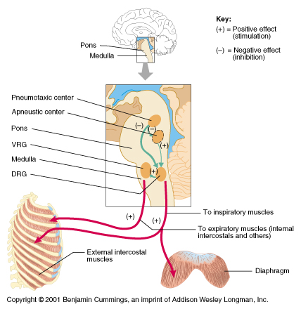
Respiratory Centers

Slide 6
Medullary Respiratory centers
Inspiratory area (Dorsal Respiratory Group) DRG
-Determines basic rhythm of breathing.
-Causes contraction of diaphragm and external intercostals.
Expiratory area (Ventral Respiratory Group) VRG
-Although it contains both inspiratory and expiratory neurons. It is inactive during normal quiet breathing.
-Activated by inspiratory area during forceful breathing.
-Causes contraction of the internal intercostals and abdominal muscles.
The medullary respiratory center stimulates basic inspiration for about 2 seconds and then basic expiration for about 3 seconds (5sec/ breath = 12breaths/min).

Slide 7
Pontine (Bridge) Respiratory centers
Transition between inhalation and exhalation is controlled by:
Pneumotaxic area
Inhibits inspiratory area of medulla to stop inhalation.
Therefore, breathing is more rapid when pneumotaxic area is active.
Apneustic area
Stimulates inspiratory area of medulla to prolong inhalation. Therefore slow respiration and prolonged respiratory cycles will result if it is stimulated.

Slide 8
Hering-Breuer inflation reflex
When the lung becomes overstretched (tidal volume is about 1.5 L), stretch receptors located in the wall of bronchi and bronchioles transmit signals through vagus nerve to DRG producing effect similar to pneumotaxic center stimulation.
Switches off inspiratory signals and thus stops further inspiration .
This reflex also increases the rate of respiration as does the pneumotaxic center.
This reflex appears to be mainly a protective mechanism for preventing excess lung inflation

Slide 9
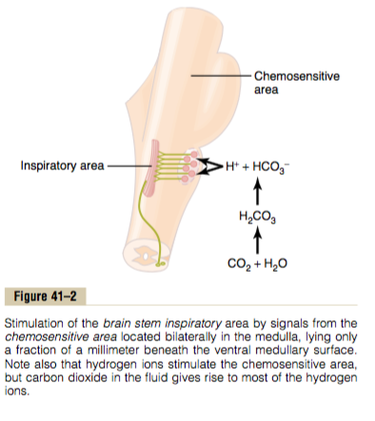
Chemical Control of Respiration Peripheral and central chemoreceptors

Slide 10
Effect of blood CO2 level on central chemoreceptors
Although carbon dioxide has little direct effect in stimulating the neurons in the chemosensitive area, it does have a potent (effective) indirect effect. It does this by reacting with the water of the tissues to form carbonic acid, which dissociates into hydrogen and bicarbonate ions; the hydrogen ions then have a potent direct stimulatory effect on respiration.

Slide 11
Why does blood carbon dioxide have a more potent effect in stimulating the chemosensitive neurons than do blood hydrogen ions?
The blood- brain barrier (BBB) is nearly impermeable to H+ ions, but CO2passes this barrier very easily. When the blood PCO2 increases, so does the PCO2 of both the interstitial fluid of the medulla and the CSF. In these fluids, the CO2 reacts with the water to form new H+ ions. Thus, more H+ ions are released into the respiratory chemosensitive sensory area of the medulla when the blood CO2 concentration increases than when the blood H+ ion increases. For this reason, respiratory center activity is increased very strongly by changes in blood CO2, a fact that we subsequently discuss quantitatively.

Slide 12
A change in blood CO2 concentration has a potent acute effect on controlling respiratory drive but only a weak chronic effect after a few days’ adaptation.
Excitation of the respiratory center by CO2 is great after the blood CO2 first increases, but it gradually declines over the next 1 to 2 days.
Part of this decline results from renal readjustment of the H+ ion concentration in the circulating blood back toward normal after the CO2 first increases.
The kidneys increasing the blood HCO3, which binds with H+ ions in the blood and CSF to reduce their concentrations.
Over a period of hours, the HCO3 (Bicarbonate) ions slowly diffuse through the BBB (blood- brain barrier) – CSF barriers and combine directly with the H+ ions adjacent to the respiratory neurons as well, thus reducing the H+ ions back to near normal.

Slide 13
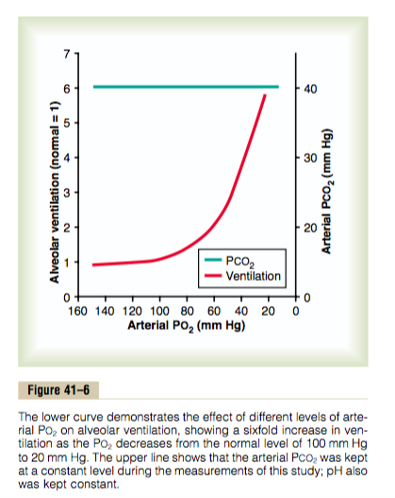
Peripheral Chemoreceptor System Activity—Role of Oxygen in Respiratory Control
Most of the chemoreceptors are in the carotid bodies. However, a few are also in the aortic bodies.
When the oxygen concentration in the arterial blood falls below normal, the chemoreceptors become strongly stimulated.
The impulse rate is particularly sensitive to changes in arterial PO2 in the range of 60 down to 30 mm Hg.
Under these conditions, low arterial PO2 obviously drives the ventilatory process quite strongly.

Slide 14
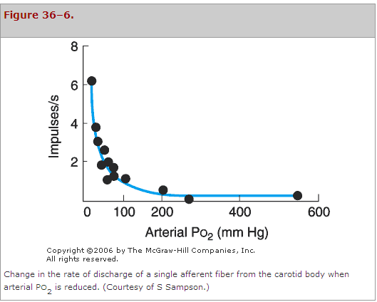
Summary of Chemoreceptor Control of Breathing

Slide 15
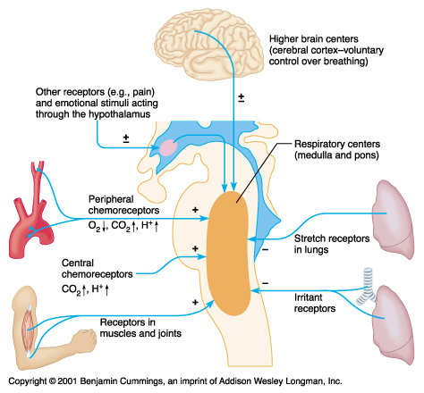
Other Factors Influencing Respiration

Slide 16
Notes:
Juxta: placed close together
Congestive heart failure (CHF)
Engorged: cause to swell with blood, water, or another fluid.

Slide 17
Cont..factors affecting respiration

Slide 18
Respiratory Acidosis
Respiratory Alkalosis
Hypoventilation.
Accumulation of CO₂ in the tissues.
P_{CO2} increases
pH decreases.
Hyperventilation.
Excessive loss of CO₂.
P_{CO2} decreases ( 35 mmHg).
pH increases.

Slide 19
Metabolic Acidosis
Metabolic Alkalosis
Ingestion (In), infusion, or production of a fixed acid.
decreased renal excretion of hydrogen ions.
loss of bicarbonate or other bases from the extracellular compartment
Excessive loss of fixed acids from the body
Ingestion, infusion, or excessive renal reabsorption of bases such as bicarbonate
pH increases.
The respiratory system can compensate for metabolic acidosis or alkalosis by altering alveolar ventilation

