Slide 1
Effects of exercise on the respiratory system.

Slide 2
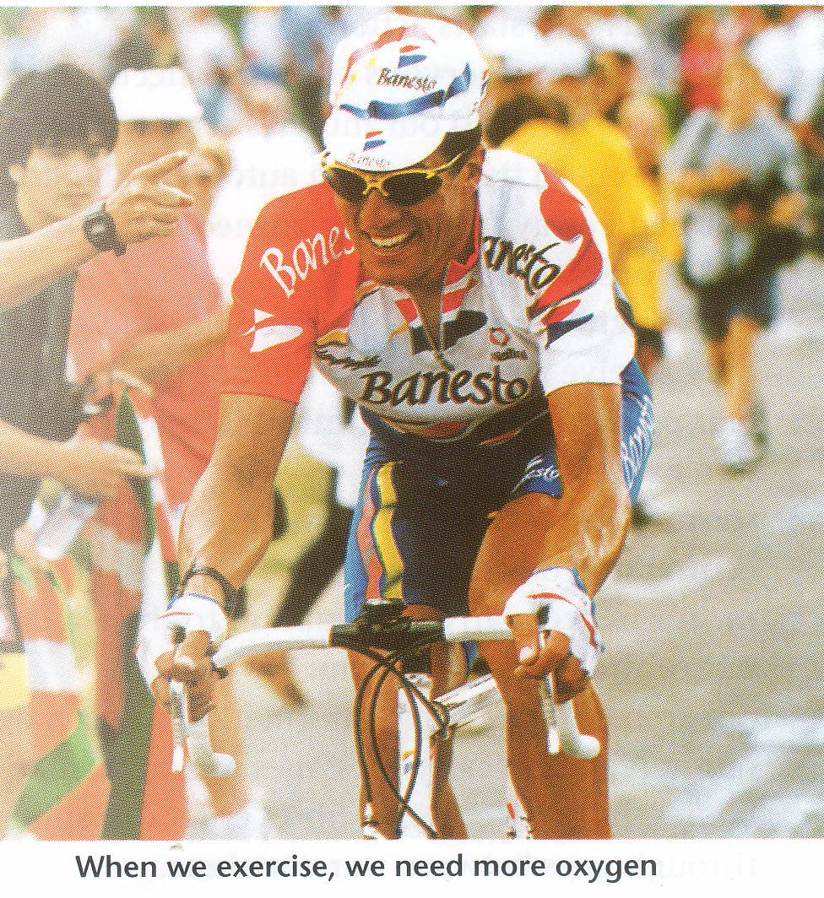

Slide 3
Objectives
By the end of this lecture the students should be able to: -
1-Describe the effects of moderate and severe exercise on oxygen consumption, and ventilation volumes.
2- Interpret the effects of exercise on arterial PO₂, PCO₂ and H⁺ ions.
3-Define the diffusing capacity of the respiratory membrane, and its typical values at rest, and explain its changes in exercise.
4-Explain causes of hyperventilation in exercise.

Slide 5
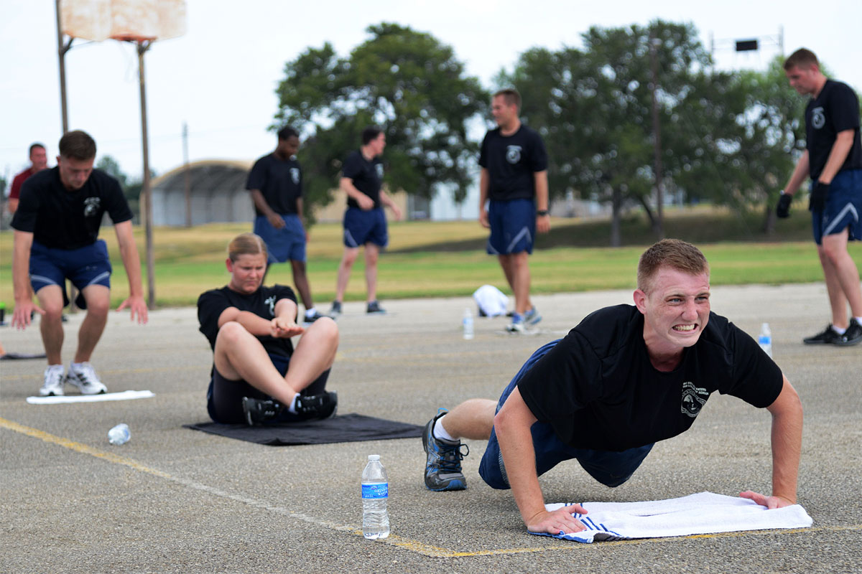
Effect of Exercise on the respiratory system
The blood gases do not always have to become abnormal for respiration to be stimulated in exercise.
Instead, respiration is stimulated mainly by neurogenic mechanisms during exercise.

Slide 6
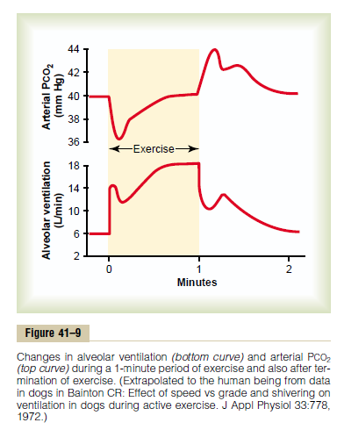
Regulation of respiration during exercise.
In strenuous exercise O2 consumption and CO2 formation may increase 20 folds but alveolar ventilation increases almost exactly in step with the increased levels of metabolism.
Therefore the arterial PO2, PCO2, PH all remain almost exactly normal.

Slide 7
What causes intense ventilation during exercise?
The brain, on transmitting motor impulses to the exercising muscles, transmits at the same time collateral impulses into the brain stem to excite the respiratory center.
A large share of the total increase in ventilation begins immediately on initiation of the exercise, before any blood chemicals have had time to change. This is mostly due to neurogenic signals

Slide 9
What cause intense ventilation during exercise?
Neural signals from the motor areas of the brain to the respiratory center.
The joint proprioceptors
Body temperature (hypothalamus).
Possibility that the neurogenic factor for control of ventilation during exercise is a learned response.

Slide 10
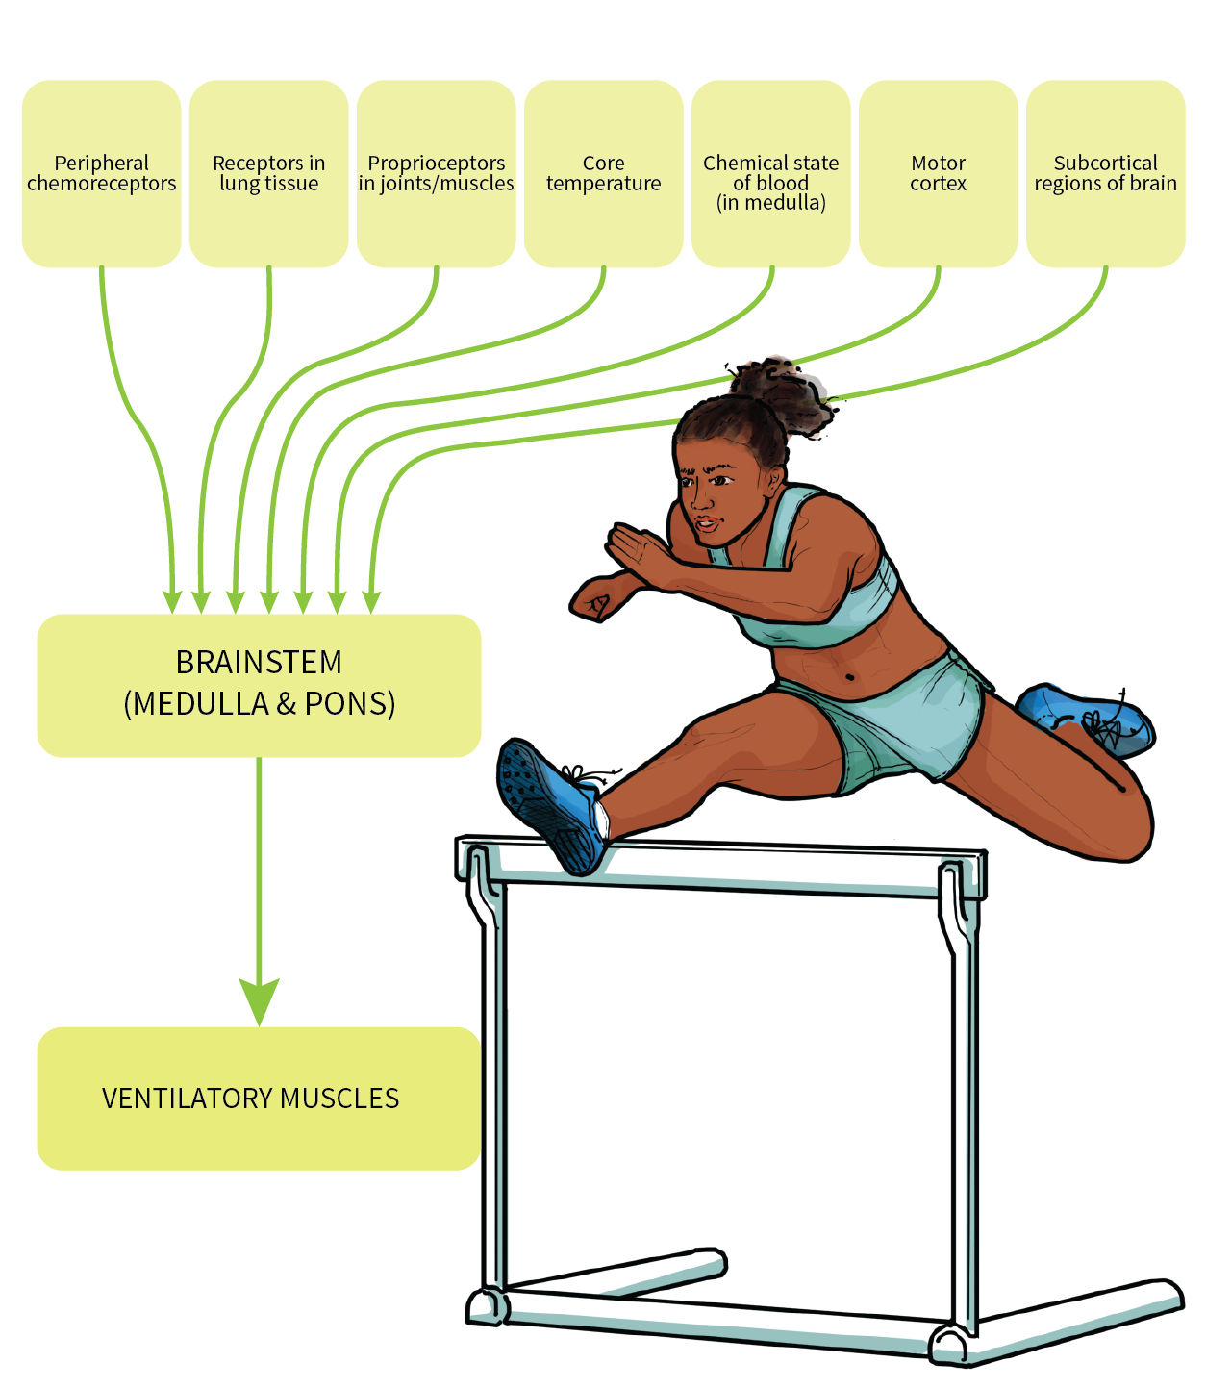

Slide 11
Relation Between Chemical and Nervous Factors in the Control of Respiration During Exercise.
Direct nervons signal stimulate the respiratory center almost the proper amount to supply the extra oxygen required for exercise and to blow off extra carbon dioxide.
Occasionally, the nervous respiratory control signals are either too strong or too weak.
Then chemical factors play a significant role in bringing about the final adjustment of respiration required to keep the O2, Co2, and H+ ion concentrations of the body fluids as nearly normal as possible.

Slide 12
The Neurogenic Factor for Control of Ventilation During Exercise Is a Learned Response.
The ventilatory response during exercise, is at least partly a learned response.
With repeated periods of exercise, the brain becomes more able to provide the proper signals required to keep the blood PCO2 at its normal level.
The cerebral cortex is involved in this learning, because experiments that block only the cortex also block the learned response.

Slide 13
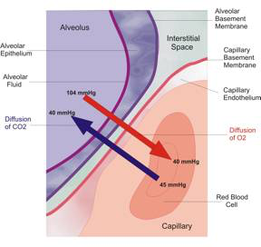
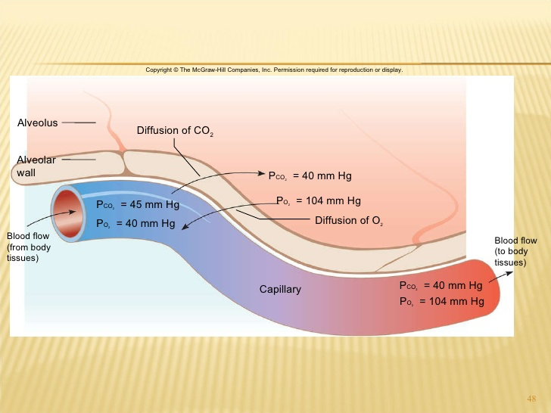
Diffusion capacity of the respiratory membrane
Is the volume of gas that diffuses through the membrane each minute for a pressure difference of 1mmHg.
Diffusing capacity for oxygen at rest
21ml/min/mmHg
Even if the oxygen pressure difference across the respiratory membrane is 11mmHg----------11x21= 230ml oxygen diffusing through the membrane each minute.
During rest tissues consume 250 ml O2 /min

Slide 14
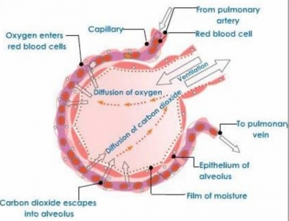
Changes in the oxygen- diffusing capacity during exercise
65ml/min/mmHg
This is due to increased number of open pulmonary capillaries which was dormant, thereby increasing the surface area for gas exchange.
In addition to increased alveolar ventilation.

Slide 15
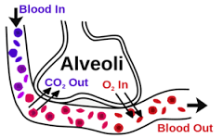
Diffusing capacity for carbon dioxide
It diffuses 20 times greater than oxygen due to greater diffusion coefficient which is 20 times that for oxygen.
Diffusion capacity for carbon dioxide 400ml/min/mmHg.
During exercise 1200 to 1300ml/min/mmHg.

Slide 16
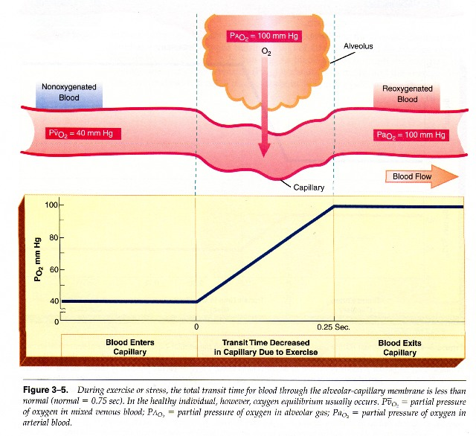
During exercise the oxygen requirement increased 20 times, and cardiac output increased and so the time blood remained in the pulmonary capillaries becomes less than half normal despite the fact that additional capillaries open up.
But the blood is almost completely saturated with oxygen when it leaves the pulmonary capillaries.

Slide 17
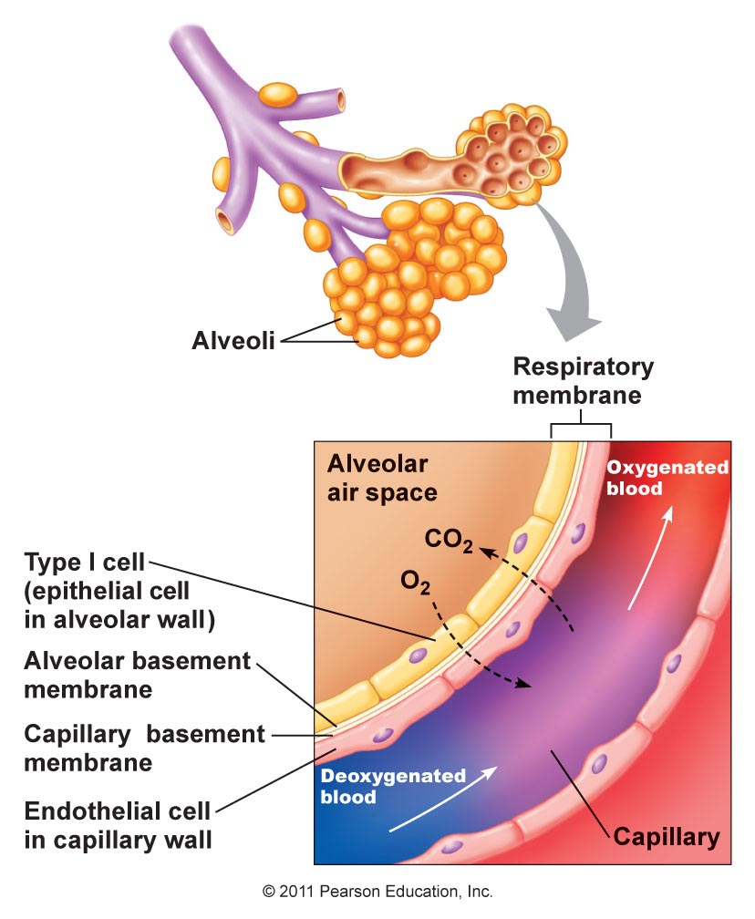
Reasons for this are as follow:
1- The diffusing capacity for oxygen increases almost three fold during exercise, this results mainly from increasing numbers of capillaries participating in the diffusion, and a more even V/Q ratio all over the lung.
2- At rest the blood normally stays in the lung capillaries about three times as long as necessary to cause full oxygenation. Therefore, even with shortened time of exposure in exercise, the blood is still fully oxygenated or nearly so.

Slide 18
Oxygen Consumption and Pulmonary Ventilation in Exercise.
Normal oxygen consumption for a young man at rest is about 250 ml/min.
However, under maximal conditions,
this can be increased to approximately the following average levels:
ml/min
Untrained average male -------------- 3600
Athletically trained average male --- 4000
Male marathon runner----------------- 5100

Slide 19
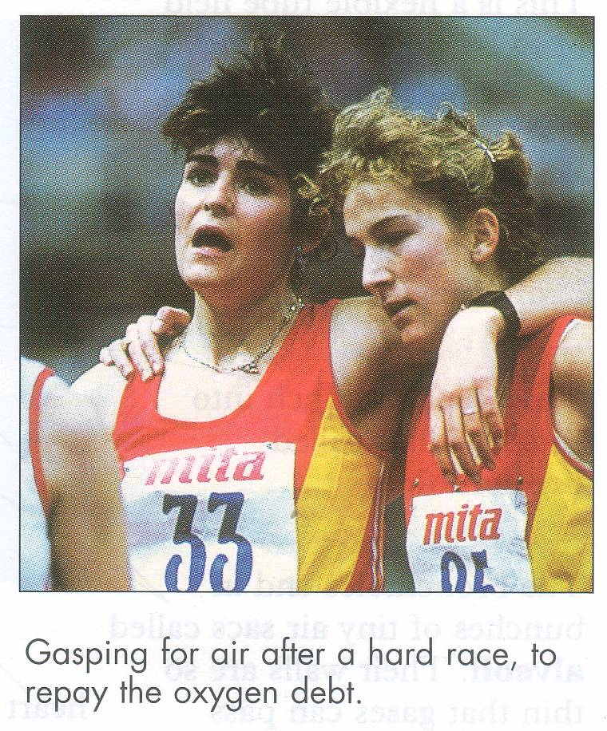

Slide 20
