Slide 1
Rheumatic Heart Disease
Immunology Unit
Department of Pathology
College of Medicine
King Saud University

Slide 2
Objectives
To understand basis of rheumatic fever as an immunologically mediated late complication of Streptococcal infection
To know that autoimmunity results from production of cross reacting antibodies against Streptococcal antigens
To describe rheumatic heart disease as one of the several manifestations of rheumatic fever
To know the signs, symptoms, pathogenesis, treatment and prophylaxis of rheumatic heart disease

Slide 3
Rheumatic Fever
Epidemiology of Rheumatic Fever (RF)
~3% of persons with untreated group A streptococcal pharyngitis develop rheumatic fever
  15-20 million new cases a year in developing countries
  Risk factors
  Low standard of living
  Crowding

Slide 4
Rheumatic fever
Individual (HLA) susceptibility is also important
Antigen-presenting cells bearing the HLA-DR7 molecule from RHD patients preferentially recognize heart-tissue protein
(Guilherme L, Kalil J. Ann N Y Acd Sci 2007,1107:426-433)
Other views in the literature exist, due to
+ The various HLA-typing methods. + Ways of grouping the cases.

Slide 5
Rheumatic fever
Rheumatic fever is an inflammatory disease which may develop after a Group A Streptococcal infection such as:
  Strep. throat infection or scarlet fever
Can involve the heart, joints, skin, and brain
It commonly appears in children ages 5 through 15

Slide 6
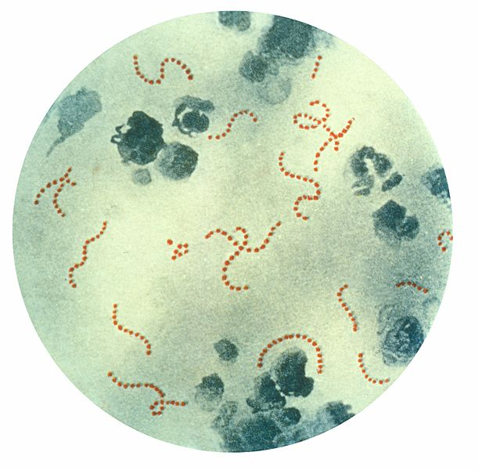
Organism
Caused by group A streptococcus
There is a latent period of ~3 weeks (1–5 weeks) between the group A streptococcal infection and the appearance of the clinical features of RF

Slide 7
Group A β−haemolytic streptococcus
All cases associated with recent infection (e.g. pharyngitis)
Antibody and cellular immune response cross-reacts with human connective tissue

Slide 8
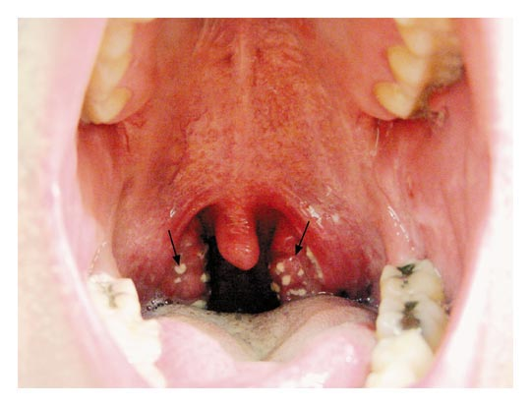
Nimishikavi S, Stead L Streptococcal Pharyngitis – Images in Clinical Medicine. NEJM 2005: 352:e10.

Slide 9
M proteins
Adherence of Streptococcus pyogenes to host cells & inhibiting the host immune response
Hyaluronic acid capsule: Camouflages the bacterium
Streptokinases: Dissolve blood clots
Peptidases:
Degrades proteins involved in immune response
Pyrogenic toxins: Stimulate fever, rash & shock
Streptolysins:
Lyse erythrocytes, leukocytes & platelets

Slide 10
PATHOGENESIS
Rheumatic fever affect the peri-arteriolar connective tissue
It is believed to be caused by antibody cross-reactivity
This cross-reactivity is a Type II hypersensitivity reaction and is termed molecular mimicry

Slide 11
Group A streptococcus pyogenes has a cell wall composed of branched polymers which sometimes contain "M proteins " that are highly antigenic
The antibodies which the immune system generates against the "M proteins" may cross react with cardiac myofiber protein myosin and smooth muscle cells of arteries, inducing cytokine release and tissue destruction
This inflammation occurs through direct attachment of complement and Fc receptor-mediated recruitment of neutrophils and macrophages

Slide 12
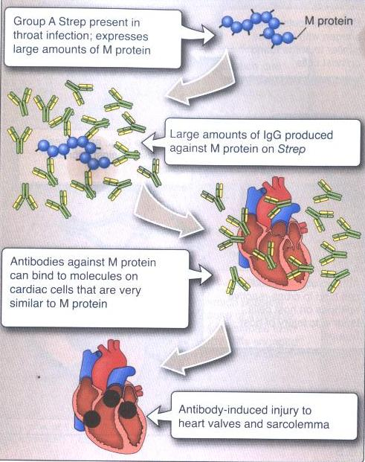

Slide 13
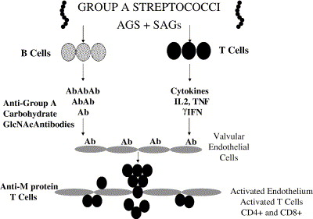
Diagram illustrating the two hit theory of rheumatic heart disease. Group A streptococcal infection leads to the production of anti-group A carbohydrate antibody which cross-reacts with the valve endothelium as well as with the myocardium and up-regulates vascular cell adhesion molecule-1 (VCAM-1) on the valve endothelium. T cells adhere to the VCAM-1 on valve endothelium and extravasate into the valve.

Slide 14
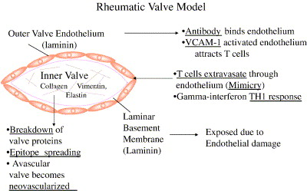
Diagram illustrating the process of initial mimicry which leads to granuloma formation, gamma interferon production and scarring in the valve. After the initial process has developed inflammation in the valve, other proteins in the valve may then be recognized by the immune system leading potentially to epitope spreading and responses against other valve proteins such as vimentin and collagen.
“Molecular mimicry in the autoimmune pathogenesis of rheumatic heart disease” by L. Guilherme; J. Kalil; M.W. Cunningham.

Slide 15
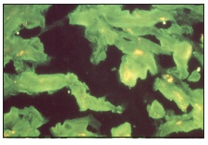
Immunofluorescent staining of heart muscle with serum obtained from an acute rheumatic fever patients

Slide 16
Pathophysiology
During a Strep. infection activated antigen presenting cells such as macrophages present the bacterial antigen to helper T cells
Helper T cells subsequently activate self reactive B cells and induce the production of antibodies against the cell wall of Streptococcus
However the antibodies may also react against the myocardium and joints, producing the symptoms of rheumatic fever

Slide 17
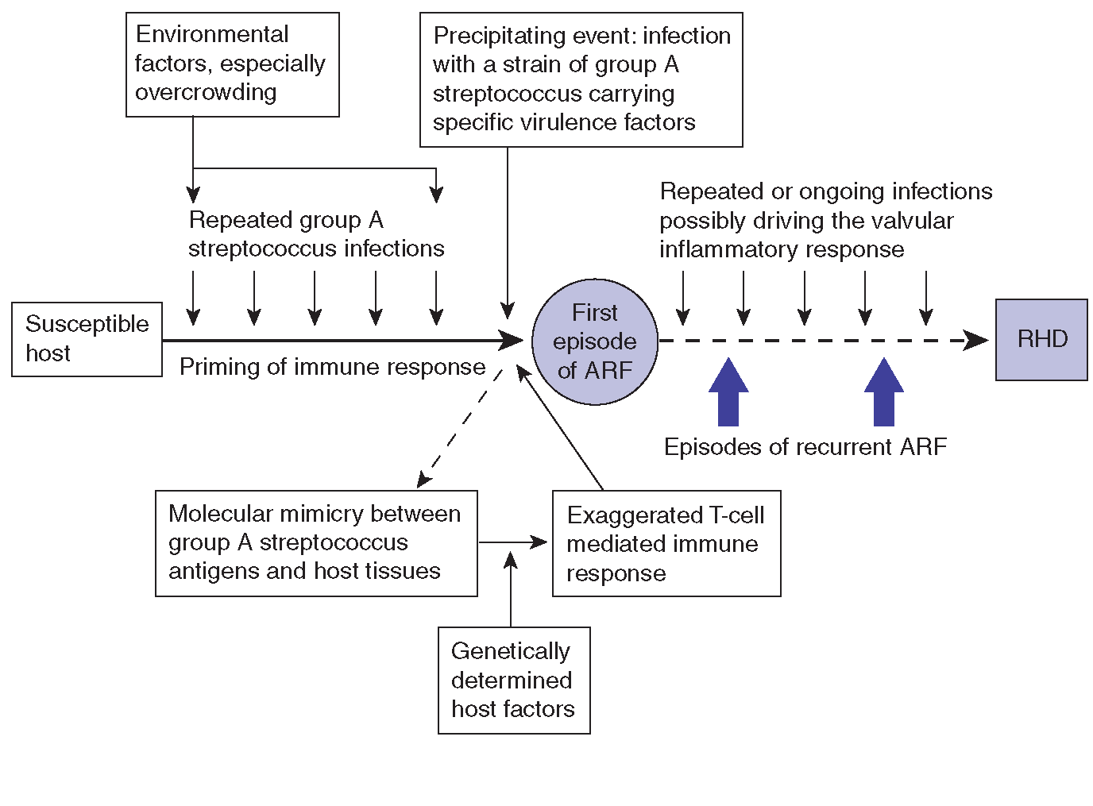

Slide 18
Clinical Presentation

Slide 19
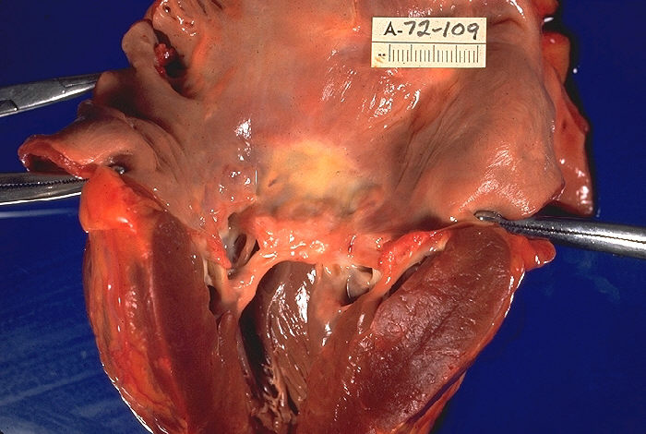
Heart
Up to 60% of patients with ARF progress to Rheumatic Heart Disease (RHD)
only manifestation of ARF with significant potential to cause long-term disability and/or death
The endocardium, pericardium, or myocardium may be affected (pancarditis)
Valvular damage is the hallmark of rheumatic carditis. The mitral valve is almost affected
Left ventricle has been cut open to display characteristic severe thickening of mitral valve, thickened chordae tendineae, and hypertrophied left ventricular

Slide 20
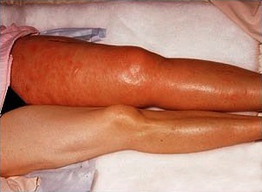
Joints (arthritis)
This is usually polyarthritis, sometimes flitting from joint to joint (migratory), affecting the larger joints more than the smaller ones.
Swelling, redness and tenderness are the common findings and occasionally joint effusions.
Inflamed Keen Joint

Slide 21
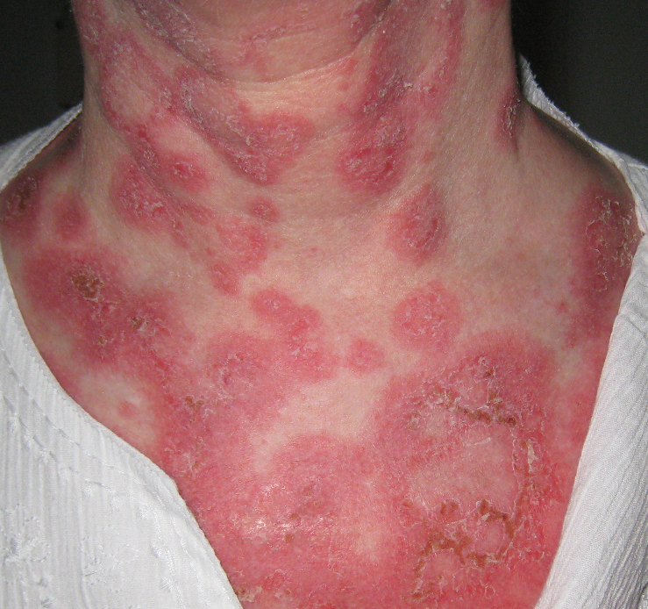
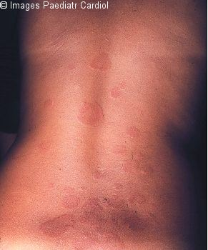
Skin (Erythema Marginatum)
Skin lesions: The classical erythema marginatum—lesions with prominent margins slightly raised

Slide 22
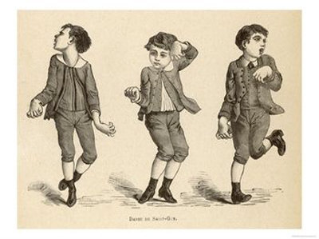
Central nervous system (chorea)
Sydenham's chorea
Occurs in children, rare in adults
The choreiform movements affect particularly the head and the upper limbs
They may be generalized or restricted to one side of the body (hemi-chorea)
Chorea eventually resolves completely, usually within 6 weeks
likely due to molecular mimicry, with autoantibodies reacting with brain ganglioside

Slide 23
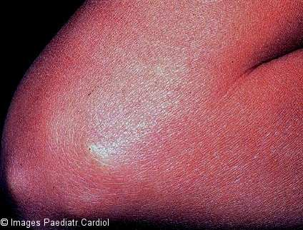
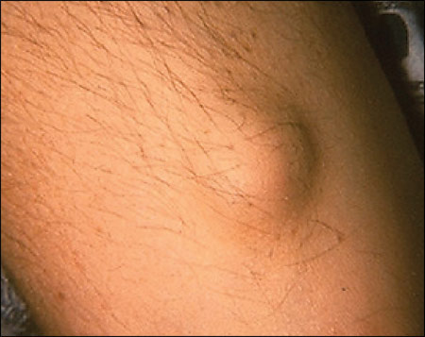
Subcutaneous nodules
Subcutaneous nodules : These are painless, round, firm lumps overlaid by normal looking skin
They range from a few millimeters to 1.5 cm in diameter, and are localized over bony prominences like the elbow, shin and spine. They sometimes last longer than a month

Slide 24
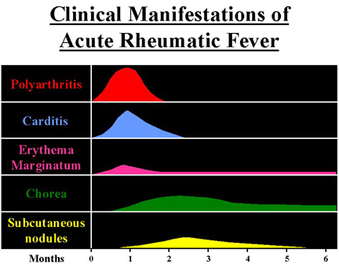

Slide 25
Investigation of Rheumatic Fever
Anti-streptolysin O (ASO) titer
  At least 80% of patients with ARF have an elevated anti-streptolysin O titer at presentation
    Rising titer is more convincing
  Anti-DNAse B
  Anti-hyaluronidase test
Throat culture for group A streptococci (obtain 2 or 3 cultures)

Slide 26
Rheumatic Fever – Clinical Course
Subsequent attacks
  Increased vulnerability to reactivation of disease with subsequent strep infections
  Same symptoms with each attack
  Carditis worsens with each attack
  Heart valves are frequently deformed (mitral)
  Heart failure develops after decades

Slide 27
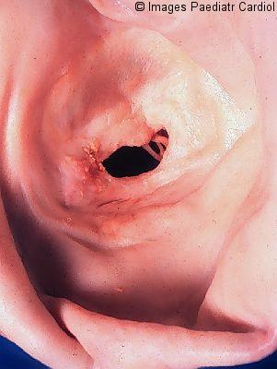
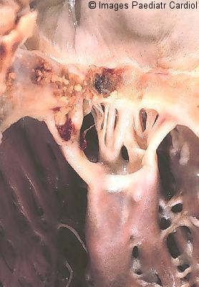
Acute, recurring, chronic:
Symptoms prone to recur with subsequent Strep. infections
Chronic disease leads to fibrosis (chordae of heart valves + valve cusps)
Stenotic mitral valve seen from left atrium
Opened stenotic mitral valve

Slide 28
Treatment of Rheumatic Fever
Treat first strep throat infection with penicillin
Treat other manifestations symptomatically
Prophylactic long term anti-strep therapy given to anyone who has had rheumatic fever

Slide 29
Take home message
Rheumatic heart disease results from cross reacting antibodies binding the heart valves
Repeated attacks of Streptococcal throat infection over the years damage heart valves resulting in either stenotic or incompetent heart valves
Treatment involves surgical replacement of the damaged heart valves
In patients with rheumatic fever long term administration of penicillin is recommended for prevention of future infections by group A Streptococcus

Slide 30
Thank you

