Slide 1
Antianginal Drugs
Learning outcomes
Recognize variables contributing to a balanced myocardial supply versus demand
Expand on the drugs used to alleviate acute anginal attacks versus those meant for prophylaxis & improvement of survival
Detail the pharmacology of nitrates, other vasodilators, & other drugs used as antianginal therapy.

Slide 2
Minicase
Helmi, a 62-year-old male smoker with T2DM & hypertension presents with a 4-month history of exertional chest pain.
Physical examination shows a BP of 152/90 mm Hg but is otherwise unremarkable.
The ECG is normal, & laboratory tests show a fasting blood glucose value of 110 mg/dL, glycosylated hemoglobin 6.0%, creatinine 1.1 mg/dL, total cholesterol 160, LDL 120, HDL 38, & triglycerides 147 mg/dL.
He exercises for 8 minutes, experiences chest pain, & is found to have a 2-mm ST-segment depression at the end of exercise.
Notes:
High BP
Bld sugar:
Normal fasting blood glucose: 3.9 to 5.5 mmols/l (70 to 100 mg/dl)
TG: Normal: Less than 150 mg/dL. Borderline high: 150 to 199 mg/dL.
LDL cholesterol levels should be less than 100 mg/dL.
ST-segment depression : It is often a sign of myocardial ischemia, of which coronary insufficiency is a major cause.

Slide 3
Minicase
What life style modifications should Helmi carry out?

Slide 4
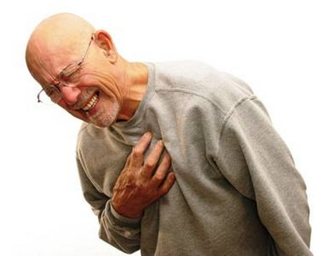
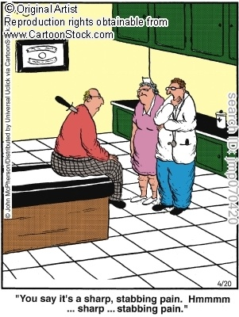
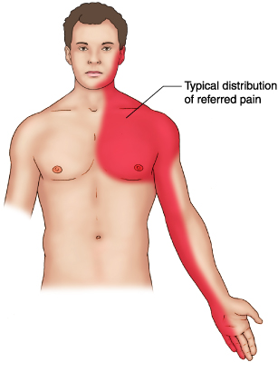
Which signs or symptoms of helmi suggest diagnosis of angina pectoris?
A clinical syndrome of chest pain (varying in severity) due to ischemia of heart muscle
Pain is caused either by obstruction
Pain is due to (accumulation of metabolites K⁺, PGs, Kinins, Adenosine….) secondary to the ischemia
Or spasm
Notes:
So what is the definition of AP ?
Strangling of the chest
& that pain can radiate into the left part like jaw, shoulder, neck & hand
When ur hrt muscle doesn’t have enough O2
Its like a suffocation/crushing of the chest
Pain due to the muscles' lack of O2
What are the causes of AP?
1- Partial occlusion due to atherosclerosis
2- VC
How does ischemia precipitate pain?
Due to release & accumulation of PG, kinins, K, ,,

Slide 5
Minicase
What is the possible underlying cause of Helmi’s exertional pain?

Slide 6
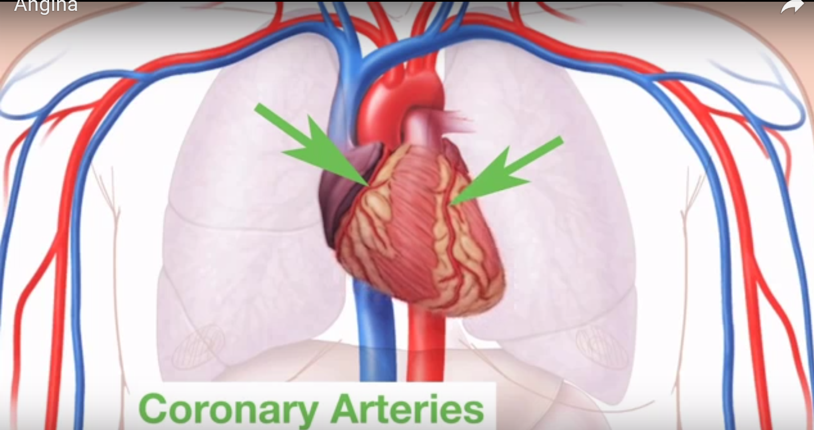
In Exercise
- Respiration in sk m , Demand for O2 & glucose , So CO has to
- Greater amount of bld to be delivered to sk m (we need perfusion to )
So we need to the amount of bld that go into the hrt (CO) to .
Notes:
Because coronary flow drops to negligible values during systole, coronary blood flow is directly related to the aortic diastolic pressure & the duration of diastole. TF, the
duration of diastole becomes a limiting factor for myocardial perfusion during tachyC. Coronary blood flow is inversely proportional to coronary vascular resistance. Resistance is determined mainly by intrinsic factors, including metabolic products & autonomic activity, & can be modified—in normal coronary vessels—by various pharmacologic agents. Damage to the endothelium of coronary vessels
has been shown to alter their ability to dilate and to increase coronary vascular resistance.SK mu is burning > ATP
To increase CO: we need +ve inotropic, or increase how fast the hrt beat = chronotropic
Bld has to go to aorta to meet the increase in demand
When the heart beat increase
Every time the hrt contract it will squash or squeeze the conorary artery bec we increased the systole (bld v is contracted) & decreased the diastole, no enough time for the hrt muscle to get enough O2 & nutrients = no enough fuel to the hrt bec the diastole (bld v dilated) is short. IN TR So to make better use of that short time its imp to dilate the BV to increase the amount of O2 delivery to the hrt even though the time is short. Spending < time in diastole so we r going to feed the hrt less
What happen if u have an atherosclerotic plaque? This will reduce the lumen & TF decrease bld flow
No good perfusion, & build up of metabolic waste products,, no enough O2 >>> myo Inf

Slide 7
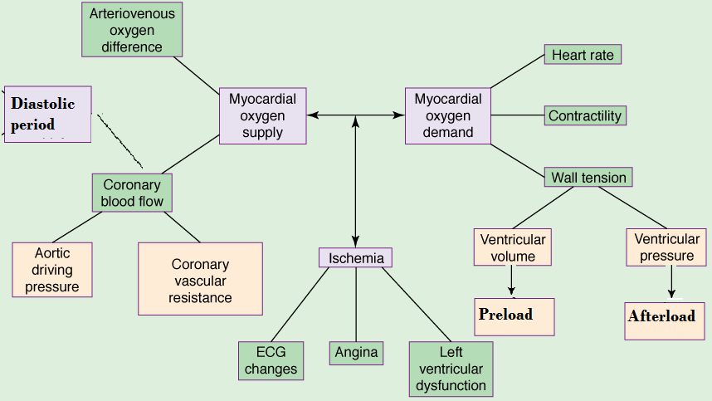
What is Basic mechanism of angia pectoris?
What are the determinants of oxygen demand & supply?
Notes:
determinants = Factors
So what are the Fs that affect O2 supply & demand ??
Myocardial oxygen demand is determined by:
-HR
-Myocardial contractility
- & ventricular wall tension
During systole: pressure rise in ..
The veins control the volume of the blood that reach the lt ventricles
When the vein capacitance ..
This is called diastolic stress determined by preload
Systolic
If the vein dilate
A decrease in mycocardial oxygen supply result from:
If the diastolic flow is prolonged
If diastolic pressure increase >>> flow ?

Slide 8
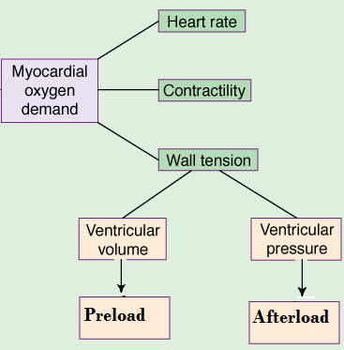
Myocardial oxygen demand is determined by:-
Myocardial oxygen demand is diminished by:-
Reducing contractility
Reducing heart rate
Reducing the preload
Reducing the afterload
Notes:
Preload ?
Afterload ?
Peripheral arteriolar & venous tone (sm m tension) both play a role in determining myocardial wall stress. Arteriolar tone directly controls peripheral vascular resistance & thus arterial BP. In systole, intraventricular pressure must exceed aortic pressure to eject blood; arterial BP thus determines the systolic wall stress in an important way. Venous tone determines the capacity of the venous circulation & controls the amount of blood sequestered in the venous system versus the amount returned to the hrt. Venous tone thereby determines the diastolic wall stress.
The myocardium O2 requirement (demand) increase when there is increase in HR, contractility
Ventricular volume: during diastole, if veins dilated blood pooled in the vein
Low bld in the lt ventricles so the ventricular volume
Ventricular P” Pressure inside the ventricles should exceed the pressure inside the artery

Slide 9
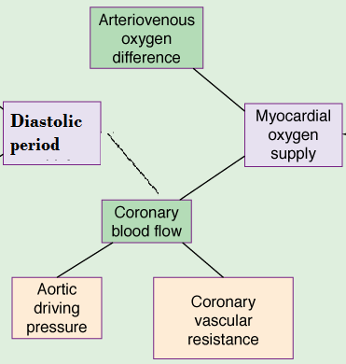
Myocardial oxygen supply is determined by:-
Myocardial oxygen supply is enhanced by:-
Reducing coronary vascular resistance
Prolonging diastolic period
Reducing external compression
Dilating collateral vessels
Notes:
Reducing external compression ?
- Atriovenous O2 difference: Arterial & venous bld O2 conc
If the diff is big, hrt extracted most of the O2
If the diff is low
By increasing diastolic period ..>> decrease resistance by dilatation of the CA
If the aortic pressure is > the diastolic pressure
So by decreasing lt ventricular diastolic pressure
Aortic pressure: Diff btw ..
Bld flow during diastole
If the diastole is long
Coronary vascular resistance:
If resistance is low >>> bld flow is >
If flow is low >>> O2 supply is decreased
- External compression: during systole .. Pressure is high.

Slide 10
Minicase
What triggers the onset of symptoms in helmi?
What factors worsen the symptoms in case of Helmi?
What is the possible underlying cause of angina in Helmi?

Slide 11
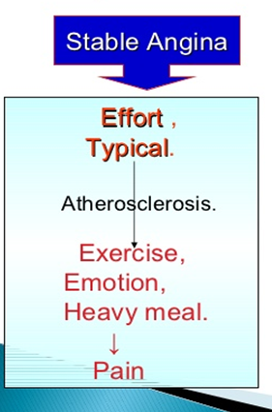
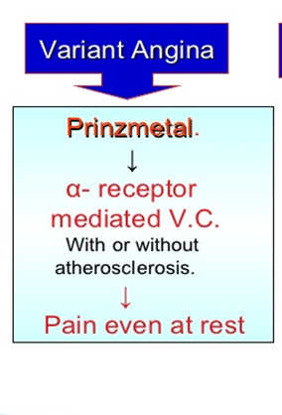
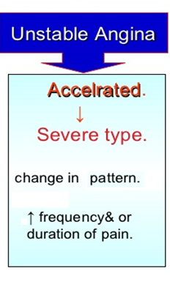
Notes:
1st : stable, is a chronic angina can be triggered by ..
>70% stenosis by palue producing atherosclerosis
Or due to hypertrophic cardiomyopathy
Or due to pumping against high pressure like in aortic stenosis Or HTN
STABLE: Exercise is gonna cause it & rest is gonna relive it
Is OK at rest, The pain goes if the patients rest from what have been doing, common type
Takes place during exertion
2nd also called vasospastic angina, the CA can be normal or atherosclerotic, the sm m around the bld v are squeezed tightly so the bld can’t go through & the hrt starve for O2
3rd: doesn’t respond to tr. Acute coronary syndrome, it is an emergency case that can lead to hrt attack. Happen any time, not predictable

Slide 12
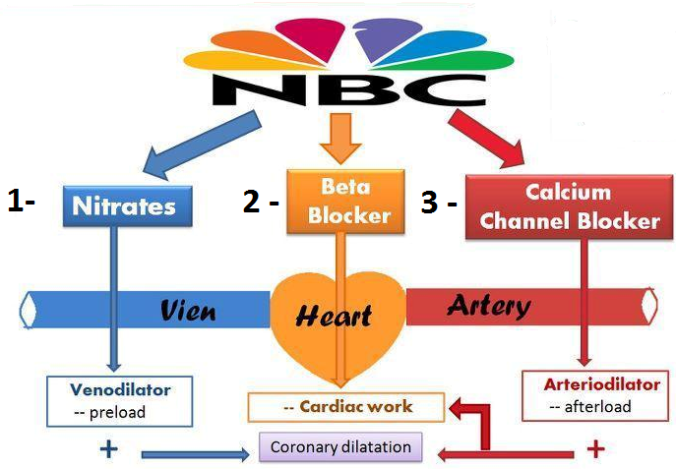
Treatment of angina pectoris
1-Agents that improve symptoms & ischemia
Notes:
Traditional approach:
The 3 drug gps traditionally used in angina (organic nitrates, CCBs, & β blockers) decrease myocardial O2 requirement by decreasing the determinants of O2 demand (HR, BP, & contractility).
Trimetazidine ?
So what do antianginal drugs do ?
They should restore the ratio between demand & supply
They should improve bld delivery to the hrt muscle by
1- dilating bld v
2- decreasing the work of the hrt ,,, decreasing demand of O2
Traditional approach ……………………..
Metabolic modulation
by shifting myocardial metabolism to substrates that require less oxygen per unit of adenosine triphosphate (ATP) produced. The hrt favors fatty acids as a substrate for energy production. HE, oxidation of Fas requires more O2 per unit of ATP generated than oxidation of carbohydrates. TF, drugs that shift myocardial metabolism toward greater use of glucose (FA oxidation inhibitors) have the potential, at least in theory, to reduce the O2 demand without altering hemodynamics.
For the production of ATP, we need less O2 for gluc-oxidation
So if we inh the oxidation of FFA >>> decrease O2 demand
So these are free FA oxidation inhibitors
K-channel opener:
Dilatation of bld vessels >>> increase coronary bld flow
Decrease the force of contraction & the HR
Stabilizing or preventing depolarization of the vascular sm m cell membrane: The membrane potential of excitable cells is stabilized near the resting potential by increasing K permeability. cGMP may increase permeability of Ca2+-activated K+ channels. K channel openers, such as minoxidil sulfate increase the permeability of K+ channels, probably ATP-dependent K+ channels. Certain agents used elsewhere and under investigation in the US (eg, nicorandil) may act, in part, by this mechanism.
SAN inhibitors >> Decrease the HR Only
Late Na current inhibitor : Late ??
TF inhibition the wall stress & O2 demand

Slide 13
Treatment of angina pectoris
2-Agents that improve prognosis
Aspirin / Other antiplatelets
Statins
ACE Inhibitors
β-AD blockers
Notes:
CCB?
We already spoken about B-ad blockers
ACEIs
We will be speaking > heavily about nitrates
Decreasing intracellular Ca2+: CCBs predictably cause VD bec they reduce intracellular Ca2+, a major modulator of the activation of myosin light chain kinase in sm m.
Beta blockers & CCBs also reduce Ca2+ influx in cardiac muscle fibers, thereby reducing rate, contractility, & O2 requirement under most circumstances.

Slide 14
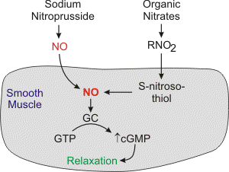
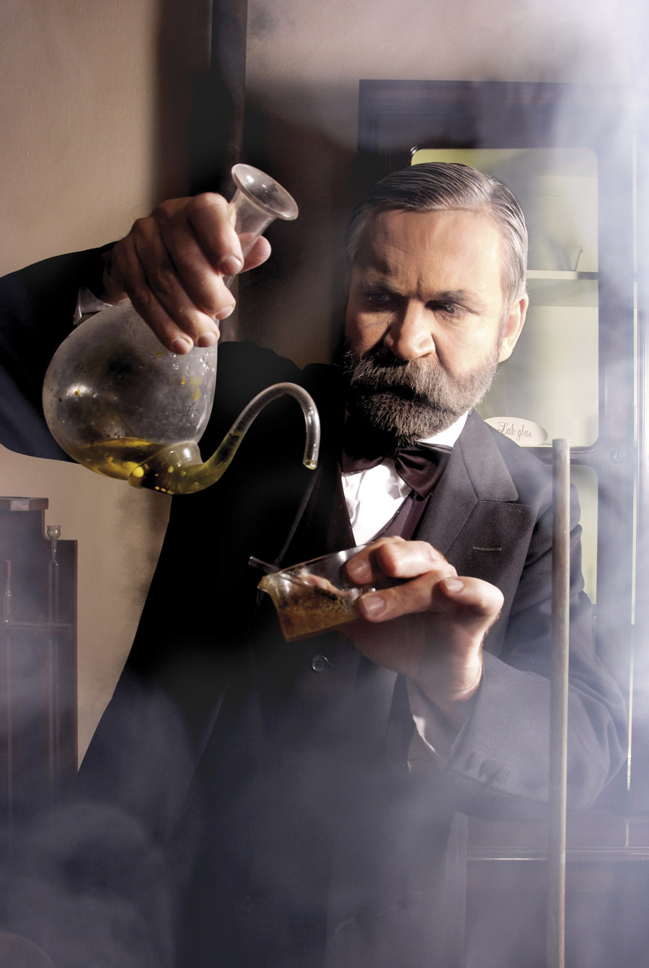
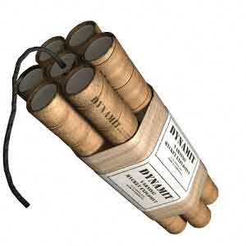
Organic nitrates
Mechanism of action
Long acting
Isosorbide mononitate
Short acting
Nitroglycerine
Nitric oxide binds to guanylate cyclase in vascular smooth muscle cell to form cGMP.
cGMP activates PKG to produce relaxation
Notes:
These agents are simple nitric & nitrous acid esters of polyalcohols. NG may be considered the prototype of the gp. The organic nitrates, eg, NG, are the mainstay of therapy for the immediate relief of angina. Although NG is used in the manufacture of dynamite, the systemic formulations used in medicine are not explosive.
Important molecular donors of NO include nitroprusside & organic nitrates. Atherosclerotic disease may diminish endogenous endothelial NO synthesis, thus making the vascular sm m > dependent upon exogenous sources of NO.
Nitroglycerine is a dynamite …… Glyceride trinitrate is an explosive developed by …
Lead to death of his bro & Nobel prize
Organic nitrate is reduced to RNO2 ..
cGMP will act on pt kinase G
Increasing cGMP: cGMP facilitates the dephosphorylation of myosin light chains, preventing the interaction of myosin with actin.
NG must be bioactivated with the release of NO. Unlike nitroprusside & some other direct NO donors, Organic nitrate (NG) activation requires enzymatic action. It can be denitrated by glutathione S-transferase in sm m & other cells. A mitochondrial enzyme, aldehyde dehydrogenase isoform 2 (ALDH2) & possibly isoform 3 (ALDH3), appears to be key in the activation & release of NO from NG & pentaerythritol tetranitrate. Different enzymes may be involved in the denitration of isosorbide dinitrate & mononitrate.
Free nitrite ion is released, w is then converted to NO. NO (probably complexed with cysteine) combines with the heme group of soluble guanylyl cyclase, activating that enzyme & causing an increase in cGMP. Formation of cGMP represents a first step toward sm m relaxation. The production of PG E / prostacyclin (PGI2) & membrane hyperpolarization may also be involved. Autonomic reflex responses, evoked when hypotensive doses are given. Tolerance is an imp consideration in the use of nitrates. Although tolerance may be caused in part by a decrease in tissue sulfhydryl groups, eg, on cysteine, tolerance can be only partially prevented / reversed with a sulfhydryl-regenerating agent. Increased generation of O2 free radicals during nitrate therapy may be another imp mechanism of tolerance.
Recent evidence suggests that diminished availability of calcitonin gene-related peptide (CGRP, a potent vasodilator) is also associated with nitrate tolerance.
Na nitroprusside spontaneously release NO, used in emergency HTN
Their action is direct & thus the response is fast

Slide 15
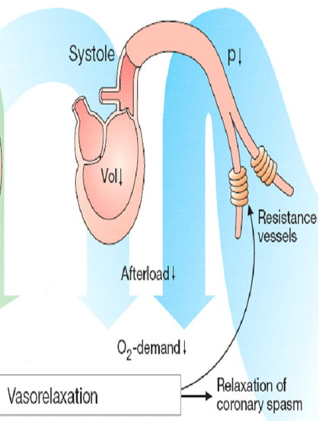
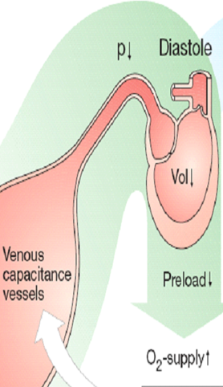
Hemodynamic effects of nitrates
Shunting of flow from normal area to ischemic area by dilating collateral vessels
Venous vasodilatation
With Nitrates
Preload
Coronary vasodilatation
Myocardial perfusion
Arterial vasodilatation
Afterload
Notes:
Nitrates dilates:
Veins in low conc >>> preload >>> increase perfusion
CA
Arteries in higher conc
Divert blood flow from normal to ischemic
This is 2 branches
Partial occlusion >>> decrease bld flow
Collateral vessel is constricted
Arterioles are maximally dilated in the ischemic area
The arterioles can not dilate > to increase bld flow bec they are fully dilated. If we apply nitrates it diverts bld flow from N to ischemic thru dilatation of the collateral vessels.
Maximal dilatation in the area no > dilatation
So the MOA of nitrates:
Veno-dilators (dilate veins) so Decrease preload
Also dilate CA >> Increase Coronary perfusion
Dilatation of the collateral arteries
Decrease of the afterload.
Increase force of contraction & increase HR …. Pro-anginal effect ???
Nitrates decrease venous return to the hrt & the resulting reduction of intracardiac volume are important beneficial hemodynamic effects. Arterial pressure also decreases. Decreased intraventricular pressure & lt ventricular volume are associated with decreased wall tension & decreased myocardial O2 requirement. In rare instances, a paradoxical increase in myocardial O2 demand may occur as a result of excessive reflex tachyC & increased contractility.

Slide 16
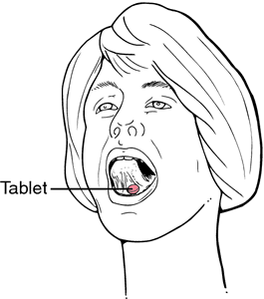
pharmacokinetics
Nitroglycrine [GTN]
Oral isosorbide dinitrate & mononitrate
Very well absorbed & 100% bioavailability
Significant first pass metabolism occurs in the liver (10-20%) bioavailability
The dinitrate undergoes denitration to two mononitrates both possess antianginal activity
Given sublingual or via transdermal patch, or parenteral
(t_{1/2} 1-3 hours)
Further denitrated metabolites conjugate to glucuronic acid in liver. Excreted in urine.
Notes:
Metabloised by dinitration in the liver into inactive cpd & …….. Urinic acid
Subjected to high first pass metabolism
Most of the drug is metabolized in the liver b4 reaching the circulation
TF not administered po, so to avoid its breakdown : sublingual, parenteral or transdermal patch

Slide 17
Indications
IN STABLE ANGINA;
Acute symptom relief  sublingual GTN
IN VARIANT ANGINA sublingual GTN
IN UNSTABLE ANGINA  IV GTN
Prevention; Persistant prophylaxis  Isosorbide mono or dinitrate
Prevention; Situational prophylaxis  sublingual GTN
Heart Failure
Refractory AHF  IV GTN
CHF  Isosorbide mononitrate + hydralazine
[ if contraindication to ACEIs]
AMI IV GTN
Notes:
Sublingual GTN dilate CA
Prophylaxis in case of climbing before expected exertion
Isosorbide: venodilator (preload) & hydralazine aretriodilator (afterload) but this is Not the first line of tr.

Slide 18
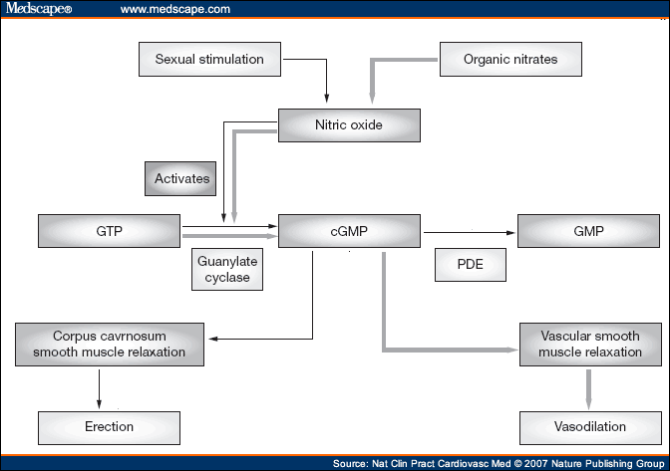
contraindications
Concomitant administration of PDE₅ Inhibitors
Known sensitivity to organic nitrates
Glaucoma; nitrates  aqueous humour formation
Head trauma or cerebral haemorrhage Increase intracranial pressure
Uncorrected hypovolemia
Sildenafil + nitrates  Severe hypotension & death
Notes:
>> O2 demand increase
Increase formation of aquous humor >> increase IOP
Head trauma bec of dilatation
Uncorrected hypov ,,, for the body in order to maintain adequate ….
Constriction of bld vessel so nitrates can make the condition worser
PDE2 terminate the action of cGMP
cGMP cause sm m relaxation w enhance erection
So why Sildenafil is CI? VD >> severe VD >> death

Slide 19
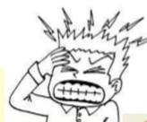
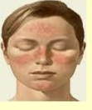
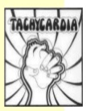
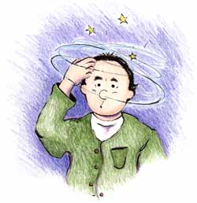
Adverse drug reactions
Throbbing headache
Flushing in blush area
Tachycardia & palpitation
Postural hypotension, dizziness & syncope
Rarely methemoglobinema
Notes:
Headache & Flushing are due to dilatation of bld vessels
Postural hypotension = orthostatic
Nitrite ion (not nitrate) reacts with hemoglobin (w contains ferrous iron) to produce methemoglobin (w contains ferric iron Fe³⁺). Bec methemoglobin has a very low affinity for O2, large doses of nitrites can result in pseudocyanosis, tissue hypoxia, & death. Fortunately, the plasma level of nitrite resulting from even large doses of organic & inorganic nitrates is too low to cause significant methemoglobinemia in adults. In nursing infants, the intestinal flora is capable of converting significant amounts of inorganic nitrate, eg, from well water, to nitrite ion. In addition, Na nitrite is used as a curing agent for meats, eg, corned beef. Thus, inadvertent exposure to large amounts of nitrite ion can occur & may produce serious toxicity.

Slide 20
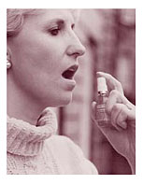
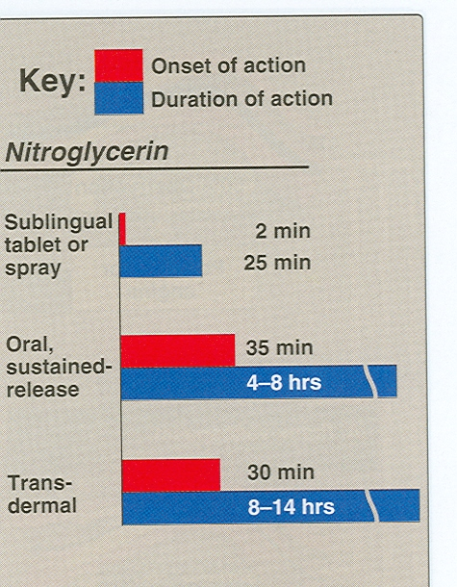
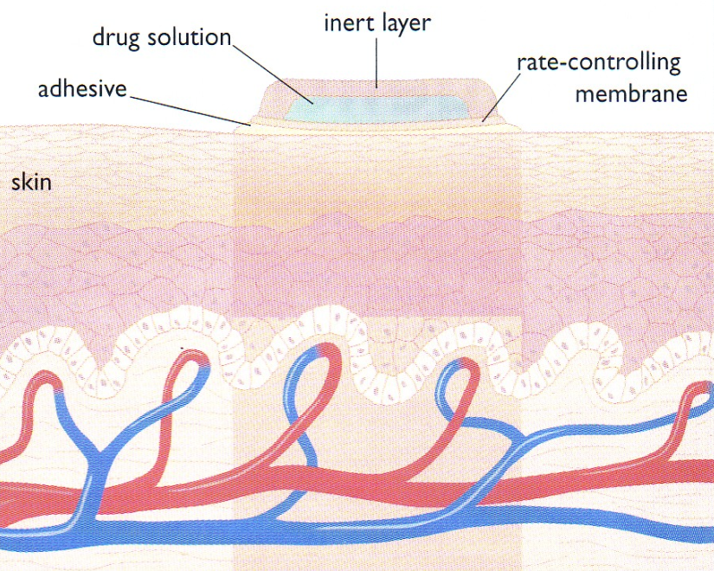
Preparations
Nitroglycerine
Sublingual tablets or spray
Transdermal patch
Oral or bucal sustained release
I.V. Preparations
Notes:
The onset of action is v rapid but the duration ….
Transderaml: in order to terminate the action the patient has to remove the patch

Slide 21
Preparations
Isosorbide dinitrate
Dinitrate Sublingual tablets
Dinitrate Oral sustained release
Infusion Preparations
Mononitrate Oral sustained release

Slide 22
Nitrates tolerance
Loss of vasodilator response of nitrates on use of long-acting preparations (oral, transdermal) or continuous IV infusions, for more than a few hours without interruption.
Mechanism
1-Compensatory neurohormonal counter-regulation
2-Depletion of free-SH groups
Notes:
Of the long acting nitrates such as ..
No to the short acting
But if these used repeatedly or IV for a long time they can cause tolerance
Tolerance due to :
Nirosothiol (thiol = sulpha gp)
1- so …………………..depletion of the sulphahydryl gp w is required for activation of …………………..
2- Activation of counter BP regulator system.. if Hypotension >>>>> reflex increase sympathetic , renin system
This will ..
To counteract tolerance:
1- Administration of sulfahyryl gp such as captopril its str is special than the other ACEIs
2- Give drug-free period in order the body to potent reactivate-regenerate the sulfhydro gp
Na nitroprusside is metabolized into cyanidetoxix)

Slide 23
Minicase
If Helmi was prescribed nitrates & tolerance developed to its effect, how to overcome tolerance to nitrates?
Nitrate tolerance can be overcome by:
Smaller doses at increasing intervals (Nitrate free periods twice a day).
Giving drugs that maintain tissue SH group e.g. Captopril.

Slide 24
Think-pair-share
Match the effects of nitrates in treatment of angina with their results
Effects
1-↓Ventricular volume
Results
2-Reflex ↑ in contractility
A-↓ O2 demand
3-↓Arterial pressure
B-↑ O2 demand
4-↑Collateral flow
C-Relief of coronary artery spasm
5-Reflex tachycardia
6-↓Left ventricular diastolic pressure
D-Improved perfusion to ischemic myocardium
7-↓Diastolic perfusion time due to tachycardia
E-Improve subendocardial perfusion
8-Vasodilation of epicardial coronary arteries
F-↓ myocardial perfusion

Slide 25
Task- selection of a P-drug
Instructions:
1- Select a leader for your group
2- Discuss the case according to the steps shown in the sheet
3- Use your internet access to obtain evidence for efficacy, toxicity, convenience & cost.
4- Due to time constrains divide yourself into groups of five, each doing one search e.g. evidence for efficacy.
5- You have 10 minutes to do this and 1 minute to report to the class.

