Slide 1
Drug Therapy
Of Heart Failure
Prof. Abdulrahman Almotrefi
Dr. Aliah Alshanwani

Slide 2
Learning objectives
By the end of this lecture, students should be able to:
- Describe the different classes of drugs used for treatment of acute & chronic heart failure & their mechanism of action
Understand their pharmacological effects, clinical
uses, adverse effects & their interactions with
other drugs.

Slide 3
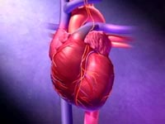
HEART FAILURE
?
Inability of the heart to maintain an adequate cardiac output to meet the metabolic demands of the body.
Notes:
HF: if the heart loose its normal function as a pump ….

Slide 4
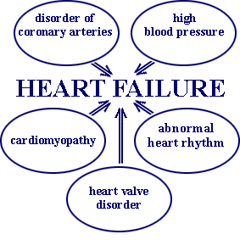
CAUSES OF HEART FAILURE
Acute or
Chronic
Notes:
HF can be caused by factors originating from within the heart (i.e., intrinsic disease or pathology) or from external factors that place excessive demands upon the heart.
Intrinsic disease includes conditions such as dilated cardiomyopathy & hypertrophic cardiomyopathy.
External factors that can lead to HF include long-term, uncontrolled HTN, increased stroke volume (volume load; arterial-venous shunts), hormonal disorders such as hyperthyroidism, & pregnancy.
Acute HF develops rapidly & can be immediately life threatening because the heart does not have time to undergo compensatory adaptations. Acute failure (hours/days) may result from cardiopulmonary by-pass surgery, acute infection (sepsis), acute myocardial infarction, valve dysfunction, severe arrhythmias, etc. Acute HF can often be managed successfully by pharmacological or surgical interventions.
Chronic HF is a long-term condition (months/years) that is associated with the heart undergoing adaptive responses (e.g., dilation, hypertrophy) to a precipitating cause. These adaptive responses, however, can be deleterious in the long-term & lead to a worsening condition
The number one cause of HF is coronary artery disease (CAD). CAD reduces coronary blood flow & oxygen delivery to the myocardium. This leads to myocardial hypoxia & impaired function. CABG surgery & coronary stenting are frequently used in the tr of CAD. Another common cause of HF is myocardial infarction, w is the final & often fatal culmination of CAD. Infarcted tissue does not contribute to the generation of mechanical activity so overall cardiac performance is diminished. Furthermore, non-infarcted regions must compensate for the loss of function & this extra burden can precipitate changes that lead to failure. Valvular disease & congenital defects place increased demands upon the heart that can precipitate failure. Cardiomyopathies, of known origin (e.g., bacterial / viral) or idiopathic (unknown origin), can lead to failure. Myocarditis can have a similar effect. Arrhythmias such as severe bradycardia or tachycardia can also precipitate failure.

Slide 5
Symptoms of Heart failure
- Tachycardia
- Decreased exercise tolerance (rapid fatigue)
- Dyspnea (pulmonary congestion)
- Peripheral edema
- Cardiomegaly.

Slide 6
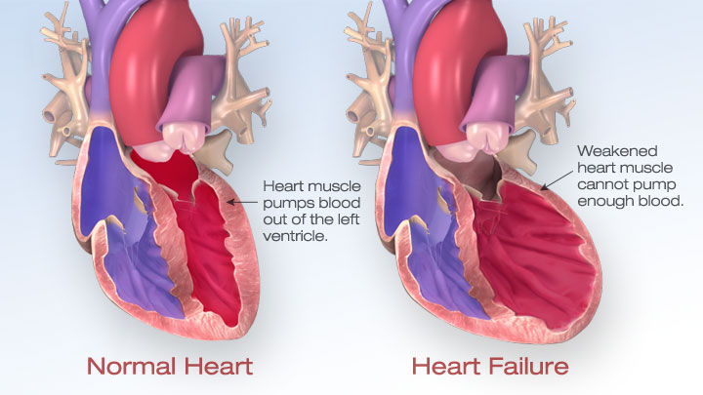
Notes:
HF: > load instead of pumping > it will dilate and fill with blood محتقن بالدم
& the power is lower to full emptying of blood.
HTN-induced cardiac remodeling is an initial adaptive response of the hrt in order to compensate the increased left ventricle wall stress induced by an augmented hemodynamic
load. This remodeling is named adaptive hypertrophy, w is featured by growing inwards of the left ventricle & septum wall, resulting in a reduction in left ventricle chamber. An important hallmark in chronic HTN is the intensive turnover from the extracellular matrix, resulting in a progressive collagen deposition. Amount evidences have shown that the cardiac fibrosis could contribute to initial diastolic dysfunction harming the re-lengthening of myocytes during diastole. Thus, despite being called “adaptive”, this hypertrophy generates
several maladaptive molecular &/or cellular mechanisms triggered in the initial remodeling.

Slide 7
Pathophysiology of CHF
↓ Force of contraction
Low C.O.
↓ Carotid sinus firing
↓ Renal blood flow
Activate renin-angiotensin-
Aldosterone system
Activate sympathetic system
↑ Sympathetic discharge
ALDOST.
Ag. II
Remodeling
Salt & Water
Retention
Volume expansion
Vasoconstriction
↑ Force of
Cardiac .cont.
Venous VC
Arterial VC
↑ HR
↑ Preload
↑ Preload
↑ Afterload
Notes:
When there is decreased force of contraction in a fainting hrt:
Afterload: peripheral resistance against which the heart will pump the bld (arterioles) during systole
Preload: the pressure by w lt ventricles is filled by blood (vessels)
Venous & venules
Arteries & arterioles
Cardiac remodeling is generally triggered due to CVDs, such as myocardial infarction, pressure overload, idiopathic dilated cardiomyopathy or volume overload. In this sense, HF is associated with intensive & progressive cardiac structural & functional modifications, leading to impaired cardiac
output

Slide 8
Factors affecting cardiac output and
heart failure
1- Preload
2- Afterload
3- Cardiac contractility
Notes:
Preload : Increase
Afterload increase from sympathetic & ang
Cardiac contractility is weak or decreased
So tr:
Either we use drugs to decrease preload (dilate venules)
Or decrease afterload (dilate arterioles)
Or both
Or increase contractility

Slide 9
Drugs used in treatment of heart failure
I- Drugs that decrease preload:
1 - Diuretics
2 - Aldosterone antagonists
3 - Venodilators
II- Drugs that decrease afterload:
1 - Arteriodilators
Notes:
So –I- will benefit the patient with HF by decreasing preload
-II- will reduce after load & peripheral resistance pressure

Slide 10
Drugs used in treatment of heart failure
III- Drugs that decrease both preload & afterload:
(Combined arteriolo- & venodilators)
1- Angiotensin converting enzyme (ACE) inhibitors
2- Angiotensin receptor antagonists
3- α₁-adrenoceptor antagonists
4- Direct vasodilators
Notes:
The most clinically used drugs are
These are v common

Slide 11
Drugs used in treatment of heart failure
IV- Drugs that increase heart contractility:
1- Cardiac glycosides (digitalis)
2- β- adrenoceptor agonists
3- Phosphodiesterase inhibitors
Notes:
يزيد قوة انقباض عضلة القلب
+ve inotropic
Glycosides اسم النبات
Active constituent digitalis
U studied b4 adr agonist

Slide 12
I- Drugs that decrease preload
1-Diuretics:
Mechanism of action in heart failure :
reduce salt and water retention
⬇
decrease ventricular preload and venous pressure
⬇
reduction of cardiac size
⬇
Improvement of cardiac performance
Notes:
Renal block for yr 1, CV block should be after the renal block
We’r gonna mention only the important things:
As blood flows through the kidney, it passes into glomerular capillaries located within the cortex (outer zone of the kidney). These glomerular capillaries are highly permeable to water & electrolytes. Glomerular capillary hydrostatic pressure drives (filters) water & electrolytes into Bowman's space & into the proximal convoluting tubule (PCT). About 20% of the plasma that enters the glomerular capillaries is filtered (termed filtration fraction). The PCT, which lies within the cortex , is the site of Na , water & bicarbonate transport from the filtrate (urine), across the tubule wall, & into the interstitium of the cortex. About 65-70% of the filtered Na is removed from the urine found within the PCT (this is termed Na reabsorption). This Na is reabsorbed isosmotically: every molecule of Na that is reabsorbed is accompanied by a molecule of water. As the tubule dives into the medulla, or middle zone of the kidney, the tubule becomes narrower & forms a loop (Loop of Henle) that reenters the cortex as the thick ascending limb (TAL) that travels back to near the glomerulus. Bec the interstitium of the medulla is very hyperosmotic & the Loop of Henle is permeable to water, water is reabsorbed from the Loop of Henle & into the medullary interstitium. This loss of water concentrates the urine within the Loop of Henle.
The TAL, w is impermeable to water, has a co-transport system that reabsorbs Na, K & Cl at a ratio of 1:1:2. Approximately 25% of the Na load of the original filtrate is reabsorbed at the TAL. From the TAL, the urine flows into the distal convoluting tubule (DCT), w is another site of Na transport (~5% via a Na-Cl cotransporter) into the cortical interstitium (the DCT is also impermeable to water). Finally, the tubule dives back into the medulla as the collecting duct & then into the renal pelvis where it joins with other collecting ducts to exit the kidney as the ureter. The distal segment of the DCT & the upper collecting duct has a transporter that reabsorbs Na (about 1-2% of filtered load) in exchange for K & H ion, w are excreted into the urine. Transporter: First, its activity is dependent on the tubular conc. of Na, so that when Na is high, > Na is reabsorbed & > K & H ion are excreted. Second, this transporter is regulated by Ald, wh is a mineralocorticoid hormone secreted by the adrenal cortex. Increased Ald stimulates the reabsorption of Na, w also increases the loss of K & H ion to the urine. Finally, water is reabsorbed in the collected duct through special pores that are regulated by antidiuretic hormone (ADH) w is released by the posterior pituitary. ADH increases the permeability of the collecting duct to water, w leads to increased water reabsorption, a > concentrated urine & reduced urine outflow (antidiuresis). Nearly all of the Na originally filtered is reabsorbed by the kidney, so that less than 1% of originally filtered Na remains in the final urine.
Mechanisms of diuretic drugs
Diuretic drugs increase urine output by the kidney (i.e., promote diuresis). This is accomplished by altering how the kidney handles Na. If the kidney excretes > Na, then water excretion will also increase. Most diuretics produce diuresis by inhibiting the reabsorption of Na at different segments of the renal tubular system. Sometimes a combination of 2 diuretics is given bec this can be significantly > effective than either compound alone (synergistic effect). The reason for this is that 1 nephron segment can compensate for altered Na reabsorption at another nephron segment; TF, blocking multiple nephron sites significantly enhances efficacy.
CV effects of diuretics
Through their effects on Na & water balance, diuretics decrease blood volume & venous pressure. This decreases cardiac filling (preload) & by the Frank-Starling mechanism, decreases ventricular stroke volume & CO, w leads to a fall in arterial pressure. The decrease in venous pressure reduces capillary hydrostatic pressure, w decreases capillary fluid filtration & promotes capillary fluid reabsorption, thereby reducing edema if present. Long-term use of diuretics results in a fall in systemic vascular resistance (by unknown mechanisms) that helps to sustain the reduction in arterial pressure.
Carbonic anhydrase inhibitors inhibit the transport of bicarbonate out of the PCT into the interstitium, w leads to < Na reabsorption at this site & TF greater Na, bicarbonate & water loss in the urine. These are the weakest of the diuretics & seldom used in CVD. Their main use is in the treatment of glaucoma.

Slide 13
I- Drugs that decrease preload
1-Diuretics:
Chlorothiazide
- first-line agent in heart failure therapy
- used in volume overload (pulmonary and/ or
peripheral edema)
- used in mild congestive heart failure.
Notes:
Thiazide diuretics, w are the most commonly used diuretic, inhibit the Na-Cl transporter in the distal tubule. Bec this transporter normally only reabsorbs about 5% of filtered Na, these diuretics are < efficacious than loop diuretics in producing diuresis & natriuresis. Nevertheless, they are sufficiently powerful to satisfy many therapeutic needs requiring a diuretic. Their mechanism depends on renal PG production.
Bec loop & thiazide diuretics increase Na delivery to the distal segment of the distal tubule, this increases K loss (potentially causing hypokalemia) bec the increase in distal tubular Na conc stimulates the Ald-sensitive Na pump to increase Na reabsorption in exchange for K & H ion, w are lost to the urine. The increased H ion loss can lead to metabolic alkalosis. Part of the loss of K & H ion by loop & thiazide diuretics results from activation of the renin-angiotensin-Ald system that occurs bec of reduced blood volume & arterial pressure. Increased Ald stimulates Na reabsorption & increases K & H ion excretion into the urine.
Chlorothiazide is not very strong
Peripheral edema like ankle edema
HF leads to activation of the renin-angiotensin-Ald system, w causes increased Na & water retention by the kidneys. This in turn increases blood volume & contributes to the elevated venous pressures associated with HF, w can lead to pulmonary & systemic edema.
The primary use for diuretics in HF is to reduce pulmonary &/or systemic congestion & edema, & associated clinical symptoms (e.g., shortness of breath - dyspnea). Long-term tr with diuretics may also reduce the afterload on the heart by promoting systemic VD, w can lead to improved ventricular ejection.
When treating HF with diuretics, care must be taken to not unload too much volume bec this can depress CO. A diuretic can safely reduce that elevated pressure to a level (e.g., 14 mmHg) that will reduce pulmonary pressures without compromising ventricular stroke volume. The reason for this is that HF caused by systolic dysfunction is associated with a depressed, flattened Frank-Starling curve. HE, if the volume is reduced too much, stroke volume will fall bec the heart will now be operating on the ascending limb of the Frank-Starling relationship. If the HF is caused by diastolic dysfunction, diuretics must be used very carefully so as to not impair ventricular filling. In diastolic dysfunction, ventricular filling requires elevated filling pressures bec of the reduced ventricular compliance.
In mild HF, a thiazide diuretic may be used.
K-sparing, aldosterone-blocking diuretics (e.g., spironolactone) are being used increasingly in HF.

Slide 14
I- Drugs that decrease preload
1-Diuretics:
Furosemide
- a potent diuretic
used for immediate reduction of pulmonary congestion & severe edema associated with :
- acute heart failure
- moderate & severe chronic failure
Notes:
Most patients in HF are prescribed a loop diuretic because they are > effective in unloading Na & water than thiazide diuretics.
It is a very potent drug
Loop diuretics inhibit the Na-K-Cl co-transporter in the thick ascending limb. This transporter normally reabsorbs about 25% of the Na load; TF, inhibition of this pump can lead to a significant increase in the distal tubular conc of Na, reduced hypertonicity of the surrounding interstitium, & < water reabsorption in the collecting duct. This altered handling of Na & water leads to both diuresis (increased water loss) & natriuresis (increased Na loss). By acting on the thick ascending limb, w handles a sig fraction of Na reabsorption, loop diuretics are very powerful diuretics. These drugs also induce renal synthesis of PGs, w contributes to their renal action including the increase in renal blood flow & redistribution of renal cortical blood flow.
There is some evidence that loop diuretics cause venodilation, w can contribute to the lowering of venous pressure.

Slide 15
I- Drugs that decrease preload
2-Aldosterone antagonists:
Spironolactone
- non-selective antagonist of aldosterone receptor
- a potassium sparing diuretic
- improves survival in advanced heart failure
Notes:
Diuretics usually take out Na & with Na it usually take out K outside of the body causing hypoK.
To prevent hypoK we use K-sparing diuretic that take out only Na.
K-sparing diuretics: unlike loop & thiazide diuretics, some of these drugs do not act directly on Na transport. Some drugs in this class antagonize the actions of Ald (Ald R antagonists) at the distal segment of the distal tubule. This causes > Na (& water) to pass into the collecting duct & be excreted in the urine. These K⁺-sparing diuretics bec they do not produce hypoK like the loop & thiazide diuretics. Bec by inhibiting Ald-sensitive Na reabsorption, less K & H ion are exchanged for Na by this transporter & TF < K & H are lost to the urine. Other K-sparing diuretics directly inhibit N channels associated with the Ald-sensitive Na pump, & TF have similar effects on K & H ion as the Ald antagonists. Their mechanism depends on renal PG production. This class of diuretic has relatively weak effects on overall Na balance, they are often used in conjunction with thiazide / loop diuretics to help prevent hypoK.

Slide 16
I- Drugs that decrease preload
2-Aldosterone antagonists:
Eplerenone
- a new selective aldosterone receptor antagonist
(does not inhibit other hormones such as
estrogens & androgens)
- indicated to improve survival of stable patients with congestive heart failure.

Slide 17
I- Drugs that decrease preload
3-Venodilators:
A- Nitroglycerine
B- Isosorbide dinitrate
- used I.V. for severe heart failure when the main symptom is dyspnea due to pulmonary congestion
- dilates venous blood vessels & reduce preload.
Notes:
A& B are nitrate cpds, Venous dilators
ONLY used in severe cases
Dyspnea so the problem is in the preload. So we finished now the 3 classes that act on the venules.
Drugs that dilate venous capacitance vessels serve 2 primary functions in treating CV disorders:
Venous dilators reduce venous pressure, w reduces preload on the heart thereby decreasing CO. This is useful in angina bec it decreases the O2 demand of the heart & thereby increases the oxygen supply/demand ratio.
O2 demand is reduced bec decreasing preload leads to a reduction in ventricular wall stress by decreasing the size of the heart.
Reducing venous pressure decreases proximal capillary hydrostatic pressure, w reduces capillary fluid filtration & edema formation. TF, venous dilators are sometimes used in the tr of HF along with other drugs because they help to reduce pulmonary &/or systemic edema that results from the HF.
Although most vasodilator drugs dilate veins as well as arteries, some drugs, such as organic nitrate dilators are relatively selective for veins.
Venous dilation increases venous compliance by relaxing the venous sm m. Increased compliance causes a parallel shift to the left of the vascular function curve, w decreases the mean circulatory filling pressure. This causes a decrease in CO with a small decrease in right atrial pressure (P_{RA}). The reason for these changes is that venous dilation, by reducing P_{RA}, decreases right ventricular preload, w decreases stroke volume & CO by the Frank-Starling mechanism. Reduced CO causes a fall in arterial pressure, which reduces afterload on the left ventricle & leads to baroreceptor reflex responses.
Sympathetic activation can also lead to an increase in systemic vascular resistance. The cardiac effects (decreased CO) of venous dilation are more pronounce in normal hearts than in failing hearts because of where the hearts are operating on their Frank-Starling curves (cardiac function) curves.
TF, the cardiac & vascular responses to venous dilation are complex when both direct effects & indirect compensatory responses are taken into consideration. The most important effects in terms of clinical utility for patients are summarized below.
Venous dilators reduce:
Venous pressure & TF cardiac preload
CO, Arterial pressure
Myocardial O2 demand, Capillary fluid filtration & tissue edema
Mixed or "balanced" dilators
As indicated above, most vasodilators act on both arteries & veins, & TF are termed mixed or balanced dilators. Notable exceptions are hydralazine (arterial dilator) & organic nitrate dilators (venous dilators).

Slide 18
II- Drugs that decrease afterload
1- Arteriodilators:
Hydralazine
- used when the main symptom is rapid
fatigue due to low cardiac output
reduce peripheral vascular resistance
Notes:
Arteriodilators mainly used for HTN
fatigue due to low CO so the problem is in the afterload

Slide 19
III- Drugs that decrease both
preload & afterload
1-Angiotensin converting enzyme (ACE) inhibitors:
- considered as first-line drugs for
chronic heart failure along with diuretics
first-line drugs for hypertension therapy.
Notes:
These are most commonly used drugs, considered as the 1st line in tr HF
Drug Classes and General Mechanisms of Action
Vasodilator drugs can be classified based on their site of action (arterial versus venous) or by MOA. Some drugs primarily dilate resistance vessels (arterial dilators; e.g., hydralazine), while others primarily affect venous capacitance vessels (venous dilators; e.g., nitroglycerine). Most vasodilator drugs, however, have mixed arterial & venous dilator properties (mixed dilators; e.g., alpha-adrenoceptor antagonists, ACEIs).
It is more common, however, to classify vasodilator drugs based on their primary MOA.. These classes of drugs, as well as other classes that produce vasodilation, are:
Alpha-adrenoceptor antagonists (alpha-blockers), ACEIs, Angiotensin receptor blockers (ARBs)
Beta₂-adrenoceptor agonists (β₂-agonists), Calcium-channel blockers (CCBs), Centrally acting sympatholytics
Direct acting vasodilators, Endothelin receptor antagonists, Ganglionic blockers
Nitrodilators, Phosphodiesterase inhibitors, K-channel openers & Renin inhibitors.

Slide 20
Angiotensin converting enzyme inhibitors
MECHANISM OF ACTION
VASOCONSTRICTION
VASODILATATION
ALDOSTERONE
VASOPRESSIN
SYMPATHETIC
Angiotensinogen
RENIN
BRADYKININ
Angiotensin I
A.C.E.
Inhibitor
Breakdown
ANGIOTENSIN II
Notes:
ACE: controls BP by regulating the volume of fluids in the body.
ACE is one of the kinase enzymes (Kinase II) that breakdown Bradykinin
So ACEIs: 1- inhibit ang II (VC) & 2- Accumulate BK (VD)

Slide 21
ACE Inhibitors
Pharmacological actions:
1 - Decrease peripheral resistance (Afterload)
2 - Decrease Venous return (Preload)
3 - Decrease sympathetic activity
4- Inhibit cardiac and vascular remodeling
associated with chronic heart failure
⬇
Decrease in mortality rate
Notes:
Decrease peripheral resistance bec it inh ang II (VC)

Slide 22
ACE Inhibitors
Captopril, Enalapril and Ramipril
Pharmacokinetics:
- rapidly absorbed from GIT after oral administration
- food reduce their bioavailability
Enalapril , Ramipril
- prodrugs, converted to their active metabolites in liver
- have long half-life & given once daily.
Notes:
The first one is Captopril from 15-20 yrs ago, then thy are now around 15 different drugs
TF, the patient is advised to take these medication in an empty stomach or 2 h b4 the meal
Prodrug= inactive >>> active
لأن مريض ال HTN & HF will take the drug for the whole life, so صارو أحسن من الprototype

Slide 23
ACE Inhibitors
Adverse effects:
1- acute renal failure, especially in patients
with renal artery stenosis
2- hyperkalemia, especially in patients with
renal insufficiency or diabetes
3- severe hypotension in hypovolemic patients
(due to diuretics, salt restriction or
gastrointestinal fluid loss).
Notes:
gastrointestinal fluid loss in severe V & D

Slide 24
ACE Inhibitors
Adverse effects:
4- dry cough sometimes with wheezing
5- angioneurotic edema (swelling in the
nose, throat, tongue, larynx)
6- dysgeusia (reversible loss or altered taste).
Notes:
Side effect No 4 & 5 are related to Kinase II enzyلي1 يحطم BK
Wheezing صفير بالصدر
If in the larynx .. This is a severe case
غوسيا

Slide 25
ACE Inhibitors
Contraindications:
during the second & third trimesters of pregnancy
(due to the risk of : fetal hypotension,
renal failure & malformations)
- renal artery stenosis.

Slide 26
III- Drugs that decrease both
preload & afterload
2- Angiotensin receptor blockers (ARBs) :
Losartan, Valsartan, Irbesartan
Mechanism of action:
- block AT₁ receptors
- decrease action of angiotensin II
Notes:
Bec of the drug cough is very severe due to accumulation of BK.
ACEIs تمنع تكون Ang II
So why don’t we find a drug that block AngII R but not affecting BK
AngII is produced as usual but blocked its Rs and prevented it action.
Sartan are also around 20 drugs

Slide 27
III- Drugs that decrease both
preload & afterload
3- α-ADRENOCEPTOR BLOCKERS :
Prazosin
- blocks α- receptors in arterioles and venules
- decrease both afterload & preload
Notes:
U already took this class in adrenergic drugs

Slide 28
III- Drugs that decrease both
preload & afterload
4- Direct acting vasodilators:
Sodium nitroprusside
- given I.V. for acute or severe heart failure
- acts immediately and effects lasts for 1-5 min.
Notes:
Direct on the wall of BV. Usually these are the most potent VD drugs.
V ideal for severe high BP & Severe HF. So used in EMERGENCY

Slide 29
IV- Drugs that increase contractility
1- Cardiac glycosides (digitalis) :
Digoxin
-increases the force of myocardial contraction (+ve inotropic effect)
Mechanism of action :
- Inhibit Na⁺ / K⁺ ATPase enzyme
(the sodium pump)
Notes:
The 3 factors to tr are either
1- Preload
2- Afterload
3- Contractility
There are so many drugs but this is the most commonly used drug

Slide 30
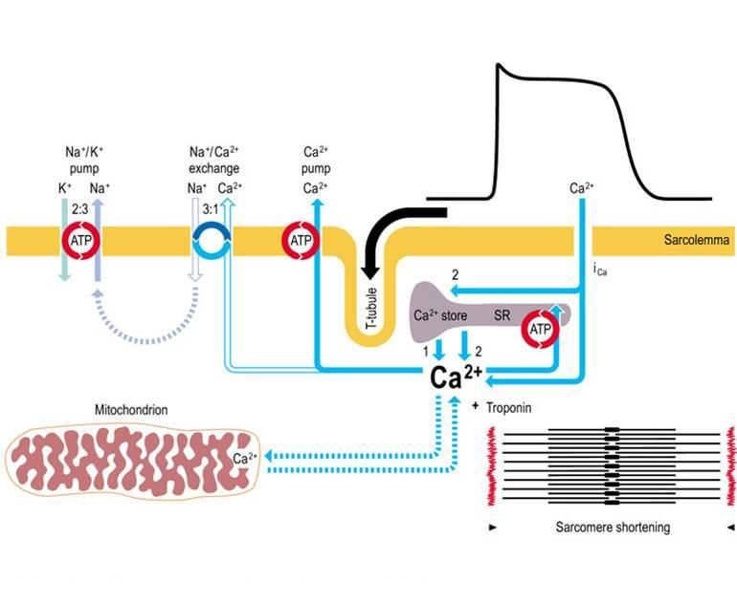
MECHANISM OF ACTION OF DIGOXIN
Notes:
The Na K pump is the active ion transport mechanism
Na out & the K in
درستوها في ال excitation contraction coupling
Ca out & Na inside
Digitalis cause > Ca inside because of
1- Ca inside by Ca channel
2- تعطيل الNa pump
بسبب تعطيل الpump: inside is very low of Na <<<
Sarcomere contractile SR as مستودعات for Ca ions

Slide 31
IV- Drugs that increase contractility
1- Cardiac glycosides (digitalis) :
Digoxin
Therapeutic uses:
- Congestive heart failure
- has narrow therapeutic index
Notes:
Therapeutic dose is v close to toxic dose

Slide 32
IV- Drugs that increase contractility
1- Cardiac glycosides (digitalis) :
Digoxin
Adverse effects (Cardiac):
- digitalis-induced arrhythmias
- extrasystoles
- coupled beats (Bigeminal rhythm)
- ventricular tachycardia or fibrillation
- cardiac arrest
Notes:
Digitalis canincrease heart automaticity
All types of arrhythmia
Cardiac arrest in high doses

Slide 33
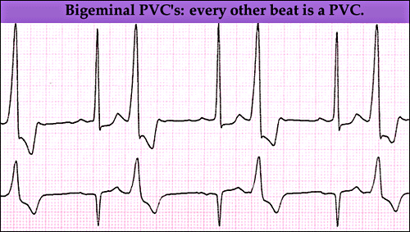

Slide 34
IV- Drugs that increase contractility
1- Cardiac glycosides (digitalis):
Digoxin
Adverse effects (non-cardiac):
GIT:
anorexia, nausea, vomiting, diarrhea
CNS:
headache, visual disturbances, drowsiness.
Notes:
visual disturbances: Can see halos in light

Slide 35
IV- Drugs that increase contractility
1- Cardiac glycosides (digitalis) :
Digoxin
Factors that increase its toxicity:
- Renal diseases
- Hypokalemia
- Hypomagnesemia
- Hypercalemia
Notes:
Predisposing factors

Slide 36
IV- Drugs that increase contractility
2- β-Adrenoceptor agonists:
Dobutamine
Selective β₁ agonist
Uses : Treatment of acute heart failure in
cardiogenic shock

Slide 37
IV- Drugs that increase contractility
3- phosphodiesterase -III inhibitors:
Milrinone
Mechanism of action:
Inhibits phosphodiesterase -III (cardiac & B. Vessels)
⬇ ⬇
Increase cardiac dilatation of arteries & veins
Contractility (reduction of preload & afterload)
Notes:
The cyclic nucleotide phosphodiesterases comprise a group of enzymes that degrade the phosphodiester bond in the second messenger molecules cAMP and cGMP. They regulate the localization, duration, & amplitude of cyclic nucleotide signaling within subcellular domains. PDEs are TF important regulators of signal transduction mediated by these second messenger molecules.
The superfamily of PDE enzymes is classified into 12 families, namely PDE1-PDE12, in mammals. Different PDEs of the same family are functionally related despite the fact that their amino acid sequences can show considerable divergence. PDEs have different substrate specificities. Some are cAMP-selective hydrolases (PDE4, 7 and 8); others are cGMP-selective (PDE5, 6, and 9). Others can hydrolyse both cAMP and cGMP (PDE1, 2, 3, 10, and 11). PDE3 is sometimes referred to as cGMP-inhibited phosphodiesterase.
Inhibitors of PDE can prolong or enhance the effects of physiological processes mediated by cAMP or cGMP by inhibition of their degradation by PDE.
Inhibits phosphodiesterase -III both in the hrt & BV
If I did inhibition >>>
So these drugs are strong

Slide 38
IV- Drugs that increase contractility
3- phosphodiesterase -III inhibitors :
Milrinone
Therapeutic uses:
- used only IV for management of
acute heart failure
not safe or effective in the longer ( > 48 hours) treatment of patients with heart failure
Notes:
We can use it in the first 48 H, but no point if longer. So بس في أول يومين
??

Slide 39
IV- Drugs that increase contractility
3- phosphodiesterase -III inhibitors :
Milrinone
Adverse effects:
- Hypotension and chest pain (angina)
Chemical interaction:
- furosemide should not be administered in I.V. lines containing milrinone due to formation of a precipitate
Enoximone & Vesnarinone
new drugs in clinical trials.
Notes:
Precipitate: راسب كيميائي فالدوائين ال2 مايشتغلون لأنه لازم الدوائ يكون ذائب في المحلول وليس مترسب
DI is either
1- PK
2- PharmacoD
3- Chemical

Slide 40
The use of β-adrenoceptor blockers
in heart failure
The elevated adrenergic activity in chronic
heart failure patients cause structural
remodeling of the heart (cardiac dilatation &
hypertrophy)
β-blockers:
- reduce the progression of chronic heart failure
not used in acute heart failure.
Notes:
We finished now preload
Afterload &
Contractility
We will come now to B-Adre blockers

Slide 41
The use of β-adrenoceptor blockers
in heart failure
Mechanism of action of β-blockers in HF:
1- attenuate cardiac remodeling
2- slow heart rate, which allows the left ventricle
to fill more completely
3- decrease renin release
⬇
reduce mortality & morbidity of patients with HF

Slide 42
The use of β-adrenoceptor blockers
in heart failure
Second generation:
cardioselective (β₁-receptors)
e.g. Bisoprolol, Metoprolol
- Third generation:
β₁-receptors blocker & have vasodilator actions (α- blocking effect)
e.g. Carvedilol , Nebivolol.

Slide 43
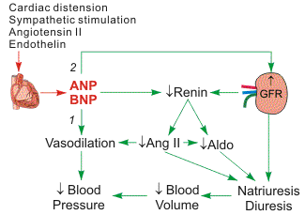
New drugs for heart failure
1- Natriuretic Peptides:
Nesiritide
BNP is secreted by
the ventricles in
response to stretch
elevated BNP is associated with advanced heart failure (compensatory mechanism in HF)
Notes:
ANP
BNP (Beta type)

Slide 44
Natriuretic Peptides
Nesiritide
a purified preparation of human BNP, manufactured by recombinant DNA technology
↑ cyclic-GMP in vascular smooth muscle, leading to smooth muscle relaxation & reduction of preload and afterload
indicated (IV) for the treatment of patients with acute decompensated heart failure (ADHF) who have dyspnea at rest or with minimal activity.

Slide 45
New drugs for heart failure
2- Calcium sensitisers:
Levosimendan
- used in the management of ADHF

Slide 46
New drugs for heart failure
Levosimendan
mechanism of action:
Calcium sensitization
(improves cardiac contractility without increasing
oxygen consumption)
potassium-ATP channel opening
(cause vasodilation, improving blood flow to vital organs)
These effects reduce the risk of worsening ADHF or death compared with dobutamine.

Slide 47
Management of chronic heart failure
Reduce work load of the heart
- Limit patient activity
- Reduce weight
- Control hypertension
Restrict sodium
Stop smoking.
Notes:
Bec smoking & CV diseases are always linked together

Slide 48
Heart Failure Functional Classification
NYHA Class | Symptoms
I | Cardiac disease, but no symptoms & no limitation in ordinary physical activity, e.g. no shortness of breath when walking, climbing stairs etc
II | Mild symptoms (mild shortness of breath &/or angina), slight limitation during ordinary activity
III | Marked limitation in activity due to symptoms, even during less-than-ordinary activity, e.g. walking short distances (20–100 m). Comfortable only at rest
IV | Severe limitations. Experiences symptoms even while at rest. Mostly bedbound patients.
Notes:
the New York Heart Association (NYHA) Functional Classification. It places patients in one of four categories based on how much they are limited during physical activity.

Slide 49
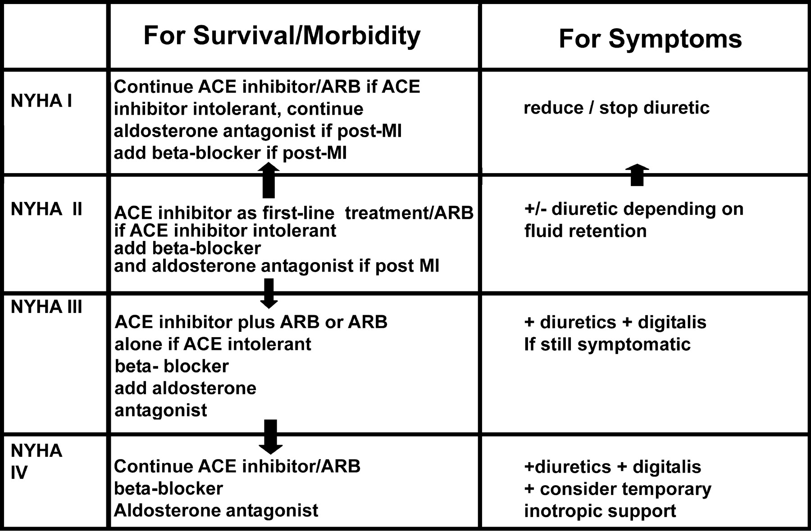
Management of chronic heart failure

Slide 50
Congestive Heart Failure in Black patients
Hydralazine/isosorbide dinitrate
fixed dose combination
FDA approved to add to standard therapy for
black Americans with congestive heart failure
(due to poor response to ACE inhibitors)
should be considered for patients intolerant
to ACE inhibitors & ARBs due to
renal dysfunction
.

Slide 51
Acute decompensated heart failure (ADHF)
A sudden worsening of the signs & symptoms of heart failure, which typically includes:
difficulty breathing (dyspnea)
leg or feet swelling
fatigue
ADHF is a common & potentially serious cause of acute respiratory distress.

Slide 52
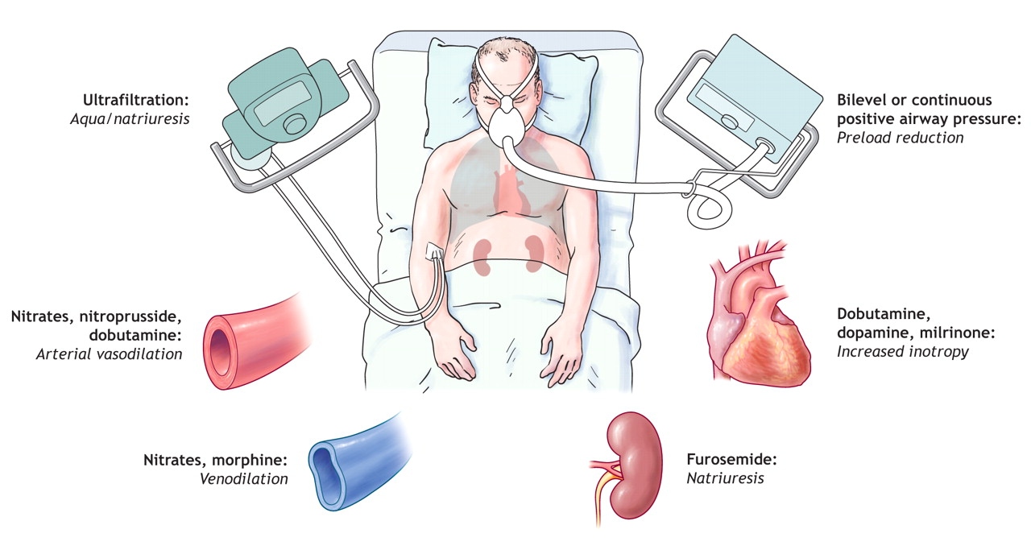
Management of acute heart failure
Notes:
Positive airway pressure (PAP) treatment uses a machine to pump air under pressure into the airway of the lungs. This helps keep the windpipe open during sleep. The forced air delivered by CPAP prevents episodes of airway collapse that block the breathing in people with obstructive sleep apnea
Ultrafiltration: Aqua/natriuresis More effectively remove sodium, control blood volume, and avoid reflex; neurohormonal activation seen with loop diurectics Nitrates, nitroprusside, dobutamine: Arterial vasodilation

Slide 53
Thank you

