Slide 1
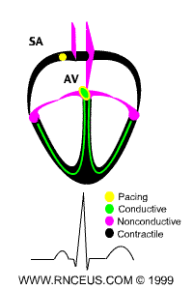
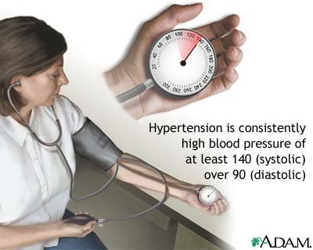
Antihypertensive drugs

Slide 2
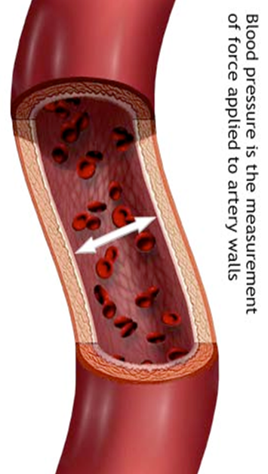
Antihypertensive drugs
ILOS
Identify factors that control blood pressure
Outline the pharmacologic classes of drugs used in treatment of hypertension
Describe mechanism of action, therapeutic uses & common adverse effects and contraindications of each class of drugs
Select the suitable antihypertensive drug used to treat a specific patient according to efficacy, safety and cost

Slide 3

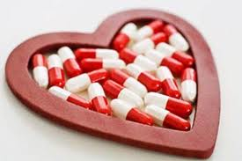

hypertension
Prevalence 25-30%
In majority of cases, it is symptomless “Silent Killer”
Number One cause of death

Slide 4
The rule of halves of Hypertension
For every 800 adults in the community
400 are hypertensive (either ↑ SBP or ↑ DBP or both)
Of them only 200 are diagnosed HT
Of them only 100 are started on treatment
Of them only 50 are on correct drug
Of them in only 25 the goal B.P. is attained
Means 25 ÷ 400 = 6% only have goal BP

Slide 5

Clinical case
Osman a 51-year-old man (95 Kg weight, 176 cm tall) is referred for evaluation of his BP. He is diabetic for 5 years and hypertensive since 12 years, with no history of hypertension target-organ damage. Examination revealed normal heart sounds, no peripheral edema, and mild arteriolar narrowing in the fundus. His BP was 156/90 mmHg, similar in both arms and did not change on standing. Urine analysis showed an unremarkable dipstick evaluation. The patient was suspected as having drug- resistant hypertension.
His medications are listed in the accompanying table.
Name | Dose | Frequency
Hydrochlorothiazide | 25mg | Daily
Valsartan | 160mg | Daily
Diltiazem, long-acting | 300mg | Daily
Clonidine | 0.2mg | Twice daily
Metoprolol, long acting | 100mg | daily
Simvastatin | 40mg | Daily
Fenofibrate | 145mg | Daily
Metformin | 1g | Twice daily
Notes:
A significant difference in the pressure (of more than 10 -15mm of mercury ) recorded in the right and left arms can signal circulatory problems; atherosclerosis that may lead to stroke, peripheral artery disease, or other cardiovascular problems.
dipstick uninalysis :can help doctors diagnose a urinary tract infection (UTI), kidney disease, diabetes, or a urinary tract injury

Slide 6

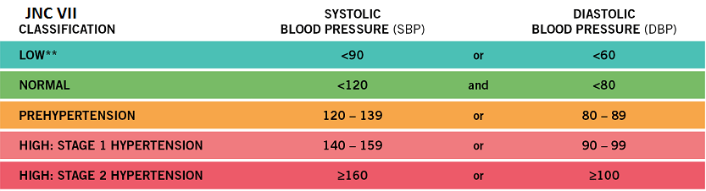

Clinical case
The seated BP of Osman was 156/90, what are the target BP values for treatment of hypertensive patients?
What are the classes of hypertension?
Osman is diabetic, what are the target BP values for a diabetic?

Slide 7
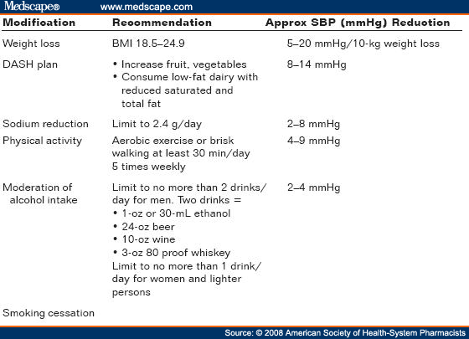
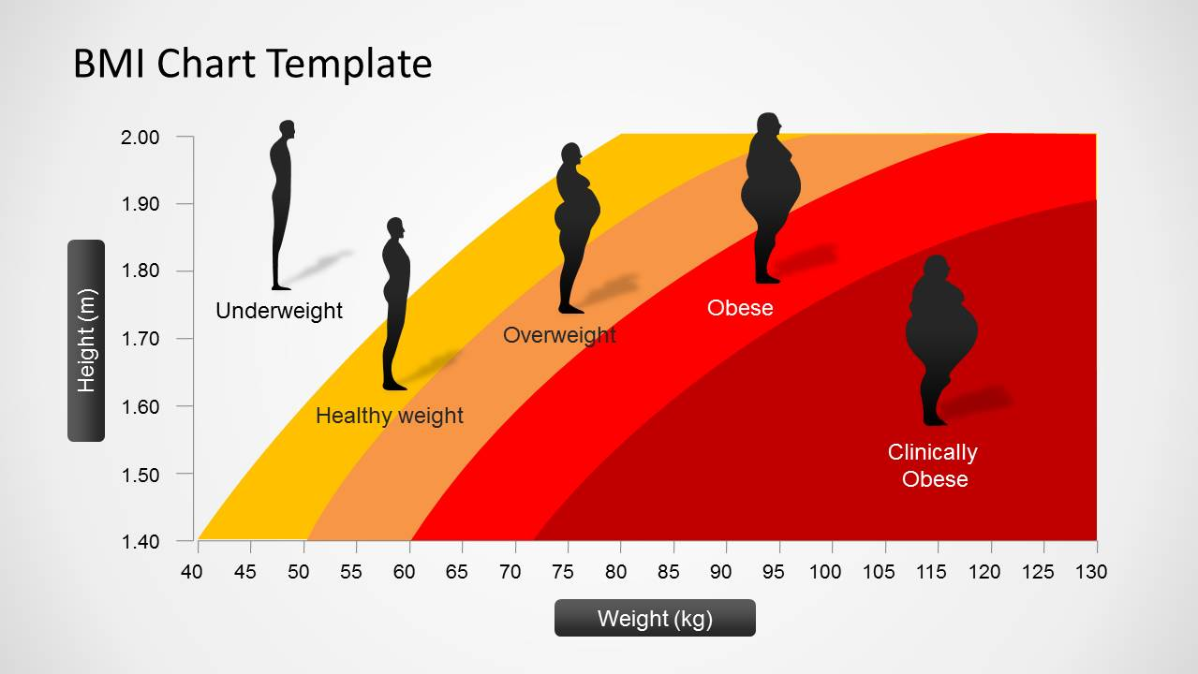
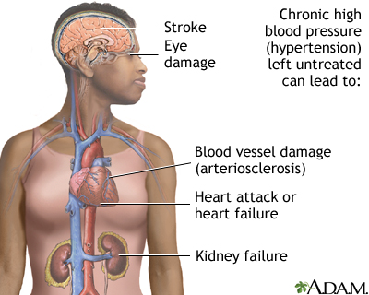
Clinical case
Osman has no history of hypertension- target organ damage. What are organs affected adversely by persistent high BP?
Osman is 95 kg. Is this weight proper for his length (176cm)?
What are the lifestyle modifications, a hypertensive patient should follow?
Notes:
Roughly half the people with untreated hypertension die of heart disease related to poor blood flow (ischemic heart disease) and another third die of stroke.
Heart ( coronary artery disease, hypertrophy, failure)
Brain (TIA, stroke)
Kidney (failure)

Slide 8
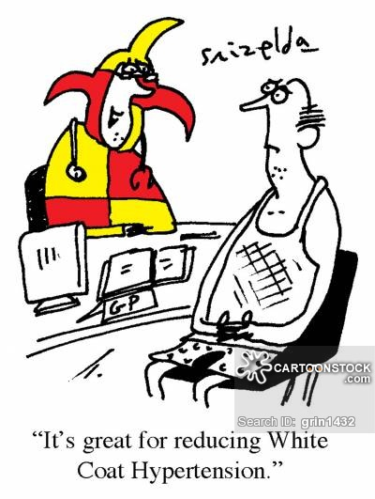
Clinical case
Could the “white coat phenomenon” be the cause for Osman’s high blood pressure readings?
In a Turkish study involving 438 patients, 43% were found to be white coat hypertensives (high pulse rate)

Slide 9
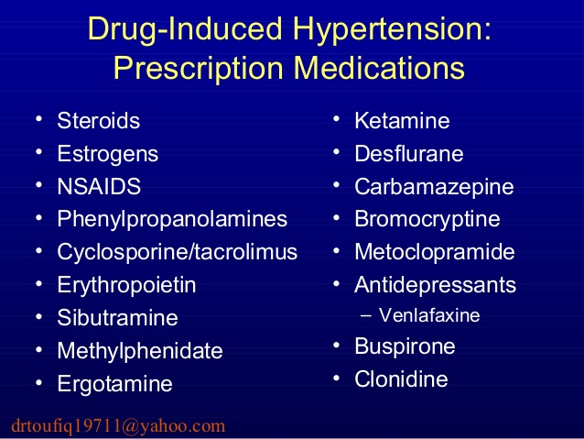
Clinical case
Could the failure of control of Osman BP be due to secondary drug – induced effects?
Which drugs elevate blood pressure?

Slide 10
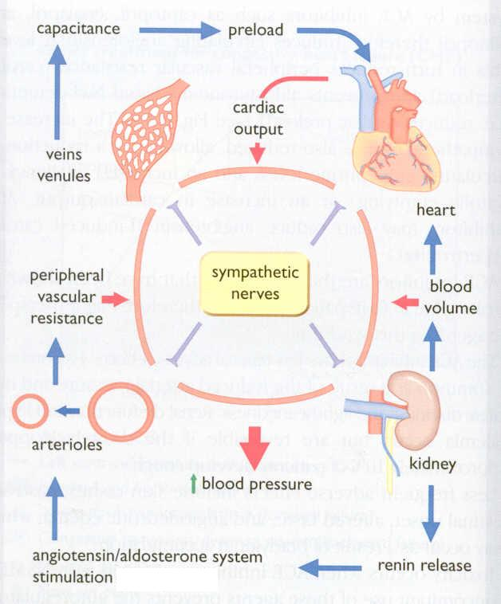
FACTORS IN BLOOD PRESSURE CONTROL
Notes:
http://www.edises.it/file/minicd/germ002/misc/assignmentfiles/cardiovascular/Fact_Aff_Blood_Pressure.pdf

Slide 11
Classification of
Antihypertensive drugs
1-Diuretics
2- Drugs acting on the renin-angiotensin-
aldosterone system (RAAS)
3- Calcium channel blockers
4-Vasodilators
5-Drugs acting on sympathetic nervous system

Slide 12

Diuretics
Hydrochlorothiazide , chlorthalidone
Thiazide diuretics
Long- term
initial
Duretics may be adequate in
mild to moderate hypertension
Na⁺ in vessel wall
sodium
& water loss
Na⁺-Ca²⁺ exchange
Mechanism of action
blood volume
Ca²⁺ in smooth muscle cell
Cardiac
output
The initial diuresis lasts 4-6 weeks and then replaced by a decrease in PVR
Peripheral resistance
Decrease in BP
Notes:
Thiazide diuretics, which are the most commonly used diuretic, inhibit the sodium-chloride transporter in the distal tubule.
Compared with other medications of the thiazide class, chlortalidone has the longest duration of action but a similar diuretic effect at maximal therapeutic doses.

Slide 13
Diuretics
Loop diuretics produce more potent diuresis but a smaller decrease in PVR : Furosemide
Loop diuretics are useful in hypertensive patients with either renal impairment, or heart failure ( edema)
Potassium- sparing diuretics have minimal effect on lowering BP
Notes:
Loop diuretics are diuretics that act at the ascending limb of the loop of Henle in the kidney. They are primarily used in medicine to treat hypertension and edema often due to congestive heart failure or renal insufficiency. While thiazide diuretics are more effective in patients with normal kidney function, loop diuretics are more effective in patients with impaired kidney function.

Slide 14
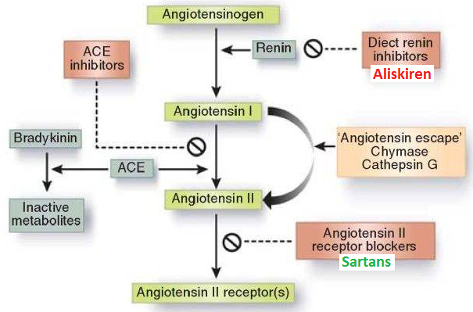
Drugs acting on the renin- angiotensin - aldosterone (RAAS) system
1- Angiotensin-converting enzyme inhibitors (ACEIs)
Captopril
Lisinopril
Enalapril
Ramipril
2-Angiotensin receptors
blockers (ARBs)
Losartan
Valsartan

Slide 15
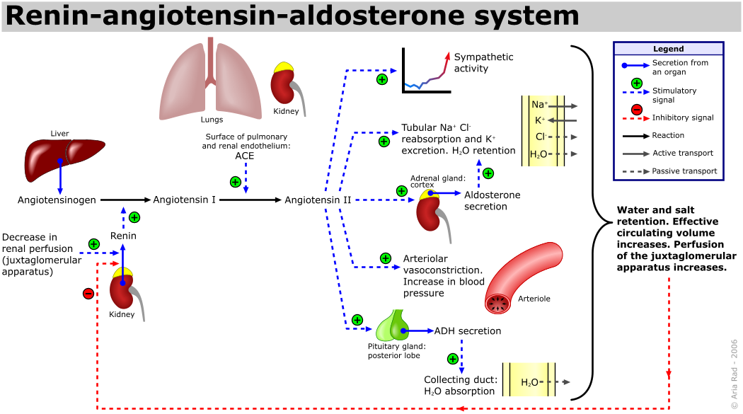

Slide 16
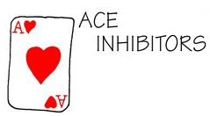
1- Angiotensin-converting enzyme inhibitors (ACEIs)
Particularly effective when hypertension results from excess renin production ( renovascular hypertension, white & young)
The antihypertensive effect of ACE inhibitors results primarily from vasodilatation ( reduction of peripheral resistance ) with little change in cardiac output;
a fall in aldosterone production may also contribute

Slide 17
Angiotensin-converting enzyme inhibitors
pharmacokinetics
Polar, excreted in urine
Do not cross BBB
Have a long half-life & given once daily
Enalapril & ramipril are prodrugs
Rapidly absorbed from GIT after oral administration
Food reduces their bioavailability
It takes 2-4 weeks to notice the full antihypertensive effect of ACEIs
Enalaprilat is the active metabolite of enalapril given by i.v. route in hypertensive emergency

Slide 18
Angiotensin-converting enzyme inhibitors
Clinical uses
1- Treatment of essential hypertension
2- Hypertension in patients with chronic
renal disease, ischemic heart
disease, diabetes
3-Treatment of heart failure

Slide 19
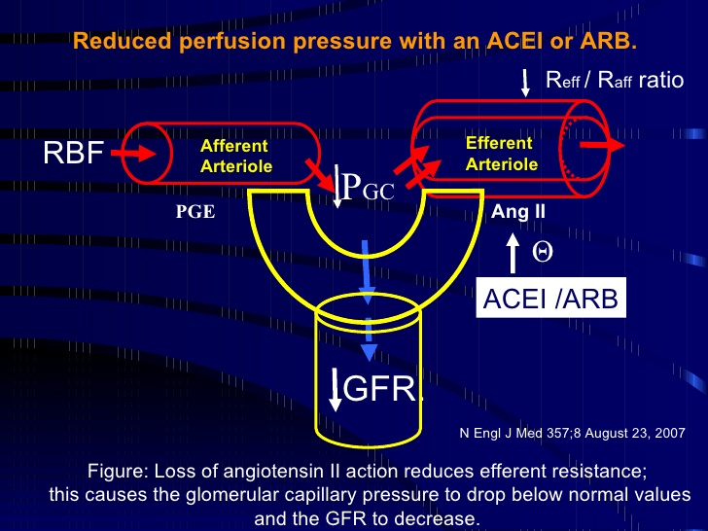
Angiotensin-converting enzyme inhibitors
adrs
Dry cough
Acute renal failure, especially in patients with renal artery stenosis
Severe hypotension in hypovolemic patients
Cause renal agensia/failure in the fetus
resulting in oligohydraminosis
Notes:
Renal agenesis refers to a congenital absence of one or both kidneys.

Slide 20

Adrs of ACEIs
Angioneurotic edema, swelling of the nose, throat, tongue, larynx (caused by inhibition of bradykinin metabolism which accumulate in bronchial mucosa)
First dose effect (severe hypotension) - give at bed time -starts with small dose and increase the dose gradually
adrs specific to captopril
Skin rash, fever
Dysgeusia = reversible loss or altered taste
Proteinuria and neutropenia
These effects are due to a sulfhydryl group in the molecule of captopril

Slide 21
Angiotensin-converting enzyme inhibitors
contraindications
During the second and third trimesters of pregnancy due to the risk of: fetal hypotension, anuria ,renal failure & malformations
Renal artery stenosis
Potassium-sparing diuretics
NSAIDs impair their hypotensive effects by blocking bradykinin-mediated vasodilatation
Notes:
Hyperkalemia is a possible complication of treatment with an ACE inhibitor due to its effect on aldosterone. Suppression of angiotensin II leads to a decrease in aldosterone levels. Since aldosterone is responsible for increasing the excretion of potassium, ACE inhibitors can cause retention of potassium. Hyperkalemia may decrease the velocity of impulse conduction in the nerves and muscles, including cardiac tissues. This leads to cardiac dysfunction and neuromuscular consequences, such as muscle weakness, paresthesia, nausea, diarrhea, and others.

Slide 22
2- Angiotensin receptors blockers (ARBs)
Losartan, Valsartan, Candesatran, Telmisartan
Cause selective block of AT1 receptors
No effect on bradykinin, no cough, no angioedema
Produce more complete inhibition of angiotensin as there are other enzymes ( not only ACE) that can generate angiotensin

Slide 23
Angiotensin receptors blockers
losartan
Has a potent active metabolite
Orally effective
Long half-life, taken once daily
Do not cross BBB
valsartan
No active metabolites
Same contraindications as ACEI
Same ADRs, except for
dry cough & angioneurotic edema

Slide 24
Plasm a Le ve ls Be fo re Aft e r
Ald o s t e r o n e Hig h Lo w
Pot assium (m Eq / L) 3.5 4.3
Re n in No r m a l Hig h
An g io t e n s in II Hig h Lo w
Plasm a Le ve ls Be fo re Aft e r
Ald o s t e r o n e Hig h Lo w
Pot assium (m Eq / L) 3.5 4.3
Re n in No r m a l Hig h
An g io t e n s in II Hig h Lo w
Think- pair-share
A 63-year-old hypertensive woman had been receiving an
antihypertensive drug for 15 days. The following serum
values were obtained from the patient before and after drug therapy.
A
Plasma level | Before | After
Aldosterone | High | Low
Potassium (mEq/l) | 3.5 | 4.3
Renin | Normal | High
Angiotensin II | High | Low
Which drug the woman has been receiving

Slide 25
Clinical case
Osman was prescribed hydrochlorthiazide & valsartan.
What is the rationale for combining hydrochlorothiazide and valsartan?
Notes:
By causing volume and sodium depletion, thiazide diuretics stimulate the production of renin and angiotensin. This leads to a relative increase in blood pressure and sodium retention, which counteracts some of the other antihypertensive effects of the thiazide diuretics. ACE inhibitors interfere with the conversion of angiotensin I to angiotensin II and thereby decrease angiotensin II levels. These effects lead to decreased sodium retention and an enhanced antihypertensive effect.

Slide 26

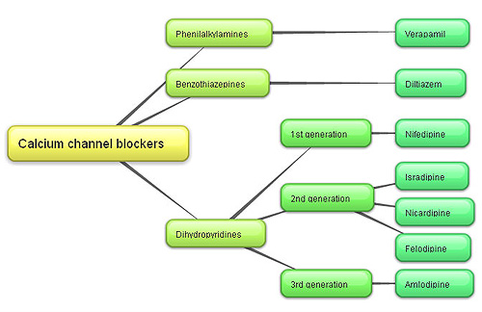
3-Calcium channel blockers
V ery
N ice
D rugs
Verapamil act more on myocardium
Dihydropyridine group act mainly on smooth muscle, Nifedipine
Diltiazem has intermediate effect

Slide 27
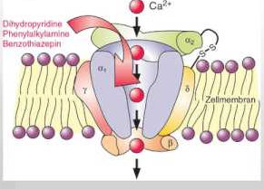
Calcium channel blockers
Mechanism
Block the influx of calcium through calcium channels resulting in:-
1- Peripheral vasodilatation
2- Decrease cardiac contractility

Slide 28
Calcium channel blockers
pharmacokinetics
Given orally or IV
Onset 1-3 min after IV, 0.5-2hr after oral
Well absorbed
Verapamil & diltiazem have active metabolites,
nifedipine has not
Verapamil and nifedipine are highly bound to plasma protiens ( more than 90%) while diltiazem is less (70-80%)
Sustained-release preparations can permit once-daily dosing

Slide 29
Calcium channel blockers
Clinical uses
Treatment of chronic hypertension
Nicardipine can be given by I.V. route in hypertensive emergency
Sustained- release formulations are preferred for the treatment of hypertension due to the short half- life of CCBs
Notes:
designed to release a drug at a
predetermined rate in order to maintain a constant drug concentration for a
specific period of time with minimum side effects

Slide 30
Calcium channel blockers
adrs
Headache, flushing, hypotension
Nifedipine: Tachycardia
Verapamil & Diltiazem: peripheral edema (ankle edema*)
Verapamil: constipation

Slide 31
Clinical case
Osman was prescribed thiazides & diltiazem. What is the benefit of combining thiazides and diltiazem? (ankle edema)
The BP of Osman did not change on standing. What is your conclusion?
The BP of Osman was almost the same in both arms. What does that imply?
Notes:
A slight fluctuation below 5 mmHg is normal between two arms, and can be explained by asymmetrical differences in muscles and tissue in each arm
atherosclerosis, stenosis, of a large artery………. Big difference in BP

Slide 32
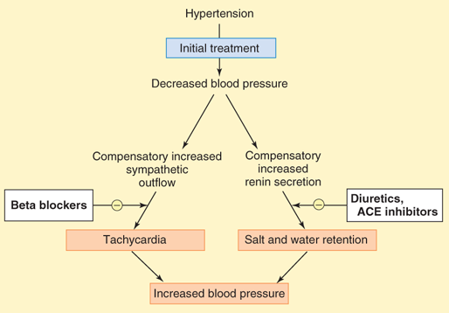
4- vasodilators
Classified into arterial, venous or mixed vasodilators
Once vasodilators are administered, fall in BP produced will activate the sympathetic system & the RAAS

Slide 33
vasodilators
Sodium nitroprusside | Diazoxide | Minoxidil | Hydralazine
Arterio & venodilator | Arteriodilator | Arteriodilator | Arteriodilator | Site of action
Release of nitric oxide ( NO) | Opening of potassium channels | Opening of potassium channels in smooth muscle membranes by minoxidil sulfate ( active metabolite ) | Direct | Mechanism of action
Intravenous infusion | Rapid intravenous | Oral | Oral | Route of admin.

Slide 34
vasodilators
Sodium nitroprusside | Diazoxide | Minoxidil |  | Hydralazine
Severe hypotension | Hypotension, reflex tachycardia, palpitation, angina, salt and water retention ( edema) |  |  |  |  | Adverse effects
1.Methemoglobinduring infusion 2. Cyanide toxicity 3. Thiocyanate toxicity | Inhibit insulin release from β cells of the pancreas causing hyperglycemia Contraindicated in diabetics |  | Hypertrichosis. Contraindicated in females |  | lupus erythematosus like syndrome | Specific adverse effects

Slide 35
vasodilators
Sodium nitroprusside |  | Diazoxide | Minoxidil |  | Hydralazine
1.Hypertensive emergency |  | 1.Hypertensive emergency | 1.Moderate –severe hypertension |  | 1.Moderate -severe hypertension. | Therapeutic uses
In combination with diuretics & β-blockers
2.Severe heart failure | 2. Treatment of hypoglycemia due to insulinoma |  | 2. baldness | 2.Hypertensive pregnant woman

Slide 36
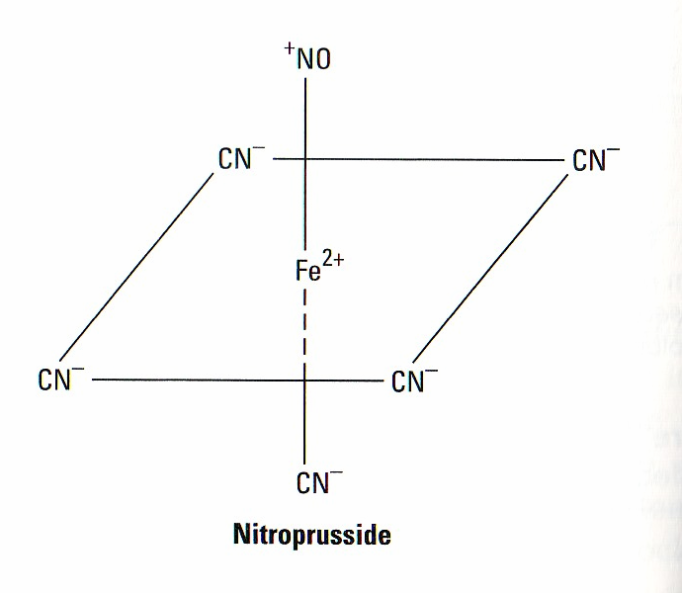
vasodilators
Sodium nitroprusside
adrs
Headache, palpitations which disappear when infusion is stopped
Cyanide accumulation cause cyanide poisoning ( metabolic acidosis, arrhythmias, severe hypotension and death)

Slide 37
5-Sympatholytic Drugs
i-ß Adrenoceptor blockers
Propranolol, atenolol, metoprolol
β- adrenoceptors are used in mild to moderate hypertension
In severe cases used in combination with other drugs
May take two weeks for optimal therapeutic response
Evidence support the use of ß-blockers in patients with concomitant coronary artery disease
When discontinued, ß- blockers should be withdrawn gradually
Notes:
Beta-blockers decrease arterial blood pressure by reducing cardiac output. Many forms of hypertension are associated with an increase in blood volume and cardiac output. Therefore, reducing cardiac output by beta-blockade can be an effective treatment for hypertension, especially when used in conjunction with a diuretic. Acute treatment with a beta-blocker is not very effective in reducing arterial pressure because of a compensatory increase in systemic vascular resistance. This may occur because of baroreceptor reflexes working in conjunction with the removal of β₂ vasodilatory influences that normally offset, to a small degree, alpha-adrenergic mediated vascular tone. Chronic treatment with beta-blockers lowers arterial pressure more than acute treatment possibly because of reduced renin release and effects of beta-blockade on central and peripheral nervous systems. Beta-blockers have an additional benefit as a treatment for hypertension in that they inhibit the release of renin by the kidneys (the release of which is partly regulated by β₁-adrenoceptors in the kidney). Decreasing circulating plasma renin leads to a decrease in angiotensin II and aldosterone, which enhances renal loss of sodium and water and further diminishes arterial pressure.

Slide 38
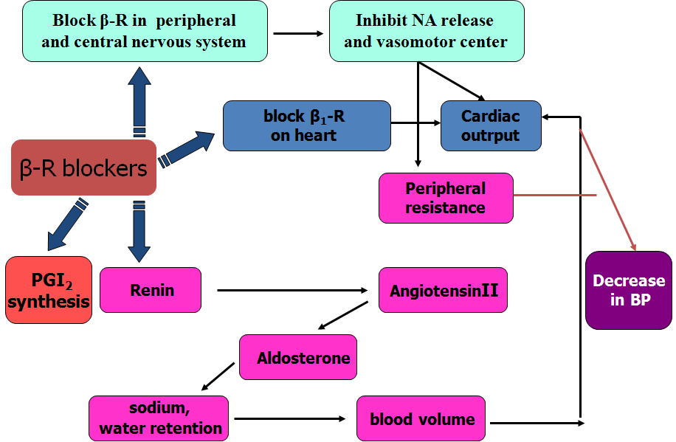
ß- Adrenoceptor blockers
mechanism
They lower blood pressure by :
i-Decreasing cardiac output.
ii-Inhibiting the release of renin
iii- Central mechanism
Notes:
Beta blockers cause retention of sodium and water. Diuretics can cause mild volume reduction that leads to an increase in renin secretion by the kidney. The rationale for combining beta blockers with diuretics is twofold: beta blockers blunt the increase in the plasma renin level that is induced by diuretics, and diuretics decrease the sodium and water retention that is caused by beta blockers.^{6,20}

Slide 39
ß Adrenoceptor blockers
ADrs
Hypoglycemia
Fatigue
Mask the symptoms of hypoglycemia in diabetes
Increased triglycerides
Aggravate peripheral arterial disease
Erectile dysfunction
Notes:
beta -2-adrenergic antagonism has a role in the inhibition of hepatic gluconeogenesis
Beta-blockers can also mask the tachycardia that serves as a warning sign for insulin-induced hypoglycemia in diabetic patients; therefore, beta-blockers should be used cautiously in diabetics.

Slide 40
Sympatholytic drugs
ii- α Adrenoceptor blockers
Block α- receptors in arterioles and venules
Reduce blood pressure by decreasing both afterload & preload
Prazosin, short- acting causes first dose hypotension & postural hypotension
Doxazosin, is preferred long half- life

Slide 41
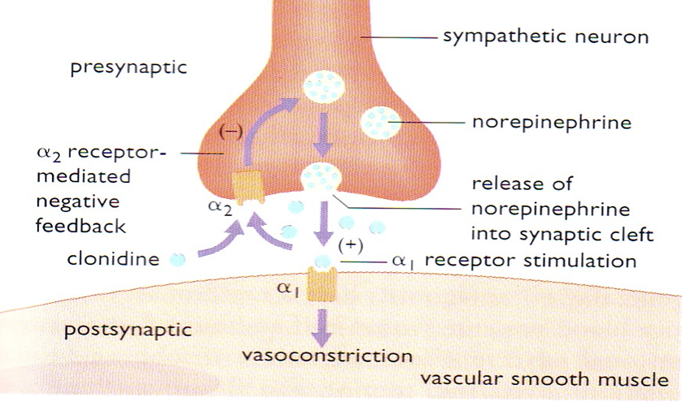
III- Centrally- acting Sympatholytic drugs
Clonidine
α2-agonist, diminishes central adrenergic outflow & ↑ parasympathetic outflow
Abrupt withdrawal may lead to rebound hypertension
Does not decrease renal blood flow or glomerular filtration
Useful in the treatment of hypertension complicated by renal disease and resistant hypertension

Slide 42
III- Centrally- acting Sympatholytic drugs
Sympatholytic drugs
α- methyldopa
An α- 2 agonist, is converted to methyl noradrenaline centrally to diminish the adrenergic outflow from the CNS
Lead to reduced total peripheral resistance, and a decrease in blood pressure
α -Methyldopa is the first line treatment of hypertension in pregnancy

Slide 43
Clinical case
List the reasons, why Osman failed to respond to antihypertensive therapy?

Slide 44
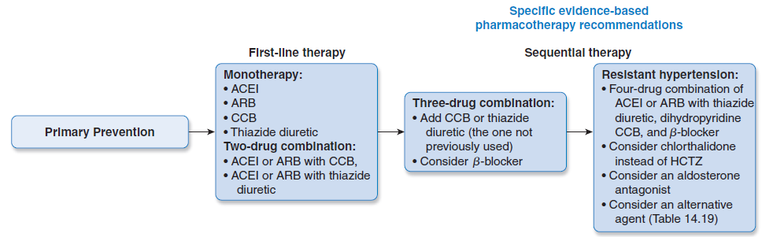
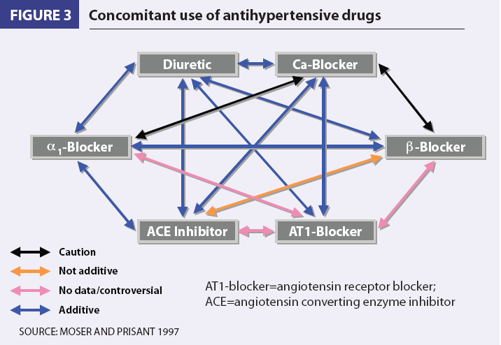
Clinical case
Could the failure of Osman control of BP be due to the use of inappropriate combinations of drugs?
Use of combinations→↓ individual dose→↓ ADRs
Select a drug that ↓ the ADR of another, e.g. thiazides versus ACEI
Select a drugs that act by different mechanisms

Slide 45
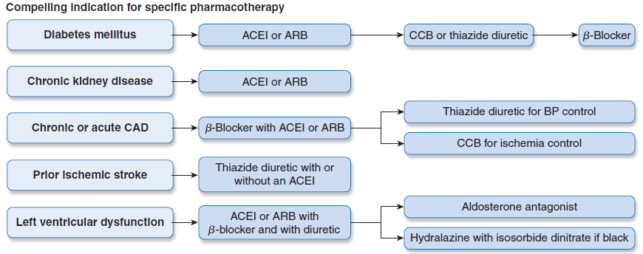
Antihypertensive drugs

Slide 46
Memory matrix
Enter + or – in the cells to indicate the presence or absence of a feature
Compelling contraindications of antihypertensive drugs
 | HF | Pregnancy | Hypokalemia | Bradycardia | Asthma | Hyperkalemia | Gout
Diuretics
ACEI
CCB
ß-blockers
ARB

Slide 47
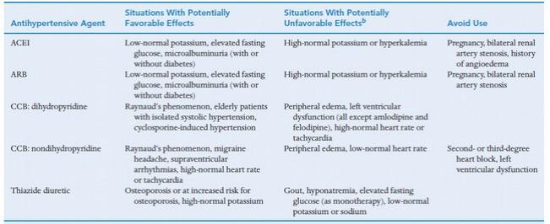
Notes:
Methyldopa is a drug of first choice for control of mild to moderate hypertension in pregnancy and is the most widely prescribed antihypertensive for this indication in several countries, including the US and the UK.^{[1,2]} The wide use of this drug in pregnancy reflects the fact that it has the best documented maternal and fetal safety record, including favourable long term (4.5 to 7.5 year) paediatric follow-up data.^{[1]} During long term use in pregnancy, methyldopa does not alter maternal cardiac output or blood flow to the uterus or kidneys,^{[1,2]} and for all these reasons is generally considered the agent of choice for chronic blood pressure control in pregnancy.^{[1]} Oral hydralazine, a direct vasodilator, is effective as monotherapy or as add-on therapy to methyldopa in the long term management of chronic hypertension in pregnancy.^{[1]} Hydralazine appears to be reasonably safe for the fetus a

