Slide 1
بسم الله الرحمن الرحيم
WALL OF THE HEART
AND
CARDIAC VALVES

Slide 2
WALL OF THE HEART AND CARDIAC VALVES
By the end of the lecture, the student should be able to describe the microscopic structure of:
1. Wall of the heart:
- Endocardium.
- Myocardium.
- Epicardium.
2. Cardiac valves.

Slide 3
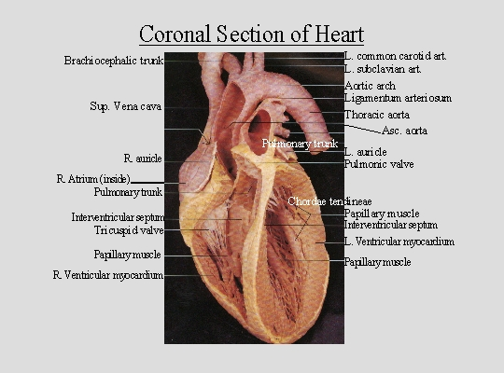
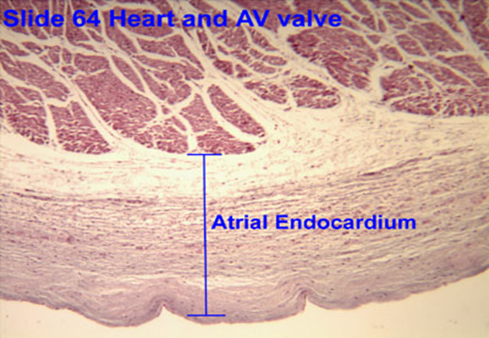
WALL OF THE HEART
(A) Endocardium: 1- Endothelium
2- Subendothelial C.T.
3- Dense C.T. layer
4- Subendocardial layer
(B) Myocardium
(C) Epicardium:
1- Mesothelium
2- C.T. layer

Slide 4
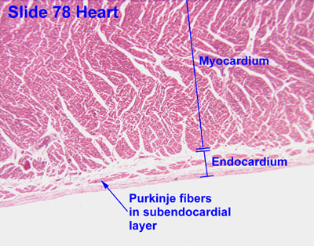
ENDOCARDIUM
1- Endothelium: simple squamous epithelium.
2- Subendothelial C.T. layer
3- Dense C.T. layer
4- Subendocardial layer:
Loose C.T. layer that
contains Purkinje fibers, small blood vessels & nerves.
It attaches to the endomysium of the cardiac muscle.

Slide 5
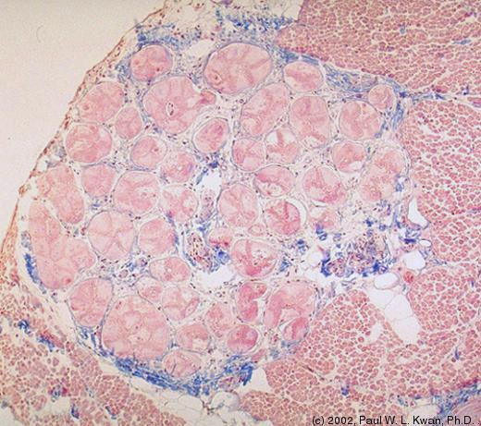
Purkinje Fibers (Moderator Band)
Purkinje fibers in comparison to cardiac muscle cells are:
Larger in diameter.
Paler in staining (more glycogen).
Peripheral nuclei.
Fewer myofibrils (mainly peripheral).
No intercalated discs.
Lumen
Endocardium
Myocardium
Moderator band

Slide 6
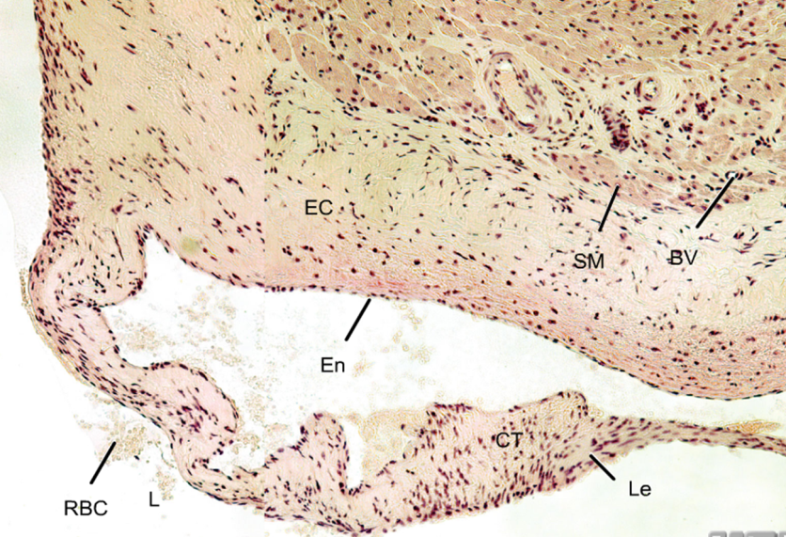
HEART VALVES (CARDIAC VALVES)
Each leaflet (cusp) of heart valve is formed of:
(1) A core of C.T.
(2) This core is covered by: Endothelium.
The leaflets of the heart valves
are normally AVASCULAR.
Blood capillaries can be found
only in the base or root of the leaflet.
Myocardium
Endocardium
Leaflet

Slide 7
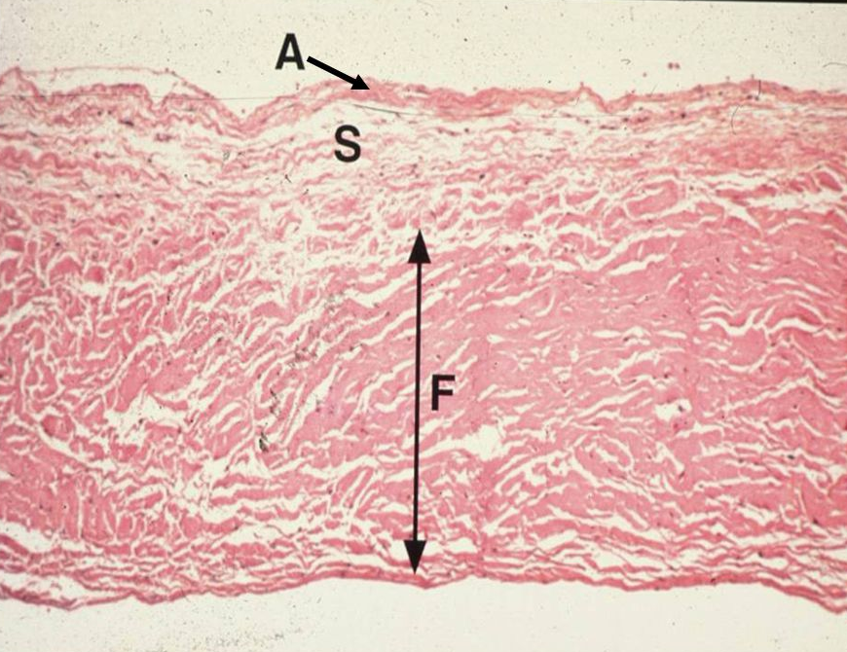
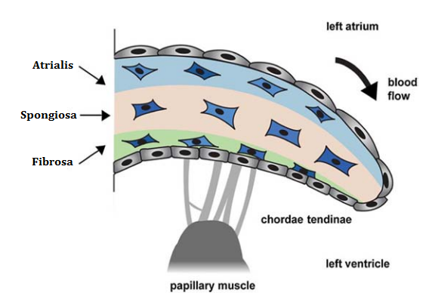
LEAFLET (CUSP) OF ATRIOVENTRICULAR (AV) VALVE
Each leaflet (cusp) of AV valve is formed of:
A core of C.T.: 3 layers:
Atrialis: elastic & collagen fibers.
Spongiosa: proteoglycans (matrix), interstitial cells (e.g. fibroblasts) & few collagen fibers.
Fibrosa: mainly dense collagen fibers.
This core is covered by: Endothelium.

Slide 8
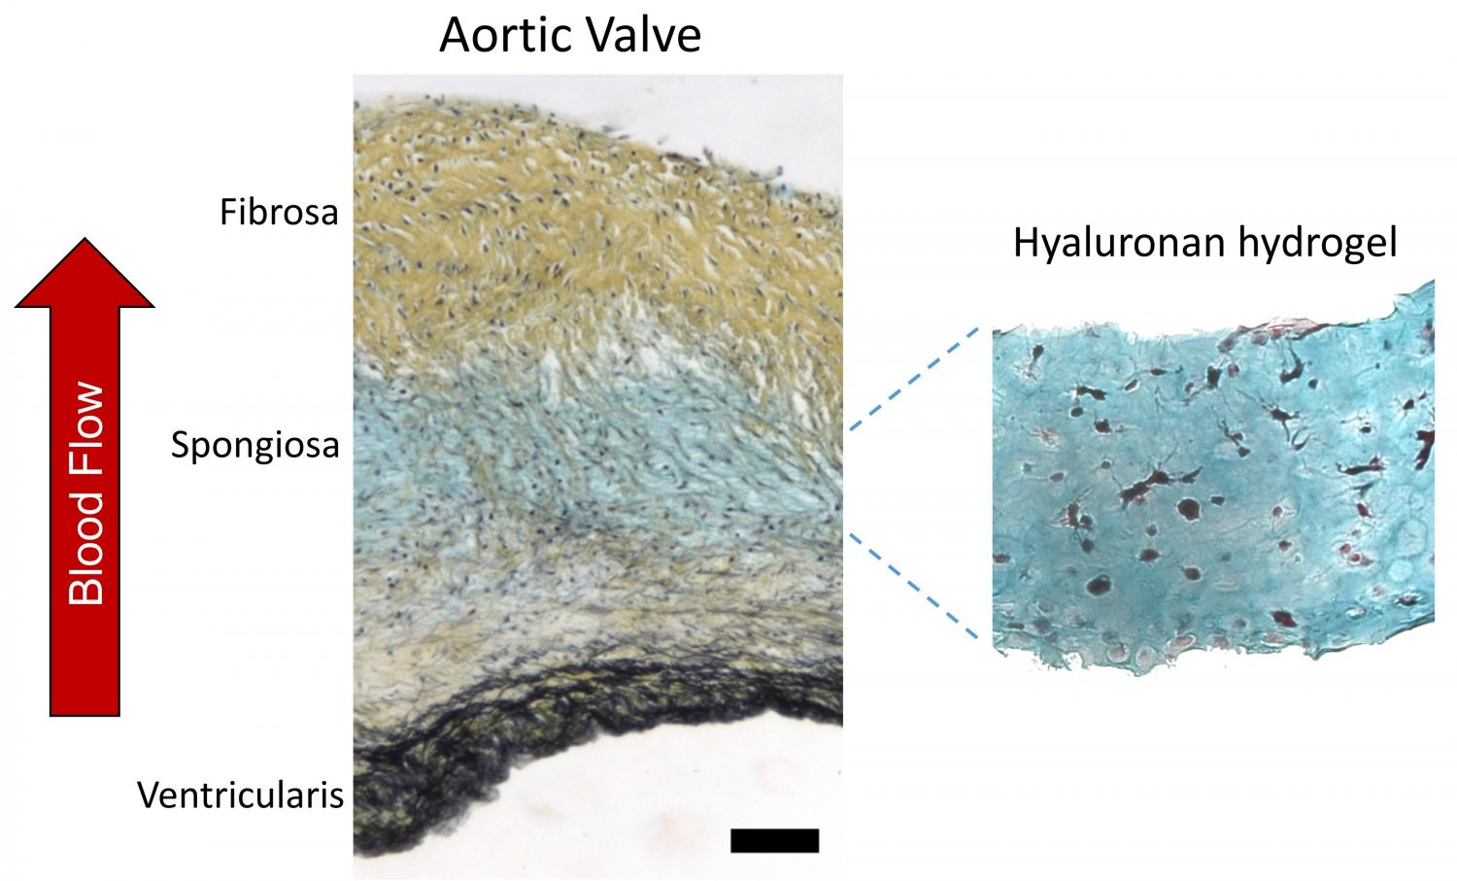
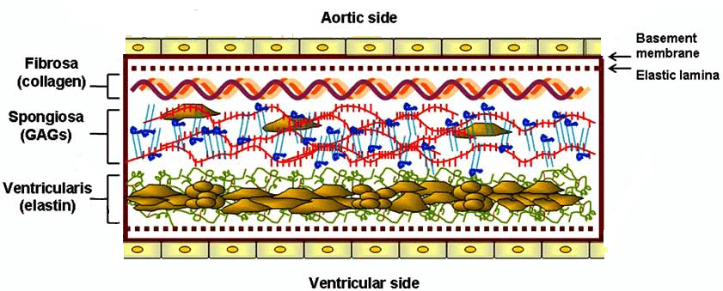
LEAFLET (CUSP) OF AORTIC VALVE
Each leaflet (cusp) of aortic valve is formed of:
A core of C.T.: 3 layers:
Ventricularis: elastic & collagen fibers.
Spongiosa: proteoglycans (matrix), interstitial cells (e.g. fibroblasts) & few collagen fibers.
Fibrosa: mainly dense collagen fibers.
This core is covered by: Endothelium.

Slide 9
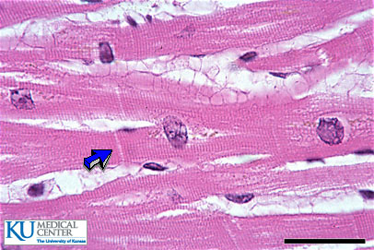
MYOCARDIUM
It is the middle layer
It is the most thick layer
It contains cardiac muscle cells with
endomysium (loose C.T.)

Slide 10
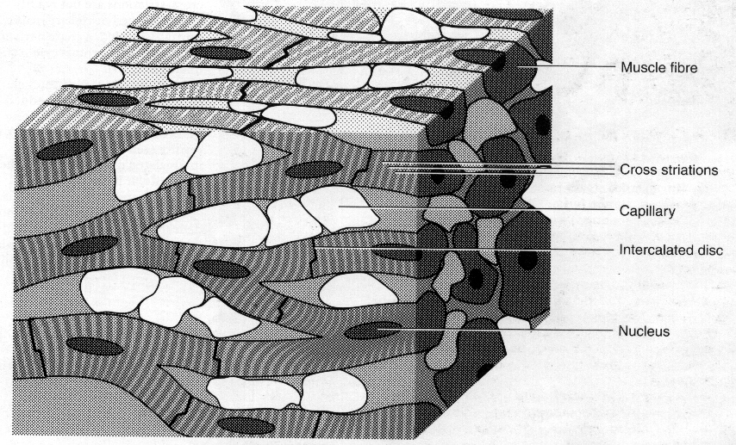
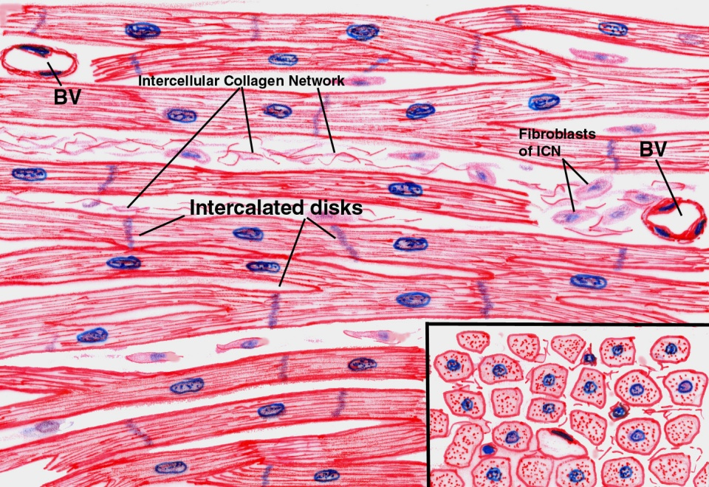
CARDIAC MUSCLE
Found in the myocardium.
Striated and involuntary.
L.M. Picture of Cardiac Muscle Fibers:
Cylindrical in shape.
Intermediate in diameter between skeletal and smooth muscle fibers.
Branch and anastomose.
Covered by a thin sarcolemma.
Mononucleated cardiac muscle cells. Nuclei are oval and central.
Sarcoplasm is acidophilic and shows non-clear striations (fewer myofibrils).
Divided into short segments (cells) by the intercalated discs.

Slide 11
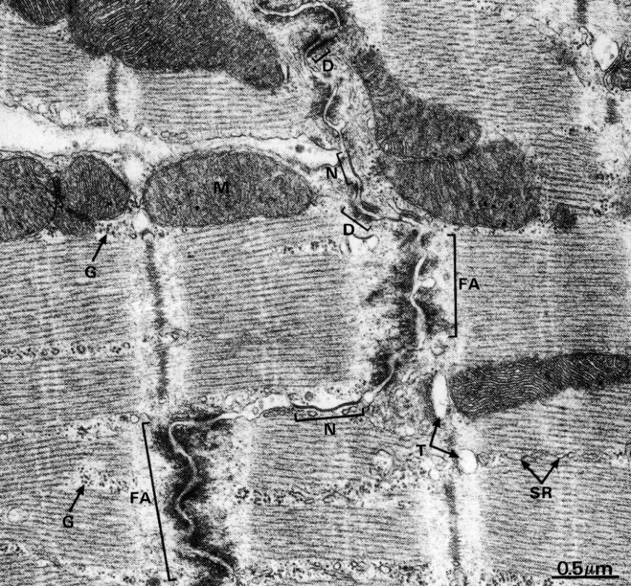
Cardiac Muscle Fibers
E.M. Picture:
Few myofibrils.
Numerous mitochondria.
Less abundant SR.
T-tubules come in contact with only one cisterna of SR forming “Diads” (not triads).
Glycogen & myoglobin.
Intercalated discs: are formed of the two cell membranes of 2 successive cardiac muscle cells, connected together by junctional complexes (desmosomes and gap junctions).
Notes:
Gap junctions allow communication and passage of impulses between cardiac muscle cells.

Slide 12
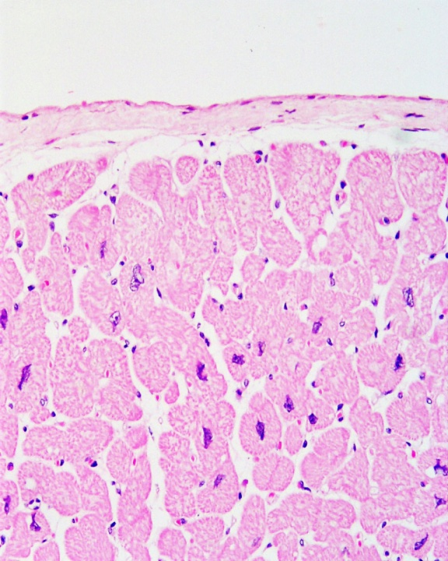
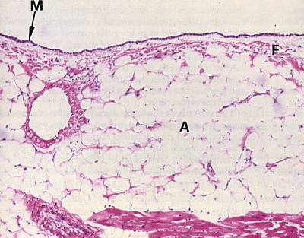
EPICARDIUM (Visceral layer of pericardium)
Mesothelium: simple squamous epithelium.
Subepicardial C.T. layer:
Loose C.T. contains the coronary vessels,
nerves, ganglia & fat cells.

Slide 13
BEST WISHES

