Slide 1
HISTOLOGY OF THE BLOOD VESSELS
By the end of this lecture, the student should be able to identify and describe the microscopic structure of the wall of the blood vessels including:
a. Elastic arteries.
b. Muscular (medium-sized) arteries.
c. Medium-sized veins.
d. Blood capillaries.

Slide 2
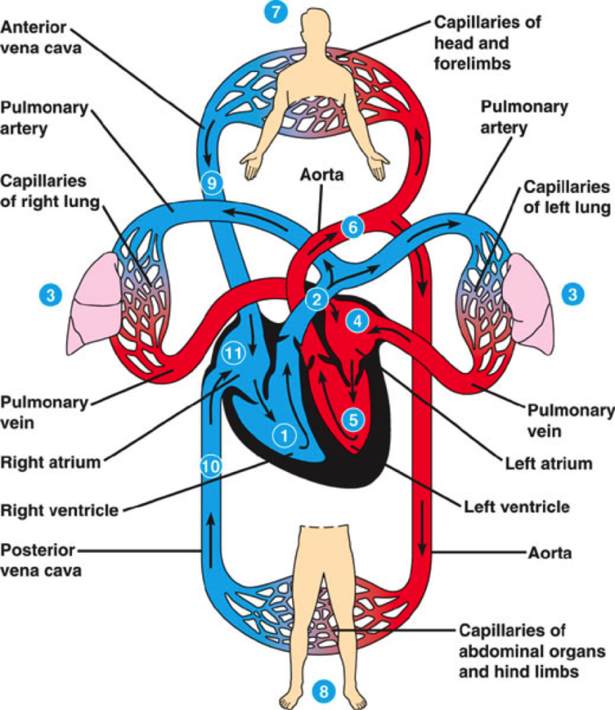
Blood vessels:
Arteries:
Elastic artery.
Muscular (distributing) (medium-sized) artery.
Arterioles.
Blood capillaries.
Veins:
Venules.
Small veins.
Medium-sized veins.
Large veins.

Slide 3
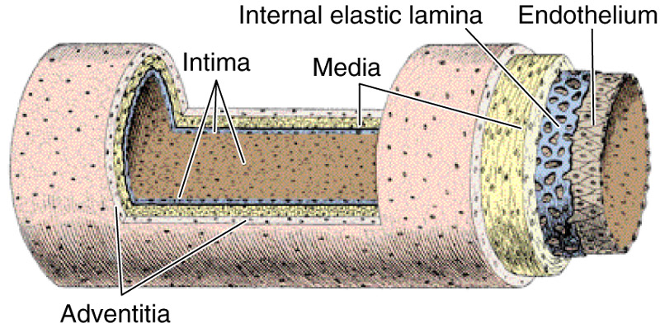
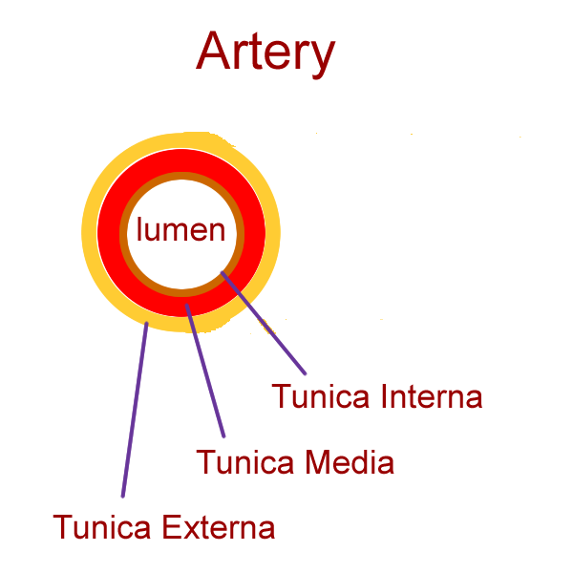
General Structure of Blood Vessels
The wall of blood vessel is formed of three concentric layers:
Tunica intima (interna)
Tunica media
Tunica adventitia (externa)

Slide 4
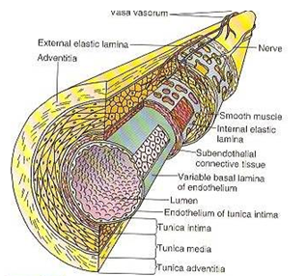
Tunica Intima
Is the innermost layer
Composed of:
Endothelial cells:
Simple squamous epithelium
Subendothelial layer:
loose C.T.
Internal elastic lamina: fenestrated elastic sheet.

Slide 5
Tunica Media
Intermediate layer
Composed of:
Smooth muscles:
Helically arranged
Elastic fibers.
Type III collagen (reticular fibers).
Type I collagen.
NB: Large muscular arteries have external elastic lamina, separating the tunica media from the tunica adventitia

Slide 6
Tunica Adventitia
Outermost layer
Composed of connective tissue containing Vasa vasorum:
They are small arterioles in tunica adventitia
and the outer part of tunica media.
They are more prevalent in the
walls of veins than arteries – why?
Venous blood contains less oxygen
and nutrients than arterial blood.

Slide 7
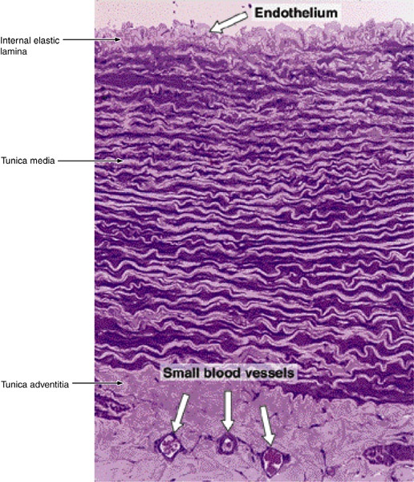
ELASTIC ARTERIES
Examples: aorta, common carotid a., subclavian a., common iliac a, pulmonary Trunk.
Microscopic structure:
T. Intima:
*Endothelium.
*Subendothelial C.T.
*Internal elastic lamina:
(not prominent)
(indistinct)

Slide 8
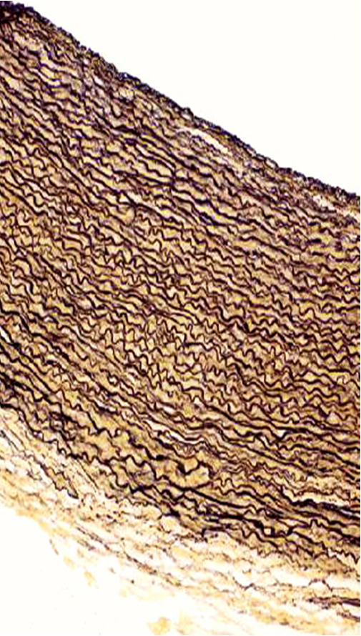
ELASTIC ARTERIES (Cont.)
T. Media: it consists of:
Fenestrated elastic
membranes (sheets) (lamellae):
It is the main component of T.M.
B. In between, there are:
Smooth muscle cells.
2. Collagen fibers (type I collagen).
3. Reticular fibers (type III collagen).
4. Elastic fibers.

Slide 9
ELASTIC ARTERIES (Cont.)
T. Adventitia:
Much thinner than T.M.
It is composed of loose C.T.
Contains vasa vasorum → send branches to the outer part of T.M.

Slide 10
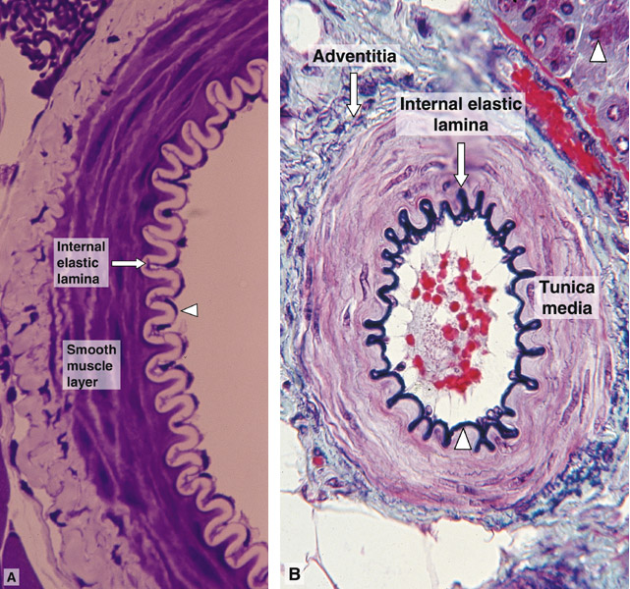
MUSCULAR ARTERIES (Medium-sized artery)
Examples: brachial, ulnar, renal.
Microscopic structure:
T. Intima.:
Endothelium.
Subendothelial C.T. layer.
Internal elastic lamina:
Is prominent.
Displays an undulating surface.

Slide 11
MUSCUALR ARTERIES (Cont.)
T. Media:(Thicker than T. Adventitia
or similar in thickness).
Components:
Smooth muscle cells (SMCs):
are the predominant component.
B. In between there are:
Elastic fibers.
Type III collagen fibers.
Type I collagen fibers.
External elastic lamina: may be identifiable.
3. T. Adventitia.: loose C.T.

Slide 12
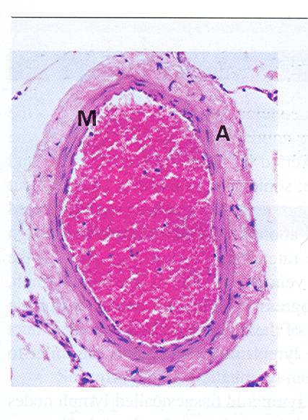
MEDIUM-SIZED VEIN
Thickness of the wall: thinner than the accompanying artery.
T. Intima: *usually forms valves.
*no internal elastic lamina
T. Media:
Thinner than T. Adventitia
Consists of:
Fewer SMCs.
Types I & III Collagen fibers.
T. Adventitia: thicker than T. Media

Slide 13
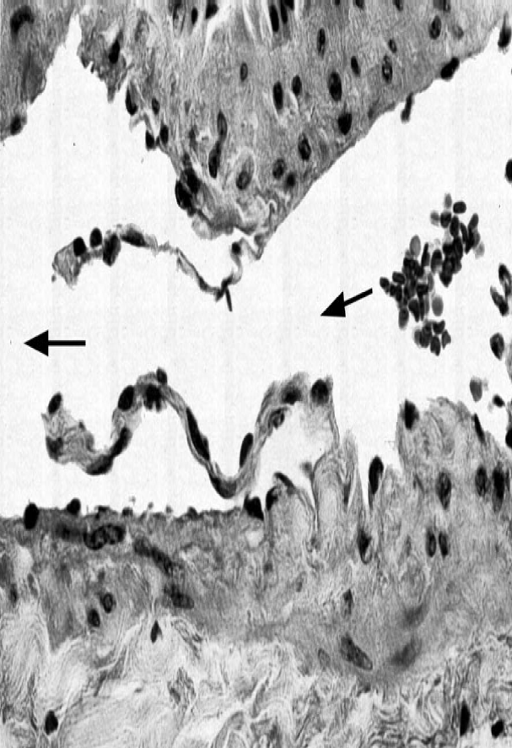
VALVES OF VEINS
Valve of a vein is composed of 2 leaflets
Each leaflet has a thin fold of the T. Intima.
Components:
Endothelium
Core of C.T.

Slide 14
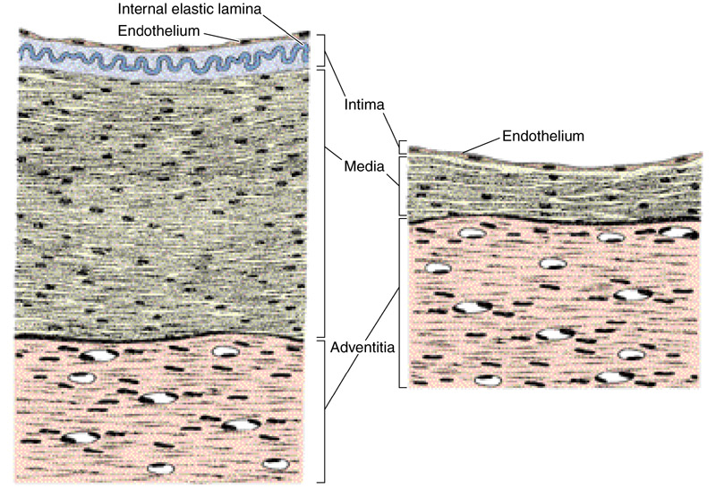
MEDIUM-SIZED ARTERY AND VEIN

Slide 15
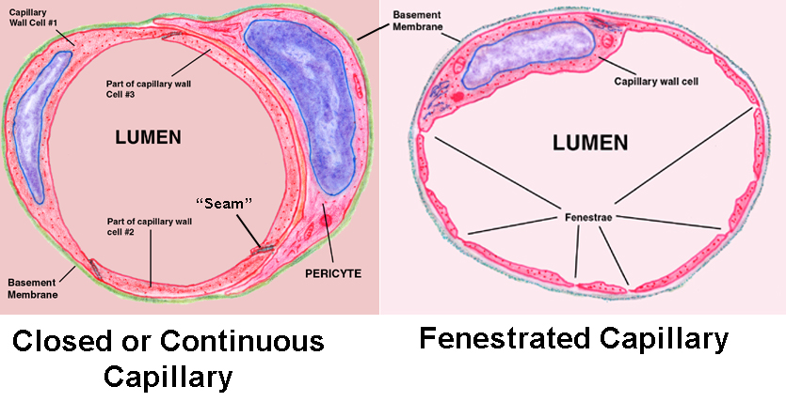
BLOOD CAPILLARIES
Diameter: usually 8-10 µm.
Microscopic structure:
Single layer of squamous endothelial cells.
Basal lamina: surrounds the external surface of the endothelial cells.
Pericytes:
Have processes.
Share the basal lamina
of the endothelial cells.

Slide 16
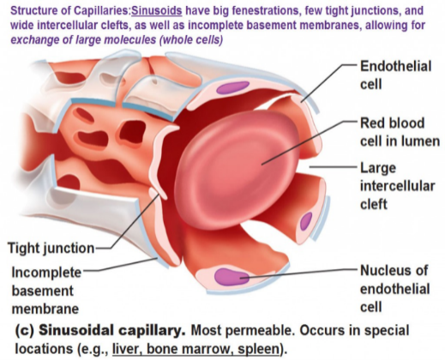
BLOOD CAPILLARIES
Types:
1- Continuous blood capillaries
2- Fenestrated blood capillaries
a- with diaphragms
b- without diaphragms
3- Sinusoidal blood capillaries

Slide 17
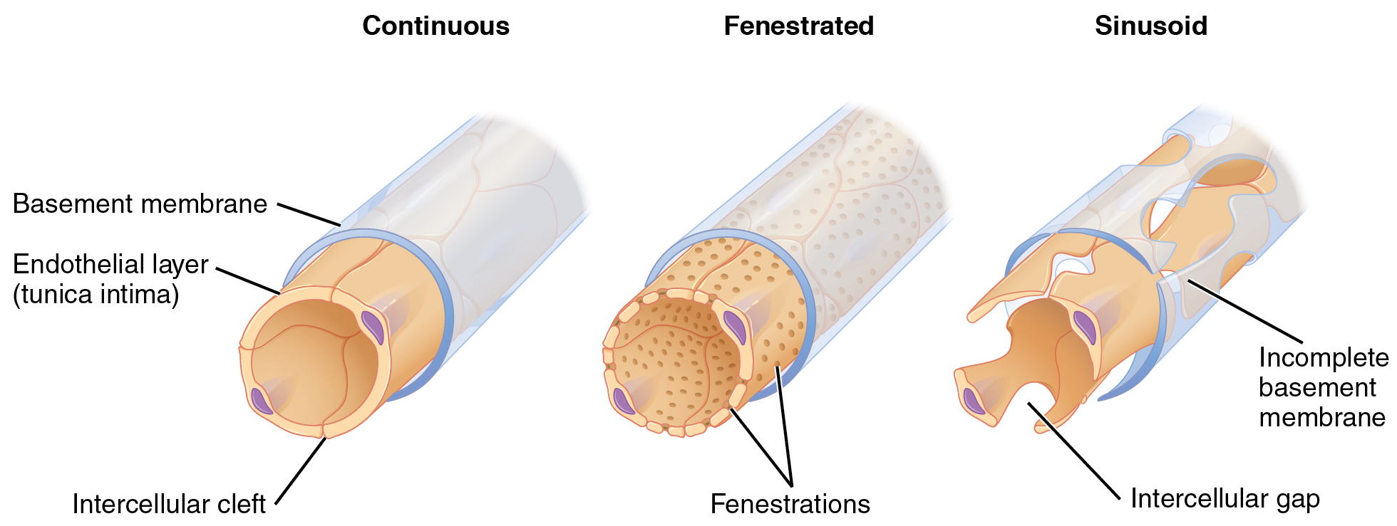
Types of Blood Capillaries

Slide 18
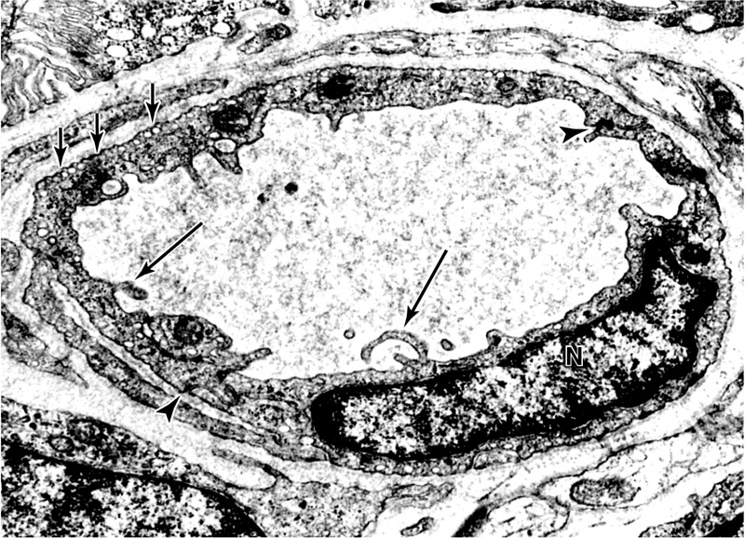
Continuous Blood Capillaries
Microscopic structure:
No pores or fenestrae in their walls.
Distribution:
In muscles,
nervous T., C.T.

Slide 19
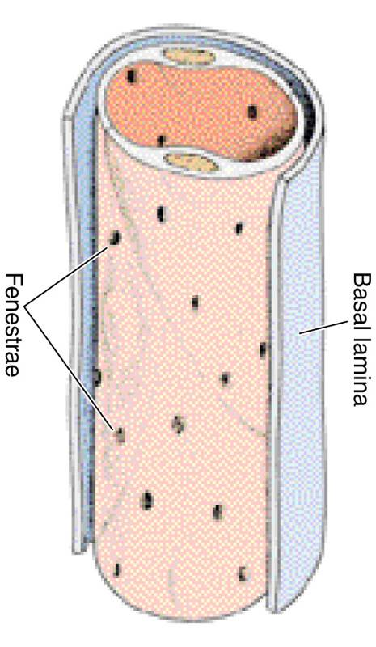
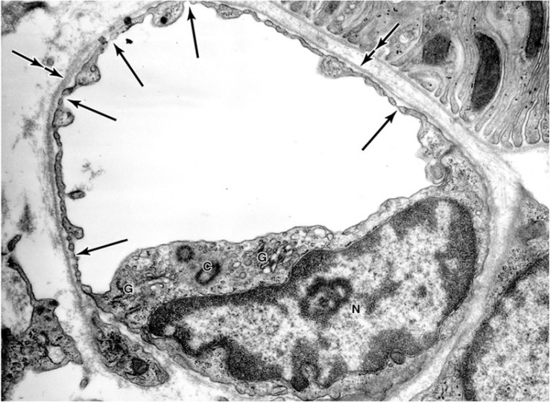
Fenestrated Blood Capillaries with Diaphragms
Microscopic structure:
The walls of their endothelial cells
have pores (fenestrae).
These pores are covered by
diaphragm.
Distribution:
In intestine, pancreas
and endocrine glands.

Slide 20
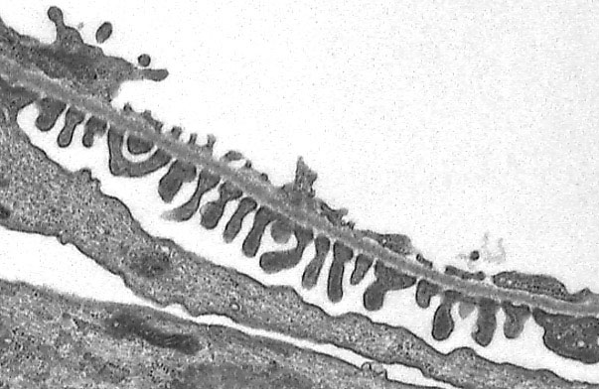
Fenestrated Blood Capillaries without Diaphragms
Microscopic structure:
The walls of their endothelial cells
have pores (fenestrae).
These pores are NOT covered
By diaphragm.
Distribution:
In renal glomerulus.

Slide 21
FENESTRATED CAPILLARY WITH DIAPHRAGMS
FENESTRATED CAPILLARY WITHOUT DIAPHRAGMS
Lumen of glomerular
Blood capillary
Endothelium
Podocyte

Slide 22
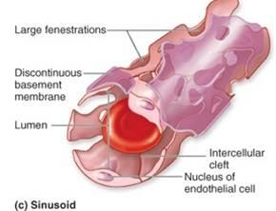
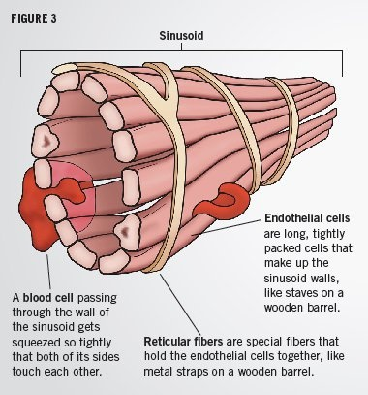
SINUSOIDAL CAPILLARIES
Diameter: irregular (30-40 µm).
Microscopic features:
Their endothelial cells
have fenestrae without diaphragms.
They possess discontinuous endothelial cells.
They possess discontinuous basal lamina.
Macrophages may be located in or along the outside of the endothelial wall.
Distribution: Red bone marrow, liver, spleen and certain endocrine glands.

Slide 23
BEST WISHES

