Slide 1
Lipoproteins and Atheroscloresis
Cardiovascular Block

Slide 2
Objectives
By the end of this lecture, the First Year students will be able to:
Correlate the imbalance in lipoprotein metabolism with the development of atherosclerosis
Understand the functions and metabolism of LDL and HDL cholesterol
Describe the receptor-mediated endocytosis of LDL and its regulation
Recognize how LDL is considered a bad cholesterol whereas HDL a good cholesterol
Understand the biochemistry of atherosclerosis and its laboratory investigations
Discuss the role of lipoprotein(a) in the development of heart disease

Slide 3
Overview
Receptor-mediated endocytosis of LDL and its regulation
LDL is bad cholesterol
High density lipoprotein (HDL) and its functions
Metabolism of HDL
HDL is good cholesterol
Atherosclerosis
Lipoprotein(a)

Slide 4
Receptor-mediated endocytosis of LDL particles
Major steps:
Binding of Apo B-100 to LDL receptor glycoprotein
Endocytosis
Endosome formation (LDL vesicle fuses with other vesicles)
Separation of LDL from its receptor
Receptor is recycled
LDL degraded by lysosomes releasing:
Free cholesterol, fatty acids, amino acids, phospholipids

Slide 5
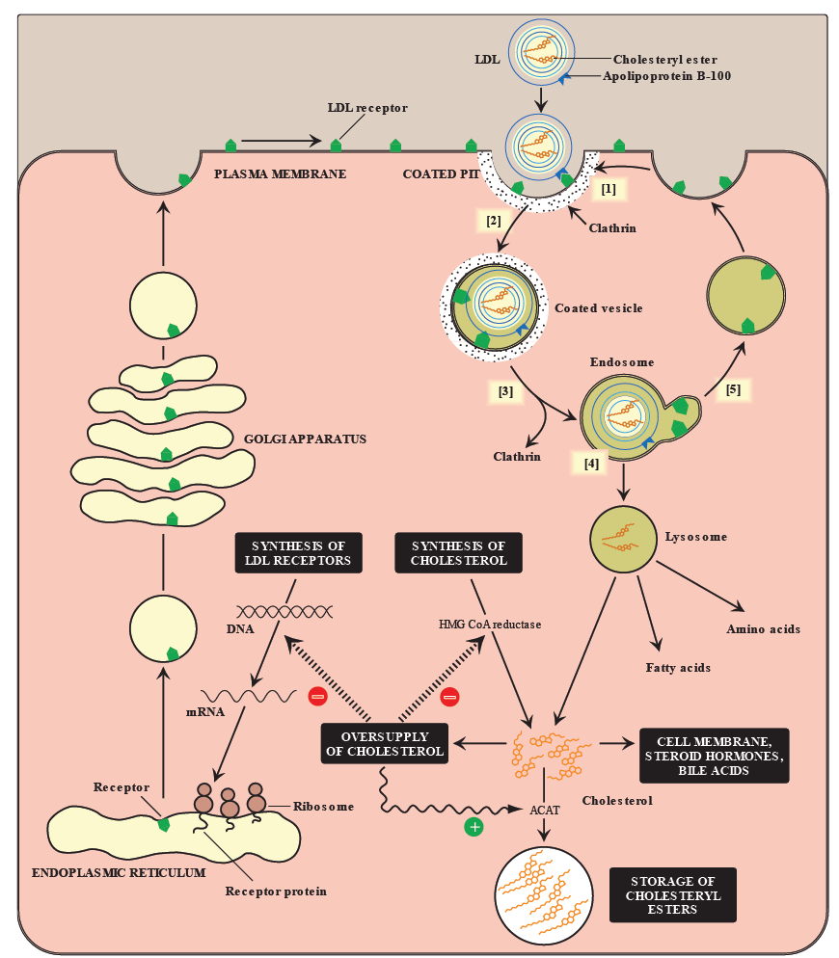
Cellular uptake and degradation
of LDL particles

Slide 6
Regulation of LDL endocytosis
Down regulation:
High intracellular cholesterol level causes:
Degradation of LDL receptors
Inhibition of receptor synthesis at gene level
Reduction in cell surface receptors
Decreased uptake of LDL by cells
Decreased de novo synthesis of cholesterol
Up regulation:
Low intracellular cholesterol level causes:
Recycling of LDL receptors
Increased receptor synthesis at gene level
Increase in cell surface receptors
Increased uptake of LDL by cells
Increased de novo synthesis of cholesterol

Slide 7
LDL is bad cholesterol
Transports cholesterol to peripheral tissues
Elevated LDL levels → increased risk for atherosclerosis / heart disease
Deficiency or defects in LDL receptors results in:
Decreased uptake of cholesterol by cells
Increased accumulation of cholesterol in blood vessels
Familial hypercholesterolemia
Patients are unable to clear LDL from blood
Premature atherosclerosis and heart disease

Slide 8
High density lipoprotein (HDL)
Nascent HDL:
Disk-shaped
Contains apo A-I, C-II and E lipoproteins
Mainly contains phospholipids
Mature HDL:
Nascent HDL + cholesteryl esters → HDL₃
HDL₃ + more cholesteryl esters → spherical HDL₂
HDL₂ transfers cholesterol to the liver

Slide 9
Functions of HDL
Reservoir of apoproteins (Apo C-II and E)
Transports cholesterol to liver from:
Peripheral tissues
Other lipoproteins
Cell membranes
Suitable for cholesterol uptake due to:
High content of phospholipids
Phospholipids solubilize cholesterol and provide fatty acids for cholesterol esterification

Slide 10
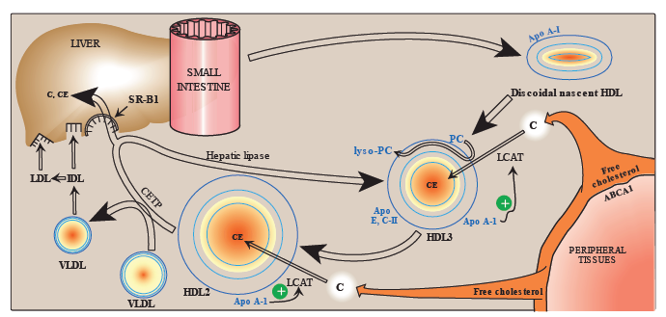
HDL metabolism

Slide 11
HDL is good cholesterol
HDL transports cholesterol from peripheral tissues to the liver for degradation
Reduces cholesterol level in tissues and circulation (reverse cholesterol transport)
High HDL levels have inverse correlation with atherosclerosis
Reverse cholesterol transport includes:
Cholesterol efflux from peripheral tissues to HDL
Cholesterol esterification
Binding and transfer of cholesteryl ester-rich HDL₂ to liver
Release of lipid-depleted HDL₃

Slide 12
Atherosclerosis
LDL uptake by cells is receptor mediated
Additionally, macrophages possess scavenger receptors called scavenger receptor class A (SR-A)
The macrophages take up chemically-modified LDL by endocytosis

Slide 13
Atherosclerosis
Chemically-modified LDL contains oxidized lipids and Apo B
Unlike LDL receptors, the SR-A is not down-regulated in response to high intracellular cholesterol
Cholesteryl esters accumulate in macrophages converting to foam cells
Foam cells contribute to plaque formation and atherosclerosis

Slide 14
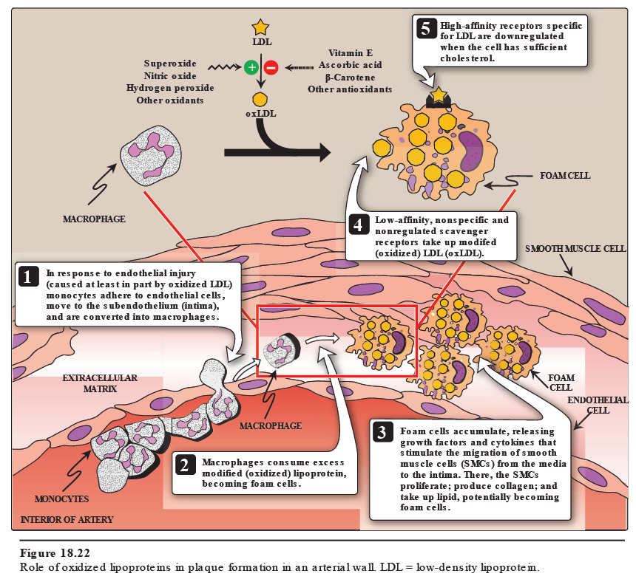

Slide 15
Lab investigations of atherosclerosis
Fasting serum lipid profile:
TAG level (reflects chylomicron and VLDL levels)
LDL, HDL levels
Total cholesterol level (reflects LDL, HDL and cholesterol levels)
Other tests:
Serum lipoprotein electrophoresis
Serum apoprotein levels (e.g., apo-B)

Slide 16
Lipoprotein (a)
Lp(a) is identical in structure to LDL particle
Contains apo(a) in addition to apo B-100
High plasma Lp(a) level is associated with increased risk of coronary heart disease
Circulating levels of Lp(a) are determined by:
Genetics (mainly)
Diet (trans FAs increase Lp(a) levels)
Estrogen (decreases Lp(a) levels)

Slide 17
Lipoprotein (a)
The apo(a) protein is structurally similar to plasminogen
Competes with plasminogen
Slows the breakdown of blood clots
Triggering heart attack
A risk factor for CAD

Slide 18
Take home message
Imbalance in the LDL and HDL metabolism causes increased accumulation of lipids in the body
LDL is bad cholesterol whereas HDL is good cholesterol
The pathogenesis of atherosclerosis includes the uptake of oxidized LDL by macrophages through scavenger receptor class A (SR-A) producing foam cells and atherosclerotic plaque
Individuals with high level of plasma Lp (a) are at higher risk for coronary heart disease

Slide 19
References
Lippincott’s Biochemistry. 6th Edition, Chapter 18, pp. 231-237. Lippincott Williams & Wilkins, New York, USA.

