Slide 1
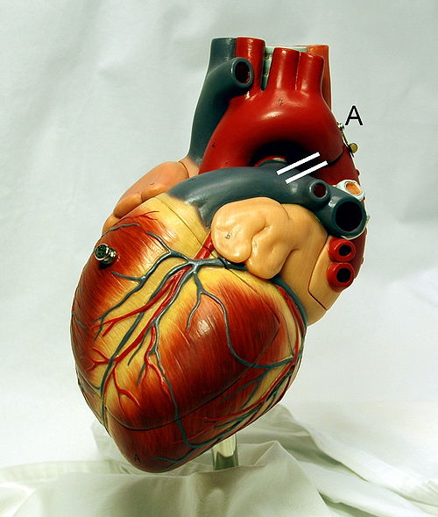
Cardiovascular System Block Cardiac Arrhythmias (Physiology)
Ahmad Hersi

Slide 2
Lecture Objectives
Describe sinus arrhythmias
Describe the main pathophysiological causes of
cardiac arrhythmias
Explain the mechanism of cardiac block
Enumerate the common arrhythmias and describe the basic ECG changes

Slide 3
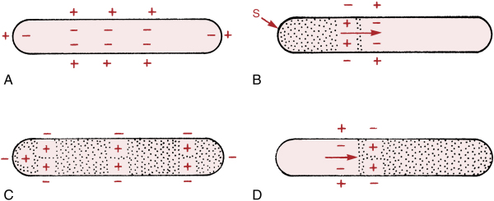
Depolarization and Repolarization

Slide 4
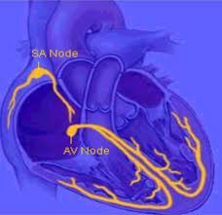
Electrical Conduction

Slide 5
The conduction system

Slide 7
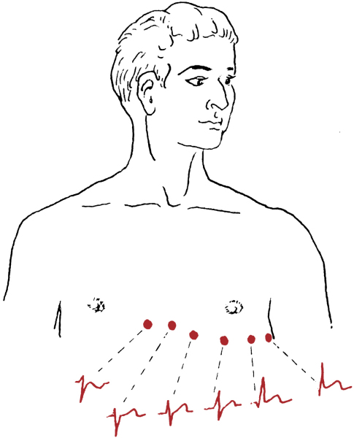
Chest leads

Slide 8
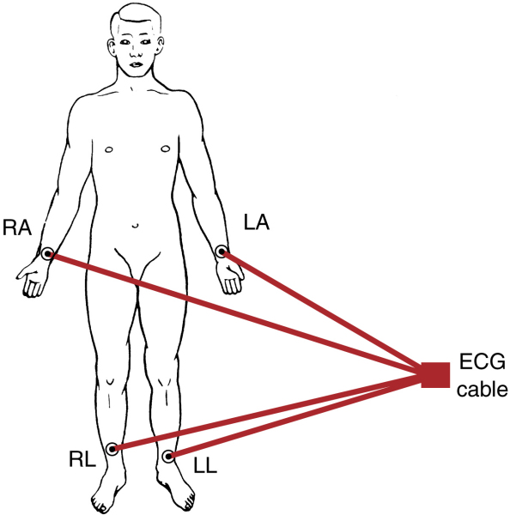
Limb leads

Slide 9
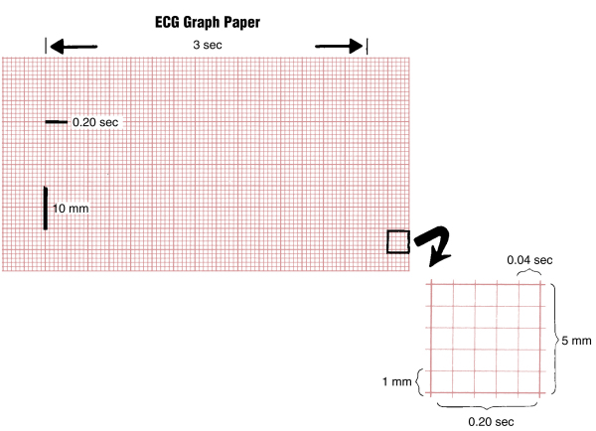

Slide 10
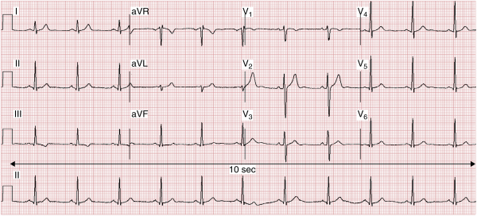
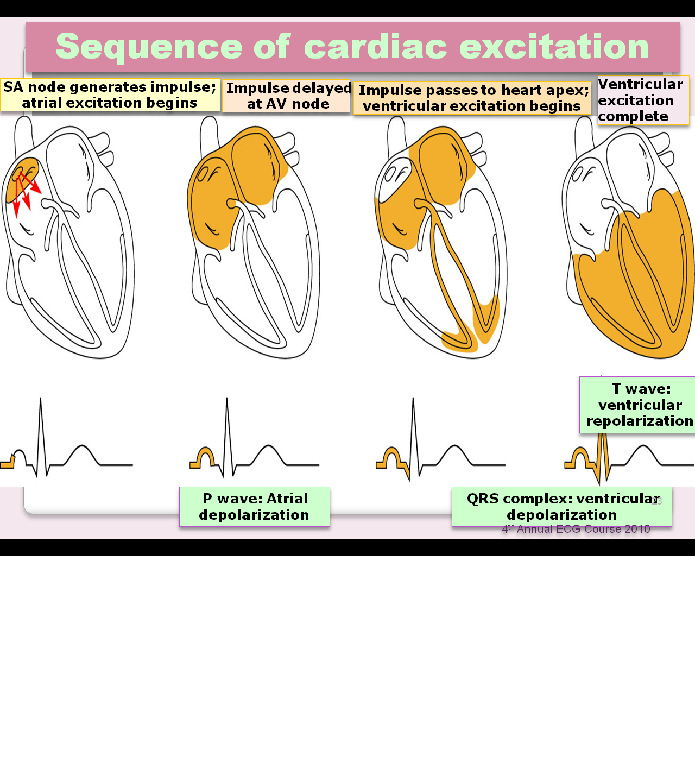
12 Leads EKG

Slide 12
Normal Sinus Rhythm
Regular
Single p-wave precedes every QRS complex
P-R interval is constant and within normal range
P-P interval is constant

Slide 13
Rate
Normal sinus rate: (60-100).
Tachycardia: >100.
Bradycardia: <60.

Slide 14
Causes/Mechanisms of Cardiac Arrhythmias
Abnormal rhythmicity of the pacemaker
Shift of the pacemaker from the sinus node to another place in the heart
Blocks at different points in the spread of impulse through the heart
Triger
Reentry

Slide 15
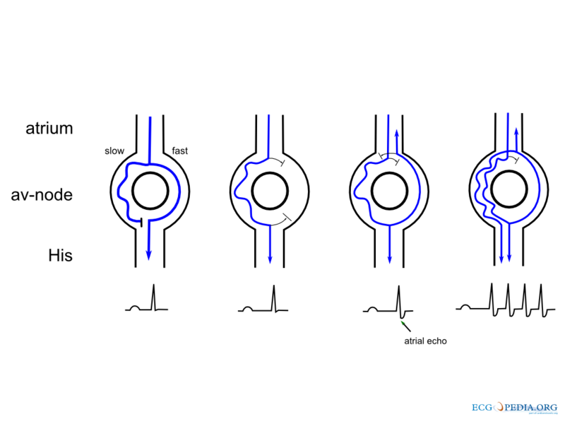
Automatic foci
SA
SVT
AV node
His bundle
VT
Bundle branches

Slide 16
Classification of Cardiac Arrhythmias
Rate above or below normal (tachy vs. Brady)
Regular or irregular rhythm
Narrow or broad QRS complex
Relation to P waves
Supraventricular Vs. ventricular

Slide 17
Abnormal Sinus Rhythm
Tachycardia: an increase in the heart rate
Heart rate > 100 beats per minute
Causes:
Increased body temperature
Sympathetic stimulation
Drugs

Slide 18
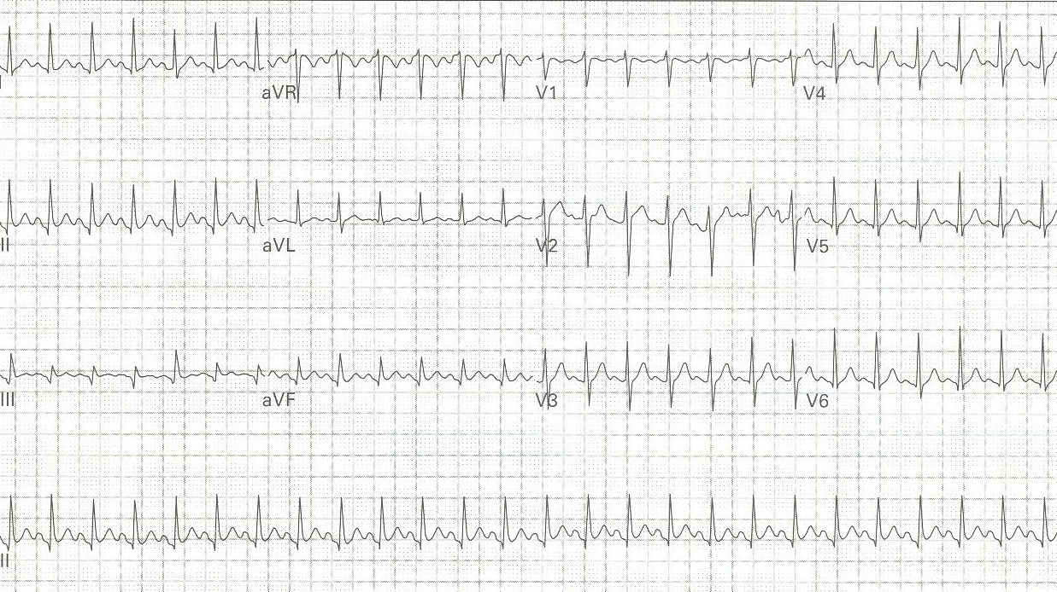
24 year-old pregnant woman with three days of frequent vomiting

Slide 19
Abnormal Sinus Rhythm
Bradycardia:
Slow heart rate < 60 beats per minute
Causes:
Parasympathetic stimulation

Slide 20
Sinus Arhythmia
Result from spillover of signals from the medullary respiratory center into the adjacent vasomotor center during inspiration and expiratory cycles of respiration
The spillover signals cause alternate increase and decrease in the number of impulses transmitted through the sympathetic and vagus nerves to the heart

Slide 21
Abnormal Cardiac Rhythms that Result from Impulse Conduction Block
Sinoatrial Block
The impulse from the S-A node is blocked before it enters the atrial muscle
Cessation of P waves

Slide 22
Abnormal Cardiac Rhythms that Result from Impulse Conduction Block
A-V Block
When impulse from the S-A node is blocked
Causes:
Ischemia of the A-V node
Compression of the A-V node by scar formation
Inflammation of the A-V node
Strong vagal stimulation

Slide 23
Types of the A-V Block
First degree block
Second degree block
Third degree block

Slide 24
Heart Block
1^{st○}
Constant PR prolongation without drop beat.
2^{nd○}
Mobitz1: Progressive PR prolongation + drop beat.
Mobits2: Constant PR prolongation + drop beat.
3^{rd ○}
Complete dissociation between P and QRS.

Slide 25
First Degree Heart Block

Slide 26
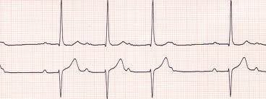
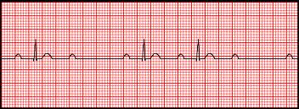
Second Degree Heart Block
Mobitz (I):
Mobitz (II):

Slide 27
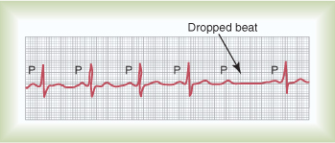
Types of the A-V block
Second Degree Block
P-R interval > 0.25 second
Only few impulses pass to the ventricles
→ atria beat faster than ventricles
→“dropped beat” of the ventricles

Slide 28
Third Degree Heart Block

Slide 29
Types of the A-V block
Third degree block (complete)
Complete dissociation of P wave and QRS waves
→The ventricle escape from the influence of S-A node
Stokes-Adams Syndrome: AV block comes and goes

Slide 30
SA
SVT
AV node
VT
His bundle
Bundle branches

Slide 31
Atrial Fibrillation
Cause: as ventricular fibrillation
It occurs more frequently in patients with enlarged heart
The atria do not pump if they are fibrillating
The efficiency of ventricular pumping is decreased 20 to 30%
A person can live for years with atrial fibrillation

Slide 32
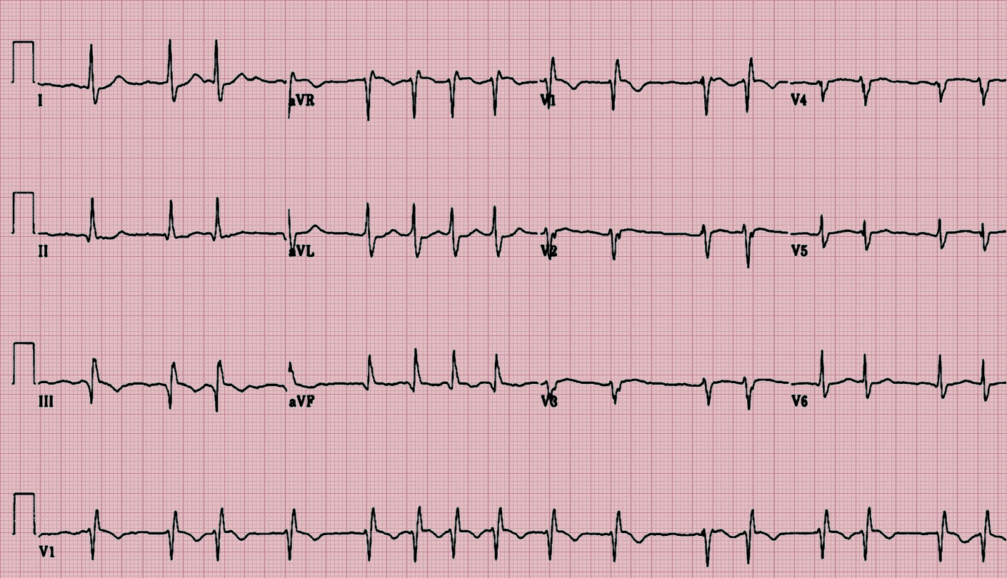

Slide 33
Atrial Flutter
A single large wave travels around and around in the atria
The atria contracts at high rate (250 time per minute)

Slide 34
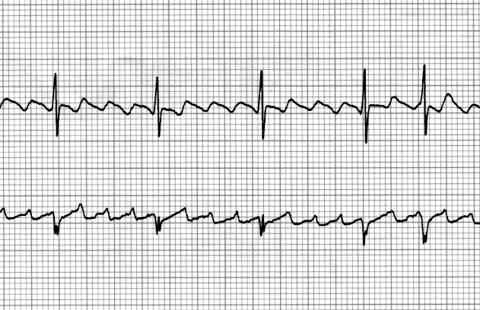

Slide 35
AVRT-Narrow complex

Slide 36
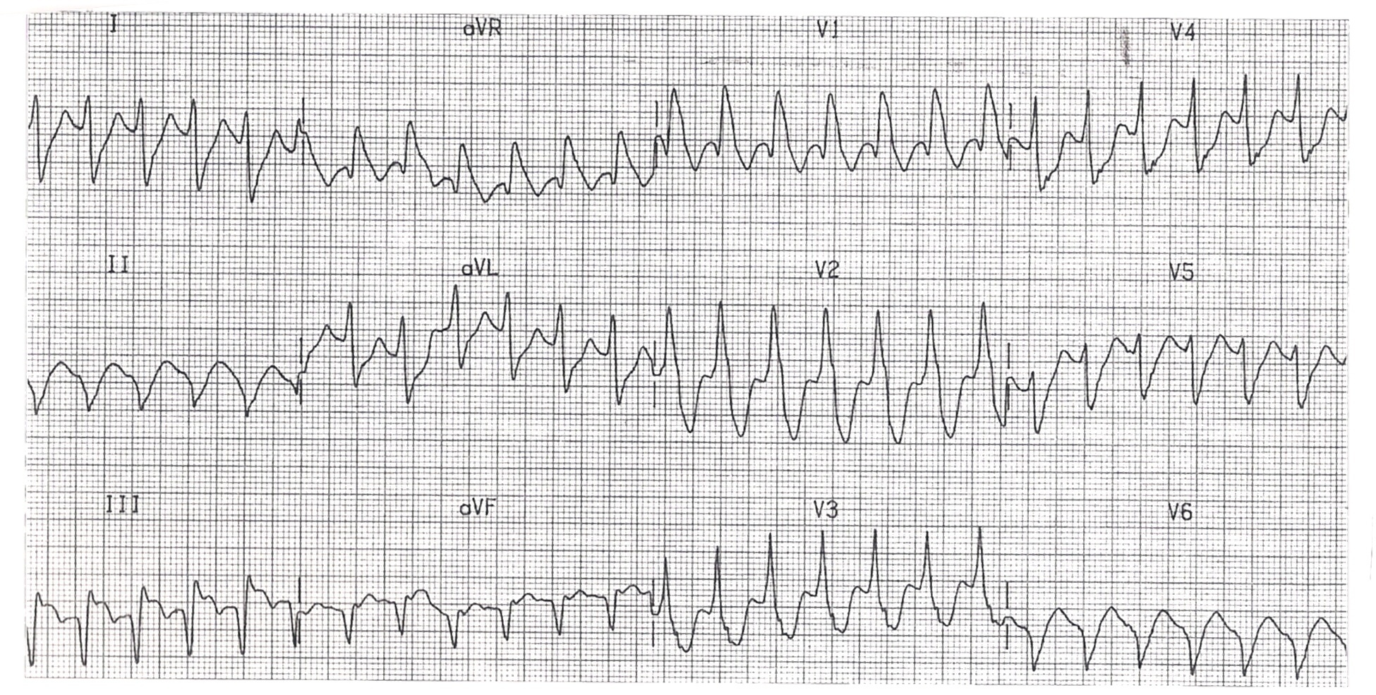
Ventricular Tachycardia

Slide 37
Ventricular Fibrillation
The most serious of all arhythmias
Cause: impulses stimulate one part of the ventricles, then another, then itself. Many part contracts at the same time while other parts relax (Circus movement)
Tachycardia
Irregular rhythm
Broad QRS complex
No P wave
Treatment : DC shock

Slide 38
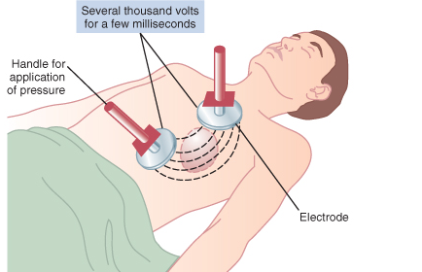
Ventricular Fibrillation
Treatment : DC shock

Slide 39
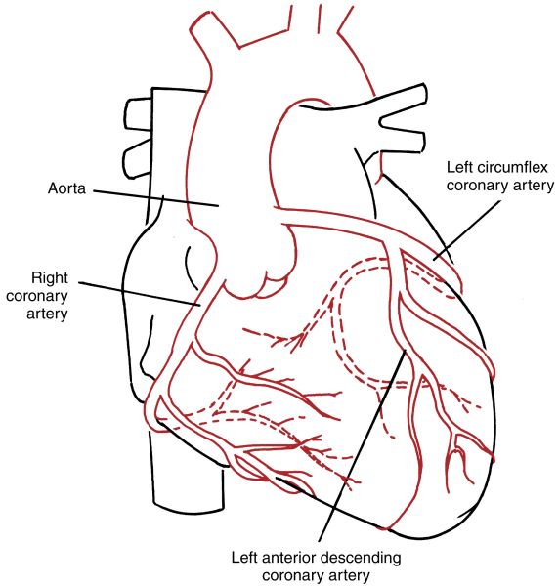

Slide 40
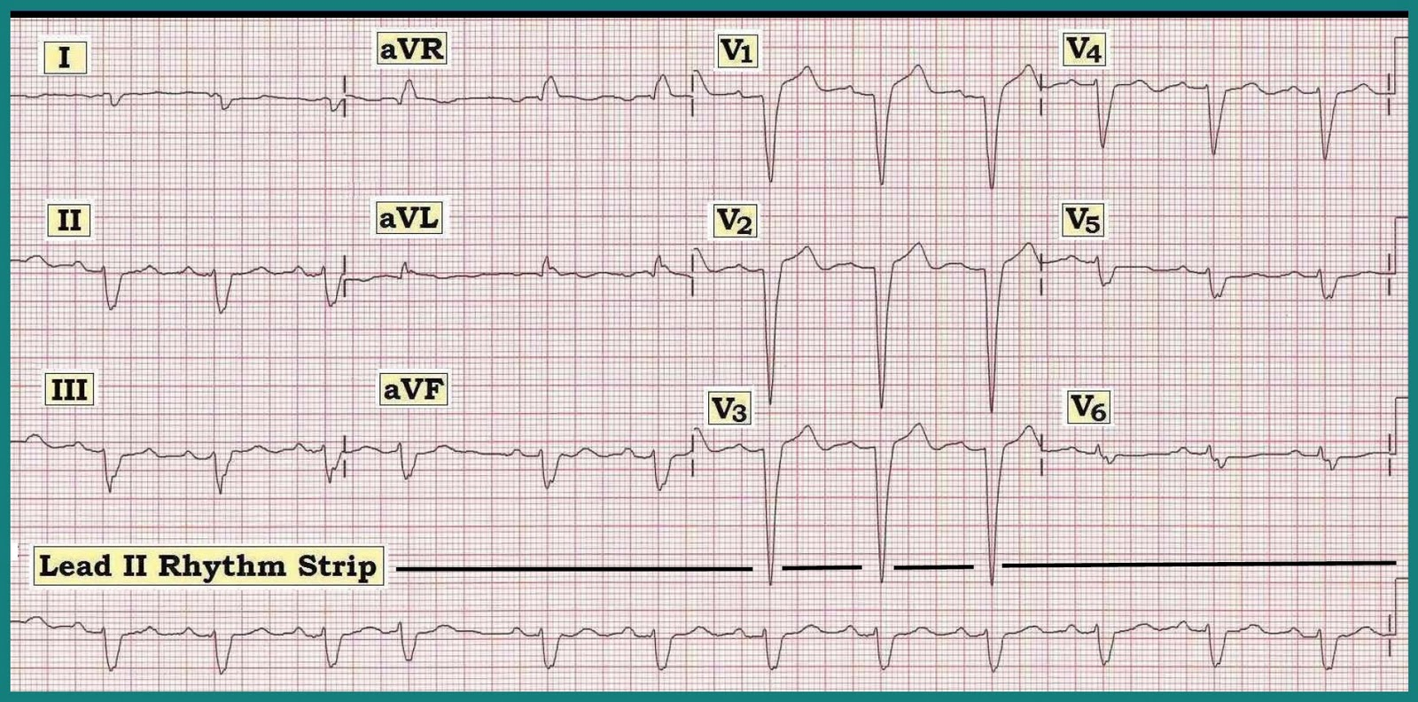
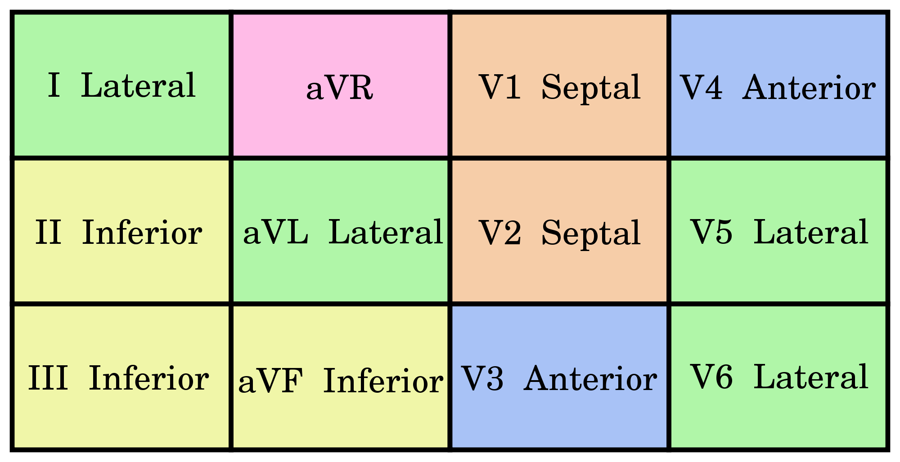

Slide 41
Ischemia and the ECG
One of the common uses of the ECG is in acute assessment of chest pain
Cause: restriction of blood flow to the myocardium, either:
Reversible: angina pectoris
Irreversible: myocardial infarction
Ischemia → injury → infarction

Slide 42
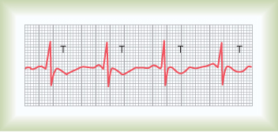
Reversible ischemia
Inverted T wave
ST segment depression

Slide 43
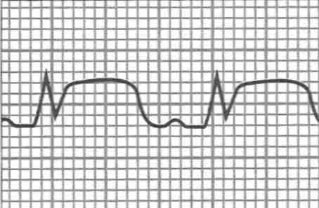
Myocardial Infarction
Complete loss of blood supply to the myocardium resulting in necrosis or death of tissue
ST segment elevation
Deep Q wave

Slide 44
Infero-Posterior MI

Slide 45
Antero-Lateral MI

Slide 46
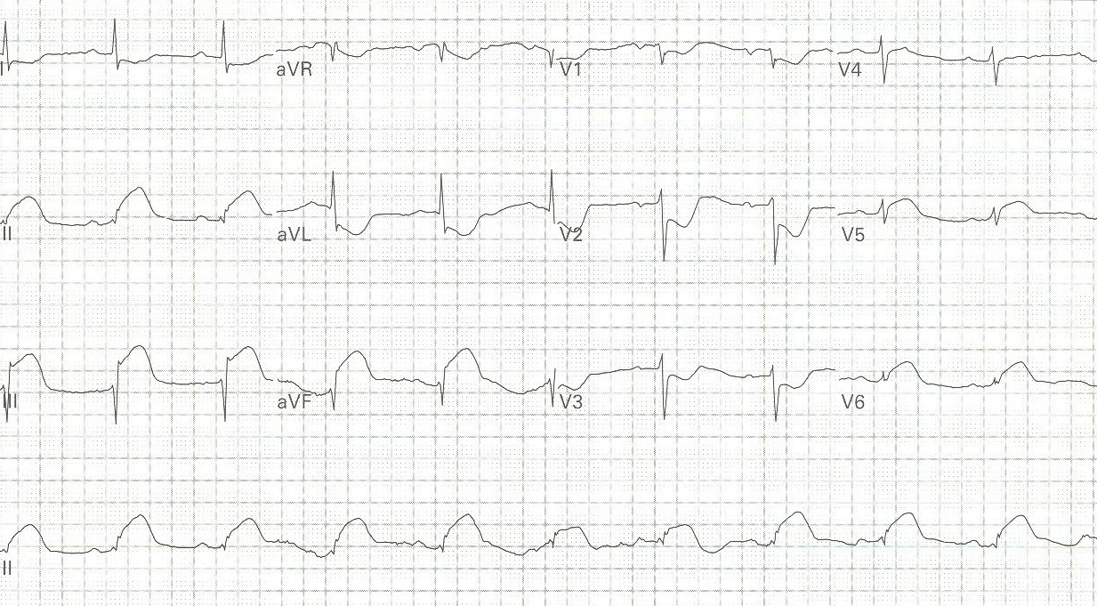
57 year-old man with chest pressure and diaphoresis

Slide 47
Potassium and the ECG
Hypokalemia:
flat T wave
Hyperkalemia:
Tall peaked T wave

Slide 48
For further readings and diagrams:
Textbook of Medical Physiology by Guyton & Hall
Chapter 10 (Cardiac Arrhythmias and their Electrocardiographic Interpretation)

