Slide 1
MECHANISMS FOR CONCENTRATING & DILUTING URINE
Regulation of ECF osmolarity

Slide 2
Objectives
At the end of this session, students should be able to;
Identify and describe that the loop of Henle is referred to as countercurrent multiplier and the vasa recta as countercurrent exchanger systems in concentrating and diluting urine.
Explain what happens to osmolarity of tubular fluid in the various segments of the loop of Henle when concentrated urine is being produced.
Explain the factors that determine the ability of loop of Henle to make a concentrated medullary gradient.
Differentiate between water diuresis and osmotic diuresis.
Appreciate clinical correlates of diabetes mellitus and diabetes insipidus.

Slide 3
ECF Osmolarity
Maintaining a constant concentration of solutes & electrolytes in the ECF is important for normal cellular function.
The concentration of solutes in the ECF = osmolarity.
Normal ECF osmolarity ≈ 300 mOsm/L
What determines the osmolarity of ECF?
Amount of solute
Volume of ECF
Osmolarity =
Water

Slide 4
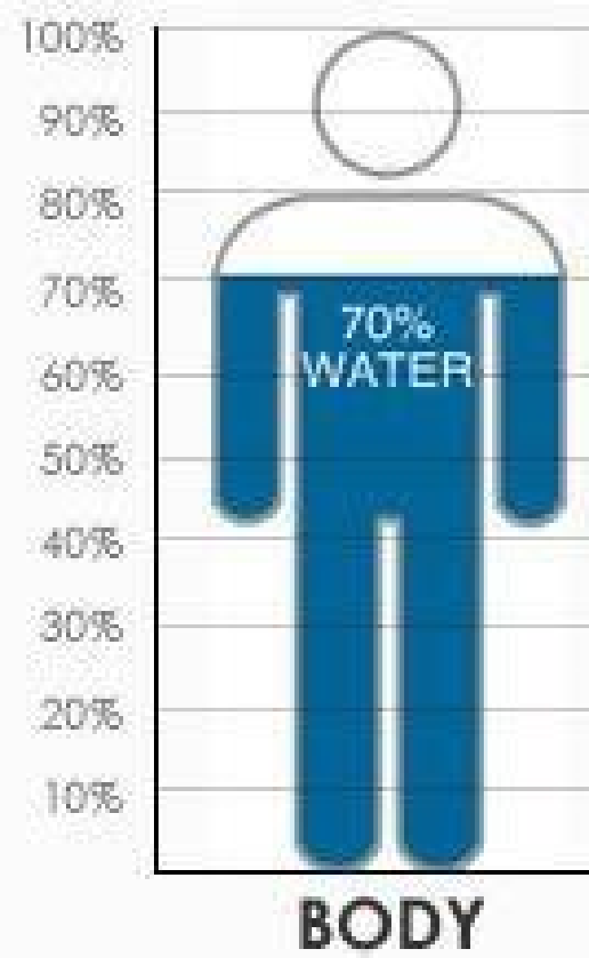
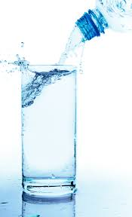
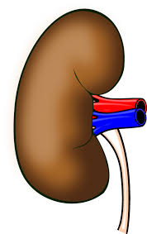
Water Balance
Simplified version!
Input
Output
Urine

Slide 5
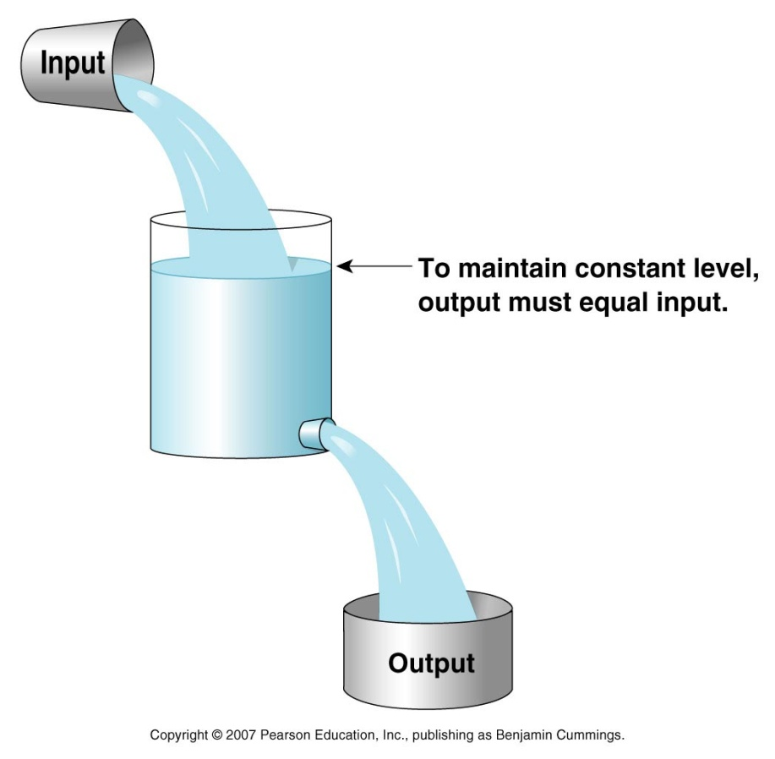
Water Balance
Input = output
Daily loss:
Insensible loss (700 ml).
Sweat (100 ml).
Feces (100 ml).
Urine (1400 ml).
Water intake:
Fluids ingested (2100 ml).
From metabolism (200ml)
Total intake = 2300 ml
Total loss = 2300 ml

Slide 6
Regulation of H2O by the Kidney
Body water excess
Body water deficit
Large volume of diluted urine
Small volume of concentrated urine
50 mOsm/L
Urine osmolarity
1200 mOsm/L

Slide 7
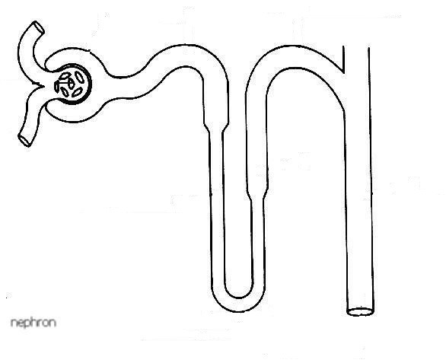
H2O Handling by the Kidney
ADH-dependent
65%
Hypo-osmotic
300
100
300
Isosmotic
ADH
Cortex
ADH
600
1200
20%
Medulla is hypertonic
1200
Medulla
hyperosmotic
What happens to the osmolarity of tubular filtrate?

Slide 8
Obligatory urine volume
The minimal volume of urine that must be excreted to rid the body of waste products of metabolism.
A 70-Kg human needs to excrete 600 mOsm of solutes per day.
What is the obligatory urine volume?
600 mOsm/d
1200 mOsm/L
= 0.5 L/day

Slide 9
Forming a Concentrated Urine
Requires:
High levels of ADH.
Hyperosmotic renal medulla.
Countercurrent mechanism.
Urea recirculation.
IF around the body has an osmolarity of ≈ 300 mOsm/L.. How did the renal medullary interstitium become hyperosmotic?

Slide 10
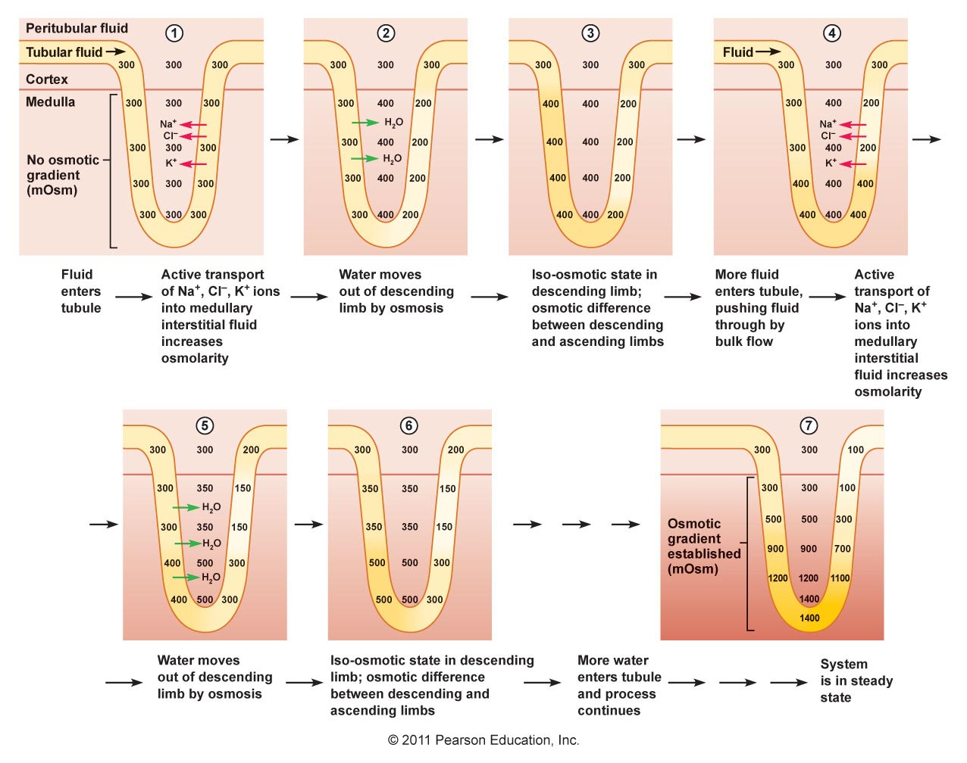
Countercurrent Multiplier Mechanism

Slide 11
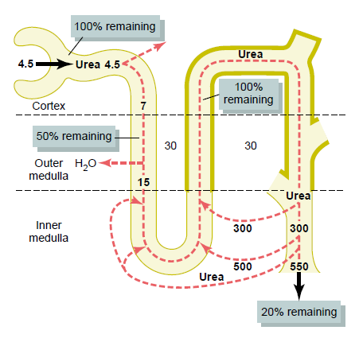
Recirculation of Urea

Slide 12
The Vasa Recta
Why doesn’t the blood flowing through the vasa recta into the renal medulla wash out the medullary hyperosmotic gradient?
Medullary blood flow is low (<5%) of renal blood flow.
The vasa recta serve as countercurrent exchangers.

Slide 13
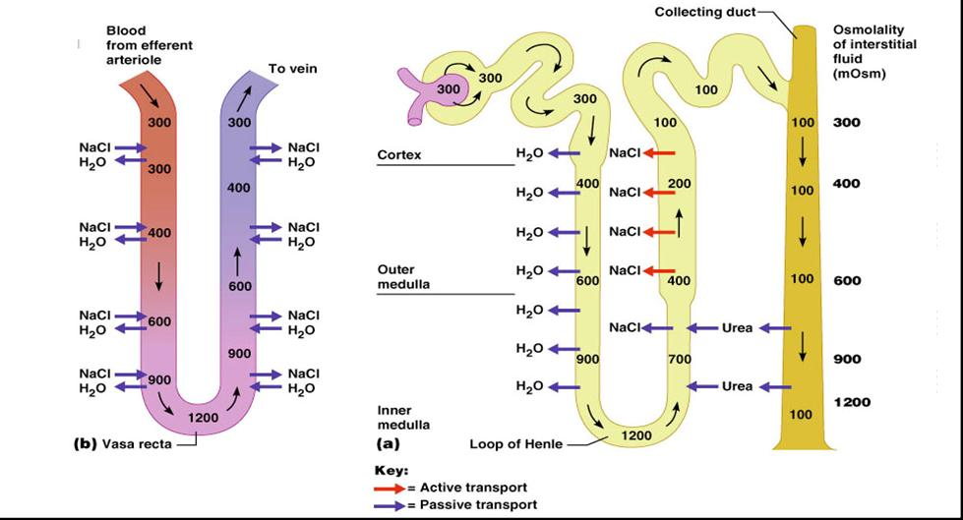
The Vasa Recta Countercurrent exchanger

Slide 14
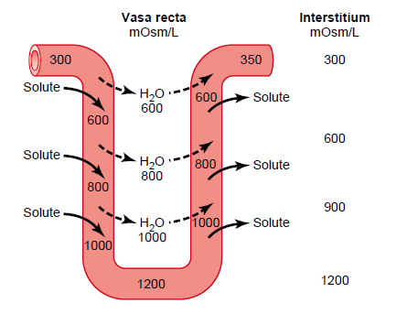
The Vasa Recta Countercurrent Exchanger

Slide 15
REGULATION OF ECF OSMOLARITY

Slide 16
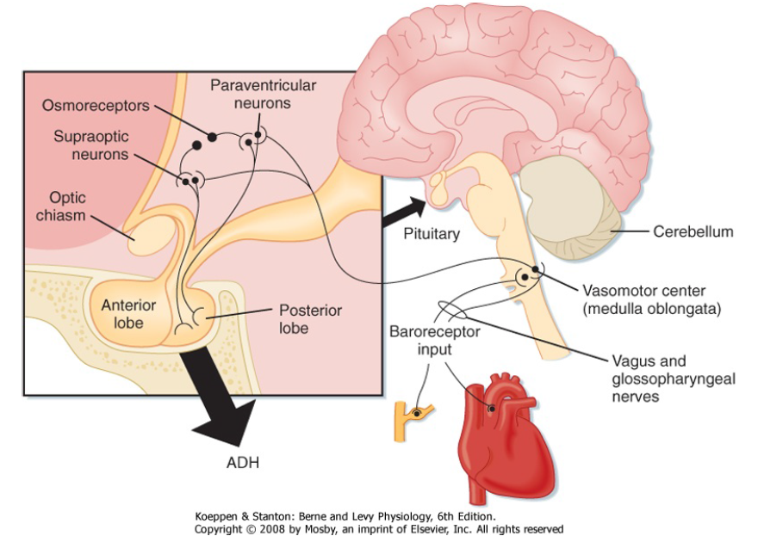
Antidiuretic Hormone (ADH)

Slide 17
Stimulants for ADH Secretion
Osmotic (most important)
Osmolarity of ECF.
1% change in osmolarity can alter ADH secretion significantly.
Hemodynamic
Volume & pressure in the vascular system.
5-10% decrease in BP or BV is required before ADH secretion is stimulated.

Slide 18
Factors That Can Alter ADH Secretion
Increase ADH | Decrease ADH
Nausea | ANP
Hypoxia
Angiotensin-II
Drugs; Morphine Nicotine | Drugs; Alcohol

Slide 19
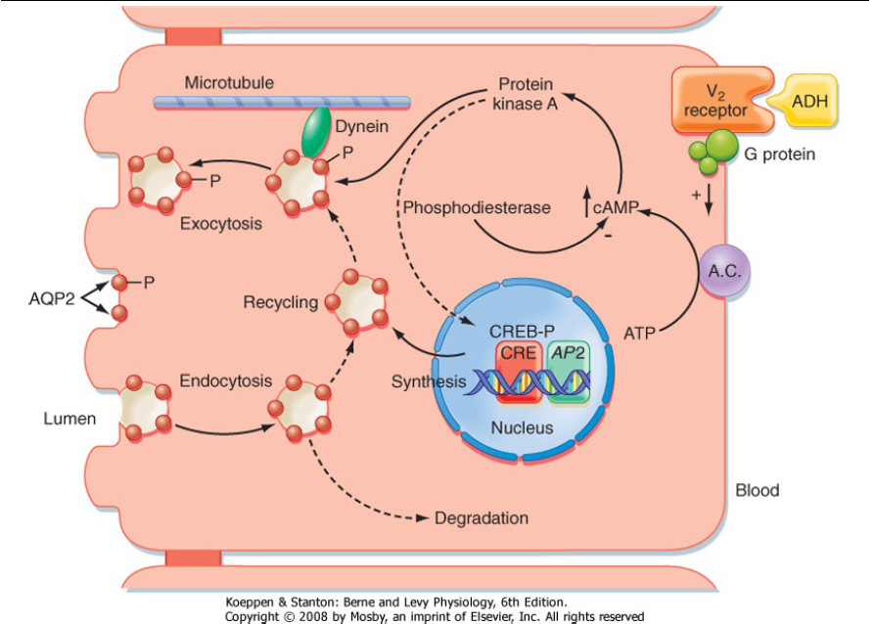
ADH Mechanism of Action

Slide 20
Water Balance
↑↑ Firing and send signals to posterior pituitary
Release ADH from Post. Pituitary
Shrinking of osmoreceptor cells in the hypothalamus
↑↑ H2O reabsorption by kidney
↑↑ Osmolality
(Dehydration)
Water
retention
Diluted urine
Osmolality=290 mosm/L
↓↓ Osmolality
(over-drinking)
↓↓ H2O reabsorption by kidney
Osmoreceptor cells in the hypothalamus
↓↓ ADH secretion by posterior pituitary

Slide 21
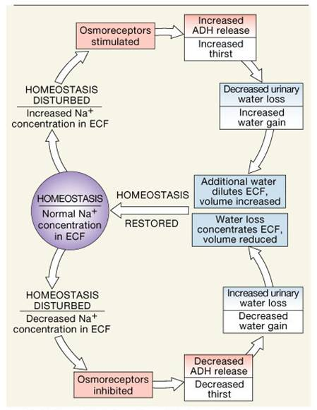
Feedback Mechanisms Involved in Regulation of Water Balance

Slide 22
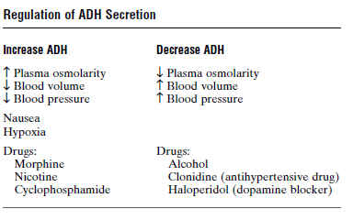
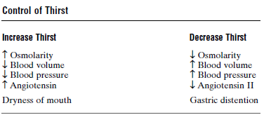
Control of ADH Secretion & Thirst

Slide 23
Abnormalities in ADH Secretion
Abnormalities in ADH secretion
No ADH effect
“Diabetes insipidus”
Excessive ADH
“SIADH”
High ADH levels.
Water retention.
ECF hypo-osmotic
Urine hyperosmotic
Central
Nephrogenic
Mutations in V2 receptors or AQP2.
Cannot respond to ADH.
Polyuria
Polydipsia
↓↓ ADH from posterior pituitary.
Polyuria
Polydipsia

Slide 24
Water Diuresis vs Osmotic Diuresis
Water diuresis | Osmotic diuresis
Increased urine flow rate (No change in urine excretion of solutes | Increase urine flow rate as well as the excretion of solutes
Causes: Excess ingestion of water Lack of ADH Defect in ADH receptors in Distal segment of nephron (nephrogenic Diabetes Insipidus) | Causes: Increase plasma glucose level (DM) Increase level of poorly reabsorbed solutes/ anions Diuretic drugs (Lasix)
Diuresis is mainly due to decrease in water reabsorption in distal segment of nephron. No change to the water reabsorbed proximally | Diuresis is mainly due to decrease reabsorption of solute in PCT or LOH. Decrease solute reabsorption results in decrease in water reabsorption proximally as well as distally

Slide 25
Water Diuresis vs Osmotic Diuresis
Water diuresis | Osmotic diuresis
Increase urine volume results from increased excretion of pure water | Increase urine volume results from increased excretion of osmotically active solutes which pulls water with it.
Urine osmolality falls far below plasma osmolality. | Urine osmolality falls but remains above plasma osmolality.
Only about 15% filtered load of water reaching distal segments may remain unabsorbed and excreted in urine (maximum urine volume 20 ml/min) | Due to decreased water reabsorption in all segments of nephron, a much greater fraction of filtered water may be excreted volume more than 20 ml/min
ADH administration will stop diuresis if it is due to lack of ADH. ADH administration will not be effective in Nephrogenic Diabetes Insipidus. | ADH administration will not stop diuresis.

Slide 26
THANK YOU

