Slide 1
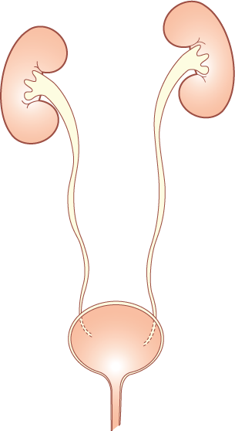
URETERS
URINARY BLADDER
URETHRA
Prof. Ahmed Fathalla Ibrahim

Slide 2
OBJECTIVES
At the end of the lecture, students should be able to:
Describe the course of ureter & identify the site of ureteric constriction
Describe the important relations & identify certain areas (trigone, uvula vesicae) in the base of urinary bladder.
List the blood supply, lymphatic drainage & nerve supply of urinary bladder
Differentiate between male & female urethra regarding length, structure, course & function.

Slide 3
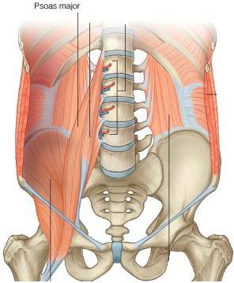
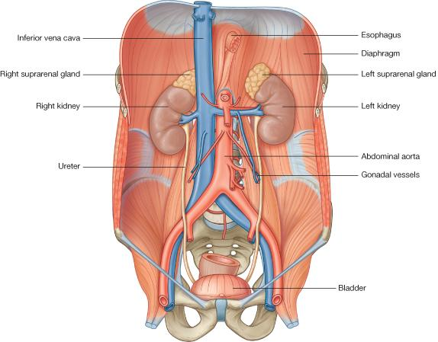
THE URETER-1
DEFINITION: It is a muscular tube transporting urine from kidney to urinary bladder.
LENGTH: 25 – 30 cm
BEGINNING: It begins as a continuation of renal pelvis.

Slide 4
THE URETER-2
COURSE IN ABDOMEN:
It descends anterior to psoas major muscle (opposite the tips of lumbar transverse processes).
It crosses the end (bifurcation) of common iliac artery to enter the pelvis.

Slide 5
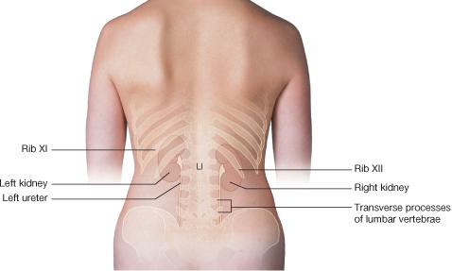
THE URETER-3
COURSE IN PELVIS & TERMINATION:
It runs downward & backward to the level of ischial spine. It curves forward to open in upper lateral angles of the base of urinary bladder.
It runs obliquely for ¾ inch in wall of bladder before opening (valve-like part).

Slide 6
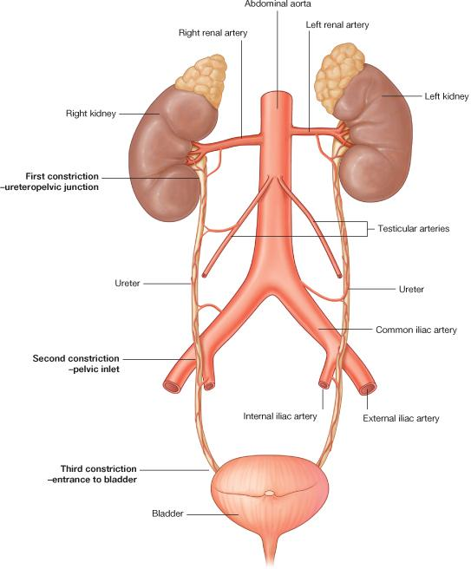
THE URETER-4
SITE OF CONSTRICTION (OBSTRUCTION-STONE IMPACTION)
At ureteropelvic junction
At pelvic inlet (site of crossing of common iliac artery)
At site of entrance to bladder
ARTERIAL SUPPLY:
Renal artery
Gonadal artery
Common iliac artery
Internal iliac artery

Slide 7
THE URINARY BLADDER
Upper surface
Infero-lateral surface
Infero-lateral surface
Apex
Anterior Aspect
Neck
Base
Posterior Aspect

Slide 8
THE URINARY BLADDER-1
(SHAPE)
It has the shape of three-sided pyramid placed on one of its angle (NECK).
It has:
An APEX: directed anteriorly
A BASE: directed posteriorly
A SUPERIOR SURFACE
Two INFERO-LATERAL SURFACE

Slide 9
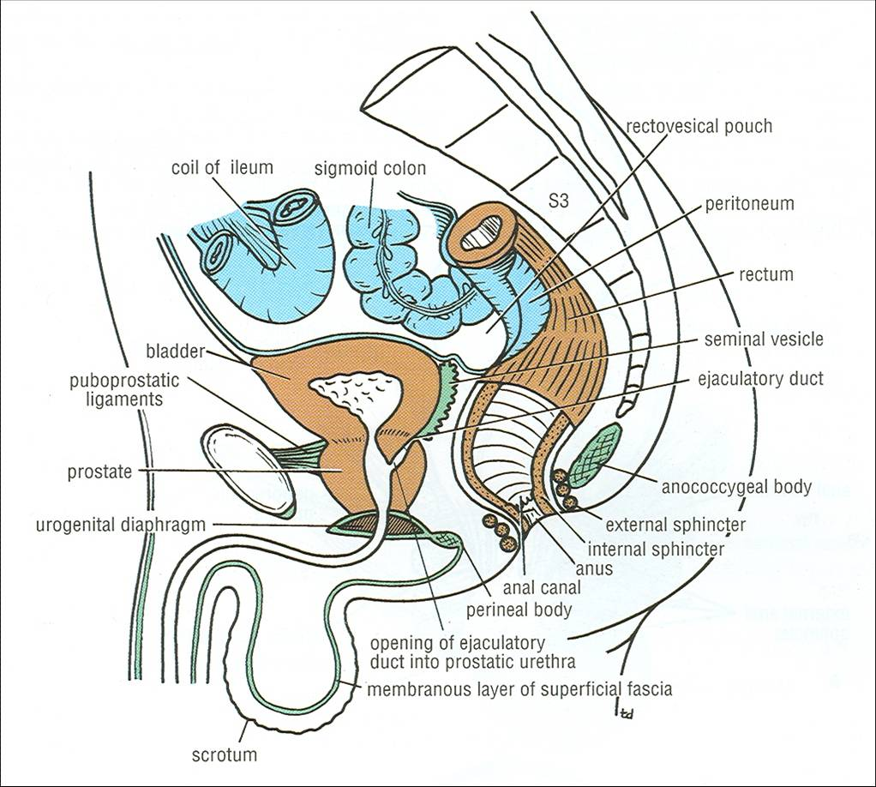
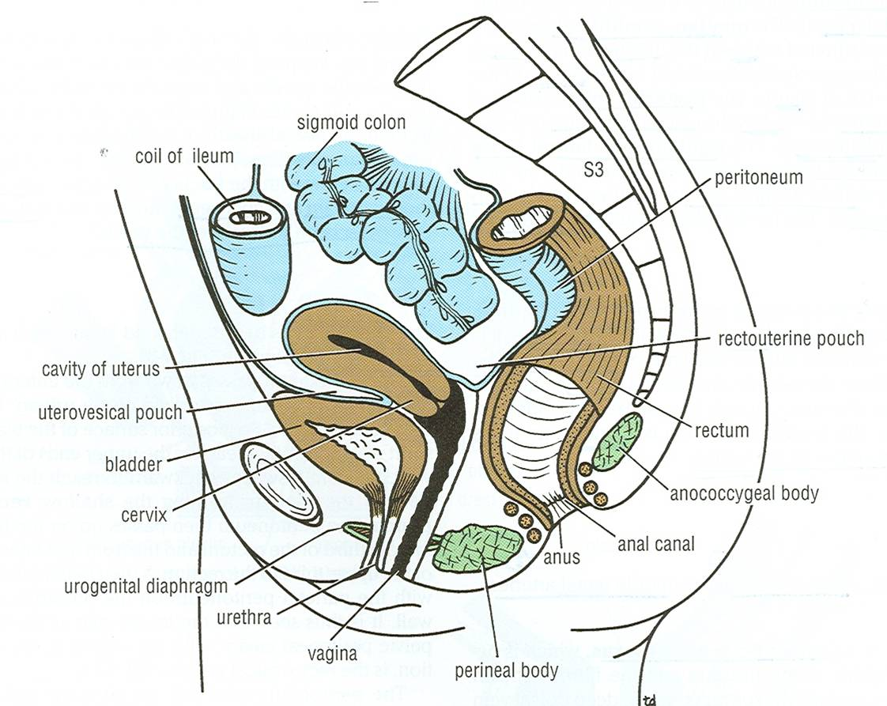
THE URINARY BLADDER-2
(APEX)
Median umbilical ligament
Is directed forward
Is related to upper border of symphysis pubis
Is connected to umbilicus by the median umbilical ligament (remnant of urachus)
Male
Median umbilical ligament
Female

Slide 10
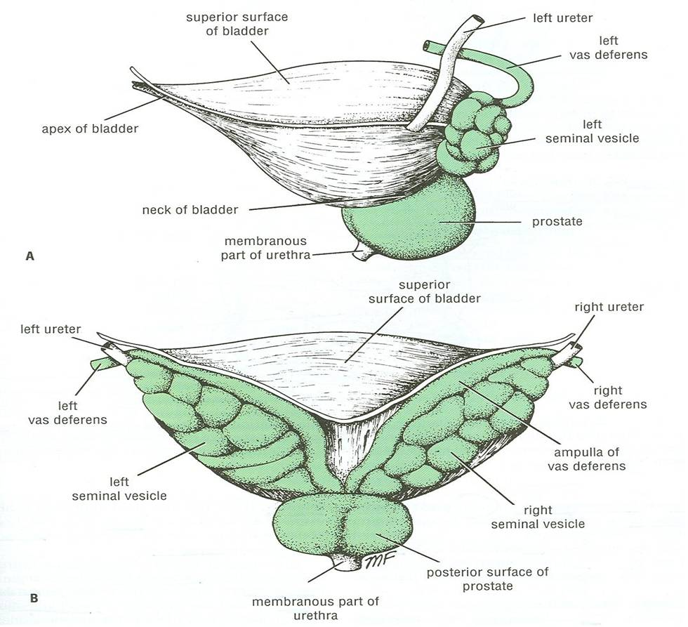
THE URINARY BLADDER-3
(BASE)
Is directed backward
IN MALE:
Is related to vas deferens & seminal vesicle of both sides
IN FEMALE:
Is related to vagina
Male
Female

Slide 11
THE URINARY BLADDER-4
(SUPERIOR SURFACE)
IN MALE:
Is related to coils of ileum & sigmoid colon
IN FEMALE:
Is related to the uterus
Male
Female

Slide 12
THE URINARY BLADDER-5
(INFERO-LATERAL SURFACES)
Are related to retropubic fat separating them from pubic bones
Retropubic fat
Accomodates distention of bladder
Continuous with anterior abdominal wall. Rupture of bladder escape of urine to anterior abdominal wall
Male
Female

Slide 13
THE URINARY BLADDER-6
(NECK)
Is the lowest & most fixed part of urinary bladder
Is continuous with urethra
Is related to lower border of symphysis pubis
IN MALE:
Is related to upper surface of prostate gland
Male
Female

Slide 14
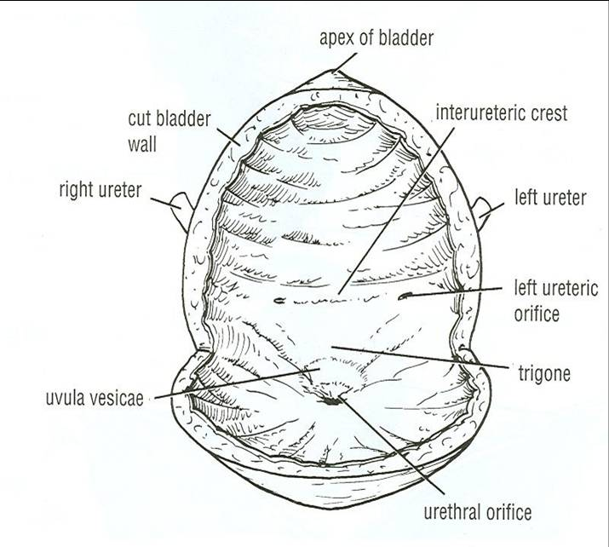
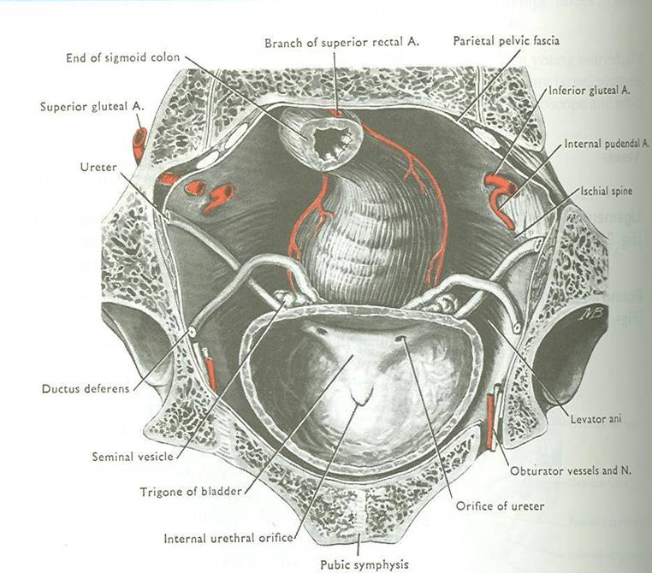
THE URINARY BLADDER-7
(INTERIOR)
Mucous membrane is folded.
Uvula vesicae: elevation behind internal urethral orifice, produced by median lobe of prostate gland
Trigone: a triangular area in base of bladder bounded by the 2 ureteric orifices & internal urethral orifice. Its mucous membrane is elastic (not folded)

Slide 15
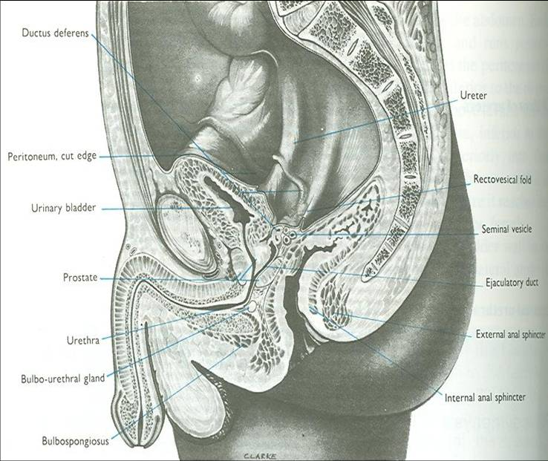
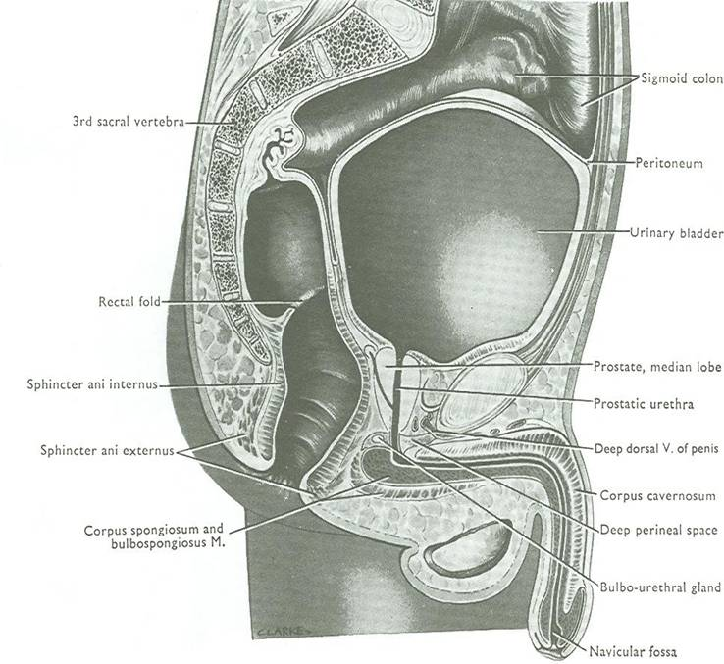
THE URINARY BLADDER-8
(CAPACITY)
EMPTY
Accomodates from 300 – 500 ml of urine
DISTENDED
Is circular in shape
Bulges into abdominal cavity

Slide 16
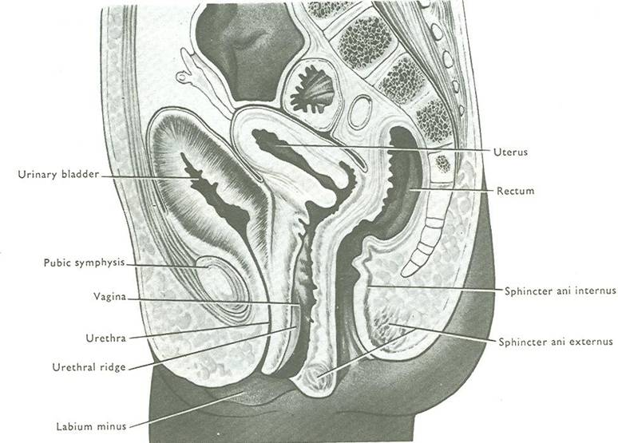
THE URINARY BLADDER-9
(POSITION)
Is found in abdomen until age of 6 years
Begins to enter the enlarging pelvis from age of 6 years onward
Is found entirely in pelvis at puberty
A median sagittal section of
a newborn female child

Slide 17
THE URINARY BLADDER-10
(SUPPLY)
ARTERIES: from internal iliac artery
VEINS: into internal iliac vein
LYMPH: into internal iliac lymph nodes
NERVES:
Parasympathetic: pelvic splanchnic nerves from S2, 3, 4
Sympathetic: from L1,2
Sensory: transmitting pain due to overdistention of bladder

Slide 18
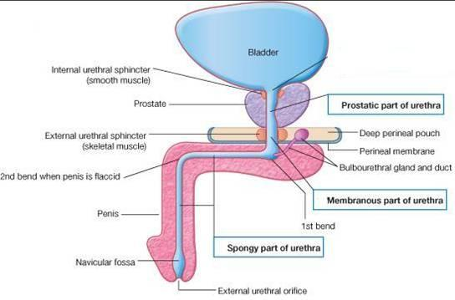
MALE URETHRA
(LENGTH: 20 CM)
PROSTATIC URETHRA (Length=3 cm):
Widest & most dilatable
Extends from neck of bladder inside prostate gland
MEMBRANOUS URETHRA (Length=1 cm):
Surrounded by external urethral sphincter
PENILE (SPONGY) URETHRA (Length=16 cm):
Extends inside penis & opens externally through external urethral orifice (narrowest part of whole urethra)
Ejaculatory duct
Structures openings into prostatic urethra:
Ejaculatory ducts: containing sperms
& secretion of seminal vesicles
Ducts of prostate gland

Slide 19
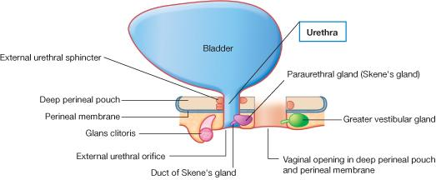
FEMALE URETHRA
(LENGTH: 4 CM)
Has only urinary function
Extends from neck of urinary bladder to open externally through the external urethral orifice (anterior to the vaginal opening)

Slide 20
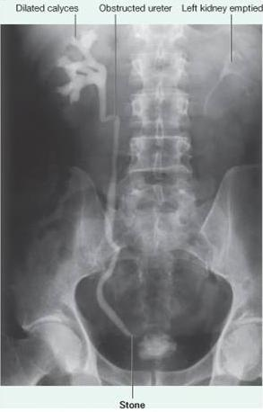
INTRAVENOUS UROGRAM
A urogram (Post micturation): demonstrates a bladder stone.

Slide 21
SUMMARY-1
URETER:
Beginning: as continuation of renal pelvis
Course: descends anterior to: psoas major & end (bifurcation) of common iliac artery.
Termination: opens at upper lateral angle of base of urinary bladder
Sites of constriction: at uteropelvic junction, at pelvic inlet, at site of entrance of bladder
Arterial supply: renal, gonadal, common & internal iliac arteries

Slide 22
SUMMARY-2
URINARY BLADDER:
Apex: related to symphysis pubis, continuous with median umbilical ligament
Base: related to vas deferens & seminal vesicle (in male) & to vagina (in female)
Superior surface: related to coils of ileum & sigmoid colon (in male) & to uterus (in female)
Inferolateral surfaces: related to retropubic fat
Neck: continuous with urethra, related to upper surface of prostate gland (in male)
Trigone: lies in the base of bladder, bounded by ureteric orifices & internal urethral orifice, its mucous membrane is elastic
Uvula vesicae: dilatation behind internal urethral orifice, produced by the median lobe of the prostate gland
Supply: internal iliac (artery, vein, lymph nodes)
Nerves: parasympathetic (S2,3,4), sympathetic (L1,2)

Slide 23
SUMMARY-3
MALE URETHRA:
Function: both urinary & genital
Length: 20 cm, divided into prostatic (3 cm), membranous (1 cm) & penile ( 16 cm)
Course: Extends from neck of bladder to opens externally through external urethral orifice (narrowest part of whole urethra)
FEMALE URETHRA:
Function: urinary only
Length: 4 cm
Course: Extends from neck of bladder to external urethral orifice (anterior to vaginal opening)

Slide 24
QUESTION 1
Which one of the following structures is related to the inferolateral surface?
Prostate gland
Sigmoid colon
Retropubic fat
Seminal vesicle

Slide 25
QUESTION 2
Which one of the following is the site of uvula vesicae?
In the superior surface of urinary bladder.
Behind the internal urethral orifice.
Between the 2 ureteric orifices.
In relation to the apex of urinary bladder.

Slide 26
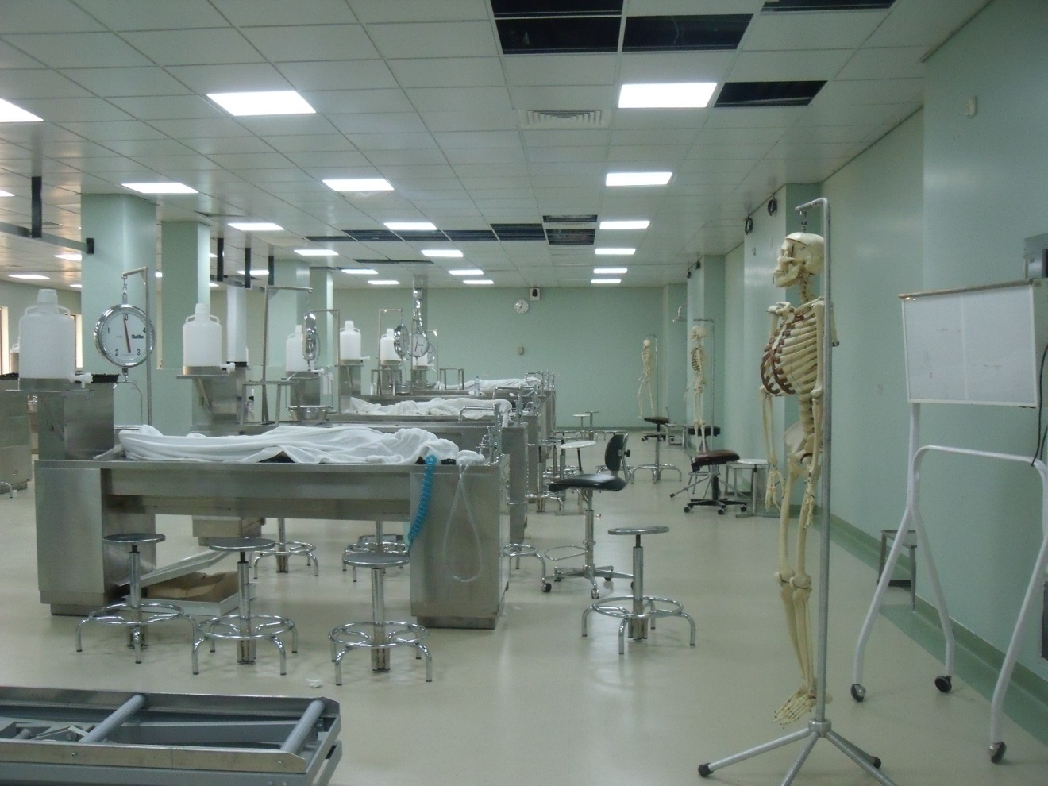
THANK YOU
&
BEST WISHES

