Slide 1
Quiz-1?
A 56-year-old woman recently diagnosed with congestive
heart failure started a therapy that included furosemide. Acetazolamide was added to counteract the potential metabolic alkalosis induced by furosemide. Which of the following molecular actions most likely mediated the therapeutic effect of acetazolamide in this patient?
A. Inhibition of carbonic acid dehydration in the tubular
lumen
B. Stimulation of bicarbonate reabsorption in the proximal
tubule
C. Inhibition of Na+ reabsorption in the early distal tubule
D. Stimulation of H+ reabsorption in the proximal tubule
E. Stimulation of carbonic acid formation inside the tubular
Cells

Slide 2
Quiz-2?
A 57-year-old Black woman, recently diagnosed with closed-angle glaucoma, was scheduled for iridectomy. Which of the
following agents was most likely given intravenously before and after surgery to reduce intraocular pressure?
A. Furosemide
B. Triamterene
C. Mannitol
D. Hydrochlorothiazide
E. Homatropine

Slide 3
Quiz-3?
Of the following agents, which one is best avoided in congestive heart failure? A) acetazolamide B) hydrochlorothiazide C) mannitol
D) furosemide

Slide 4
Quiz-4?
Which of the following agents decrease excretion of chloride ions? A) furosemide B) hydrochlorothiazide C) mannitol
D) acetazolamide

Slide 5
Quiz-5?
A patient with a compromised renal hemodynamic was given a trial of mannitol. Which of the following is least likely to be associated with the effect of mannitol? A) retention of water in tubular fluid B) ability to be metabolized into an
active metabolite C) capacity to be freely filtered
D) ability to resist complete
reabsorption by kidney tubules

Slide 6
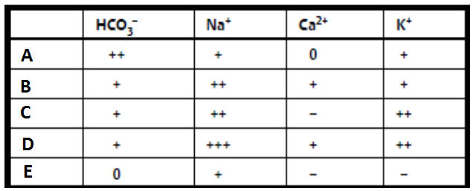
Quiz-6?
A 27-year-old woman with a history of high altitude sickness was placed on prophylactic treatment with a diuretic drug prior to going on a hiking trip in Abha Mountains. Which
of the following urine electrolyte profiles is most consistent with this drug treatment?

Slide 7
Quiz-7?
A patient presents to the emergency department with an extreme headache.
After a thorough workup, the attending physician concludes that the pain is due to increased intracranial pressure. Which diuretic would work best to reduce this pressure?
A. Acetazolamide.
B. Indapamide.
C. Furosemide.
D. Hydrochlorothiazide.
E. Mannitol.

Slide 8
Quiz-8?
Which of the following statements is wrong about mannitol?
It inhibits water reabsorption in the proximal tubule
It is not used to treat cardiac, renal or hepatic edema
It is contraindicated in acute left ventricular failure
It is contraindicated in patients with increased intracranial pressure

Slide 9
Quiz-9?
A 69-year-old man with a 10-year history of glaucoma was admitted to the emergency department after he took several tablets of one of his medications in a suicidal attempt. The patient was drowsy & complained of nausea, paresthesias & tiredness. Lab test indicated hyperchloremic metabolic acidosis. Which of the following medications might have caused the patient’s symptoms?
Mannitol
Timolol
Acetazolamide
Pilocarpine

Slide 10
Quiz-10?
Which of the following is a current therapeutic indication of acetazolamide?
A. Congestive heart failure
B. Renal insufficiency
C. Cirrhosis of liver
D. Glaucoma

