Slide 1
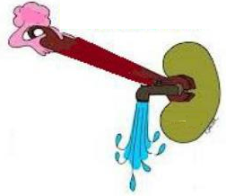
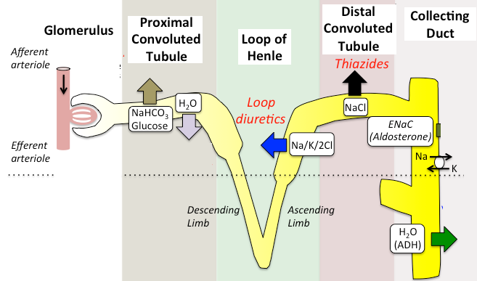
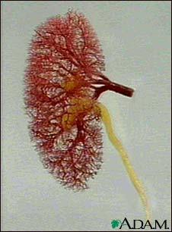
Diuretics-ii
Thiazides & loop diuretics

Slide 2
Thiazide diuretics
Na-Cl SYMPORT INHIBITORS
Thiazide Diuretics
Thiazide-Like Diuretics
Hydrochlorothiazide
Potency 1 , t½ 3h
Metolazone
Potency 5, t½ 5h
Chlorthalidone
Potency 10, t½ 26h
Chlorothiazide
Potency 0.1, t½ 2h
Indapamide
Potency 20, t½ 16h

Slide 3
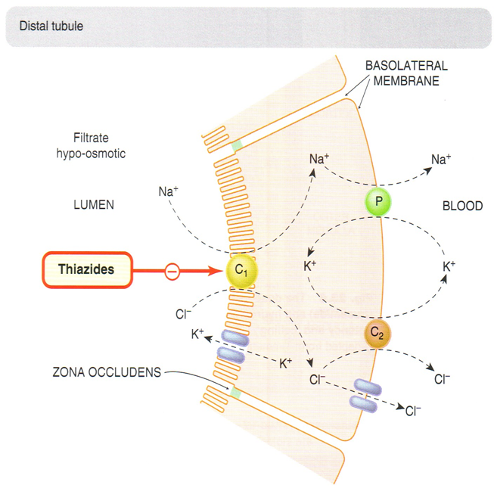
thiazides
Act on early distal tubule[5-10%of filtered load of sodium is reabsorbed]
Thiazides inhibit Na/Cl cotransporter
Weak inhibitors of carbonic anhydrase , but this does not contribute to their action

Slide 4
thiazides
pharmacokinetics
Thiazides are lipid soluble
Given orally, efficiently absorbed from the GIT
Long duration of action
Eliminated by glomerular filtration & tubular secretion , some is reabsorbed
May interfere with uric acid secretion and cause hyperuricemia

Slide 5
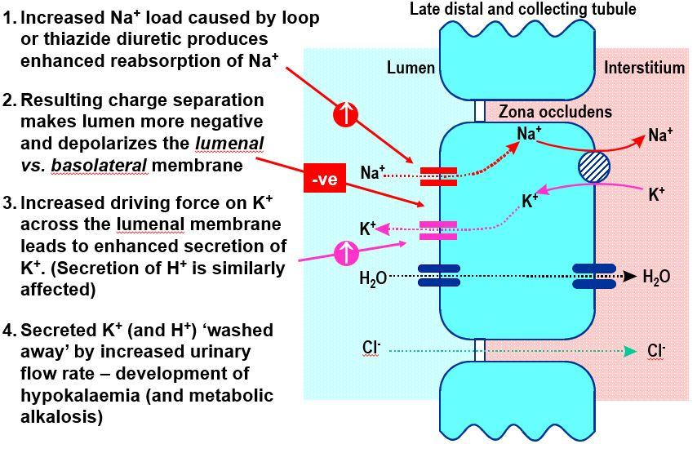
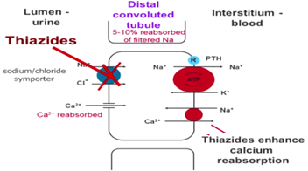
Thiazide diuretics
Pharmacodynamic effects
1-Considerable K+ loss
2-May give rise to hypokalemic alkalosis
3-↓uric acid &↓Ca++ excretion & ↑Mg++ excretion

Slide 6
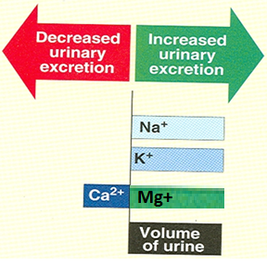
thiazidediuretics
Pharmacodynamic effects
4- Causes vasodilatation , diazoxide , non diuretic thiazide is a potent vasodilator
5-↓of urine volume in case of diabetes insipidus

Slide 7
Thiazide diuretics
Drug- drug interactions
Thiazides
Diminish
effect
Uricosurics
Sulphonylurea
Thiazides
Increase effect
Digitalis
Diazoxide
Reduce thiazide
efficacy
NSAIDs

Slide 8
thiazides
adrs
ECFV
Depletion
Metabolic
Alkalosis
Hypokalemia
Hypercalcemia
Hyponatremia
Hyperuricemia
Hypomagnesemia
Hyperglycemia
Impotence
↑ LDL

Slide 9
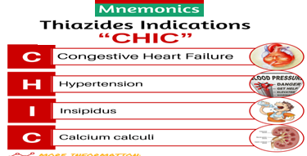
thiazides
Clinical uses
Increase Na Excretion
to 5% of Filtered Load
Treatment for
Mild Edema
Treatment for
Hypertension
Treatment for
Nephrogenic Diabetes Insipidus
Ineffective when the GFR is less than 30 to 40 ml/min, except metolazone & indapamide
Treatment for
Calcium Nephrolithiasis
Decrease Ca Excretion
Treatment for Osteoporosis

Slide 10
Loop diuretics
Na-K-2Cl SYMPORT INHIBITORS
Also Called:
Loop Diuretics
High Ceiling Diuretics
Furosemide
Potency 1, t½ 1.5h
Ethacrynic
Acid
Potency 0.7, t½ 1h
Bumetanide
Potency40 ,t½ 0.8 h
Torsemide
Potency 3, t½ 3.5h

Slide 11
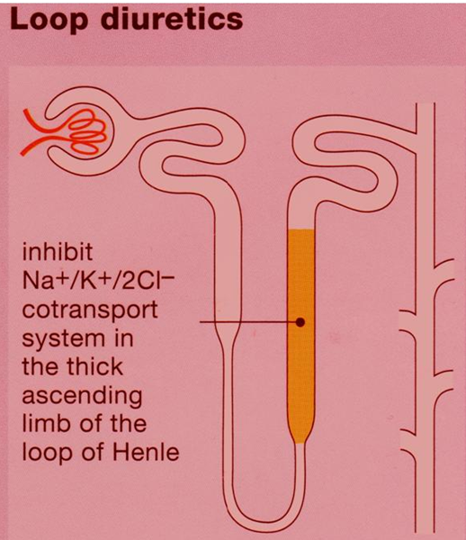
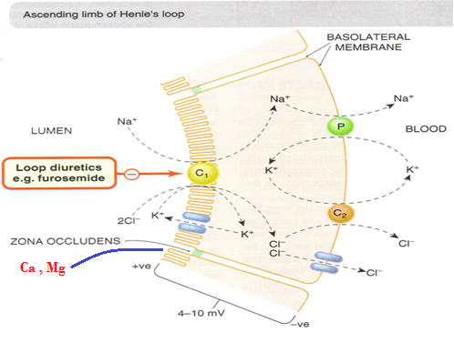
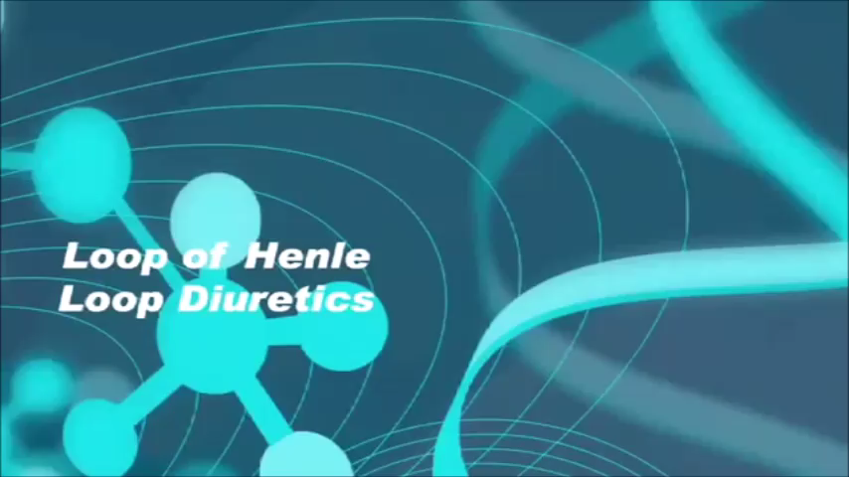
Loop diuretics
Act on the thick segment of the ascending loop of Henle[25% of glomerular filtrate of Na+ is reabsorbed]
Inhibit Na-K-2Cl transporter

Slide 12
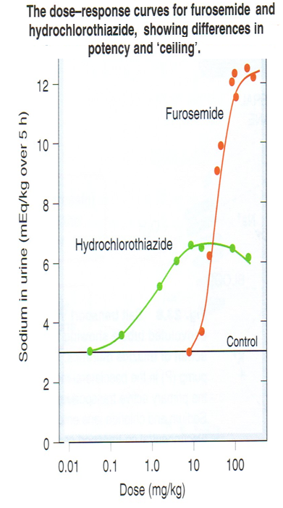
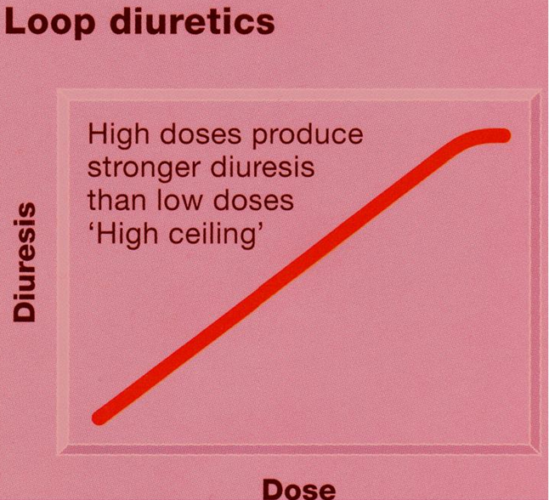
Loop diuretics
Pharmacodyamic effects
The most potent diuretics, termed “high ceiling diuretic”
Induce expression of COX, PGE↓ salt transport in TAL
↓Renal vascular resistance &↑renal blood flow→ PGs

Slide 13
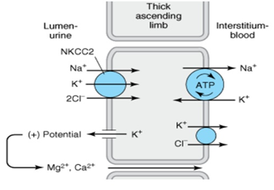
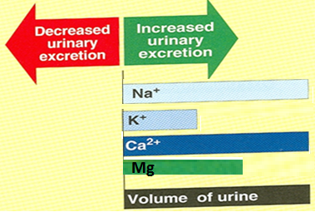
Loop diuretics
Pharmacodyamic effects
Increase Ca & Mg excretion
Furosemide and ethacrynic acid reduce pulmonary congestion
and left ventricular filling pressures in heart failure →↑ venous capacitance

Slide 14
Loop diuretics
pharmacokinetics
Given orally or IV
Have fast onset of action (suitable for emergency)
Have short duration of action
Bumetanide is the most potent
Excreted by active tubular secretion of weak acids into urine(avidly bound to plasma proteins).
Interfere with uric acid secretion

Slide 15
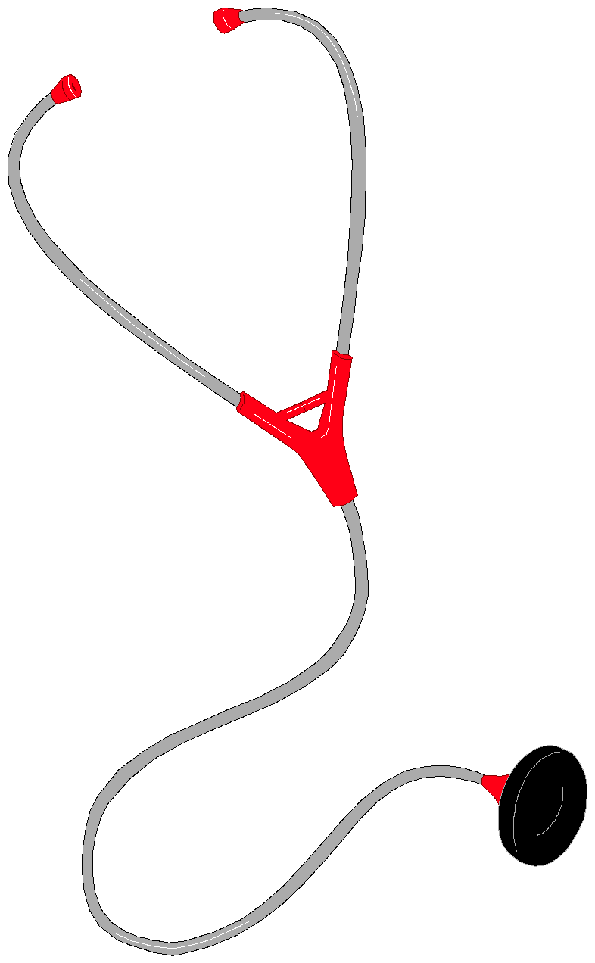
Loop diuretics
Therapeutic uses
Increase Na Excretion
to 25% of Filtered Load
Treatment for
Severe Edema
Treatment for
Oliguric ARF
Increase Urine Volume
Treatment for
Hypercalcemia
Increase Ca Excretion
Treatment for
Pulmonary Edema
Increase Venous
Capacitance
Acute Treatment for
Hyperkalemia
Increase K+ Excretion
Anion overdose
Toxicity of Br, F & I

Slide 16
Loop diuretics
adrs
Profound ECFV
Depletion
Metabolic
Alkalosis
Ototoxicity
Hypokalemia
Hyperuricemia
Hypocalcemia
Hyperglycemia
Hypomagnesemia

Slide 17
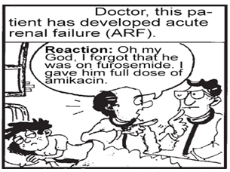
Loop diuretics
Drug- drug interactions
↓Diuretic
Response
NSAIDS
Probenecid
Arrhythmias
Digitalis
↑ Ototoxicity
of Loop Diuretic
Aminoglycosides
↑ Nephrotoxicity of Aminoglycosides
Loop Diuretic

Slide 18
Loop diuretics
contraindications
Severe Na+
& volume
depletion
Anurea
unresponsive
to a trial dose of
loop diuretic
Hypersensitivity
To sulphonamides

