Slide 1
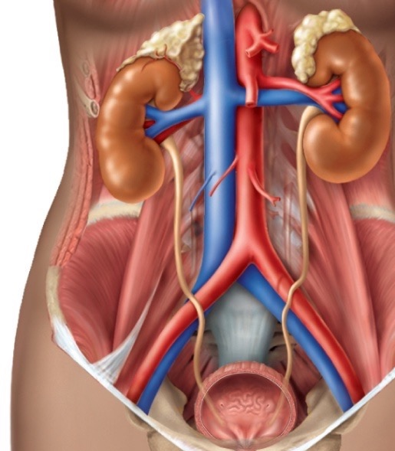

Renal Physiology 1
Renal Functions and Basic Concepts

Slide 2
Learning Objectives:
Enumerate general functions of the kidney.
Identify and describe that the nephron is the structural and function unit of the kidney.
Explain glomerular filtration membrane & filtration forces.
Describe mechanism of filtration & composition of the glomerular filtrate.
Calculate the net filtration pressure using parameters of Starling forces.

Slide 3

Urinary System
Kidneys perform the functions of the urinary system.
Ureters transport urine from the kidneys to the bladder
Urinary bladder temporary storage of urine
3

Slide 4
Kidney functions
Filtration
200 liters of blood daily, allowing toxins, metabolic wastes, and excess ions to leave the body in urine
blood pressure Regulation
By controlling the rate at which water is excreted in the urine → regulate plasma volume → total blood volume → blood pressure.
By release of renin → vasoactive agents
4

Slide 5
Regulation
of water and electrolyte balance: Maintain the proper balance between water and salts, and acids and bases
By ↑ or ↓ the excretion of specific ions in the urine, the kidneys regulate the concentration of the following ions in the plasma:
Na⁺, K⁺, Ca²⁺, Mg²⁺, Cl⁻, HCO₃⁻, H⁺ and phosphates.
RBC production by bone marrow by controlling erythropoietin hormone levels.

Slide 6
Kidney functions
Excretion
of bioactive substances (hormones and many foreign substances, especially drugs) that affects body function
Gluconeogenesis
during prolonged fasting glucose can be synthesized in the liver and kidneys
Glycerol and certain amino acids are used to synthesize glucose
6

Slide 7
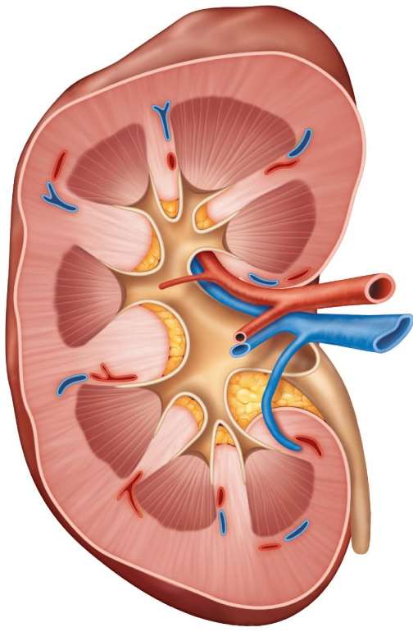
Three distinct regions
Renal cortex
Cortex granular superficial region
Medulla exhibits cone-shaped pyramids
Renal medulla
Renal
hilum
Pyramids are bundles of collecting tubules
Renal pelvis
Ureter
Renal pelvis flat, funnel-shaped tube
Renal pyramid
Renal column
Diagrammatic view of the kidney
7

Slide 8
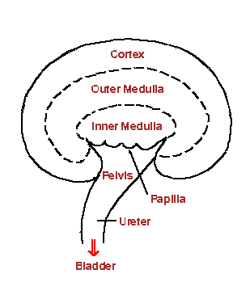

Slide 9
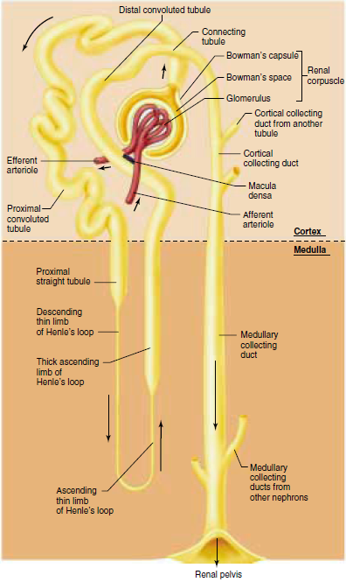
Nephron as a functional unit

Slide 10
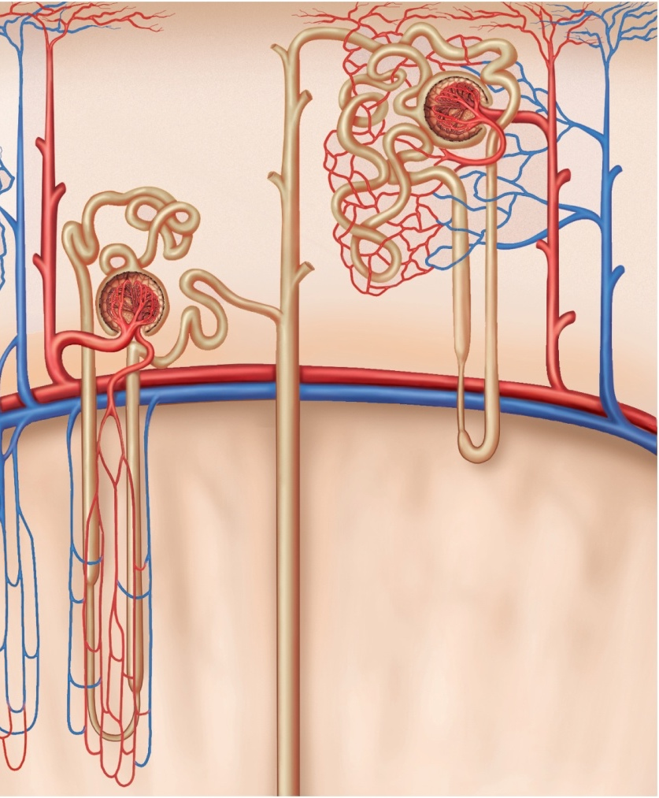
Cortical nephron
Types of nephrons
Juxtamedullary
nephron
Cortical nephrons:
85% of nephrons
Juxtamedullary nephrons:
- loops of Henle deeply invade the medulla
- involved in the production of concentrated urine
Cortex
PCT
DCT
Peritubular
capillaries
Arcuate artery
Cortico-
medullary
junction
Arcuate vein
Vasa recta
Medulla
Collecting duct
Copyright © The McGraw-Hill Companies, Inc. Permission required for reproduction or display.
10

Slide 11
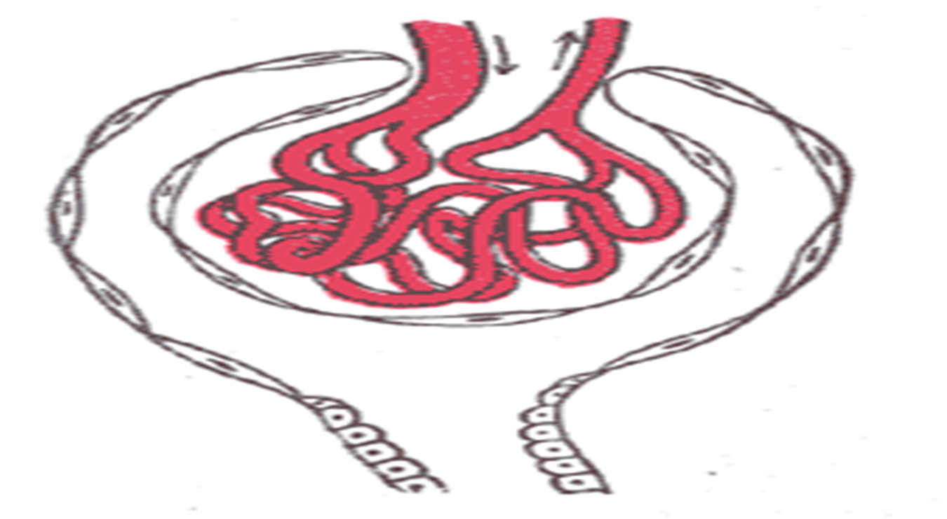
20%

Slide 12
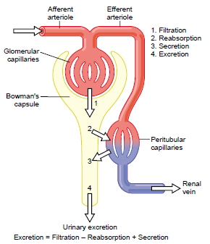
RBF
= 20% of CO
GFR
= 20% of RBF

Slide 13
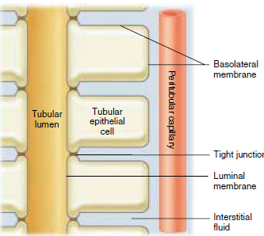

Slide 14
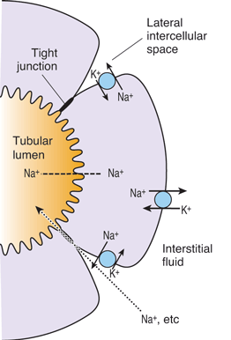
Tubular cell

Slide 15
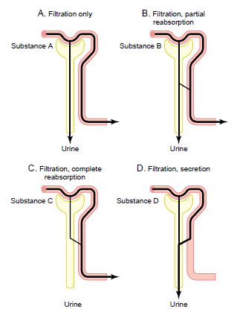

Slide 16
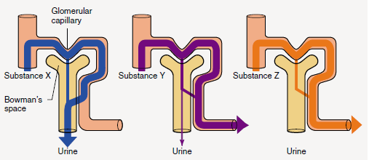

Slide 17
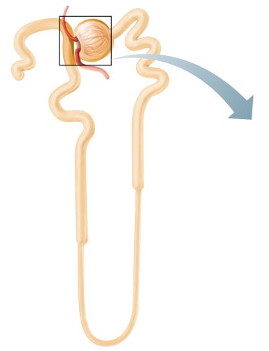
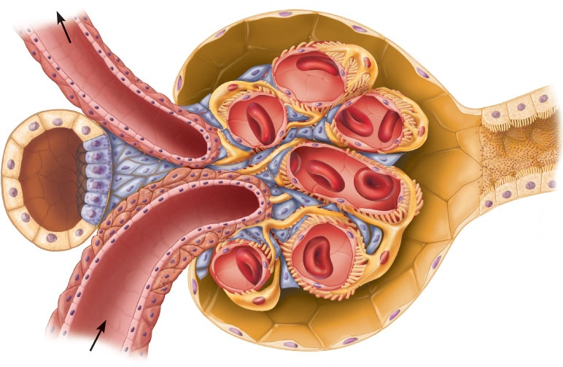
The nephron
Bowman’s capsule: Blind end of the tubule completely surrounds the glomerulus
Capsular
space
Proximal
tubule cell
Efferent
arteriole
The structural and functional units that form urine.
Glomerulus: A tuft of capillaries associated with a renal tubule
Renal corpuscle
Afferent arteriole
Renal corpuscle

Slide 18
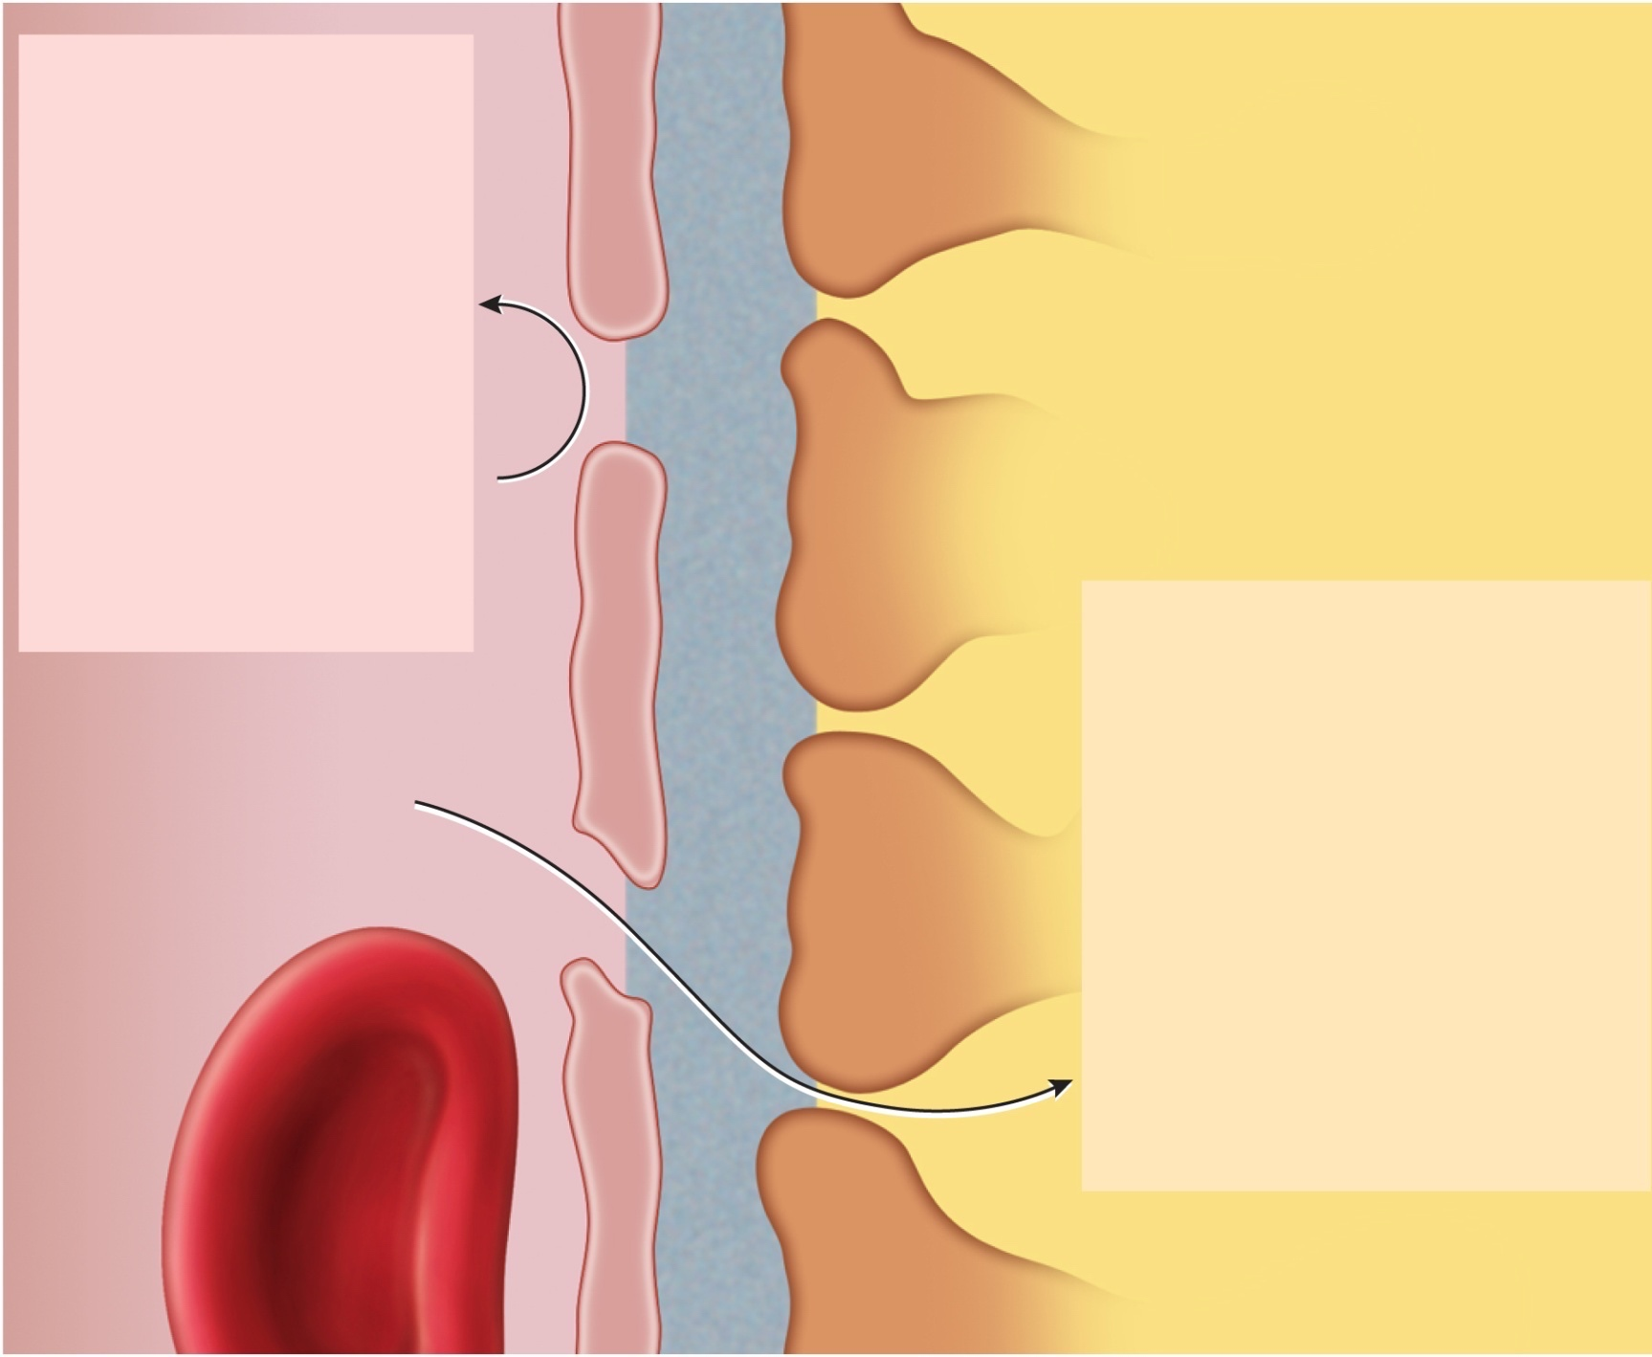
Turned back:
Endothelial cell of
glomerular capillary
Blood cells
Plasma proteins
Basement membrane
Large anions
Filtration slit
Protein-bound
minerals and
hormones
Filtration pore
Foot process of podocyte
Most molecules
> 8 nm in
diameter
Passed through filter:
Water
Electrolytes
The Glomerular Filtration Membrane
Glucose
Amino acids
Fatty acids
Vitamins
Urea
Uric acid
Creatinine
Capsular space
Blood stream
18
Copyright © The McGraw-Hill Companies, Inc. Permission required for reproduction or display.

Slide 19
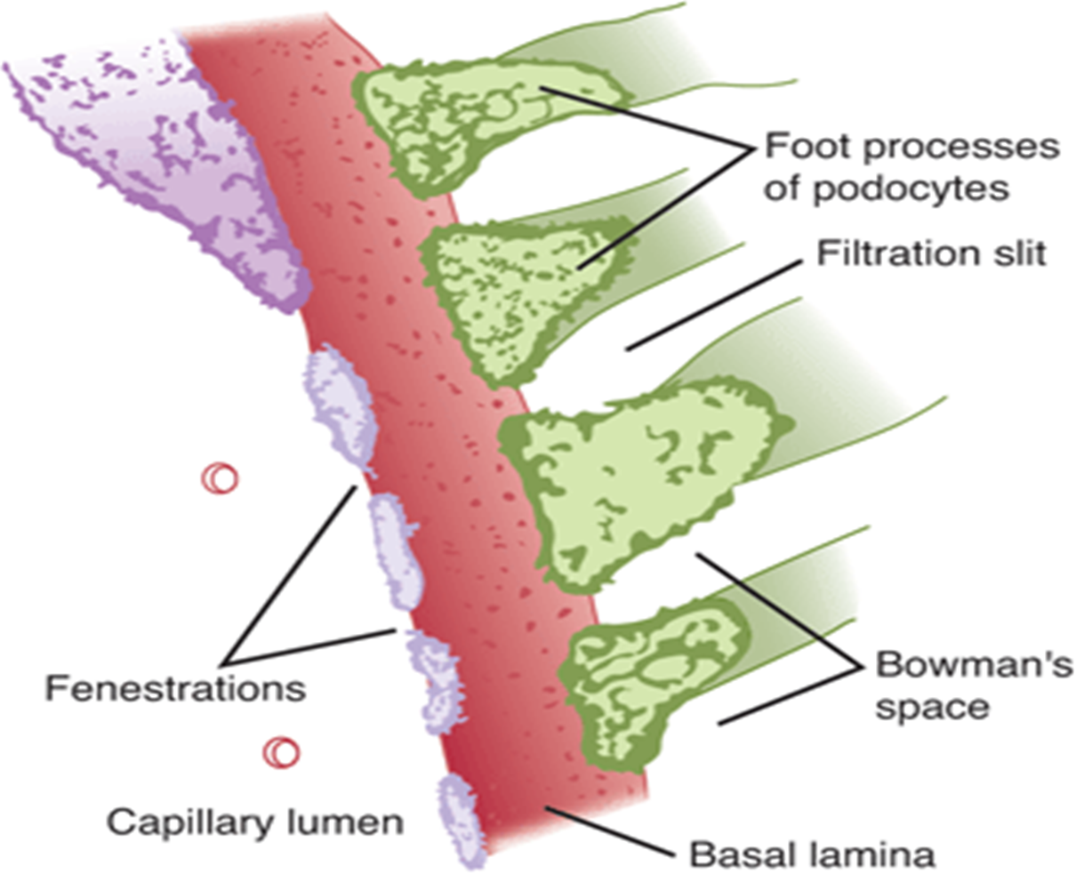

Slide 20
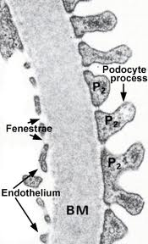

Slide 21
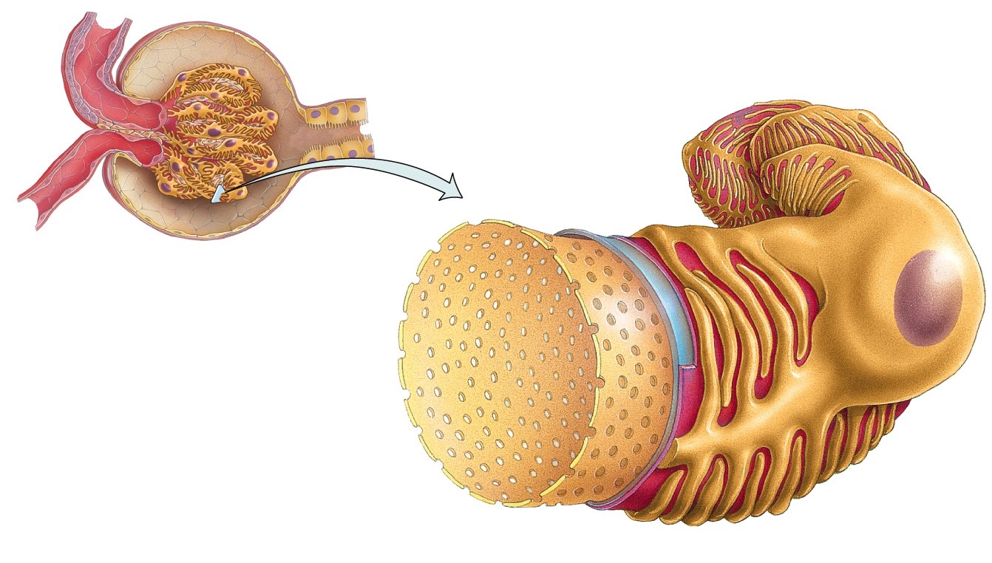
Filtration Membrane
Filter that lies between the blood and the interior of the glomerular capsule
Podocyte of visceral layer of glomerular (Bowman’s) capsule
Filtration slit
Pedicel
■ composed of 3 layers:
1
Fenestration (pore) of glomerular
endothelial cell: prevents filtration of blood cells but allows all components of blood plasma to pass through
2
Basal lamina of glomerulus:
prevents filtration of larger proteins
3
Slit membrane between pedicels:
prevents filtration of medium-sized proteins
21
Details of filtration membrane

Slide 22
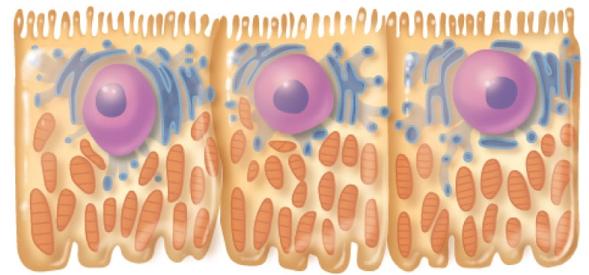
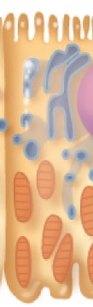
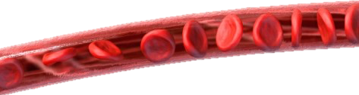
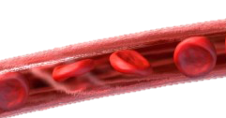
Proximal convoluted tubule
Microvilli
Cuboidal cells
numerous microvilli and mitochondria
Mitochondria
Glucose,
Amino acids
Na⁺, Cl⁻, K⁺, HCO₃⁻
H₂O
Urea, uric acid, creatinine, H⁺, NH₄⁺
22
Notes:
Cells extensively interdigitate with each other.
This ⬆ surface area and is characteristic of salt-transporting epithelia.
Microvilli provide a maximal area for reabsorption.
Numerous mitochondria due to higher metabolic activity and active transport.

Slide 23
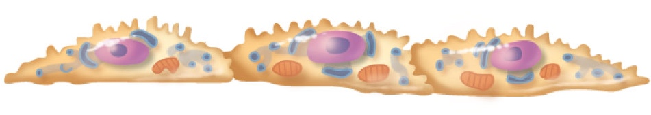
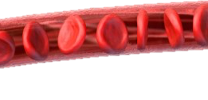
Loop of Henle
Proximal part is similar to PCT
Thin segment (simple squamous cells) followed by thick segment (cuboidal to columnar cells)
H₂O
H₂O
H₂O
H₂O
23

Slide 24
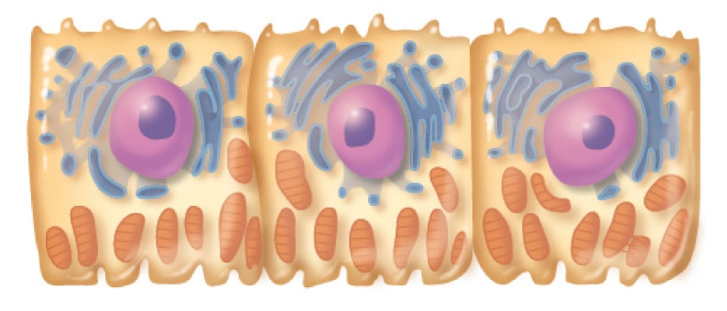
Distal convoluted tubule
Cuboidal cells without microvilli that function more in secretion than reabsorption
Na⁺, Cl⁻
H⁺, K⁺
24
Notes:
Cells extensively interdigitate with each other.
This ⬆ surface area and is characteristic of salt-transporting epithelia.
Microvilli provide a maximal area for reabsorption.
Numerous mitochondria due to higher metabolic activity and active transport.

Slide 25
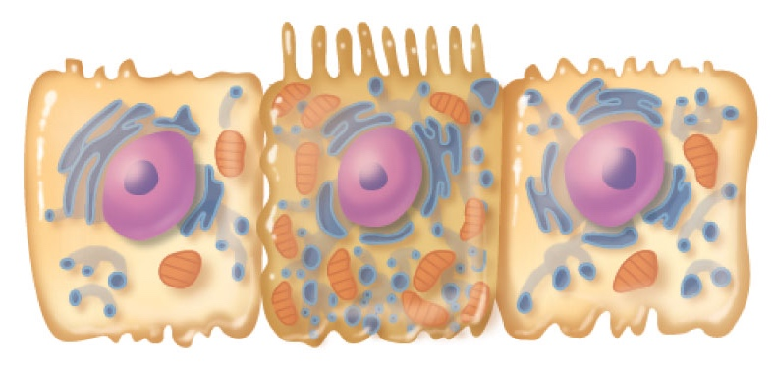
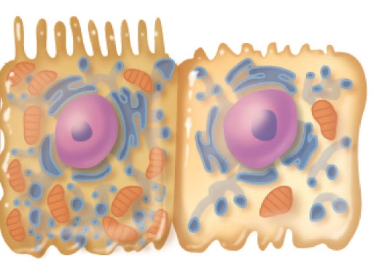
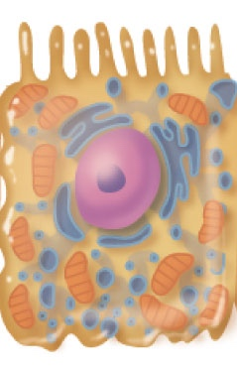
Collecting duct cells
Intercalated cell
Acid-base balance
Water and salt balance
Principal cell
H₂O
Na⁺, Cl⁻
H⁺, K⁺
25
Notes:
Cells extensively interdigitate with each other.
This ⬆ surface area and is characteristic of salt-transporting epithelia.
Microvilli provide a maximal area for reabsorption.
Numerous mitochondria due to higher metabolic activity and active transport.

Slide 26
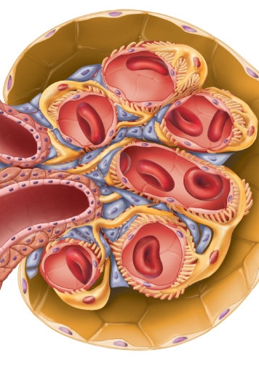
Mesangial cells
Irregularly shaped cells in the central part of the glomerular tuft.
Phagocytic function → prevent the accumulation of macromolecules in the basement membrane which have escaped from the capillaries.
Hold the delicate glomerular structure in position.
Contraction → modifies the surface area of the glomerular capillaries available for filtration.

Slide 27
JGA
Juxtaglomerular Apparatus
Mesangial cells
-contractile properties
-capillary filtration
Granular Cells
-smooth muscles
-secrete Renin
-mechanoreceptors
Efferent
arteriole
Macula densa cells
Proximal
tubule cell
Mesangial cells
Granular cells
Mesangial cells
Macula Densa
-tubular cells
-chemoreceptors (Na+, K+ and Cl-)
Afferent arteriole
27
Notes:
Juxtaglomerular apparatus is where the distal tubule lies against the afferent (sometimes efferent) arteriole
Arteriole walls have juxtaglomerular (JG) cells
- Enlarged, smooth muscle cells
- Have secretory granules containing renin
- Act as mechanoreceptors
Macula densa
- tall, closely packed distal tubule cells
- lie adjacent to JG cells
- function as chemoreceptors or osmoreceptors
- sensitive to the ionic content and water volume of the fluid in the tubule
produce molecular signals that promote renin secretion by JG cells
Mesangial cells
- have phagocytic and contractile properties
- influence capillary filtration
- provide structural support and regulate blood flow of the glomerular capillaries by their contractile activity

Slide 28
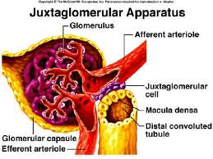

Slide 29
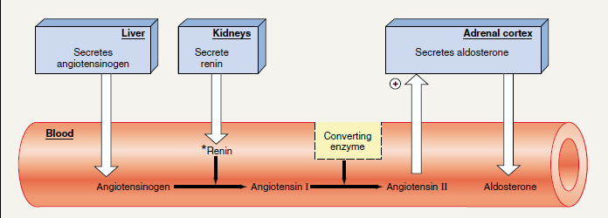

Slide 30
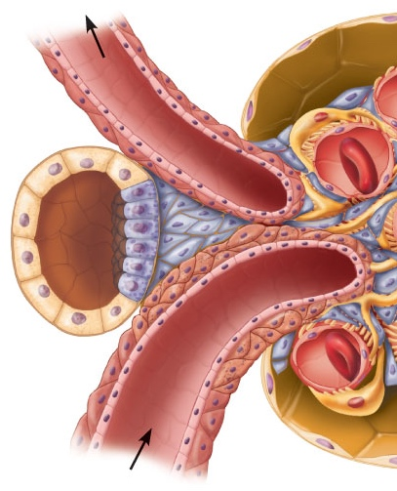
Macula densa
Tall, closely packed distal tubule cells
Lie adjacent to JG cells
Function as chemoreceptors or osmoreceptors
The cells of the macula densa are sensitive to the ionic content and water volume of the fluid in the tubule.
produce molecular signals that promote renin secretion by the juxtaglomerular cells

Slide 31
RAS
What is ?
A hormone system that regulates BP and water balance.
Day-to-day control of Na⁺ excretion.
Three main stimuli for renin release
Renal Symp.
2
Renin
1
3
Renal Perfusion P
McDensa
Notes:
RBP=Renal blood prefusion

Slide 32
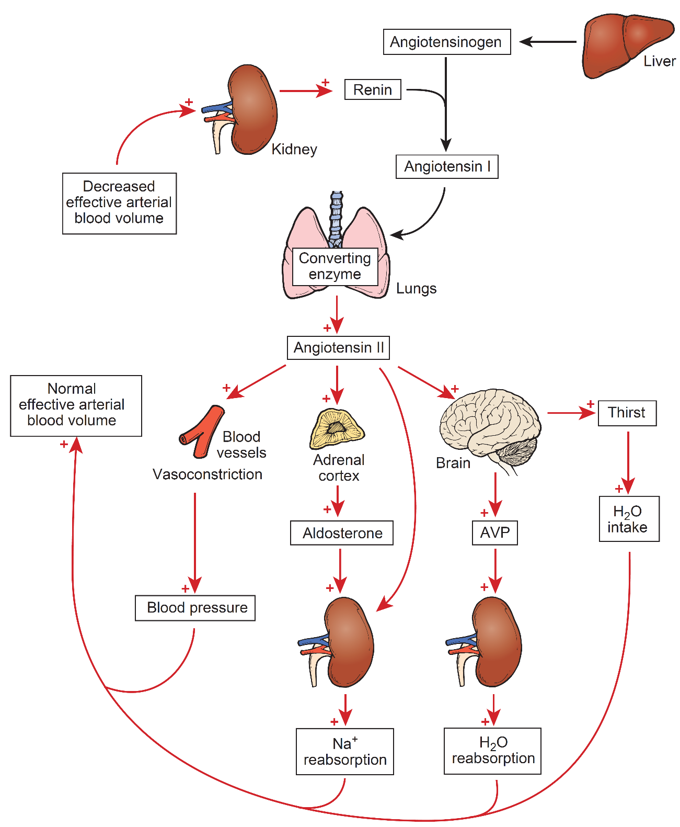
RAS
Notes:
Components of the Renin-Angiotensin System
■ Renin in the blood plasma acts on angiotensinogen.
■ Angiotensinogen is a plasma α₂-globulin produced by the liver.
■ the decapeptide angiotensin I is produced.
■ Angiotensin I is converted to the octapeptide angiotensin II as the blood courses through the lungs.
The angiotensin-converting enzyme (ACE), which is present on the surface of endothelial cells, catalyzes this reaction.
This system is activated by a decrease in the effective arterial blood volume (e.g., following hemorrhage) and results in compensatory changes that help restore arterial blood pressure and blood volume to normal

Slide 33
Innervation of the kidney
■ Only sympathetic nerves supply renal blood vessels
- regulate blood flow, filtration, water reabsorption, renin secretion.
↑ sympathetic = constriction, ↓ blood flow
■ There is no parasympathetic innervation
33

Slide 34
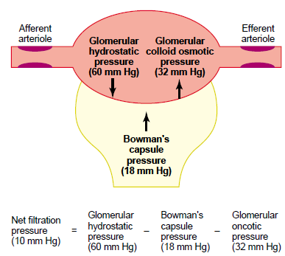
Control of GFR

Slide 35

Thanks

