Slide 1


Slide 2


Slide 3
Renal Physiology
GFR

Slide 4
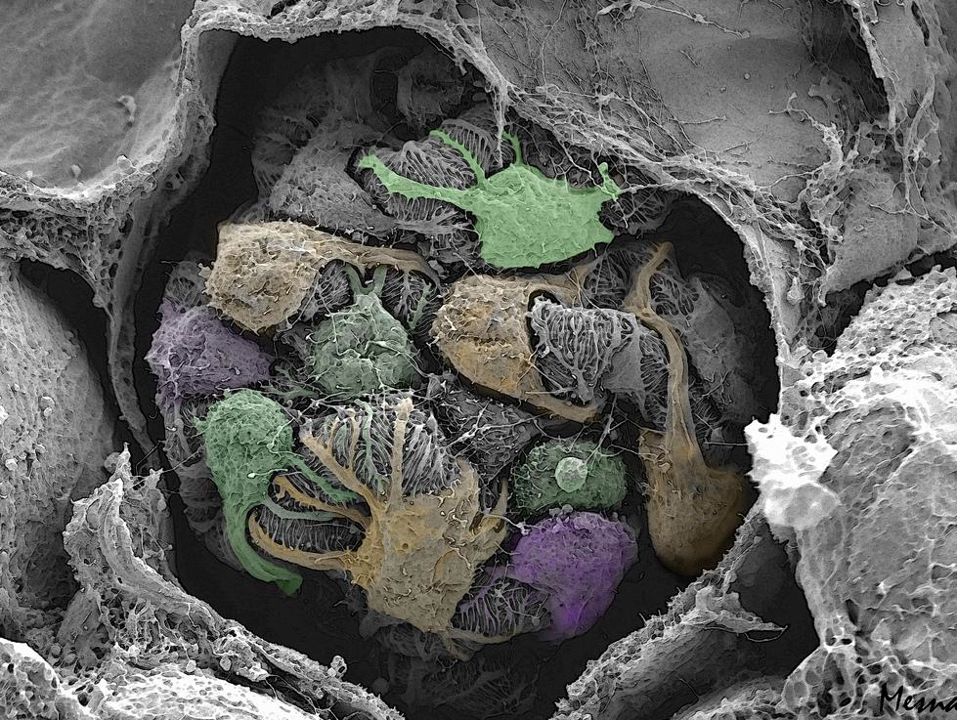
Renal Physiology 2
Glomerular Filtration Rate
Notes:
Coloured scanning electron micrograph of the glomerulus.

Slide 5
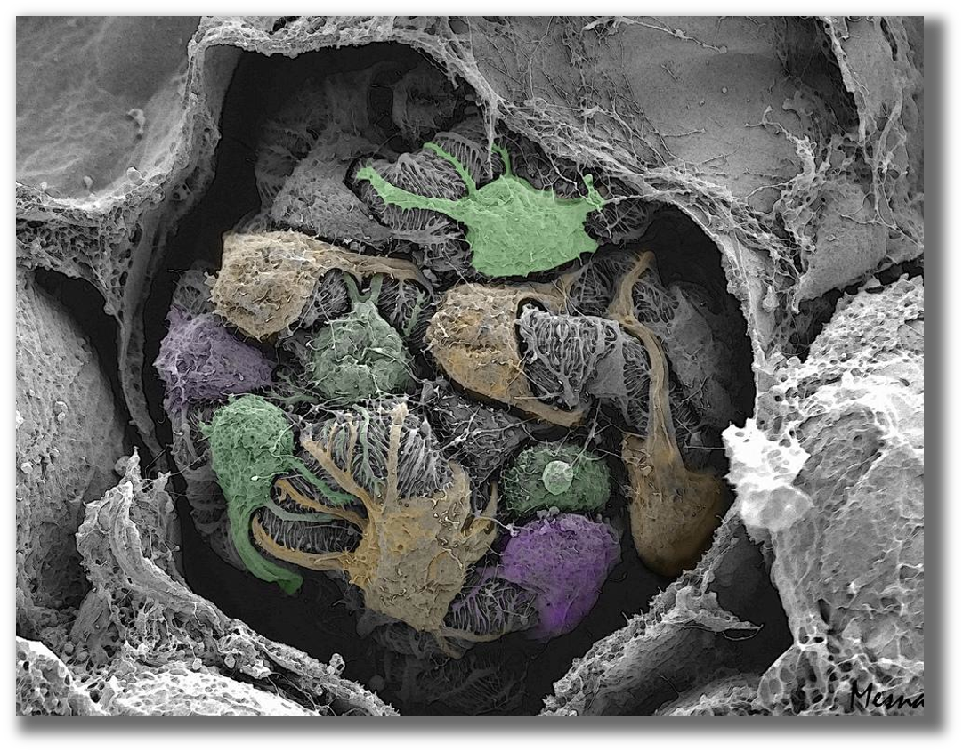
Learning Objectives:
Describe that the mechanism of urine formation include three basic processes; glomerular filtration, tubular reabsorption and tubular secretion.
Define GFR and quote normal value.
Identify and describe the factors controlling GFR in terms of starling forces, permeability with respect to size, shape and electrical charges and ultra-filtration coefficient.
Describe Intrinsic and extrinsic mechanism that regulate GFR.
Describe autoregulation of GFR & tubuloglomerular feedback mechanism.

Slide 6
Capillary Beds of the Nephron:
Every nephron has (Glomerulus & Peritubular capillaries)
Each glomerulus fed by afferent arteriole & drained by efferent arteriole.
Blood pressure in the glomerulus is high because:
  Arterioles are high-resistance vessels.
  Afferent arterioles have larger diameters than efferent arterioles.
Fluids and solutes are forced out of the blood throughout the entire length of the glomerulus

Slide 7
Capillary Beds & Resistance
Peritubular beds are low-pressure, porous capillaries adapted for absorption that:
  Arise from efferent arterioles
  adhere to adjacent renal tubules
  Empty into the renal venous system
Resistance in afferent arterioles:
  Protects glomeruli from fluctuations in systemic blood pressure.
Resistance in efferent arterioles:
  Reinforces high glomerular pressure.
  Reduces hydrostatic pressure in peritubular capillaries.

Slide 8
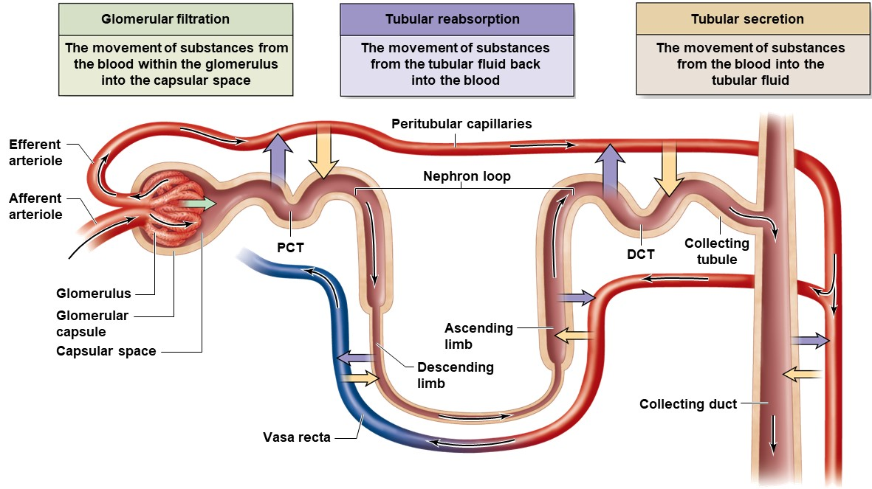
Mechanisms of Urine Formation

Slide 9
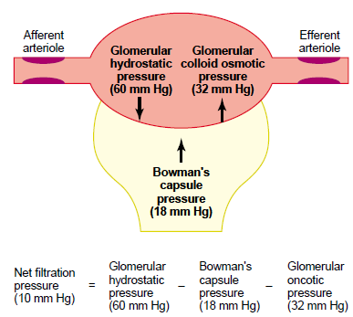
Control of GFR
GFR = NFP X Kf (Permeability) = 125 ml/min

Slide 10
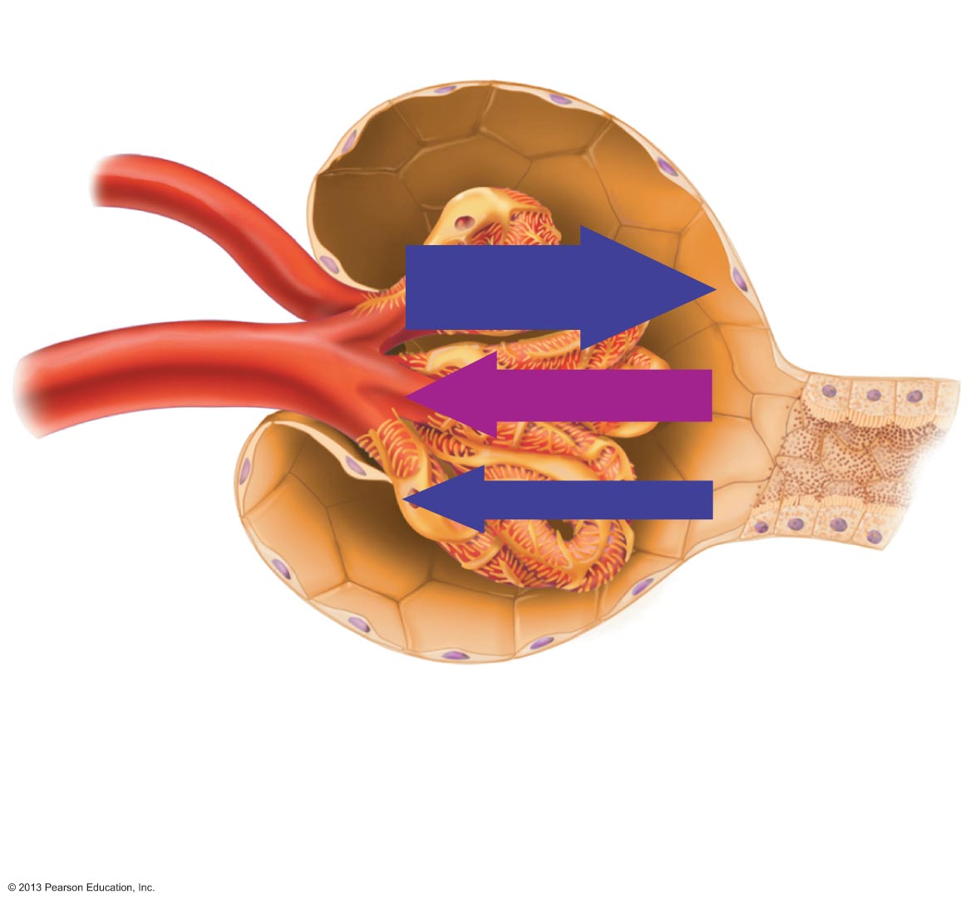

Determinants of GFR
Filtration coefficient (K_{f})
Surface area available for filtration (mesangial cells)
Filtration membrane permeability
Glomerular
capsule
Efferent
arteriole
PGC = 60 mm Hg
Afferent
arteriole
Net Filtration Pressure (NFP)
The cumulative pressure responsible for filtrate formation.
πGC = 32 mm Hg
NFP = 10 mm Hg
PBS = 18 mm Hg
= OUTWARD pressures – INWARD pressures
= (PGC + πBS) – (PBS + πGC)
= (60) – (18 + 32) = 10 mm Hg
GFR = Kf⋅[PGC–(PBS+πGC)]
Changes in GFR result from changes in glomerular blood pressure
Notes:
Concept The filtration coefficient is dependent on two factors, the surface area available for filtration of the plasma water and the water or hydraulic permeability. The student should note that the GFR is not dependent on solute permeability as we are dealing with the movement of fluid volume not filtered solute load. The surface area for filtration can be altered by the degree of contraction of the glomerular mesangial cells. Vasoactive agents can reduce the Kf when the mesangial cells contract.
Glomerular hydrostatic pressure (PGC) push fluid out of vessels (promotes filtration) ------ Increases in hypertension
Capsular hydrostatic pressure (PBS) push fluid back into vessels (opposes filtration) ------ Increases in obstructive nephropathy
Blood colloid osmotic pressure (πGC)- proteins in blood (hyperosmotic) - Draw water back into blood (Opposes filtration) ------ Decreased in hypoalbuminemia
Bowman space colloid osmotic pressure (πBS) normally negligible ------ Increased in minimal change disease (refer to previous lecture)
Filtration at the glomeruli depends on starling forces:
■ The glomerular capillaries have very high hydrostatic pressures this is why filtration occurs here
■ ↑ the glomerular hydrostatic pressure → ↑ GFR
↓ the glomerular hydrostatic pressure → ↓ GFR (e.g. 20% decrease (50 to 40 mm Hg) → filtration would stop)
■ Blood colloid osmotic pressure opposes GFR,
↑ plasma protein → ↑ πGC → ↓ GFR
↓ plasma protein → ↓ πGC → ↑ GRF
CLINICAL CORRELATION Patients with urinary tract obstruction secondary to cancer, stones, or prostatic enlargement may present with profound reductions in GFR. Renal function can often be restored following removal of the obstructing lesion.
Note: There is no clinical utility in calculating filtration pressures because we do not have the technology to measure pressures within capillaries. Consider also, that the pressures change along the length of the capillary, and our “calculations” require that we use average or “net” pressures for the entire capillary. However, it is considered important to know how to juggle with these values to gain a better understanding of capillary function.

Slide 11
Net Filtration Pressure (NFP)
The pressure responsible for filtrate formation
NFP equals the glomerular hydrostatic pressure (HP_{g}) minus the oncotic pressure of glomerular blood (OP_{g}) combined with the capsular hydrostatic pressure (HP_{c})
NFP = HP_{g} – (OP_{g +} HP_{c})
Or
NFP = P_{GC} – P_{BS} - O_{GC}

Slide 12
GFR
Factors governing filtration rate at the capillary bed are:
  Total surface area available for filtration.
  Filtration membrane permeability.
  Net filtration pressure.
GFR is directly proportional to the NFP.
If the GFR is too high:
  Needed substances cannot be reabsorbed quickly enough and are lost in the urine.
If the GFR is too low:
  Everything is reabsorbed, including wastes that are normally disposed of.

Slide 13
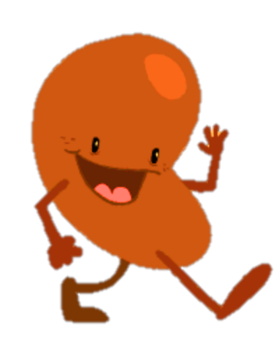
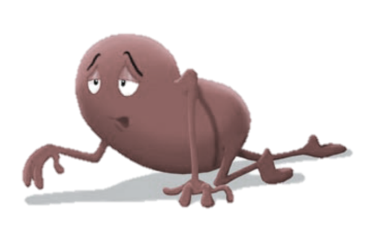
What is GFR?
The rate of production of filtrate at the glomeruli from plasma
■ index of kidney function
■ GFR is the sum of filtration rates of all functioning nephrons
■ level depends on age, sex and body size.
GFR (mL/min/1.73 m²) | Period of time | Kidney damage | Comment
>90 |  | NO | Normal
60–89 |  | NO | Normal (elderly or infants)
60–89 | ≥ 3 months | YES | Early kidney disease
<60 | ≥ 3 months | YES | Chronic kidney disease
13
Notes:
Plasma volume is filtered 60 times per day
Glomerular filtrate composition is about the same as plasma, except for large proteins.
GFR too high = Needed substances cannot be reabsorbed quickly enough and are lost in the urine
GFR too low = Everything is reabsorbed, including wastes
Filtration fraction (GFR/Renal Plasma Flow) = 0.2 (i.e., 20% of plasma is filtered)
Men have a higher GFR than women at the same level of serum creatinine. This is due to higher average muscle mass and creatinine generation rate in men. Second is that body surface area is larger in men and also the glomerular volume but the same number of glomeruli in both male and female.
The corrected GFR is approximately 8% lower in women than in men, and declines with age at an annual rate of 1 mL/min/1.73m² from the age of 40.
Q: If one kidney is removed what will happen to GFR? ½ of the functioning nephrons are lost, GFR ⬇ only about 25% because the other nephrons compensate.

Slide 14




Constriction/dilation of afferent/efferent arterioles & GFR
↓ RPF
↓ RPF
$FF=\frac{GFR}{RPF}$ ↓
$FF=\frac{GFR}{RPF}$ ↑
↑ RPF
↑ RPF
$FF=\frac{GFR}{RPF}$ ↓
$FF=\frac{GFR}{RPF}$ ↔︎
Notes:
Figure from Vander’s Human Physiology 2015: Control of GFR by constriction or dilation of afferent arterioles (AA) or efferent arterioles (EA). (a) Constriction of the afferent arteriole or (c) dilation of the efferent arteriole reduces PGC, thus decreasing GFR. (b) Constriction of the efferent arteriole or (d) dilation of the afferent arteriole increases PGC, thus increasing GFR.
In response to ANG II, both afferent and efferent resistances increase. Thus, RPF decreases. The generally opposing effects on GFR of increasing both afferent resistance and efferent resistance explain why the combination of both keeps GFR fairly constant despite a decline in RPF.
An example of a predominantly efferent arteriolar effect is seen after administration of ANG II inhibitors (e.g., captopril) to patients with hypertension resulting from increased endogenous angiotensin levels. Administering such agents not only decreases blood pressure, but also often leads to a significant fall in GFR. Reducing the resistance of the efferent arteriole causes GFR to decrease.
In certain realistic examples, changes in either the afferent or the efferent arteriolar resistance dominate. A striking case in which a decrease in afferent arteriolar resistance dominates is the large increase in RPF that occurs with the loss of renal tissue, as after nephrectomy in a kidney donor. GFR in the remnant kidney nearly doubles, owing primarily to a dramatic decrease in the resistance of the afferent arteriole
A question to think about: What are the immediate consequences of a blood clot occluding the afferent arteriole or the efferent arteriole?.
Answer: A blood clot occluding the afferent arteriole would decrease blood flow to that glomerulus and greatly decrease GFR in that individual glomerulus. A blood clot in the efferent arteriole would increase PGC and, therefore, GFR. If this only occurred in a few glomeruli, it would not have a significant effect on renal function because of the large number of total glomeruli in the two kidneys providing a safety factor.
Summary: We have a poor understanding of the details of the control of renal function, but it is a good bet that it involves adjustments in afferent and / or efferent arteriolar resistance. Therefore we must be aware that increases in afferent resistance decrease both GFR and RPF, while increases in efferent resistance will decrease RPF but tend to increase GFR. Most physiologists believe that GFR is regulated primarily by changing afferent resistance with one or more of the vasoactive substances listed in the next slide. But, there is limited evidence that preferential actions on efferent arterioles might be a significant locus for control.

Slide 15
Regulation of GFR & RBF
■ Intrinsic controls (renal autoregulation)
  Act locally - maintain GFR, BP 80-180 mmHg
Renal AutoR
Myogenic
McDensa TGF
■ Extrinsic controls (Sympathetic)
  Neuroendocrine mechanisms - maintain BP.
  Can negatively affect kidney function
  Take precedence over intrinsic controls if systemic BP < 80 or > 180 mmHg
15
Notes:
Blood pressure varies from time to time and theoretically blood flow should vary directly with blood pressure (Pressure = Flow X Resistance). However, renal function relies upon maintenance of a constant flow, so there must be a system in place to protect renal plasma flow from variations in blood pressure. Maintenance of constant flow in the face of changing blood pressure is termed autoregulation. The kidney is capable of maintaining RPF and GFR quite well between ~80 - 180 mmHg mean arterial blood pressure. This can only be done by adjusting renal vascular resistance. The afferent and/or efferent arterioles are the sites of resistance adjustments. We are not clear about the signals detected for autoregulation, nor the relative contributions of the afferent and efferent arterioles, nor the exact constrictor / dilators involved. Two main “signal” theories prevail; the myogenic theory states that flow is detected as circumferential tension and vascular smooth muscle constricts/dilates in a reflex manner. The tubuloglomerular feedback theory states that “tubular fluid load” is detected (?) at the macula densa and constrictors/dilators are released locally to affect renal arterioles.
Autoregulation can be overridden when the need arises. For example, a loss of blood volume stimulates renal sympathetic nerves to cause afferent constriction and effect a small decrease in GFR to limit fluid excretion.

Slide 16
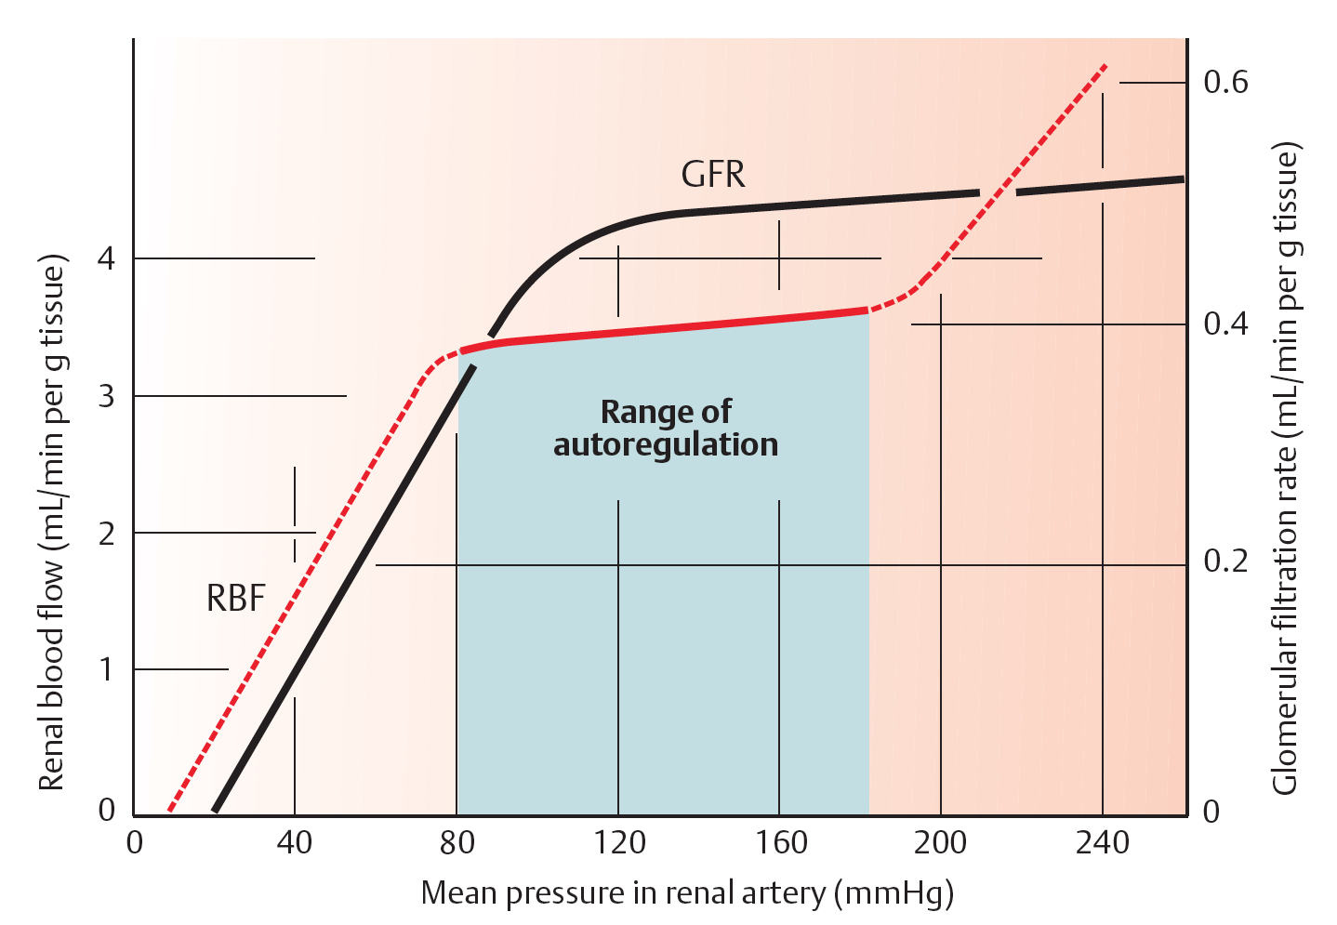
Intrinsic Autoregulation
RBF remains ~ constant as BP changes between 80 and 180 mmHg.
Autoregulation, is achieved by changes in resistance, mainly through the afferent arterioles.
< 80 mmHg, filtration ⬇, and ceases altogether when MAP = 50 mmHg.
- Autoregulation is independent of nerves or hormones
- occurs in denervated and in isolated perfused kidneys.
Notes:
The afferent arteriole, efferent arteriole, and interlobular artery are the major resistance vessels in the kidneys and thereby determine renal vascular resistance. Like most other organs, the kidneys regulate their blood flow by adjusting vascular resistance in response to changes in arterial pressure. As shown in the Figure, these adjustments are so precise that blood flow remains relatively constant as arterial blood pressure changes between 80 and 180 mm Hg. GFR is also regulated over the same range of arterial pressures. The phenomenon whereby RBF and GFR are maintained relatively constant, namely, autoregulation, is achieved by changes in vascular resistance, mainly through the afferent arterioles of the kidneys. Because both GFR and RBF are regulated over the same range of pressures and because RBF is an important determinant of GFR, it is not surprising that the same mechanisms regulate both flows.
If MAP ↑ → an automatic ↑ in afferent arteriolar constriction → preventing a rise in GHP. Dilatation occurs if MAP falls.
Three points concerning autoregulation should be noted:
1. Autoregulation is absent when arterial pressure < 80 mm Hg.
2. Autoregulation is not perfect; RBF and GFR do change slightly as arterial blood pressure varies.
3. Despite autoregulation, RBF and GFR can be changed by certain hormones and by changes in sympathetic nerve activity

Slide 17
Regulation of the diameter of arterioles
Ι- Local vascular regulatory mechanisms
(Autoregulation).
Pressure
Flow
R

Slide 18
Intrinsic autoregulation of RBF
Mechanism
(Physiological response)
Initial change
(Stimulus)
Result
ABP
RBF
(Back to normal)
1 - Myogenic
2 – TG Feedback
ABP
RBF
(Back to normal)

Slide 19
Intrinsic autoregulation of RBF
Initial change
(Stimulus)
Mechanism
(Physiological response)
Result
ABP
RBF
(Back to Normal)
1 - Myogenic
2 – TG Feedback
ABP
RBF
(Back to normal)

Slide 20
VC
Calcium influx (Myogenic)
VC
Flow
(back to normal)
ABP
Flow
Release of VC substance (TG feedback)
= Negative feedback

Slide 21
21
Notes:
Flow charts from Cindy Stanfield Physiology: Intrinsic controls of glomerular filtration rate. (a) In response to a change in the mean arterial pressure, myogenic regulation of afferent arteriolar resistance prevents significant changes in GFR by affecting glomerular capillary pressure. (b) Tubuloglomerular feedback, triggered by chemical signals released from cells in the macula densa in response to increased GFR, prevents significant changes to GFR when mean arterial pressure changes by affecting glomerular capillary pressure.
The Myogenic mechanism (similar to what we discussed in CVS Physiology lectures): ⬆ Blood pressure → ⬆ stretch → opens cation channels in smooth muscle cells → membrane depolarisation → opens voltage-dependent Ca²⁺ channels → ⬆ intracellular Ca²⁺ → smooth muscle contraction → ⬇ vessel diameter → ⬆ vascular resistance.

Slide 22
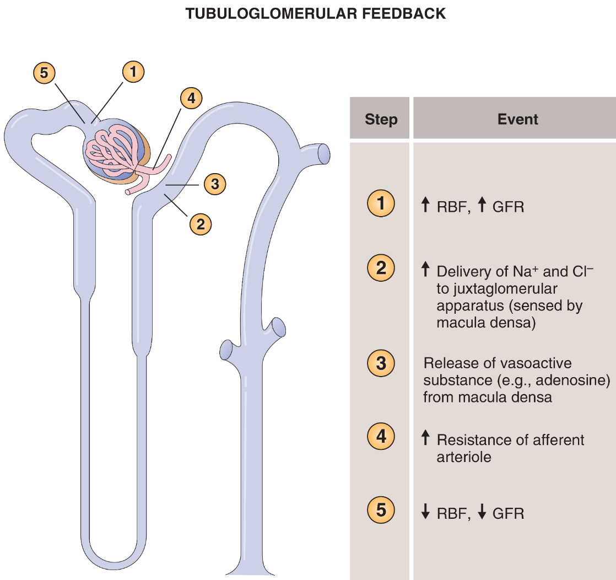
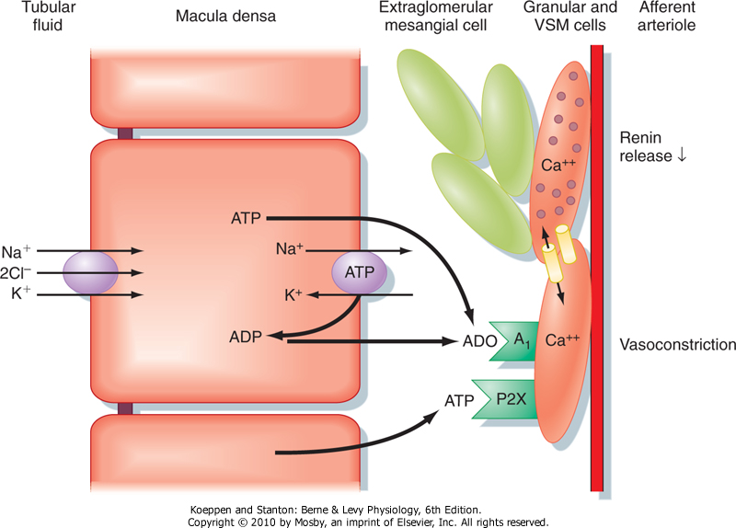
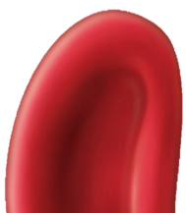
Tubulo-glomerular feedback
McDensa TGF
⬆ FLOW
⬇ Renin release
Mediators Adenosine and Renin
Afferent arterioles
[NaCl] dependent mech.
22
Notes:
In the tubuloglomerular feedback mechanism, the transient increase in GFR resulting from an increase in blood pressure leads to increased NaCl delivery to the macula densa. This increases NaCl reabsorption and adenosine triphosphate (ATP) release from macula densa cells. ATP is metabolized to adenosine diphosphate (ADP), adenosine monophosphate (AMP), and adenosine in the juxtaglomerular interstitium. Adenosine combines with receptors in the afferent arteriole and causes vasoconstriction, and blood flow and GFR are lowered to a more normal value. Sensitivity of the tubuloglomerular feedback mechanism is altered by changes in local renin activity, but adenosine, not angiotensin II, is the vasoconstrictor agent. The tubuloglomerular feedback mechanism is a negative-feedback system that stabilizes RBF and GFR.
Cellular mechanism whereby an increase in the delivery of NaCl to the macula densa causes vasoconstriction of the afferent arteriole of the same nephron (i.e., tubuloglomerular feedback). An increase in GFR elevates [NaCl] in tubule fluid at the macula densa. This in turn enhances uptake of NaCl across the apical cell membrane of macula densa cells via the 1Na+-1K+-2Cl- (NKCC2) symporter, which leads to an increase in [ATP] and [adenosine] (ADO).
ATP binds to P2X receptors and adenosine binds to adenosine A1 receptors in the plasma membrane of smooth muscle cells surrounding the afferent arteriole, both of which increase intracellular [Ca++]. The rise in [Ca++] induces vasoconstriction of the afferent arteriole, thereby returning GFR to normal levels. Note that ATP and adenosine also inhibit renin release by granular cells in the afferent arteriole. This too results from an increase in intracellular [Ca++] as a reflection of electrical coupling of the granular and vascular smooth muscle (VSM) cells.
When GFR is reduced, [NaCl] in tubule fluid falls, as does uptake of NaCl into macula densa cells. This in turn decreases release of ATP and adenosine, which decreases intracellular [Ca++] and thereby increases GFR and stimulates the release of renin by granular cells.
A decrease in entry of NaCl into macula densa cells enhances the production of PGE2, which also stimulates renin secretion by granular cells. Renin increases plasma [angiotensin II], a hormone that enhances NaCl and water retention by the kidneys.
P2X receptors are a family of cation-permeable ligand gated ion channels that open in response to the binding of extracellular adenosine 5'-triphosphate (ATP). They belong to a larger family of receptors known as the purinergic receptors.
CLINICALCORRELATION TGF may be an important mechanism in the prevention of massive losses of fluid in the setting of injury to the renal tubular reabsorptive epithelium (also known as acute tubular necrosis, ATN). For example, certain drugs are capable of injuring the proximal tubular reabsorptive epithelium which could precipitate massive fluid losses. However, activation of TGF would lead to decrements in the GFR and RBF of the parent glomerulus preventing life-threatening fluid losses from occurring. Interestingly, disorders which result in proximal tubule epithelial injury are invariably associated with profound (? protective) reductions in GFR.

Slide 23
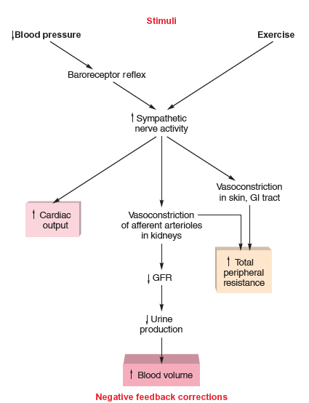
Sympathetic Regulation of GFR
Extrinsic controls
■ Stimulates vasoconstriction of afferent arterioles.
  -Preserves blood volume to muscles and heart.
Cardiovascular shock:
  ⬇ glomerular capillary hydrostatic pressure.
  ⬇ urine output.
23
Notes:
Sympathetic nerve fibers richly innervate the renal blood vessels
Sympathetic nervous system and adrenal epinephrine constrict the afferent arterioles in strenuous exercise or acute conditions like circulatory shock
Reduces GFR and urine output
Redirects blood from the kidneys to the heart, brain, and skeletal muscles
GFR may be as low as a few milliliters per minute

Slide 24
Summary of neurohumoral control of GFR and RBF
Hormone or autacoid | Effect on GFR | Effect on RBF
⬆ Sympathetic activity/Catecholamines ⬆⬆ R_{A} + ⬆ R_{E} = ⬇ GFR + ⬇⬇ RBF | ⬇ | ⬇
⬆ Angiotensin II ⬆ R_{E} = ⬆ GFR + ⬇ RBF | ⬆ | ⬇
⬆ Nitric oxide ⬇⬇ R_{A} + ⬇ R_{E} = ⬆ GFR + ⬆⬆ RBF | ⬆ | ⬆
⬆ Endothelin ⬆⬆ R_{A} + ⬆ R_{E} = ⬇ GFR + ⬇⬇ RBF | ⬇ | ⬇
⬆ Prostaglandins D,E,I ⬇⬇ R_{A} + ⬇ R_{E} = ⬆ GFR + ⬆⬆ RBF | ⬆ | ⬆
e.g. severe hemorrhage
e.g. low sodium diet, volume depletion
Protects against excessive vasoconstriction
Antagonists are useful in acute renal failure
important when other disturbances ⬇ GFR
Notes:
Table constructed based on Guyton’s book.
Whereas we cannot pinpoint which vasoactive substances are most important for the regulation of renal hemodynamics, the list is still important to remember because many therapeutic agents interfere with these substances.
Renal insufficiency can be caused by commonly used drugs that interfere with renal vascular resistance; for example:
■ Nonsteroidal anti-inflammatory drugs (NSAIDs) such as ibuprofen inhibit prostaglandins, which are the primary endogenous vasodilators of the afferent arteriole. Reduced local prostaglandin levels cause vasoconstriction of the afferent arteriole and a decrease in GFR.
■ Angiotensin-converting enzyme (ACE) inhibitors or angiotensin II receptor blockers may cause a decrease in GFR due to vasodilation of the efferent arteriole.
Clinical correlation: What would happen if you gave NSAIDs to the 75-year-old man who is haemorrhaging?
Answer: During a stress state the increase in sympathetic tone causes vasoconstriction of the afferent arterioles. The same stimuli activate a local production of prostaglandins. Prostaglandins lead to vasodilation of the afferent arterioles, thus modulating the vasoconstriction. Unopposed, the vasoconstriction from the sympathetic nervous system and angiotensin II can lead to a profound reduction in RPF and GFR, which in turn, could cause renal failure. NSAIDs inhibit synthesis of prostaglandins and interfere with these protective effects.

Slide 25
Control of GFR

Slide 26
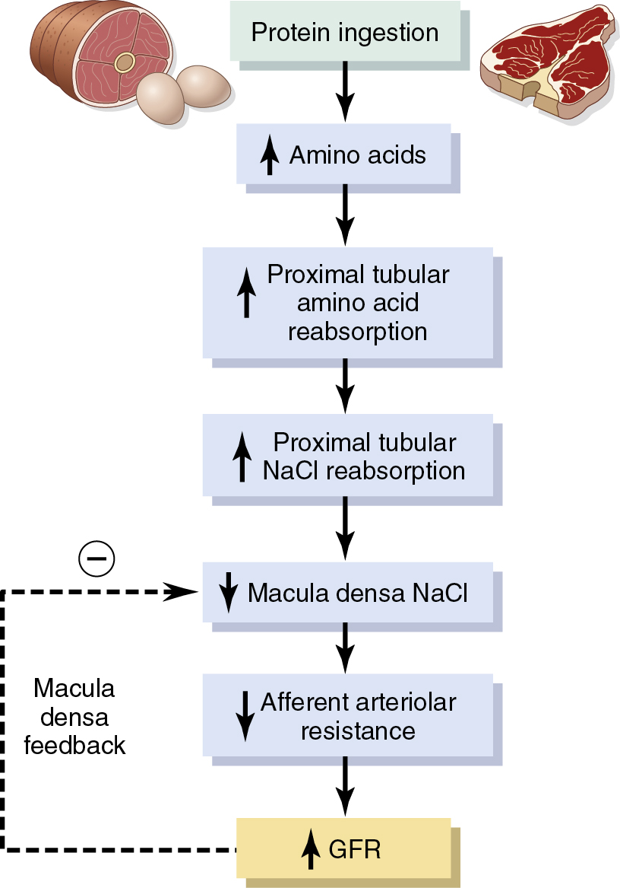
How does a high protein diet affect, if any, GFR?
Possible role of macula densa feedback in increasing GFR after a high protein meal
Notes:
How does a high protein diet affect, if any, GFR?
Answer A high protein diet will lead to an increase in RBF and hence the GFR.
Concept A high protein diet does not postprandially change the plasma oncotic pressure. The plasma oncotic pressure is due to the plasma proteins, and this osmotic pressure is a major force that affects the capillary dynamics at the microcirculation.
Proteins are digested and the component amino acids are absorbed into the blood from the intestinal lumen. The plasma amino acids are higher during and after a meal.
Students who think that a high protein meal increases the plasma oncotic pressure will reason that the GFR will decrease since the net filtration pressure will be lower when the oncotic pressure is higher.
The GFR actually increases within an hour after consuming a high protein dinner (all you can eat steak buffet!). The hyperamino acidemia is the reason for the increased GFR. The mechanism interestingly involves the macula densa tubule-glomerular feedback.
The increased filtered amino acid load leads to a reduction in the NaCl sensing by the distal tubular macula densa. This is because at the proximal tubule, the higher filtered amino acids will promote sodium reabsorption via the sodium-coupled, secondary active reabsorption of amino acids by the proximal epithelial cells. The macula densa (McD) detects less of the electrolyte in the distal tubular fluid and “assumes” that this could be due to a decreased RBF/GFR. The McD responds by transmitting paracrine signals to the afferent arteriole (less vasoconstrictor and/ or theoretically, more paracrine vasodilators). The McD activates this effect of the intrinsic renal autoregulatory mechanism and the RBF increases as the afferent arteriole vasodilates.
A question to think about: What would happen to the glomerular filtration rate (GFR) if a person suffered from severe malnutrition?
Answer: A person suffering from severe malnutrition would have decreased plasma proteins, which would result in decreased osmotic pressure in the blood. As a result, there would be less difference between glomerular osmotic pressure and capsular osmotic pressure. There would be less tendency for fluid to move back into the glomerulus by osmosis; therefore the effective filtration pressure (EFP) and GFR would increase.
Question: Suppose a drug that decreased sodium transport in the proximal and distal convoluted tubules was administered. What effect would it have on urine volume?
Answer: Urine volume would increase (a diuretic effect) because less sodium would be removed from the filtrate, the osmotic concentration of the filtrate would be increased, and less water would move from the filtrate back into the blood.

Slide 27

Thanks

