Slide 1
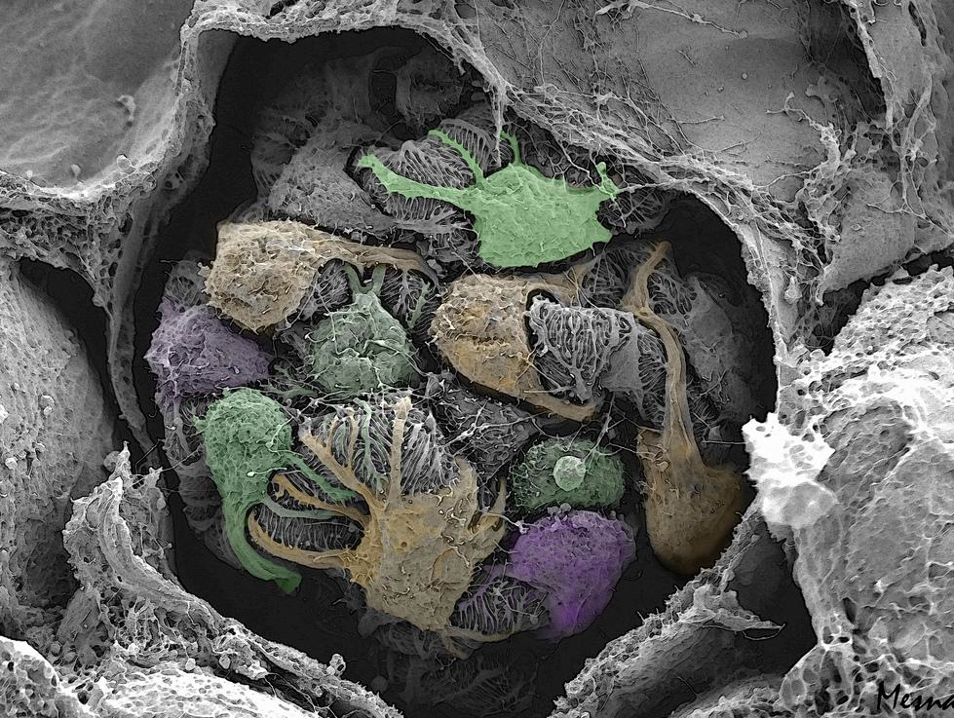
Renal Physiology 3:
Renal Clearance
Ahmad Ahmeda
aahmeda@ksu.edu.sa
Notes:
Coloured scanning electron micrograph of the glomerulus.

Slide 2
Learning Objectives:
Describe the concept of renal plasma clearance.
Use the formula for measuring renal clearance.
Use clearance principles for inulin, creatinine etc. for determination of GFR.
Explain why it is easier for a physician to use creatinine clearance Instead of Inulin for the estimation of GFR.
Describe glucose and urea clearance.
Explain why we use of PAH clearance for measuring renal blood flow.

Slide 3
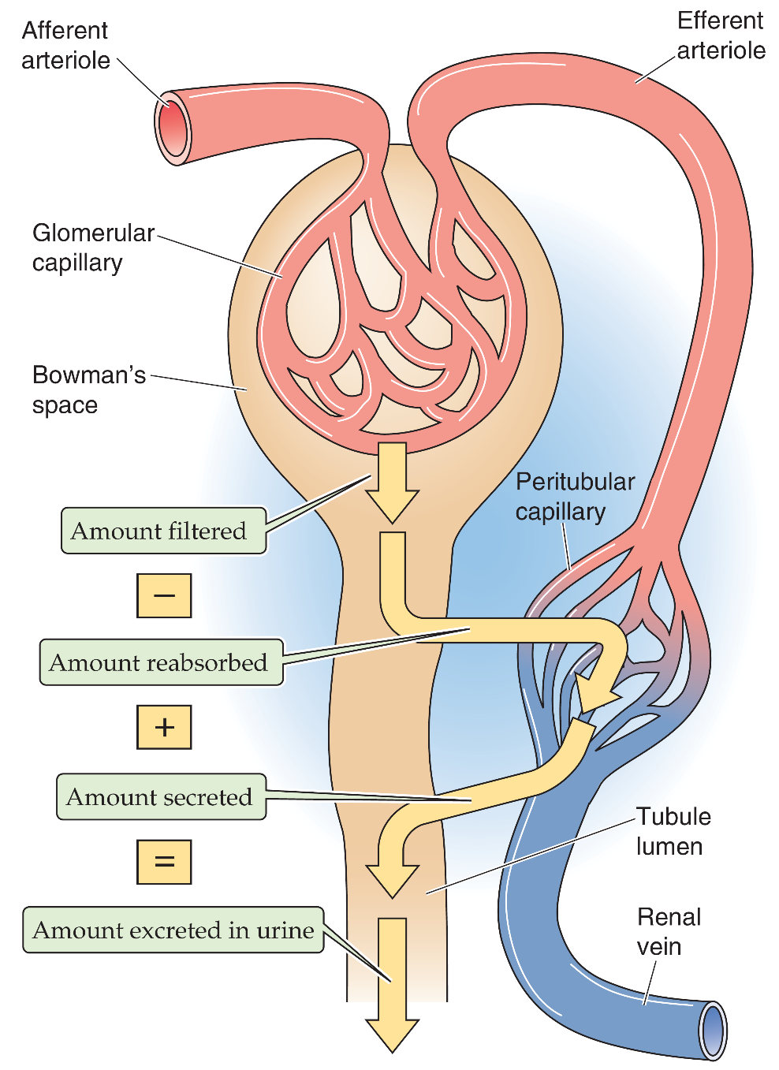
How to measure GFR?
Clearance method
Volume of plasma which is completely cleared of a substance per unit time.
amount excreted = amount filtered – amount reabsorbed + amount secreted
amount filtered per minute = GFR . P_{x} (filtered load)
amount excreted per minute = Ṽ . U_{x} (excretion rate)
3
Notes:
Why we measure GFR? The level of GFR and its magnitude of change over time are vital to:
• the detection of kidney disease
• understanding its severity
• making decisions about diagnosis, prognosis, and treatment.
Clearance of a solute is the volume of plasma (per unit time) needed to supply the amount of solute that appears in the urine. This CLEARANCE method uses the amount balance of an I.V. injected test substance such as inulin.
Summary of important points:
Clearance is a “quantitative concept” which is useful for evaluating several aspects of renal function. If one liter of plasma contains one milligram of a substance, and we remove that entire mg, then the clearance is one liter (not one mg). If we removed one tenth of a mg, then the clearance would be one tenth of a liter. Renal clearance describes the removal of substances from “a volume of” plasma (excretion) per time period (usually per minute).
If a substance is not excreted then the renal clearance is zero. If a substance could be 100% removed from plasma, then the clearance would be the entire volume of plasma processed by the kidneys ( = renal plasma flow, ml/min !!). Para-amino-hipuric acid (PAH) is almost entirely removed from plasma by the kidneys (85-90%), so the clearance of PAH is almost equal to RPF (actually 85-90% of RPF). Similarly, if a substance (like inulin) is freely filtered, but not reabsorbed or secreted, then the amount excreted (removed) = the amount filtered. Thus the clearance of inulin is equal to the volume filtered, the glomerular filtration rate (GFR).

Slide 4
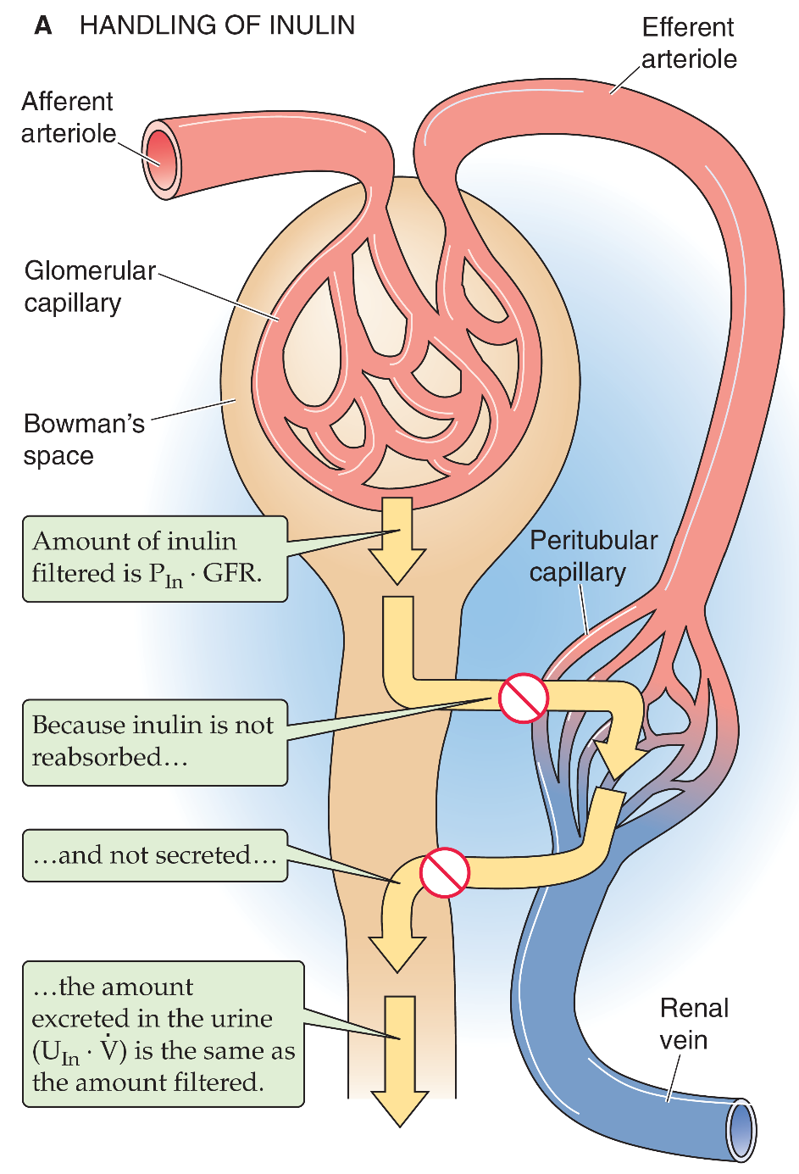
Clearance = GFR
Criteria of substance:
1. freely filtered
2. NOT reabsorbed, NOT secreted or metabolized in the nephron
amount filtered per minute = amount excreted per minute
■ e.g., inulin
GFR . [P]_{Inulin} =
[U]_{Inulin} . Ṽ
[U]_{Inulin} . Ṽ
Cl_{Inulin} = GFR =
[P]_{Inulin}
4
Notes:
Cl, clearance.
Some substances are handled by the kidneys in a very specific fashion and this can be useful in determining kidney function.
example: if it were possible for the kidneys to completely remove a substance from plasma then the clearance of that substance is identical to RPF!
example: if a substance is freely filtered but is not transported by the tubules, then that which is filtered is also excreted. Therefore, only the filtrate is "cleared" and the clearance of that substance is identical to the GFR!

Slide 5
■ For substances reabsorbed by the kidney:
amount filtered per minute > amount excreted per minute
GFR . [P]_{x} >
[U]_{x} . Ṽ
GFR . [P]_{x} – Absorbed ‘T’ =
[U]_{x} . Ṽ
■ Cl_{sub} < Cl_{inulin} Absorption from nephrons is occurring
■ Cl = 0 for glucose & amino acids (normally).
Not
■ e.g., glucose, sodium, urea.
5
Notes:
‘T’ means transported which is in this case ‘reabsorbed’.
The rate of urinary excretion of a substance can be affected by glomerular filtration, tubular reabsorption, and tubular secretion.
The amount of a substance filtered per unit time is known as the filtered load.
The amount excreted per unit time is referred to as the excretion rate.
The rate of net tubular transport is the difference between the filtered load and the excretion rate. When excretion is less than the filtered load, there is net tubular reabsorption (as shown above). When the excretion rate is more than the filtered load, there is net tubular secretion (next slide). Solutes with net reabsorption have clearance values less than GFR (i.e., less than inulin clearance). If there is net tubular secretion, solute clearance is greater than GFR.
■ Fractional excretion (FE) expresses solute excretion as a percentage of its filtered load. FE is useful because changes reflect altered tubular transport rather than simply changes in GFR. FE is also known as the clearance ratio because it can be calculated as the ratio of solute clearance to creatinine clearance.

Slide 6
■ For substances secreted by the kidney:
PAH, creatinine.
amount filtered per minute < amount excreted per minute
GFR . [P]_{x} <
[U]_{x} . Ṽ
GFR . [P]_{x} + Secreted ‘T’ =
[U]_{x} . Ṽ
Not
12 mg/min <
60 mg/min
■ Cl_{sub} > Cl_{inulin} Secretion into nephrons is occurring
6
Notes:
PAH, para aminohipuric acid.
‘T’ means transported which is in this case ‘secreted’.

Slide 7
Q: Given the following information for a freely filterable substance
GFR = 120 mL/min
Plasma concentration = 3 mg/mL
Urine flow rate = 2 mL/min
Urine concentration = 10 mg/mL
we can conclude that:
a) the kidney tubules reabsorbed 340 mg/min
b) the kidney tubules reabsorbed 200 mg/min
c) the kidney tubules secreted 200 mg/min
d) the kidney tubules secreted 340 mg/min
e) Net transport is 0 mg/min
Amount Filtered per minute = (GFR X [Sub]_{plasma})
= 120 ml/min X 3 mg/ml = 360 mg/min
Amount excreted per minute = ([sub]_{urine} X Urine flow rate)
= 2 ml/min X 10 mg/ml = 20 mg/min
Amount Filtered per minute > Amount excreted per minute
Amount transported per minute = Filtered – Excreted
= 360 - 20 = 340 mg/min
7
Notes:
Substances that are present in the filtrate at the same concentration as found in the plasma are said to be freely filtered. (Note that freely filtered does not mean all filtered. The amount filtered is in exact proportion to the fraction of plasma volume that is filtered.) Many low-molecular-weight components of blood are freely filtered. Among the most common substances included in the freely filtered category are the ions sodium, potassium, chloride, and bicarbonate; the neutral organics glucose and urea; amino acids; and peptides like insulin and antidiuretic hormone (ADH).

Slide 8
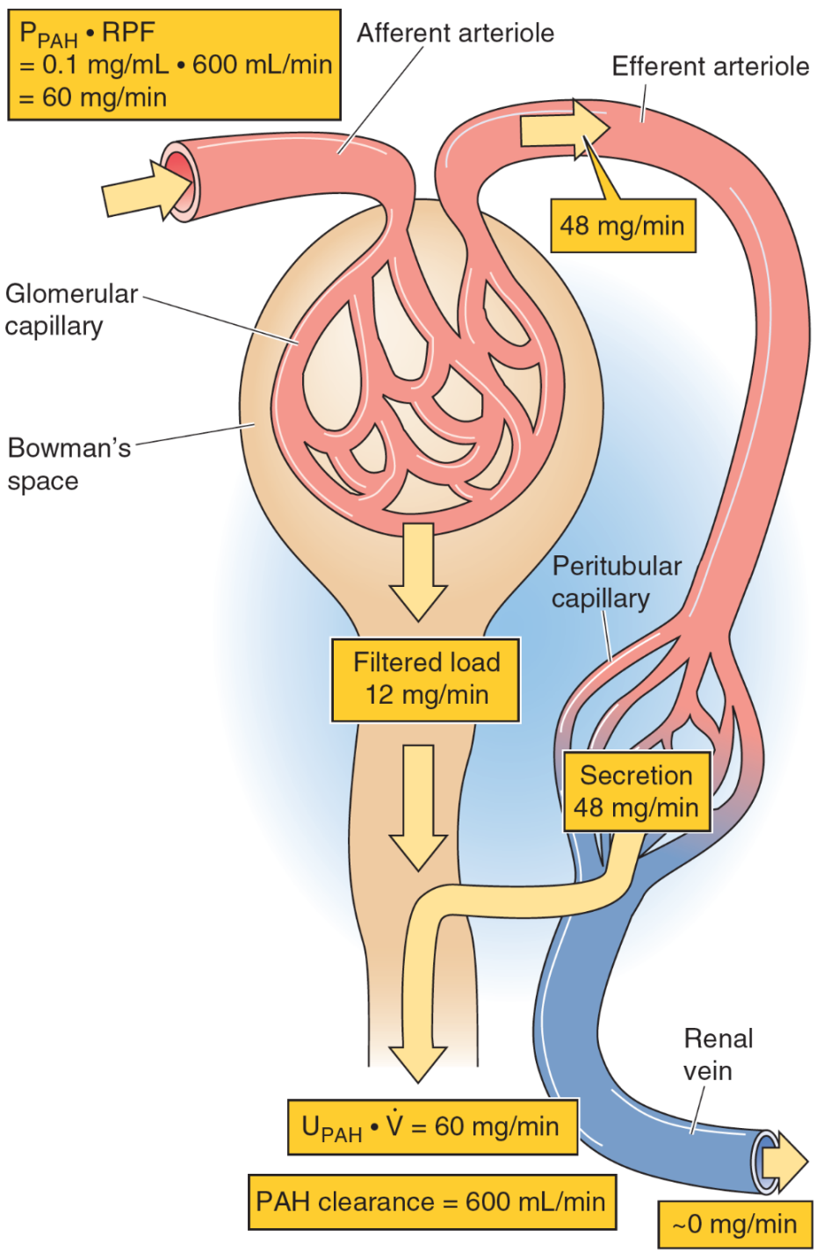
Clearance method to measure RPF
Criteria of substance used
filtered + secreted
NOT reabsorbed
■ PAH
Amount of PAH excreted = Amount filtered + amount secreted
■ 100% removed on passage through the kidney:
[U]_{x} . Ṽ
Cl_{PAH} = RPF =
[P]_{x}
48
Notes:
PCT, proximal convoluted tubule; Cl, clearance.
p-Aminohippuric acid (PAH)
Because PAH is an organic acid that is not normally present in the body, PAH must be administered by continuous intravenous infusion. Some PAH binds to plasma proteins, but a significant amount remains freely dissolved in the plasma and therefore filters into Bowman’s space. However, the kidney filters only ~20% of the renal plasma flow (i.e., FF = ~0.2), and a major portion of the PAH
remains in the plasma that flows out of the efferent arterioles. PAH diffuses out of the peritubular capillary network and reaches the basolateral surface of the proximal tubule cells. These cells have a high capacity to secrete PAH from blood into the tubule lumen against large concentration gradients. This PAH secretory system is so efficient that—as long as we do not overwhelm it by infusing
too much PAH—almost no PAH (~10%) remains in the renal venous blood. We assume that all the PAH presented to the kidney appears in the urine.

Slide 9
A patient is infused with PAH to measure renal blood flow. She has a urine flow rate of 1 mL/min, a plasma [PAH] of 1 mg/mL, a urine [PAH] of 600 mg/mL, and a hematocrit of 45%. What is her RBF?
555 mL/min
600 mL/min
660 mL/min
1,091 mL/min
1,333 mL/min
[U]_{x} . Ṽ
600 mg/mL x 1 mL/min
Cl_{PAH} = RPF =
=
= 600 mL/min
[P]_{x}
1 mg/min
RBF = 600 / (1-0.45) = 1,091 mL/min
Notes:
Answer is d.

Slide 10
Glucose Reabsorption
From tubular lumen to tubular cell: Sodium co-transporter (Carrier-mediated secondary active transport).
Uphill transport of glucose driven by electro-chemical gradient of sodium, which is maintained by Na-K pump presents in basolateral cell membrane.
From tubular cell to peritubular capillary: Facilitated diffusion (Carrier-mediated passive transport)

Slide 11
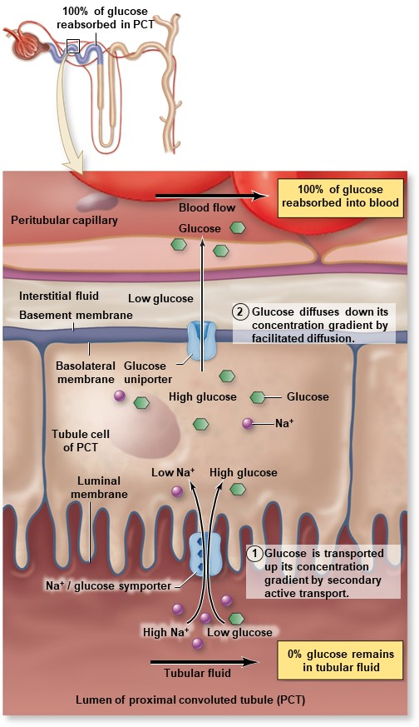
Glucose Reabsorption

Slide 12
Tubular transport maximum
It is the maximal amount of a substance (in mg) which can be transported (reabsorbed or secreted) by tubular cells/min.
Many substances are reabsorbed by carrier mediated transport systems e.g. glucose, amino acids, organic acids…
Carriers have a maximum transport capacity (T_{m}) which is due to saturation of the carriers. If T_{m} is exceeded, then the excess substrate enters the urine.
Glucose is freely filtered, so whatever its [plasma] that will be filtered.

Slide 13
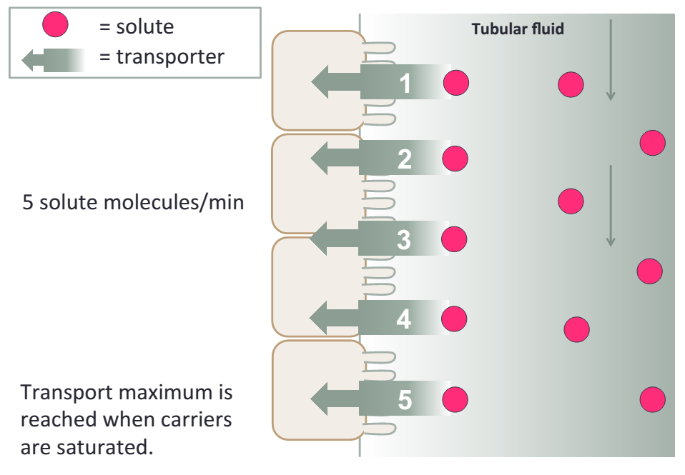

Slide 14
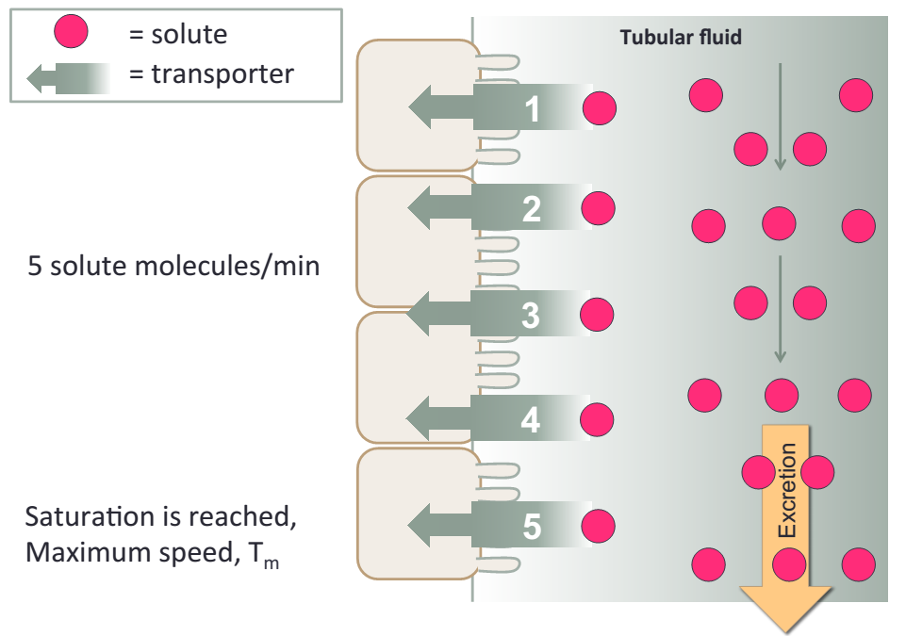

Slide 15
Tubular Transport Maximum
The plasma concentration at which the Tmax of glucose is reached and the glucose is first appearing in the urine is called Renal Plasma Threshold of glucose.
(If plasma [glucose] = 275 mg/dl, 275 mg/dl will be filtered, 180mg/dl reabsorbed and 95 mg/dl may be excreted.)
Kidney does NOT regulate [glucose], (insulin and glucagon). Normal [glucose] of 90 mg/dl, so T_{m} is set way above any possible level of (non-diabetic) [glucose] at 375 mg/min. Thus, ensure that all this valuable nutrient is normally reabsorbed. The appearance of glucose in the urine of diabetic patients = glycosuria, is due to failure of insulin, NOT, the kidney.

Slide 16
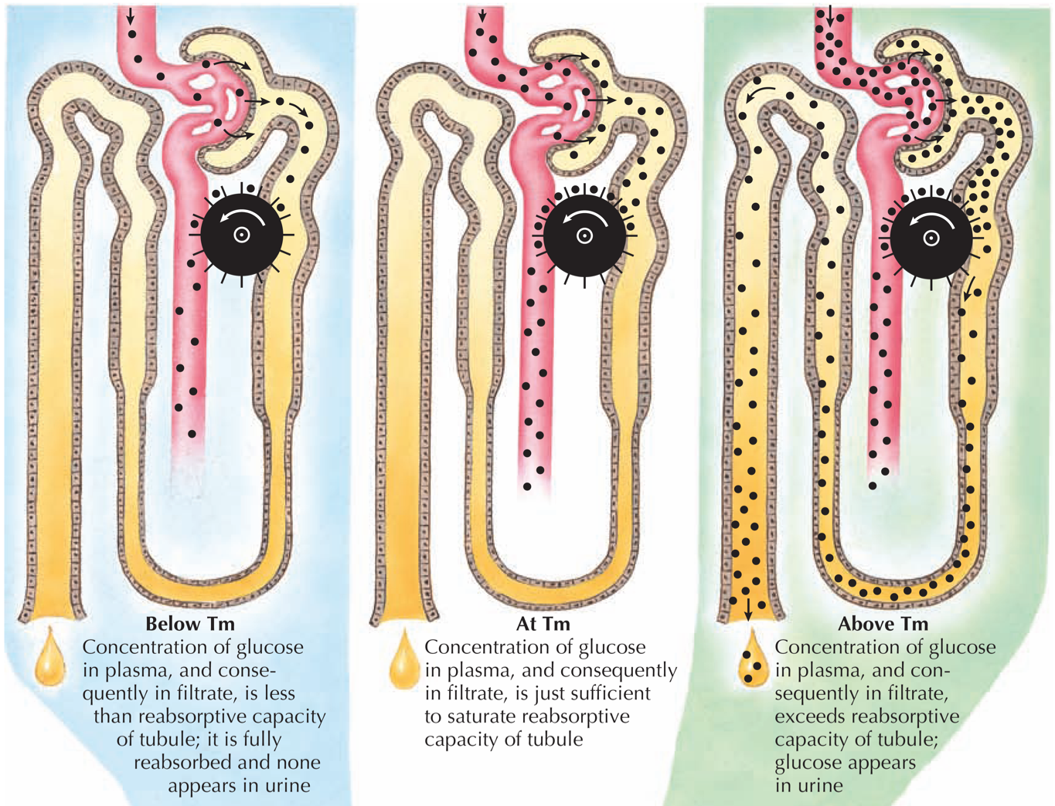
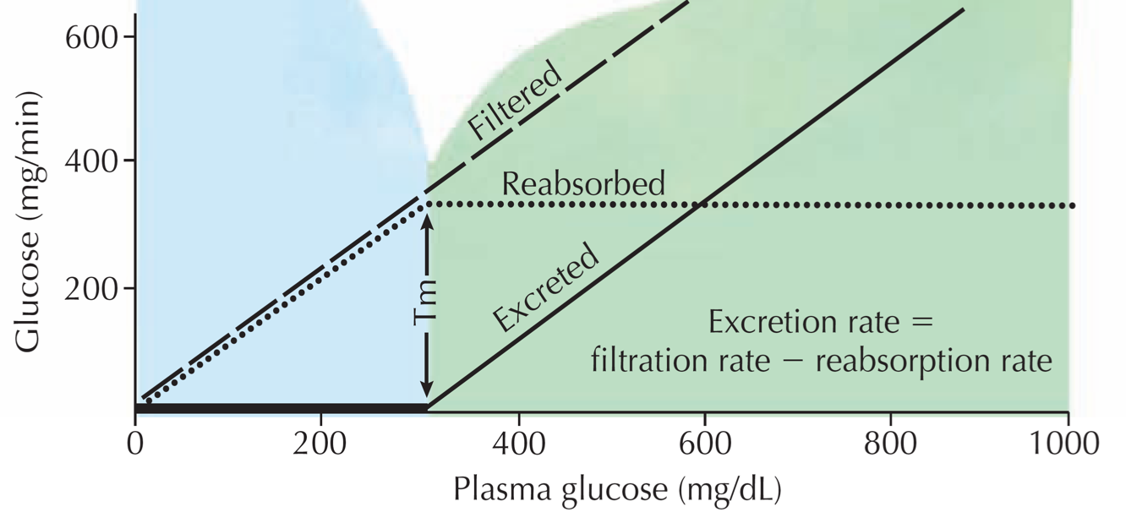
Once T_{m} is reached for all nephrons, further ↑ in tubular load are not reabsorbed, but are then excreted.
Threshold (T) is the plasma conc. at which tubular load just exceeds T_{m} for reabsorption, where below threshold all solute molecules are reabsorbed, and above threshold, some solutes are not
T
16

Slide 17
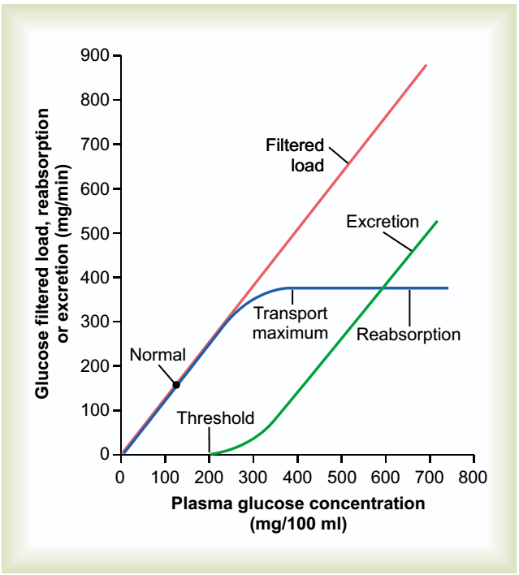

Slide 18
Thanks

