Slide 1
Diuresis
Faciliatators’ Team

Slide 2
Objectives:
To measure the volumes and determine the compositions of urine excreted by 4 groups:
Fasting
drank 1L water
drank 1L saline
took 1 tab of Lasix
To be able to discuss the mechanisms by which the body maintain the water and sodium homeostasis in these 4 different conditions.

Slide 3
Group A
Emptied their bladders at 8:00 am and discarded the urine.
From 8:00 they are restricted to take any fluids and they are asked to provide various urine samples for analysis at:
10:00 am, 12:00 noon, 2:00 pm and 3:00 pm.

Slide 4
Group B
Emptied their bladder at 10:00 am and discarded the urine.
At 12:00 noon emptied their bladder again, but this time they measured its volume and provided a sample for analysis. This sample will be pre-experimental sample.
Drank 1 liter of water immediately after providing the pre-experimental sample.
Were then asked to empty their bladders and provide post-experimental samples every half an hour after drinking water until 3:00 pm.

Slide 5
Group C
Emptied their bladder at 7:00 am and discarded the urine.
At 9:00 am emptied their bladder again, but this time they measured its volume and provided a sample for analysis. This sample will be pre-experimental sample.
Drank 1 liter of 0.9% saline (isotonic saline) immediately after providing the pre-experimental sample.
Were then asked to empty their bladders and provide post-experimental samples every hour after drinking saline until 3:00 pm.

Slide 6
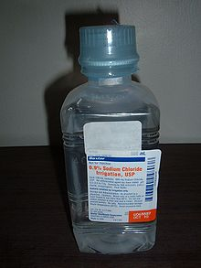
What is 0.9% saline (isotonic saline)?
contains 154 mmol of NaCI, equivalent to 9 g of salt or 3.6 g of sodium.
The sodium concentration of isotonic saline is equivalent to the normal sodium concentration of plasma water.

Slide 7
Group D
Emptied their bladder at 8:00 am and discarded the urine.
At 10:00 am emptied their bladder again, but this time they measured its volume and provided a sample for analysis. This sample will be pre-experimental sample.
Swallowed a Lasix (Furosemide) tablet 40 mg with the help of 25 ml of water immediately after providing the pre-experimental sample.
Were then asked to empty their bladders and provide post-experimental samples every half hour after taking Lasix until 3:00 pm.

Slide 8
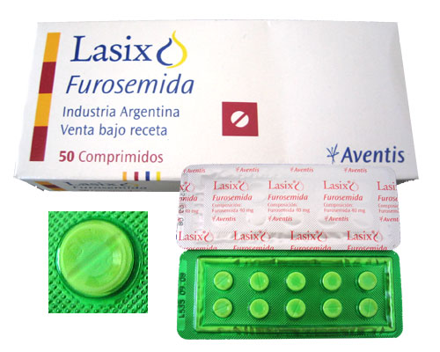
What is Lasix?
Furosemide is a loop diuretic
Its also called osmotic diuretic
used in the treatment of
hypertension, congestive
heart failure and edema.
It inhibits the sodium-potassium- 2 chloride co-transport system located within the ascending limb of the Loop of Henle.

Slide 9
Urine samples used to determine:
Volume ( measuring cylinder)
Sodium and potassium concentration ( flame photometry)
PH ( PH meter)
Osmolality ( Osmometer)

Slide 10
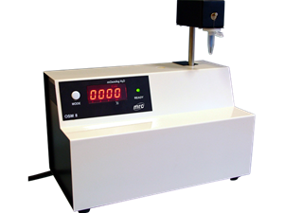
Flame photometry
Osmometer

Slide 11
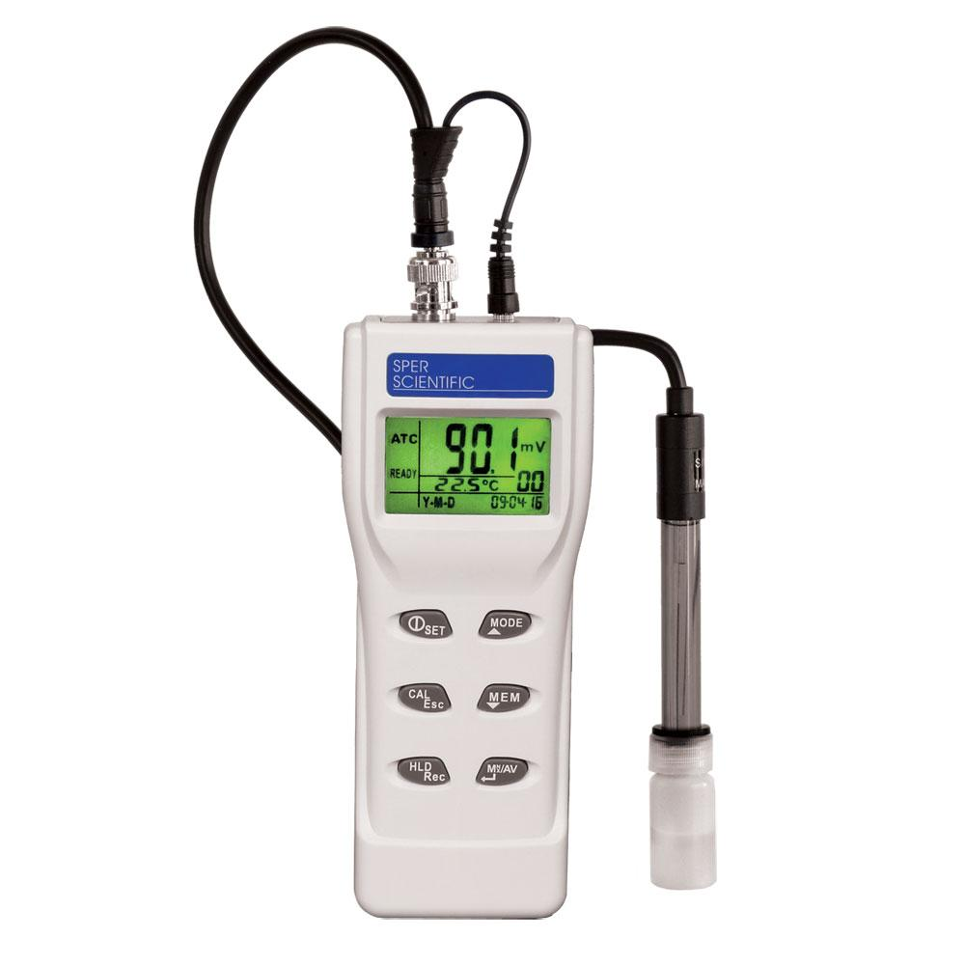
Measuring cylinder
PH meter

Slide 12
Table of results

Slide 13
Calculation
Total sodium excretion is obtained by applying following equation:
Sodium excretion rate is obtained by applying the following equation:

Slide 14
Group A
What will happen?
Subsequent urine sample is lesser in volume and darker yellow in color that shows the kidneys try to conserve water in fasting state.

Slide 15
Group A
Deprive of H2O
1
Plasma Osmolarity
2
Stimulates Osmoreceptors in anterior hypothalamus
Thirst
3
3
ADH secretion from posterior pituitary
H2O drinking
4
H2O permeability in late distal tubule and collecting duct
5a
Plasma Osmolarity Toward Normal
H2O reabsorption
5b
Urine osmolarity and urine volume
6

Slide 16
Group B results

Slide 17
Group B

Slide 18
Group B

Slide 19
Group B
m
1
Drink 1L H2O
Plasma Osmolarity
2
3
Thirst
Inhibits osmoreceptors in anterior hypothalamus
3
ADH secretion from posterior pituitary
H2O drinking
4
H2O permeability in late distal tubule and
collecting duct
5a
H2O reabsorption and excretion
Plasma osmolarity toward Normal
5b
Urine Osmolarity and
urine volume
6

Slide 20
Group C results

Slide 21
Group C

Slide 22
Group C

Slide 23
Group C
Isotonic Saline (0.9%)
1 liter
Volume of E.C.F. Osmolality same (as isotonic saline) total solute amount
Stretch on right atrium (volume receptors in right atrium)
ANP (Atrial Natriuretic peptide)
Na excretion by Kidneys

Slide 24
Group D results

Slide 25
Group D

Slide 26
Group D

Slide 27
Group D
1 tab of Lasix (furosemide) (40mg)
with 25ml of water
Action starts 1-2 hours and lasts for 4-6 hours
(1/2 life of furosemide is 6hr)
Acts on thick ascending limb of loop of Henle and blocks the Na-K-2Cl co-transport (called loop diuretic)
Na excretion in urine and water excretion (osmotic drag)

Slide 28
Urine Flow Rate for all groups

Slide 29
Sodium Excretion Rate for all groups

Slide 30
Thank you

