Slide 1
The Kidney
Editing file
Important
Doctor notes / Extra

Slide 2
Objectives:
By the end of this lecture, the student should be able to describe:
The microscopic structure of the renal cortex and medulla.
The histology of renal corpuscle, proximal and distal tubules, loop of Henle, and collecting tubules & ducts.
The histological structure of juxtaglomerular apparatus.
The functional structures of the different parts of the kidney.

Slide 3
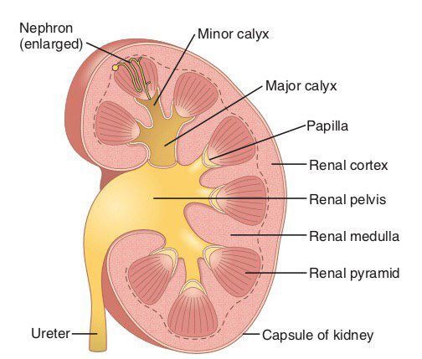
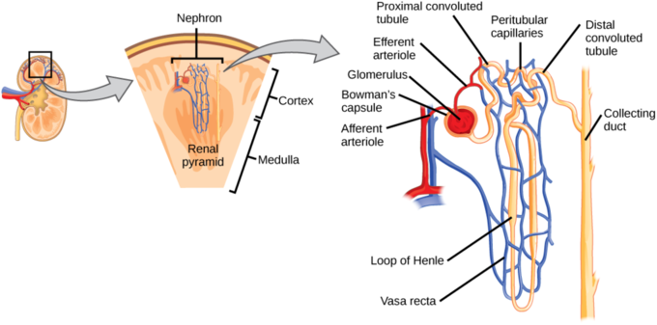
The kidney
Cortex: Dark brown and granular.
Medulla: 6-12 pyramid-shape regions (renal pyramids)
The base of pyramid is toward the cortex (cortico-medullary border)
The apex (renal papilla) toward the hilum, it is perforated by 12 openings of the ducts of Bellini in region called area cribrosa . The apex is surrounded by a minor calyx.
3 or 4 minor calyces join to form 3 or 4 major calyces that form renal pelvis.
Pyramids are separated by cortical columns of Bertin.
Uriniferous tubule
It is the functional unit of the kidney.
Is formed of:
Nephron.
Collecting tubule.
The tubules are densely packed. The tubules are separated
by thin stroma and basal lamina.v

Slide 4
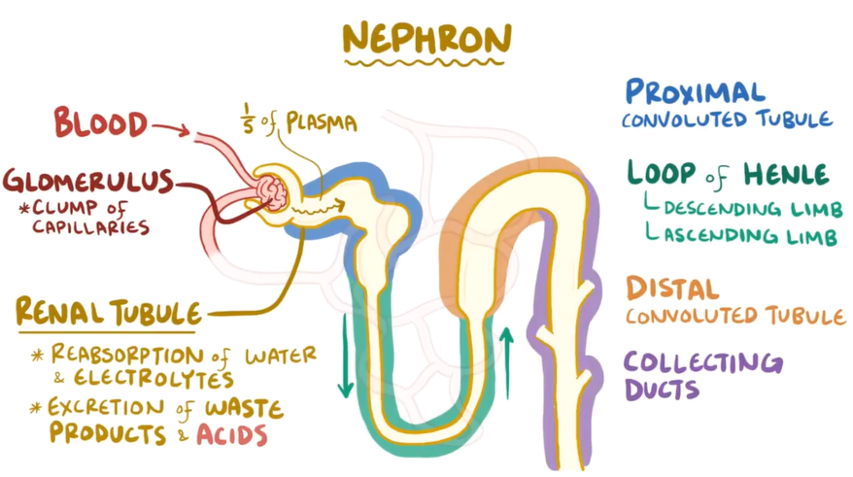
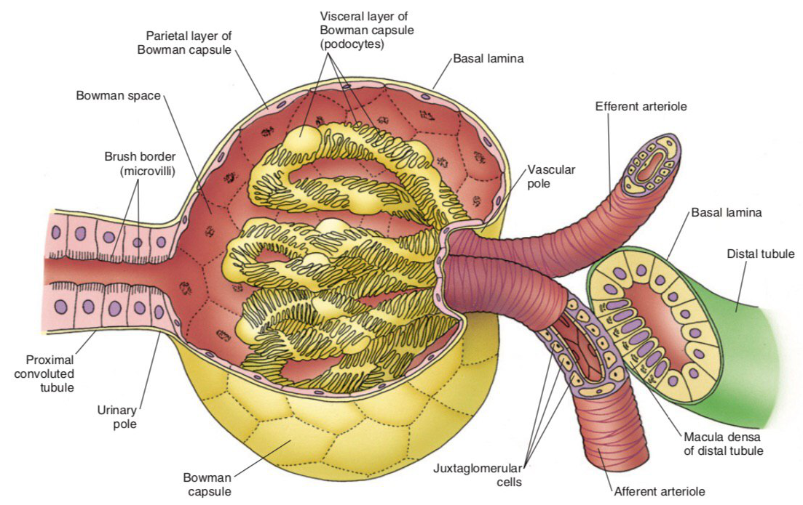
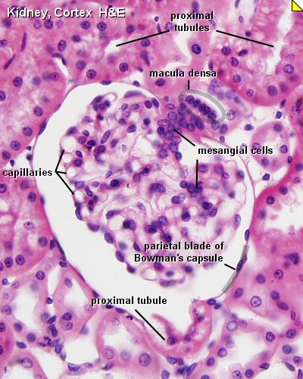
Nephron
There are 2 types of nephrons:
a- Cortical nephrons. 85% of nephrons
b- Juxtamedullary nephrons.
It is formed of :
Renal corpuscle.
Proximal tubule.
Thin limbs of Henle’s loop.
Distal tubule
1. Renal corpuscle
The renal corpuscle is composed of a tuft of capillaries, the glomerulus, surrounded by Bowman's capsule
Bowman’s capsule; (Parietal layer, urinary space and visceral layer or podocytes).
Glomerulus; (tuft of fenestrated capillaries "without diaphragm”)
Mesangial cells; (intra-glomerular cells).

Slide 5
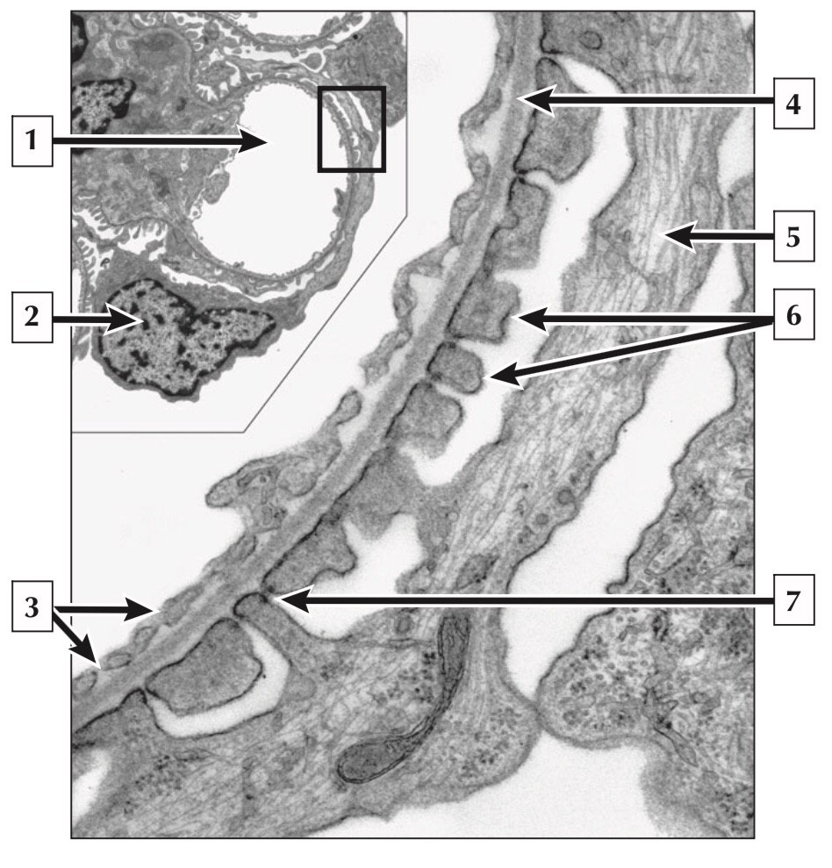
Glomerular Filtration Barrier
Endothelial wall of the glomerular capillaries.
The glomerular basal lamina (inner and outer laminae rarae and middle lamina densa).
Visceral layer of Bowman’s capsule (podocytes)
Podocytes have primary (major) processes and secondary (minor) processes “pedicles”.
Between pedicles (on the surface of capillaries) there are filtration slits that have filtration slit diaphragms
Glomerular capillary
Nucleus of podocyte
Fenestrae of capillary endothelial cell
Basement membrane
Primary process of podocyte
Pedicels of podocyte
Slit membrane

Slide 6
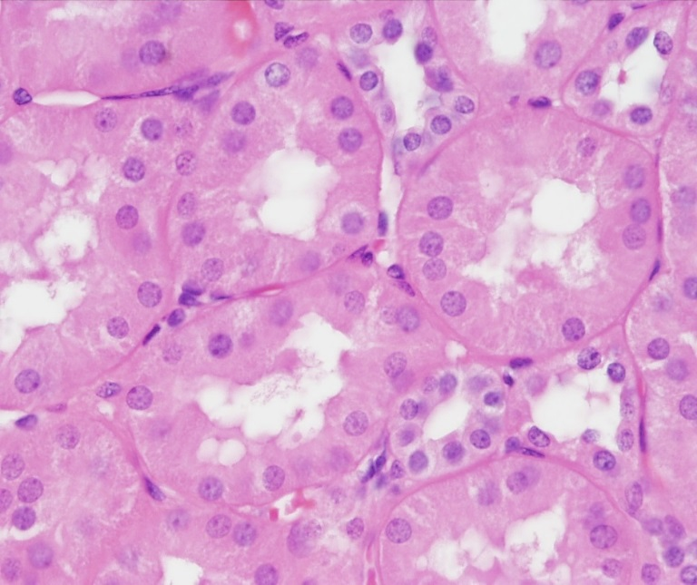
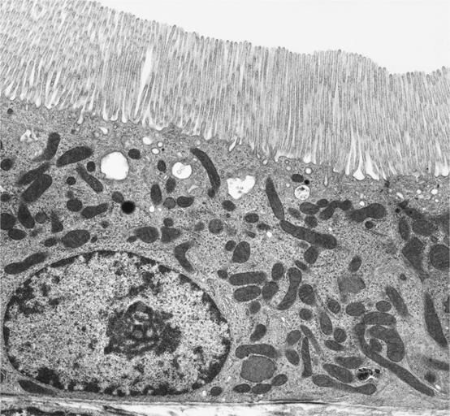
2. Proximal convoluted tubule
It is composed of simple cuboidal epithelium with acidophilic cytoplasm.
The cells have striated or brush border and lateral
inter-digitations.
They have well-defined basal lamina.
thick wall and brushy lumen
proximal tubular malformation cause renal glucosuria
3. Thin limbs of Henle’s loop
It has 3 regions:
Descending thin limb.
Crest of Henle’s loop.
Ascending thin limb.
NB: It is longer in juxta-medullary nephron than in cortical nephron.
It is composed of simple squamous epithelium.

Slide 7
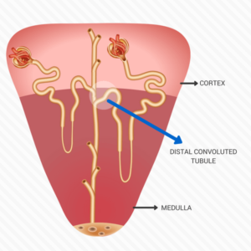
4. Distal convoluted tubule
It starts at the macula densa.
macula densa (tall columnar & narrow cells)
The Distal convoluted tubule is formed of low cuboidal epithelium.
NB: Because distal convoluted tubules are much shorter than proximal convoluted tubules, any section of renal cortex presents many more sections of proximal convoluted tubules.
Distal tubules drain into collecting tubules.
thin wall clear lumen
no brush border , no microvilli
sensory cell

Slide 8
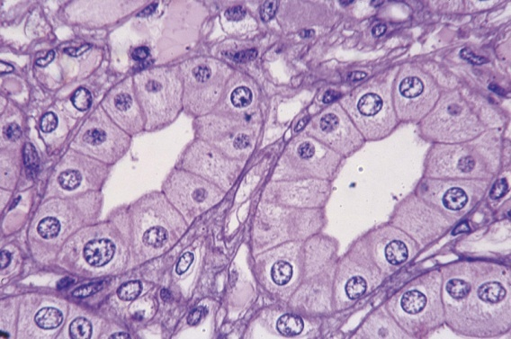
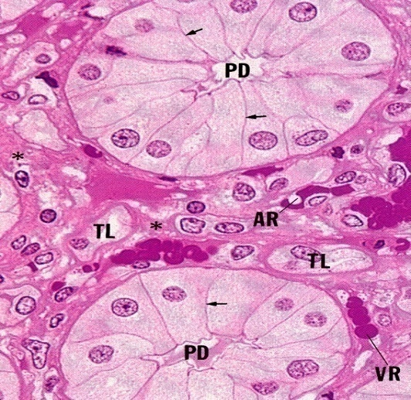
Collecting tubules
Endothelial wall of the glomerular capillaries.
Are composed of simple cuboidal epithelium.
They aren’t part of nephron.
They have 3 regions:
Cortical: Simple Cuboidal Epithelium.
Medullary: Simple Cuboidal Epithelium.
Papillary ducts (ducts of Bellini): Simple Columnar Epithelium.
They open in area cribrosa.
They are impermeable to water except in presence of ADH.
Renal interstitium
It is a very flimsy, scant amount of loose connective tissue that contains:
Fibroblasts.
Macrophages.
Interstitial cells : They secrete medullipin I, which is converted in the liver into medullipin II, that lowers blood pressure.

Slide 9
Quiz
1.A 2.C 3.C 4.A 5.B 6.C
1. the lining of the proximal convoluted tubule differs from the distal due to the presence of which structure?
brush border
simple squamous epithelium
nephrons
vasa recta
2. the thin limb of the loop of Henle is lined by:
Simple Cuboidal Epithelium
Simple Columnar Epithelium
simple squamous epithelium.
stratified squamous epithelium.
3. distal tubule drain into
proximal tubule
Thin limbs of Henle’s loop
collecting duct
Renal corpuscle
4. another name of Visceral layer of Bowman’s capsule
podocytes
pedicles
Mesangial cells
area cribrosa
5. ducts of Bellini lined by:
Simple Cuboidal Epithelium
Simple Columnar Epithelium
simple squamous epithelium.
stratified squamous epithelium.
6. which one of the following cells secrete medullipin I ?
Fibroblasts.
Macrophages.
Interstitial cells
Mesangial cells

Slide 10
Histology438.sarahah.com
📧 Histology438@gmail.com
Team Members
Team Leaders
Alhanouf Alhaloli
Rawan Alzayed
Renad Alkanaan
Roaa Aljohani
Abdullah shadid
Sarah Alflaij
Done by :
Abdullah shadid

