Slide 1
URINARY PASSAGE
Editing file
Important
Doctor notes / Extra

Slide 2
Objectives:
By the end of the lecture, the student should be able to describe the microscopic structure of:
The Renal pelvis and ureter.
The urinary bladder and male and female urethra.

Slide 3
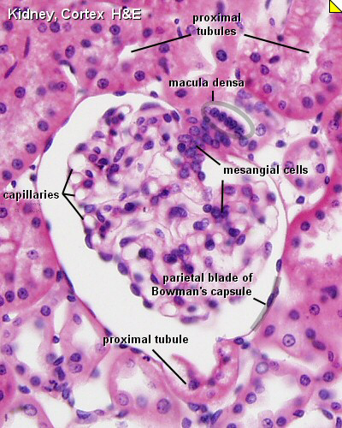
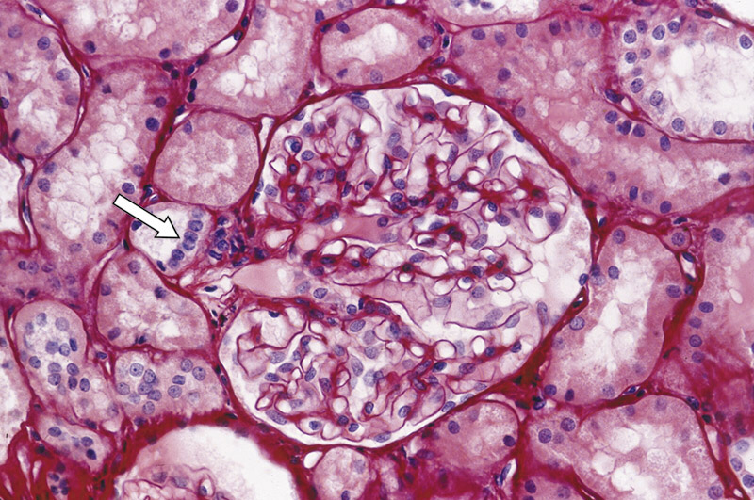
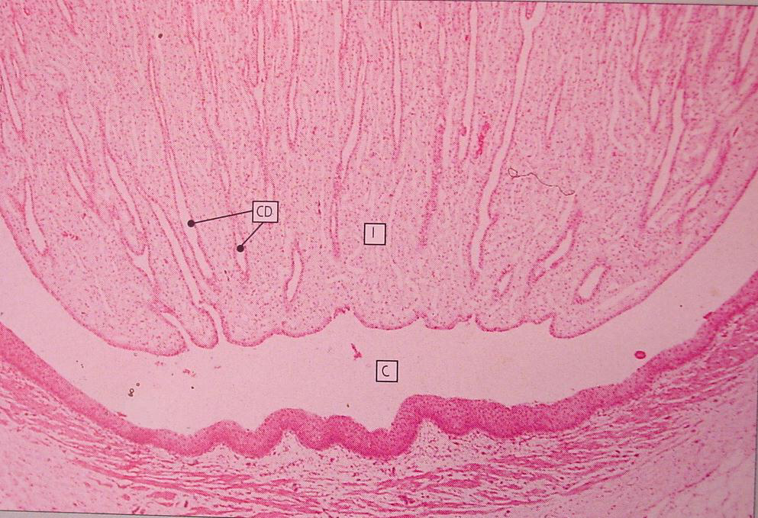
Juxtaglomerular apparatus
It has 3 components:
A-The macula densa of distal tubule, they are tall cells with centrally-placed nuclei
B-Juxtaglomerular cells of afferent glomerular arteriole, they’re modified smooth muscle of tunica media. Nuclei are round with granular cytoplasm, they secrete renin.
C-The extraglomerular mesangial cells.
The cells communicate with each others by gap junction
Renal Calyces
Each calyx accepts urine from the renal papilla of a renal pyramid.
They are lined with transitional epithelium lamina propria and smooth muscle.
Minor calyces merge to form major calyces
(with same lining tissue as minor calyces).
Major calyces open into renal pelvis.

Slide 4
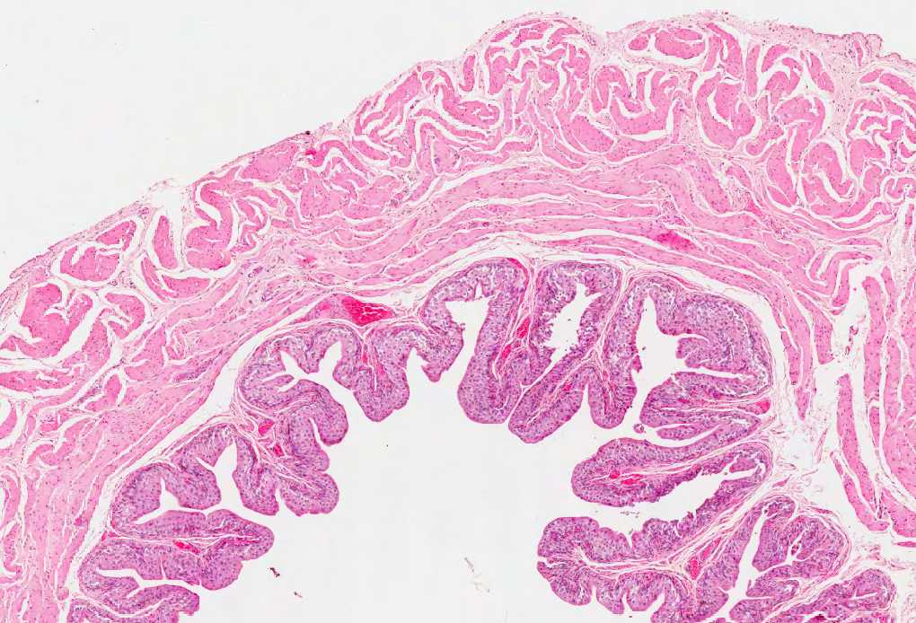
Ureter around 25cm |  | Urinary Bladder
1. Mucosa: Is formed of transitional epith. and lamina propria. |  | It has the same structure as the lower third of ureter. ( except: the urinary bladder is with serosa while ureter is without serosa)
2. Muscularis (muscular coat): |  | Superficial layer of transitional epithelium has dome-shaped cells (in empty bladder).
upper ⅔: | lower 1/3:
A- Inner longitudinal. B- Outer circular. | It has 3 layers of smooth muscle: 1) Inner longitudinal. 2) Middle circular. 3) Outer longitudinal.
3. Adventitia: fibrous C.T. covering. No serosa. |  | Its outer covering is adventitia or serosa. Part of urinary bladder cover with Adventitia and other part cover with Serosa

Slide 5
Female Urethra short and lined by : | Male Urethra long and is divided into:
A- Epithelium: 1- Transitional epith. Near the bladder. 2- Pseudostratified columnar epith. 3- Stratified squamous non-keratinized epith. | 1- Prostatic urethra: is lined with transitional epith.
B- Sub-epithelial fibroelastic CT that contains glands of Littre (mucus-secreting glands). | 2- Membranous urethra: is lined with: Stratified columnar epith. with patches of pseudustratified columnar epithelium.
C- Smooth muscle: inner longitudinal and outer circular layers. | 3- Penile (spongy) urethra: is lined with: Stratified columnar epith. with patches of pseudustratified columnar epithelium.
 | In navicular fossa ( enlarged terminal portion): Stratified squamous non-keratinized epith. The lamina propria contains mucus-secreting glands of Littre.

Slide 6
Quiz
1.B 2.D 3.B 4.A 5.A 6.D
They secrete renin
macula densa of distal tubule
Juxtaglomerular cells
extraglomerular mesangial cells
Interstitial cells
Renal Calyces lined with
Pseudostratified columnar epithelium
Stratified columnar epithelium
Stratified squamous non- keratinized epithelium
transitional epithelium
Which of the following is true about urinary bladder
Its adventitia has no serosa
Its adventitia has serosa
The structure is the same as upper third of ureter
has 2 layers of smooth muscle
4. Prostatic urethra is lined with
transitional epithelium
Pseudostratified columnar epithelium
Stratified columnar epithelium
None of them
5. Sub-epithelial fibroelastic C.T in female contain
glands of Littre
patches pseudostratified columnar epithelium
navicular fossa
All
6. What is the correct passage of urine out of these sequences
Renal pyramid > major calyces > minor calyces > renal pelvis
Major calyces > minor calyces > renal pyramid > renal pelvis
Renal pelvis > major calyces > minor calyces > renal pyramid
Renal pyramid > minor calyces > major calyces > renal pelvis

Slide 7
Histology438.sarahah.com
📧 Histology438@gmail.com
Team Members
Team Leaders
Alhanouf Alhaloli
Rawan Alzayed
Renad Alkanaan
Roaa Aljohani
Abdullah shadid
Sarah Alflaij

