Slide 1
Introduction to Anatomy and Skeletal System

Slide 2
OBJECTIVES
By the end of the lecture, you should be able to:
Define the word “Anatomy”.
Enumerate the different anatomical fields.
Describe the anatomical position.
Describe different anatomical terms of position & movements as well different anatomical planes.
Classify bones according to shape, structure & development.
Enumerate different bones of both axial & appendicular skeleton.

Slide 3
WHAT IS ANATOMY?
The word anatome is of Greek origin meaning cutting up (ana= up; tome= cutting).
Gross (macroscopic) anatomy: Study of human body with naked eye.
Microscopic anatomy; (Histology): Study of fine structure (cells & tissues) of the human body with the help of microscope.
Developmental anatomy; ( Embryology).
Radiological anatomy.
Applied anatomy.
Surface anatomy.
Surgical anatomy.

Slide 4
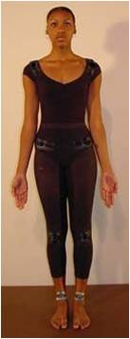
ANATOMICAL POSITION
It is the standard position in which the body assume to describe its parts.
Body is erect
Arms hanging by the side
Palm facing forward
Feet are parallel

Slide 5
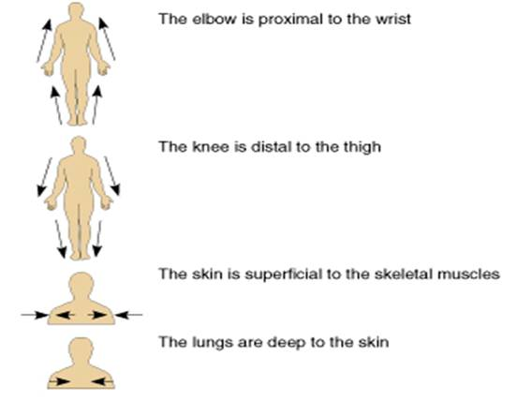
ANATOMICAL TERMINOLOGY
Superior (cranial): near to head.
X Inferior (caudal): away from head.
Anterior (ventral): near to front.
X Posterior (dorsal): near to back.
Medial: near to median plane.
X Lateral: away from median plane
Proximal: near to trunk.
X Distal: away from trunk.
Superficial: near to skin (surface).
X Deep: away from skin.

Slide 6
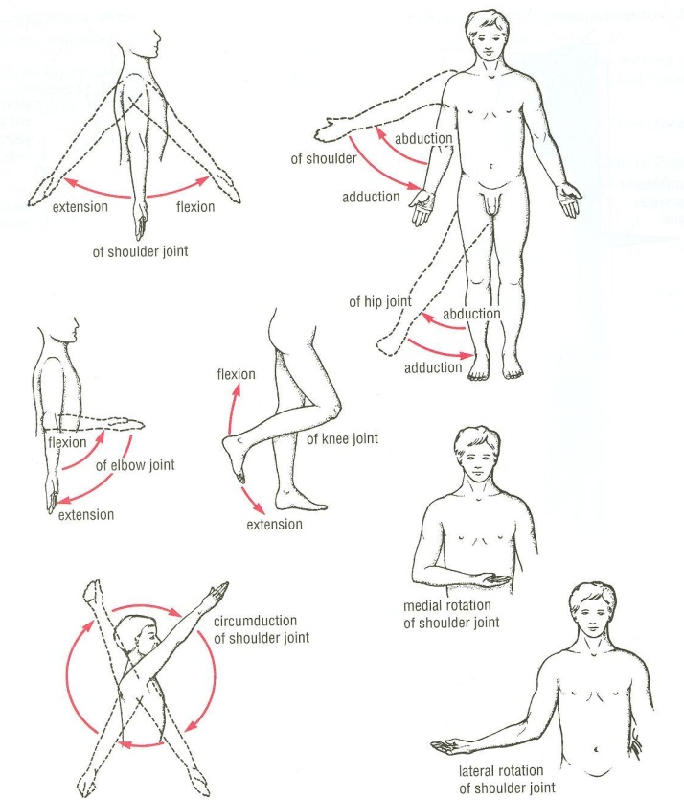
ANATOMICAL TERMINOLOGY
TERMS OF GENERAL MOVEMENTS
Flexion: approximation of 2 parts (decreasing the angle between 2 parts).
X Extension: straightening (increasing the angle between 2 parts).
Abduction: away from median plane.
X Adduction: toward median plane.
Lateral rotation: rotation away from median plane.
X Medial rotation: rotation toward median plane.
Circumduction: combined movements of flexion, extension, abduction & adduction.

Slide 7
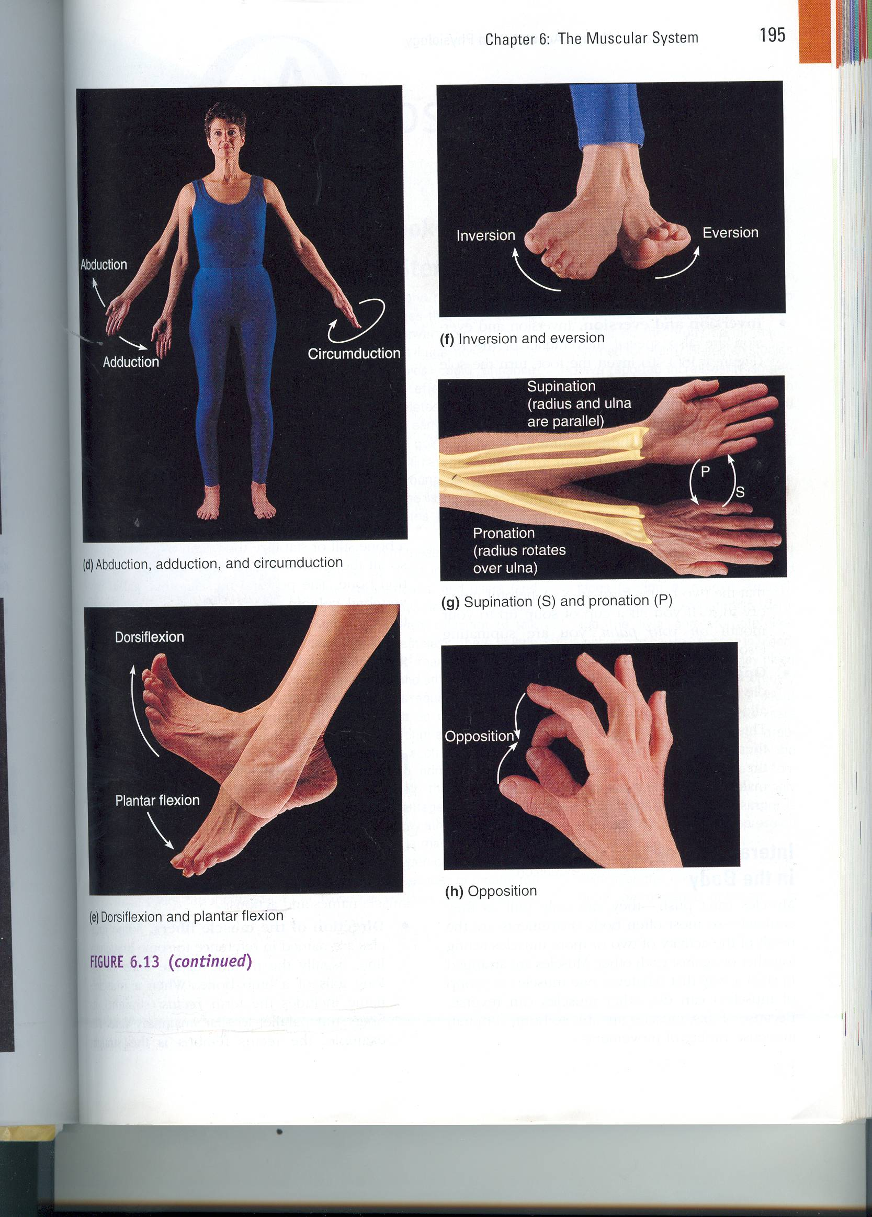
Special Movements Of Upper Limb
Opposition: bringing tips of fingers and thumb together as in picking something up

Slide 8
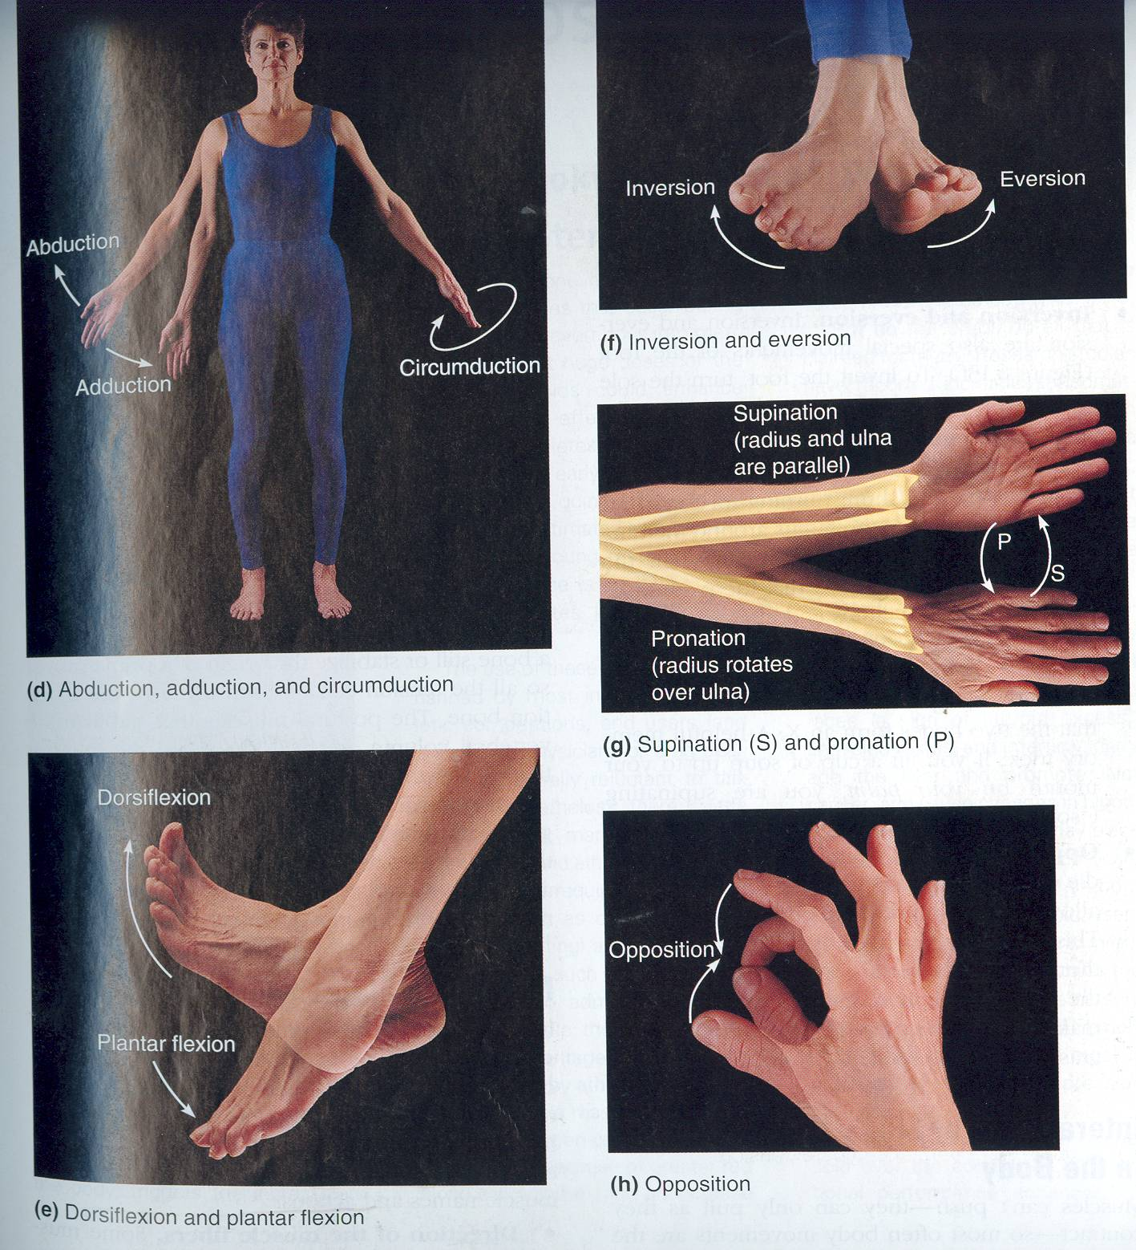
Special Movements Of Upper Limb
Supination:
Lateral rotation of the forearm.
The palm faces Anteriorly.
The radius and ulna are Parallel.
Pronation:
Medial rotation of the forearm.
The palm faces Posteriorly
The radius Crosses the ulna and the two bones form an X.

Slide 9
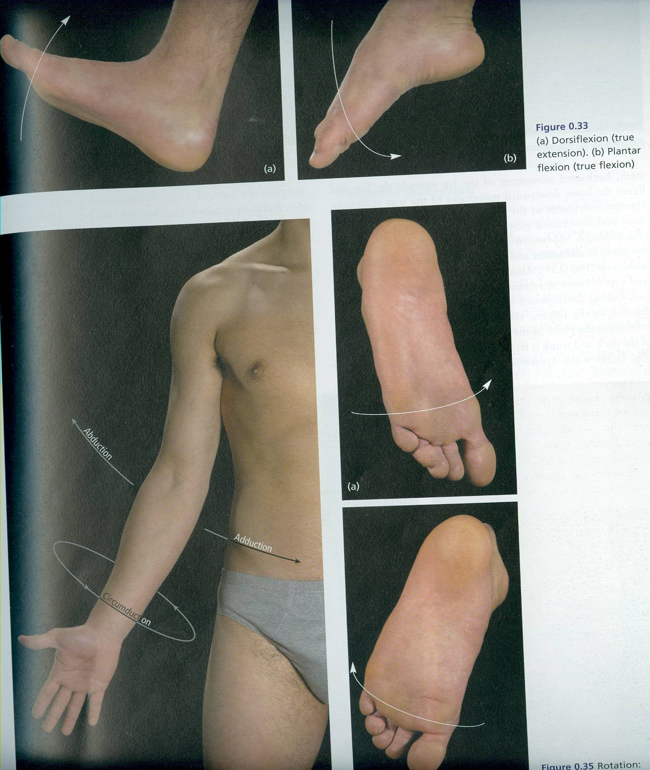
Special Movements Of Lower Limb
Dorsiflexion
Up movement of the foot
(Standing on the heels)
Planter Flexion:
Depressing the foot (down ).
Movement with pointing the toes.

Slide 10
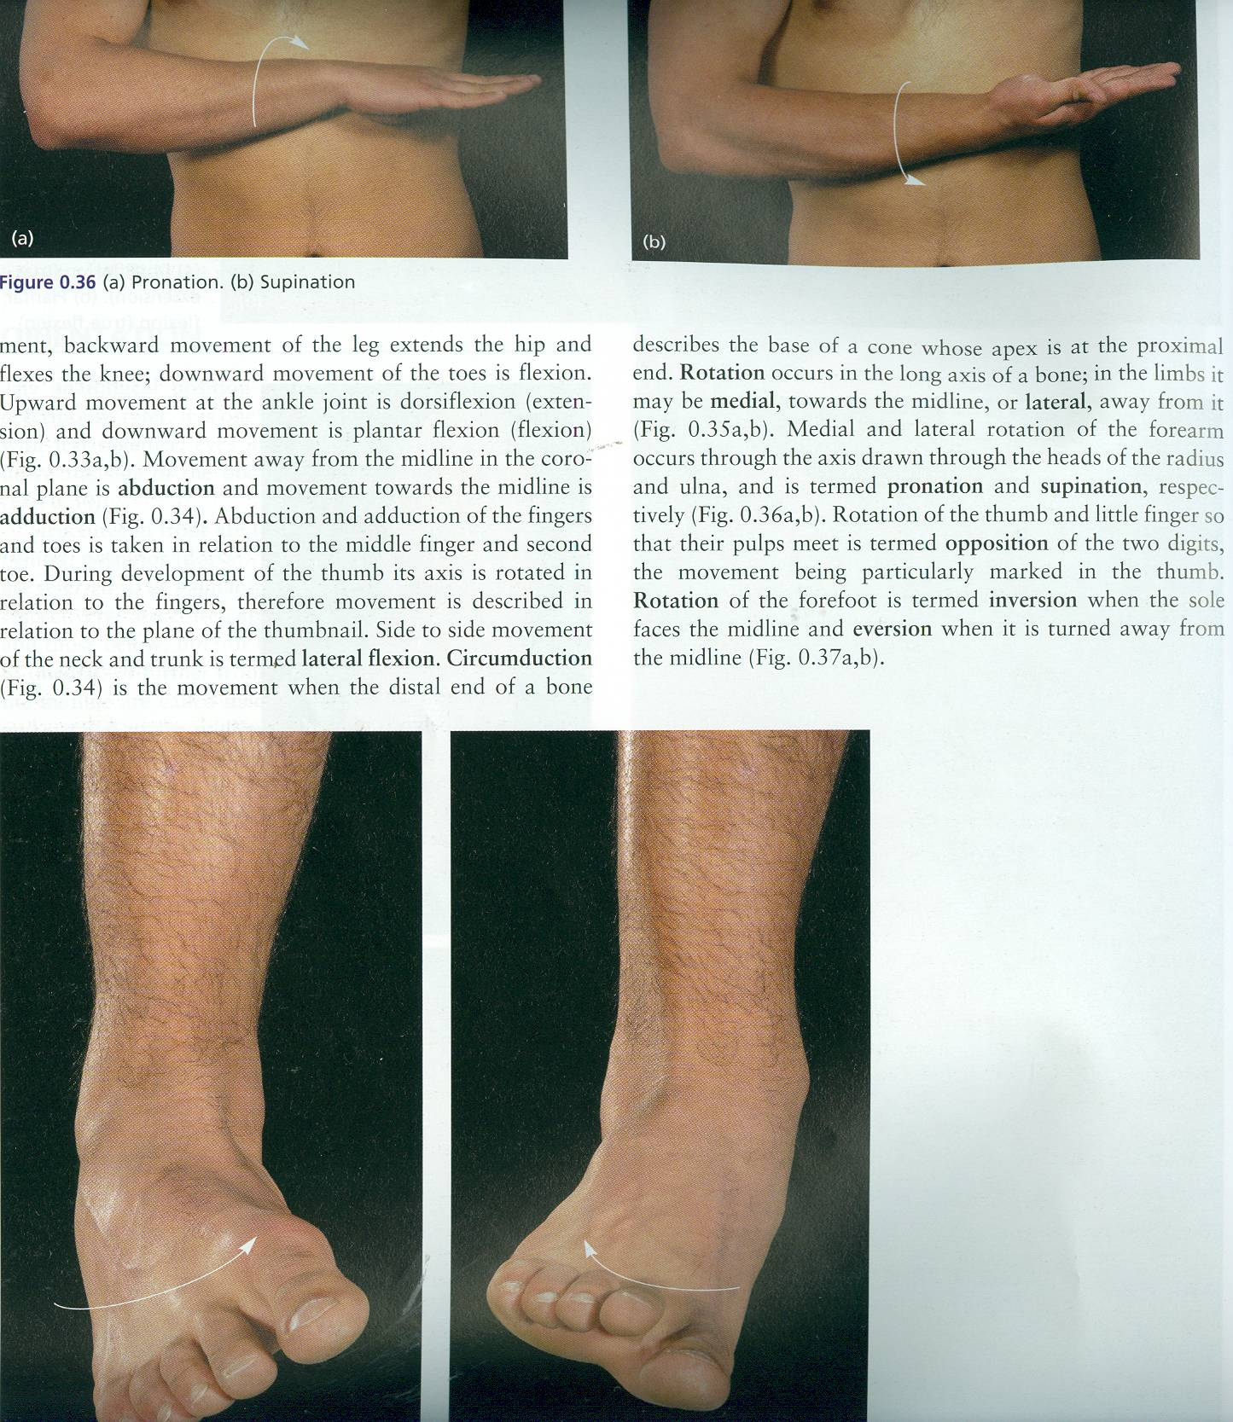
Special Movements Of Lower Limb
Inversion :
The sole faces in a Medial direction.
Eversion :
The sole faces in a Lateral direction

Slide 11
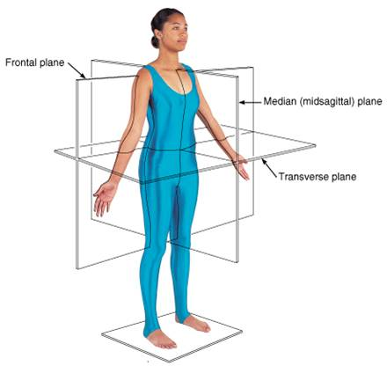
ANATOMICAL PLANES & SECTIONS
Sagittal (median): divides the body into 2 equal halves (right & left).
Parasagittal (paramedian):
divides the body into 2 unequal parts (right & left).
Frontal (coronal):
divides the body into anterior & posterior parts.
Transverse (cross): divides the body into superior & inferior .parts

Slide 12
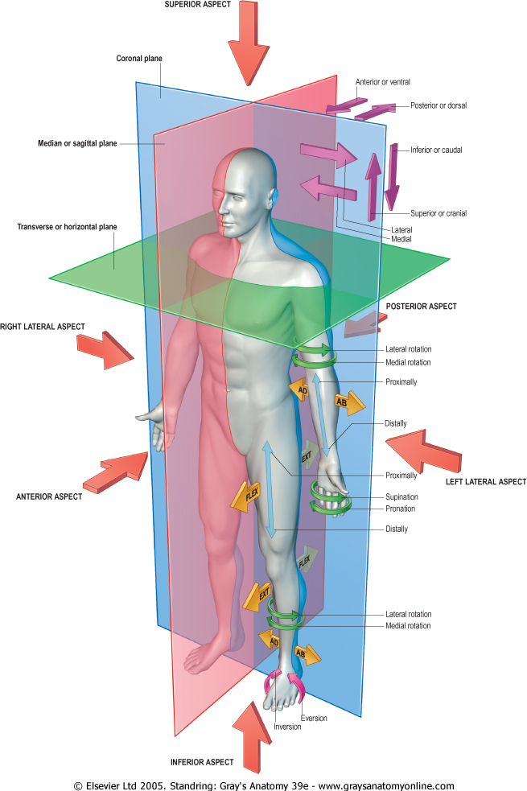
PLANES, TERMS OF POSITION & TERMS OF MOVEMENT

Slide 13
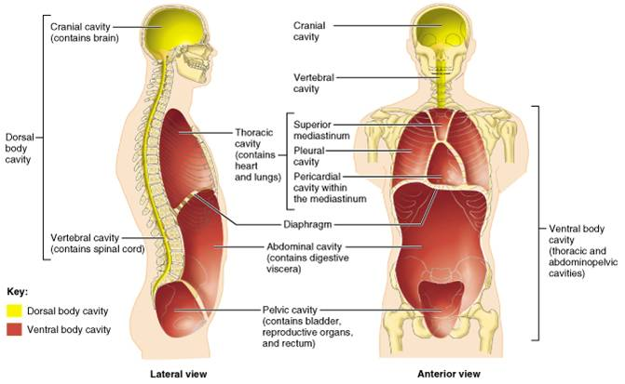
BODY CAVITIES
Ventral body cavity: divided by diaphragm into:
Thoracic cavity: superior to diaphragm, contains heart & lungs.
Abdominal cavity: inferior to diaphragm, contains stomach, intestine, liver, urinary bladder, etc…
Dorsal body cavity: divided into 2 parts continuous with each other:
Cranial cavity: space inside skull, contains brain
Spinal cavity: space inside vertebral column, contains spinal cord

Slide 14
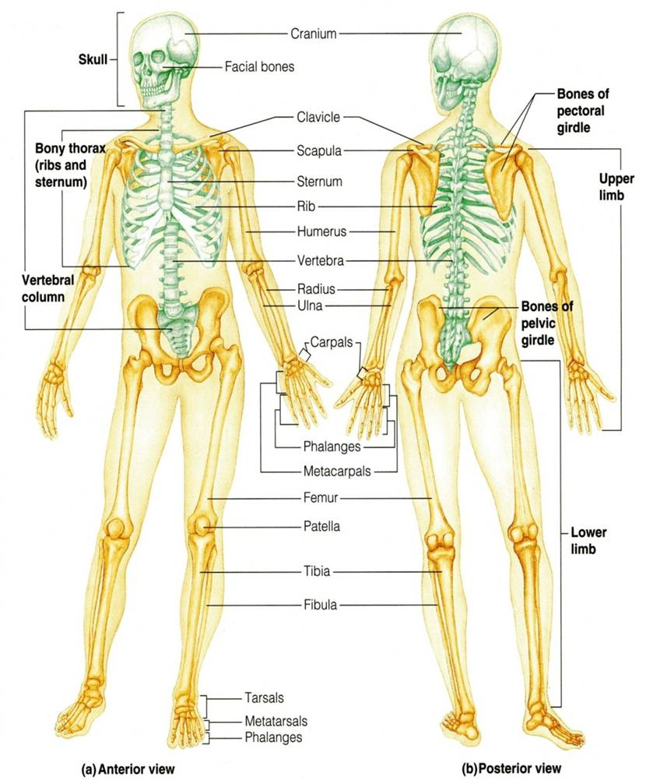
SKELETAL SYSTEM
Includes:
Bones
Joints: articulations between bones

Slide 15
FUNCTIONS OF BONE
Support: of the body.
Storage: of fat and minerals e.g. calcium and phosphorus.
Protection: of soft body organs.
Attachment: of muscles.
Movement: of the body as a whole, or of the body parts.
Blood cell formation.

Slide 16
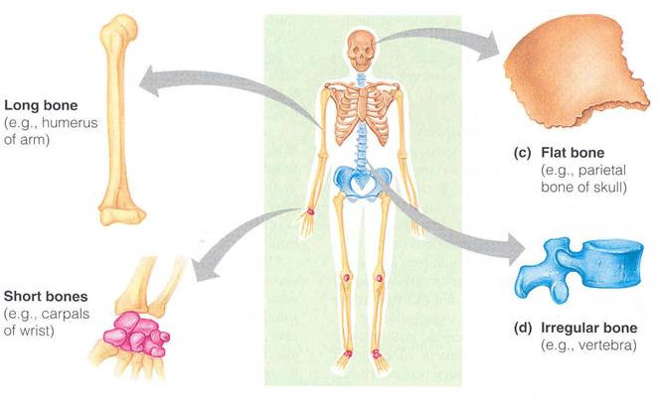
CLASSIFICATION OF BONE
Bones are classified on the bases of their:
Shape:
Long,
Short,
Flat,
Irregular.
Structure:
Compact,
Spongy.
Development:
Membrane,
Cartilage.

Slide 17
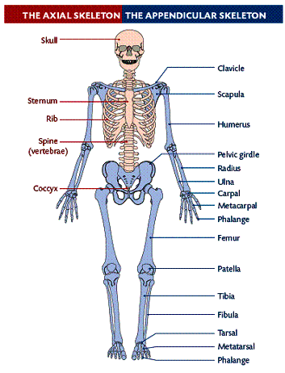
THE SKELETON
Formed of 206 bones.
Divided into:
1. Axial skeleton:
Bones forming the trunk (longitudinal axis) of body.
2. Appendicular skeleton:
Bones forming the girdles & limbs.

Slide 18
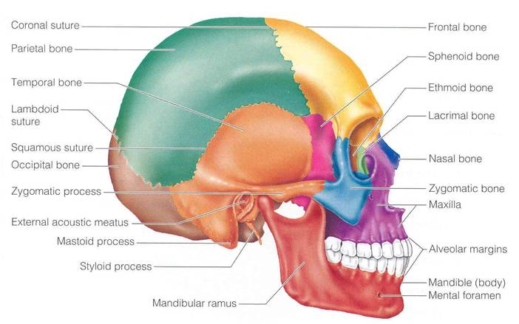
BONES OF AXIAL SKELETON
SKULL
Consists of:
Cranium:
bones enclosing brain:
- Frontal
- Occipital
- Parietal
- Temporal
Facial bones:
bones of face:
- Maxilla
- Nasal
- Zygomatic
- Mandible.

Slide 19
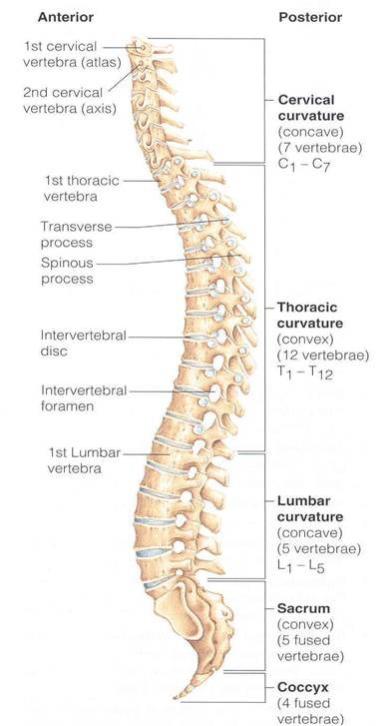
BONES OF AXIAL SKELETON
VERTEBRAL COLUMN
Number: 33 vertebrae.
Functions: protects spinal cord and supports the body.
Formed of:
7 cervical vertebrae.
12 thoracic vertebrae.
5 lumbar vertebrae.
5 sacral vertebrae fused to form sacrum.
4 coccygeal vertebrae fused to form coccyx.

Slide 20
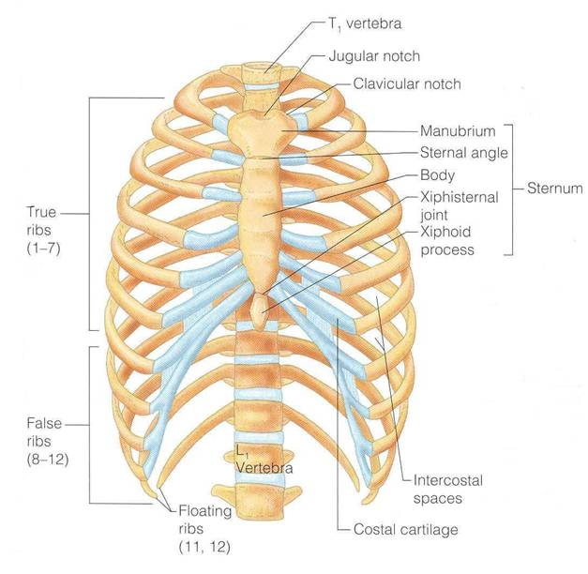
BONES OF AXIAL SKELETON
STERNUM
Has 3 parts:
Manubrium,
Body &
Xiphoid process.
RIBS
12 pairs:
All ribs articulate with vertebrae.
Only upper 7 pairs articulate with sternum, (true ribs).
8th ,9th & 10th ribs are false ribs.
11th & 12th ribs are floating ribs.

Slide 21
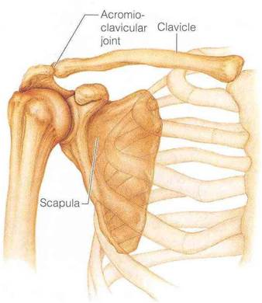
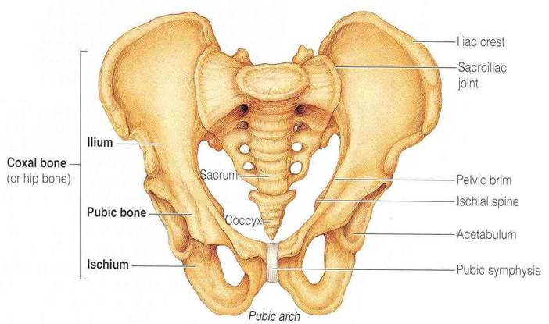
BONES OF APPENDICULAR SKELETON
PECTORAL GIRDLE
Connects upper limb with axial skeleton.
Formed of:
Clavicle &
Scapula.
(2 bones on each side)
PELVIC GIRDLE
Connects lower limb with axial skeleton.
Formed of:
Hip bone,
(one only on each side).

Slide 22
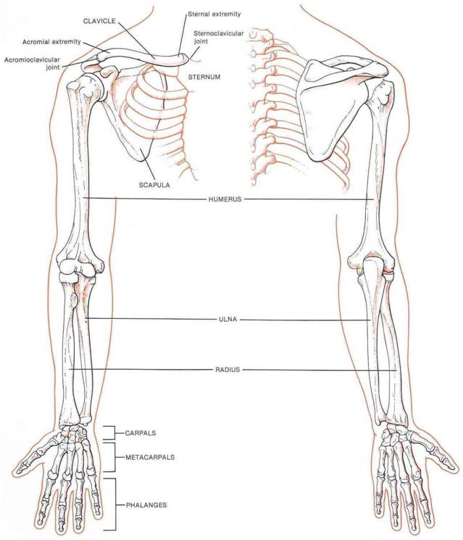
BONES OF APPENDICULAR SKELETON
UPPER LIMB
Bone of arm:
Humerus.
Bones of forearm:
Radius (lateral) &
ulna (medial).
Bones of the hand:
8 carpal bones.
5 metacarpal bones.
14 phalanges:
2 for thumb &
3 for each of medial 4 fingers.

Slide 23
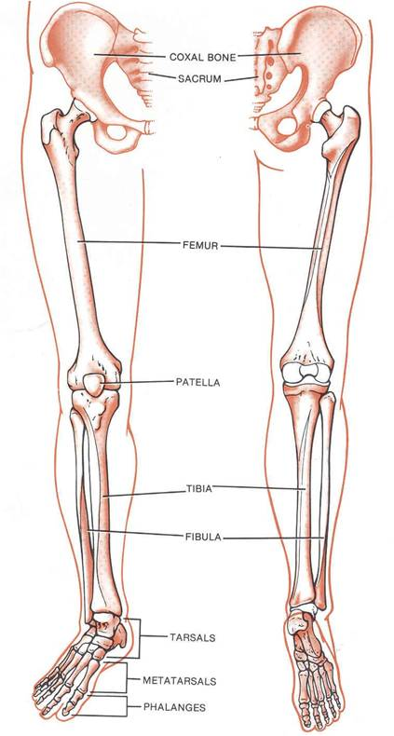
BONES OF APPENDICULAR SKELETON
LOWER LIMB
Bone of thigh:
Femur.
Bones of leg:
Fibula (lateral) &
Tibia (medial).
Patella.
Bones of foot:
7 tarsal bones.
5 metatarsal bones.
14 phalanges:
2 for big toe & 3 for each of lateral 4 toes.

Slide 24
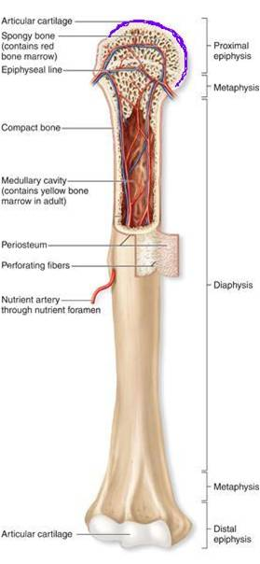
LONG BONES
Formed of:
A shaft (diaphysis): composed of compact bone.
Two ends (epiphysis): composed of spongy bone.
Metaphysis: This is the region of contact between epiphysis & diaphysis.
The metaphysis contains epiphyseal plate of cartilage responsible for linear bone growth.

Slide 25
TEST YOURSELF!
Which one of the following bones is a bone of the axial skeleton?
Femur.
Humerus.
Scapula.
Sternum.

Slide 26
Which one of the following bones is an example of an irregular bone?
Femur.
Vertebra.
Scapula.
Sternum.

Slide 27
Which one of the following planes divides the body into superior & inferior parts?
Frontal (coronal) plane.
Sagittal (median) plane.
Parasagittal (Paramedian) plane
Transverse (cross) plane.

Slide 28
GOOD LUCK

