Slide 2
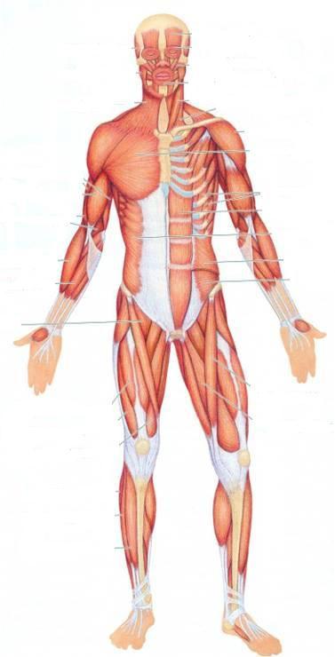
SKELETAL MUSCLES
Dr. Jamila EL Medany

Slide 3
OBJECTIVES
At the end of the lecture, students should be able to:
Describe the main criteria of skeletal muscles.
Describe the attachments of skeletal muscles.
Describe the different directions of skeletal muscle fibers.
Describe the mode of action of skeletal muscles.
Describe briefly the naming of skeletal muscles.
Describe briefly the nerve supply of skeletal muscles.

Slide 4
Classification of muscles
Muscles are classified on the base of their:
Location
Action
Microscopic structure

Slide 5
Location
Skeletal
Cardiac
Visceral

Slide 6
Action
Voluntary: muscle
Subject to conscious control: e.g. Muscles attached to skeleton
Involuntary: muscles
Not under conscious control: e.g. muscles of the heart and other organs

Slide 7
Microscopic Structure
Striated:
The muscle fibers show transverse striations e.g. skeletal & cardiac muscles
Non striated (smooth):
No striations e.g. visceral muscles

Slide 8
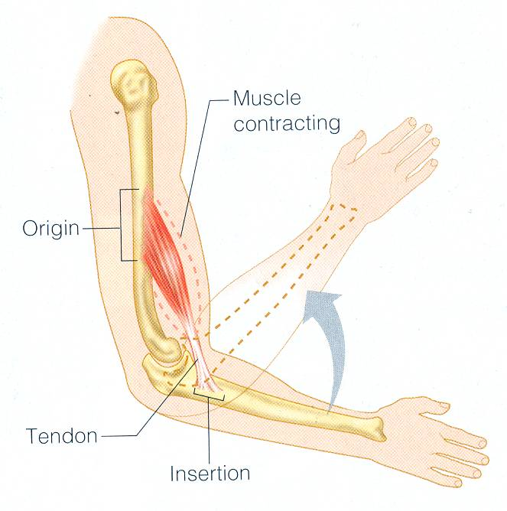
I
MAIN CRITERIA OF SKELTAL MUSCLES
Striated.
Attached to skeleton.
Produce movement of skeleton.
Voluntary
Supplied by Somatic Nerves.

Slide 9
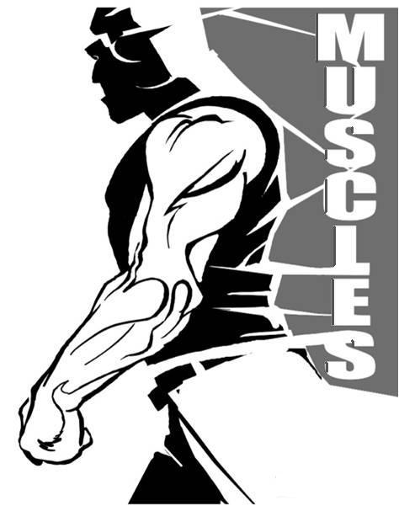
Functions of skletal Muscles
Movement of body and its parts
Maintain posture
Generate heat
Stabilize joints

Slide 10
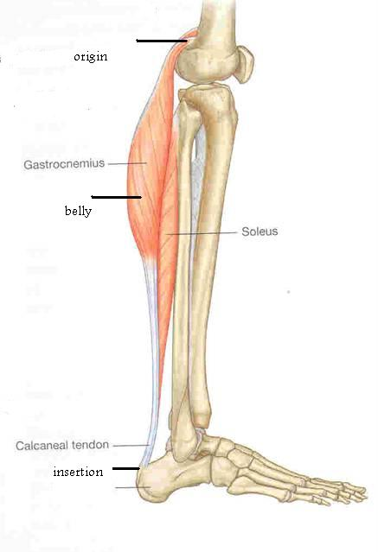
ATTACHMENTS OF SKELETAL MUSCLES
Number: (MOSTLY TWO)
ORIGIN | INSERTION
The Proximal end Mostly Fleshy, Least Movable, | The Distal end Mostly Fibrous, Most Movable,

Slide 11
Types of ATTACHMENT
Muscles are attached to bones, cartilage or ligaments through:
(1) Tendons :
Cords of fibrous tissue.
(2) Aponeurosis :
A thin and strong sheet of fibrous tissue.
(3) Raphe :
An interdigitation of the tendinous ends of the flat muscles.

Slide 12
The Direction of Muscle Fibers
The range of motion and the power of a muscle depends on the arrangement of its fascicles. It can be:
Circular
Convergent
Fusiform

Slide 13
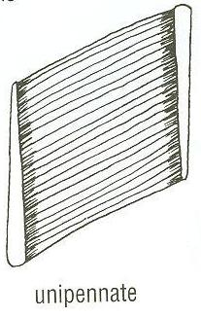
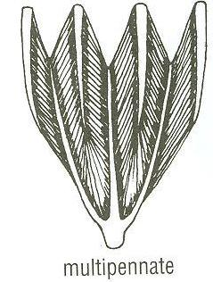
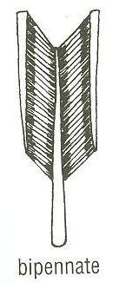
DIRECTION OF MUSCLE FIBERS
Parallel to line of pull: More range of movement, (less powerful).
Pennate (oblique to line of pull):
More powerful, (less range of movement.)
Unipennate.
Bipennate.
Multipennate.
parallel

Slide 14
MECHANISM OF ACTION
(1) Prime mover (Agonist) :
It is the chief muscle responsible for a particular movement
Example:
Quadriceps Femoris is the prime mover for extension of the knee joint.

Slide 15
(2) Antagonist :
It opposes the action of the prime mover.
Before contraction of prime mover, the antagonist must be relaxed.
Example: Biceps Femoris (Flexor of knee)
It opposes the action of quadriceps when the knee joint is extended.

Slide 16
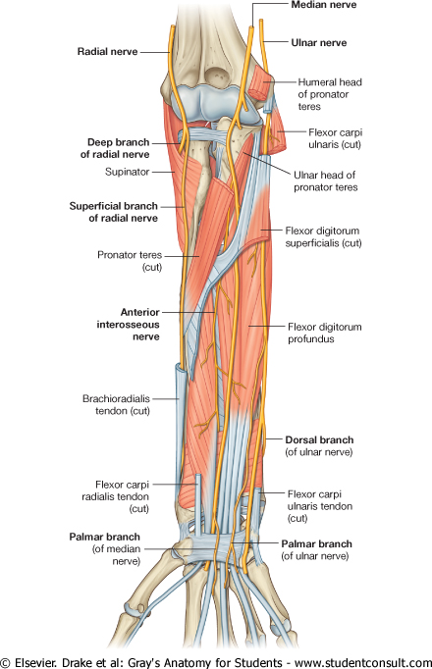
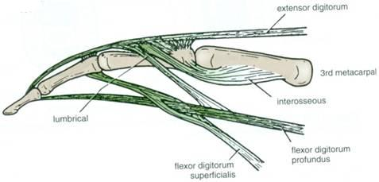
(3) Synergist :
Prevents unwanted movement in an intermediate joint crossed by the Prime Mover.
Example:
Flexors and Extensors of wrist joint
They contract to fix wrist joint in order that flexors and extensors of fingers work efficiently.

Slide 17
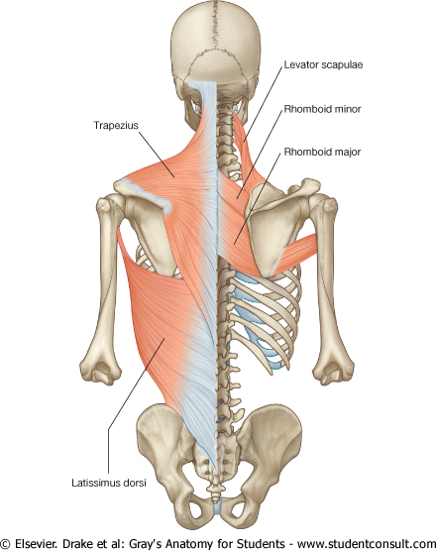
(4) Fixator :
Its contraction does not produce movement by itself but it stabilizes the origin of the prime mover so that it can act efficiently.
Example:
Muscles attaching the shoulder girdle to the trunk contract to fix shoulder girdle, allowing deltoid muscle (taking origin from shoulder girdle) to move shoulder joint (humerus).

Slide 18
NAMING OF MUSCLES
It is according to:
1. Size:
Major or maximus (large).
Minor or minimus (small).
Latissimus (broad).
Longus (long).
Brevis (short).
2. Position:
Pectoralis (pectoral region)
3. Depth:
Superficialis (superficial).
Profundus (deep).
Externus (external).

Slide 19
4. Shape:
Deltoid (triangular).
Teres (rounded)
Rectus (straight).
5. Number of Heads:
Biceps (2 heads).
Triceps (3 heads).
Quadriceps (4 heads).
6. Attachments:
Coracobrachialis (from coracoid process to arm).
7. Action:
Flexor digitorum: flexion of digits.

Slide 20
NERVE SUPPLY of Skeletal Muscles
The nerves supplying the skeletal muscles are Mixed:
60% are Motor.
40% are Sensory.
It has some Autonomic fibers (Sympathetic) for its blood vessels.
The nerve enters the muscle at about the middle point of its deep surface.

Slide 21
Effect of Exercise on Muscles
The amount of work done by a muscle is reflected in changes in the muscle itself
Muscle inactivity leads to muscle weakness and wasting
Regular exercise increases muscle size, strength and endurance

Slide 22
SUMMARY
Skeletal muscles are striated, voluntary muscles attached to & move the skeleton.
They have 2 attachments: origin & insertion.
Their fibers may be parallel or oblique (pennate) to the line of pull.
According to mode of action, they are classified as: prime mover, antagonist, synergist or fixator.
They may be named according to: size, shape, number of heads, position, attachments, depth or action.
They are supplied by a mixed somatic nerve.

Slide 23
Main Muscles
A. Facial Muscles
Frontalis
Orbicularis oculi
Orbicularis oris
Buccinator
zygomaticus
1
2
5
3
4

Slide 24
Muscles of Mastication
Temporalis
Masseter
Lateral pterygoid
Medial pterygoid
(3,4 are deep muscles, not shown in the diagram)
1
2

Slide 25
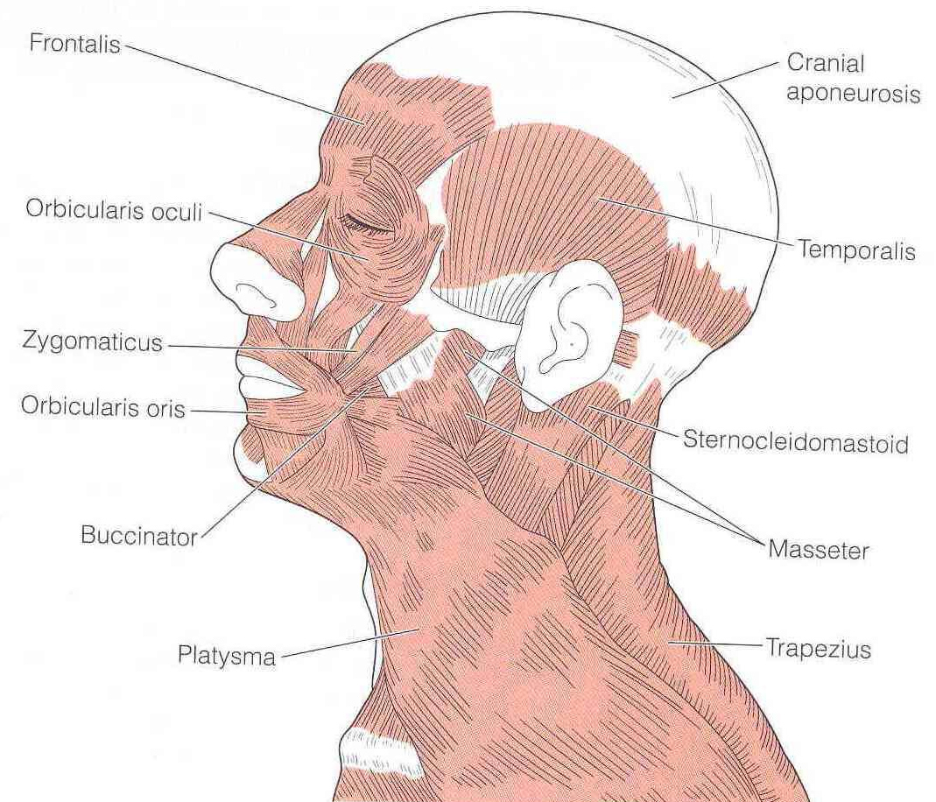
B. Neck Muscles
Platysma
Sternomastoid
2
1

Slide 26
C Trunk Muscles: Front
Pectoralis major
Intercostals
External oblique
Internal oblique
Transversus abdominis
Rectus abdominis
1
2
4
6
3
5

Slide 27
Trunk Muscles: Back
Trapezius
Latissimus dorsi
1
2

Slide 28
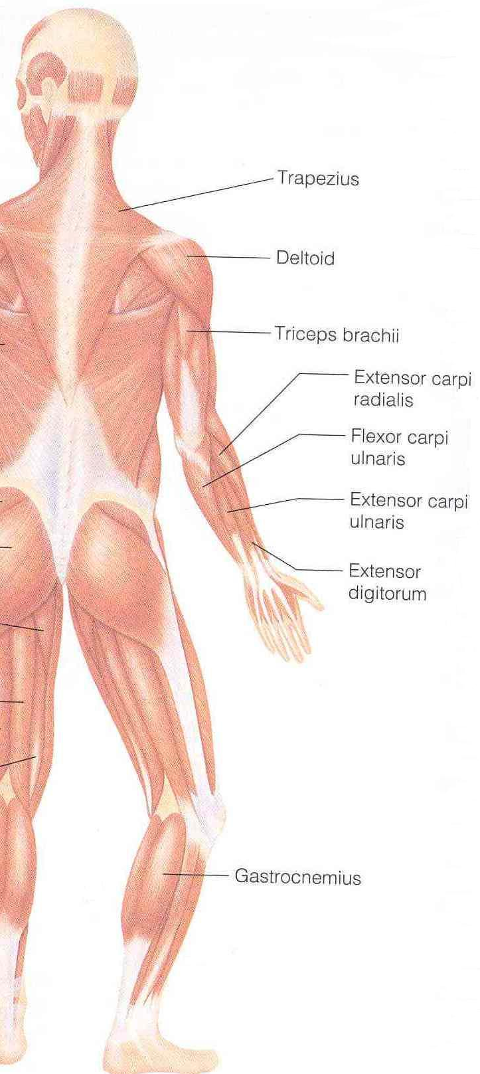
D. Upper Limb Muscles
1
1
Deltoid
Biceps
Brachialis
Triceps
2
4
3
Front
Back

Slide 29
E. Lower Limb Muscles
2
1
Quadriceps femoris
Sartorius
Tibialis anterior
Gluteus maximus
Gluteus medius
Hamstrings
Gastrocnemius
3
Front
5
4
6
7
Back

Slide 30
THANK YOU

